Slide 1


Empowered to Flourish – GEDSI Devotion
A: Let us think about the Spiritual Foundation of Empowerment
  True empowerment originates from God, equipping individuals and communities to thrive holistically in all aspects of life.
  Genesis 1:26-28, God created both male and female in His own image and granted them dominion and stewardship over the earth [Genesis 2:15]-[inclusive participation, ownership, access].
  Deuteronomy 8:18
  “Remember the Lord your God, for it is He who gives you the ability to produce wealth…”
  This verse reminds us that inclusive economic empowerment is not merely a development strategy—it is a divine endowment.
  It is a pathway to restored dignity. It is about enabling marginalised families to break cycles of dependency and step into their God given potential.
Notes:
This opening slide sets the tone for a morning devotion centered on economic empowerment, emphasizing the spiritual foundation behind the work carried out through THRIVE. The theme “Empowered to Flourish” highlights the belief that true empowerment originates from God, who equips individuals and communities with the ability to thrive holistically. In the context of development and faith-based practice, this phrase reminds participants that prosperity and human flourishing are both spiritual and practical pursuits. It calls attention to how economic empowerment reflects God’s intention for dignity, stewardship, and growth within households and communities. The THRIVE model integrates economic, social, and spiritual dimensions, recognizing that when individuals gain knowledge, confidence, and opportunity, they step into the life God desires for them. This theme encourages teams and participants to see their work not merely as program implementation but as participation in God’s redemptive mission to uplift the poor and restore hope. By starting with this focus, the devotion establishes a shared mindset that each effort—whether through training, digital tools, or relational accompaniment—contributes to transformation grounded in faith. It sets a reflective atmosphere, inviting listeners to align their intentions, motivations, and actions with God’s vision for flourishing communities. Through this lens, empowerment becomes more than a technical achievement; it becomes an expression of divine partnership in restoring dignity and supporting families toward sustainable well-being.

Slide 2
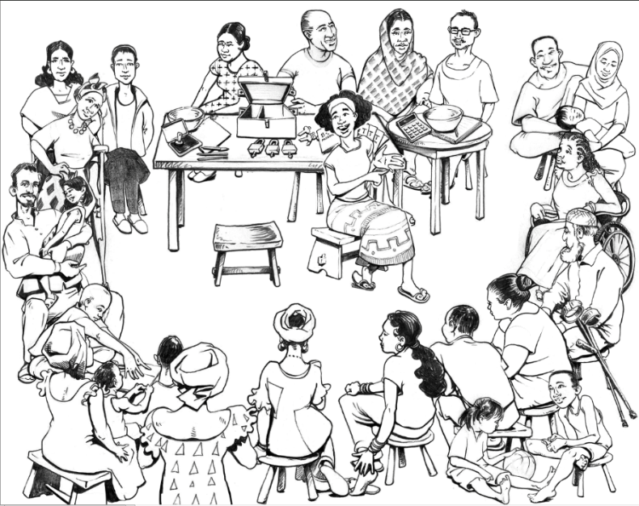
  B: The Missing Needle
  John 10:10“The thief comes only to steal and kill and destroy; I have come that they may have life and have it to the full.”
  Empowerment starts with identity: Jesus affirms that we are created for fullness, not survival.
  Abundant life includes spiritual, social, relational, and economic flourishing.
  BUT: there are cultural, social, spiritual barriers preventing holistic inclusive enjoyment of life by the marginalised communities.
  NEEDED: Strategies to Unlock potentials of the marginalised to meaningfully participate in economic activities and AWAKEN THE SLEEPING GIANTS IN THEM.
Notes:
Deuteronomy 8:18 serves as a profound foundation for understanding economic empowerment through a biblical lens: “Remember the Lord your God, for it is He who gives you the ability to produce wealth.” This scripture reminds us that all capacity—skills, knowledge, creativity, and opportunity—originates from God. In the context of development work, this verse reframes empowerment not as human achievement alone but as stewardship of God-given resources. The Israelites were warned not to forget the Source of their prosperity, a lesson that applies equally today: as communities rise economically, they must remain anchored in humility and gratitude. From a THRIVE standpoint, this scripture affirms that digital financial tools, savings groups, entrepreneurship training, and agricultural interventions are vehicles through which God equips His people. The ability to generate income, build assets, and strengthen livelihoods is therefore seen as part of God’s provision. This perspective shifts empowerment from a transactional concept to a spiritual responsibility. For practitioners, it encourages reliance on God for wisdom; for participants, it highlights their inherent potential as endowed by God. Ultimately, this verse underscores that economic empowerment is a divine partnership, cultivating resilience not only materially but spiritually as well.

Slide 3

Women Endowed with God Given Capabilities
The Proverbs 31 woman is the Bible’s strongest example of a diversified businesswoman. Her enterprises include:
Real estate investor – She buys fields and plants vineyards (v.16)
Agribusiness operator – vineyards, farming
Manufacturing – making linen garments
Import/export trader – She brings food from afar (v.14)
Retail merchant – She sells garments to merchants (v.24)
NB: Vs23: Her husband is known in the [city’s] gates, When he sits among the elders of the land.
You empower a woman, not only have you empowered her, but her children, her husband and the entire household
Proverbs 31 woman represents what THRIVE calls market‑driven, multi-stream income resilience.
Notes:
This slide emphasizes that those serving within THRIVE are stewards of God’s mission to empower communities. The calling extends beyond delivering trainings or facilitating savings groups—it involves nurturing dignity, inspiring hope, and recognizing the divine potential in every individual. As stewards, practitioners carry the responsibility to act with compassion, excellence, and integrity. Each financial literacy session, digital tool deployment, or agricultural demonstration becomes a seed of transformation planted in God’s garden. The calling requires attentiveness to both spiritual and practical needs, understanding that economic empowerment contributes to holistic flourishing. Additionally, the work of THRIVE reflects Jesus’ ministry of restoring the vulnerable and marginalized, affirming their value and helping them step into fuller lives. This perspective encourages staff and partners to see themselves as co‑laborers with Christ in rebuilding communities, restoring broken systems, and enabling generational change. It reminds everyone involved that empowering households is not simply a task but a sacred partnership with God, whose desire is for His people to live in dignity, resilience, and purpose.

Slide 4
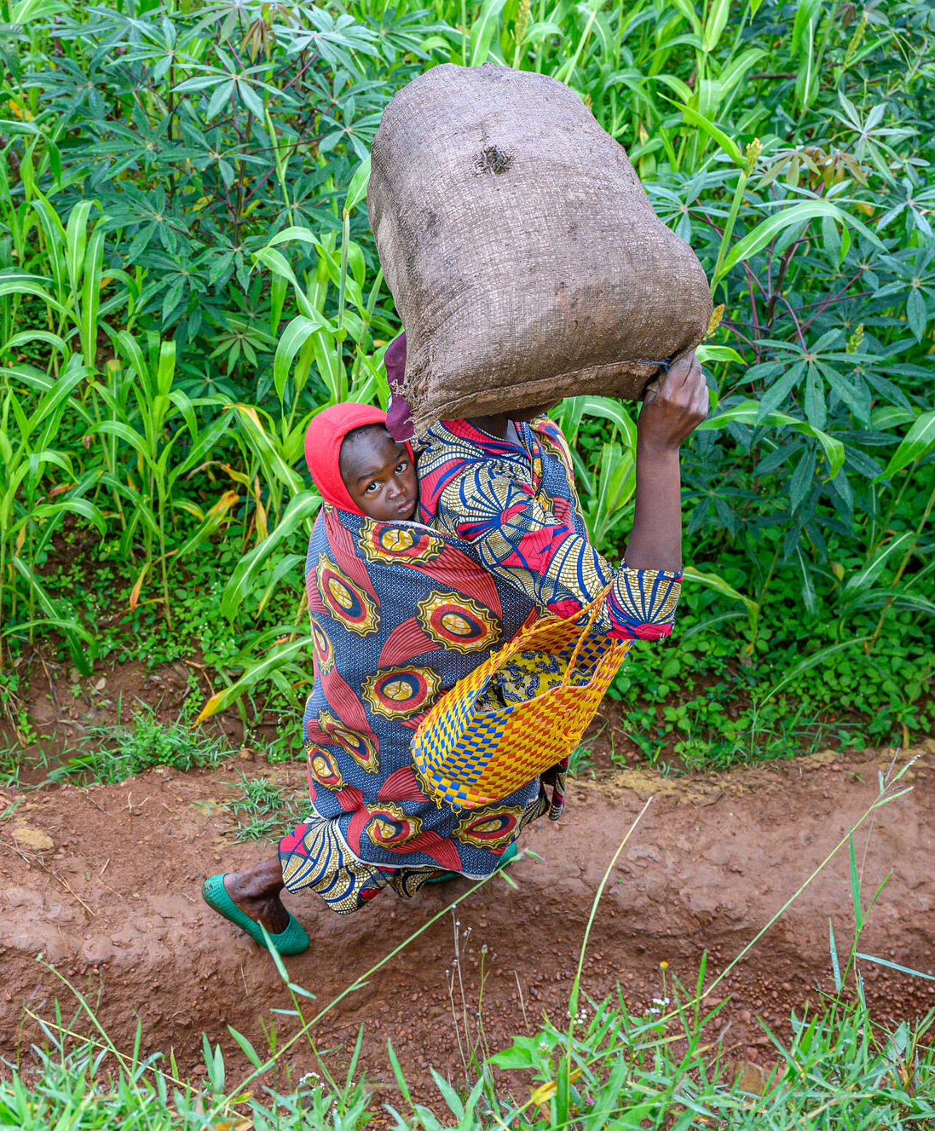
Lydia – Dealer of Purple Cloth (Acts 16:14–15)
Lydia was a successful textile and dye merchant in Philippi—a luxury goods sector of the ancient world.
A business owner, financially independent woman and a homeowner who hosted Paul and the early church. She was also a patron who funded ministry work.
The Widow Who Worked with Oil – Microenterprise Start-up (2 Kings 4:1–7)
Elisha empowered this woman to create a home-based oil business: She collected jars. Produced oil. Sold it in the market. Earned enough to pay debts and sustain her household.
This mirrors THRIVE: BEWV, Savings group start ups; market knowledge and access, FAST loans; CrediEnterprise microenterprises
God meets women at the point of their small beginnings and multiplies their impact.
________________________________________
Notes:
This slide emphasizes that those serving within THRIVE are stewards of God’s mission to empower communities. The calling extends beyond delivering trainings or facilitating savings groups—it involves nurturing dignity, inspiring hope, and recognizing the divine potential in every individual. As stewards, practitioners carry the responsibility to act with compassion, excellence, and integrity. Each financial literacy session, digital tool deployment, or agricultural demonstration becomes a seed of transformation planted in God’s garden. The calling requires attentiveness to both spiritual and practical needs, understanding that economic empowerment contributes to holistic flourishing. Additionally, the work of THRIVE reflects Jesus’ ministry of restoring the vulnerable and marginalized, affirming their value and helping them step into fuller lives. This perspective encourages staff and partners to see themselves as co‑laborers with Christ in rebuilding communities, restoring broken systems, and enabling generational change. It reminds everyone involved that empowering households is not simply a task but a sacred partnership with God, whose desire is for His people to live in dignity, resilience, and purpose.

Slide 5
Economic Empowerment for PWDs
•Economic inclusion of people with disabilities is not an add on—it is core to God’s vision for flourishing households.
•They can be entrepreneurs; producers; livestock managers; digital savings group members; leaders and market influencers. Just like Mephibosheth, the man at the gate,, they can thrive with supportive systems, market access, and dignity restoration.
Mephibosheth – Landowner with a Managed Agricultural Estate (2 Samuel 9; 2 Samuel 19:24–30)
Mephibosheth, who was physically disabled in both feet, oversaw a productive economic asset. He Owned land and agricultural fields. Had servants and workers (Ziba and his sons) who farmed on his behalf. Managed estate-level production. Benefited from profits generated by his land.
Although he could not farm physically, he exercised economic agency through land ownership, decision-making, and management.
This story affirms that:
  Disability does not erase gifting or economic potential.
  God consistently meets disabled individuals where they are—affirming dignity and capacity.
  Therefore, Disability inclusion is not an act of generosity but an act of responsibility. Inclusion aligns with God’s heart.
Notes:
This slide emphasizes that those serving within THRIVE are stewards of God’s mission to empower communities. The calling extends beyond delivering trainings or facilitating savings groups—it involves nurturing dignity, inspiring hope, and recognizing the divine potential in every individual. As stewards, practitioners carry the responsibility to act with compassion, excellence, and integrity. Each financial literacy session, digital tool deployment, or agricultural demonstration becomes a seed of transformation planted in God’s garden. The calling requires attentiveness to both spiritual and practical needs, understanding that economic empowerment contributes to holistic flourishing. Additionally, the work of THRIVE reflects Jesus’ ministry of restoring the vulnerable and marginalized, affirming their value and helping them step into fuller lives. This perspective encourages staff and partners to see themselves as co‑laborers with Christ in rebuilding communities, restoring broken systems, and enabling generational change. It reminds everyone involved that empowering households is not simply a task but a sacred partnership with God, whose desire is for His people to live in dignity, resilience, and purpose.

Slide 6
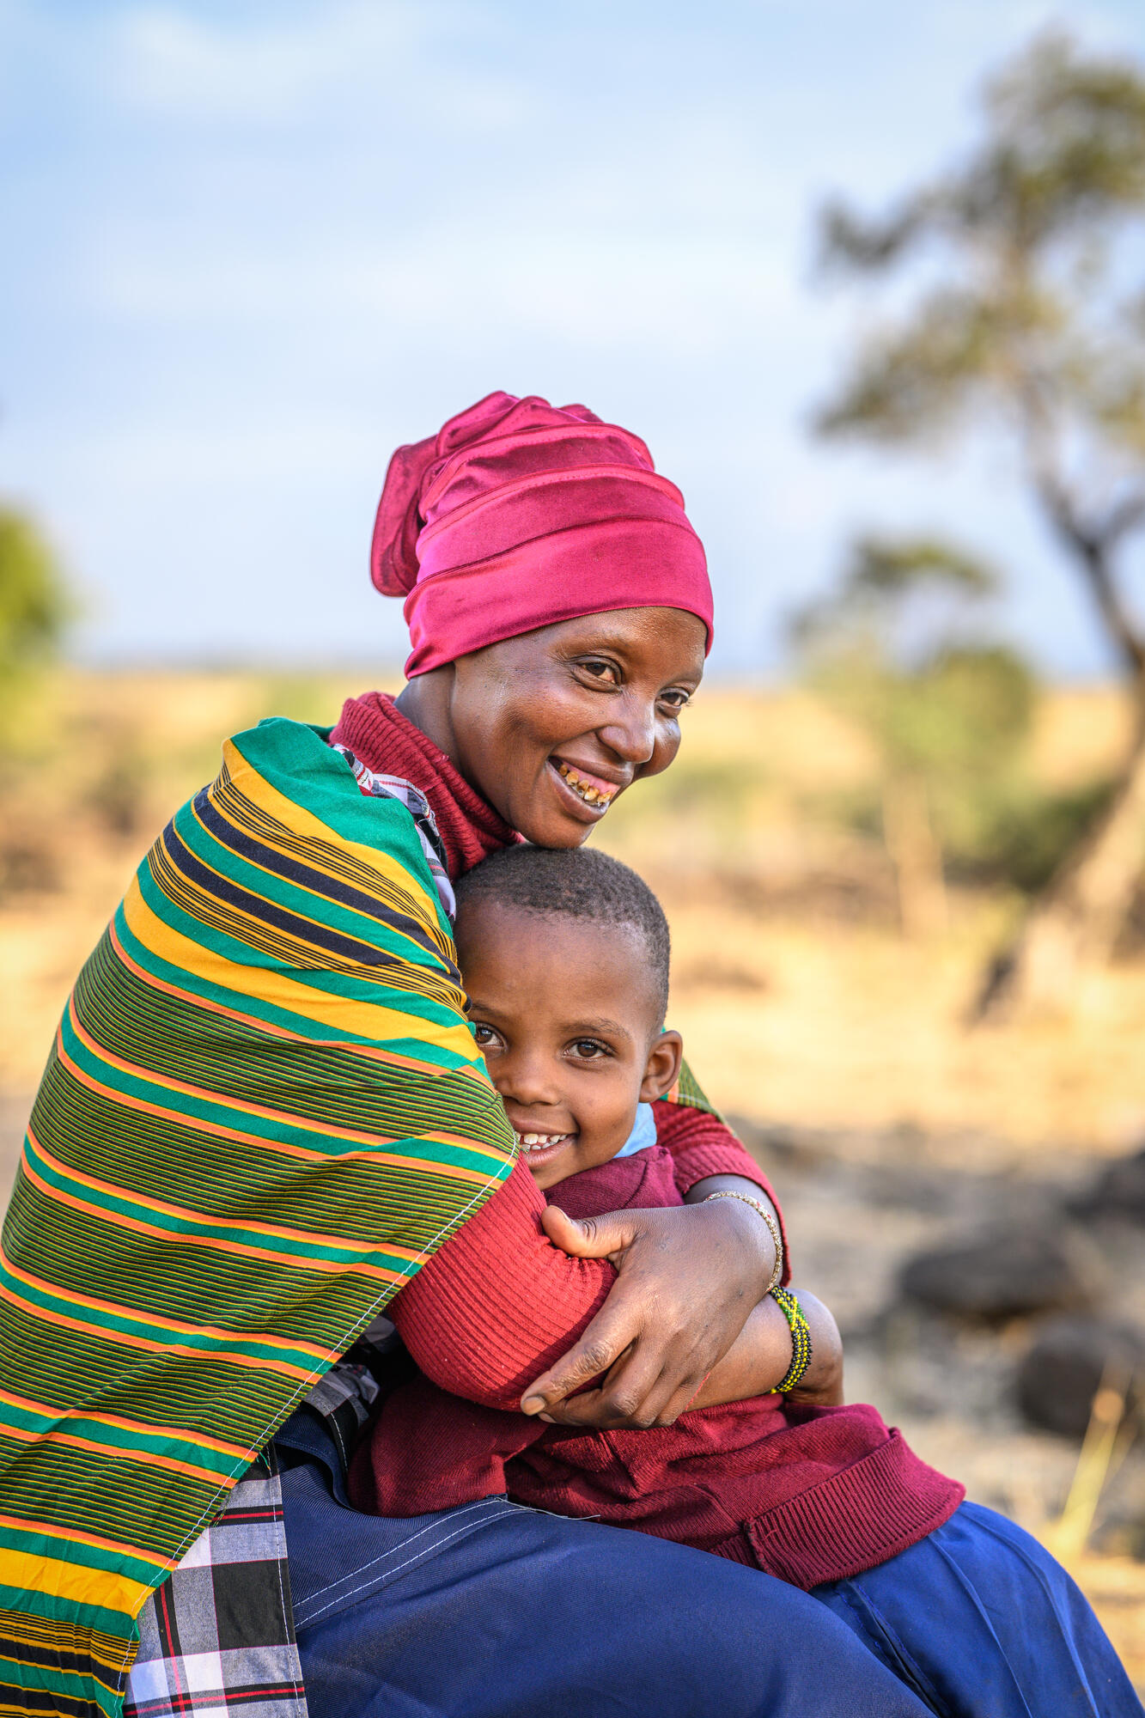
Children/Youth EE
Skills development is key to break intergenerational cycles of poverty.
Jesus is the perfect example of youth participation. (Luke 2:41–52; Mark 6:3)
Jesus grew up in Joseph’s carpentry business. Jewish sons traditionally learned their father’s trade from childhood.
Implications: Hands-on apprenticeship; Skill transfer within the household; Contribution to family income
Joseph – Managing Family Agricultural Supply Chains (Genesis 37)
Joseph worked with his brothers caring for: Sheep, Goats, Household production assets. His father sent him to check on business operations, showing he had growing managerial responsibilities even as a teenager.
The Boy with Five Loaves and Two Fish – Small-Scale Food Business (John 6:8–9)-wisdom and seeing challenges as possibilities.
The stories illustrate that Household-based enterprises thrive when young people are included. Youth can grow from household laborers to market leaders and community influencers—just like Joseph, and Jesus.
Notes:
This slide emphasizes that those serving within THRIVE are stewards of God’s mission to empower communities. The calling extends beyond delivering trainings or facilitating savings groups—it involves nurturing dignity, inspiring hope, and recognizing the divine potential in every individual. As stewards, practitioners carry the responsibility to act with compassion, excellence, and integrity. Each financial literacy session, digital tool deployment, or agricultural demonstration becomes a seed of transformation planted in God’s garden. The calling requires attentiveness to both spiritual and practical needs, understanding that economic empowerment contributes to holistic flourishing. Additionally, the work of THRIVE reflects Jesus’ ministry of restoring the vulnerable and marginalized, affirming their value and helping them step into fuller lives. This perspective encourages staff and partners to see themselves as co‑laborers with Christ in rebuilding communities, restoring broken systems, and enabling generational change. It reminds everyone involved that empowering households is not simply a task but a sacred partnership with God, whose desire is for His people to live in dignity, resilience, and purpose.

Slide 7
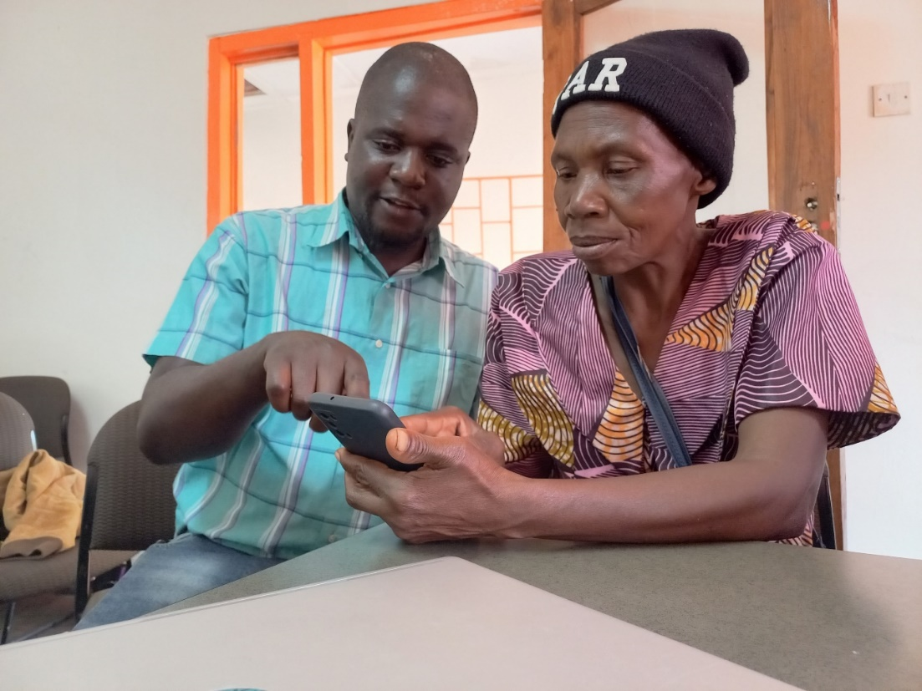
THRIVE: Evidence of God at Work
Practical Tools and Support
  The THRIVE approach provides over 80% of the 10 million participants with tools, knowledge, and systems that break dependency cycles and foster growth. GEDSI is cross cutting across all the pillars and its very intentional as a foundation.
  EWV [secret sauce to break barriers and shift mindsets. Each HH develops a GEDSI inclusive business plan]
  Savings Groups [by the time we organize them in the groups, they are already GEDSI sensitive
  Market Knowledge and Access: Focus on nutrition, climate and gender sensitive value chains
  FAST and other MF products [With digital tools like DreamSave, they now manage their finances digitally, access FAST loans to build assets, and make future oriented decisions as a household.
  In rural communities across Africa, Latin America, and Asia, we now meet women who once felt powerless, excluded, and lacking a voice. Their testimony is often the same:
  “For the first time, I can see my progress. I feel seen. I feel capable.” That is what divine empowerment looks like—clarity, dignity, hope.
  Through IMKA pathways, financial literacy, and enterprise development, they begin to see themselves as solution makers in their communities.
  Many say: “I always thought I needed someone else to rescue me. But now I see God has placed the ability inside me.”
  ✨ God plants potential in every person. Our role is to water it.
  ________________________________________
Notes:
Economic empowerment is woven throughout Scripture as part of God’s concern for human well‑being. The story of Joseph illustrates strategic economic planning in times of scarcity, showing that God grants wisdom to ensure community survival and resilience. Jesus’ ministry emphasized justice, restoration, and good news for the poor, reinforcing that economic dignity aligns with the heart of God. From a kingdom standpoint, empowerment is not simply about increasing income but restoring identity and enabling individuals to participate fully in God’s design for their lives. In the THRIVE approach, this is evident as communities receive tools, knowledge, and support systems that allow them to break cycles of dependency. Savings groups foster discipline and unity; skills development builds confidence; and entrepreneurship creates pathways for purpose-driven impact. The kingdom perspective emphasizes that poverty is not just a financial issue but a relational and spiritual one, requiring holistic restoration. This slide encourages listeners to view economic empowerment as a sacred calling—an opportunity to reflect God’s justice, compassion, and desire for flourishing communities. It reinforces that engaging in empowerment work is not only practical development but active participation in God’s redemptive mission.

Slide 8

Closing Prayer of Empowerment
Encouraging Reflective Mindset: How do we change mindsets and break barriers to unlock the potential of the marginalized?
Let us think of intentionality in project design: In designing economic programs, we need intentionality to undertake a landscape analysis to understand barriers preventing the marginalised from equitably accessing productive assets and participate in decision making
A Call to Participation in Redemptive Mission: Our divine mission is to restore dignity of those marginalized, uplift the poor, and create hope-filled communities. [Isaiah 58, the kind of fasting God requires]
  Prayer
  Lord, thank You for giving us the ability to produce wealth, to build resilience, and to uplift communities. Empower us to continue walking with the marginalised households so that they may experience dignity, hope, and economic freedom. May Your wisdom guide our work, and may Your love be evident in every relationship we build. Bless the families we serve, that they may flourish and testify of Your goodness. Amen.
Notes:
This closing slide offers a prayer that centers the devotion on God’s continued guidance and blessing. The prayer seeks divine empowerment for households and communities, asking God to provide wisdom, resilience, and opportunities for growth. It acknowledges that while human efforts play a role, ultimate transformation flows from God’s presence and favor. The prayer requests God’s guidance for those facilitating THRIVE programs, that they may carry out their work with compassion, clarity, and spiritual sensitivity. It asks that His love be evident in every interaction—with participants, partners, and communities—reinforcing that empowerment must be rooted in relationship and dignity. The prayer also invites God to bless the families served, that they may experience economic stability, renewed hope, and flourishing in every dimension of life. By closing in prayer, the devotion brings all efforts back to God, expressing trust in His provision and reaffirming dependence on Him for sustainable impact. This reinforces that THRIVE is not only a development initiative but a ministry shaped by faith, compassion, and God’s restorative power.

