Slide 1
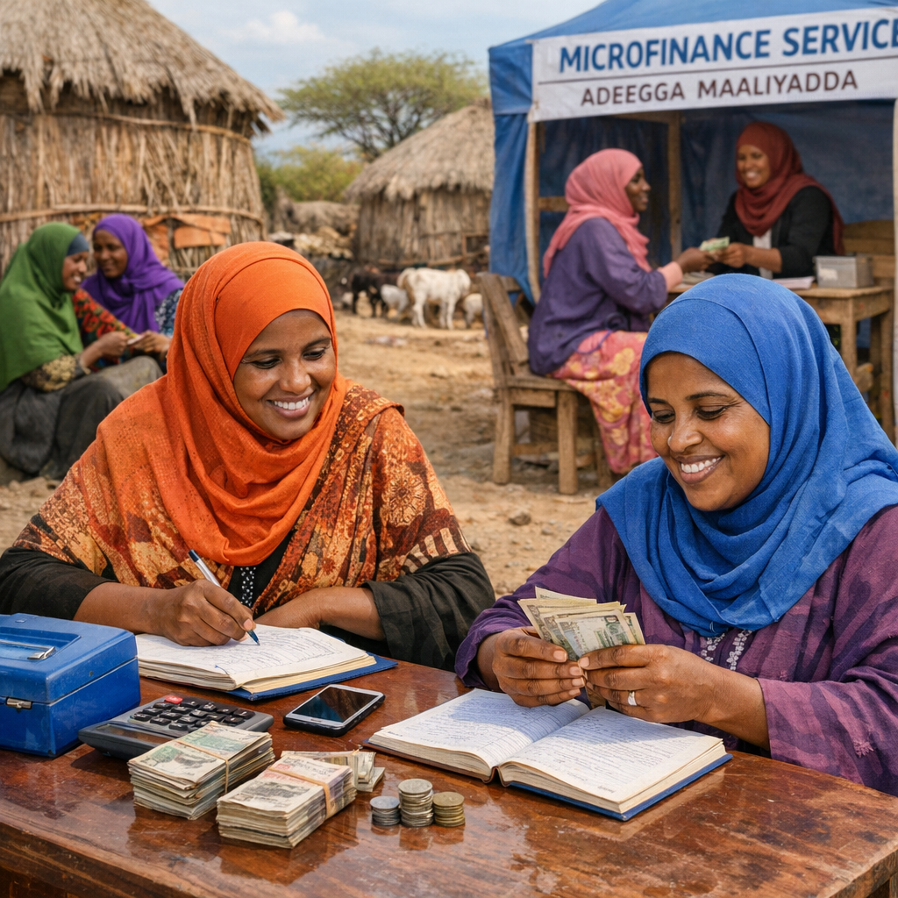
experiences from bha upg Empowering Marginalized Groups through Economic Graduation in Somalia (EMERGE) Project somalia
03/03/2026
Notes:
---

Slide 2
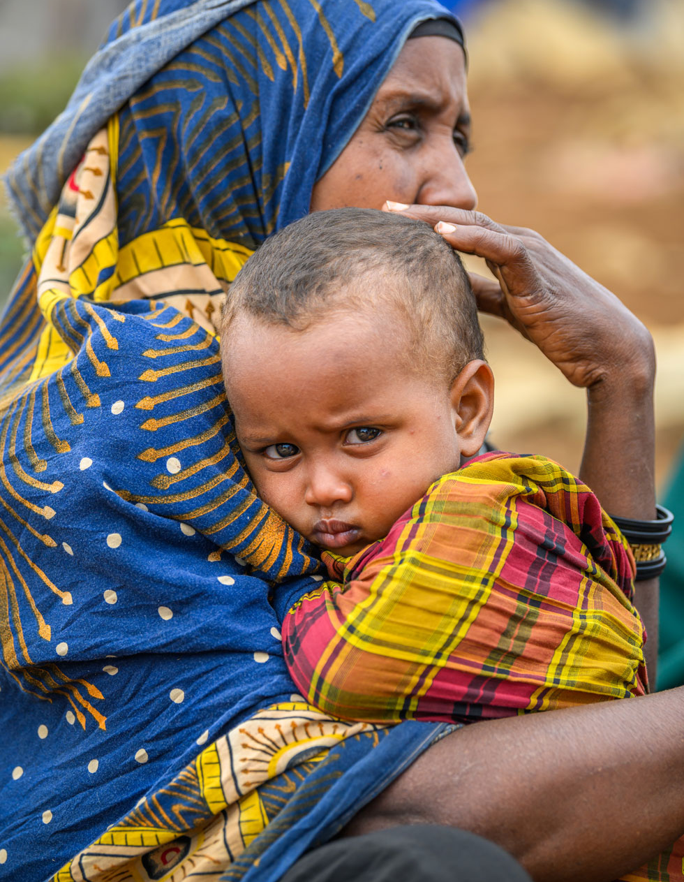
Context Overview
Access- The team has not encountered any new access restrictions in Southwest State. The political environment remained relatively stable, with the most notable development being the one-year postponement of the state election and the extension of the current president’s term.
This has not yet impacted the implementation of project activities,
Access to project locations in catchment areas 7 and 9, prioritized for Cohort 1 has been consistent.
Security- The security environment remains volatile. Ongoing operational and funding challenges facing AUSSOM pose a strategic risk to overall stability and project operations in the Southwest.
The funding shortfall raises concerns about potential troop drawdowns or restricted operations, making access harder.
Food Insecurity: Extreme drought conditions continue to intensify the humanitarian crisis in the Southwest State.
The poor performance of the October-December 2024 Deyr rains has triggered a drought across southern and central Somalia.
Forecasts for 2026 predict below-average rainfall in the Gu region (April–August), with a delayed onset in key agricultural areas and higher-than-average temperatures that will worsen the drought’s severity.
As of August 2025, an estimated 4.4 million people face acute food insecurity, with 1.6 million children at risk of malnutrition.

Slide 3
GEDSI Background
Somalia continues to experience overlapping, mutually reinforcing crises prolonged drought, failed rains, conflict, disease outbreaks, displacement, rising food prices, and severe funding shortfalls.
These shocks create unique constraints for women, youth, persons with disabilities (PLWDs), minority clans, and IDPs making GEDSI integration essential for safe, equitable, and effective programming.

Slide 4
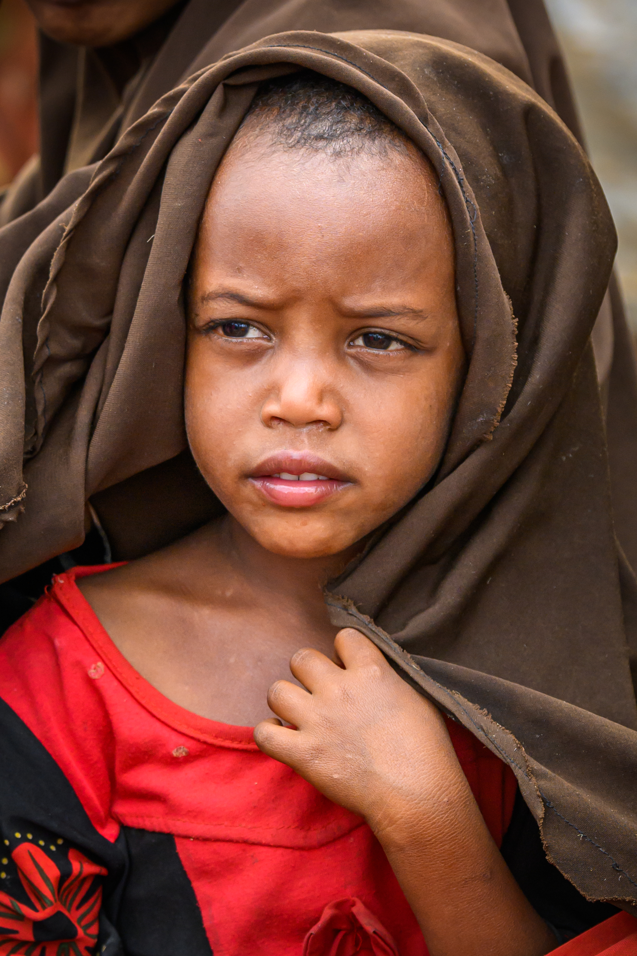
Project Overview
Project Name/Donor: EMERGE Project– Funded by U.S. Department of State
Goal: Improve food security & resilience for 26,453 households Baidoa & Hudur using the Graduation Approach.
Period: 5 Years (Oct 1, 2024 – Sept 30, 2029)
Target: 26,453 HHs (approximately 158,453 individuals)
Implemented in 3 Cohorts:
Cohort 1: 5,291 participants
Cohort 2: 10,581 participants
Cohort 3: 10,581 participants
Partners: Led by World Vision Somalia in partnership with Elman Peace, Shaqodoon, and Tulane University.
Local implementing partners include MARDO, CeRID, ARD, PASOS, and SYPD.

Slide 5
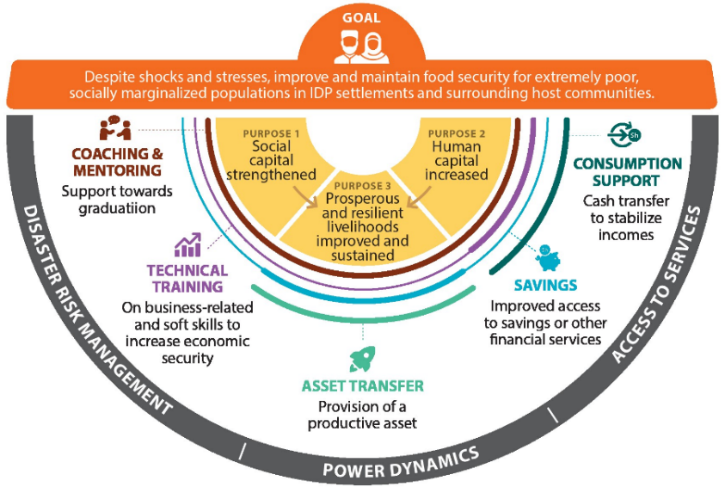
EMERGE Graduation Framework

Slide 6
