Slide 1
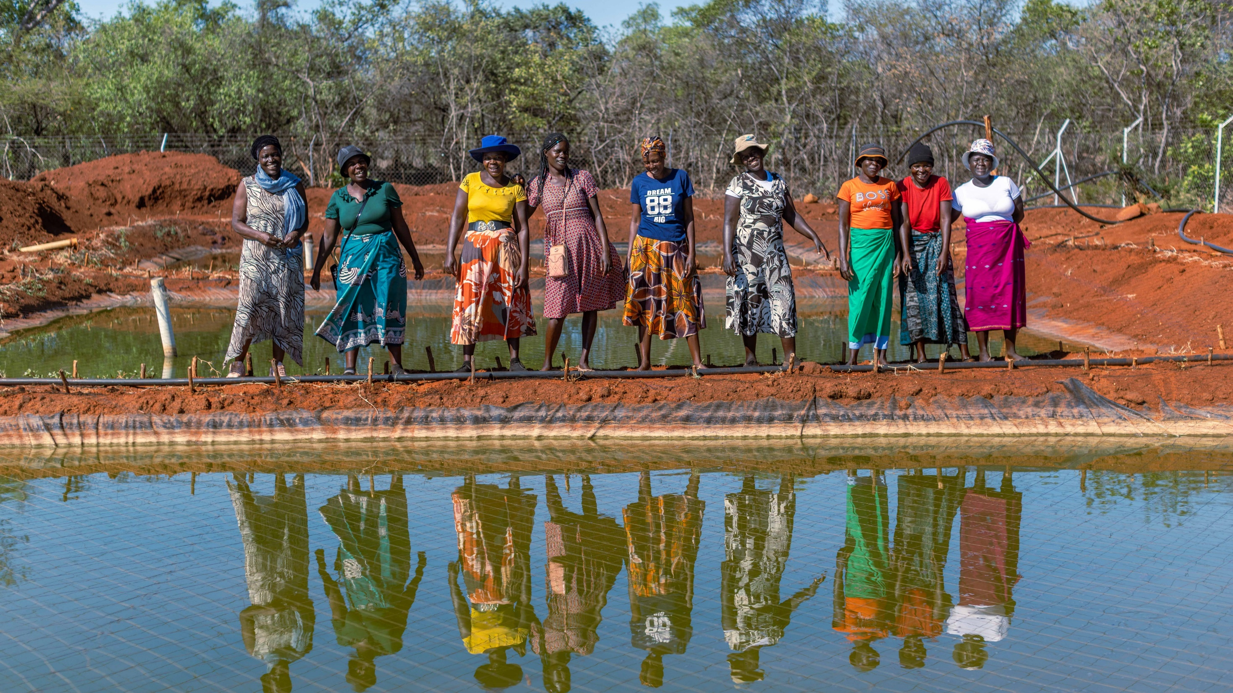

Beyond Access
Program

Slide 2
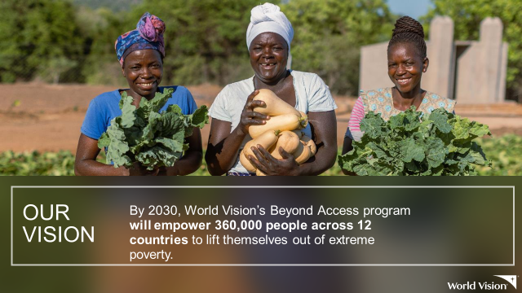

Slide 3
Expected Outcomes
“What are the impacts of GEDSI-transformative WASH, particularly in communities, healthcare facilities and schools? How can combined impact of an integrated sector approach improve GEDSI outcomes?”
Deepen the impact of WASH programming on the needs of women and girls, beyond WASH access
Collect GEDSI Annual Impact Measures (AIM) annually to track changes over time in key sectoral and women's empowerment indicators
Identify key learnings for scale-up of these multi-sectoral approaches

Slide 4
WASH Business Plan
Place Based Initiatives
Women-centered Design
Focus Track
(select one)
WASH + Livelihoods (Beyond Access
WASH + Health/Nutrition
WASH + Education
Tracking female & disability participants | Empowered Worldview | Gender-focused mindset change (CoH Gender, Celebrating Families, etc.)
Beyond Access
Community WASH
WASH in HCF
WASH in Schools
WASH Service Delivery Component
Savings Groups
Behavior change
(NCG or similar)
School-based SBC (Sesame or other)
Behavior Change Component
Integration Component
Planned with sector
Planned with sector
Planned with sector

Slide 5

Target Considerations
Area selected should already be prioritized for WASH AND the selected focus sector. The WASH and Livelihoods has additional requirements in the Beyond Access approach
If a GEDSI assessment has not already been completed in the selected area, this should be done at baseline and accounted for in the design.
A local GEDSI focal point should be consulted in the design of the initiative.
For the Health and Nutrition and Education tracks, there should be sufficient funding in place to meet the WASH needs of the health facilities or the education facilities in the target area.

Slide 6


MINDSET CHANGE
Family Centered programming, with a focus on women
ECONOMIC EMPOWERMENT
WASH

Slide 7
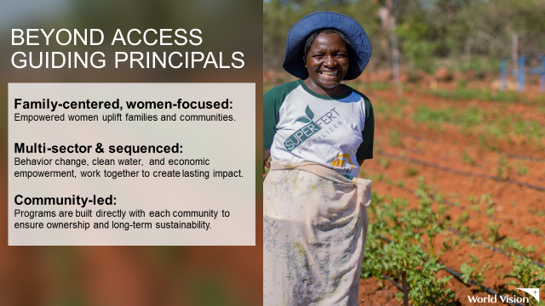

Slide 8



OUR APPROACH
Beyond Access accelerates
transformation by strengthening families and uplifting entire communities, through unlocking
women’s potential.
Multi-sector approach executed through intentional sequencing of:
BEHAVIOR CHANGE
WATER AND SANITATION
ECONOMIC EMPOWERMENT

Slide 9
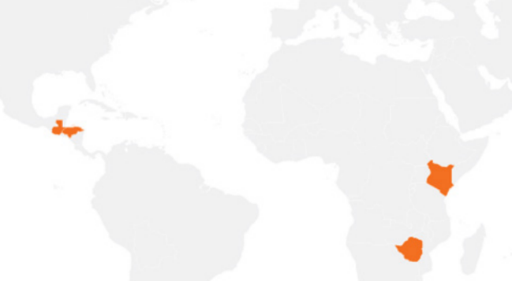




THE APPROACH
Beyond Access
Mindset
Economic Empowerment
Step 1: Dignifying enabling environment: safety and health
WASH
Empowered Worldview
GEDSI
Local-level advocacy
Women in Leadership trainings
Household Water Access
School WASH Infrastructure
HH sanitation and hygiene
HH and school –based WASH behavior change
Savings for Transformation
Local value-chain development
Financial literacy and business management training
Step 2: Opportunities to learn and use skills
Step 3: Resiliency and growth
Connecting S4T groups to microfinance institutions
Strengthening S4T groups to disburse loans
Micro-credit, Support, and Sustainability
Women and girls experience an increased sense of self-worth, ability to determine their own choices, and right to influence social change for themselves and others
Ongoing learning partnership with local learning partner
Notes:
Is this idea here to talk about phase 1, or the overall approach? If the latter, I added a more recent version below – though slides 11 and 12 cover similar topics. If the former, then I’d add “phase 1” somewhere.

Slide 10



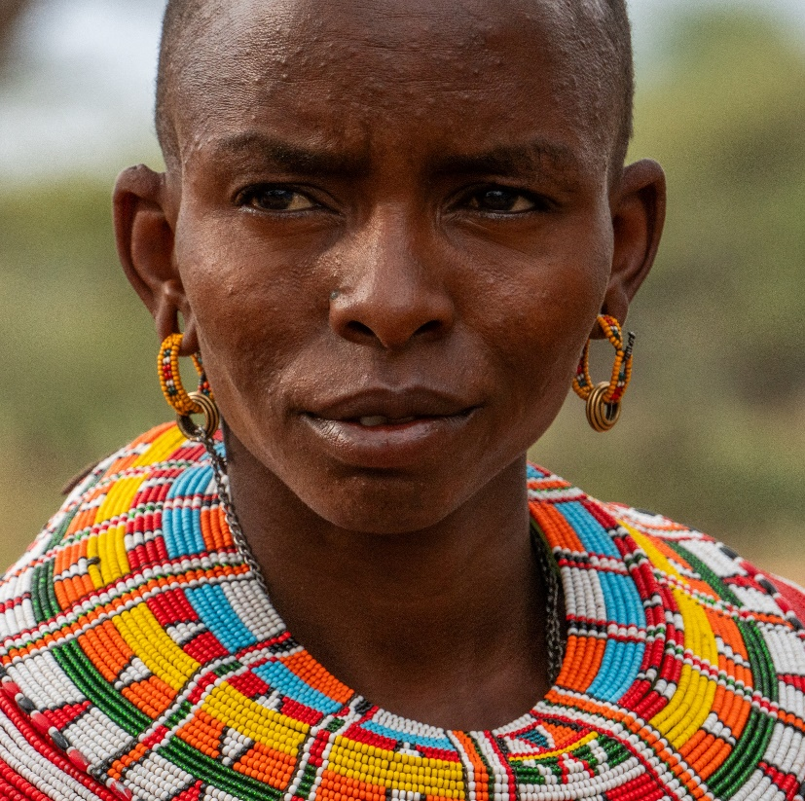
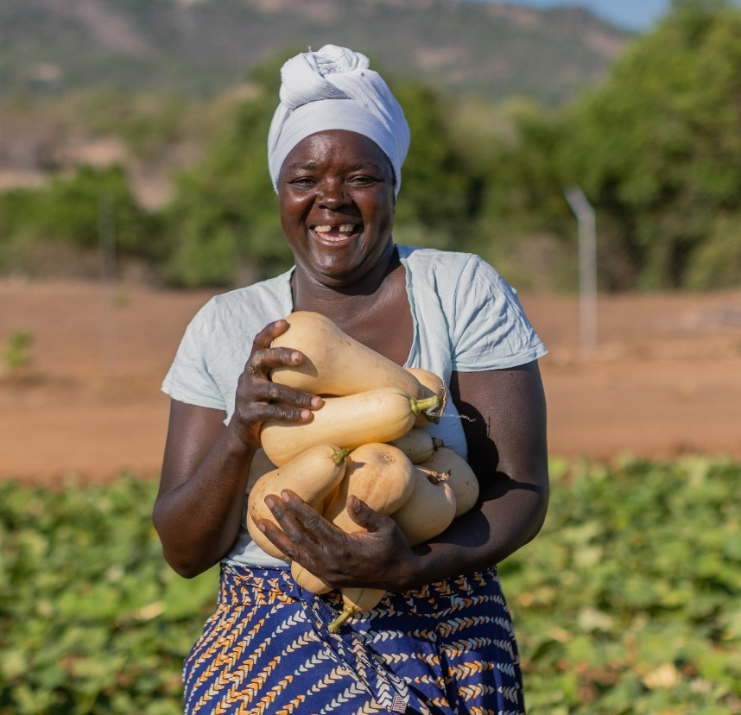

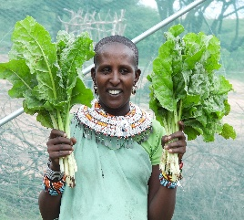
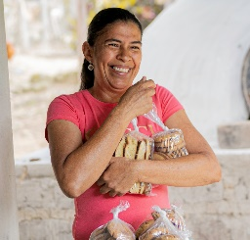
Beyond Access Approach
Goal: Empowered* women, Accelerated Impact in Communities
Unlocking opportunities, building economic resilience and catalyzing lasting change for women and their families
Mindset
WASH
THRIVE
Equity and Inclusion
Step 1
Community water access
Biblical Empowered Worldview
Savings Groups
Community sanitation & hygiene
Celebrating Families
Institutional WASH
Step 2
Citizen Voice in Action
Institutional behavior change & menstrual health
Inclusive Market Knowledge & Access
Step 3
Microfinance (FAST) Loans
*Women and girls experience an increased sense of self-worth, ability to determine their own choices, and right to influence social change for themselves, their families and communities.
Notes:
Step 1: Establish a dignifying enabling environment
Step 2: Expand involvement and earning opportunities
Step 3: Reinforce resilience

Slide 11
Empowered Worldview
FOUND-
ATIONAL
Citizen Voice in Action
Community water access
Institutional WASH
Celebrating Families
Savings for Transformation:
HH financial literacy
Women’s economic empowerment
STEP 1
GESI Training
Staff & community
Channels of Hope for Restore (Gender)
Required
Contextual
Nurturing Care Groups
Climate Smart Agriculture
HH sanitation & Hygiene
WASH UP!
Inclusive Market Knowledge and Access:
Business management
Business financial literacy
Entrepreneurship
Local Value Chain Development (IGAs)
Water for Production
STEP 2
Girl Talk/WASH United
Institutional Menstrual health
HH Menstrual Health & hygiene
FMNR
MenCare
Youth Ready
Required
Contextual
FAST Loans to savings groups
Continued business financial literacy
Women’s economic empowerment
STEP 3
Required

Slide 12




BEYOND ACCESS PROGRAM SEQUENCING
INTERVENTIONS
BEHAVIOR CHANGE
ACCESS TO CLEAN WATER
ECONOMIC EMPOWERMENT
Step 1
Establish a dignifying enabling environment
Equity and Inclusion
Community Water Access
Biblical Empowered Worldview
Savings Groups
Community Sanitation & Hygiene
Celebrating Families
Step 2
Expand involvement and earning opportunities
Institutional WASH
SEQUENCING
Citizen Voice in Action
Institutional Behavior Change & Menstrual Health
Market Knowledge & Access
Step 3
Reinforce resilience
Lending to Savings Groups

Slide 13
Intentional GEDSI Integration
Baseline: benchmarking tools assess the targeted households across all 5 GEDSI domains across the sectors integrated at all levels
Research respondents include all groups (women, men, boys and girls and people with disabilities)
Use of GEDSI tool kit for GEDSI trainings adapted and contextualised to barriers identified from the GEDSI assessment at baseline
Community participation and decision making is key at identification of barriers of disempowerment, causes and formulation of strategies to address significantly contribute to proper formulation of appropriate interventions

Slide 14

Research and Learning
Implement, review, refine and implement as you go process

Slide 15
Dive deeper into research.......
Midline results: informed us of the emerging barriers to guide in the refining our program interventions
Water journeys: Exploring program assumptions
Process evaluation: assessing program delivery (fidelity, dose delivery, quality, effectiveness)

Slide 16
Phase 1 learnings and program improvements for phase 2
1. Disapproval from husbands and community leaders limited women’s participation. Enhance male engagement to encourage buy-in and mutual benefit.
2.Literacy challenges affected comprehension despite adaptations: Continue refining contextual adaptations to ensure appropriateness and accessibility.
3. Migration disrupted group continuity: While the program does not focus on migration, it can ensure existing groups are trained and connected to other support structures.
4. Limited market access hindered entrepreneurial success: Implement the Inclusive Market Knowledge and Access component (from the THRIVE framework) to strengthen market access.

Slide 17
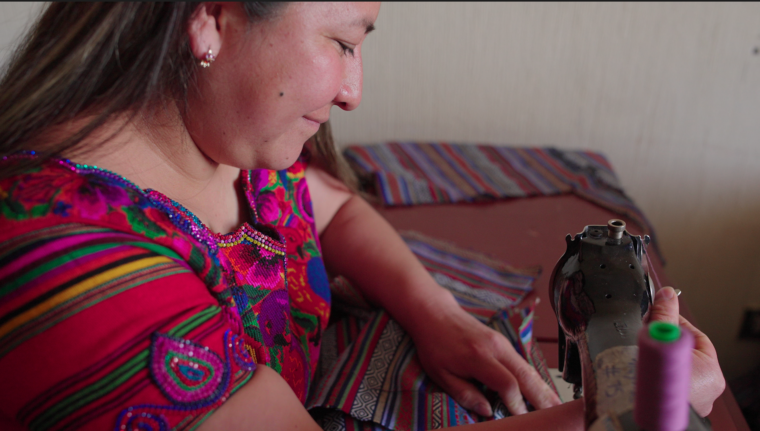
BEYOND ACCESS IMPACT
Multiplier effect
Sequenced interventions amplify impact-each dollar goes further as efforts strengthen one another.
Transformational impact
Children thrive in safe homes free from extreme poverty, where families grow resilient and raise empowered youth who strengthen their communities.
Rapid progress
Families fast-track their path out of extreme poverty, building resilience and self-sufficiency.

Slide 18
Benefits of multi-sectoral integration
Enhance each other outcomes
Ensures sustainability of infrastructures
It enables the environment for other sector outcomes to be achieved

Slide 19
Q&A

Slide 20
Breakout Discussion Questions
What shared harmful norms cut across WASH, economic empowerment/livelihoods, and education?
With Beyond Access being women- and girl-focused, where have been opportunities to engage men and boys across the 3 sectors ?
In WASH and Economic Empowerment sectors, how have women moved from participation into leadership?
What can education learn from economic empowerment with respect to supporting female youth interested in TVET/vocational education?
What monitoring systems need to be in place to capture outcomes around intersectionality?
What measures does BA take to use WASH data to enhance EE programming? What about EE data to enhance WASH programming? What about EE data to enhance education programming?

