Slide 1




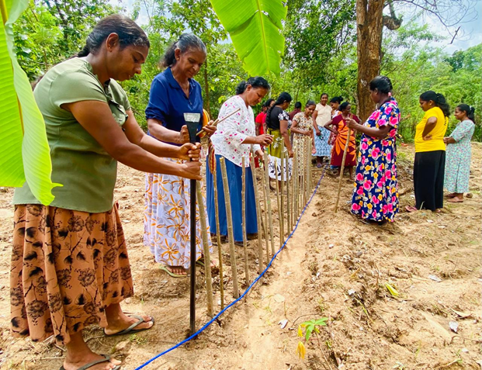
Promoting Gender Equality & Social Inclusion in Community Structures
Climate-Resilient Soil Conservation & Watershed Management
Mihikatha (ACCESS) Project
Welikanda & Rideemaliyadda

Slide 2
Context:
Climate Context – Sri Lanka
Average temperature: 27–28°C
• Observed warming: +0.8°C (20th century)
• Projected rise: up to 3.2°C by 2090s
• Dry Zone rainfall: <1,750 mm annually
• Increasing droughts & intense rainfall events
Project Focus Areas:
Welikanda (Polonnaruwa District)
• 573.75 km²
• 9,667 ha irrigated land
Rideemaliyadda (Badulla District)
• 37 irrigation tanks
• 8,604 acres irrigated paddy
• 75% employment in agriculture
Key Climate Risks:
Severe drought probability: ~4% annually
70% of national paddy in Dry Zone
Harvest reduced by ~50% (last 20 years)
Reduced Yala cultivation
Increased pests & crop diseases
Social & Gender Impacts:
Declining farm income
Youth leaving agriculture
Increased household stress
Women face water scarcity for domestic use
Higher vulnerability of women farmers
Existing Adaptation Practices•
Bethma irrigation sharing system
• Short-duration rice varieties
• Drought-resistant seeds
• Crop diversification (maize, cowpea, green gram)
• Village tanks & agro-wells
Source Climate Vulnerability Assessment

Slide 3
Ultimate outcome :- “enhanced gender-responsive resilience of farming households, especially women-headed, and their agri-food based livelihoods to the impacts of climate change in the Dry Zone divisions of Welikanda and Rideemaliyadda, Sri Lanka.”

Slide 4
1100 – “Strengthened sustainable land and watershed management mechanisms for climate adaptive farming used by climate-vulnerable farmers especially women in the Welikanda and Rideemaliyadda divisions of Sri Lanka”
1200: “increased adoption of climate adaptive farming practices by vulnerable farmers, especially women, to climate-adaptive farming risks in the Welikanda and Rideemaliyadda divisions of Sri Lanka.”
1300: “Enhanced women's agency in leadership, decision making and collective action in reducing gender and poverty related barriers for climate adaptive farming practices in the Welikanda and Rideemaliyadda divisions of Sri Lanka”

Slide 5
Target Groups
Members of Women Farmer Organizations
Members of Main Farmer Organizations
Social exclusion affecting:
  Women with disabilities
  Widows & female-headed households
  Landless and marginalized women
* The project will directly benefit 23,689 people (13,029 women and 10,660 men) from 5,640 households and indirectly benefit 86,430 people

Slide 6

What adaptation/ integration was necessary for transformative change to occur
- _ Gender Roles and Responsibilities
- Community Change concept
- Leadership and Governance – Org., and Individual capacity, Steering Committee Meeting
- Soil Conservation and Water Management – Individual plans, Department of Agrarian
- Water Governance – Agrarian Act
- Water Shed Management- replating, encroaching, soil management
- Soil quality testing services
- Crop based mentors for the Female Farmers
- Community Voice of Action
- MenCare
- Production market :mini mkt places, Agri business development
- Street Drama on Breaking Gender Norms in Agriculture
- National Level Policy Review Paper

Slide 7
Thank You

