Slide 1
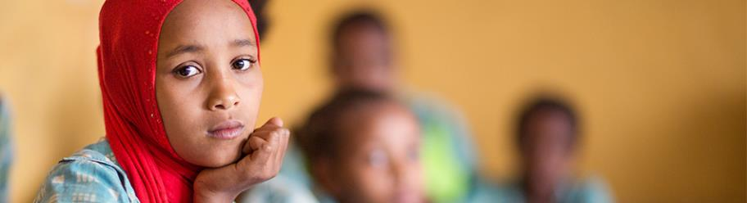

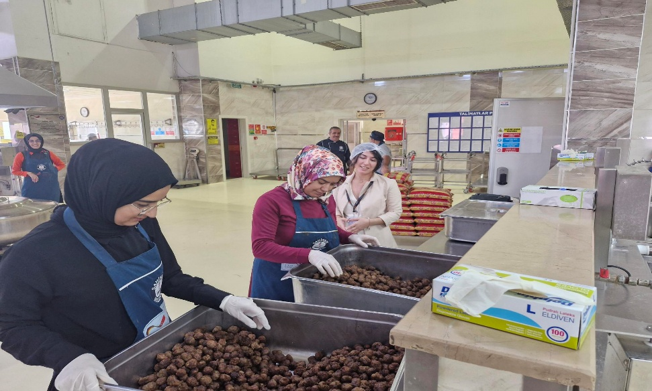
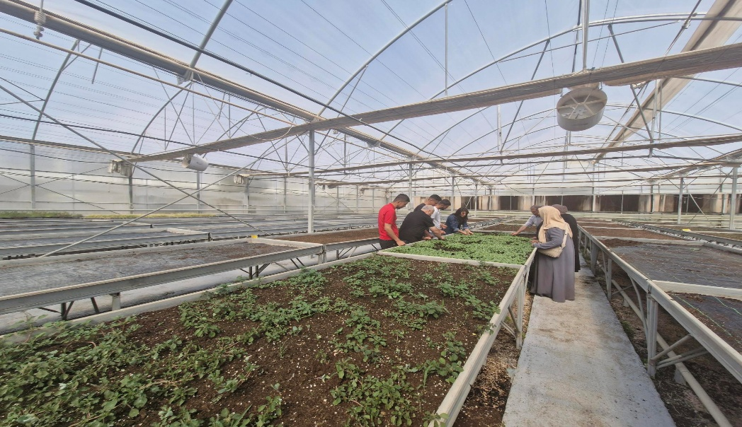
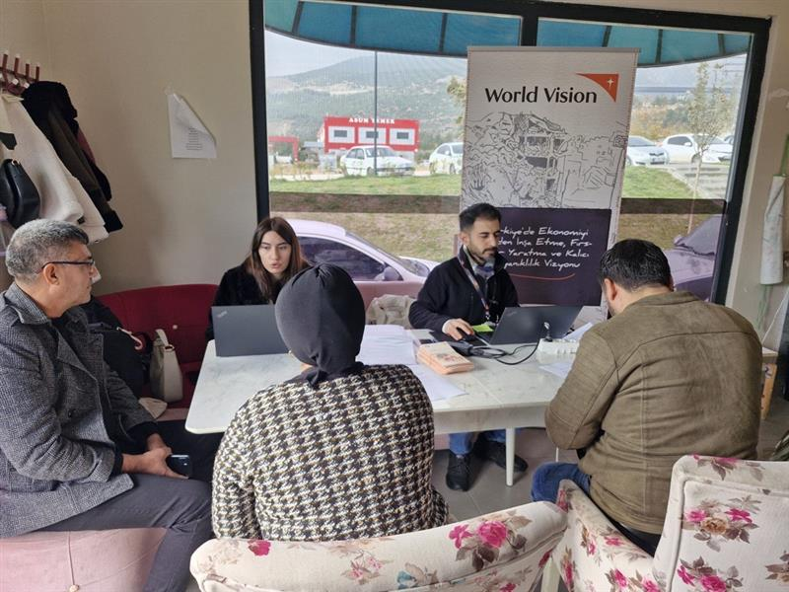
Rebuilding Economies, Creating Opportunities,
and the Vision of Enduring Resilience (RECOVER-TR)
Gönül Doğru
World Vision Syria Response
4th Global GEDSI Learning Forum – 2026

Slide 2

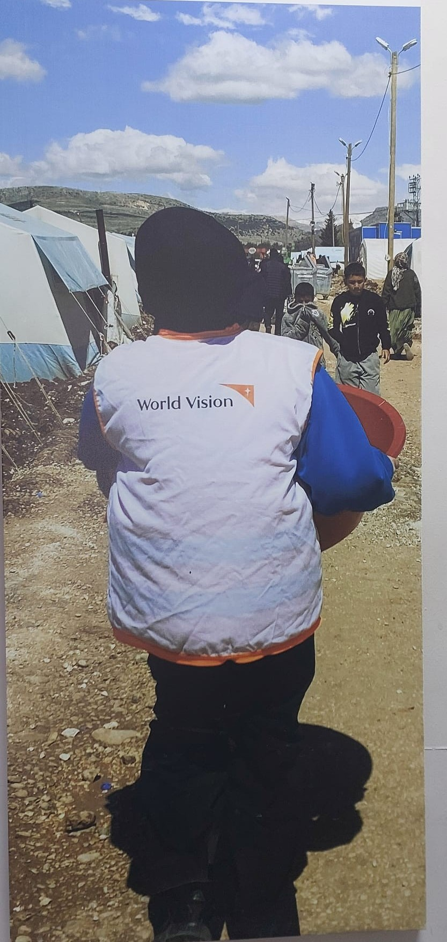
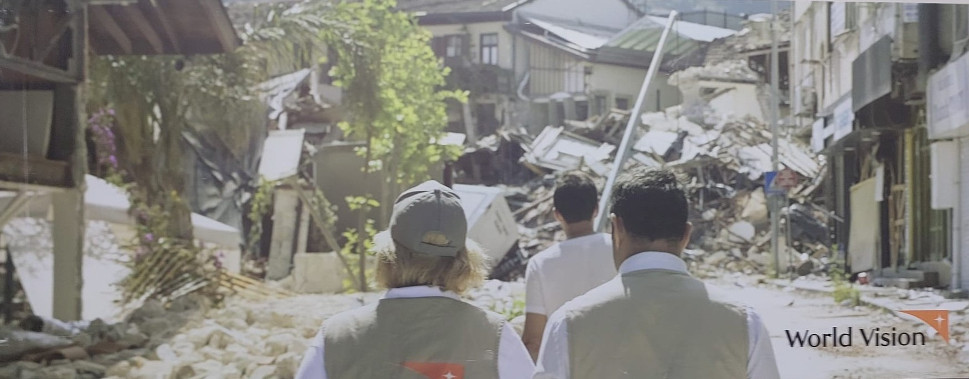
Post-Earthquake Fragility Context
Economic Recovery
Widespread infrastructure damage disrupted markets and livelihoods.
Unemployment surged among women, youth, and refugees.
SMEs and agri-businesses face operational and capital challenges.
High refugee population under temporary protection.
Structural gender inequality in economic participation.
Humanitarian Needs
Immediate: shelter, food, water, healthcare, psychosocial support.
Medium-term: livelihoods support, vocational training, access to micro-grants.
Vulnerable groups: female-headed households, PwDs, refugees, children, and youth.
Protection risks: gender-based violence, child labor, social exclusion.
Recovery priorities: Pre-existing poverty & informal labour markets, job creation, skills training, market linkages.

Slide 3
Project Goal & Outcomes
The project is being implemented in the earthquake-affected provinces of Gaziantep and Şanlıurfa following the 6 February earthquake. The “Rebuilding Economies, Creating Opportunities and Vision of Enduring Resilience in Türkiye” (RECOVER-TR) project aims to sustainably strengthen secure livelihoods for marginally poor households.
Project Goal: Empower earthquake-affected households to secure sustainable well being through the establishment and improvement of HHs income adequacy, and resilience, by promoting positive behavior changes within their families that contribute to the households' resistance to poverty and food security.
The project adopts and contextualizes the Building Secure Livelihoods (BSL) model, which defines the marginal poor as households living slightly below or above the poverty line but not classified as extremely poor.

Slide 4
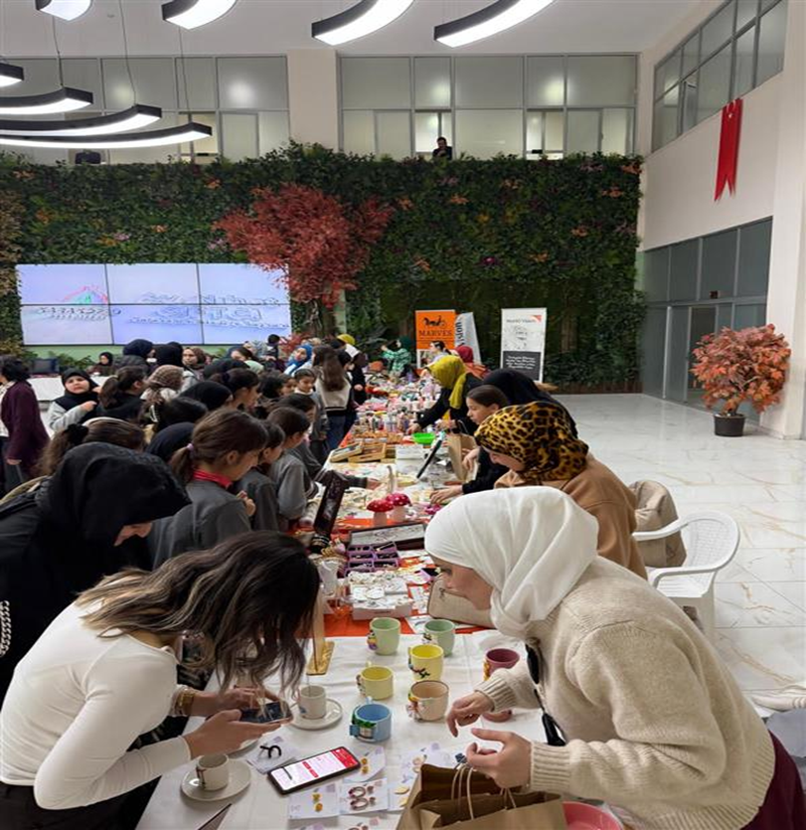
Project Goal & Outcomes
Outcome 1: Individuals improve well-being and career success through personalized career counselling, legal guidance, and skills development.
One-to-one Career Counselling (1918/2000)
One-to-one Legal Advisory Support (955/1000)
Parental & Well-being Support (PAW) (122)
Outcome 2: Participants gain market-relevant technical and vocational skills aligned with labor market needs.
Market Driven TVET (technical and vocational) training (350/397)
Capacity Building & Skills Development
Outcome 3: Households increase resilience and income, reduce reliance on negative coping strategies, and manage debts more effectively.
Creating linkages to job approctunites (88 jp & 134 referrals)
Access to Financial Support & Restoring opration capacities of SMEs (100/105)
Supporting women’s collective afforts to access financial means and create income generating approtunites 20/13)

Slide 5
Project Goal & Outcomes
Enhancing Secure Livelihoods and Economic Inclusion
Labour Market and Career Support
Comprehensive Labour Market & Socio-Economic Gender Assessments informed project design, stakeholder engagement, and sector selection, ensuring gender-sensitive, demand-driven approaches.
Personalized career counseling was delivered to 1,918 individuals (96% of the 2,000 target), including 1,072 women and 846 men. Sessions addressed career aspirations, CV preparation (Turkish & English), job application strategies, and barriers to employment.
Career counseling targeted diverse participant groups: 60% unemployed, 20% skilled workers (welding, sewing, farming, hairdressing, etc.), 10% professionals, and 8% SME/cooperative aspirants.
Workshops and Legal Awareness
Monthly employability workshops reached 300 participants, providing practical training on CV writing, interviews, labor regulations, and workplace rights.
Legal awareness sessions addressed SME legislation, labor law, work permits, tax procedures, and cooperative management, enabling participants to navigate formal employment and entrepreneurial opportunities.
Market-Facing Skills & Job Placement
Technical and Vocational Education and Training (TVET) included chef assistant, agribusiness, welding, CNC operator, packaging/wrapping, footwear, and textile skills.
SME and Women’s Cooperative Capacity-Building strengthened operational, financial, and market management skills.
Job placements: 88 participants secured employment in local sectors, including food services, manufacturing, agriculture, and textiles, linking training to sustainable livelihoods.
Seed fund distribution: 105 SMEs and 13 women cooperative member SMEs received $5,000 grants each, enhancing entrepreneurship and women’s economic empowerment.
Community engagement events promoted local market access, sales, and networking, with municipalities supporting visibility and collaboration

Slide 6
Project Goal & Outcomes
Enhancing Secure Livelihoods and Economic Inclusion
Coaching and Mentoring
Continuous monthly mentoring ensured follow-up for SMEs, women cooperative members, and job-placed participants, addressing business development, workplace integration, and adherence to labor regulations.
Monitoring emphasized skill development, employment rights, and overall participant well-being.
Women’s Economic Empowerment
Women were actively targeted across career counseling, vocational training, SME grants, and cooperative initiatives.
High female participation (58%)
Women’s cooperative programs included capacity-building and seed fund support, enabling women to establish or expand small enterprises, generate income, and strengthen resilience.
Legal guidance empowered women entrepreneurs on cooperative governance, tax compliance, work permits, and labor laws.
Child Protection and Parenting Support
Parents Awareness Workshops (PAW) reached 122 participants (47 in Gaziantep, 75 in Şanlıurfa), focusing on:
Positive parenting practices
Effective communication and emotional support
Coping with post-displacement stress and economic hardship

Slide 7
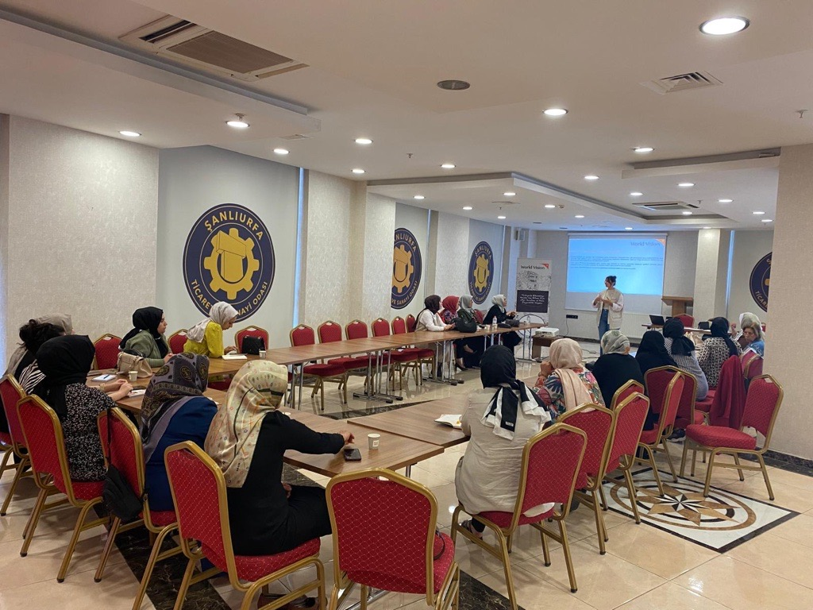
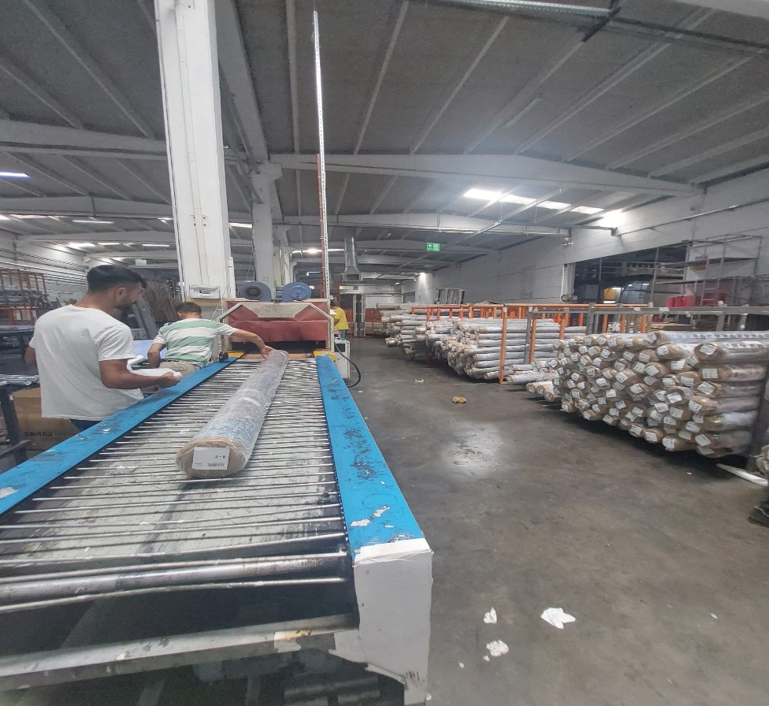
Primary Target Groups
Marginally Poor Households
  Households with dependent children.
  Households affected by displacement or migration due to the earthquake.
  Households in both community host and refugee populations.
  Elderly individuals, people with disabilities, and other vulnerable community members.
  Refugees and displaced populations residing in Gaziantep and Şanlıurfa.
  Households facing higher debt burdens, lower savings, or economic fragility exacerbated by the earthquake.
Women and Women’s Cooperatives
  Women engaged in income-generating activities, including those in cooperatives.
  Female-headed households and women with caregiving responsibilities.
Job Seekers
  Youth and adults seeking employment or career guidance.
  Individuals excluded from economic life and willing to work
  Individuals requiring skills development, training, or access to labor market opportunities.
Small and Medium Enterprises (SMEs) and Cooperatives
  SMEs affected by the earthquake and seeking business recovery and growth support.
  Women cooperative member
Families and Communities
  Beneficiaries of awareness-raising programs, such as Parents Awareness Workshops (PAWs).
  Communities engaged in risk reduction, preparedness, and long-term resilience activities.
Key Inclusion Principles:
Promoting gender equality and social inclusion.
Supporting self-efficacy and financial literacy.
Ensuring equitable access for both host communities and refugees.
Targeting those most affected by displacement, economic loss, or limited access to resources due to eartquake

Slide 8
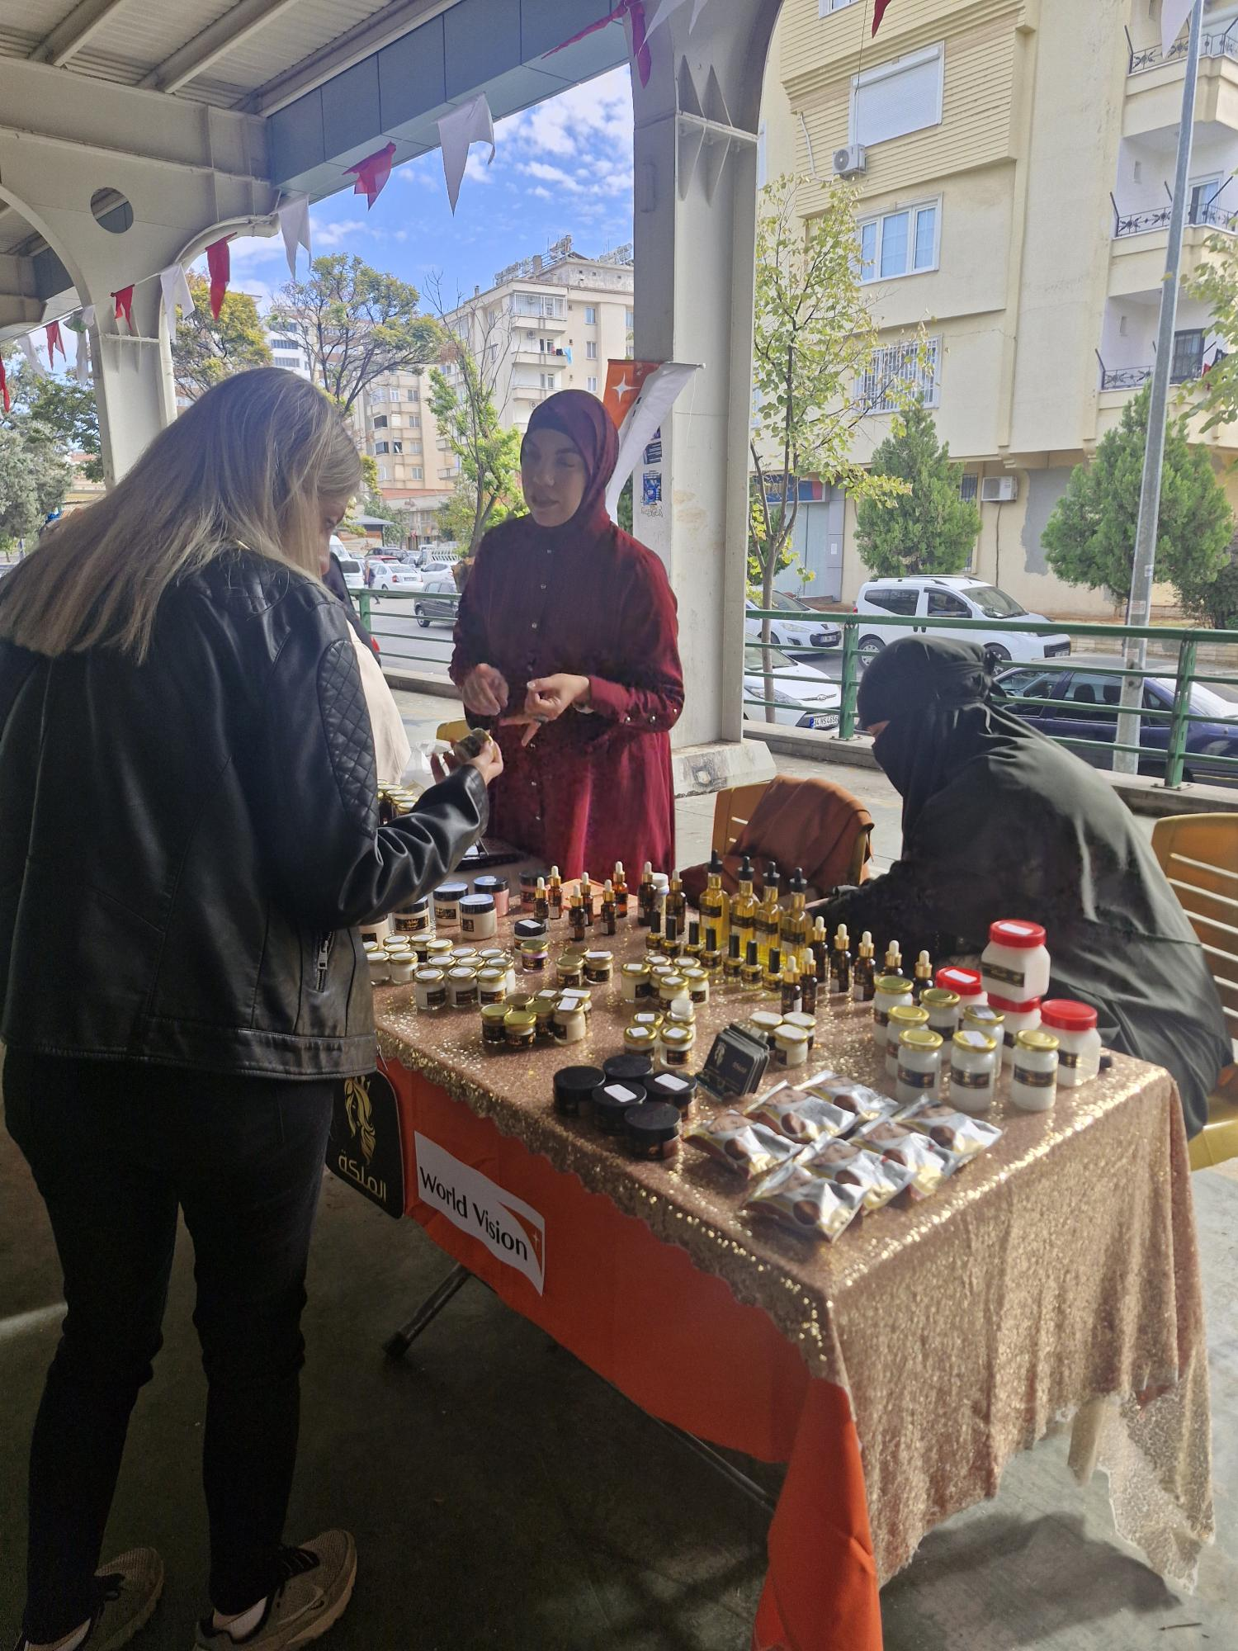
GEDSI-Integrated Targeting
Gender Equality: Women-focused SMEs, women cooperative members, capacity-building, gender-sensitive training.
Social Inclusion: Equal access for refugees and marginalized Turkish communities, legal assistance
Households with disability or chronic illness, SME owners’ households include members of PwDs, the elderly, pregnant or lactating women
13.5% PwDs included

Slide 9
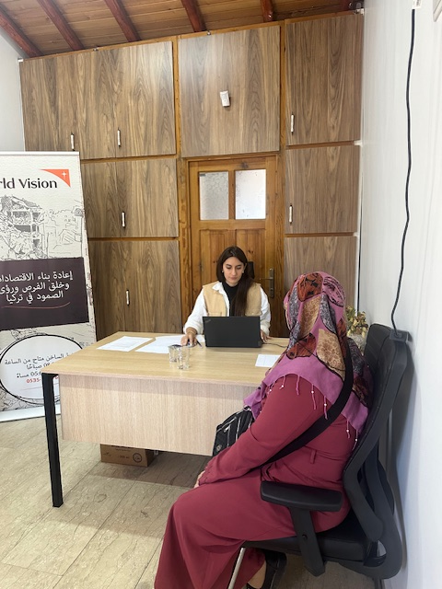
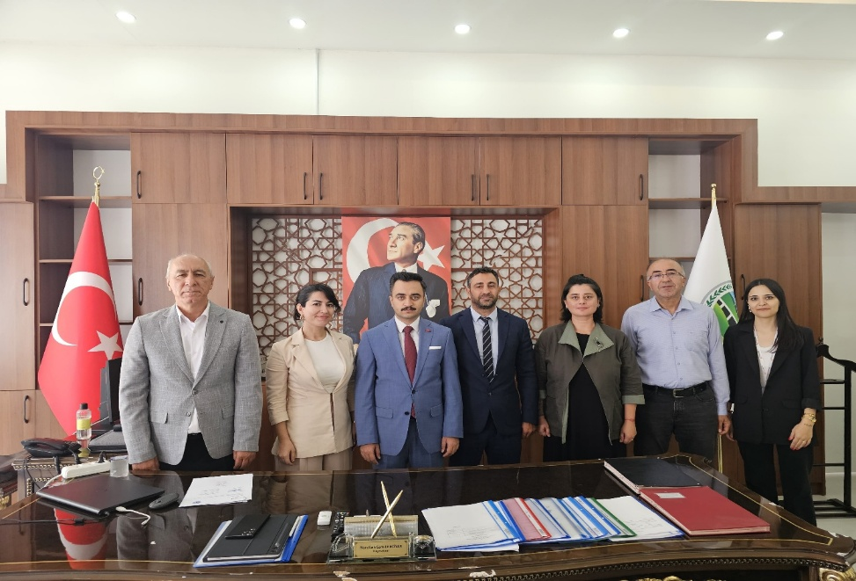
Approaches Across the Project
Personalized Support: One-on-one counselling, tailored legal guidance, mentorship, and coaching.
Data-Driven Design: Labour market and socio-economic gender assessments informed targeting and program design.
Market-Oriented Training: TVET and SME capacity-building aligned with local economic opportunities.
Gender Inclusion: Strong female engagement in career, SME, and cooperative interventions.
Digital Integration: Use of online job platforms and digital tools for CV development and job search.
Multi-Level Support: Combination of training, mentoring, legal awareness, and community engagement.
Collaboration with Local Authorities: Municipalities and chambers supported access to markets and employment opportunities.
Sustainability Focus: Follow-ups, coaching, and structured pathways for employment and SME development ensured long-term impact.

Slide 10
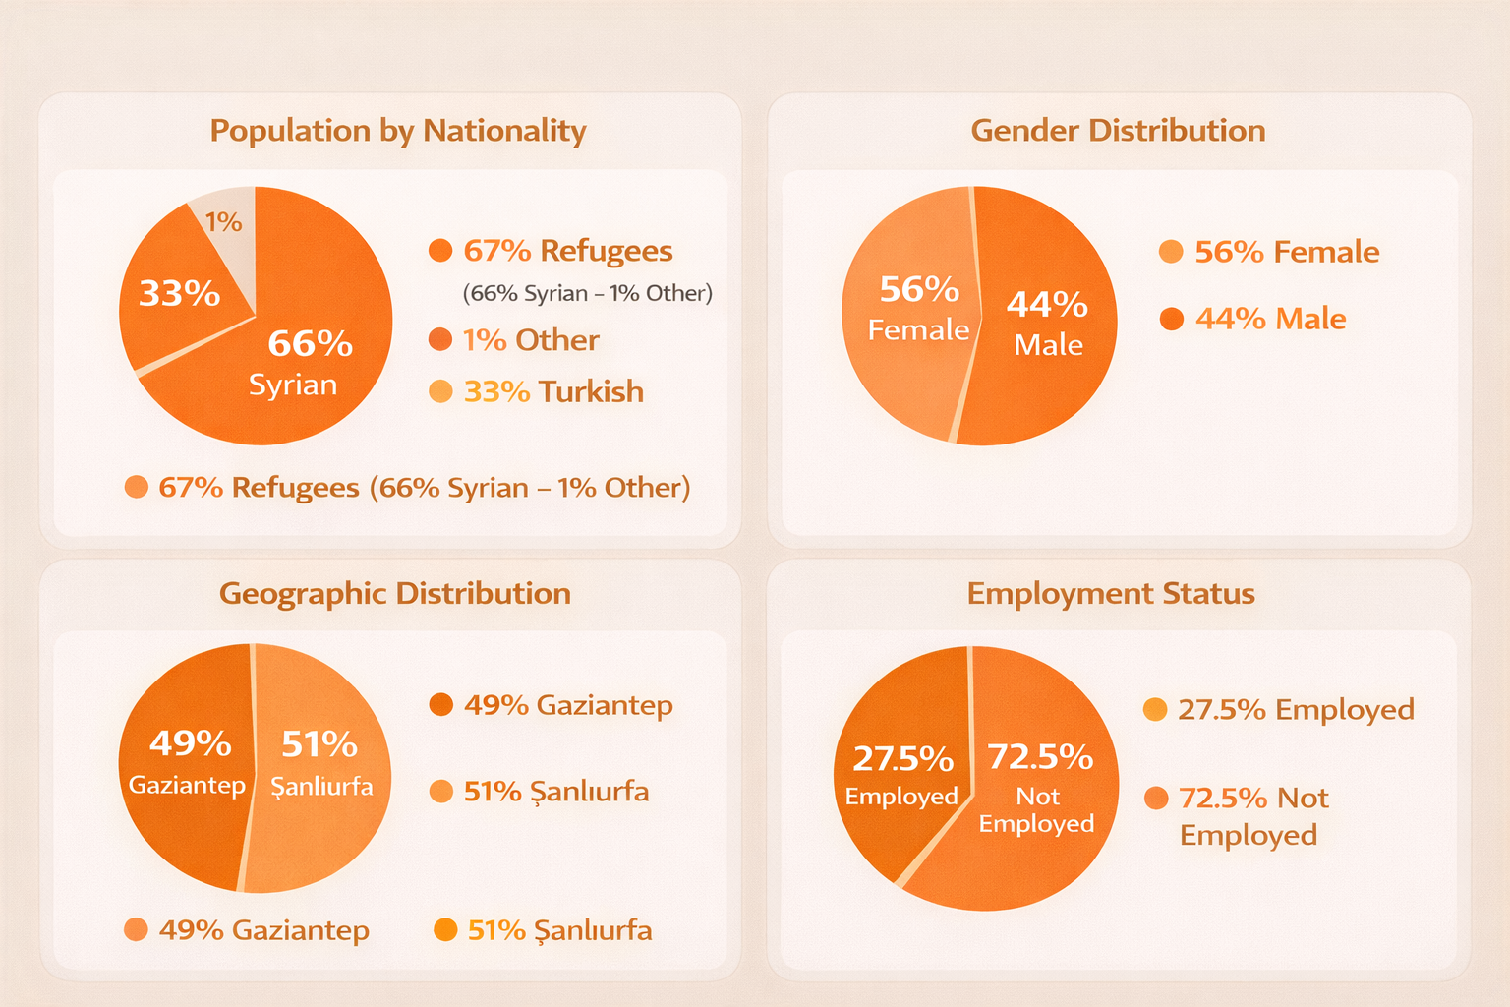
Demographic Inclusion

Slide 11
Impact and Transformed Lives
Semra Bayrak: Semra Bayrak is a mother of three who earns a living by operating her own hairdressing salon. She is a survivor of gender-based violence (GBV) and is currently in the process of divorcing her husband. Following the earthquake, her workplace sustained damage, forcing her to close the salon and relocate to a different location. Due to financial hardship, she was unable to fully equip and operate the new salon, which significantly limited her income and her ability to provide for her children. After receiving business management training and a USD 5,000 grant from World Vision, Semra was able to reopen her salon, purchase the necessary equipment and supplies, and resume full operations. As a result, she has restored her source of income and is now able to sustainably support her children and rebuild her life with greater financial independence and stability. | Feride El Osman: Feride El Osman is a 53-year-old entrepreneur who moved to Türkiye in 2013 and later settled in Şanlıurfa in 2014 with her family. She operates a small tailoring workshop in Şanlıurfa. and works in the same sector as her husband. Her business was severely affected by both the earthquake and subsequent flooding, resulting in significant damage to equipment and operational capacity. The household consists of four family members, including two children. The loss of productivity placed considerable financial pressure on the family. Through the grant support provided, Feride was able to purchase new equipment and restore her production capacity. With upgraded tools, her workflow accelerated, allowing her to increase sales, procure new materials, and fulfill customer orders on time. As a result, her business performance improved, contributing to greater household income stability and economic resilience for her family. She is preparing expand her work and open the second workshop for her husband.
Refik Uğur Can: Refik was engaged but employed as a cleaner in low-paid, unstable work, with limited career prospects and no pathway to professional advancement. Refik enrolled in the CNC Operation TVET course, successfully obtained his nationally recognized MYK certification, and completed a six-month supported job placement. Through this structured pathway, he acquired in-demand technical skills aligned with labor market needs. He secured formal employment in the manufacturing sector and continues to work in the same field, demonstrating strong job retention and career progression. The intervention enabled Refik to transition from precarious labor to skilled employment, ensuring stable income, professional growth, and long-term employment sustainability | Ibrahim Sevvah: Ibrahim owned a very small grocery shop with almost empty shelves and limited stock. The business generated insufficient income, placing his family of eight children at serious risk of economic hardship and school dropout. After completing business management capacity-building training, Ibrahim received a USD 5,000 grant to strengthen his enterprise. He invested strategically by opening a new, better-positioned shop on the same street and purchasing essential equipment, including a coffee machine to diversify products and attract customers. As a result, Ibrahim significantly increased his sales and customer flow, improved stock availability, and stabilized his income. His business is now sustainable, enabling him to meet household needs and ensure his children continue their education without interruption. The intervention transformed a vulnerable micro-enterprise into a viable and growing family business.

Slide 12
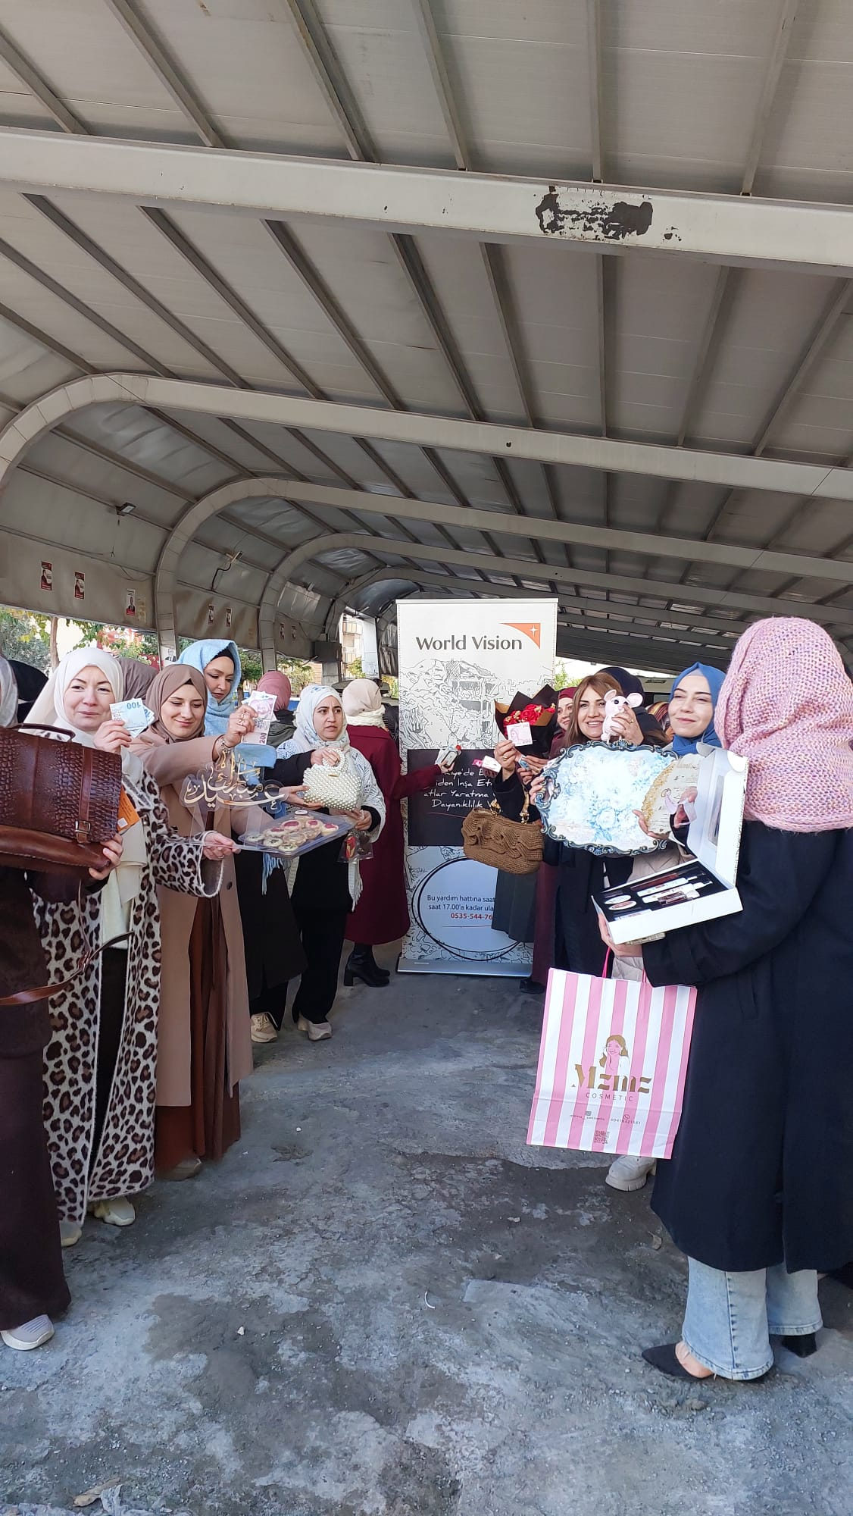
Thanks for listening

