Slide 1

Harvest Ridge Phase 7
Community Kickoff
4/13/26

Slide 2
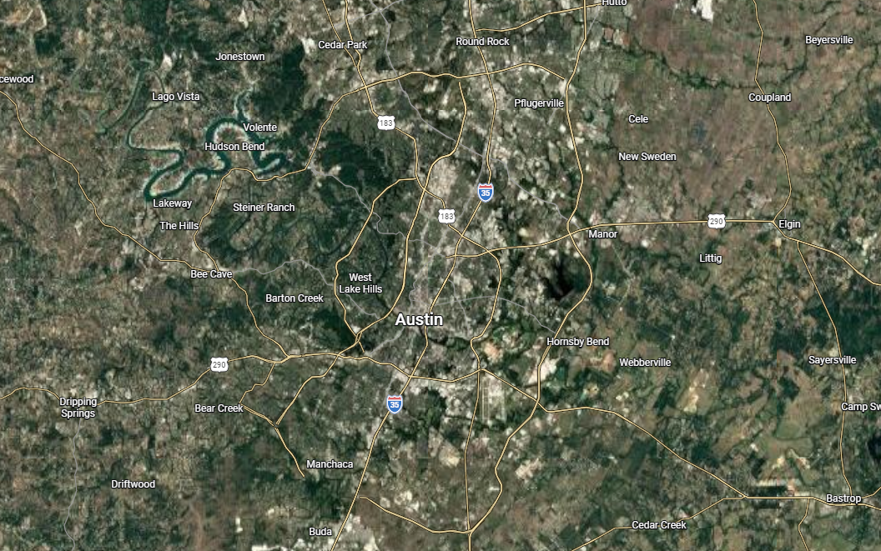
Harvest Ridge by Brohn Homes
LOCATION
103 Roost Rd, Elgin, TX 78621
24.5 Miles East of Downtown Austin (32 Min.)
12.5 Miles East of Texas 130 Toll (17 Min.)
17.1 Miles To Samsung (28 Min.)

Slide 3
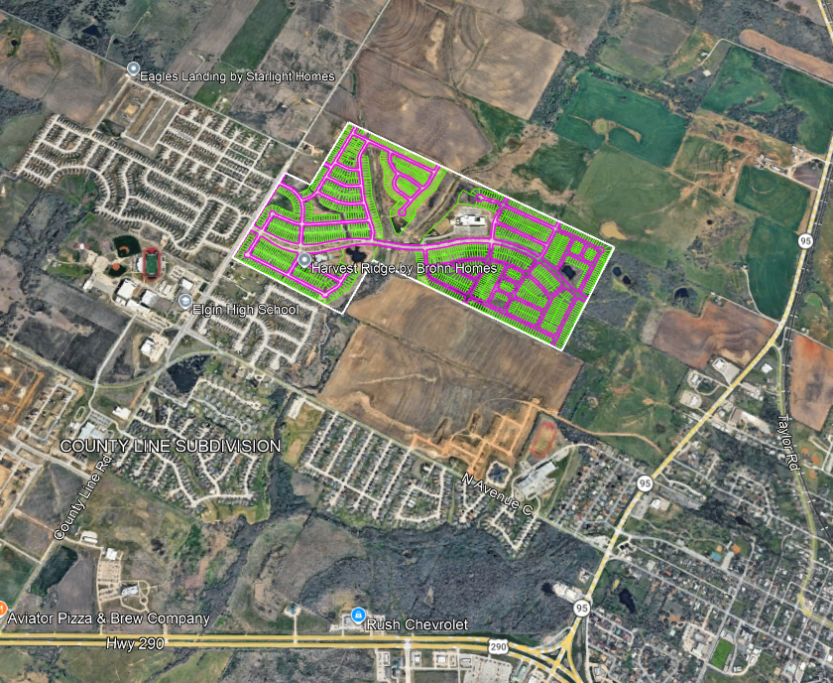
Eagles Landing by Starlight Homes
Fika by Blossoms L&Y Development
Homestead Estates – LGI Homes
Harvest Ridge by Brohn Homes
Triada by Empire Homes
Commercial Tract
NEIGHBORS

Slide 4
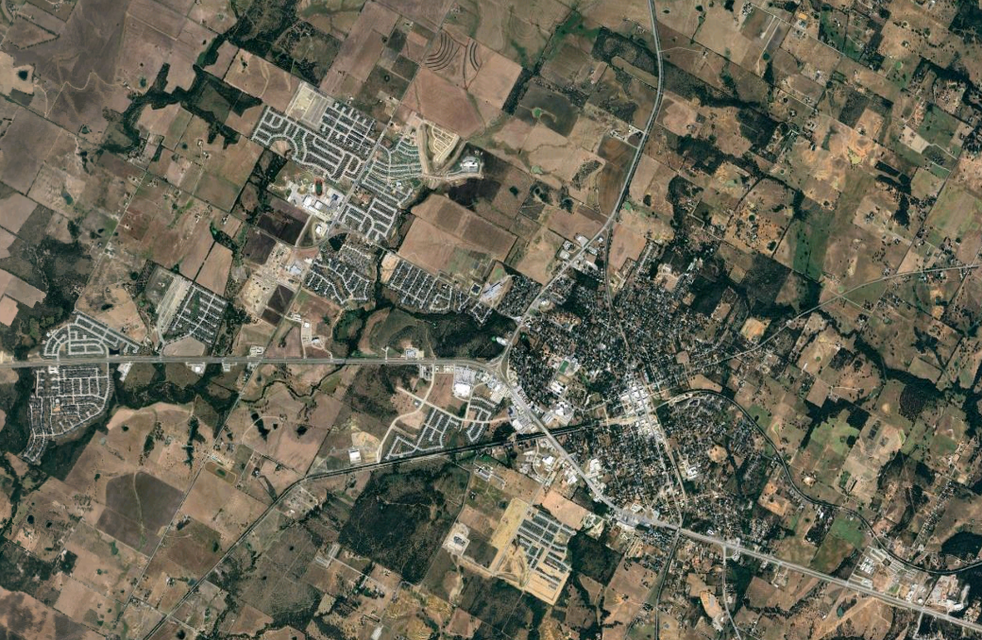
WEISS HIGH SCHOOL
Harvest Ridge Elementary
Elgin High School
Elgin Middle School
DESSAU ELEMENTARY SCHOOL
Austin Community College, Elgin
Elgin Intermediate School
DESSAU MIDDLE SCHOOL
EDGEBROOKE
ELGIN ISD
Harvest Ridge Elementary School (0 miles)
Elgin Intermediate School (2.8 Miles)
Elgin Middle School (2.0 miles)
Elgin High School (0.6 miles)
Austin Community College (1.6 Miles)

Slide 5
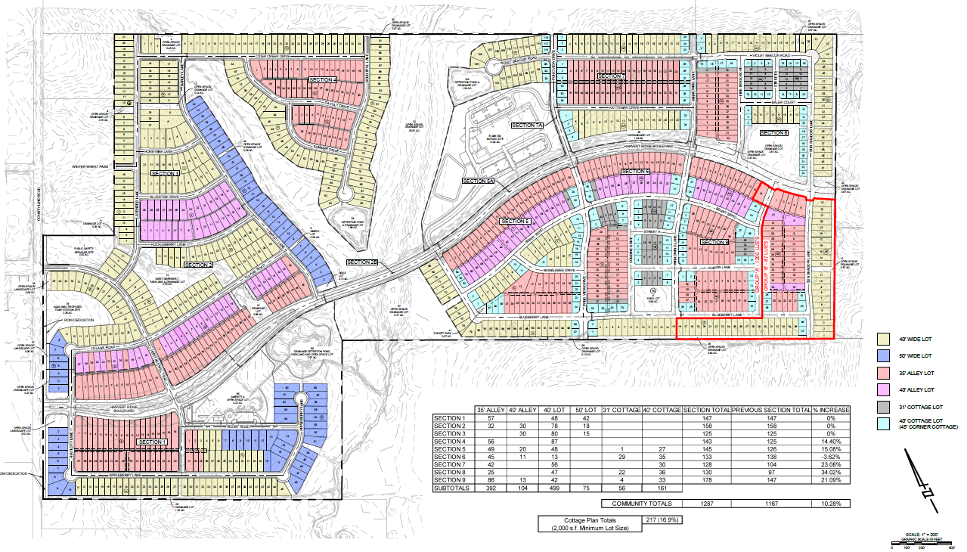
Group A: 1200 LUEs
Group B: 87 LUEs
HARVEST RIDGE COMMUNITY MAP
9 Phases, +/- 283 Acres
1,287 Lots
35’ Alley (392 Total)
40’ Alley (104)
40’ Front Load (499 Total)
50’ Front Load (75 Total)
31’ Cottage (56 Total)
40’ Cottage (161 Total)

Slide 6
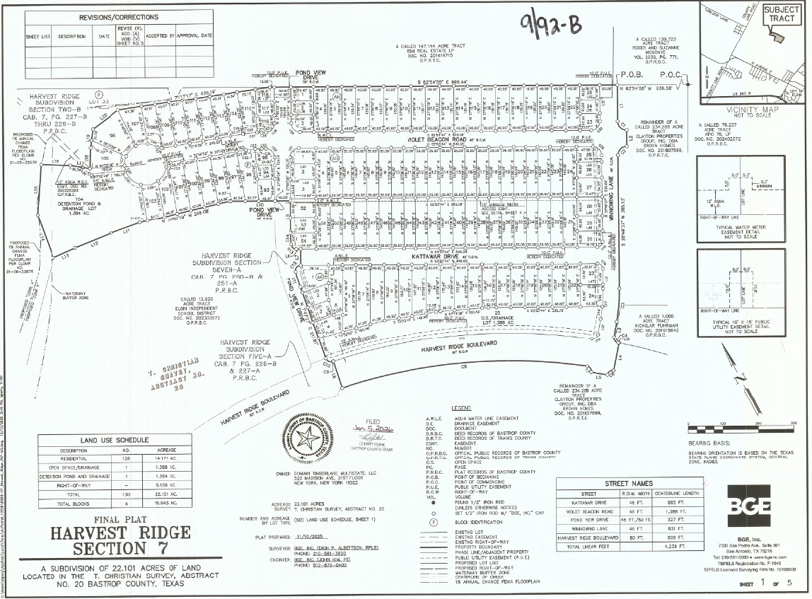
HARVEST RIDGE PHAES 7 FINAL PLAT
130 platted lots, 128 Residential
22.101 acres

Slide 7
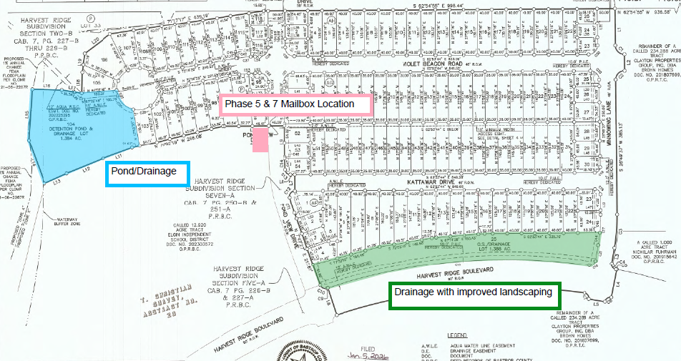
PHASE 7 DRAINAGE LOTS & MAILBOX LOCATION

Slide 8
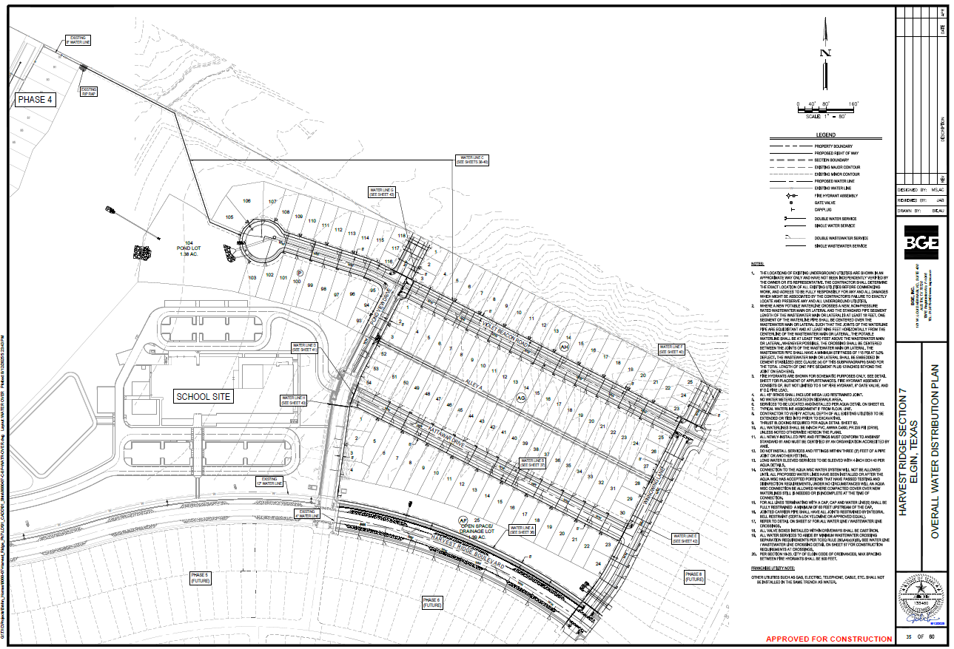
OVERALL WATER DISTRIBUTION PLAN

Slide 9
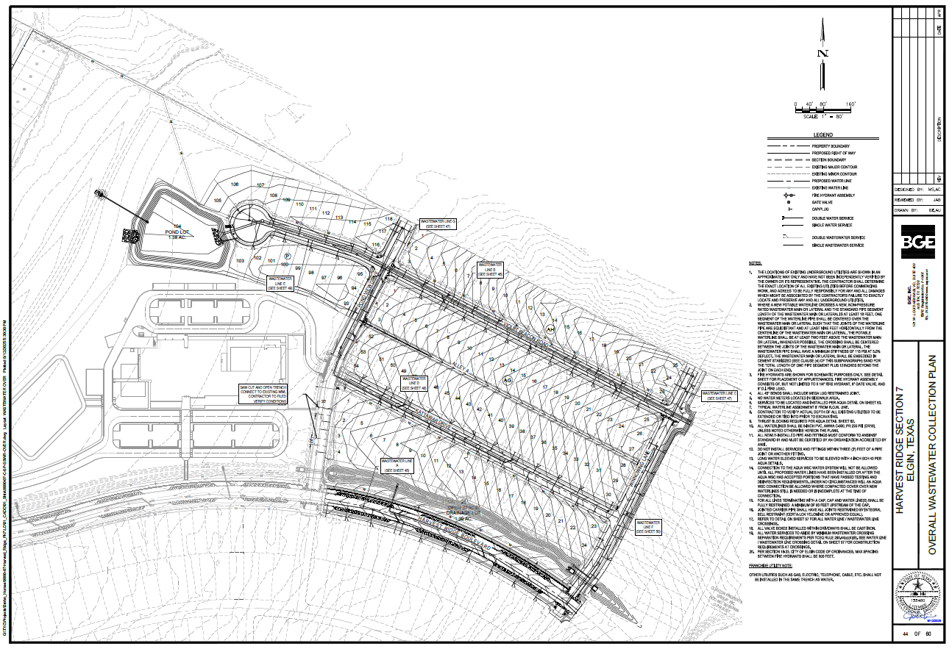
OVERALL WASTEWATER COLLECTION PLAN

Slide 10
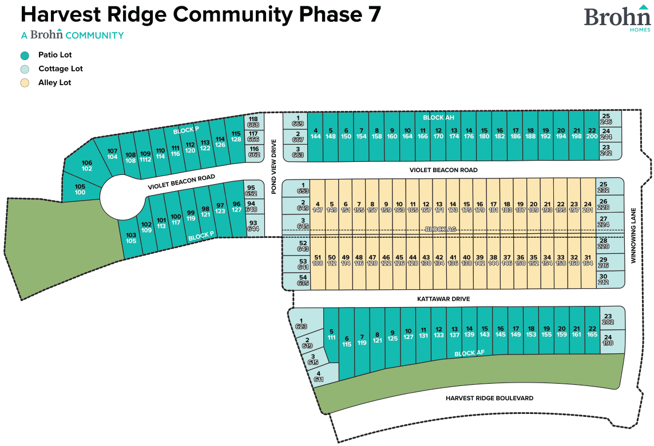
PHASE 7 LOT MIX
35’ Alley (42)
40’ Cottage (30)
40’ Front Load (56)

Slide 11
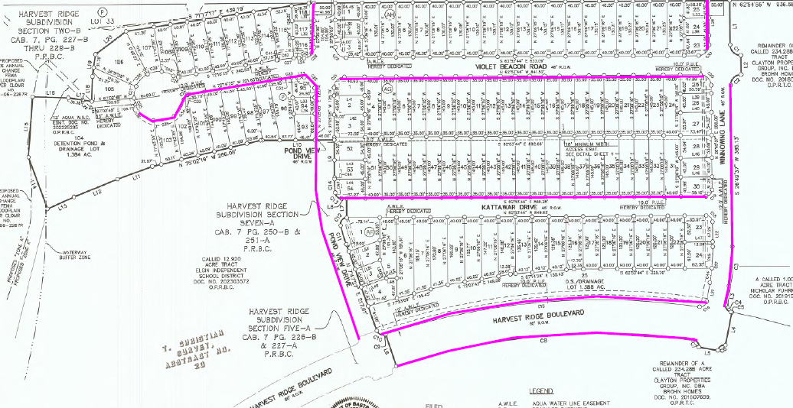
PHASE 7 SIDEWALK EXHIBIT

Slide 12
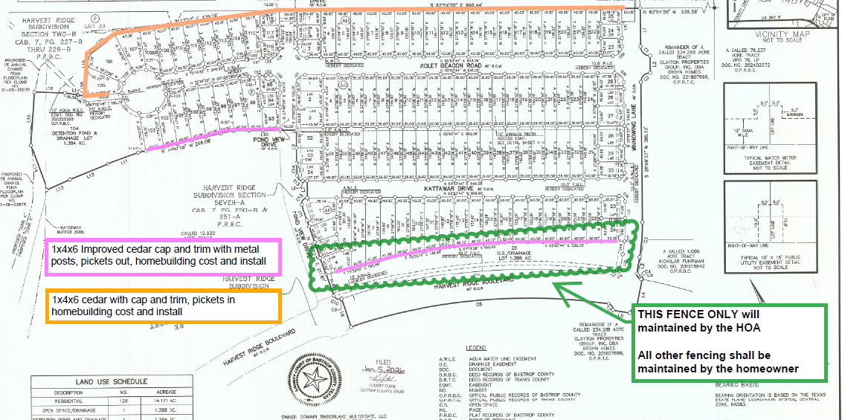
PHASE 7 FENCING PLAN

Slide 13
Fencing to be 6’ in height
All street facing fencing shall consist of 1”x4” pickets with 2”x6” cap and 1”x2” trim
All fencing to be painted “white paint” (Color – PPG (Pittsburg Paint “WHITE NG” Paint)
Fencing shall be good neighbor on ALL internal fences
Corner lots only, AC condensers shall be screened in with fencing or shrubs if the condenser cannot be placed on the internal side of the lot
DESIGN GUIDELINES (GENERAL FENCING)

Slide 14
UTILITIES & LOCAL SERVICES
Gas: Centerpoint Energy (800) 376-9663
centerpointenergy.com
Electric TXU (866) 898-4968 | txu.com Power to Choose
powertochoose.org
Water MUD - Aqua (512) 303-3943 | aquawsc.com
Cable/Internet Centric Fiber (877) 342-7270 | centricfiber.com
Garbage Service & Wastewater Crossroads (512) 246-1400
crossroadsus.com
POST OFFICE
301 Heatherwilde Blvd
Pflugerville, TX 78660
800-275-8777
HOA
Management Company: PAMCO
HOA Manager: Kelly Kilpatrick
512-918-8100
Lifestyle Coordinator: Courtney Olson
Monthly Dues: $70/mo.
Capital Contribution: $275 paid by the Buyer at closing
COUNTY TAXES
Travis:
Travis County: 0.375845%
Elgin ISD: 1.2234%
Travis ESD: 0.1000%
Travis Co. Healthcare: 0.118023%
ACC: 0.1034%
Altessa MUD: 0.8300%
Total = 2.750668%
Bastrop:
Bastrop County: 0.35049%
Elgin ISD: 1.2234%
Bastrop ESD: 0.1000%
Altessa MUD: 0.8300%
ACC: 0.1034%
County Rd: 0.07821%
Total = 2.6855%
PARKING & SIDEWALKS
One-way streets may have a min pavement width of 14ft but will not be used for parking.
Only designated parking on Harvest Ridge Blvd.
4’ sidewalks on one side of the street and are not required in alleys.
GENERAL INFORMATION

Slide 15
SETBACKS
Alley Load:
Front: 10’ (Per Plat)
Side: 5’ (Per Plat)
Corner Side: 15’ (Per Plat)
Rear: 18.5’ from pave line (Self Imposed per design guidelines to allow for two parking spaces in driveway)
Front Load:
Front: 20’ (Per Plat)
Side: 5’ (Per Plat and Plat)
Corner Side: 15’ (Per Plat)
Rear: 10’ (Per Plat)
Cottage:
Front: 10’ (Per Plat)
22’ On Aqua Side
Side: 5’ (Per Plat)
Rear: 7.5’ (Self Imposed)
Corner: 10’ (Self Imposed)
Buildings cannot be placed within 10ft of the edge of the Aqua easement. – Per Inspector
Prelim/Plat Restrictions
  A typical 12’ Easement, measured from the ROW, shall be dedicated to Aqua Water Supply Corporation along one side of the side of streets as shown (on the plats and prelim). A typical 10’ PUE shall be dedicated along the opposite side of said streets.
Driveways
  All driveways shall be surfaced with concrete or similar substance approved by the Architectural Reviewer.
Sidewalks
  Street sidewalk (4’ W) shall sit 1’ from front property line and be installed within the ROW
  Lead walk (3’ W) shall connect the front door to the street sidewalk or driveway
  Alley load walkways shall connect backdoor to either the garage or driveway
Roof Pitch
  No less than 5:12
GENERAL RESTRICTIONS (PLAT AND CCR’s)

Slide 16
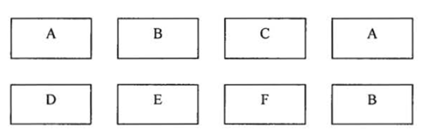
Plans and exterior color schemes can be repeated every 3rd lot.
The same plan or exterior color scheme cannot be placed across the street or diagonal from the same plan or exterior color scheme, unless otherwise approved by the Architectural Reviewer.
PLAN AND EXTERIOR COLOR REPITITION

Slide 17
Main Fencing Internal Lots:
  Gate is to be installed on the same side as entry door/driveway access
  Fencing to start at rear corner of the house
Driveway:
  Begins at front property line and shall be 40’ (L) and 8’ (W)
  Driveway placement shall be up against the property line
  Entry door shall be on driveway side
Square Footage:
  Minimum of 2,000 sqft per Third Amendment to Development Agreement
  Wet utilities
  Single service and will be located in the middle of the lot
  Landscaping:
  All Cottages
    10 front yard shrubs
    2 trees required at each front yard. 1 (3”) Lacebark Elm tree in the ROW and 1 Crape Myrtle (6-10’ tall minimum)
  Corner Lots
    5 shrubs along the house on the ROW side
    5 shrubs spaced evenly along the fenceline on the alley street or ROW side
  FRONT LOAD WITHOUT GARAGES (COTTAGES)

Slide 18
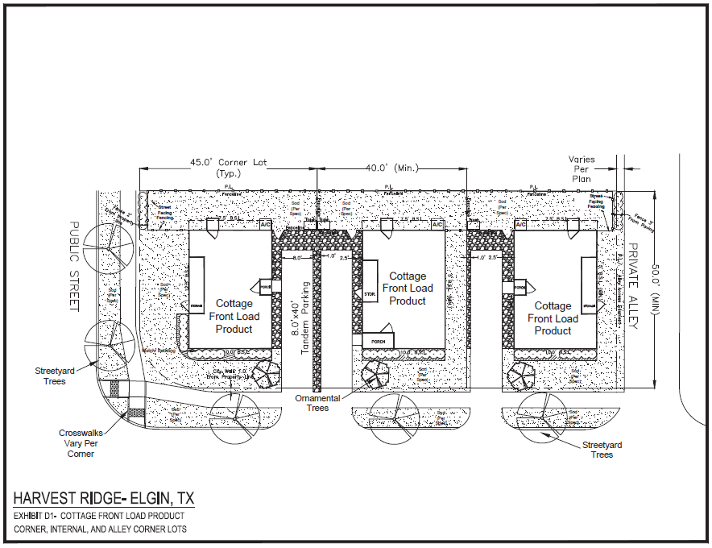
  FRONT LOAD WITHOUT GARAGES (COTTAGES)

Slide 19
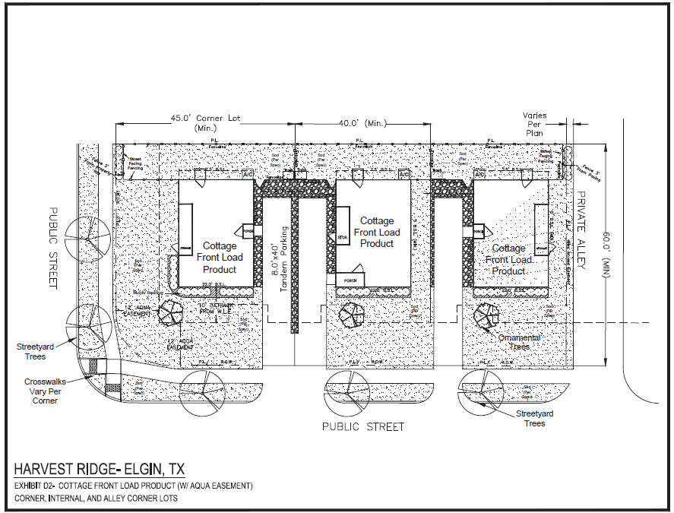
  FRONT LOAD WITHOUT GARAGES (COTTAGES)

Slide 20
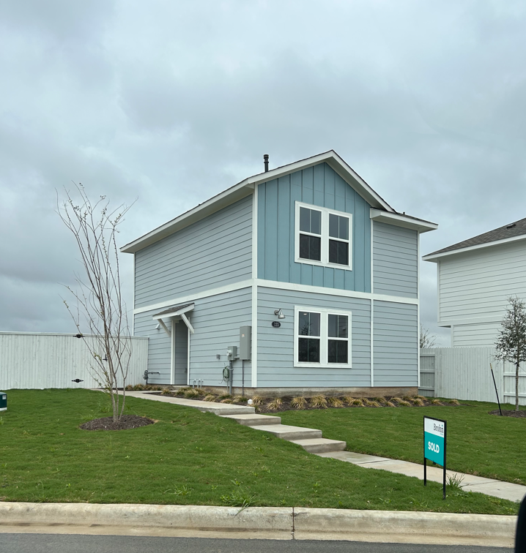
  FRONT LOAD WITHOUT GARAGES (COTTAGES)

Slide 21
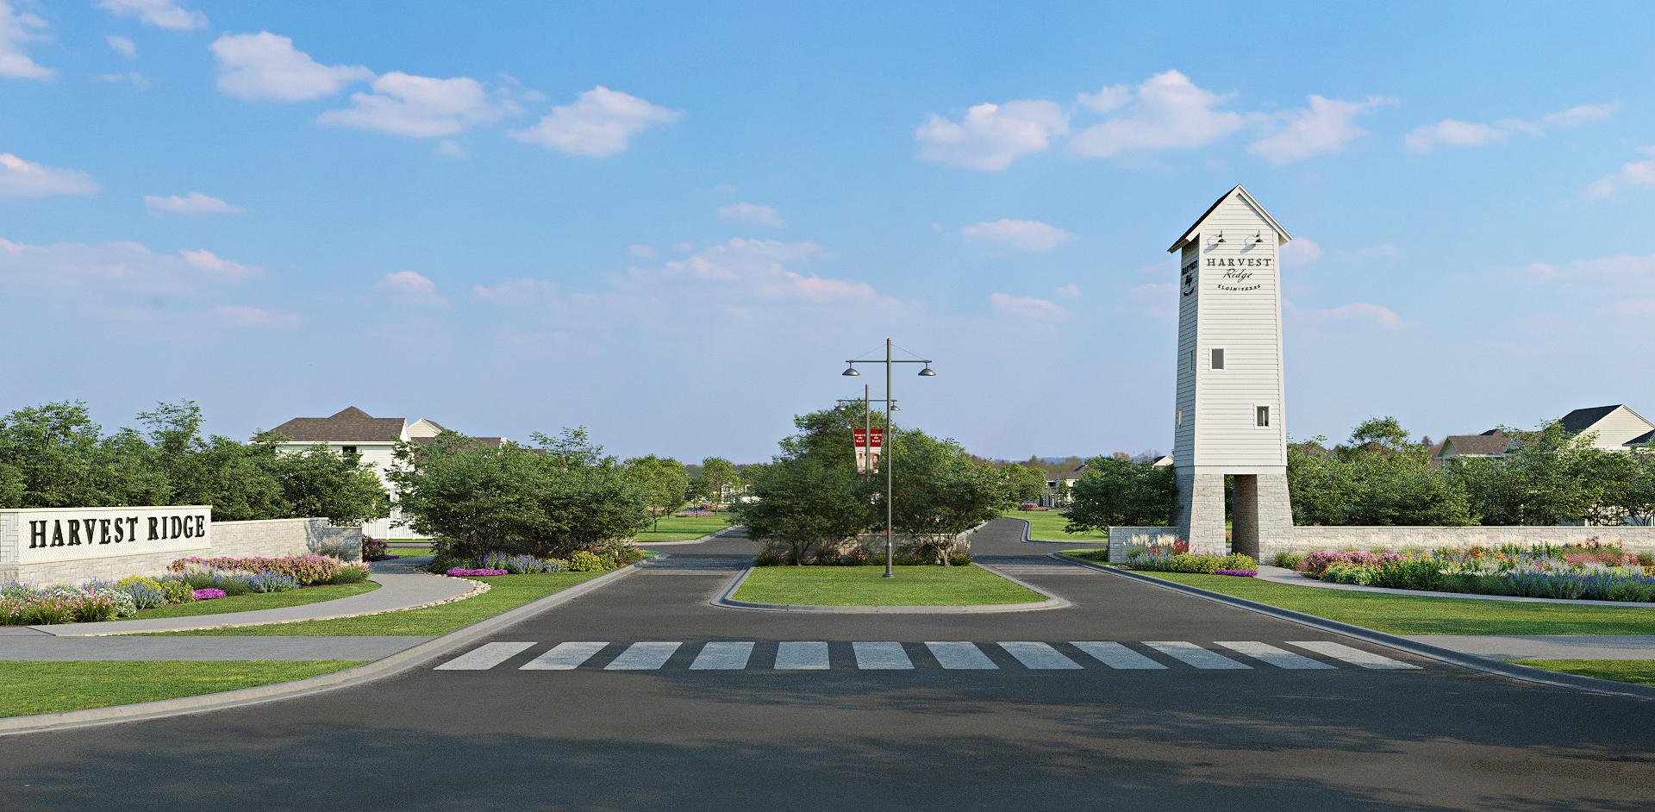
ENTRY MONUMENTATION

Slide 22
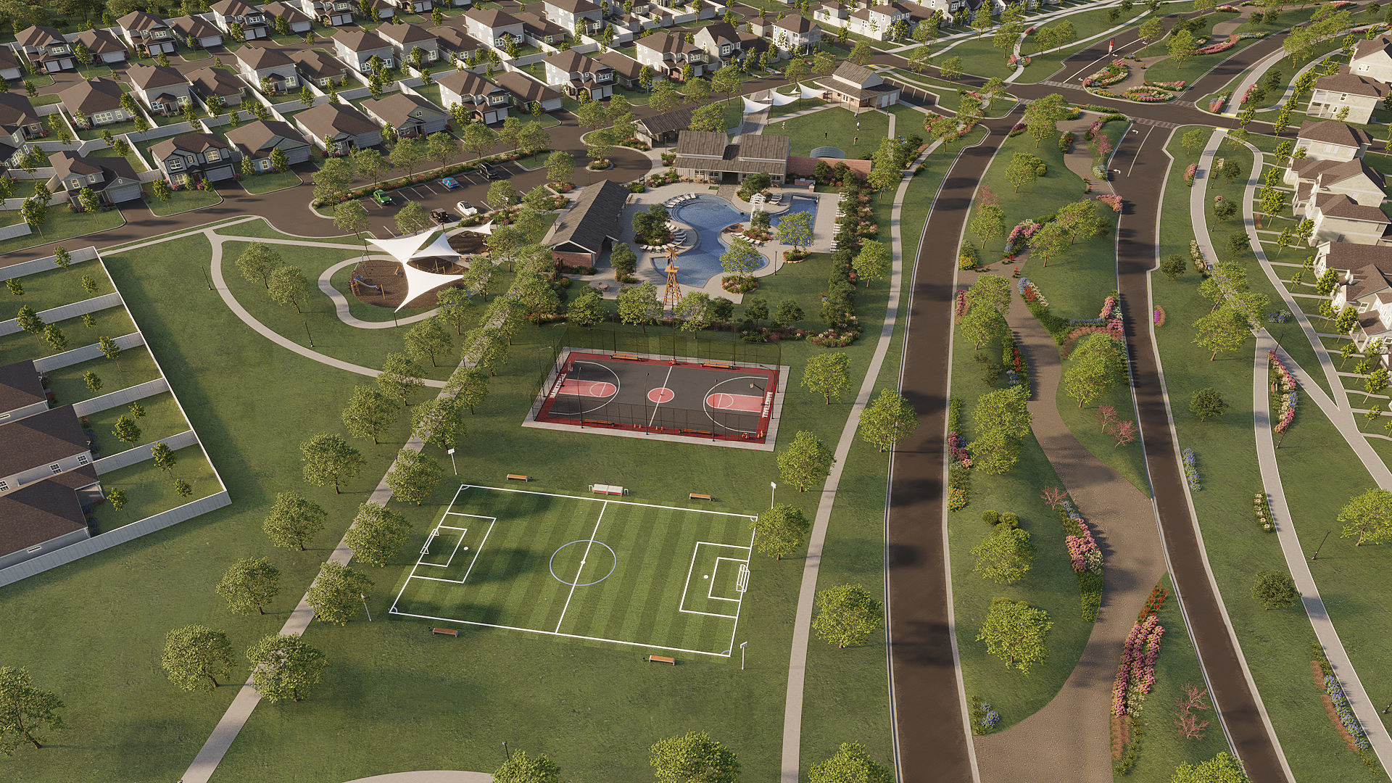
AMENITIES

Slide 24
General Planting & Tree Requirements
• Screen all A/C condenser units, gas meters, electric meters and panels, low voltage boxes, pool equipment, and any above ground utilities with shrubs, if not screened with fence.
• All Street Yard Trees shall be Lacebark Elm
• Front Yard Trees shall be Live Oak
• Ornamental Trees shall be Crape Myrtle
• 1 Gallon Shrubs shall be Knock Out Roses
• Full Shrub Package shall be provided for approval on all lots.
General Planting & Tree Requirements (Front Load)
• All Corner/ROW Side Lots (Alley’s) shall get 13 shrubs installed against the house (street side), 10 – (2 sets of 5) 1-gallon shrubs against the fence between sidewalk and fence (centered on fence), 8 shrubs installed in groups of 4 (2 sets) shall be spaced evenly along the fence, 1 (3”) alley corner tree installed between the ROW and the driveway and 3 (3”) street trees installed within the ROW (Street Side)
• All Corner/Alley Side Lots shall get 13 shrubs installed against the house (alley side), 10 – (2 sets of 5) 1-gallon shrubs against the fence between sidewalk and fence (centered on fence), 8 shrubs installed in groups of 4 (2 sets) shall be spaced evenly along the fence. 1 (3”) alley corner tree installed between the alley street and the driveway and 2 ornamental trees (6-10’ tall minimum) installed between the house and the alley (alley street side)
• Alley Load Rear Plantings shall consist of 1 (2”-3”) yard tree (Live Oak) and 5 1-gallon shrubs to be located on the non-garage side.
DESIGN GUIDELINES (LANDSCAPING)

Slide 25
General Planting & Tree Requirements (Front Load)
• All Front Load internal lots shall get 1 (3”) street yard tree planted in the ROW, 1 (3”) front yard tree and 1 ornamental tree (6-10’ tall minimum). Front Street yard tree shall be centered on the lot. If lot is atypical, placement to be approved by the Architectural Control Committee
General Front Yard Landscape
• All Front Yards shall be landscaped using a minimum of 20 (1) gallon shrubs
• All Alley Lots shall get 1 (3”) street yard tree planted in the ROW, 1 (3”) front yard tree, and 1 ornamental tree (6-10’ tall minimum). Front Street yard tree shall be centered on the lot. If lot is atypical; placement to be approved by the Architectural Control Committee
• All Alley Lots shall have front yard landscape beds which shall start from the house and stop 5’ from the city walk and generally the width of the lot. Grass shall be installed starting at back of city walk running 5’ towards the house.
• All Front Load internal lots shall get 1 (3”) street yard tree planted in the ROW, 1 (3”) front yard tree and 1 ornamental tree (6-10’ tall minimum). Front Street yard tree shall be centered on the lot. If lot is atypical, placement to be approved by the Architectural Control Committee
DESIGN GUIDELINES (LANDSCAPING)

Slide 26
Alley Load Fencing Corner Lots
Fence to start as close to 5’ as possible from the front corner of the house; depending on architectural features, windows, gas meters, electric meters and panels, low voltage boxes, and pool equipment, but shall not be less than 5’.
Fence to be offset 2’ from property line – street side (Corner Lot) (3’ grass/landscape space between fence and city walk
Fence to be offset 3’ from alley/edge of pavement – alley side (Alley lot)
Provide front gate on non-street side. If AC condenser conflicts (as they may on corner lots), gate is to be located on opposing side.
Provide rear gate that opens to largest side of rear yard.
Fence to extend past garage street side to 3’ from edge of alley pavement
Fence to extend past garage alley side 3’ from edge of pavement
Alley Load Fencing Main Internal Lots
Fence to start as close to 5’ as possible from the front corner of the house; depending on architectural features, windows, gas meters, electric meters and panels, low voltage boxes, and pool equipment, but shall not be less than 5’.
Fence to return 3’ forward from front corners of detached garage on alley facing sides.
Provide front gate on patio side. If AC condenser conflicts, gate shall be located on opposing side.
Provide rear gate that opens to largest side of rear yard to alley.
DESIGN GUIDELINES (ALLEY LOAD FENCING)

Slide 27
Front Load Fencing Corner Lots
Fence to start 5’ forward rear corner of house or 5’ forward rear patio on street side
Fence to start at rear corner of house non street side
Fence to be offset 2’ from property line – street side (Corner Lot) (3’ grass/landscape space between fence and city walk)
Gate to be installed on non-street side
Front Load Fencing Internal Lots
Fence to start at rear corners of house
Gate to be installed on garage side
DESIGN GUIDELINES (FRONT LOAD FENCING)

Slide 28
Internal Alley Load; No Garage
  Driveway parking shall be 18’ (w) x 18.5’ (d) and no less than 333 sqft.
Internal Alley Lot Fencing
  Fence to start as close to 5’ as possible from the front corner of the house; depending on architectural features, windows, gas meters, electric meters and panels, low voltage boxes, and pool equipment, but shall not be less than 5’.
  Fence to return 3’ forward from front corners of detached garage on alley facing sides.
  Provide front gate on patio side. If AC condenser conflicts, gate shall be located on opposing side.
  Provide rear gate that opens to largest side of rear yard to alley.
Internal Alley Storage Shed (Non-Corner Lots)
  All Internal Alley Lots (non-corner) without a garage option, shall receive 1 standard storage shed and sited accordingly
  Storage shed shall be no more than 100 sqft
  Storage shed shall be no more than 8.5’ in height when measured from the surface of the lot to the highest point of the storage building
  Storage shed to be placed 3’ from rear fence and 1’ from rear walkway.
  Storage shed colors and materials (including shingles) to match house
DESIGN GUIDELINES (PRODUCT SPECIFIC REQUIREMENTS)

Slide 29
SETBACKS
Alley Load:
Front: 10’ (Per Plat and Prelim)
Side: 5’ (Per Plat and Prelim)
Corner Side: 15’ (Per Prelim)
Rear: 18.5’ from pave line (self imposed per design guidelines to allow for two parking spaces in driveway)
Front Load:
Front: 20’ (Per Prelim)
Side: 5’ (Per Plat and Prelim)
Corner Side: 15’ (Per Prelim)
Rear: 10’ (Per Prelim)
Buildings cannot be placed within 10ft of the edge of the Aqua easement. – Per Inspector
Prelim/Plat Restrictions
  A typical 12’ Easement, measured from the ROW, shall be dedicated to Aqua Water Supply Corporation along one side of the side of streets as shown (on the plats and prelim). A typical 10’ PUE shall be dedicated along the opposite side of said streets.
Garage Color
  All garages shall be the color white unless otherwise approved by the Architectural Control Committee
Sidewalks
  Lead walk (3’ W) shall connect the house to the back of city walk
  City walk (4’ W) shall sit 1’ from front property line and be installed within the ROW, or per City/County Requirements.
Roof Pitch and Building Height
  No less than 5:12
  35’ Height
Driveways
  All driveways shall be surfaced with concrete or similar substance approved by the Architectural Reviewer.
Roofing
  Weatherwood shingles unless otherwise approved by the Architectural Control Committee
GENERAL RESTRICTIONS (PLAT AND CCR’s)

