Slide 1
Stock Recommendation: Materials Sector
BUSFIN 4228 – Stock Market
Jaren Leiken, Quintin Liao, David Noel, Brendan Leonard, Hayden Mosher

Slide 2
SIM Portfolio Materials Holdings
International Paper (IP)
% of SIM portfolio: 0.54%
Average Cost/Share: $39.28
Total Cost: $58,920.00
Shares: 1,500
Market Price: $36.50 (4.11.2026 close)
Market Value: $54,750.00
Unrealized loss: $4,170

Slide 3
SIM Materials Sector
S&P 500 Materials Weight: 2.10%
SIM Materials Weight: 0.54%
We are underweight compared to benchmark
Sector recommendation: remain underweight

Slide 4
Sector Size
Materials Sector Size Overview:
- Total Market Capitalization: $2.467 trillion USD
- Percentage of S&P 500 Market Value: 2.7%
- Number of Industries: 14
- Number of Companies: 276
Source: Yahoo Finance – Basic Materials Sector, Visual Capitalist S&P 500 Breakdown

Slide 5
Industries
11.43%
9.01%
3.57%
6.09%
28.02%
30.22%
5.15%
Source: Yahoo Finance – Basic Materials Sector Breakdown

Slide 6




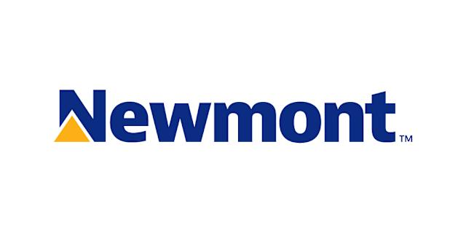


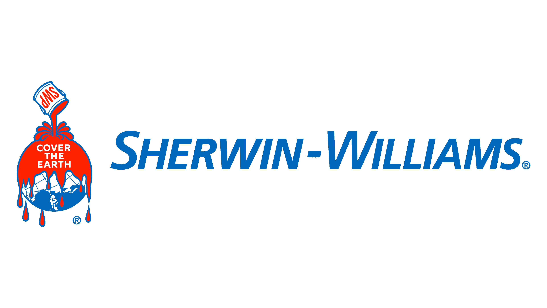

Companies
205.67b
170.36b
161.67b
128.93b
117.32b
94.24b
85.93b
84.16b
Source: Stock Analysis – Materials Sector Stocks, Google Images

Slide 7
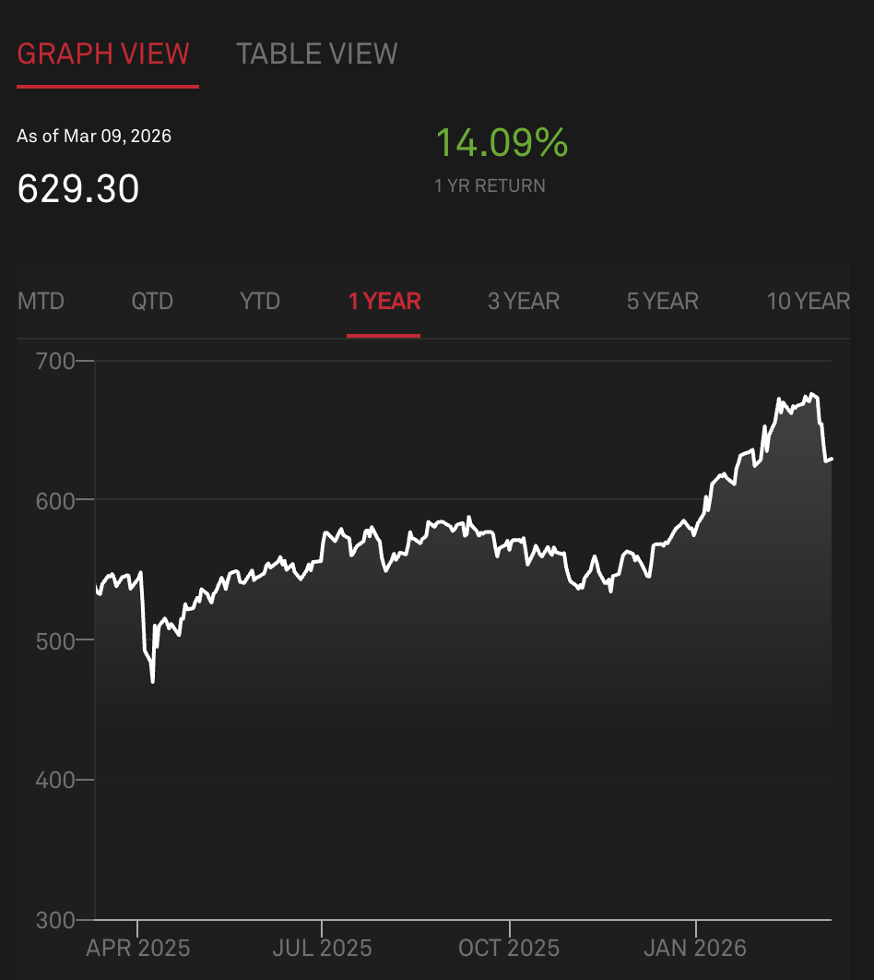
Performance
Driven by strong demand for industrial commodities (metals and chemicals)
Driven by increased investment in infrastructure inputs
Supports rotation in cyclical sectors
Source: S&P Dow Jones Indices – S&P 500 Materials

Slide 8
International Paper (IP) Overview
International Paper (NYSE: IP) is a global producer of renewable, fiber-based packaging.
They are primarily an Industrial Packaging business after divesting their Global Cellulose Fibers division ($1.5B).
They produce products such as linerboard, medium, whitetop, recycled linerboard, recycled medium and saturated kraft; 75% of those products are further processed into corrugated packaging material.
Two business segments: Packaging Solution North America and Packaging Solutions EMEA

Slide 9
International Paper (IP) Overview
Sector
Market Capitalization | $19,301.2 M
Price as of April 10, 2026 | $36.50
Shares Outstanding | 528.8 M
Individual Stock Recommendation | Hold
Value derived from fundamental analysis | $34.38
Downside/Upside from Actual | -5.81%
2025 Dividend Yield | 5.5%
1-year High Market Price | $56.64
1-year Low Market Price | $33.65
1-year Projected Return excl. dividend yield | 31.5%
1-year Consensus Target Price | $48.00
2025 Revenue | $23,634.00 M
2025 EBITDA | $3,948.00 M
2025 Net Income | -$3,516.00 M

Slide 10
International Paper Business Analysis
Key Business Drivers: overall market conditions (equity beta close to 1), demand for containerboard/corrugated packaging, business structure simplification and 80/20 plan implementation, energy and input costs.

Slide 11
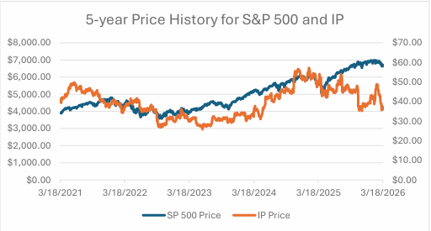
International Paper Business Analysis

Slide 12
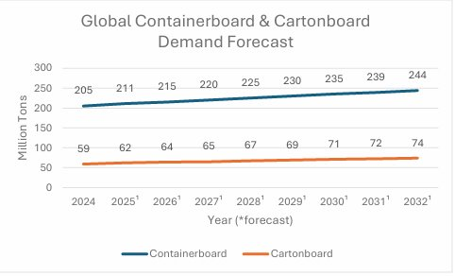
International Paper Business Analysis

Slide 13
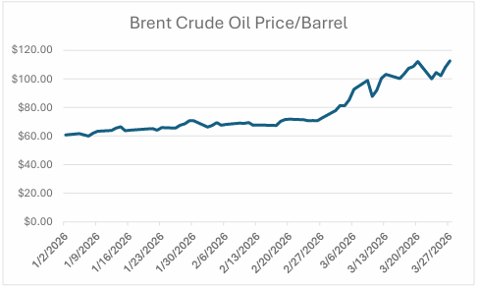
International Paper Business Analysis

Slide 14
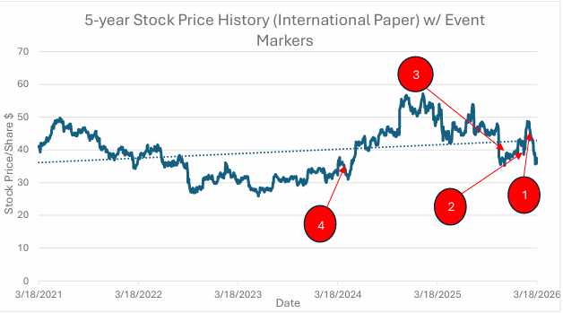
International Paper Recent Performance
Event 1: global conflict seemingly triggers decline in stock price at beginning of March. Resulted in ~ 18% decline in stock price.
Event 2: Earnings call on Jan 29, reported a net earnings loss of $3,516 M. Not followed by price decrease. Also announced IP would split into two publicly traded companies.
Event 3: Jan 23, 2026 IP finalized sale of Global Cellulose Fibers business.
Event 4: April 16, 2024 IP announces plant to acquire DS Smith, which corresponds with an increase in price.
Note the upward trendline, cyclical but going in a good direction.
Positive target prices indicate price may go up 1-year from now.
Question about the validity of those target prices, changing environment.

Slide 15
International Paper Financial Analysis
Projected Earnings and Sales for International Paper
(In $Millions) | 2028 F | 2027 F | 2026 F | 2025
Revenue | 26,394 | 25,440 | 24,520 | 23,634
Net Income | 1,312 | 1,265 | 1,219 | (3,516)
Tapered to a terminal revenue growth rate of 3% by 2036
Net Income tapers to a 3.3% growth rate by 2036

Slide 16
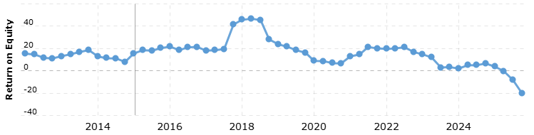
International Paper ROE
2025 Year-end ROE = -20.43%
Source: macrotrends

Slide 17

International Paper Financial Ratios
Negative return due to expenses related to restructuring and acquisitions. Since this a one-time occurrence, the negative ROI is not as concerning.
Notes:
EBITDA margin below peer average
ROI TTM is negative due to restructuring and acquisition expenses, one time only
ROI 5-year is below average as well
Revenue growth is below, but close, to peer average of 7.06%
Relatively lower debt/total capital ratio lower than peer average, can be inferred it is a little less risky
Low interest coverage ratio, compared to peer average, may negate the previous inference.

Slide 18
International Paper Valuation
Implied equity value/share: $34.38
Terminal Growth Rate: 9.75%
Terminal FCF Growth: 3.30%
Current Price: $36.50
Downside to DCF of 5.8%
Currently, given that assumptions are somewhat correct, IP's market price is close to its intrinsic value. Not a large enough margin of safety, furthering hold recommendation.

Slide 19
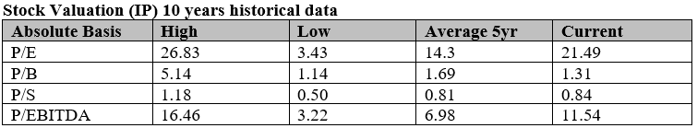
International Paper Relative Valuation

Slide 20
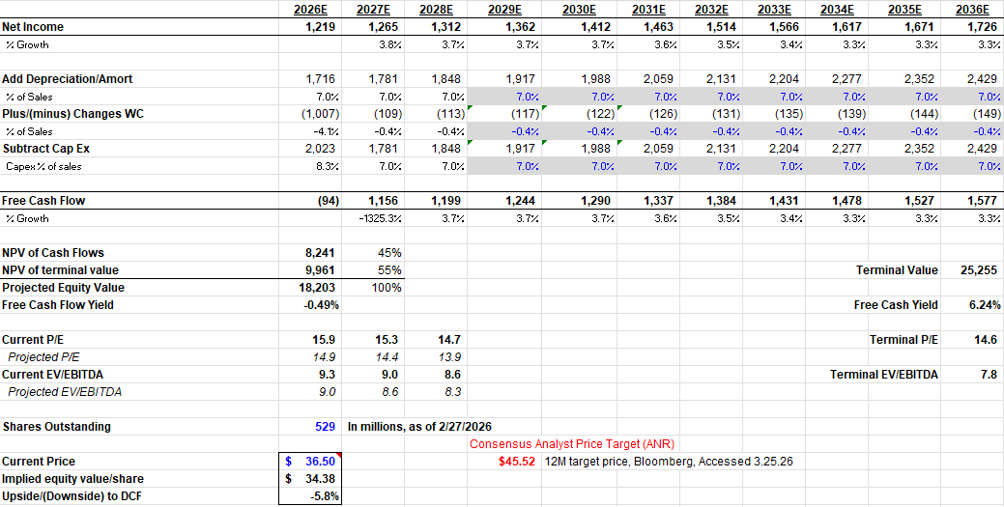
International Paper DCF

Slide 21

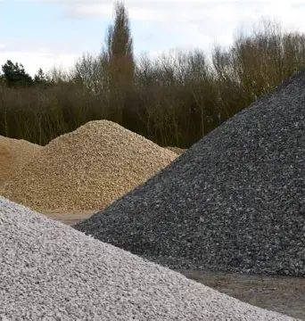
Martin Marietta Materials Overview
International Paper (NYSE: MLM) is a leading U.S. supplier of construction aggregates and heavy-side building materials.
Martin Marietta’s core products include crushed stone, sand, gravel, ready-mixed concrete, asphalt and related materials used in infrastructure, residential and non-residential construction projects.
Martin Marietta is a fundamental input driver for various industries as well, including the railroad, agricultural and environmental industries

Slide 22
Martin Marietta Materials Overview
Overview
Market Capitalization | $33.816B
Industry | Building Materials
Sector | Basic Materials
Current Stock Price | $560.69
Target Stock Price | $525.57
Dividend Yield | 0.59%
Total Projected Return | -5.67%
52-Week Range | $441.96-$710.97
Diluted Shares Outstanding | 61.63M

Slide 23
Martin Marietta Materials Business Analysis
Key Business Drivers: Some of Martin Marietta’s key business drivers include consistent demand stemming from infrastructure and highway construction spending, residential construction / housing recovery, strict pricing power in the aggregates industry, local positions in relevant geographic markets and finally energy, freight and input cost trends.

Slide 24
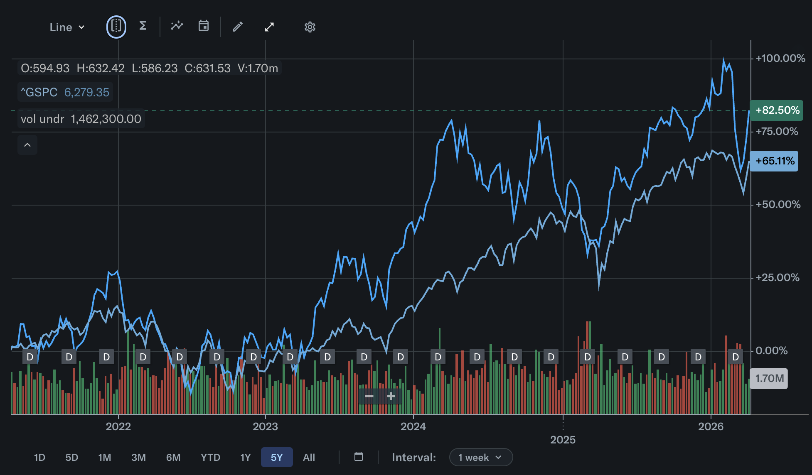


Martin Marietta Materials Business Analysis
5-year Price History: S&P 500 v. MLM

Slide 25
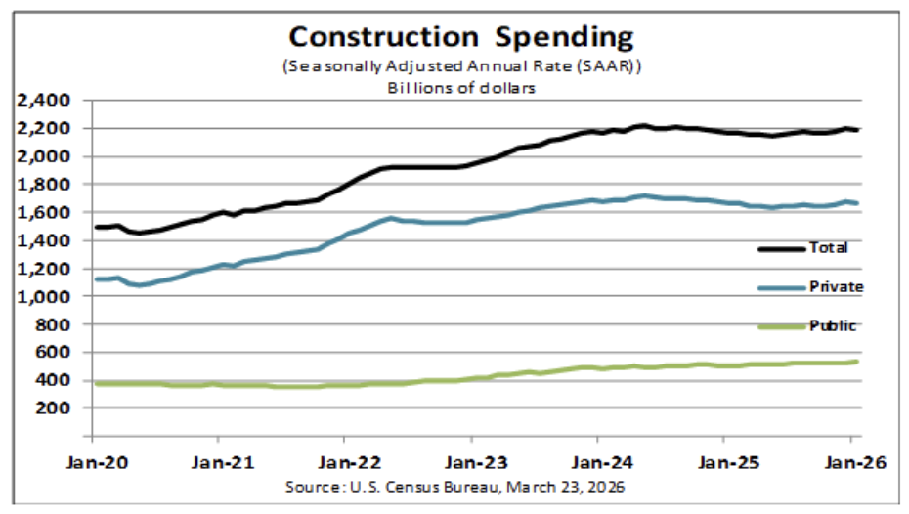
Martin Marietta Materials Business Analysis

Slide 26
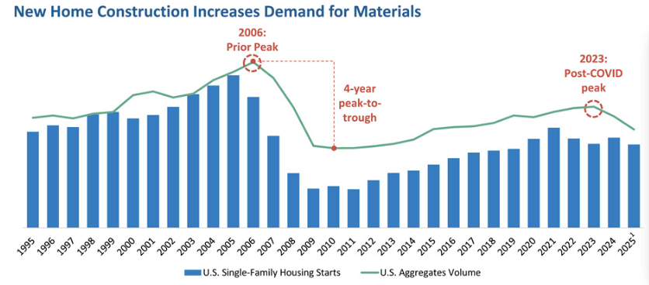
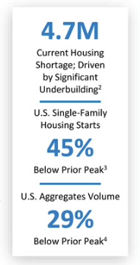
Martin Marietta Materials Business Analysis

Slide 27
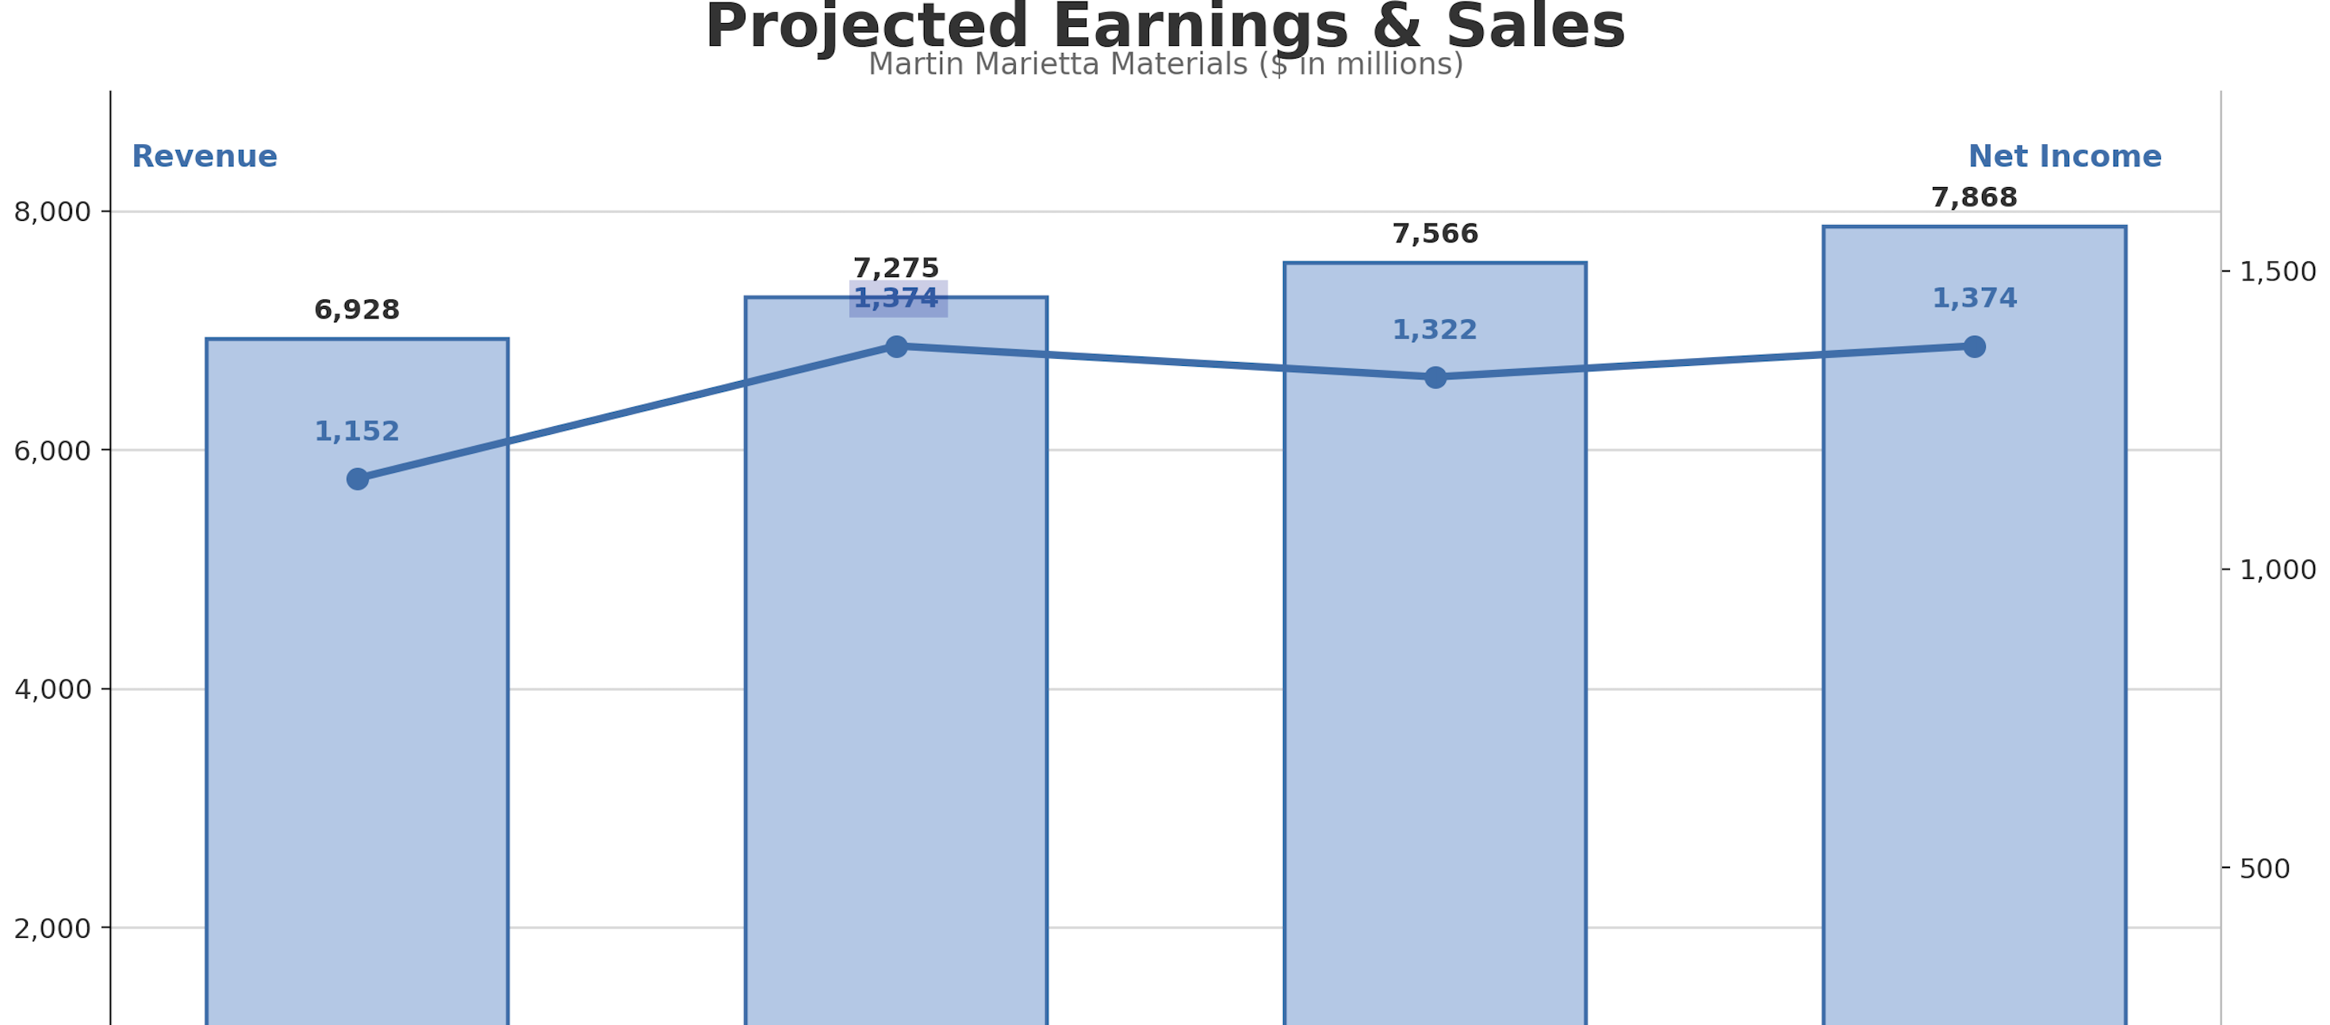
Martin Marietta Projected Earnings

Slide 28
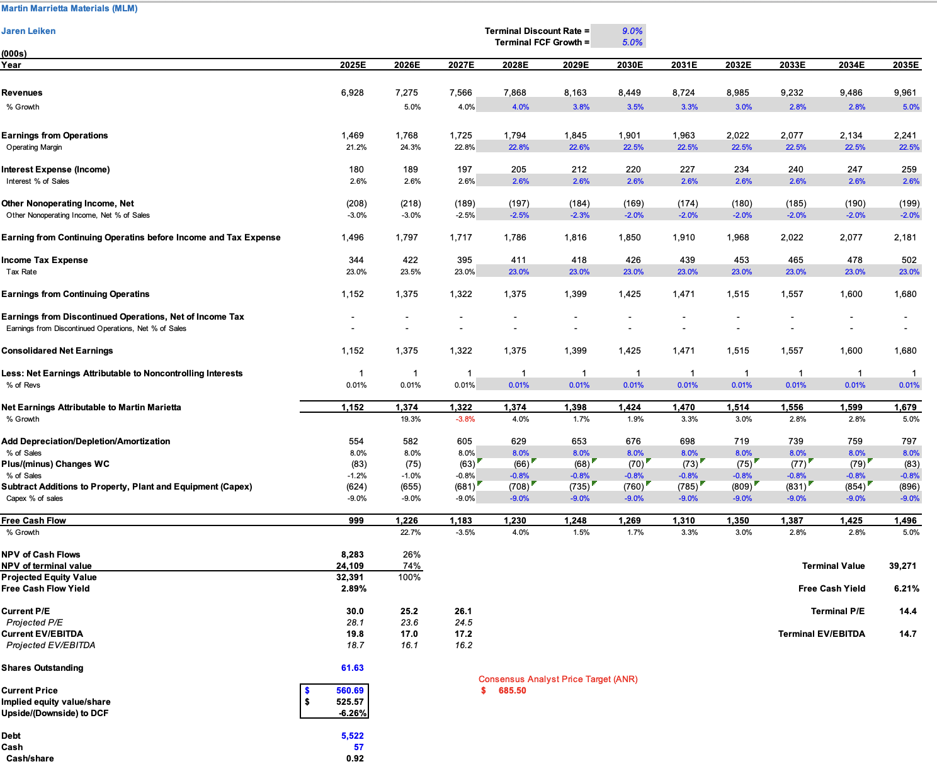
Martin Marietta Materials Valuation

Slide 29
Martin Marietta Recommendation
Hold
Recommendation
MLM
Stock
$560.69
Current Price
$525.57
Current Price
-5.67%
Expected Return
-0.59%
Dividend Yield
Primary Catalysts
Long-term, capturable infrastructure demand promotes aggregates-centered business
Optimism in housing recovery efforts looking forward
Pricing power + strong market positions provide stable margins and profits
Primary Risks
Cyclical construction and infrastructure demand
High input costs (fuel, freight, labor)
Materials sector overall recent performance relative to S&P 500

Slide 30
Vulcan Materials Company Overview
NYSE: VMC
5-year Price History: S&P 500 v. MLM
$34.1B
Market Cap.
$261.46
Current Price
1.06
Beta
$7.94B
Revennue (2025)
Largest producer of construction aggregates in the United States
Products include crushed stone, sand, gravel, asphalt mix, and ready-mix concrete
Serves infrastructure, commercial, and non-residential construction markets
Extensive network of quarries, distribution yards, and marine terminals
Company Overview
Vulcan Materials is the largest aggregates producer in the United States. Their core products — crushed stone, sand, and gravel — are essential materials used in highways, commercial buildings, and infrastructure development across the country.

Slide 31
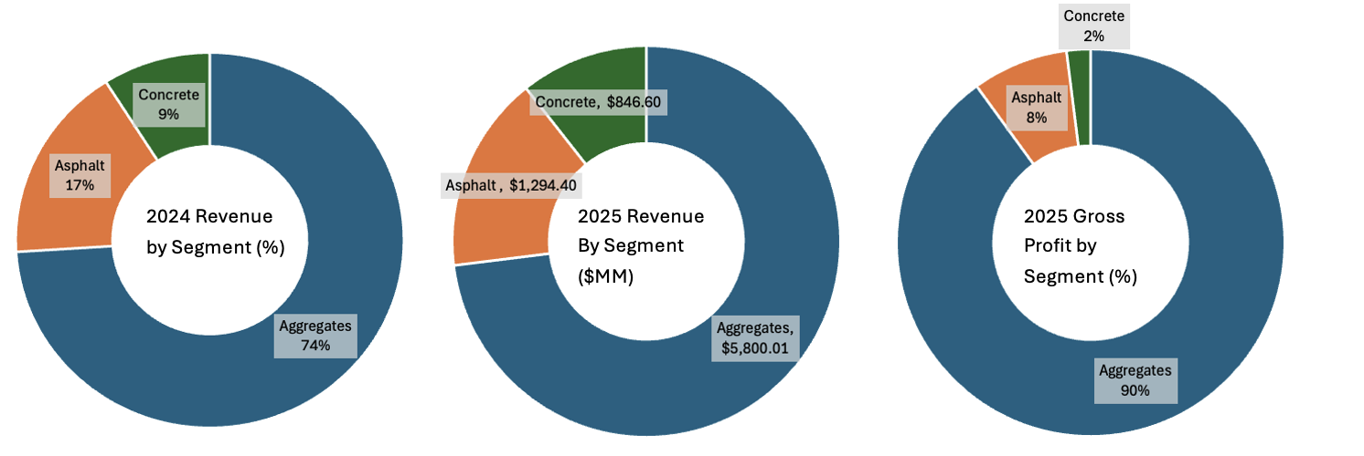
Vulcan Materials Company Overview
NYSE: VMC
5-year Price History: S&P 500 v. MLM

Slide 32




Vulcan Materials Business Analysis
NYSE: VMC
5-year Price History: S&P 500 v. MLM
Aggregate Reserve Ownership
Transportation Advantage
Billions of tons of permitted aggregate reserves
New quarry permits are difficult due to environmental regulations
Aggregates are heavy and expensive to transport
Local quarry networks give Vulcan cost advantage
Scale & Operational Efficiency
Vertical Integration
Largest aggregates producer in the U.S.
Large production network improves margins and logistics efficiency
Operations in aggregates, asphalt, and concrete
Allows Vulcan to capture more value across the construction supply chain

Slide 33
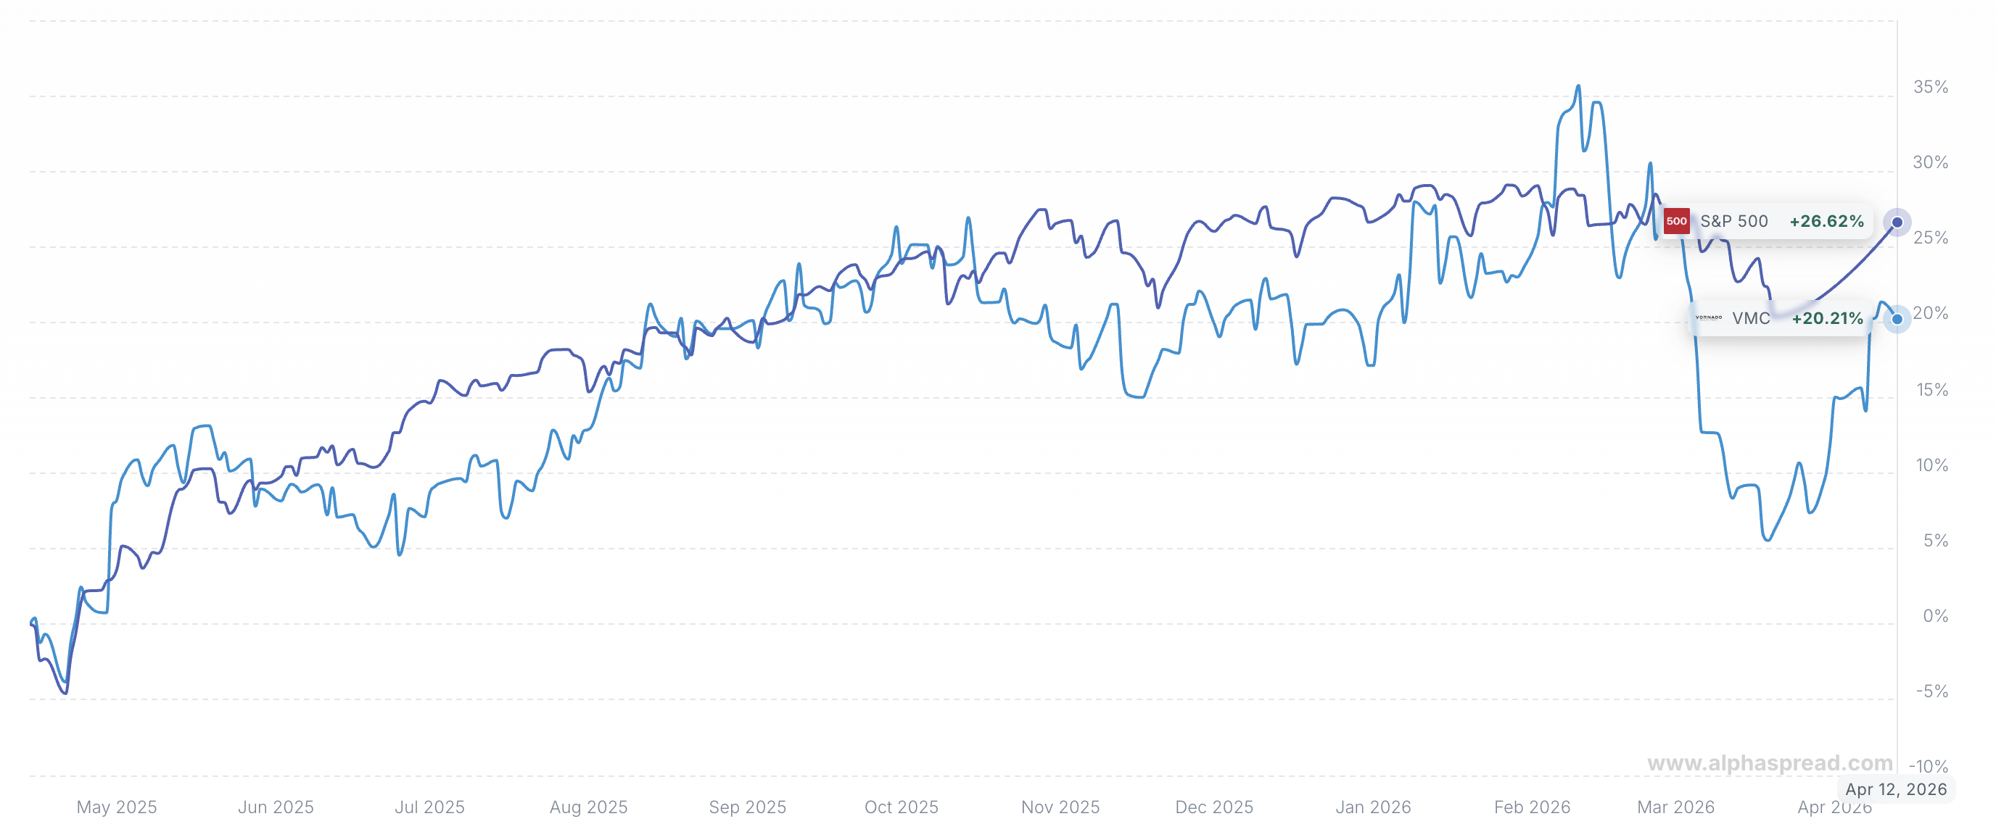
Vulcan Materials Business Analysis
NYSE: VMC
1 Year VMC VS. S&P500 Performacne
5-year Price History: S&P 500 v. MLM
Vulcan’s stock pullback was primarily driven by macro concerns about construction demand and interest rates, which pressured the broader building materials sector.
The decline was also amplified by valuation compression after the stock had reached relatively high multiples.

Slide 34
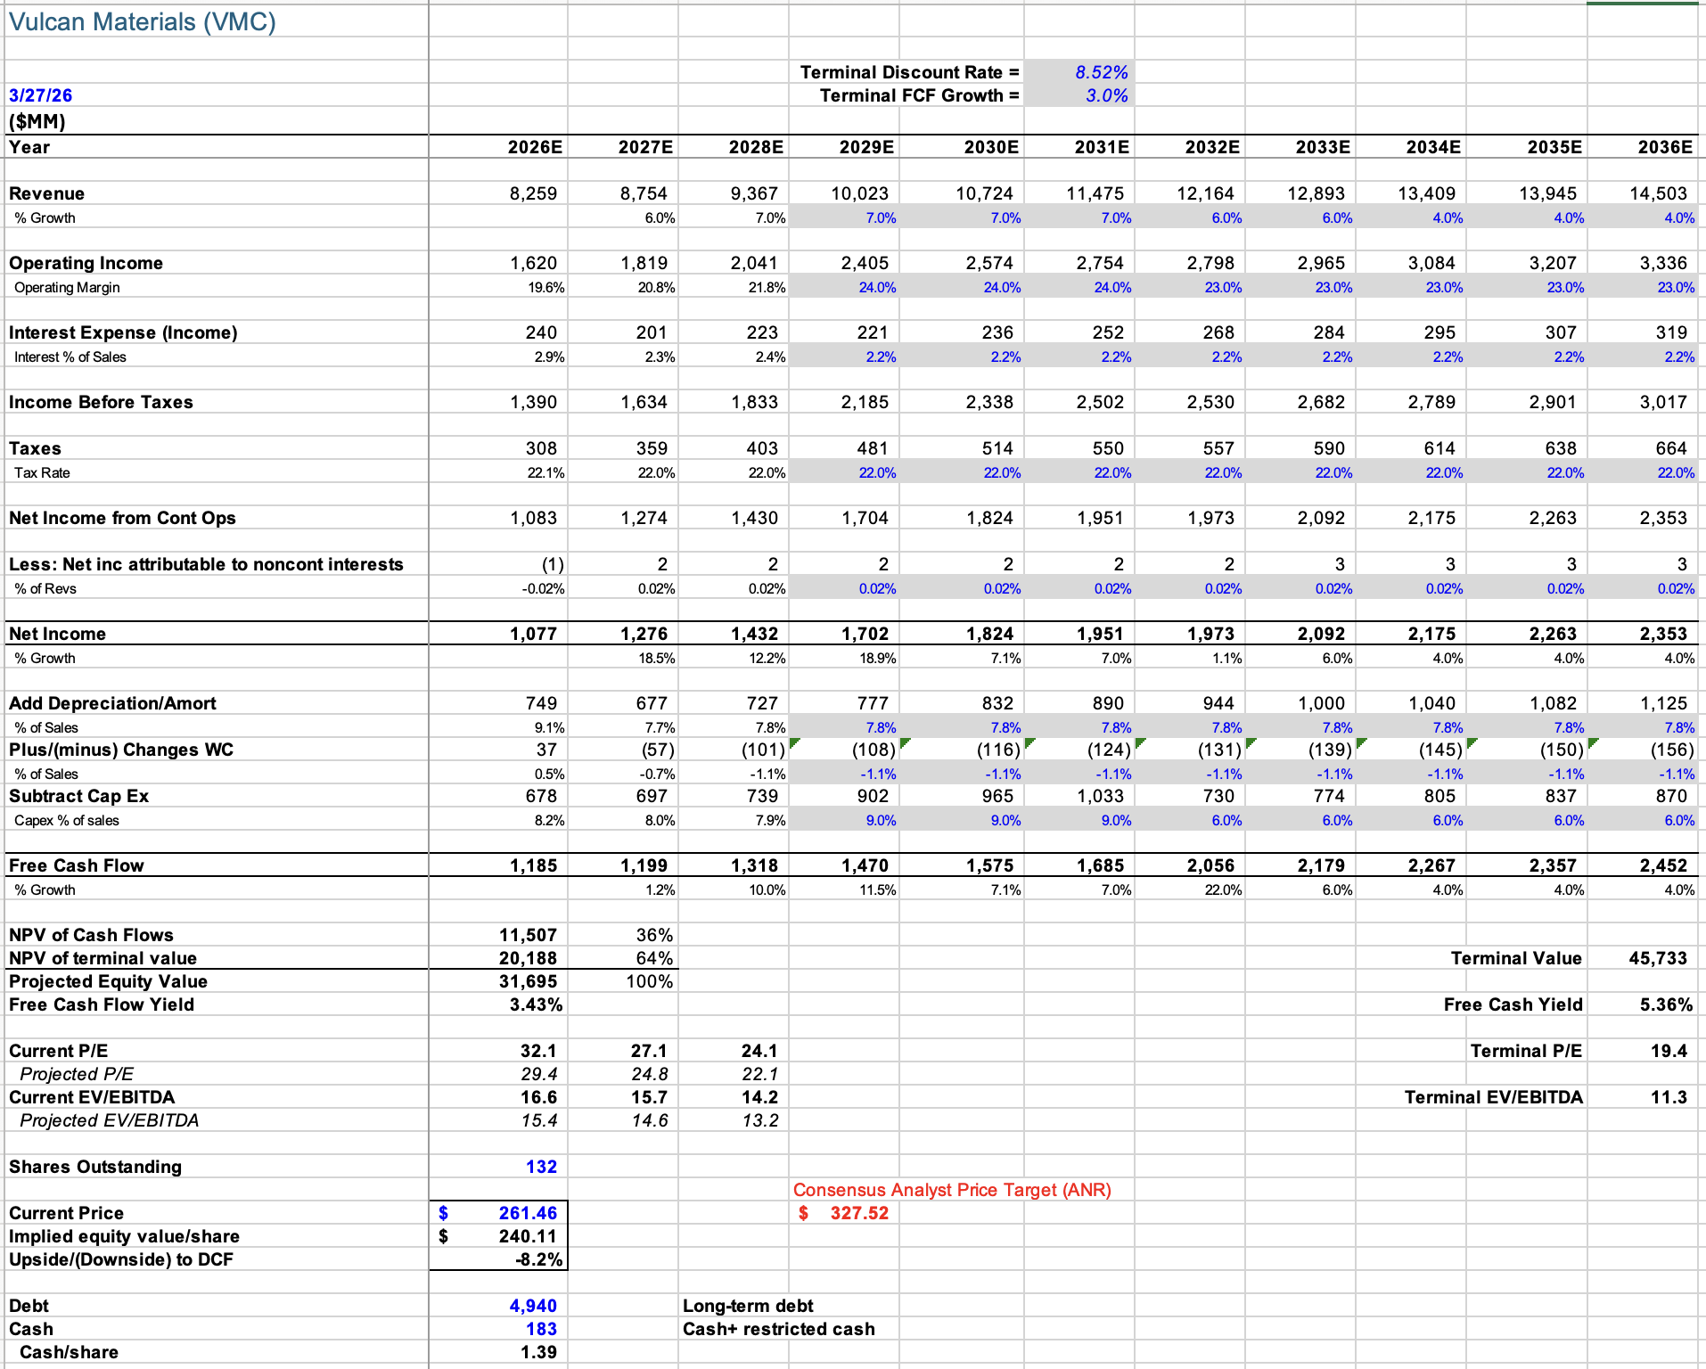
Vulcan Materials Valuation
NYSE: VMC
Key Valuation Assumptions
WACC: 8.52%
Terminal Growth Rate: 3.0%
Revenue Growth (2027–2031): ~7%
Long-term Margin: ~23–24%
Capex: 6–9% of revenue
5-year Price History: S&P 500 v. MLM

Slide 35
Vulcan Materials Recommendation
NYSE: VMC
HOLD
Recommendation (No Position)
VMC
Stock
$261.46
Current price
$240.11
Target Price
-8.2%
Expected Return
Reasons Not to Add
Elevated valuation
Cyclical risk in construction demand
Materials sector underperformance vs S&P 500
Key Risks
Stronger than expected infrastructure spending
Continued pricing power in aggregates market
Potential operational improvements or acquisitions

Slide 36
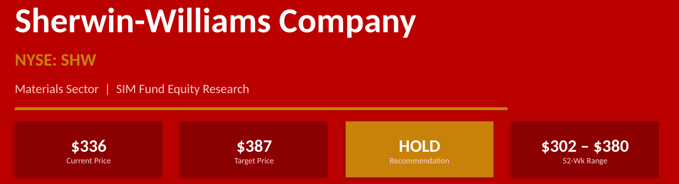

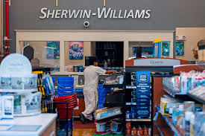
Sherwin Williams

Slide 37
Business Overview
Company Overview
Founded 1866, headquartered in Cleveland, OH. World's largest paint & coatings company by revenue.
~$23B annual revenue | ~$83B market cap | ~60,000 employees worldwide
Operates 4,900+ company-owned stores in the Americas — unmatched retail distribution moat.
Dividend Aristocrat — 45+ consecutive years of dividend increases.
Key Business Drivers
Housing turnover & renovation cycle (primary demand driver)
New residential & commercial construction activity
Raw material costs: TiO₂, petrochemical inputs (~40% of COGS)
Pro-painter channel pricing power & contractor loyalty programs
International expansion & Performance Coatings industrial growth
Paint Stores Group: ~58% of sales
~4,900 company-owned stores; serves pro painters & contractors; highest-margin segment
Performance Coatings: ~27% of sales
Industrial coatings, auto refinish, protective & marine; global diversification
Consumer Brands Group: ~15% of sales
Sells branded & private-label products through Lowe's, Home Depot, and independent dealers

Slide 38
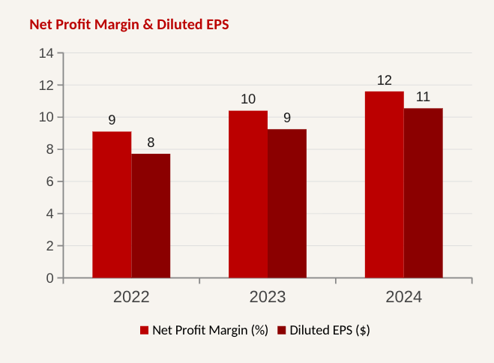
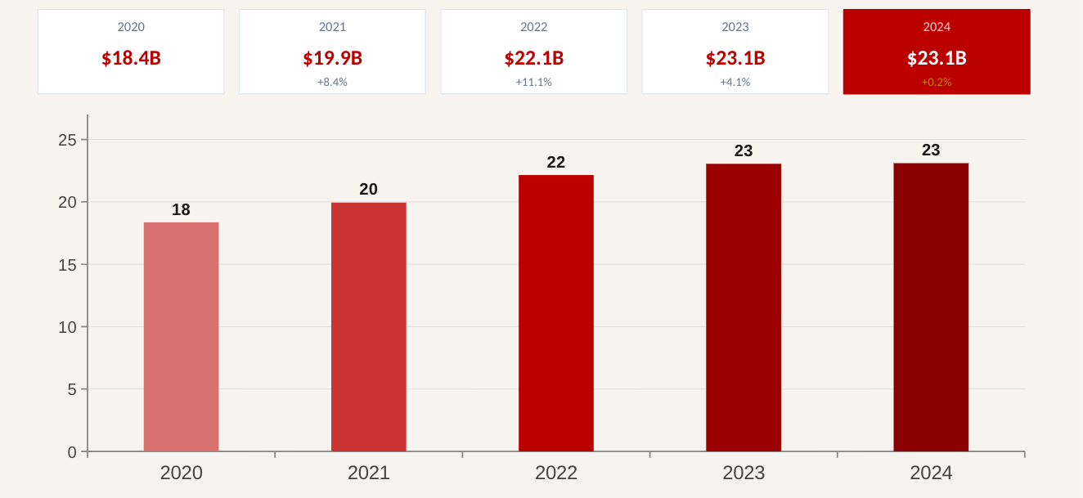
Financial analysis
Revenue
~23B (2025)
Adj. EPS
$11.65 (10.91 Yr prior)
Gross Margin
49.4% (+60 Bps YoY)
ROIC
~16.5% vs S&P500 avg. Of ~10%
Revenue Trend

Slide 39
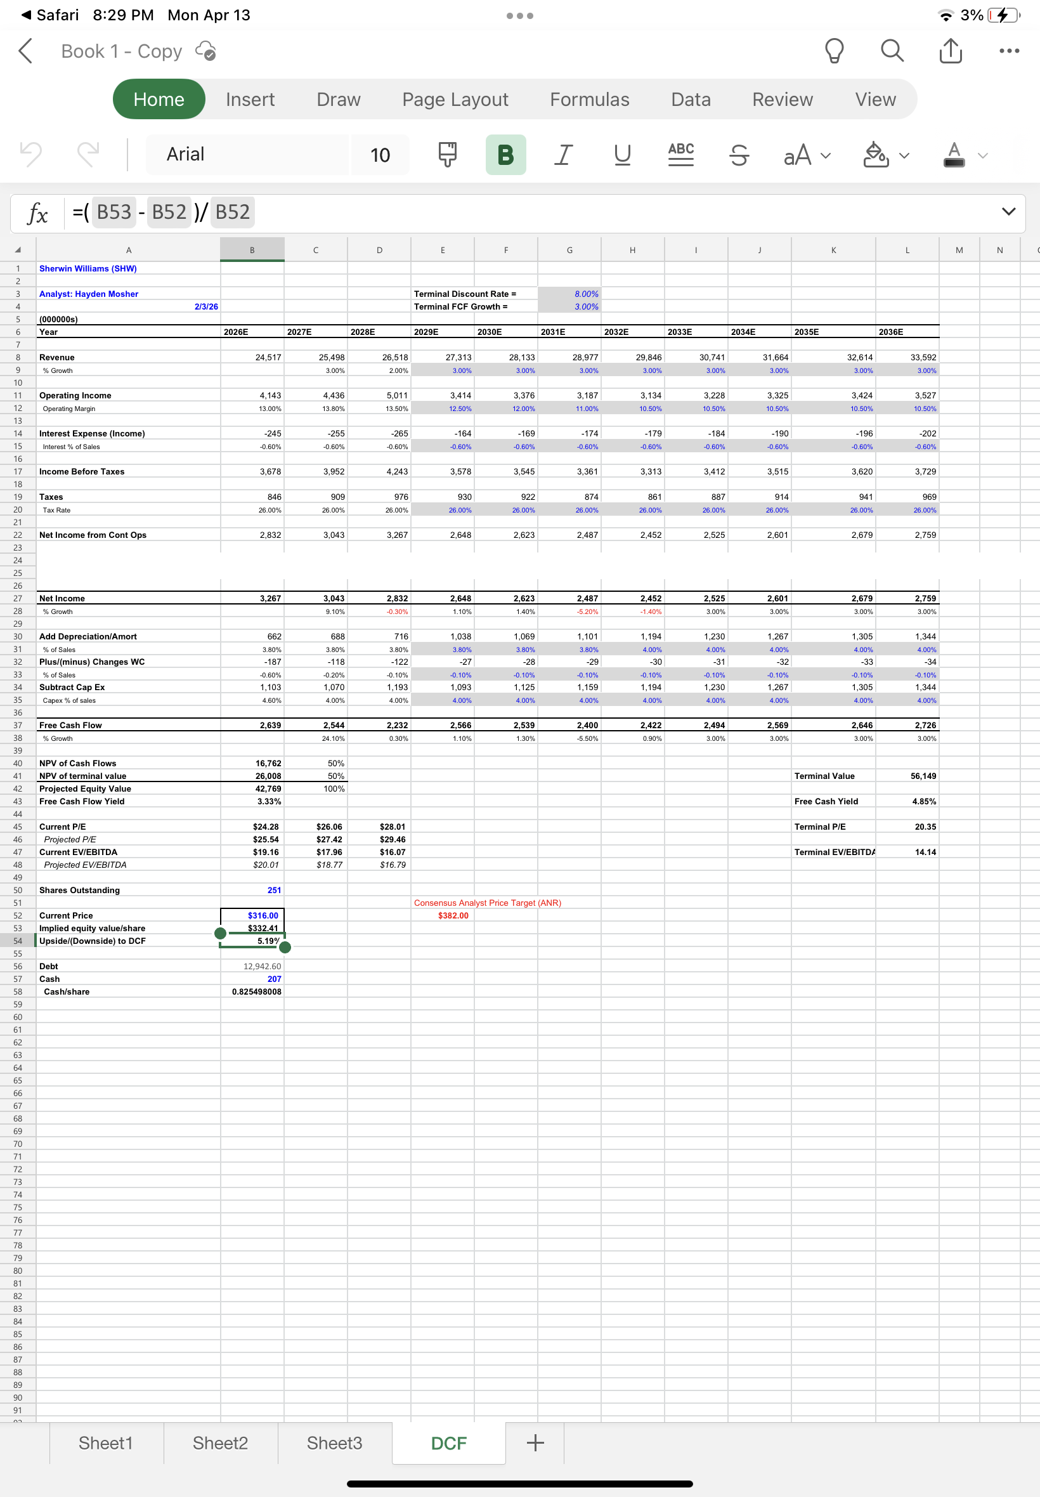
SHW DCF

Slide 40
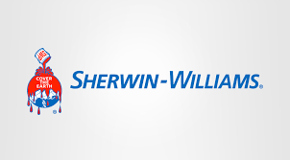
SHW Recommendation
HOLD at 20 Bps
Current Price: $336
Price Target: $387
% Material weight:~8.5%
S&P 500 weight:~0.2%
Our DCF puts fair value at $387 — at $336 today, there's ~15% upside on the table, not enough to buy more but too much to sell
Housing is the key unlock — renovation and turnover volumes are still depressed by elevated rates, but any Fed cuts go straight to SHW's top line
Margins are quietly improving — gross margin expanded to 49.4% in 2025 and the company has $80M in restructuring savings still hitting the P&L
The moat is real — nearly 5,000 company-owned stores and deep contractor relationships make this brand nearly impossible to displace

Slide 41
Albemarle Overview (ALB)
Albemarle Corporation (ALB) is a global specialty chemicals company and one of the world's largest lithium producers.
They have three main segments which are energy storage, specialties and ketjen. Energy storage focuses on battery-grade lithium, specialties focuses on specialty grade lithium and bromine, and ketjen focuses on catalysts used in petroleum mining.
$21.16B
Market Cap.
$185.43
Current Price
$34.1B
Market Cap.
1.43
Beta

Slide 42
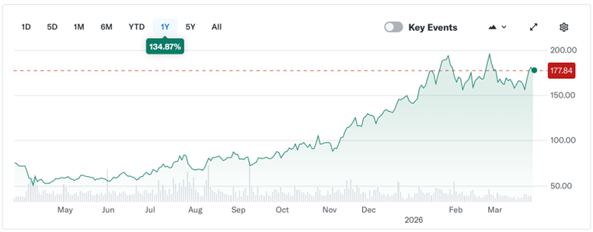
Albemarle Business Analysis (ALB)
Key Drivers
  The main driver for ALB is lithium prices. Lithium is the biggest component of their company, when it is in demand, they do well. Global EV demand is another big driver for them.

Slide 43
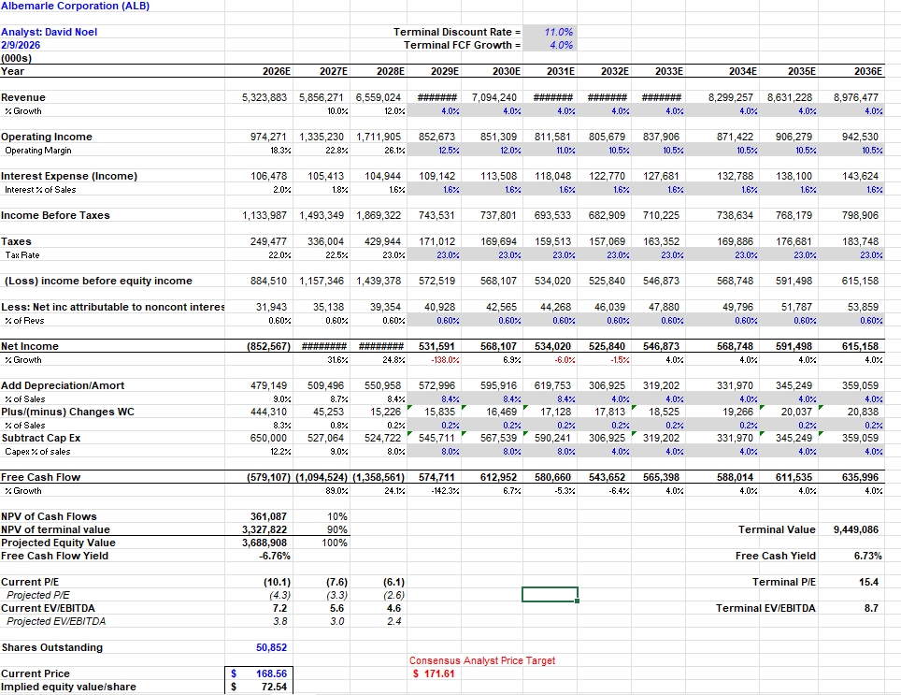
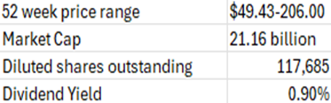
Albemarle Financial Analysis (ALB)
The DCF model shows a price target of $168.56 (about a 9% downside from current price).
However, there is a lot of uncertainty here with how cyclical this company is.

Slide 44
Albemarle Recommendation (ALB)
Recommendation:
HOLD
Current Price
185.43
Price Target
168.56
Expected Return
-9.1%
We value ALB at $168.56, about a 9% downside from its current price.
We recommend a HOLD due to ALB being a highly cyclical company and the expected return can vary a ton based on lithium pricing and EV demand.

Slide 45
Recommendation Summary
 | Suggestion (+/-bps change) | Current Price | Target Price | Current Weighting | Weighting after Suggestion | Expected Return | Catalysts | Risks
International Paper (IP) | Hold (0 bps) | $36.50 | $45.52 | 0.54% | 0.54% | -5.81% | Dividend yield, + demand. | Economic volatility, split uncertainty
Martin Marietta (MLM) | Hold | $560.69 | $525.57 | 0% | 0% | -5.67% | Pricing power + housing recovery optimism | Cyclical infrastructure demand
Vulcan (VMC) | Hold | $261.46 | $240.11 | 0% | 0% | -8.2% | Macro concerns | Stronger infrastructure spending
Sherwin Williams (SHW) | Hold | $336 | $387 | 0% | 0% | 14% | Rate cuts, new store openings | Tariffs, rates stay high
Albemarle Corporation (ALB) | Hold | $185.43 | $168.56 | 0% | 0% | -9.1% | EV demand rising, increased lithium demand | Lithium demand decreasing

