Slide 1
Sector Analysis: Materials
BUSFIN 4228 – Stock Market
Jaren Leiken, Quintin Liao, David Noel, Brendan Leonard, Hayden Mosher

Slide 2
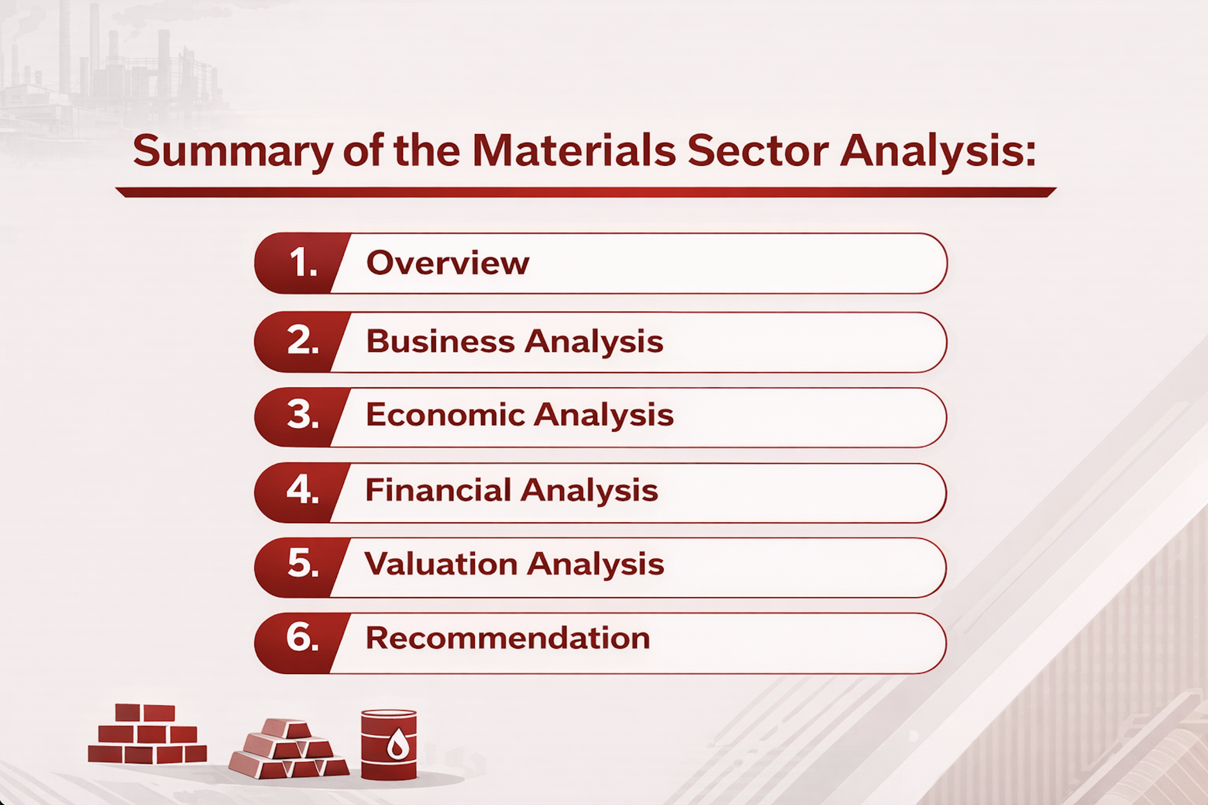


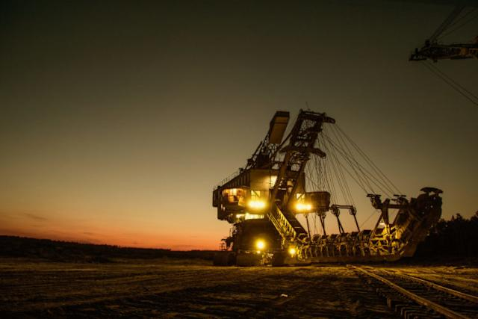
Overview
Source: Google Images

Slide 3
Sector Size
Materials Sector Size Overview:
- Total Market Capitalization: $2.467 trillion USD
- Percentage of S&P 500 Market Value: 2.7%
- Number of Industries: 14
- Number of Companies: 276
Source: Yahoo Finance – Basic Materials Sector, Visual Capitalist S&P 500 Breakdown

Slide 4
Industries
11.43%
9.01%
3.57%
6.09%
28.02%
30.22%
5.15%
Source: Yahoo Finance – Basic Materials Sector Breakdown

Slide 5









Companies
205.67b
170.36b
161.67b
128.93b
117.32b
94.24b
85.93b
84.16b
Source: Stock Analysis – Materials Sector Stocks, Google Images

Slide 6
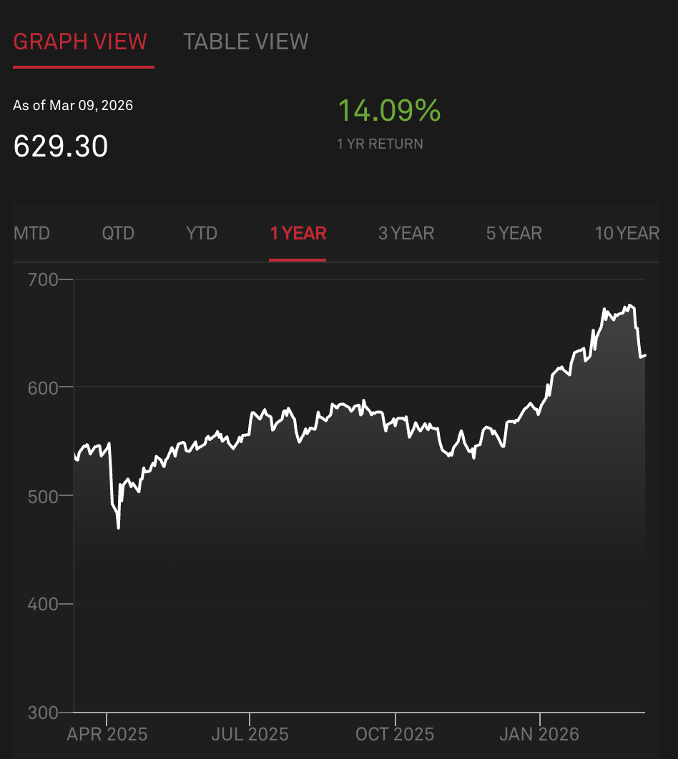
Performance
Driven by strong demand for industrial commodities (metals and chemicals)
Driven by increased investment in infrastructure inputs
Supports rotation in cyclical sectors
Source: S&P Dow Jones Indices – S&P 500 Materials

Slide 7
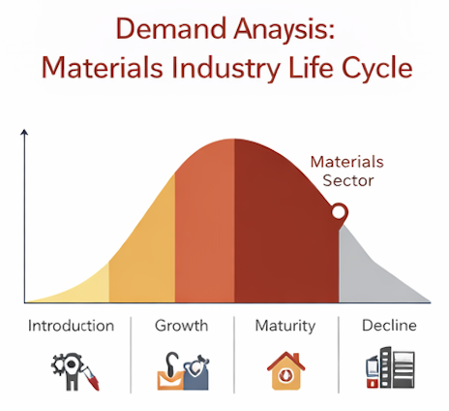
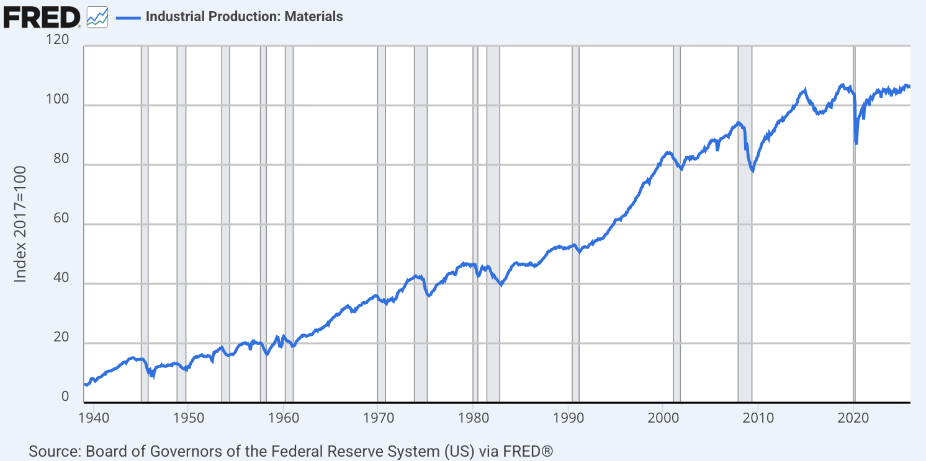
Demand: Life Cycle and Business Cycle
Materials Life Cycle:
Mature
Cyclical
Produces basic inputs for other businesses
Growth moves w/ economic cycles
Materials Business Cycle:
Demand rises with GDP growth, manufacturing production increases and infrastructure spending increases
Demand falls during recessions, industrial slowdowns and reduced manufacturing output
Materials are upstream in the supply chain → requirement for finished goods to be produced
FRED Industrial Production: Materials (IMPAT) → measures how much “stuff” the U.S. is producing in materials-heavy activity
  IPMAT → RISES in expansions
  IPMAT → FALLS in recessions
Source: FRED – Industrial Production: Materials, Images per ChatGPT+
Notes:
Industry Life Cycle:
What the slide should say
The Materials sector is generally considered a mature cyclical industry.
It produces raw materials used by other industries, such as chemicals, metals, and construction materials.
Demand depends heavily on economic activity and industrial production.
Growth tends to be moderate but cyclical.
Simple explanation
Materials companies produce the basic inputs used to build and manufacture products, including metals, chemicals, paper, and construction materials. Because nearly every industry needs these inputs, demand for materials rises when the economy is expanding and falls during economic slowdowns.
Visual idea
Use a simple life-cycle diagram:
Introduction → Growth → Maturity (Materials sector)
Business Cycle:
What the slide should say
The Materials sector is highly cyclical.
Demand increases when:
GDP growth rises
Industrial production increases
Infrastructure spending expands
Construction activity increases
Demand weakens when:
Economic growth slows
Manufacturing declines
Construction activity falls
Simple explanation
Because materials are used to make physical goods, the sector’s performance closely mirrors economic growth. When the economy grows and factories produce more goods, companies need more metals, chemicals, and raw materials. During recessions, demand for these inputs falls.
Visual idea
Small graphic:
Economic expansion → ↑ Materials demand
Recession → ↓ Materials demand

Slide 8
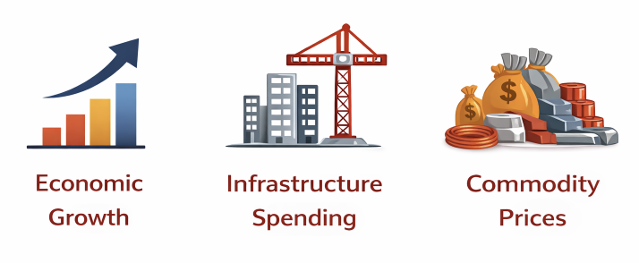
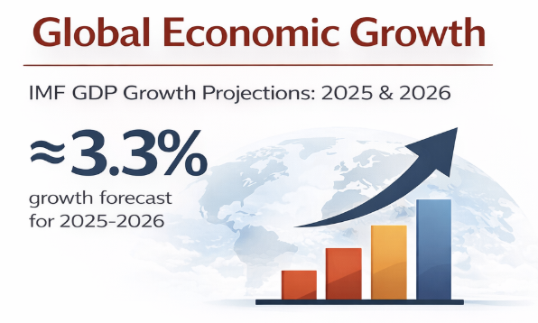
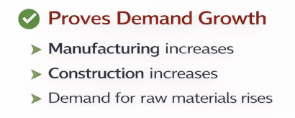

Demand: External Factors
+ Economic Growth
=
+ Manufacturing
=
+ Demand for Raw Materials
+ Infrastructure Budget
=
+ Manufacturing
=
+ Demand for Raw Materials
+ Commodity Prices
=
+ Higher Revenues
Example:
Avg. Copper Price (2024/2025) = $4.00-$4.50 per pound
Increasing price of copper raises revenues for copper
Mining and materials companies
Source: International Monetary Fund – World Economic Outlook , Images per Chat GPT+
Notes:
Industry Life Cycle:
What the slide should say
The Materials sector is generally considered a mature cyclical industry.
It produces raw materials used by other industries, such as chemicals, metals, and construction materials.
Demand depends heavily on economic activity and industrial production.
Growth tends to be moderate but cyclical.
Simple explanation
Materials companies produce the basic inputs used to build and manufacture products, including metals, chemicals, paper, and construction materials. Because nearly every industry needs these inputs, demand for materials rises when the economy is expanding and falls during economic slowdowns.
Visual idea
Use a simple life-cycle diagram:
Introduction → Growth → Maturity (Materials sector)
Business Cycle:
What the slide should say
The Materials sector is highly cyclical.
Demand increases when:
GDP growth rises
Industrial production increases
Infrastructure spending expands
Construction activity increases
Demand weakens when:
Economic growth slows
Manufacturing declines
Construction activity falls
Simple explanation
Because materials are used to make physical goods, the sector’s performance closely mirrors economic growth. When the economy grows and factories produce more goods, companies need more metals, chemicals, and raw materials. During recessions, demand for these inputs falls.
Visual idea
Small graphic:
Economic expansion → ↑ Materials demand
Recession → ↓ Materials demand

Slide 9



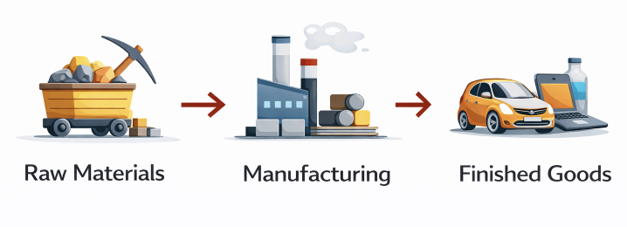


Demand: User/Geography and Material Flow
Materials Sector Major End Users:
Construction Industries
Manufacturing Industries
Automotive / Energy / Electronics Industries
Geographic Demand:
China
- 50-55% of global metal consumption
2. United States
- $2 trillion annually generated
in construction industry
Input/Output Analysis:
Sits EARLY in supply chain
Provides raw inputs
Sells for finished goods
Materials include:
  Steel
  Copper
  Aluminum
  Chemicals
  Cement
Source: FRED – Industrial Production: Materials, images per Chat GPT+, Google Images, US Census Bureau, World Bank Commodity Markets Outlook
Notes:
Industry Life Cycle:
What the slide should say
The Materials sector is generally considered a mature cyclical industry.
It produces raw materials used by other industries, such as chemicals, metals, and construction materials.
Demand depends heavily on economic activity and industrial production.
Growth tends to be moderate but cyclical.
Simple explanation
Materials companies produce the basic inputs used to build and manufacture products, including metals, chemicals, paper, and construction materials. Because nearly every industry needs these inputs, demand for materials rises when the economy is expanding and falls during economic slowdowns.
Visual idea
Use a simple life-cycle diagram:
Introduction → Growth → Maturity (Materials sector)
Business Cycle:
What the slide should say
The Materials sector is highly cyclical.
Demand increases when:
GDP growth rises
Industrial production increases
Infrastructure spending expands
Construction activity increases
Demand weakens when:
Economic growth slows
Manufacturing declines
Construction activity falls
Simple explanation
Because materials are used to make physical goods, the sector’s performance closely mirrors economic growth. When the economy grows and factories produce more goods, companies need more metals, chemicals, and raw materials. During recessions, demand for these inputs falls.
Visual idea
Small graphic:
Economic expansion → ↑ Materials demand
Recession → ↓ Materials demand

Slide 10
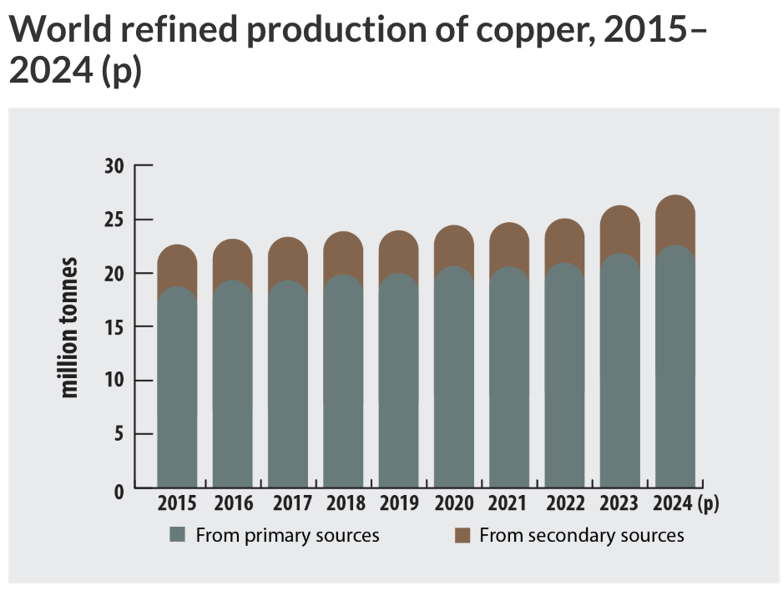
Supply Structure
Supply Trends in the Materials Sector:
Materials supply depends on two things:
  1. Mining Production
  - Copper → 3rd most produced in sector
  - Expansion over time in Copper production
  - Copper production is mining steadily
  Industrial Capacity Expansion
  - Increasing supply means…
  a. new mines
  b. new chemical plants
  c. expanded refining capacity
Source: Government of Canada – Natural Resources Canada

Slide 11
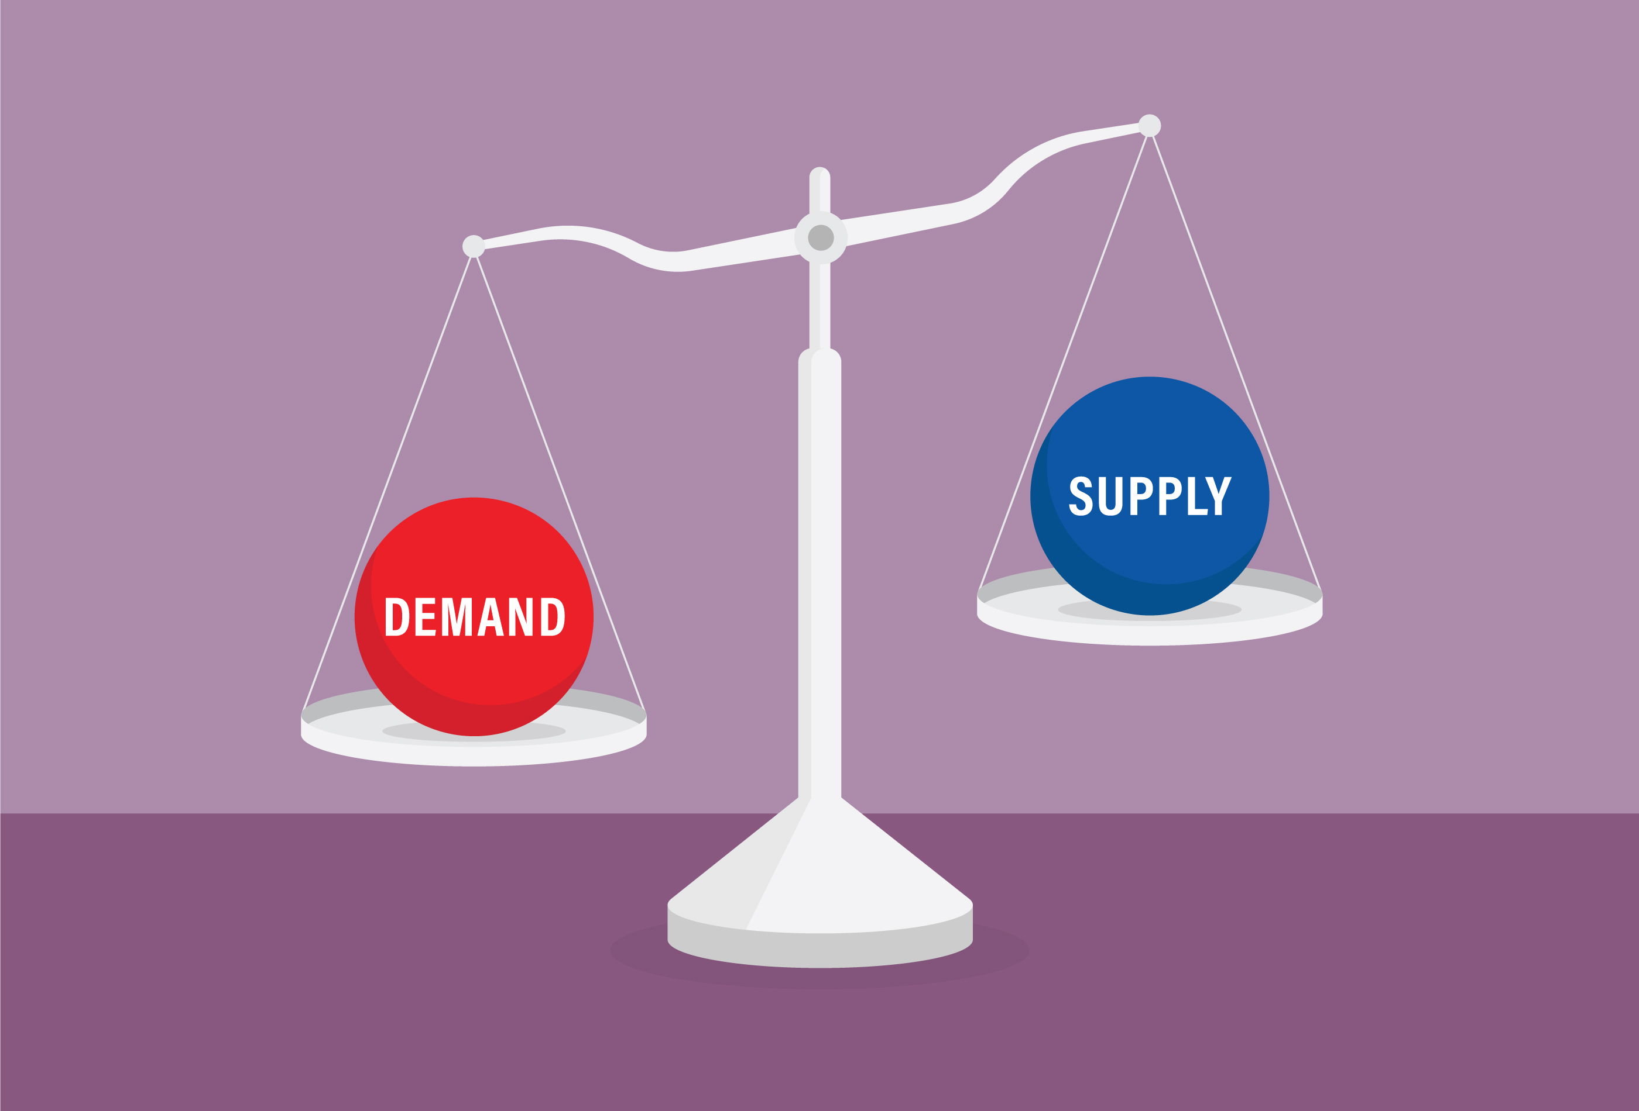
Profitability and Pricing
Materials Pricing is Driven by S/D:
- Commodity prices → determine profitability in sector
- When demand > supply → prices increase → company profits rise
- Participants are Price Takers: profits depend on…
  Global commodity demand
  Production costs
  Supply constraints
Source: Google Images

Slide 12



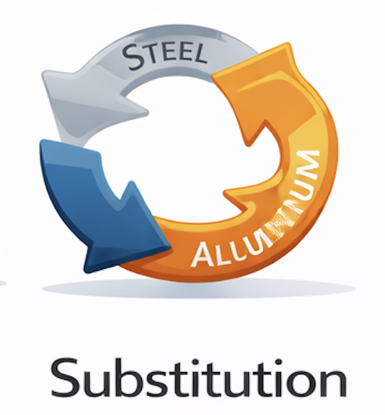
Profitability and Pricing
- High barriers to entry
- Large capital requirements
- Strict regulations
- Projects take 10+ years
- Extremely large firms
- Time to capture EoS
- Highly competitive sector
- Large # of global producers
- Continued re-investment for…
  - Innovation
  - Scale
- Compete on…
  - Cost efficiency
  - Scale
  - Production Capacity
- Buyer power: High
- Product type: commodities
- Little product differentiation
- Purchases in bulk
- Supplier power = Moderate
- Key inputs = influence production
- Limited # of suppliers
- Low threat of substitution
Raw materials always needed
Low threat due to…
  Strength requirements
  Durability requirements
Some material replacement
  Depends on cost
  Depends on performance
Source: Google Images

Slide 13
Economic Overview
Materials Sector is highly cyclical and strongly tied to macroeconomic conditions.
Key Drivers
Global industrial production
Infrastructure and construction spending
Commodity price trends
Inflation
Interest rates
Global trade activity
The sector often moves early in economic cycle because it produces raw inputs

Slide 14
Key Drivers
Demand for Materials
Driven by manufacturing, construction and infrastructure
Growth in EVs, renewable energy and data centers increase demand for materials like copper and aluminum
Industrial Production
Materials demand tied closely with global manufacturing activity
Industrial production growth often leads to positive sector performance
Capital Investment
Infrastructure spending and investment boost materials demand
Commodity Prices
Higher commodity prices increase revenues for these companies
Global Trade
Materials are a globally traded good
Trade slowdowns reduce demand for them
Interest Rates
High interest rates reduce construction and demand for materials

Slide 15
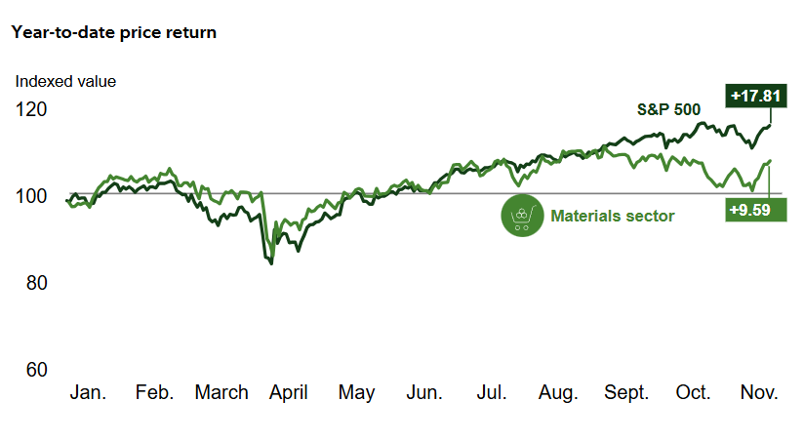
Materials Sector vs S&P 500
The materials sector underperformed compared to the S&P 500 in 2025. Source: Fidelity

Slide 16
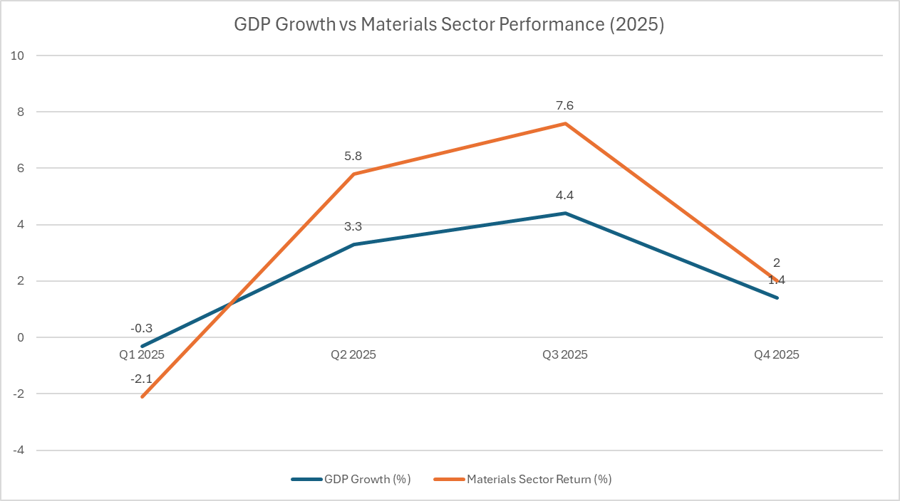
Materials Sector Performance vs GDP
Materials sector highly correlated with GDP growth and is highly cyclical

Slide 17
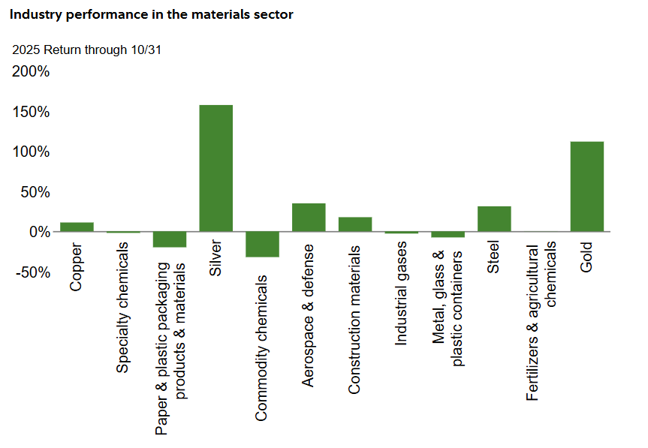
Industry Performance 2025
Source: Fidelity

Slide 18
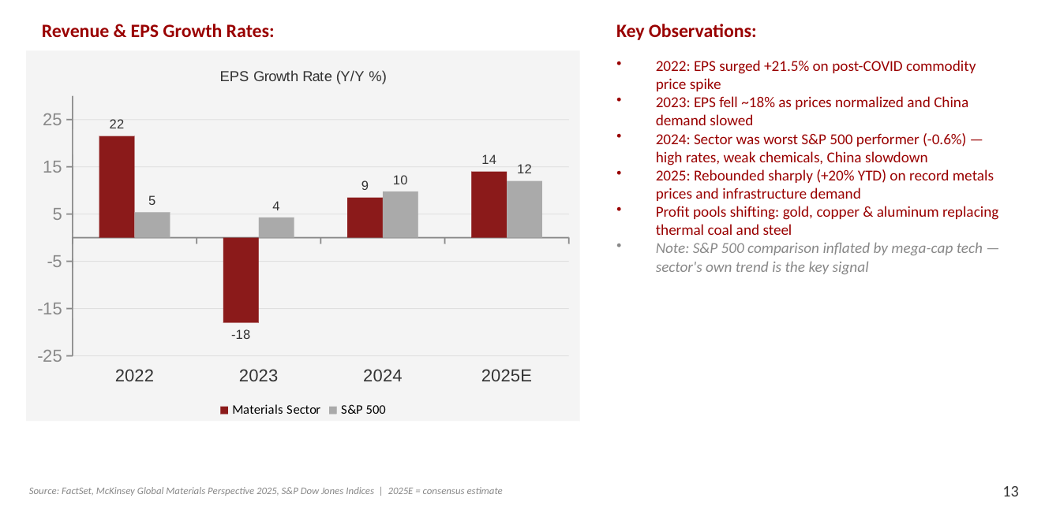
Revenue & Earnings Growth Sector

Slide 19
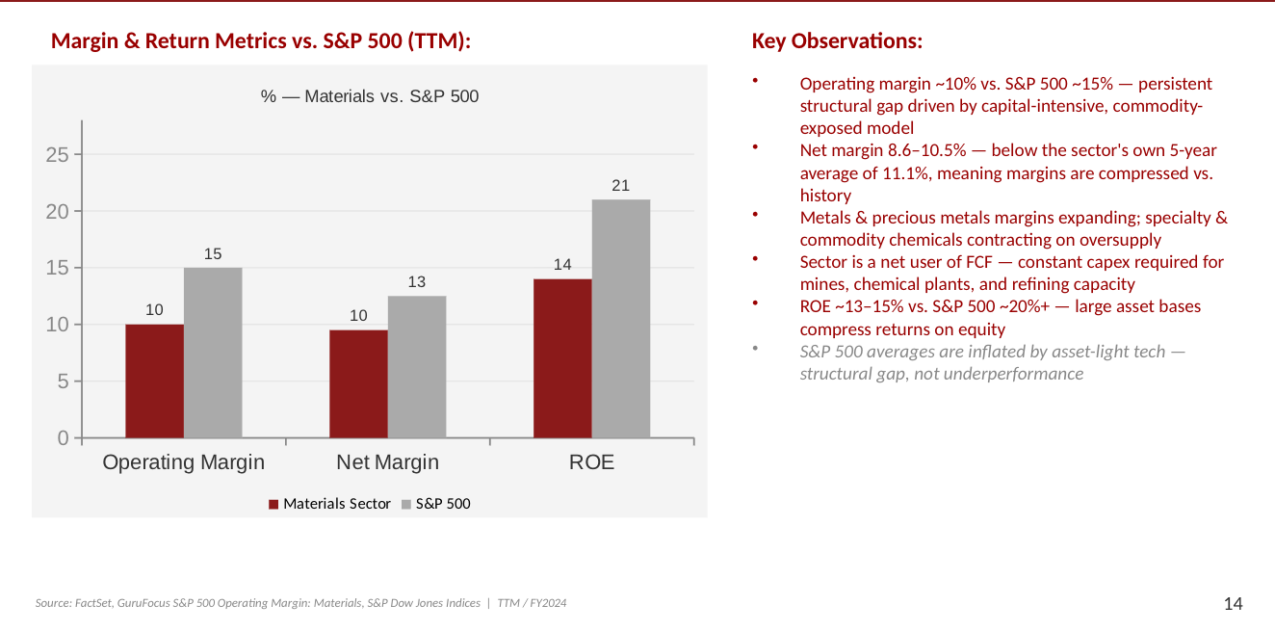
Margins and Profitability

Slide 20
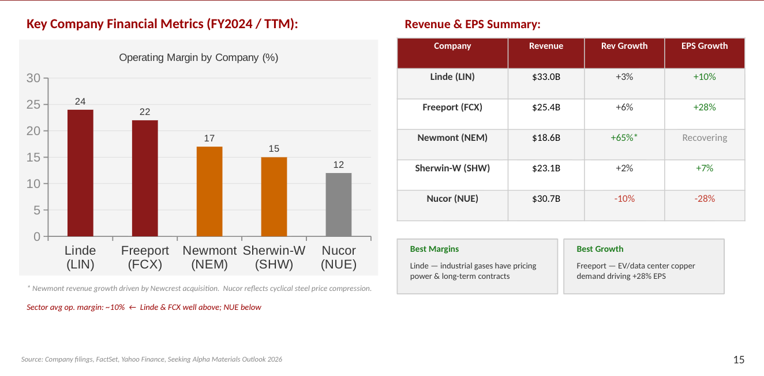
Company level breakdown

Slide 21



Sector Valuation Overview
Valuation Metric | Materials Sector | S&P 500 | Interpretation
P/E | 21.9x | 28.5x | Materials trades at lower earnings multiple
P/B | 2.1x | 5.3x | Market values S&P assets higher
EV / Revenue | 1.8x | 3.8x | Materials firms generate lower sales multiples
EV / EBITDA | 11.0x | 18.2x | Cash-flow valuation lower than market
EV / EBIT | 16.2x | 24.1x | Operating earnings valued less than market
The Materials sector trades at a significant discount to the S&P 500 across all valuation metrics.
Lower multiples reflect cyclical earnings, commodity price volatility, and capital-intensive operations.
Investors typically assign higher valuations to the broader market due to growth sectors like technology.

Slide 22




Valuation Within the Sector
Industry | EV/Revenue | EV/EBITDA | EV/EBIT | P/E | P/B
Specialty Chemicals | 2.4x | 14.1x | 20.7x | 26.5x | 2.5x
Diversified Metals & Mining | 2.0x | 10.3x | 14.7x | 23.3x | 2.9x
Construction Materials | 2.2x | 11.1x | 17.1x | 22.6x | 1.6x
Copper | 3.1x | 13.7x | 17.3x | 27.9x | 4.2x
Steel | 1.0x | 9.2x | 14.4x | 19.7x | 1.1x
Diverse Multiples
Valuation multiples vary significantly across industries within the Materials sector.
High-Multiple Leaders
Specialty chemicals and copper companies trade at higher multiples due to stronger margins and pricing power.
Cyclical Discounts
Steel and mining industries trade at lower valuations because earnings are highly cyclical and tied to commodity prices.

Slide 23



Historical Valuation Trend
Multiples Expanded
Valuation multiples expanded significantly after 2022, reflecting recovery in industrial demand and commodity markets.
Persistent Discount
The Materials sector remains consistently discounted relative to the S&P 500 due to higher cyclicality and commodity price exposure.
Normalizing
Multiples stabilized slightly in 2026, suggesting the sector may be approaching a more normalized valuation level.

Slide 24








Material Sector Outlook & Technical Analysis
Valuation Outlook
Technical Analysis
The Materials sector will likely continue trading at a discount to the S&P 500 due to its cyclical earnings and commodity price exposure.
Valuations may expand moderately if global industrial activity and infrastructure spending increase.
Demand for energy transition metals such as copper and lithium could support long-term sector growth.
The Materials sector generally follows global economic and commodity cycles.
Recent price trends suggest stable support levels during market corrections.
If the sector remains above long-term moving averages (e.g., 200-day moving average), it indicates a potential bullish trend.

Slide 25
Sector Weight Recommendation
Factors suggesting overweighting:
Trending infrastructure such as data centers, EVs, AI all require greater need for copper and special chemicals such as lithium
Precious metals (i.e. gold/silver) have increased in price, especially in face of macroeconomic uncertainty
Supply constrained, demand not, upward pressure on commodity prices
Basic inputs to most goods/services
Factors suggesting underweighting:
Highly cyclical, very sensitive to macroeconomic factors
  Uncertain trade policies
  Federal Reserve is maintaining interest rate goals, uncertain future
    High capital intensity industry -> long term fixed-rate liabilities are highly sensitive to interest rate changes.
    Strong competitive forces, lower sector profitability
    Sector is highly mature, overall, not much room for growth
    Lower sector profitability ratios than S&P 500
Notes:
Brendan 1 min?

Slide 26
Sector Weight Recommendation
Entire Sector: Underweight
Within-sector: Depends

Slide 27
Within-Sector Weight Recommendation
Copper: overweight due to the increasing demand for data centers, AI infrastructure, grid buildout and high P/E multiple for the sector at 27.9x
Specialty chemicals: overweight due to high demand (i.e. lithium as a battery part) and high P/E multiple for sector at 26.5x
Gold: overweight due to increased macroeconomic volatility
Steel: underweight due to lowest P/E multiple at 19.5x, very competitive, no differentiation, commodity, tariffs
Notes:
Brendan 1 min?

Slide 28
Sources
Yahoo Finance – Basic Materials Sector (https://finance.yahoo.com/sectors/basic-materials/?utm_source=chatgpt.com)
Visual Capitalist S&P 500 Breakdown (https://www.visualcapitalist.com/complete-breakdown-of-sp-500-companies/?utm_source=chatgpt.com)
Stock Analysis – Materials Sector Page (https://stockanalysis.com/stocks/sector/materials/?utm_source=chatgpt.com)
Fred – Industrial Production: Materials (https://fred.stlouisfed.org/series/IPMAT?utm_source=chatgpt.com)
International Monetary Fund – World Economic Outlook (https://www.imf.org/en/publications/weo)
US Census Bureau (https://www.census.gov/economic-indicators/)
World Bank Commodity Markets Outlook (https://www.worldbank.org/en/research/commodity-markets)
Government of Canada – Natural Resources of Canada (https://natural-resources.canada.ca/minerals-mining/mining-data-statistics-analysis/minerals-metals-facts/copper-facts?utm_source=chatgpt.com)
https://institutional.fidelity.com/advisors/insights/spotlights/equity-sector-performance-outlook/materials-sector
https://www.bea.gov/data/gdp/gross-domestic-product
S&P Dow Jones Indices – Materials Sector (https://www.spglobal.com/spdji/en/indices/equity/sp-500-materials-sector/?utm_source=chatgpt.com#overview)
Fidelity Materials Sector Commentary - Materials sector
Source: Google Images

