Slide 1

Information Technology: Stock Pick Presentation
April 2026

Slide 2







Management Team
Adam Oyekola
Pavan Patel
Colin Pelzer
Dylan Robinson
Ben Randall
Jacob Pitcole
Jay Ralston

Slide 3
Sector:
Overview
Stock:
Business Analysis
Financial Analysis
Agenda
Valuation
Recommendation
Class Vote
Other:
Appendices (DCFs, Buy/Sell Breakdown)

Slide 4
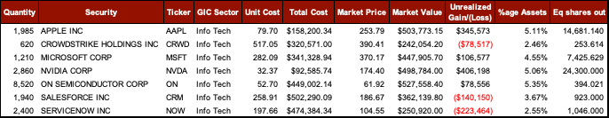
Overview
Sector Recommendation
What we own?
BUY
What to buy/sell
Company | Decision
Apple Inc | Sell
Crowdstrike Holdings Inc | Sell
Microsoft Corp | Buy
Nvidia Corp | Buy
ON Semiconductor Corp | Sell
Salesforce Inc | Buy
Servicenow Inc | Buy

Slide 5
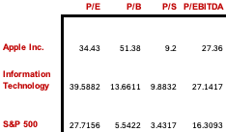
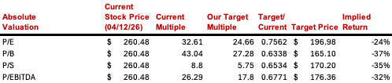
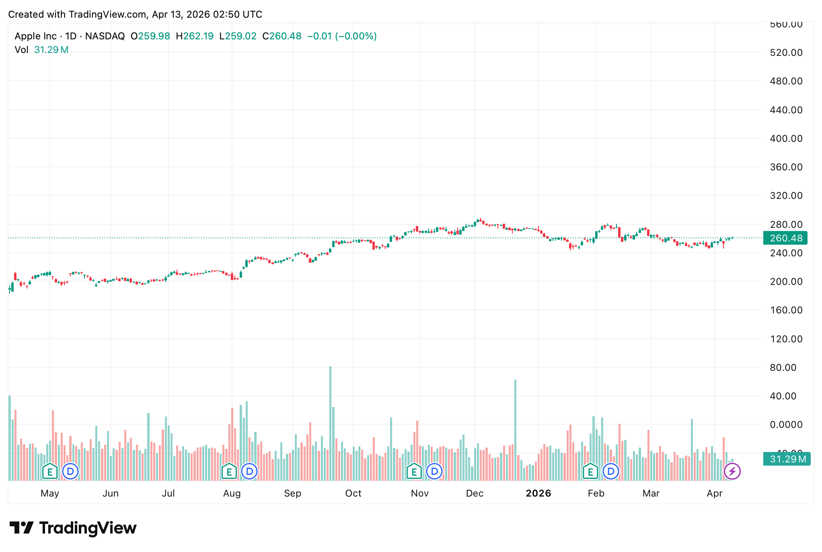
Apple Inc. (AAPL)
Business Analysis Headline: Apple stock has been performing moderately well. Solid long-term returns and resilience versus the broader market. Key Business Drivers – artificial intelligence and the incorporation of Apple AI, aiming to improve regional sales through driving demand, services expansion with high margins, share buybacks
Financial Analysis
in millions of dollars | 2023 | 2024 | 2025 | 2026E | 2027E
Sales | 383,285 | 391,035 | 416,161 | 465,384 | 498,033
Operating Margin | 114,301 | 123,216 | 133,050 | 150,139 | 160,688
EPS (Diluted) | 6.13 | 6.08 | 7.46 | 8.52 | 9.36
ROE | 171.95 | 157.41 | 171.42 | NM | NM
Review (improve, deteriorate or stay the same?) Believe the financial environment is expected to improve driven by Services business line growth and capital returns. Relative to Microsoft, Apple’s improvement is more stability-focused whilst someone like Microsoft is looking to benefit from stronger AI-led organic growth, partnering with more businesses to deploy agentic tools and could render Apple-AI obsolete.
Valuation – Target Price & Relative Ratios
Technical Analysis
Been trending sideways around $260, general support around $250, neutral momentum, investors waiting for a catalyst which will break price upwards toward resistance or downward towards support
Review Apple trades at a premium versus the S&P 500 and most mature mega-cap technology peers which depicts their great brand equity, strength in terms of balance sheet and capital return profile. Compared to the S&P 500, the company is commanding a premium due to their consistent free cash flow generation and large-scale share repurchase program supporting the growth of their EPS. We slightly disregard P/B ratio for Apple because certain intangible assets are not captured on their balance sheet and the share buybacks shrink equity which inflate the P/B ratio. Based on the other ratios Apple’s valuation appears just in line/less compelling relative to the Information Technology sector. The premium, as mentioned before, is more so justified by stability and predictability rather than upside through growth – not saying zero is possible.

Slide 6
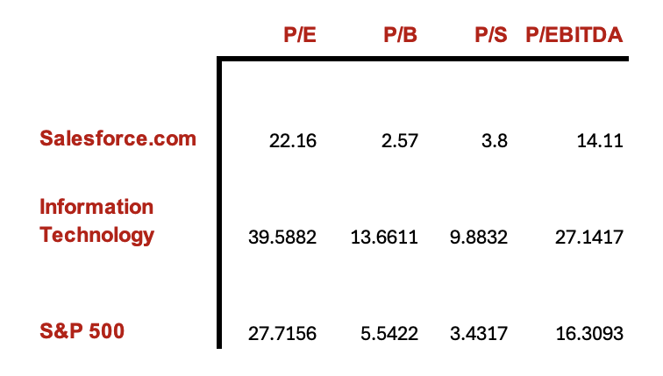
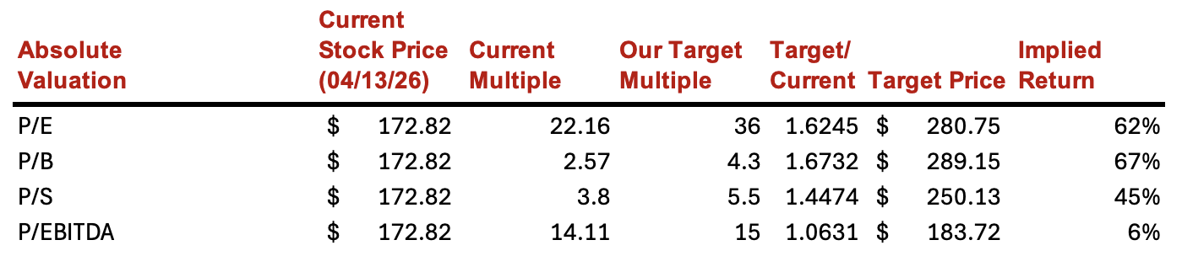
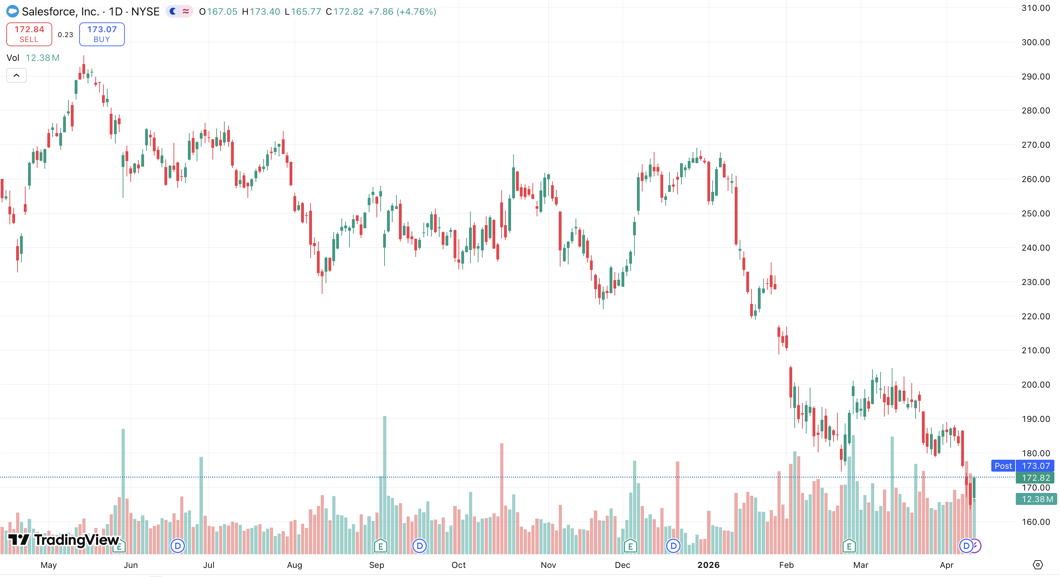
Salesforce.com (CRM)
Business Analysis Headline: Strong fundamental indicators, however stock price has been seen to be struggling. Key Business Drivers: Agentforce & AI monetization, Informatica integration, profitability growth, and accelerated share repurchase
Financial Analysis
in millions of dollars | 2023 | 2024 | 2025 | 2026E | 2027E
Sales | 35,352 | 34,857 | 37,895 | 42,063 | 47,111
Operating Margin | 3.29% | 14.38% | 19.01% | 16.80% | 21.10%
EPS (Diluted) | 0.21 | 4.20 | 6.36 | 8.97 | 12.65
ROE | 4.47% | 10.08% | 11.88% | NM | NM
Review (improve, deteriorate or stay the same?) Believe the financial environment will improve driven by growth in profitability through a higher reported free cash flow. Improved data through Informatica acquisition gives the AI agents a better model to work from prompting organic re-acceleration.
Valuation – Target Price & Relative Ratios
Technical Analysis
Stock is trading near its lower end of 52-week range of $167-$296 indicating a bearish position. Currently on a downtrend with no clear reversal signal yet.
Review Currently Salesforce is being traded at a discount with the stock price near the lower end of its 52-week range. Given this, Salesforce is still a fundamentally strong business with their strong AI growth, recent major government contract, and accelerated share buyback program. S&P 500 is down but nowhere near Salesforce's drawdown. The company is outperforming investor expectations but is not being properly reflected in its stock price. We are seeing growth in the business' margins through its annual reports indicating a growth in profitability, however, this is contradicting stock performance. Wall Street remains bullish giving a target price of around $280 which is roughly a 70% upside. This stands on the basis on their Agentforce AI providing meaningful revenue acceleration.

Slide 7
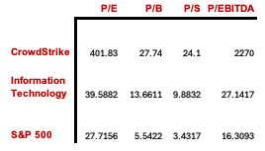
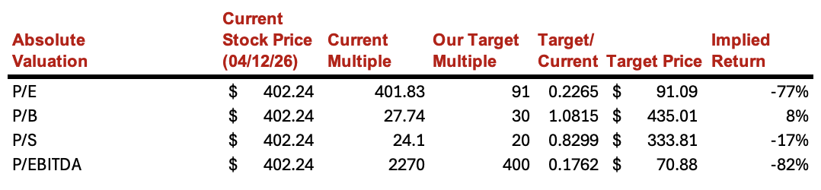
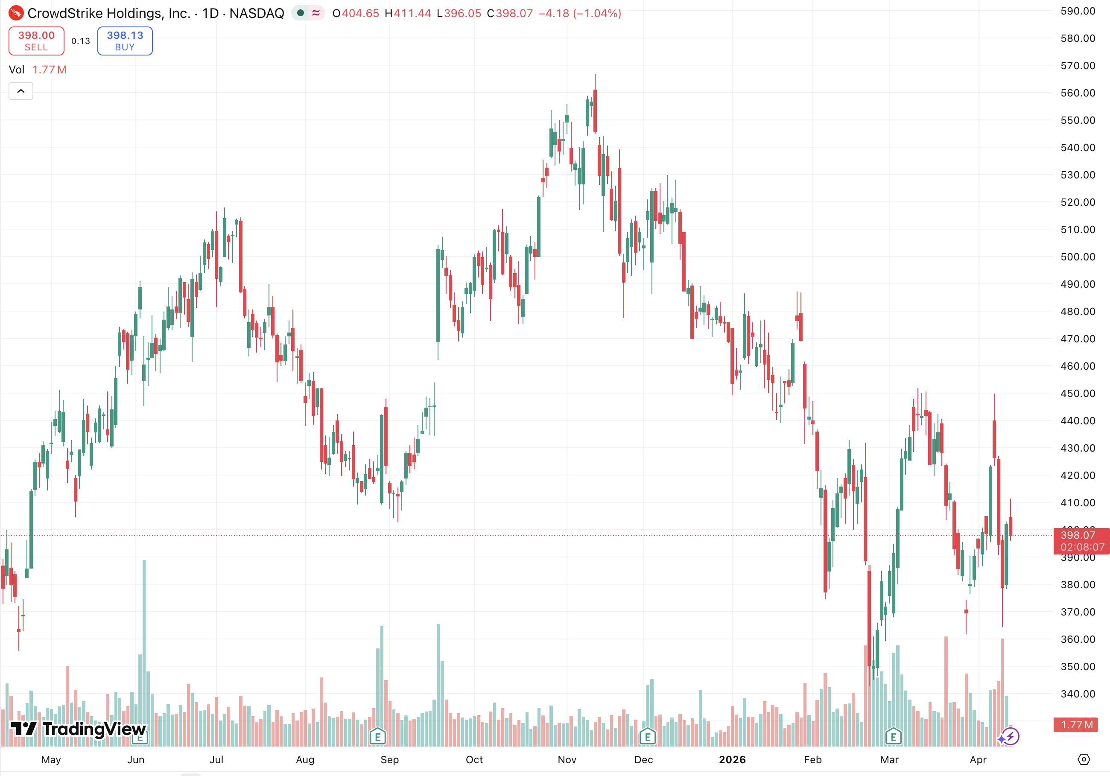
Crowdstrike Holdings (CRWD)
Business Analysis Headline: Cloud-native Cybersecurity service with strong platform execution, negative earnings with extremely premium valuation leaves little margin for error moving forward. Key Drivers: Falcon Platform Expansion, Recurring Revenue/AAR Growth, Cybersecurity Demand, Artificial Intelligence
Financial Analysis
in millions of dollars | 2023 | 2024 | 2025 | 2026A | 2027E
Sales | 2241 | 3055 | 3953 | 4812 | 5870
Gross Margin | 73.2% | 75.3% | 74.9% | 74.7% | 75%
Operating Margin | -8.5% | -0.1% | -3.0% | -6.1% | -2.0%
EPS (Diluted) | (0.79) | 0.37 | (0.08) | (0.65) | (0.12)
Review (improve, deteriorate or stay the same?) Improving financials. Sales growth expected to increase at 20%+ through 2030. High gross margins staying stable. Operating margins improving as revenue growth outpaces expense growth. Transitioning from hyper growth to a scalable model where efficiency drives returns.
Valuation – Target Price & Relative Ratios
Technical Analysis
Stock is trading toward the lower end of 52 week range, however cyclical price changes heavily reliant on external factors and extreme premium relative to market and peers cause speculation.
Review Currently, CrowdStrike is trading at a heavy premium to its peers and industry. The business model is great and favorable going forward, especially with hopeful improving financials, however its pricing that factors in perfection moving forward, as well as its susceptibility to major improvements in artificial intelligence and software stock repricing make it an unattractive stock to own in the short term. With a DCF derived intrinsic value of roughly $290, the ~28% downside leads me to believe that the risk/reward is unfavorable. Maintaining a smaller position allows us to stay exposed to long-term upside while reallocating capital to better investment opportunities.

Slide 8
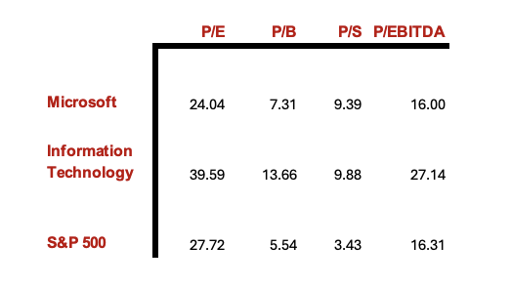
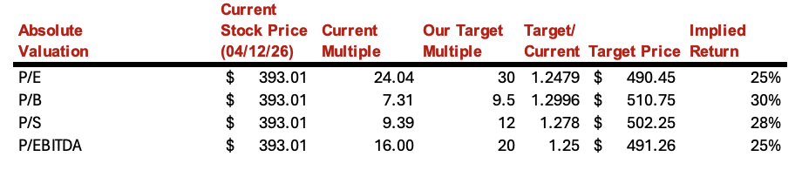
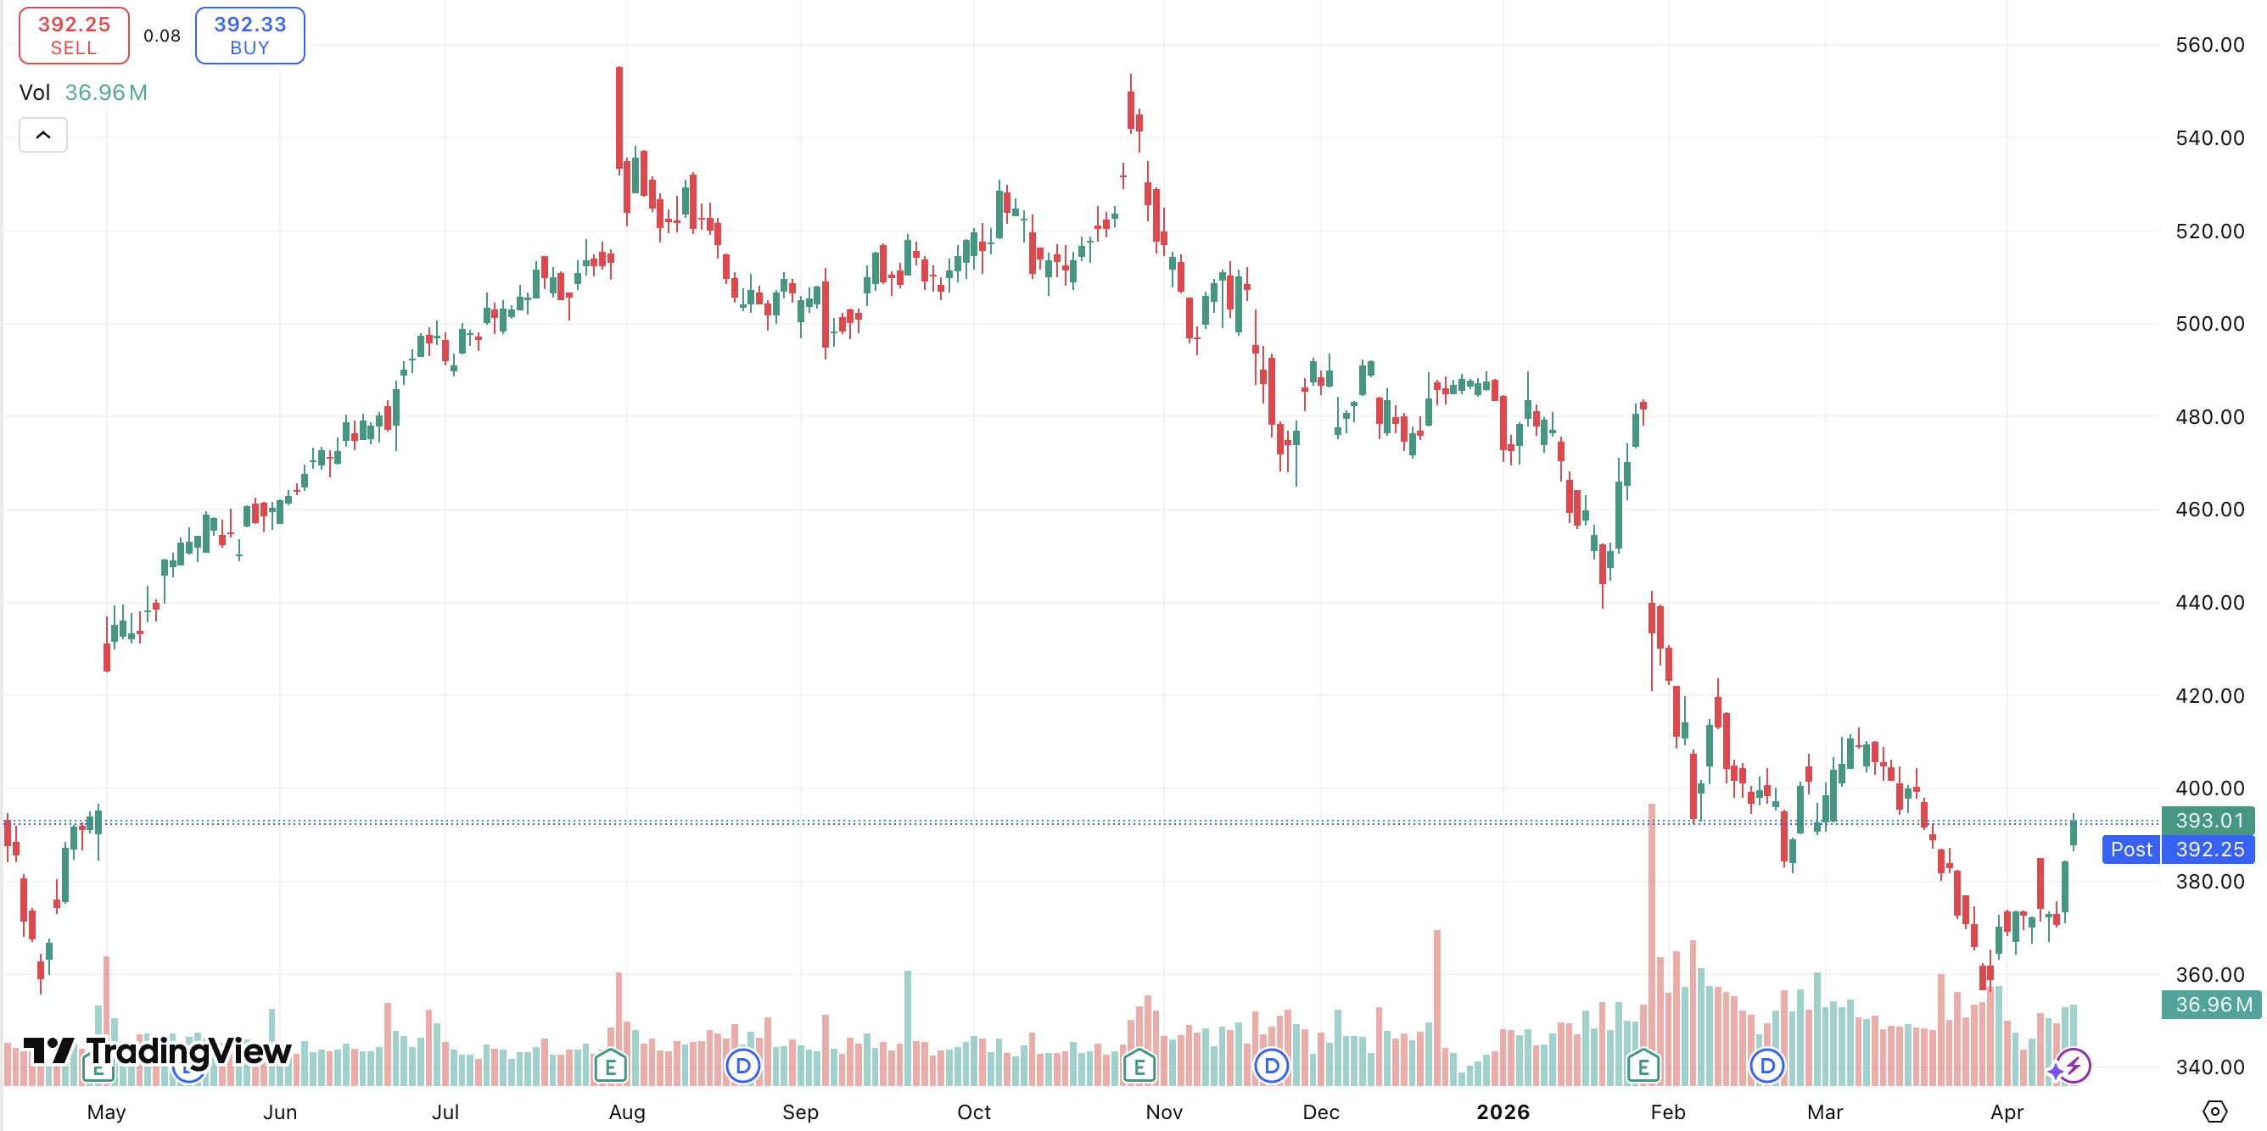
Microsoft (MSFT)
Business Analysis Headline: Microsoft is turning from a traditional cloud provider into an AI-driven enterprise platform, trading at multi-year valuation lows in spite of accelerated Azure growth and monetizing and expanding AI. Key Business Drivers – Azure cloud and AI workload demand, OpenAI partnership, subscription based billing, Intelligent Cloud segment expansion
Financial Analysis
in millions of dollars | 2023 | 2024 | 2025 | 2026E | 2027E
Sales | 211,915 | 245,122 | 281,724 | 323,983 | 359,621
Operating Margin | 41.6% | 44.6% | 45.6% | 43.0% | 44.7%
EPS (Diluted) | 9.72 | 11.80 | 13.64 | 15.91 | 17.83
ROE | 37.2% | 37.7% | 38.8% | 36.9% | 37.5%
Review (improve, deteriorate or stay the same?) Improve. Revenue growing 15%+ annually with Azure growth through the increasing AI workload demand through Azure OpenAI services. Shifting to a more service based revenue company, now making up around 77% of total revenue, improves their margin quality. Recent operating margin compressions from the data centers is more temporary than structural.
Valuation – Target Price & Relative Ratios
Technical Analysis
MSFT stock is currently trading around $393, sitting closer to its 52-week range of $344.79 - $555.45 and below our target price of $555. Brief recovery in February failed to hold, looks like a compelling entry point
Review Microsoft Is trading at a significant discount compared to its own historical averages, and the broader IT sector. Each valuation metric is below its 10 year average. The compression is driven by investor concern over the $64.6B in CapEx spending, not anything wrong with the business itself. This compression has happened twice before already. In 2022, the P/E compressed to ~28x as interest rates rose and weighed on the whole IT sector. MSFT stock fell from $343 to $276, but once Azure's cloud growth accelerated shortly after and AI demand turned to real revenue than hype, the stock recovered and surged to $515 mid 2025. Once before, in 2016 the P/E hit a decade low of ~19.8x, with the shares going for $51 as investors were skeptical about MSFT's relevance in a mobile world. MSFT proved investors wrong as Azure began scaling. Both times, nothing was internally wrong with the company, exactly what is at play today in my eyes. We believe the current price significantly undervalues the AI monetization opportunity ahead. We rate MSFT as a BUY

Slide 9
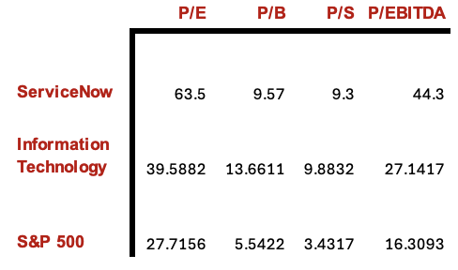
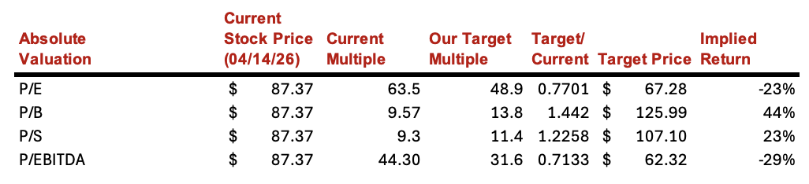
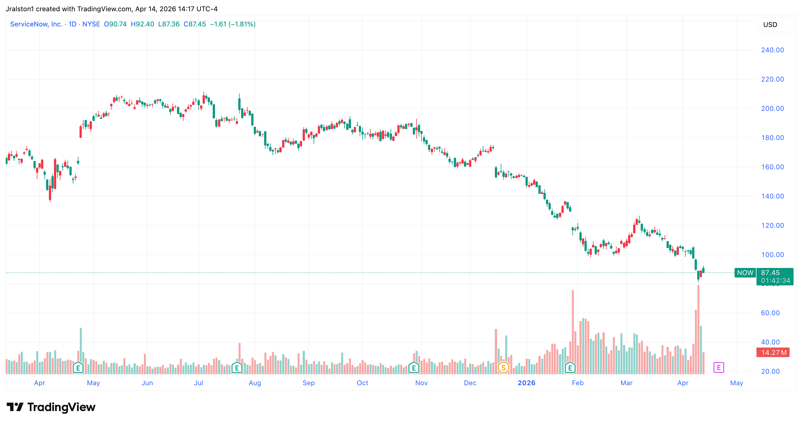
Service Now (NOW)
Business Analysis Headline: Strong fundamental indicators, recent news has driven price down as of recent. Positioned outside of the race for AI infrastructure, platform built to capture the expansion of AI without being directly involved. Working with companies in the space rather than competing against them.
Financial Analysis
in millions of dollars | 2023 | 2024 | 2025 | 2026E | 2027E
Sales | 8660 | 10646 | 12883 | 15492 | 18511
Operating Margin | 19.30% | 12.97% | 13.16% | 18.06% | 19.41%
EPS (Diluted) | 1.68 | 1.37 | 1.67 | 2.11 | 2.69
ROE | 25.32% | 15.83% | 15.45% | 15.5% | 15.5%
Review (improve, deteriorate or stay the same?) Improve. Revenue growing around 20% annually and consistently high gross margins. Subscription based model with high renewal rate around 95% year over year for the past 5 years. ServiceNow is positioning itself as a tool for the AI expansion rather than a direct competitor. Their AI Control Tower allows businesses to connect various parts of their organization facilitating faster adoption of AI, helps businesses manage, secure and measure their AI tools. Currently partnered with Google Gemini, Microsoft CoPilot and Claude AI.
Valuation – Target Price & Relative Ratios
Technical Analysis
ServiceNow is down 45% year to date and 63% from all time highs just over a year ago. Currently price is the lowest it has been since May of 2023.
Review Based on fundamental analysis ServiceNow is a currently a buy. Compared a year ago ServiceNow is trading at a 45% discount as well as 63% down from its all-time highs. This price dip in price comes in despite of strong fundamentals, ServiceNow's revenue has grown an average of 22.5% year over year for the past 5 years and gross margin has remained consistently in the 77-80-% range during that same period. ROE has leveled to around 15% in 2024 and 2025 indicating the company is running operations more efficiently, this is especially important as they continue to grow and scale. The DCF model projects a price target of around $138, or around a 58% upside from current prices. A big risk factor is competition from companies such as anthropic, who recently announced new managed agents which have the ability to complete complex tasks, putting pressure on traditional software as a service (SaaS) businesses. Despite this, much of the new AI technology is still years away from completely eliminating traditional SaaS providers.

Slide 10
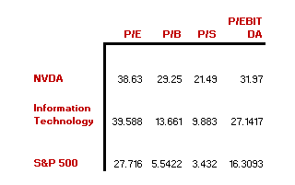
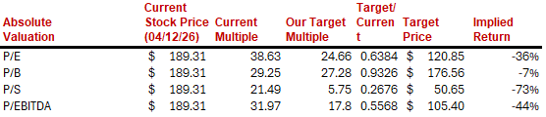
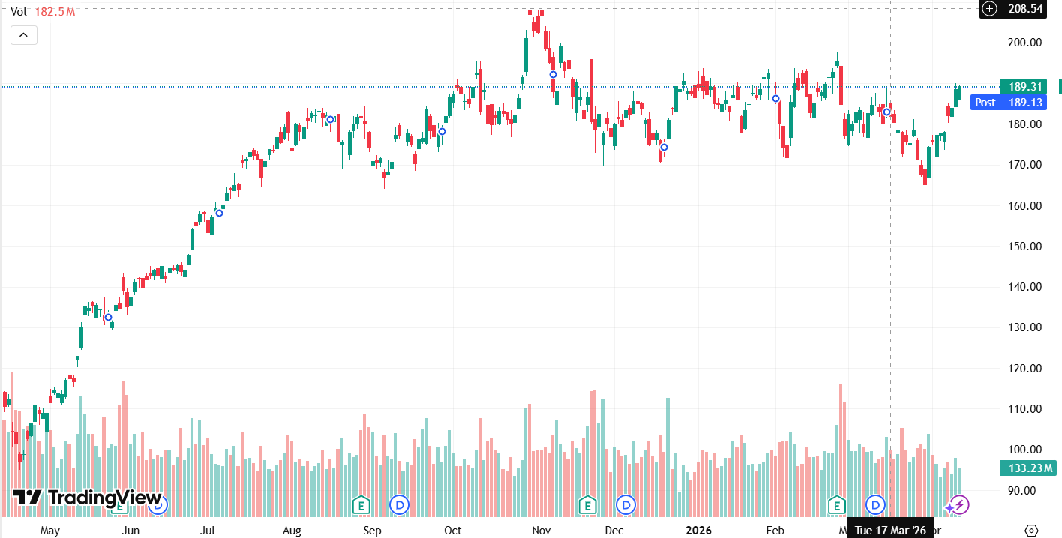
Nvidia Corp. (NVDA)
Business Analysis Headline: NVIDIA is the leader in AI accelerated computing, with explosive revenue growth, expanding margins, and a dominant GPU ecosystem that positions it as the backbone of the global AI buildout making it a compelling long-term Buy despite short-term noise. Key business drivers – AI data center demand, Blackwell GPU ramp, and sovereign AI infrastructure spending.
Financial Analysis
in millions of dollars | 2023 | 2024 | 2025 | 2026E | 2027E
Sales | 26974 | 60922 | 130497 | 214015 | 331723
Gross Margin | 15356 | 44301 | 97858 | 158371 | 245475
Operating Margin | 4224 | 32972 | 81453 | 124128 | 192399
EPS (Diluted) | 1.74 | 1.19 | 2.94 | 4.70 | 7.25
Review (improve, deteriorate or stay the same?) Revenue grew 114% year-over-year in fiscal 2025, operating margins have expanded dramatically, and EPS is projected to nearly double from 2025 to 2027. ROE has surged from 17.9% to over 119%, reflecting exceptional capital efficiency. All key financial metrics point toward continued improvement driven by AI data center demand.
Valuation – Target Price & Relative Ratios
Technical Analysis
NVDA is currently trading around $188, approaching its 52-week high of $211.19, with the stock buoyed by massive AI chip demand and potential breakout momentum above $185. The stock is still below my target for NVDA.
Review Based on the target price valuation figures, we believe NVDA is a Buy. With a DCF price target of ~$253 which represents significant upside from current levels, explosive revenue growth, expanding margins, and dominant positioning in AI infrastructure, the fundamentals strongly support continued growth. Key risks include export restrictions, increased competition from AMD and Intel, and potential moderation in hyperscaler AI spending. I still believe there is room to grow with NVDA as they have posted consistent good earnings and the Compute and Networking line of business has consistently grown which shows they are putting money into that line and getting results. Even though NVDA is above the 5% mark in the SIM I would still suggest a small buy as we see AI being apart of the future.

Slide 11
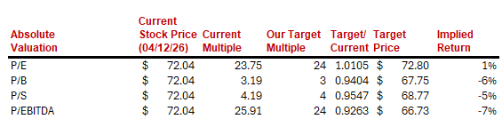
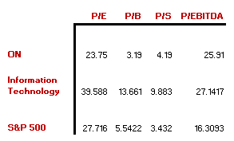
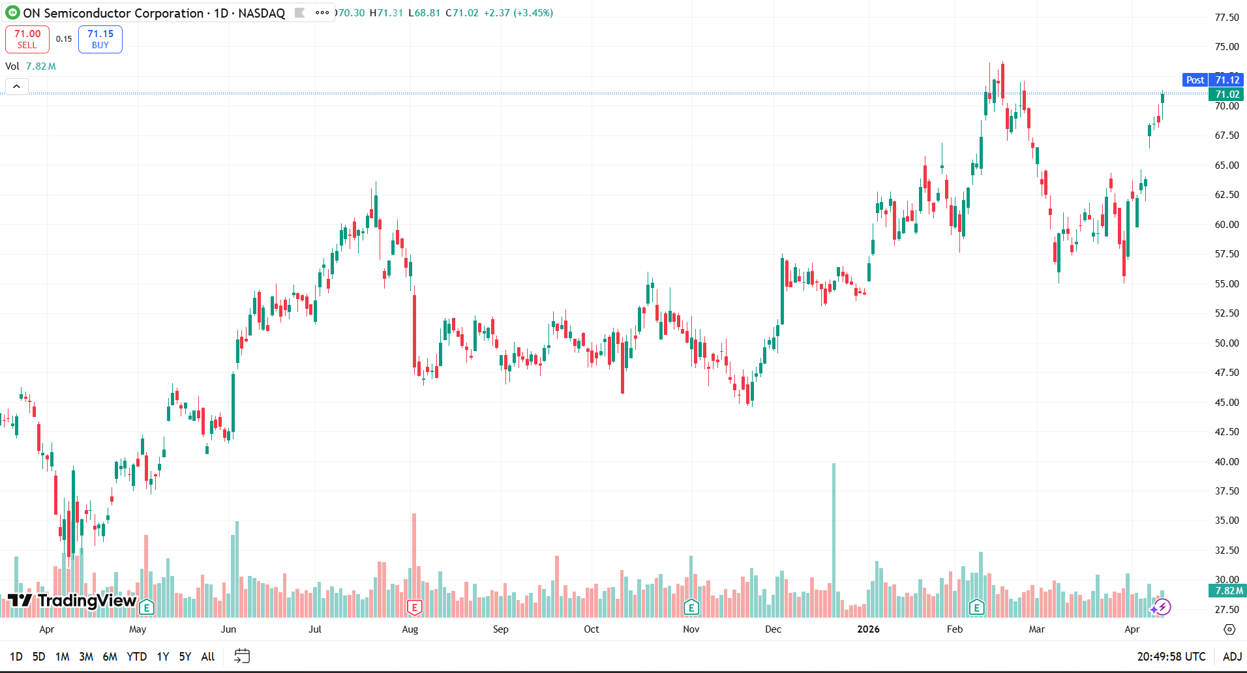
ON Semiconductor Corp. (ON)
Business Analysis Headline: ON is a solid semiconductor company with strong exposure to EVs, industrial automation, and power efficiency, but near-term cyclical weakness and limited valuation upside support a Hold view. Key business drivers – EV growth, automotive demand, and industrial demand
Financial Analysis
in millions of dollars | 2023 | 2024 | 2025 | 2026E | 2027E
Sales | 8,253 | 7,082 | 5,995 | 6331 | 6919
Gross Margin | 47.1% | 45.4% | 33.1% | 38.0% | 39.5%
Operating Margin | 30.8% | 25.0% | 1.4% | 18.0% | 20.0%
EPS (Diluted) | 4.89 | 3.63 | 0.29 | 2.40 | 2.85
Review (improve, deteriorate or stay the same?) Improve. 2025 was clearly a weak year, with revenue, margins, and EPS all falling sharply. That said, ON still generated strong cash flow, kept a solid balance sheet, and should benefit if automotive and industrial demand improve from here.
Valuation – Target Price & Relative Ratios
Technical Analysis
The stock has had a strong recent move higher and is now trading around $72.04. With the stock above my DCF target, I think the recent rally makes the valuation less attractive from here.
Review ON Semiconductor has a solid long-term story because of its exposure to EVs, industrial automation, and power semiconductors, but the stock is not as attractive at the current price. From a valuation standpoint, my DCF came out to $62.33 per share. At the time of the paper, that supported a Hold rating because upside was already limited. Now that the stock is trading around $72.04, shares are above my fair value estimate, which makes the risk reward even less compelling from here. Overall, I think ON is a good company, but I like the business more than I like the stock at this level. The balance sheet is still solid, the company continues to generate cash flow, and the long-term positioning makes sense, but the current valuation already reflects a lot of that potential. Because of that, I would keep the rating at Hold.

Slide 12
Recommendation – Catalysts and Risks
Stock | Primary Catalysts | Primary Risks
Apple Inc. | iPhone saturation and longer replacement cycles Regulatory pressure on high-margin Services Stock priced for ”too much good news” – market stops paying a premium for a maturing business | AI-driven upgrade cycle sustains revenue and margins Services growth offsets hardware deceleration Aggressive capital returns support EPS
Salesforce.com | Data cloud expansion Operating margin improvement AI & Agentforce adoption | AI competition from Microsoft Valuation & multiple compression Leadership stability
Crowdstrike Holdings | Emergence of AI tools and flaws in software Extreme premium compared to peers and industry | Continued strong growth and operating margins AI advancements bringing software uncertainty Accelerated cyber demand through emergence of tech weakpoints
Microsoft | Azure AI revenue acceleration Copilot enterprise adoption across 300M+ Office 365 seats FCF recovery as data centers finish building and D&A normalizes Valuation going back to its historic averages from the current 10-year lows | AI CapEx overbuilding, if AI adoption is slower than projected than FCF margin trough persists beyond 2026 OpenAI relationship (risk of OpenAI IPO, renegotiating terms) Hyperscaler competition from AWS and Google Cloud closing AI inference gap
Service Now | AI control tower expansion Strong revenue and EPS growth Subscription based business model with strong renewals | Competition from AI companies such as anthropic Does not pay dividends High valuation ratios relative to the sector and S&P 500
Nvidia Corp. | Blackwell GPU ramp driving record data center revenue growth Sovereign AI and enterprise AI infrastructure buildout expanding addressable market CUDA software ecosystem creating high switching costs and recurring revenue | U.S.-China export restrictions limiting access to a major revenue market Elevated valuation leaves little room for execution misses or demand slowdown Increasing competition from AMD, custom silicon
ON Semiconductor Corp. | Recovery in automotive and industrial demand Continued EV growth and electrification trends Margin recovery as cyclical pressure eases | Ongoing weakness in automotive and industrial markets Semiconductor cyclicality and margin pressure Strong competition in power semiconductors

Slide 13
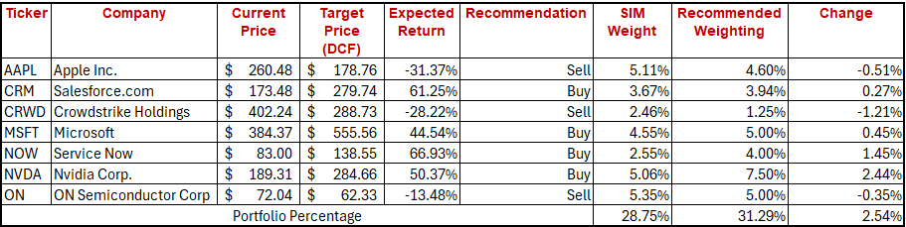
Recommendation

Slide 14
Appendices

Slide 15
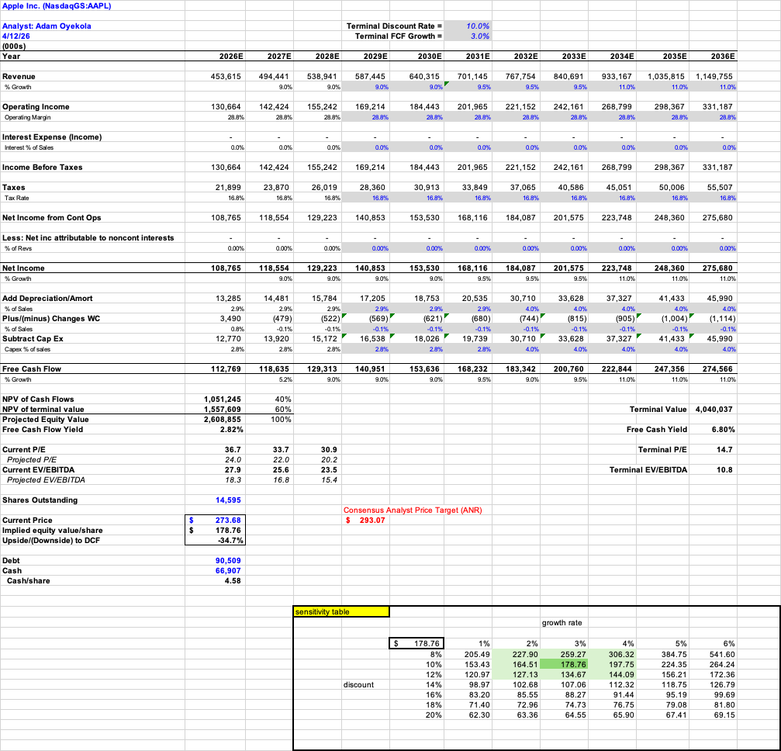
Apple Inc. (AAPL) – DCF Model

Slide 16
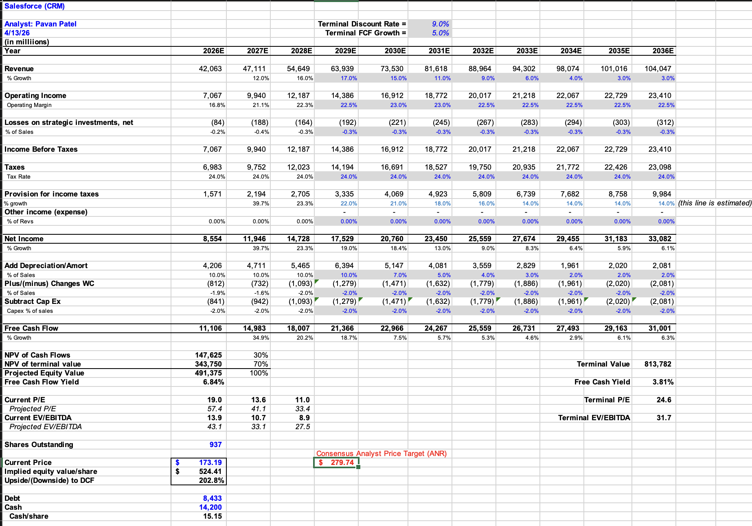
Salesforce.com (CRM) – DCF Model

Slide 17
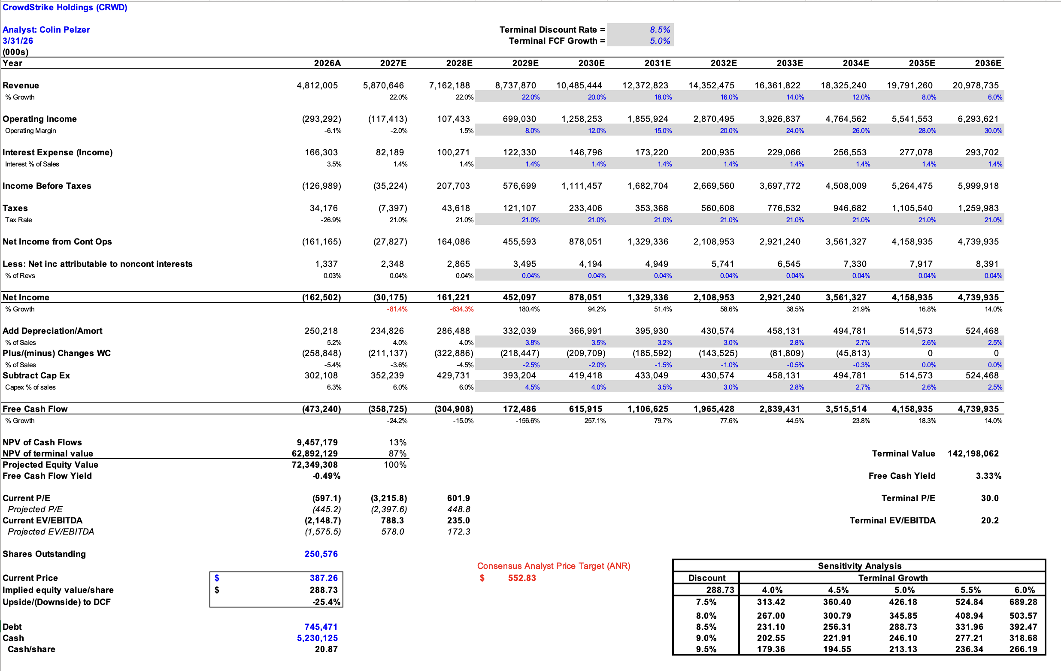
Crowdstrike Holdings (CRWD) – DCF Model

Slide 18
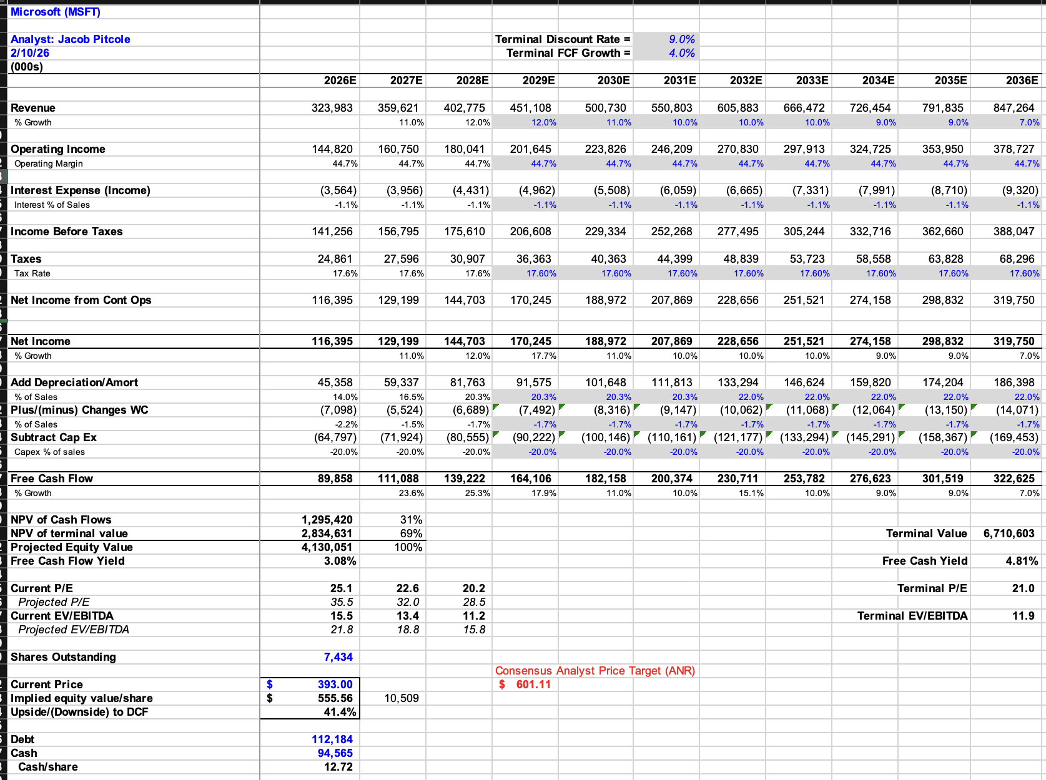
Microsoft (MSFT) – DCF Model

Slide 19
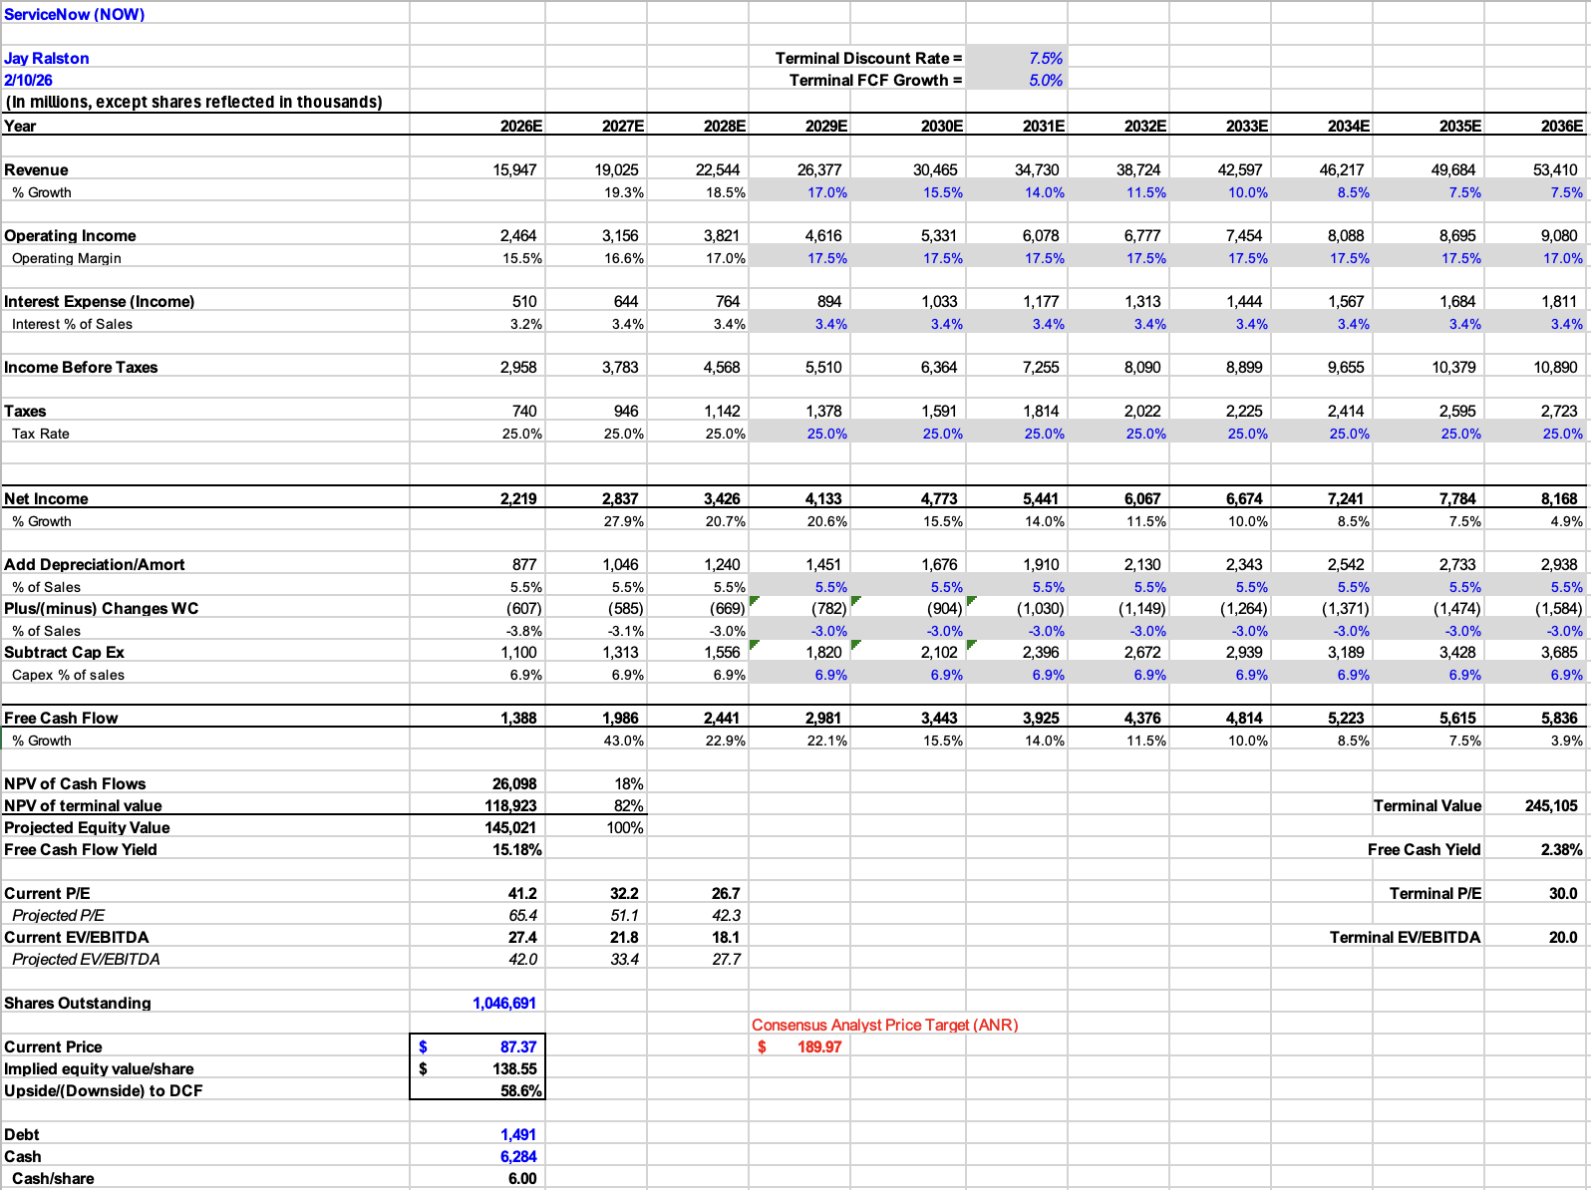
Service Now (NOW) – DCF Model

Slide 20
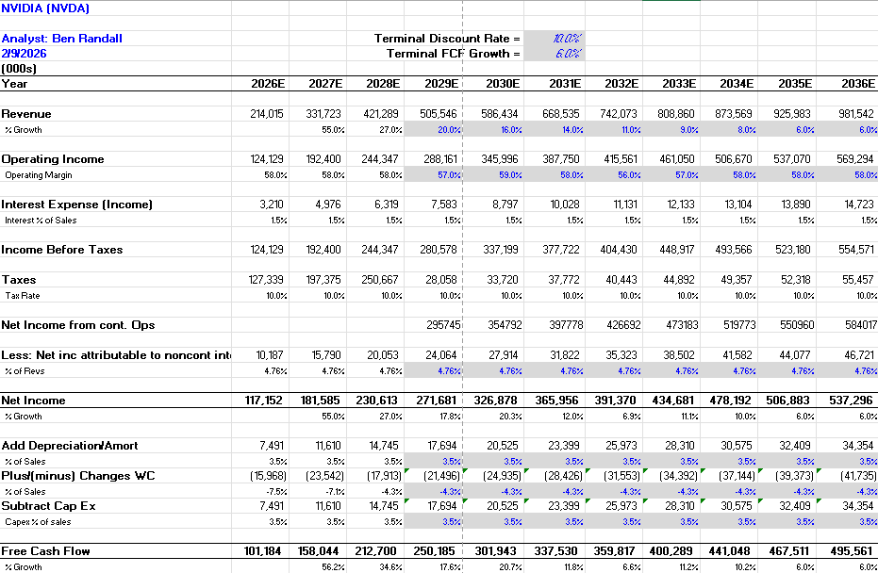
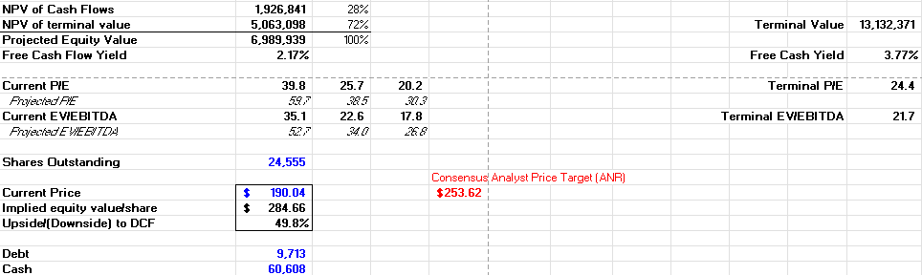
Nvidia Corp. (NVDA) – DCF Model

Slide 21
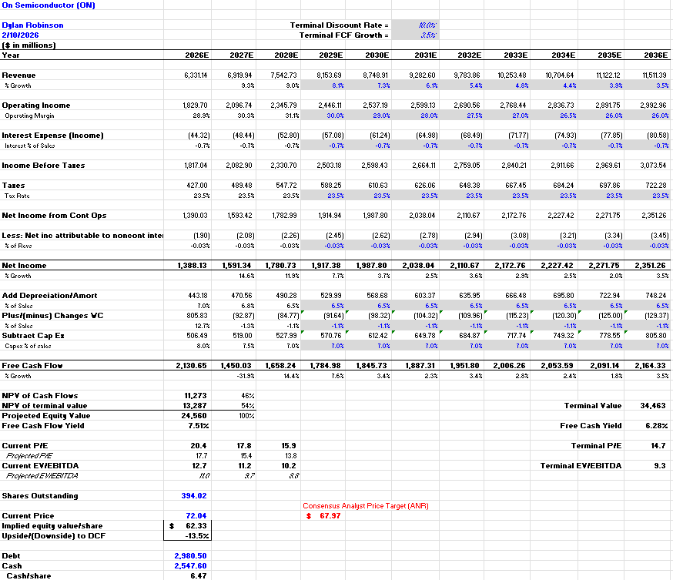
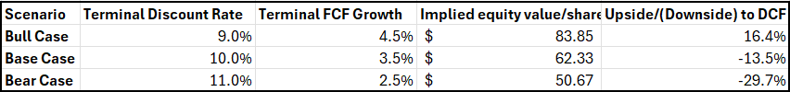
ON Semiconductor Corp. (ON) – DCF Model

Slide 22
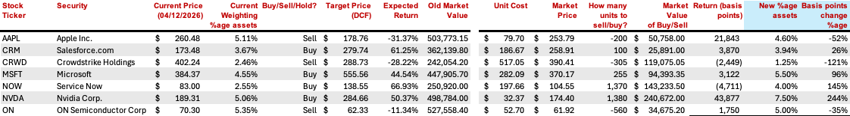
Recommendation Buy/Sell Breakdown Table

