Slide 1

Fish
Information Technology Sector Analysis Prepared By
Coll
Of
Adam Oyekola, Benjamin Randall, Colin Pelzer, Dylan Robinson, Jacob Pitcole, Pavan Patel, Jay Ralston
Busi
March 24 2026

Slide 2







Our Team
Adam Oyekola
Pavan Patel
Colin Pelzer
Dylan Robinson
INFORMATION TECHNOLOGY SECTOR ANALYSIS
Ben Randall
Jacob Pitcole
Jay Ralston

Slide 3
Agenda
Page
Overview
1
Business Analysis
2
Economic Analysis
7
Financial Analysis
19
Valuation Analysis
20
Recommendation
26
INFORMATION TECHNOLOGY SECTOR ANALYSIS

Slide 4
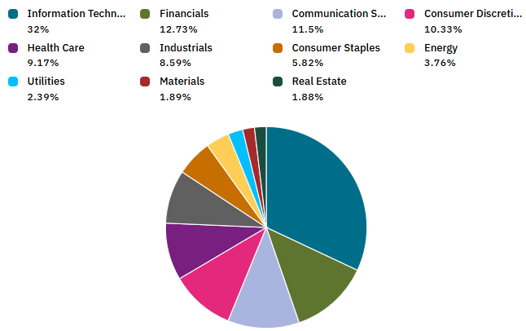
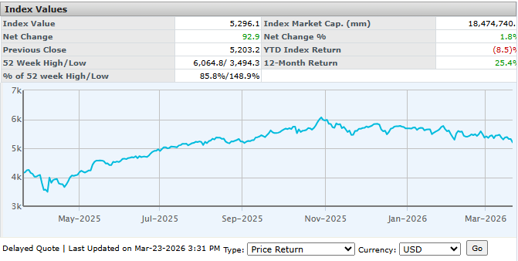
Overview of the Information Technology Sector
Size of the sector
Industries in the sector
Information Technology
Total Return: +1.79
Weight (%): 33.42%
Count: 73.00
Realtime Securities
Largest companies
Sector performance YTD
INFORMATION TECHNOLOGY SECTOR ANALYSIS
Source(s): CapitalIQ, us500.com, Bloomberg

Slide 5
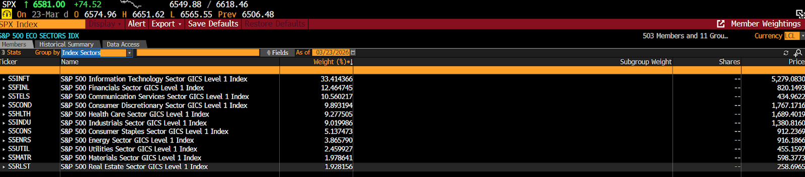
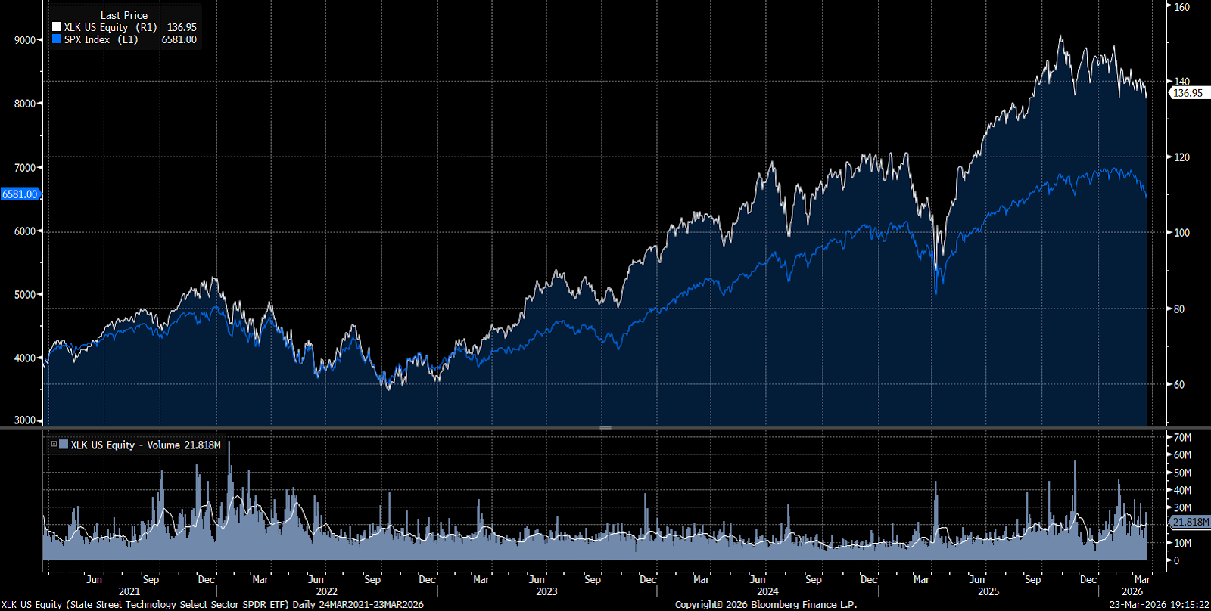
Overview of the Information Technology Sector
INFORMATION TECHNOLOGY SECTOR ANALYSIS

Slide 6
Agenda
Page
Overview
1
Business Analysis
2
Economic Analysis
7
Financial Analysis
19
Valuation Analysis
20
Recommendation
26
INFORMATION TECHNOLOGY SECTOR ANALYSIS

Slide 7
Input
Data, energy, CAPEX & hardware
Output
Cloud computing, software products, IT services
Business Analysis
Business Cycle
Mature high growth phase driven by AI driven capital expenditures and infrastructure investment
Shift from a pure growth phase to a maturity dominated growth phase
Cyclical sector
Business investment in technology outpaced consumer spending
Global tariffs
External factors
P
Government regulation bills
E
High rates affecting funding cycles
S
More remote work
T
Evolving technology
Global privacy frameworks
L
E
E-waste regulation
INFORMATION TECHNOLOGY SECTOR ANALYSIS

Slide 8
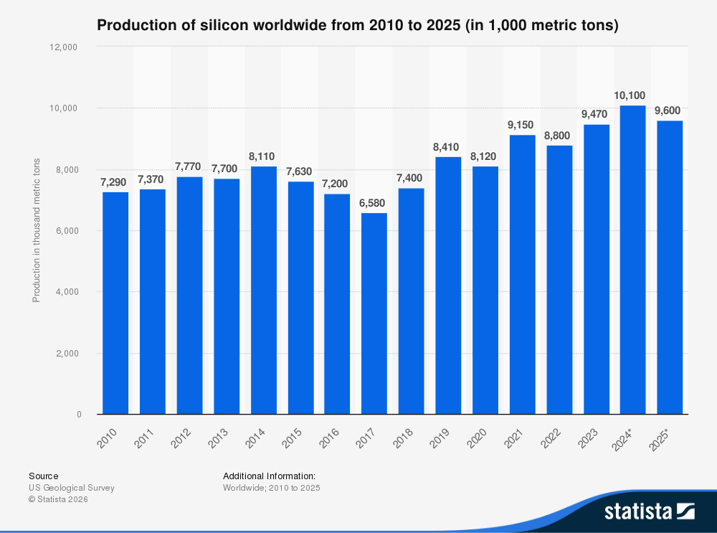
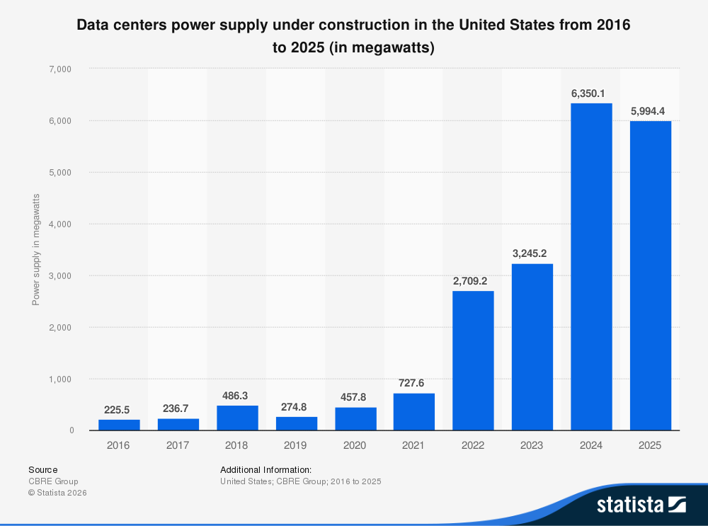
Business Analysis
Silicon is one of the main components in semiconductors
Relatively flat, slightly increasing production
China controls most of production
Greater semiconductor demand could put pressure on silicon supply
Exponential growth in demand for data centers in US
Power is the largest constraint on data center infrastructure
Greater competition in areas with access to power
Greater data center demand puts pressure on power supply
INFORMATION TECHNOLOGY SECTOR ANALYSIS

Slide 9
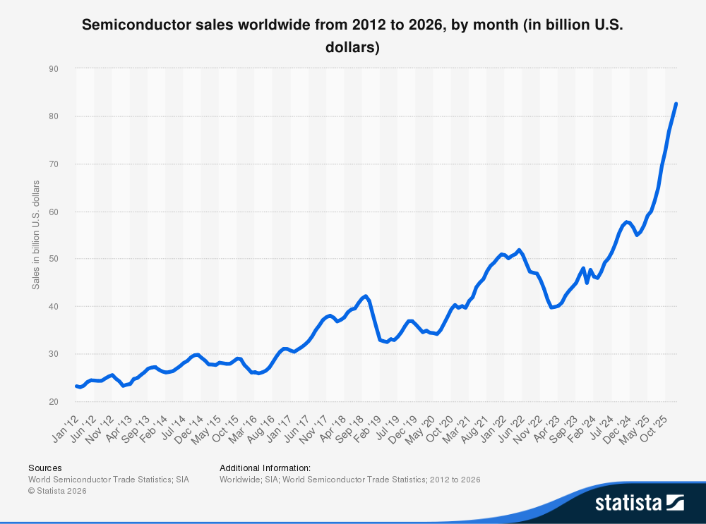
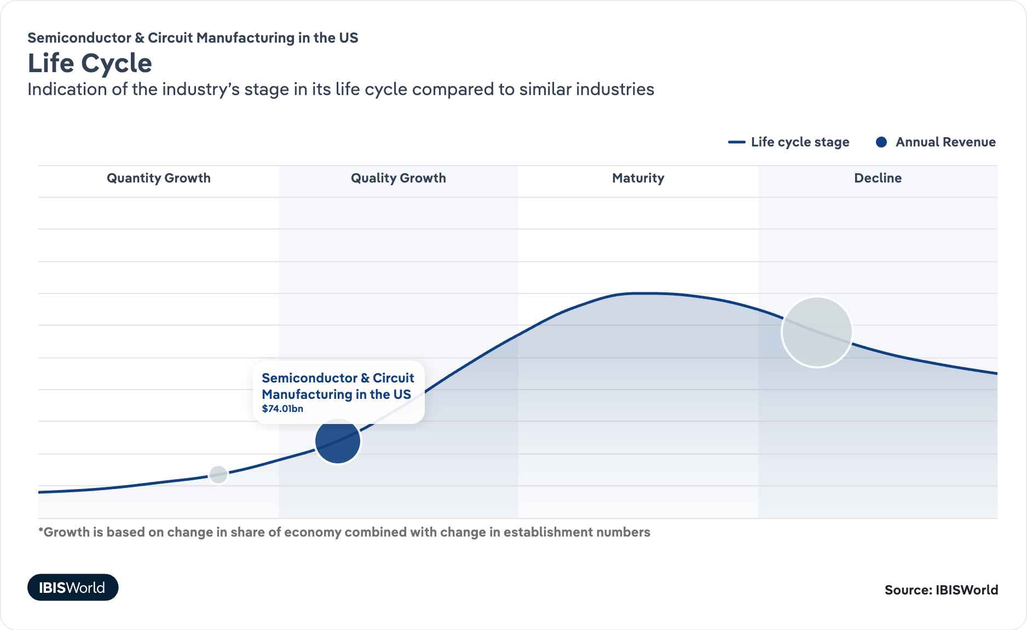
Business Analysis
US semiconductor manufacturing in early stages of life cycle growth
Exponential sales growth in semiconductors within the last 1-2 years
Large investment to support growing demand
Increased demand for natural resources and power could lead to expansion constraints
Larger firms dominating leaves less room for new additions
INFORMATION TECHNOLOGY SECTOR ANALYSIS

Slide 10

Business Analysis – Profitability Of The Sector
Ticker | Revenue Growth (YoY) | Gross Margin | Operating Margin
NVDA | +65% | 71.1% | 60.4%
AAPL | +6.4% | 46.9% | 32.0%
MSFT | +14.9% | 68.8% | 45.6%
AVGO | +23.9% | 67.8% | 39.9%
MU | +48.8% | 39.8% | 26.1%
Cheap to scale: once a product is built, it can be sold to millions at very low additional cost
High switching costs: customers don’t want to change systems, so companies can maintain pricing
Strong demand: businesses rely on tech (cloud, software, chips), making revenue more consistent
Differentiated products: innovation allows companies to charge premium prices (software, cloud, etc)
High upfront costs, low ongoing costs: leads to strong long-term margins
INFORMATION TECHNOLOGY SECTOR ANALYSIS

Slide 11

Business Analysis – Pricing Power
What Drives Pricing Power?
High industry concentration: A few large firms dominate the market
High barriers to entry: Difficult for new competitors to enter
Barriers to Entry
Pricing Power + High Margins
Lock-In
Tech Demand
Limited substitutes for advanced technology and platforms
Strong customer lock-in from switching costs and ecosystems
Ongoing competition, but firms differentiate through innovation
Strong growing demand for tech: Supports pricing strength
Impact on Profitability
Firms can maintain or increase prices
Demand remains relatively stable despite price changes
INFORMATION TECHNOLOGY SECTOR ANALYSIS
Leads to consistently high margins across the sector

Slide 12
Agenda
Page
Overview
1
Business Analysis
2
Economic Analysis
7
Financial Analysis
19
Valuation Analysis
20
Recommendation
26
INFORMATION TECHNOLOGY SECTOR ANALYSIS

Slide 13
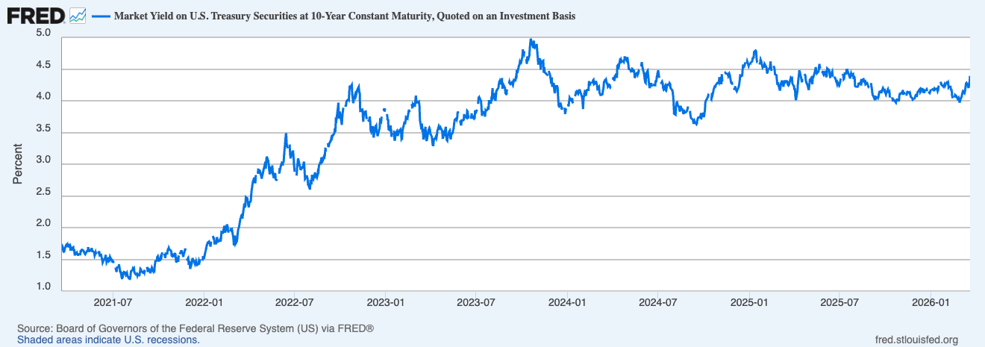
Economic Analysis - Economic Drivers
INFORMATION TECHNOLOGY SECTOR ANALYSIS

Slide 14
Economic Analysis – Economic Drivers
Interest Rates (10-year OTR)
Elevated rates
Valuation compression driven by discount rate effects
Inflation
Stabilized
Macro conditions creating short-term headwinds
INFORMATION TECHNOLOGY SECTOR ANALYSIS

Slide 15
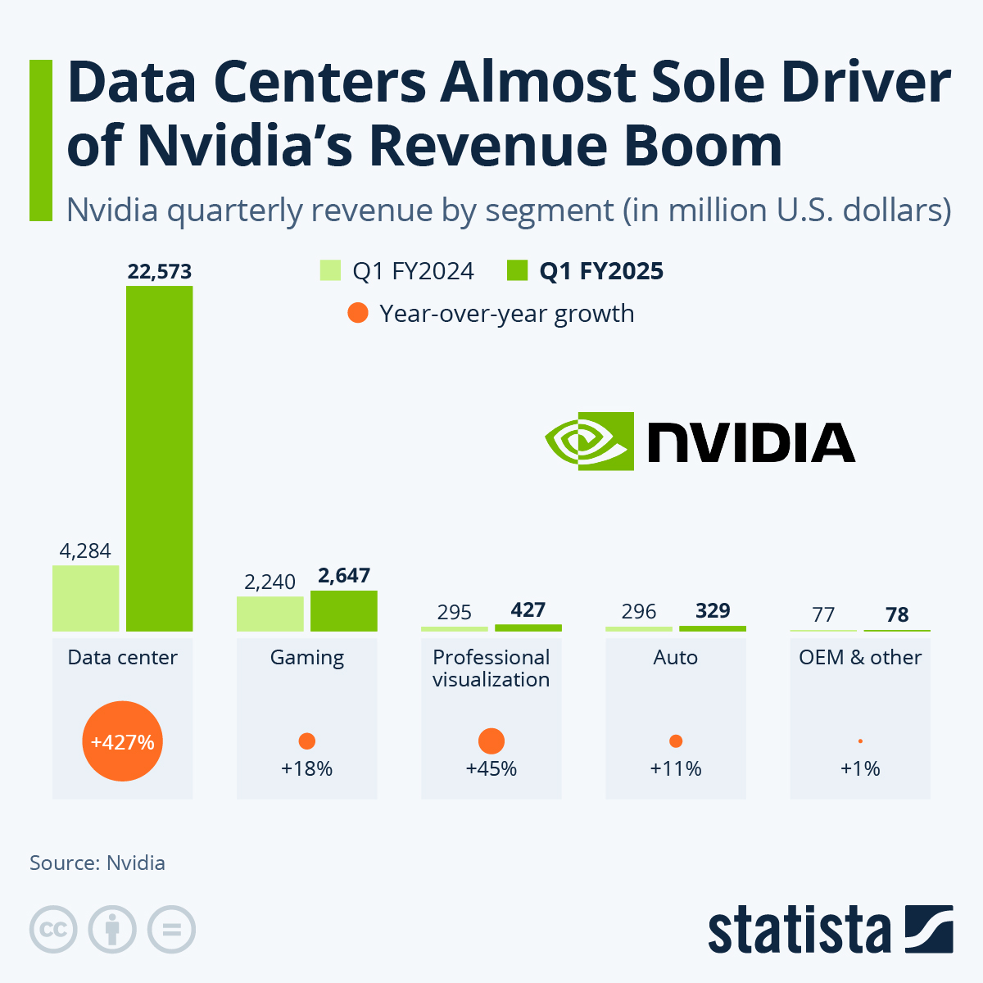
Economic Analysis – AI CapEx Cycle
Investment Surge
Tech firms massively increased their CapEx
Built data centers, GPUs, cloud infrastructure
Self-Reinforcing Growth
Grow AI → higher productivity → higher margins → more cash flow
More Cash Flow = Reinvestment into AI (CapEx)
INFORMATION TECHNOLOGY SECTOR ANALYSIS
AI CapEx has become its own economic engine, reducing reliance on traditional macro drivers like interest rates and GDP
Source(s): Nvidia, Statista

Slide 16
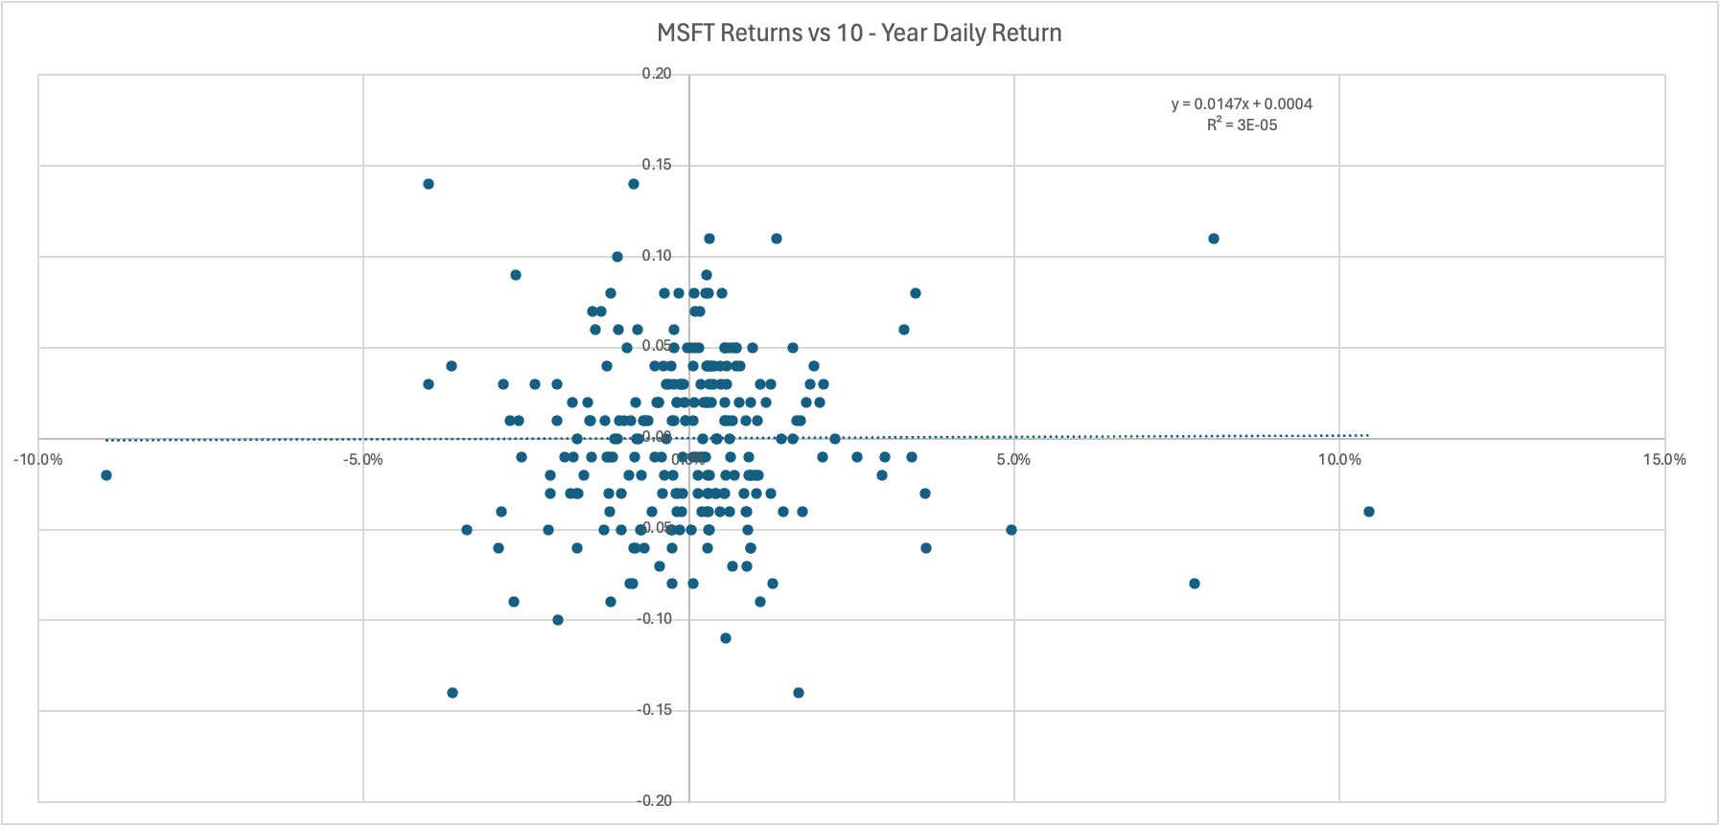
Economic Analysis - Regression Analysis
INFORMATION TECHNOLOGY SECTOR ANALYSIS

Slide 17
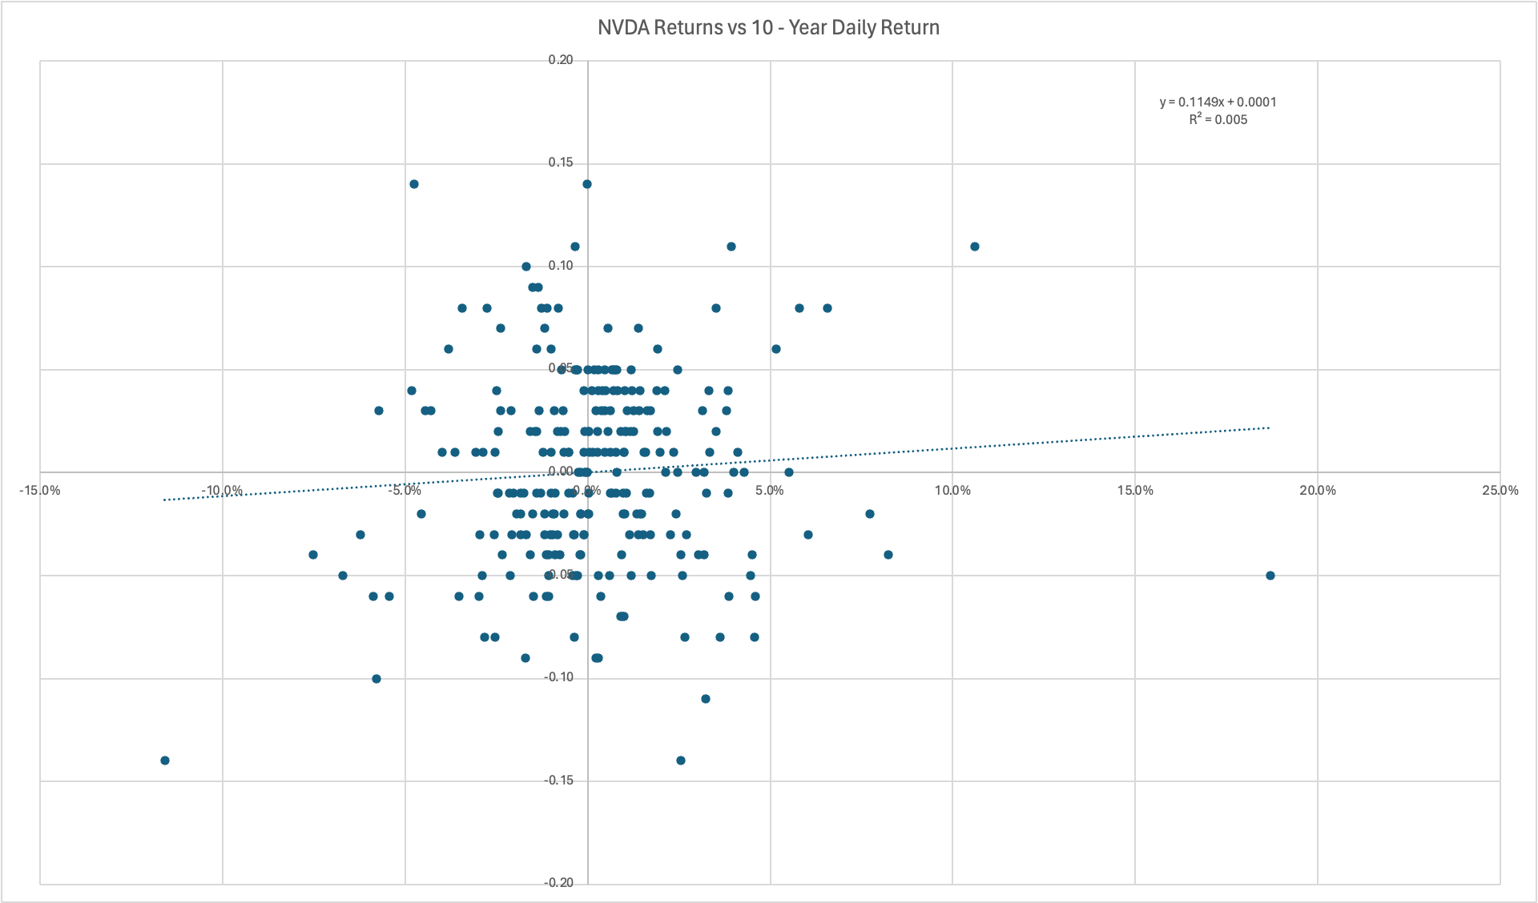
Economic Analysis - Regression Analysis
INFORMATION TECHNOLOGY SECTOR ANALYSIS

Slide 18
Economic Analysis – “X” vs GDP For Sector Growth
2021 – 2023
Energy Sector driven by Oil Prices
2020 – 2022
Housing / Real Estate driven by interest rates (exploded during COVID period, unstable)
2020 – 2021
EV / Clean Energy (policy and narrative)
2024 - ?
INFORMATION TECHNOLOGY SECTOR ANALYSIS
Tech sector driven by AI

Slide 19
Economic Analysis – “X” vs GDP For Sector Growth
Stock | Pre- Boom | Under-Boom | Post Boom | Now | Type
XOM | $70-80 (2018) | $30-40 (2020) | $100-110 (2023) | $160-170 | Oil-driven
CVX | $110-125 (2018) | $70-80 (2020) | $150-160 (2022) | $180-200 | Oil-driven
OXY | $60-70 (2018) | $10-15 (2020) | $70-75 (2022) | $50-60 | Oil-driven
DHI | $40-50 (2019) | $55-65 (2020/21 surge) | $100-140 (2022) | $140-160 | Rate-driven
LEN | $45-55 (2019) | $75-85 (2020/21 surge) | $100-115 (2023) | $90-100 | Rate-driven
TSLA | $10-20 (2019) | $80-150 (2020) | $230-260 (2021) | $380-400 | EV-driven
NIO | $3-5 (2019) | $15-30 (2020 surge) | $40-50 (2021) | $3-5 | EV-driven
INFORMATION TECHNOLOGY SECTOR ANALYSIS

Slide 20
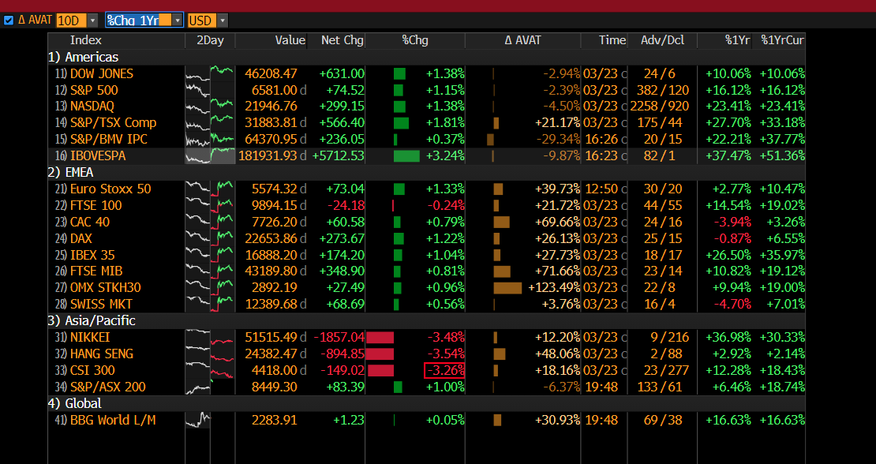
Economic Analysis – % Change 1 Year
INFORMATION TECHNOLOGY SECTOR ANALYSIS

Slide 21
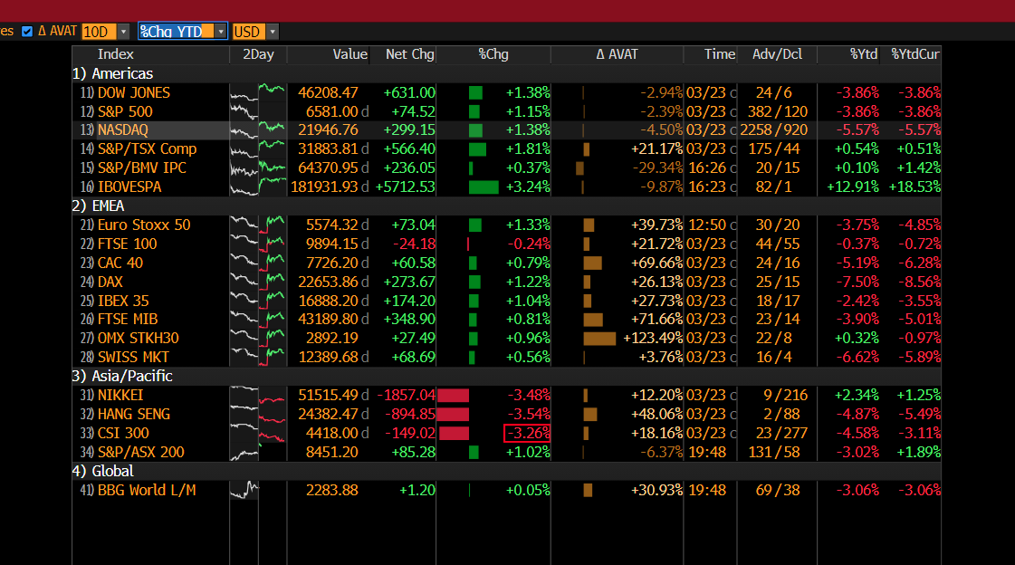
Economic Analysis – % Change YTD
INFORMATION TECHNOLOGY SECTOR ANALYSIS

Slide 22
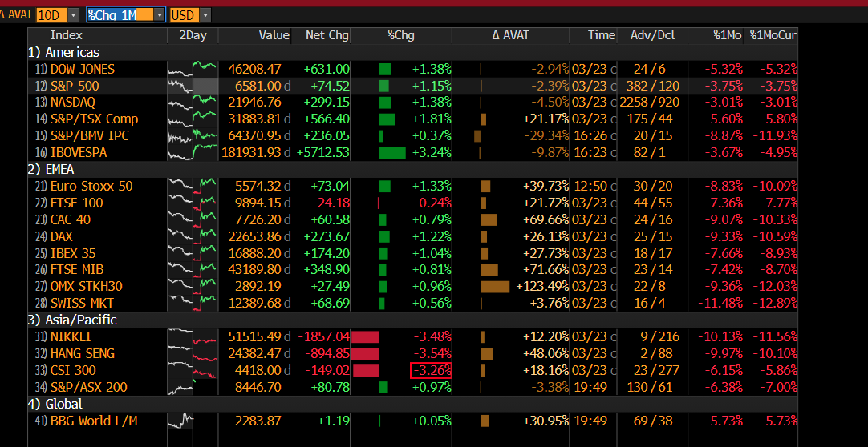
Economic Analysis – % Change 1 Month
INFORMATION TECHNOLOGY SECTOR ANALYSIS

Slide 23
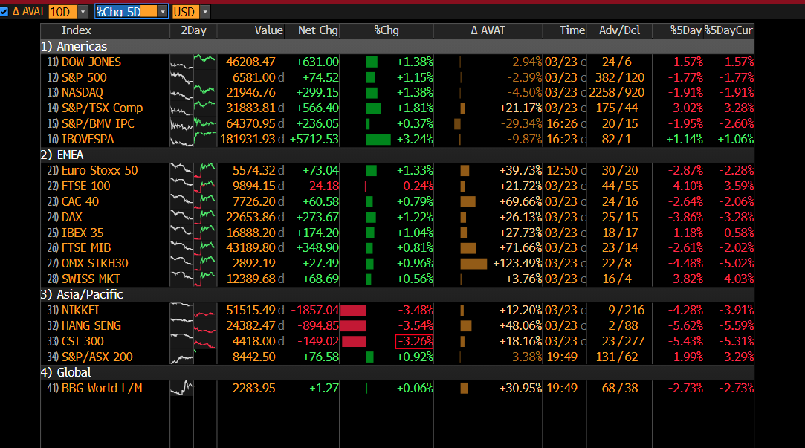
Economic Analysis – % Change 5 Days
INFORMATION TECHNOLOGY SECTOR ANALYSIS

Slide 24
Economic Analysis - Technology Sector Performance
1
Strong 1-year performance confirms powerful AI-driven earnings momentum
2
Short-term weaknesses reflect macro pressure NOT a fundamental breakdown
3
Earnings are being made due to AI, but valuations are being held back by interest rates
4
Attractive opportunity to accumulate positions in a structurally strong, AI - driven sector
INFORMATION TECHNOLOGY SECTOR ANALYSIS

Slide 25
Agenda
Page
Overview
1
Business Analysis
2
Economic Analysis
7
Financial Analysis
19
Valuation Analysis
20
Recommendation
26
INFORMATION TECHNOLOGY SECTOR ANALYSIS

Slide 26
Financial Analysis
The S&P 500 Information Technology sector still shows very strong fundamentals, with healthy margins and solid returns while its valuation is expected to become less stretched over the next two years as earnings growth improves.
Growth Rates of Sector, Industries & Major Companies
Info Tech Sector Highlights
Sales |  |  |  |  | 2023 | 2024 | 2025
Info Tech Sector |  |  |  |  | 4% | 8% | 20%
Semiconductors Industry |  |  |  |  | -6% | 24% | 27%
Software & Services Industry |  |  |  |  | 8% | 6% | 9%
Tech Hardware Industry |  |  |  |  | -1% | 5% | 16%
Earnings |  |  |  |  | 2023 | 2024 | 2025
Info Tech Sector |  |  |  |  | 0% | 17% | 28%
Semiconductors Industry |  |  |  |  | -15% | 50% | 44%
Software & Services Industry |  |  |  |  | 8% | 14% | 14%
Tech Hardware Industry |  |  |  |  | -2% | 5% | 14%
Sales |  |  |  |  | 2023 | 2024 | 2025
NVIDIA Corporation |  |  |  |  | 0.2% | 126% | 114%
Apple Inc. |  |  |  |  | -3% | 2% | 6%
Microsoft Corporation |  |  |  |  | 7% | 16% | 15%
EBIT |  |  |  |  | 2023 | 2024 | 2025
NVIDIA Corporation |  |  |  |  | -39% | 395% | 144%
Apple Inc. |  |  |  |  | -4% | 8% | 8%
Microsoft Corporation |  |  |  |  | 8% | 22% | 17%
Margins are expanding versus the past and expanding even faster relative to the S&P 500. The market is already operating/trading at a premium and this is only increasing.
INFORMATION TECHNOLOGY SECTOR ANALYSIS
Source(s): Bloomberg

Slide 27
Agenda
Page
Overview
1
Business Analysis
2
Economic Analysis
7
Financial Analysis
19
Valuation Analysis
20
Recommendation
26
INFORMATION TECHNOLOGY SECTOR ANALYSIS

Slide 28
Valuation Analysis – The State of the Sector
Absolute Basis | High | Low | Average | Current | % Up from Average
P/E | 45.4425 | 11.0305 | 23.7466 | 39.5882 | 66.71%
P/B | 14.9783 | 2.4141 | 6.3111 | 13.6611 | 116.46%
P/S | 10.7124 | 1.3831 | 4.3302 | 9.8832 | 128.24%
P/EBITDA | 30.7422 | 6.7999 | 15.5156 | 27.4717 | 77.06%
Tech valuations are significantly above historic averages
% Up category shows how much the current ratio is from their historical average
Expansion is driven by AI growth expectations and strong earnings momentum
Creates downside risk if growth slows or interest rates remain elevated
INFORMATION TECHNOLOGY SECTOR ANALYSIS
Source(s): Bloomberg

Slide 29
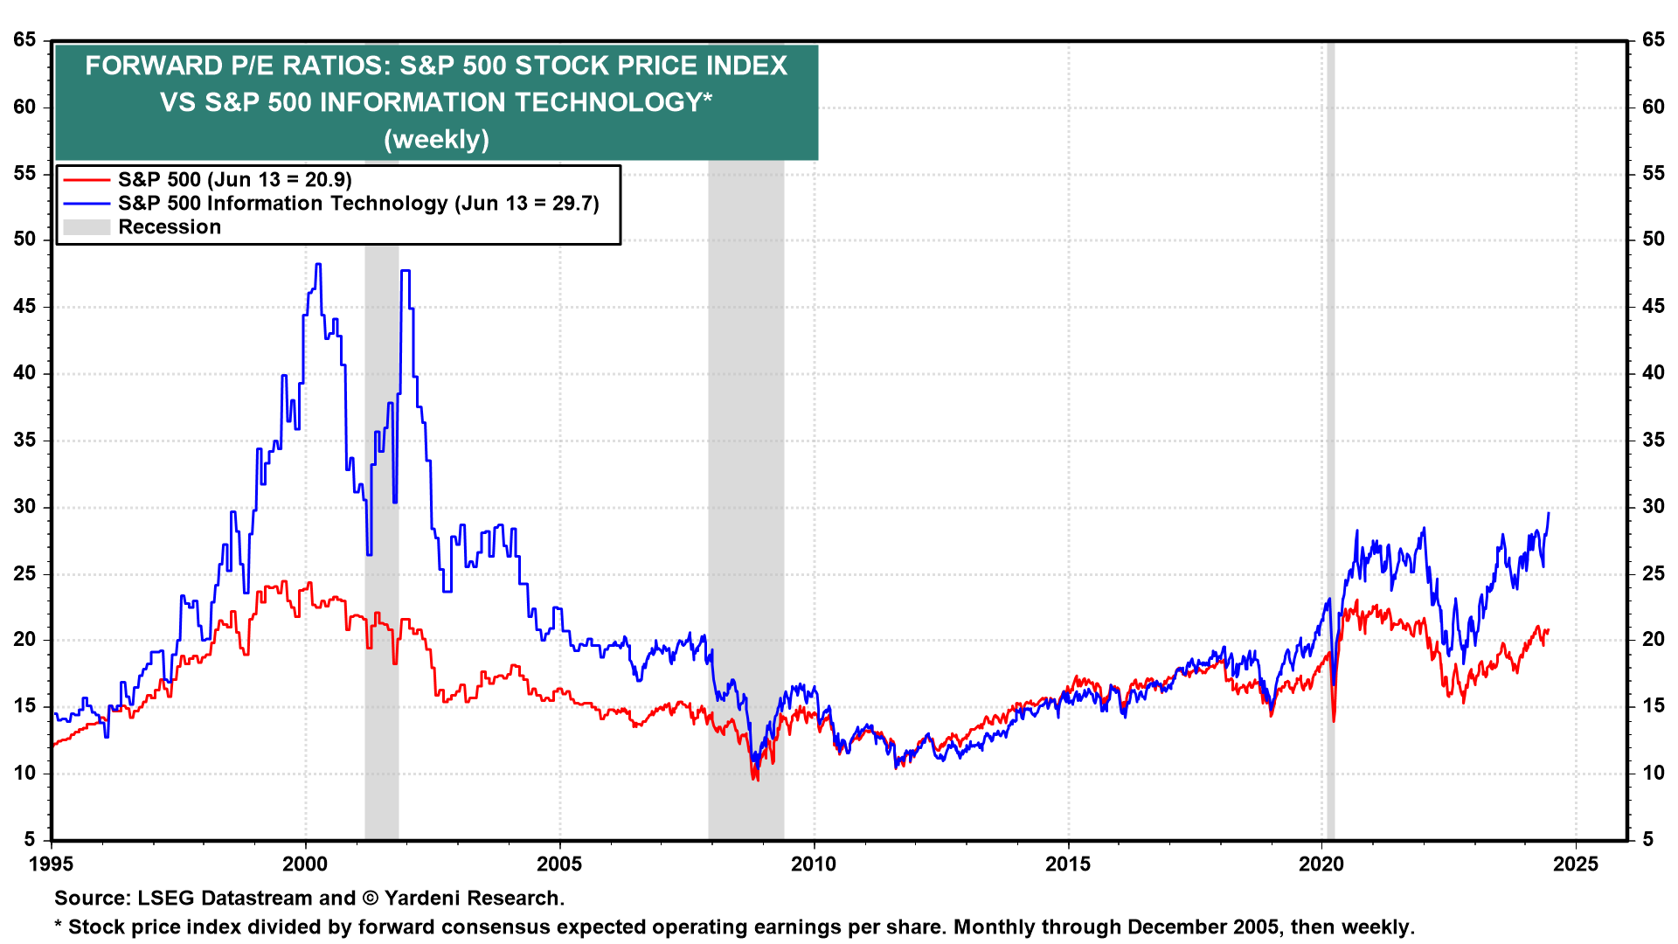
Valuation Analysis – Cont.
INFORMATION TECHNOLOGY SECTOR ANALYSIS

Slide 30
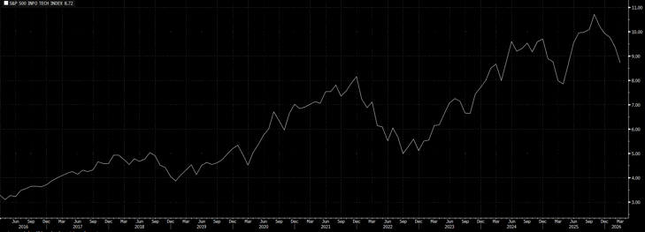
Valuation Analysis – P/S 10Y Graph
Growth Overtime In Price to Sales
INFORMATION TECHNOLOGY SECTOR ANALYSIS
Source(s): Bloomberg

Slide 31
Valuation Analysis – State Of The Market Relative To S&P 500
Relative to SP500 | High | Low | Average | Current | % Up from Average
P/E | 1.7349 | 0.9392 | 1.2423 | 1.4284 | 14.98%
P/B | 2.6868 | 1.411 | 2.0639 | 2.4649 | 19.42%
P/S | 3.3863 | 1.6965 | 2.3296 | 2.8799 | 23.62%
P/EBITDA | 2.055 | 1.0843 | 1.4536 | 1.6642 | 14.49%
Tech continues to trade at a premium relative to the S&P 500 across all major valuation metrics
Current multiples are above historical relative averages, but not at extreme levels
Premium reflects strong earnings growth, AI-driven demand, and higher margins
Suggests valuation remains elevated, but supported by fundamentals
INFORMATION TECHNOLOGY SECTOR ANALYSIS
Source(s): Bloomberg

Slide 32
Valuation Analysis – State Of 3 Info Tech Stocks Inside ‘MAG7’
Ticker | P/E | P/S | P/B
NVDA | 48.5797 | 25.0490 | 39.2437
AAPL | 34.2905 | 9.2057 | 51.3198
MSFT | 33.9527 | 12.1329 | 9.8182
Nvidia trades at the highest multiples, reflecting strong AI-driven growth expectations
Microsoft is in line with sector averages, supported by stable earnings and cloud growth
Apple trades at a lower multiple relative to peers, reflecting a more mature growth profile
Valuation differences highlight varying growth expectations across the sector
INFORMATION TECHNOLOGY SECTOR ANALYSIS
Source(s): Bloomberg

Slide 33
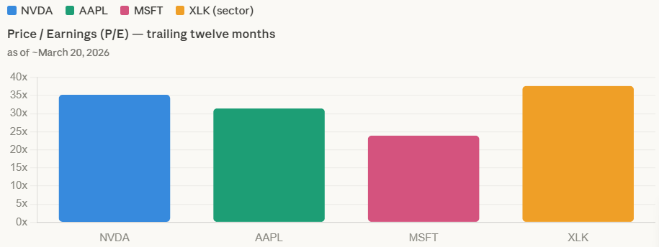
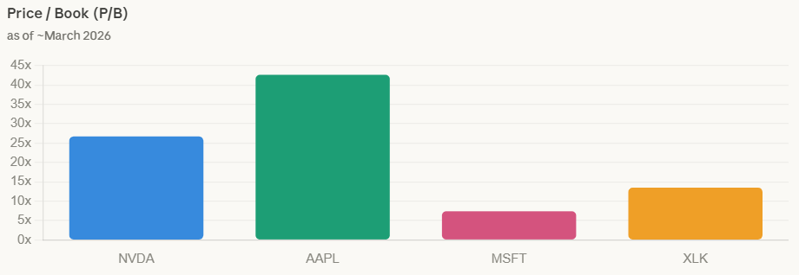
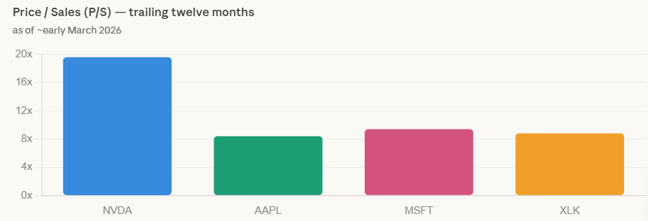
Valuation Analysis – State Of 3 Info Tech Stocks Inside ‘MAG7’ Compared To Info Tech Sector
INFORMATION TECHNOLOGY SECTOR ANALYSIS

Slide 34
Agenda
Page
Overview
1
Business Analysis
2
Economic Analysis
7
Financial Analysis
19
Valuation Analysis
20
Recommendation
26
INFORMATION TECHNOLOGY SECTOR ANALYSIS

Slide 35
Risks That Affect Our Recommendation
Risk Assessment Matrix
Most Important Risks
Ch | Risk Name | Priority
 | Big tech carries too much weight
 | Tech valuations compress sharply
 | Semiconductor demand weakens unexpectedly
 | New regs. hurt profits
 | Businesses cut tech spend
 | Cyberattacks
 | Chip demand slowing
Very likely
1
Very high
2
High
Probability
4
2
3
3
High
Possible
4
Medium
Unlikely
6
7
5
1
5
Medium
6
Low
INFORMATION TECHNOLOGY SECTOR ANALYSIS
Marginal
Serious
Major
Catastrophic
Impact
7
Low

Slide 36





Our Recommendation
SELL
UNDERWEIGHT
HOLD
OVERWEIGHT
BUY
BEARISH
BULLISH
Strong sell
Moderate sell
Weak hold
Underperform
Reduce
Neutral
Moderate buy
Accumulate
Outperform
Add
Strong buy
INFORMATION TECHNOLOGY SECTOR ANALYSIS
Class vote?

Slide 37
Fish
Coll
Of
Thank You
Questions?
Busi

