Slide 1
HEALTHCARE SECTOR
LLY
Stock Recommendations
UNH
SIM Portfolio Review | Q2 2026
MDT
COR
PRESENTED BY
Connor Williamson · Joseph Wiegand · Haojun Wang
Michala Wings · Jiahang Zhou
GEHC
APRIL 2026

Slide 2
SECTOR OVERVIEW
Current Holdings & Recommendations
SECTOR RECAP
PORTFOLIO HOLDINGS
Market-Weight Healthcare
TICKER
COMPANY
RATING
PRIMARY CATALYST
Current weight: 9.27% vs. S&P 9.49% (slight underweight)
Defensive demand profile with secular tailwinds from aging demographics and GLP-1 adoption
Policy overhang from CMS rate decisions and drug pricing reform
Rotate within; add pharma/medtech exposure, trim insurer
LLY
Eli Lilly & Co.
GLP-1 pipeline expansion
BUY
UNH
UnitedHealth Group
Peak valuation / downside risk
SELL
MDT
Medtronic plc
Hugo robotics ramp
BUY
Cencora Inc.
Specialty distribution
COR
HOLD
GEHC
GE HealthCare Technologies
AI driven digital solutions
BUY
OSU SIM | Healthcare Sector | Q2 2026
2

Slide 3
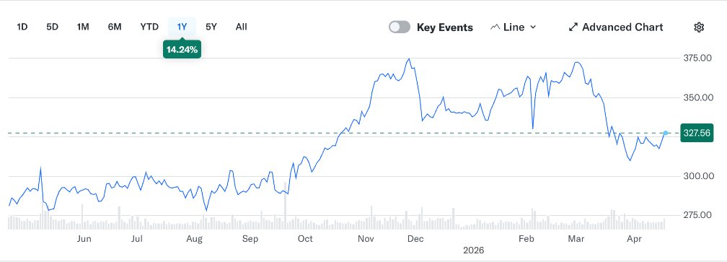
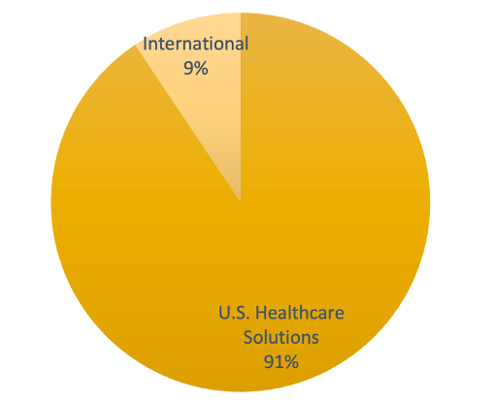
COR
Cencora Inc.
CURRENT PRICE
TARGET / UPSIDE
RECOMMENDATION
$327.56
$399.07
HOLD
NYSE: COR
As of 4/17/2026
+21.8% upside
Absolute Basis | High | Low | Average | Current
P/E | 44.41 | 24.41 | 34.15 | 44.41
P/B | 148.91 | 27.43 | 63.34 | 45.60
P/S | 0.21 | 0.15 | 0.18 | 0.21
P/EBITDA | 19.24 | 12.19 | 16.14 | 19.24
REVENUE FORECAST (3-YEAR)
(dollars in thousands) | FY 2027E | FY 2026E | FY 2025A
Consensus | $362,685,000 | $341,279,000 | $321,333,000
Revenue | $362,678,785 | $341,280,498 | $321,326,145
% Growth | 6.27% | 6.21% | 9.31%
Operating Income | $4,569,753 | $4,129,494 | $2,313,548
Net Income | $3,277,311 | $2,923,136 | $1,560,488
FY2025
FY2026E
FY2027E
Business​
Pharmaceutical distribution ​
Defensive demand ​
U.S. dominant business ​
Growth Drivers​
Specialty pharmaceuticals ​
Physician-service expansion ​
Valuation​
P/E ~44x (above peers) ​
Growth already priced in ​
REVENUE EPS FORECAST (3-YEAR)
RISKS
EPS | FY 2027E | FY 2026E | FY 2025A
Basic | $16.81 | $14.99 | $7.99
Diluted | $16.66 | $14.86 | $7.92
Consensus – GAAP | $16.75 | $14.92 | $7.96
OSU SIM | Healthcare Sector | Q2 2026
3

Slide 4
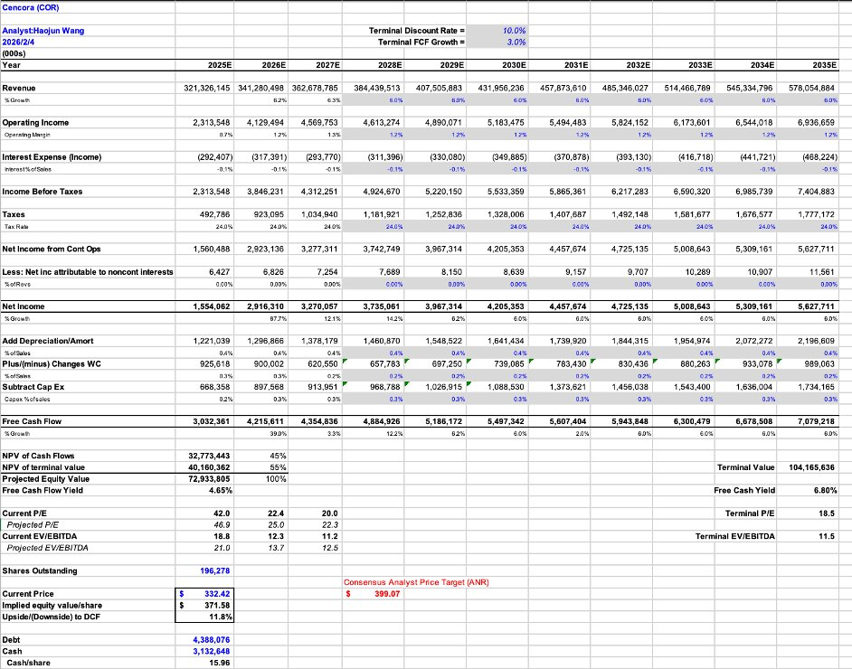
COR
Cencora Inc.
CURRENT PRICE
TARGET / UPSIDE
RECOMMENDATION
$327.56
$399.07
HOLD
NYSE: COR
As of 4/17/2026
+21.8% upside
DCF VALUATION
IMPLIED PRICE PER SHARE
$399.07
+21.8% vs. current
SIM POSITION
CURRENT WEIGHT
MARKET VALUE
1.50%
$147.6K
RECOMMENDATION
TARGET WEIGHT
HOLD
1.50%
SIM Portfolio Position & Recommendation
Shares Held | 470
Current Price | $314.14
Market Value | $147,645.80
Current Weight | ~150 bps
S&P 500 COR Weight | ~15 bps
Recommendation | HOLD
Target Weight | ~150 bps
Target Price | $399.07
Expected Return | 21.8%
OSU SIM | Healthcare Sector | Q2 2026
4

Slide 5
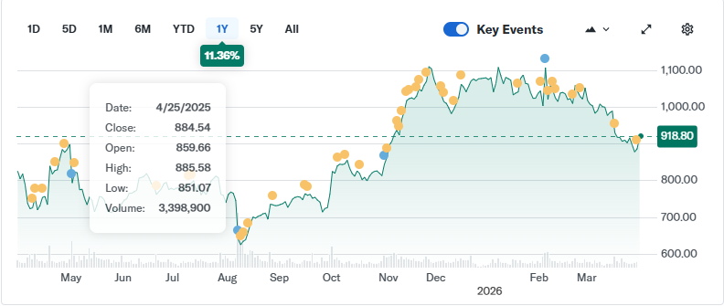
LLY
Eli Lilly & Co.
CURRENT PRICE
TARGET / UPSIDE
RECOMMENDATION
$903.02
$1076.44
BUY
NYSE: LLY
As of 3/24/2026
19.2% upside
Absolute Basis | High | Low | Average | Current
P/E | 228.32 | 13.57 | 54.47 | 52.07
P/B | 65.30 | 4.79 | 31.35 | 40.03
P/S | 22.74 | 3.45 | 6.61 | 16.13
P/EBITDA | 70.8 | 10.5 | 28.5 | 38.2
REVENUE FORECAST (3-YEAR)
Business​
Discovers, develops, and markets pharmaceutical drugs globally
Defensive demand ​
U.S. dominant business ​
Growth Drivers​
Strategic Partnerships and Acquisitions
Manufacturing Moat
GLP-1 Market Leadership​
Valuation​
P/E ~43.2x (above peers) ​
Growth already priced in ​
(dollars in thousands) | FY 2027E | FY 2026E | FY 2025A
Consensus | $91,540,000 | $78,400,000
Revenue | $89,947,000 | $78,215,000 | $65,179,000
% Growth | 15% | 20% | 45%
Operating Income | $44,524,000 | $38,716,000 | $26,373,000
Net Income | $34,027,000 | $29,589,000 | $20,640,000
CATALYSTS
REVENUE EPS FORECAST (3-YEAR)
EPS | FY 2027E | FY 2026E | FY 2025A
Basic | $38.00 | $33.05 | $22.95
Diluted | $37.98 | $33.03 | $22.95
Consensus – GAAP | $25.46 | $31.53
OSU SIM | Healthcare Sector | Q2 2026
5

Slide 6
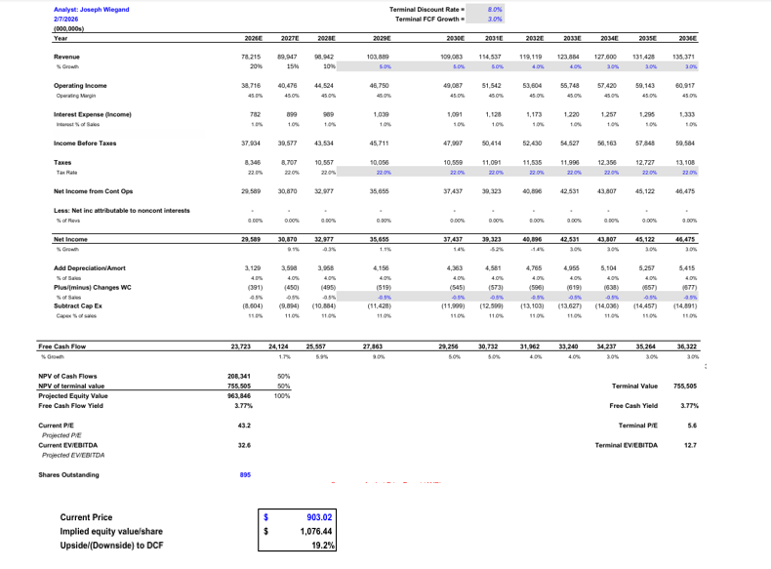
LLY
Eli Lilly & Co.
CURRENT PRICE
TARGET / UPSIDE
RECOMMENDATION
$903.02
$1,076.44
BUY
NYSE: LLY
As of 3/24/2026
19.2% upside
DCF VALUATION
IMPLIED PRICE PER SHARE
$ 1,076.44
19.2 % vs. current
SIM POSITION
CURRENT WEIGHT
MARKET VALUE
4.20%
$413.9K
RECOMMENDATION
TARGET WEIGHT
BUY 30 bps
4.5%
Shares Held | 450
Current Price | $903.02
Market Value | $413,896.50
Current Weight | ~420 bps
S&P 500 LLY Weight | ~125 bps
Recommendation | Buy
Target Weight | ~150 bps
Target Price | $1076.44
Expected Return | 19.2%
OSU SIM | Healthcare Sector | Q2 2026
6

Slide 7
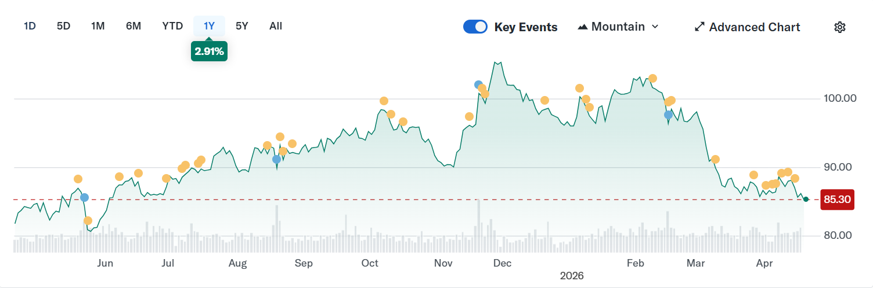
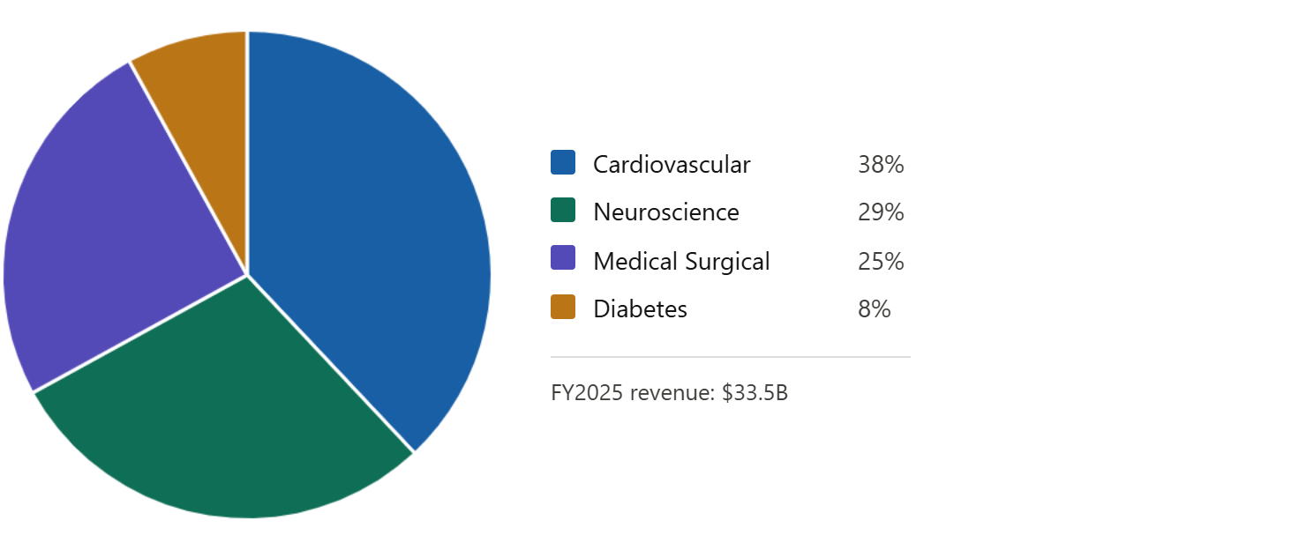
MDT
Medtronic plc
CURRENT PRICE
TARGET / UPSIDE
RECOMMENDATION
$85.00
$130.21
BUY
NYSE: MDT
As of 4/20/2026
+53.2% upside
Business​
Global leader in medical devices/healthcare​
4 segments: Cardiovascular, Neuroscience, Medical Surgical, Diabetes​
$33.5B FY25 Revenue, 90k employees, 150+ countries​
Growth Drivers ​
PulseSelect/Affera- CAS grew about 80% YoY
Hugo RAS U.S. launch + renal denervation (Symplicity Spyral)​
MiniMed diabetes IPO/spin-off unlocks multiple re-rating ​
Valuation​
DCF target: $​130.21
P/E near 5-year lows, valuation re-rating underway
Pipeline catalysts largely priced in post-rally​
REVENUE FORECAST (3-YEAR)
(dollars in millions) | FY 2027E | FY 2026E | FY 2025A
Consensus | $38,130 | $36,050 | $33,540
Revenue | $38,130 | $36,050 | $33,540
% Growth | 6% | 7.0% | 4.0%
Operating Income | $18,850 | $16,100 | $15,230
Net Income | $7,281 | $6,590 | $4,662
FY2025
FY2026E
FY2027E
REVENUE EPS FORECAST (3-YEAR)
EPS | FY 2027E | FY 2026E | FY 2025A
Basic | $6.16 | $5.70 | $5.53
Diluted | $6.12 | $5.65 | $5.49
Consensus – GAAP | $6.12 | $5.65 | $5.49
Absolute Basis | High | Low | Average | Current
P/E | 58.94 | 16.34 | 24.90 | 15.0
P/B | 3.53 | 1.79 | 2.45 | 2.2
P/S | 6.33 | 2.89 | 4.07 | 3.0
P/EBITDA | 15.66 | 9.86 | 12.66 | 12.0
OSU SIM | Healthcare Sector | Q2 2026
7

Slide 8
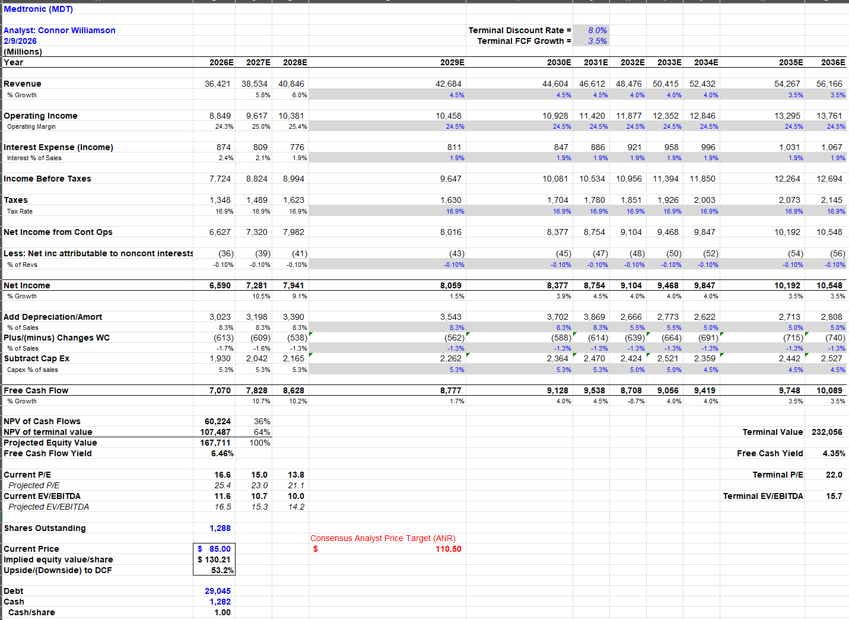
MDT
Medtronic plc
CURRENT PRICE
TARGET / UPSIDE
RECOMMENDATION
$85.00
$130.21
BUY
NYSE: MDT
As of 4/20/2026
+53.2% upside
DCF VALUATION
IMPLIED PRICE PER SHARE
$130.21
53.2% vs. current
SIM POSITION
CURRENT WEIGHT
MARKET VALUE
1.95% (~195 bps)
$188,700 (2,220 shares x $85)
RECOMMENDATION
TARGET WEIGHT
BUY 50 bps
~2.45% (245 bps)
Shares Held | 2,220
Current Price | $85.00
Market Value | $188,700
Current Weight | ~195 bps
S&P 500 MDT Weight | ~20 bps
Recommendation | BUY 50 bps
Target Weight | ~245 bps
Target Price | $130.21
Expected Return | +53.2%
RISKS
OSU SIM | Healthcare Sector | Q2 2026
8

Slide 9
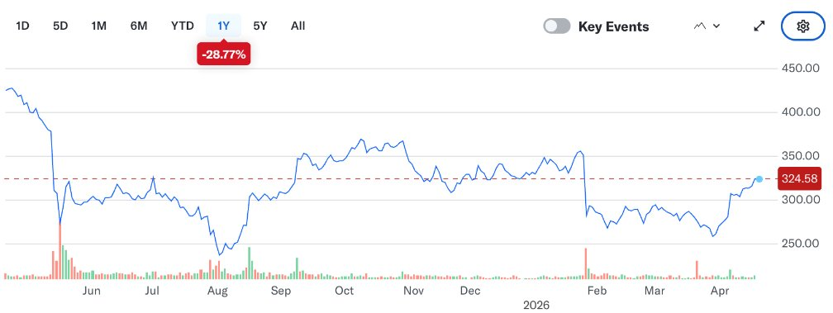
UNH
UnitedHealth Group Inc.
CURRENT PRICE
TARGET / UPSIDE
RECOMMENDATION
$323.48
$263.82
SELL
NYSE: UNH
As of 4/20/2026
-18.6% downside
Business​
Largest U.S. health insurer​
Dual platform: UnitedHealthcare +Optum​
$447.6B FY2025 revenue​
Growth Drivers ​
Aging population / MA tailwind​
Optum analytics & PBM expansion​
2.48% MA rate increase (2027)​
Valuation​
DCF target: $263.82/share​
P/E ~24.5x (near historical peak)​
Growth headwinds priced in late​
REVENUE FORECAST (3-YEAR)
(dollars in millions) | FY 2027E | FY 2026E | FY 2025A
Consensus | $486,200 | $464,800 | $447,600
Revenue | $478,500 | $453,200 | $447,640
% Growth | 5.6% | 1.2% | –2.2%
Operating Income | $18,850 | $16,100 | $15,230
Net Income | $16,240 | $13,860 | $14,990
FY2025
FY2026E
FY2027E
Absolute Basis | High | Low | Average | Current
P/E | 24.75 | 12.40 | 18.80 | 24.53
P/B | 12.60 | 4.20 | 7.90 | 11.80
P/S | 1.85 | 0.30 | 0.95 | 0.66
P/EBITDA | 16.05 | 6.50 | 11.20 | 16.05
REVENUE EPS FORECAST (3-YEAR)
EPS | FY 2027E | FY 2026E | FY 2025A
Basic | $18.80 | $15.40 | $16.35
Diluted | $18.60 | $15.20 | $16.15
Consensus – GAAP | $20.10 | $17.30 | $16.35
OSU SIM | Healthcare Sector | Q2 2026
9

Slide 10
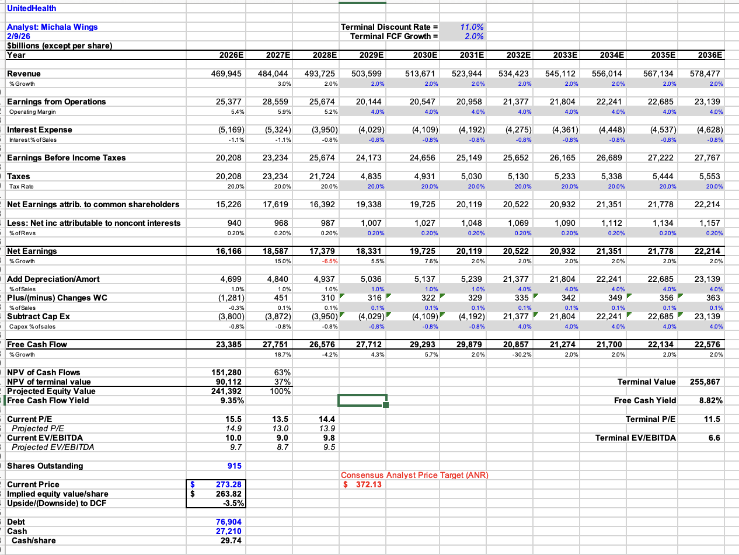
UNH
UnitedHealth Group Inc.
CURRENT PRICE
TARGET / UPSIDE
RECOMMENDATION
$323.48
$263.82
SELL
NYSE: UNH
As of 4/20/2026
-18.6% downside
DCF VALUATION
IMPLIED PRICE PER SHARE
$263.82
-18.6% vs. current
SIM POSITION
CURRENT WEIGHT
MARKET VALUE
1.62%
$159.6kK
RECOMMENDATION
TARGET WEIGHT
Sell
0.62% - closer to market
SIM Portfolio Position & Recommendation
Shares Held | 590
Current Price | $324.00
Market Value | $191,160
Current Weight | ~190 bps
S&P 500 UNH Weight | ~64 bps
Recommendation | SELL 100 bps
Target Weight | ~90 bps (≈ benchmark)
Target Price | $263.82
Expected Return | –15.9%
RISKS
OSU SIM | Healthcare Sector | Q2 2026
10

Slide 11
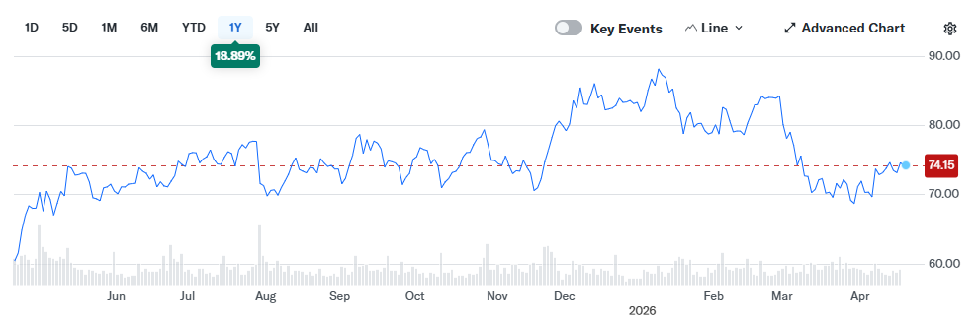
GEHC
GE HealthCare Technologies
CURRENT PRICE
TARGET / UPSIDE
RECOMMENDATION
$74.15
$95.94
BUY
NASDAQ: GEHC
As of 4/20/2026
+29.39% upside
Business​
Medtech with focus in imaging and visualization
30%+ market share in imaging industry
Sells services and consumables that pairs with equipment
Growth Drivers ​
Aging demographic
AI-enabled productivity solutions
Emerging markets
Valuation​
P/E ~15.26 (value)
Beat EPS and Revenue for 4 quarters
REVENUE FORECAST (3-YEAR)
(dollars in millions) | FY 2027E | FY 2026E | FY 2025A
Consensus | $22,592 | $21,606 | $20,524
Revenue | $23,536 | $21,450 | $20,625
% Growth | 3.0% | 3.8% | 4.8%
Operating Income | $18,850 | $16,100 | $15,230
Net Income | $2,464 | $2,226 | $2,083
Absolute Basis | High | Low | Average | Current
P/E | 26.26 | 11.34 | 17.99 | 15.26
P/B | 5.99 | 1.52 | 4.37 | 3.26
P/S | 2.19 | 1.36 | 1.82 | 1.64
P/EBITDA | 14.02 | 8.07 | 11.22 | 9.94
Revenue EPS Forecast (3-YEAR)
RISKS
EPS | FY 2027E | FY 2026E | FY 2025A
Basic | $5.55 | $5.02 | $4.56
Diluted | $5.52 | $5.00 | $4.55
Consensus – GAAP | $5.57 | $5.02 | $4.55
OSU SIM | Healthcare Sector | Q2 2026
11

Slide 12
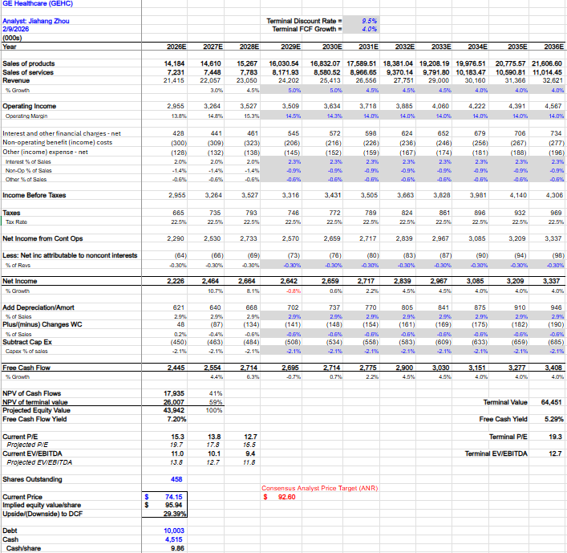
GEHC
GE HealthCare Technologies
CURRENT PRICE
TARGET / UPSIDE
RECOMMENDATION
$74.15
$95.94
BUY
NASDAQ: GEHC
As of 4/20/2026
+29.39% upside
DCF VALUATION
IMPLIED PRICE PER SHARE
$95.94
+29.39% vs. current
SIM POSITION
CURRENT WEIGHT
MARKET VALUE
0%
$0.0
RECOMMENDATION
TARGET WEIGHT
Buy
0.50%
SIM Portfolio Position & Recommendation
Shares Held | 0
Current Price | $74.15
Market Value | $0
Current Weight | 0 bps
S&P 500 GEHC Weight | 5 bps
Recommendation | BUY 50 bps
Target Weight | 50 bps
Target Price | $95.94
Expected Return | 29.39%
RISKS
OSU SIM | Healthcare Sector | Q2 2026
12

Slide 13
FINAL RECOMMENDATION
Portfolio Actions & Target Returns
TICKER
COMPANY
PRICE
TARGET
CURRENT WT.
ACTION
NEW WT.
Δ (BPS)
EXP. RETURN
LLY
Eli Lilly
$903.02
$1,076.44
4.20%
BUY
4.50%
+30
+19.2%
UNH
UnitedHealth
$323.48
$263.82
1.62%
SELL
0.62%
-100
-15.9%
MDT
Medtronic
$85.00
$130.21
1.95%
BUY
2.45%
+50
+53.2%
COR
Cencora
$327.56
$399.07
1.50%
HOLD
1.50%
—
+21.8%
GEHC
GE HealthCare
$74.15
$95.94
0.00%
BUY
0.50%
+50
+29.39%
SUMMARY
Current sector weight: 9.27% (slight underweight vs. S&P 9.49%)
Action: SELL UNH (−100 bps); BUY MDT (+50), GEHC (+50), LLY (+30) · Funding: UNH proceeds + cash
Thesis: Trim UNH to benchmark; add to pharma (LLY), devices (MDT), and imaging (GEHC)
OSU SIM | Healthcare Sector | Q2 2026
13

Slide 14
QUESTIONS & DISCUSSION
Thank you.
OSU Student Investment Management | Healthcare Sector Team | Q2 2026

