Slide 1


Healthcare Sector
Joseph Wiegand, Connor Williamson, Haojun Wang, Michala Wings, and Jiahang Zhou

Slide 2






Agenda
01
Overview
02
Business Analysis
03
Economic Analysis
04
Financial Analysis
05
Valuation Analysis
06
Recommendation
2 / 22

Slide 3



Healthcare Sector Size & Weights
10%
~9.3%
$7.083T
SIM Weight
S&P Weight
Market Cap
1139 Companies Total in the Sector
59 Companies in the S&P 500
~ .5% decrease in S&P Weight in the past month
3 / 22

Slide 4





Industries Within the Sector
Pharmaceuticals
Medical Devices
Drug discovery, development, and commercialization
Surgical instruments, implants, diagnostics
Biotechnology
Healthcare Services
Biologic therapies, gene editing, immunology
Hospitals, clinics, lab services, distribution
Health Care Insurance
Managed care, Medicare Advantage, PBMs
4 / 22

Slide 5
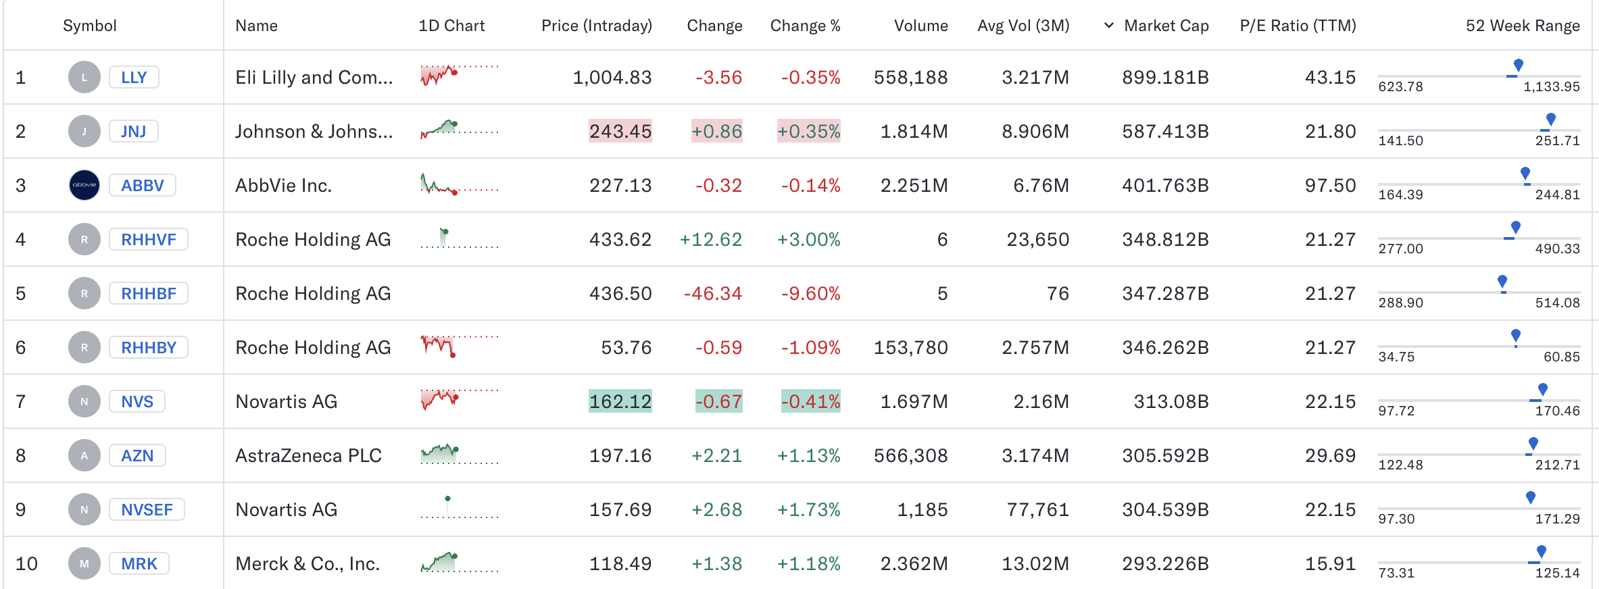
Largest Companies
Source: Yahoo Finance
5 / 22

Slide 6
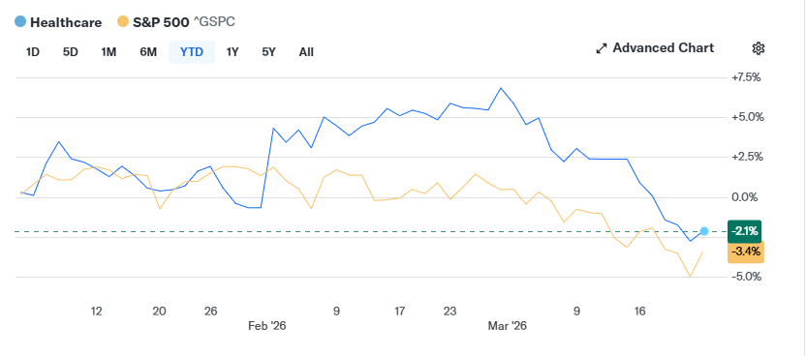
Sector Performance
Year-to-Date
6 / 22

Slide 7
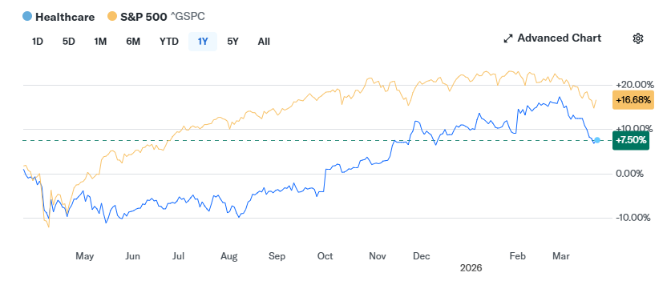
Sector Performance
1-Year Return
7/ 22

Slide 8

Demand Analysis
Life Cycle Phase
Mature with growth pockets in AI diagnostics, weight-loss drugs, and biotechnology. Total U.S. healthcare spending is projected to reach $7.7T by 2032, growing ~5.6% annually.
Business Cycle Classification
Healthcare is defensive, and demand is inelastic; people need healthcare regardless of economic conditions.
Sensitivity to US/Global Economy
The healthcare sector has low domestic sensitivity and moderate global exposure. U.S. government programs fund ~45% of all healthcare spending. International FX and emerging-market risk.
8/ 22

Slide 9
External Factors & Demographics
Aging Population
Geography
Medicare enrollment is expanding by ~3M annually
Adults 65+ consume 3x more healthcare per capita
Chronic disease is a demand engine for pharma and devices
U.S. dominates ~43% of global healthcare spending, but emerging international markets are growing 8-12% annually
Uneven domestic utilization
ACA / Policy Environment
Consumer Trends
Pricing headwinds for pharma through IRA
Medicaid expansion covers ~24M additional Americans
Medicaid cuts over 10 years show downside risk
GLP-1 drugs are reshaping demand for the sector
Telehealth has stabilized outpatient visits post-COVID
Consumer preference is moving toward lower-cost generics/biosimilars
9/ 22

Slide 10

Supply Analysis
Pipeline Capacity
7,000+ drugs in active clinical development, catalysts being GLP-1s, Next-gen oncology, Alzheimer's therapies. Pipeline breadth at historic highs
FDA Approvals
55 approvals in 2023 and 50 in 2022 (around ~60% of oncology approvals) vs. ~42/year 10-year average. Faster time-to-market through breakthrough & accelerated approval, key catalysts: obesity, oncology, and rare disease drugs
New Entrants
High barriers: cost & development timeline, increasing biosimilar competition (50+ approved in U.S), and venture-funded biotech in niche markets
Generic Competition
$200B+ in drugs facing patent expiration (2025-2030), Loss of exclusivity drugs, paragraph IV challenges accelerating generic entry, and increases pressure on branded drug pricing
10/ 22

Slide 11
Profitability & Competitive Dynamics
Porter's Five Forces Snapshot
Threat of New Entrants
Low:
High R&D costs, regulation, and brand barriers
Supplier Power
Competitive Rivalry
Buyer Power
Medium:
Specialized suppliers/CROs have leverage, offset by vertical integration
High:
-Patent races, pipeline competition, and pricing pressure
High:
Medicare, Medicaid, and PBMs drive pricing power, while IRA increases leverage
Threat of Substitutes
Medium:
Generics, biosimilars, and alternative therapies
11 / 22

Slide 12
Macro Correlations
Key Economic Drivers
Defensive Characteristics
Healthcare demand is largely non-cyclical and price inelastic
Sector remains resilient during economic downturns
Government spending (Medicare/Medicaid) provides stability
Historically outperforms or declines less during recessions
GDP Growth
Employment Trends
Interest Rates
Inflation / CPI
12 / 22

Slide 13
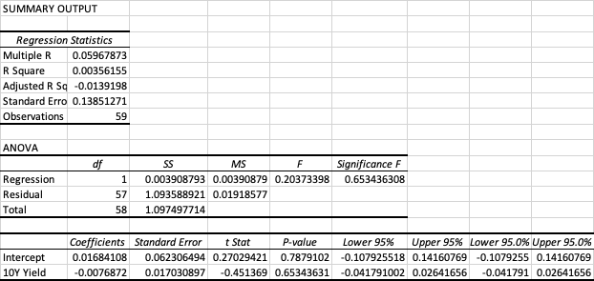
Regression Analysis
Weak relationship between interest rates and healthcare returns
13 / 22

Slide 14
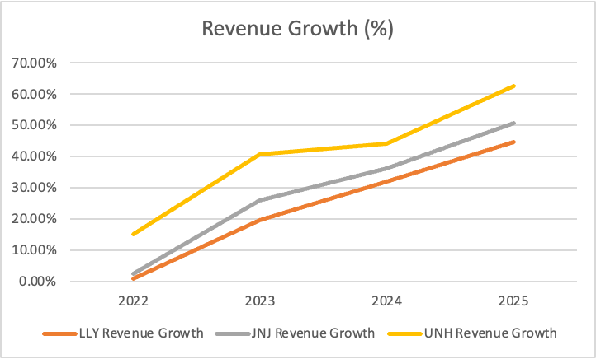
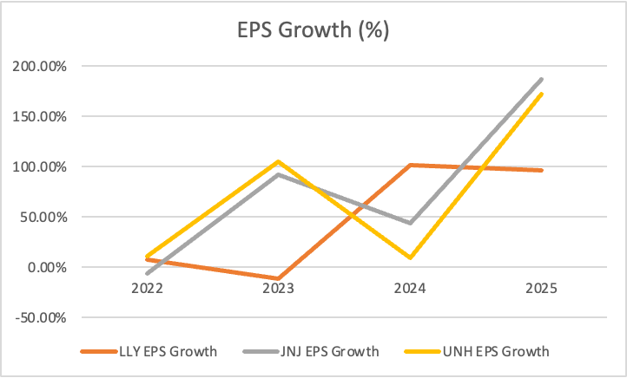
Revenue & Earnings Growth
Key Takeaways: Revenue growth is relatively stable across major firms, reflecting consistent demand in the healthcare sector. In contrast, EPS growth is much more volatile, driven by differences in cost structures and product cycles. Overall, the sector demonstrates steady demand but uneven profitability across companies.
14 / 22

Slide 15
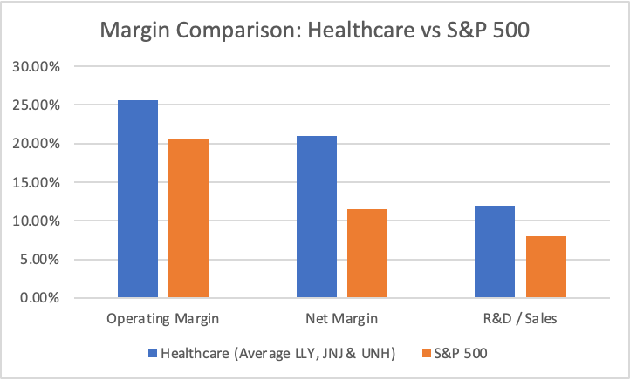
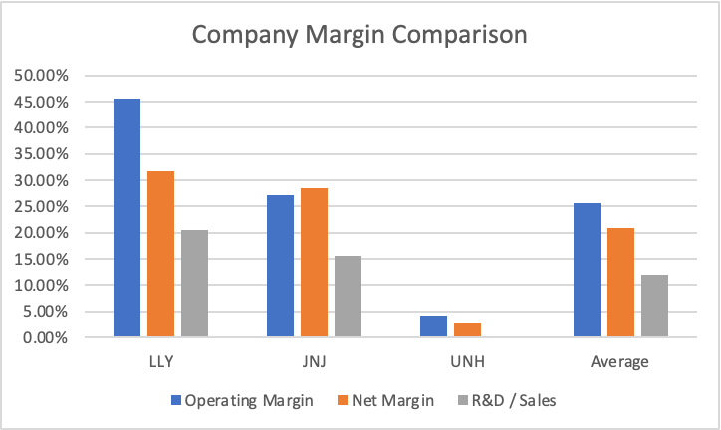
Margin & Profitability
Operating Margin
Net Margin
R&D / Sales
25.66%
20.94%
12.01%
vs. S&P: 20.53%
vs. S&P: 11.46%
vs. S&P: 7.95%
15/ 22

Slide 16

Cash Flow & Returns
Free Cash Flow
Return on Equity
Healthcare companies are strong free cash flow generators, supported by stable demand and high margins.
Healthcare firms generally exhibit strong ROE, driven by high profitability and efficient capital usage.
16 / 22

Slide 17
Valuation Multiples
Multiple | Healthcare Sector | S&P 500 | Discount
P/E | [20.76] | [27.34] | [-24.07%]
P/S | [1.59] | [3.39] | [-53.10%]
P/B | [5.13] | [5.47] | [-6.22%]
P/CF | [19.27] | [21.81] | [-11.65%]
Multiple | 5 Year Average (Healthcare) | 5 Year Average (S&P 500) | Average Premium/Discount
P/E | [21.73] | [24.16] | [-10.08%]
P/S | [1.77] | [2.88] | [-38.68%]
P/B | [5.05] | [4.76] | [+5.96%]
P/CF | [18.12] | [18.55] | [-2.34%]
17 / 22

Slide 18
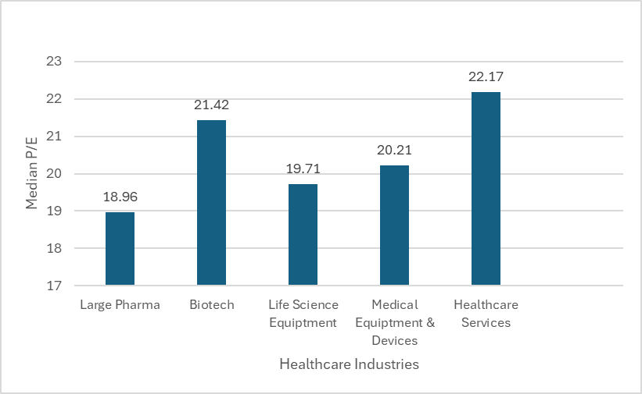
Valuation Dispersion
18 / 22

Slide 19
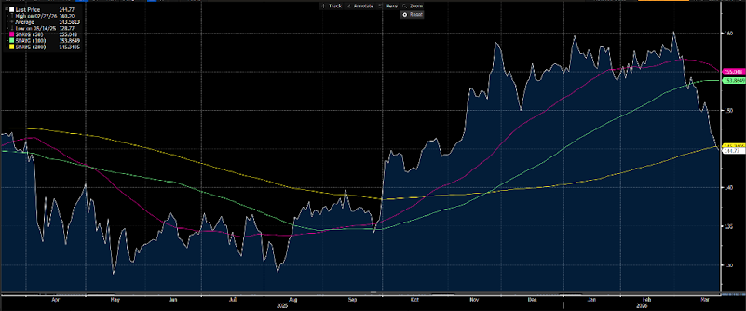
Technical Analysis
Health Care Sector
Last Price: 1689.40
High on 02/27/26: 1864.30
Average: 1671.94
Low on 05/14/25: 1500.21
SMAVG (50): 1805.51
SMAVG (100): 1791.66
SMAVG (200): 1692.44
19 / 22

Slide 20
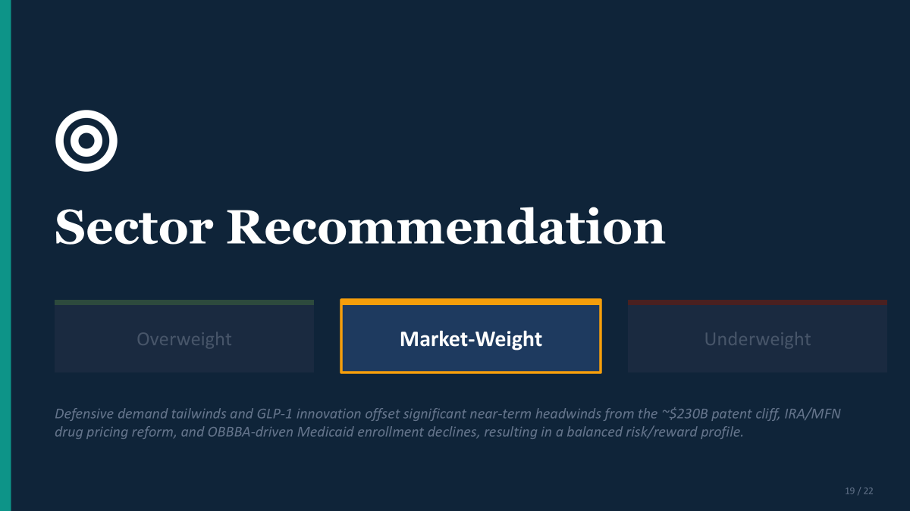

Sector Recommendation
Overweight
Market-Weight
Underweight
[Circle or highlight your recommendation. Provide brief rationale below.]
19 / 22

Slide 21


Positives & Risks
Bull Case Drivers
Key Risks
Aging demographics: Baby Boomers enrolling in Medicare through 2029 drive durable, non-discretionary demand for chronic care and specialty drugs
Innovation pipeline: GLP-1 obesity/diabetes therapies, gene editing platforms, and AI-driven drug discovery are expanding addressable markets
Defensive characteristics: Inelastic demand and government-backed spending (Medicare/Medicaid) provide earnings resilience through economic downturns
M&A tailwind: ~$1.4T in biopharma cash/debt capacity fueling acquisitions to backfill patent losses, benefiting small/mid-cap biotech targets
Unprecedented patent cliff: ~$230B in annual drug sales face generic/biosimilar entry by 2030, with Eliquis, Keytruda, and Ozempic among the most exposed
Drug pricing pressure: IRA Medicare negotiations now live (10 drugs in 2026, 15 in 2027), plus MFN executive orders targeting U.S. price premiums
Policy headwinds: OBBBA Medicaid cuts projected to reduce enrollment and worsen payer mix; ACA subsidy expiration could add millions of uninsured
Binary biotech risk: Clinical trial failures, FDA regulatory uncertainty, and narrow IPO windows constrain capital access for smaller companies
21 / 22

Slide 22
Industry Over/Underweights
Which sub-industries to favor and avoid within healthcare?
Sub-Industry | View | Rationale
Pharmaceuticals | MW | Manageable IRA pricing impact offset by GLP-1 growth; strong FCF but major patent cliffs ahead limit upside
Biotechnology | UW | Constrained capital markets, narrow IPO window, and binary clinical trial risk; high-reward but elevated downside
Life Science Equipment | OW | Cyclical recovery in lab budgets and biopharma R&D spending; Thermo Fisher, Danaher, and Agilent well-positioned for tools demand upturn
Medical Devices | OW | Resilient demand from aging population and surgical volume recovery; less exposed to drug pricing reform
Healthcare Services | MW | Fragile hospital margins, labor cost inflation, and payer mix deterioration from Medicaid disenrollment
22 / 22

Slide 23

Thank You
Healthcare Sector — The Ohio State University
Questions?

