Slide 1
S&P 500 FINANCIALS
Company Presentation
BUSFIN 4228 | Student Investment Management
Prepared By: Jay Thankappan • Luke Taylor • Sid Sehgal • Kyle Sprenger • Hasan Siddiqui
April 2026
The Ohio State University • Fisher College of Business

Slide 2
Sector Recap & Macro Update
SLIGHT OVERWEIGHT
SIM Weight: 14.37%
S&P 500: 12.51% | +187 bps OW
XLF YTD: -10%
Worst S&P 500 sector in 2026
Maintained from March 2026
Fed Funds Rate: 3.50–3.75%
Higher-for-longer supports bank NII; shallow easing path prevents margin compression
Yield Curve Steepening
10Y at ~4.29%; supports bank NIM expansion; deposit betas remain manageable
Geopolitical Risk Elevated
Iran war tensions, oil disruptions; Dimon flagged stagflationary risk in annual letter (Apr 7)
Bank Earnings Season Imminent
JPM reports Apr 14, BAC Apr 15, V & PYPL Apr 28 - key catalysts for sector re-rating
XLF Technical Setup
Death cross in effect, but RSI near oversold (~30); last time this occurred (Apr 2025), XLF rallied 20%+

Slide 3
Current Holdings & Proposed Trades
Stock | Analyst | Price (Report) | Price (Today) | Current Weight | Rec | Proposed Weight | Δ bps | Target Price | Upside
JPM | Kyle S. | $283 | $308 | 472 | HOLD | 472 | 0 | $345 | +12.0%
BAC | Sid S. | $49 | $52 | 391 | TRIM | 291 | -100 | $79 | +52.3%
V | Jay T. | $296 | $306 | 298 | HOLD | 298 | 0 | $380 | +24.2%
PYPL | Luke T. | $45 | $46 | 92 | BUY | 142 | +50 | $66 | +38.5%
GPN | Hasan S. | $66 | $66 | 186 | BUY | 236 | +50 | $115 | +74.2%
Trade Summary
TRIM BAC -100 bps
Take profit on a +65% gain from cost basis ($31.42 → $52); lowest ROTCE among holdings (~10% vs JPM 20%)
ADD GPN +50 bps | ADD PYPL +50 bps
Reallocate to the two highest-upside names trading near 52-week lows with compelling valuation dislocations
Net effect: Total Financials weight unchanged at ~1,438 bps (OW +187 bps vs S&P)

Slide 4



Global Payments (GPN) - Business Transformation
$66
$115
4.8x
$3.7T
BUY
Current Price
Target Price
Fwd P/E
Annual Volume
Near 52-wk low ($62.45)
+74.2% upside
vs peers 13-30x
Post-Worldpay
Worldpay Acquisition
Genius POS + AI
Valuation Dislocation
Closed Jan 2026 for $24.25B. GPN is now the world's largest pure-play merchant acquirer. Divested Issuer Solutions to FIS for $7.7B. Identified $600M in synergies over 3 years.
Next-gen cloud POS system driving 5.5% SMB volume growth. AI-powered fraud detection. Expanding to Ireland and Spain in 2026. IRS selected Link2Gov as preferred digital tax payments provider.
Trading at historic low 4.8x fwd P/E vs peer avg of 13-30x. Market over-discounting integration risk. Consensus analyst PT $96 (+46% upside). 2026 guidance: adj EPS $13.80-$14.00 (+13-15% YoY).

Slide 5
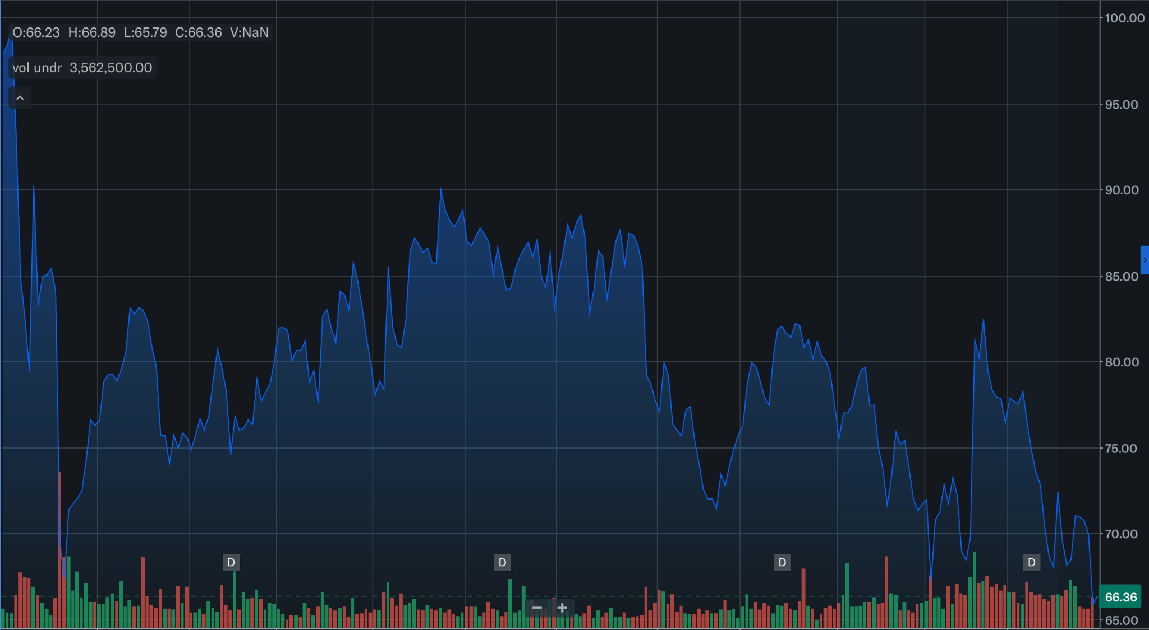

GPN - Valuation & DCF Summary
DCF Summary
WACC | 10.0%
Terminal Growth | 4.0%
PV of FCFs | $16,271M
PV of Terminal Value | $11,210M
Projected Equity Value | $27,625M
Implied Price/Share | $116.71
Upside from $66 | +76.3%
Valuation Method | Implied Price | Upside
DCF (WACC 10%, TGR 4%) | $116.71 | +77%
Current P/E × FY26E EPS | $86.18 | +31%
Current EV/EBITDA × FY26E | $84.50 | +28%
Consensus Analyst Target | $96.33 | +46%
Our Target Price | $115.00 | +74%
Key Risks
Integration Risk: Worldpay is a massive acquisition; integration challenges could delay synergy realization | Competition: Cloud-native processors (Adyen, Stripe) are gaining share in enterprise segments | Macro: Consumer spending slowdown would directly reduce merchant transaction volumes

Slide 6
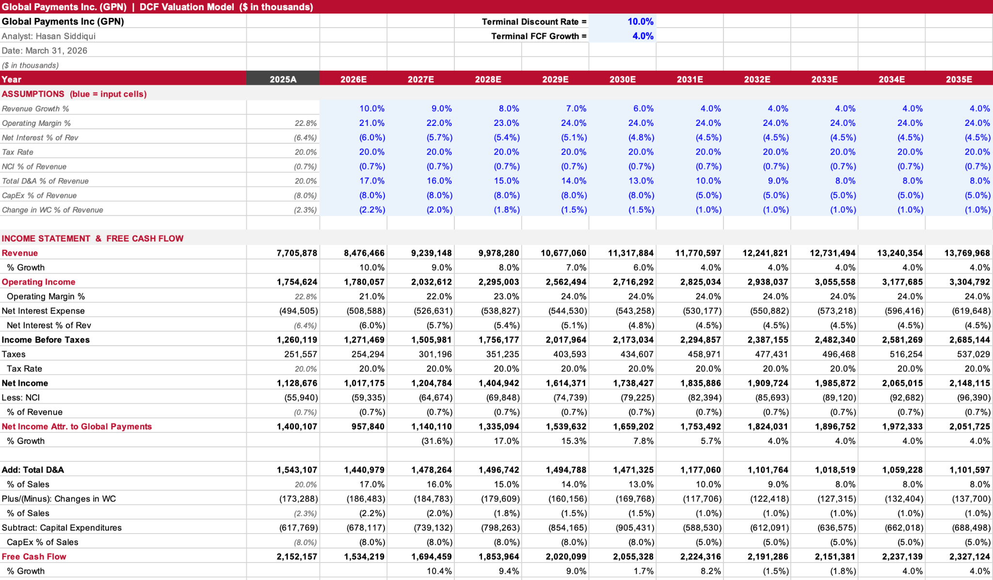
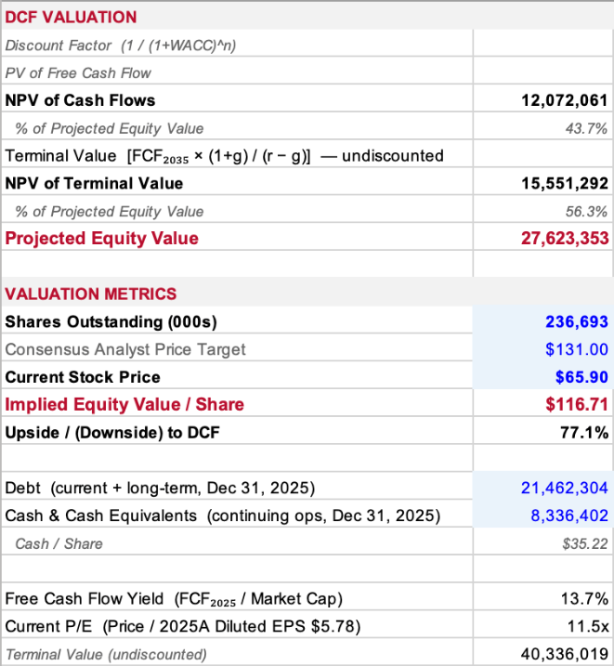
Global Payments (GPN) Appendix

Slide 7


PayPal (PYPL)
$46
$66.21
8.3x
44.1%
BUY
Current Price
DCF Target
P/E (TTM)
Market Share
Near 52-wk low ($38.46)
+38.5% upside
vs peer avg 33x
#1 in online payments
Massive Undervaluation
Dominant Market Position
Catalysts & Optionality
P/E of 8.3x vs peer avg 33x. EV/EBITDA of 6.5x vs avg 18x. Every valuation metric screams undervaluation. DCF at $66.21, consensus at $63. Significant margin of safety with support at ~$40.
439M active users. $1.79T total payment volume in 2025. Active in 200+ countries. 25.4B transactions. PYUSD stablecoin expanded to 70 markets. Canva integration launched Apr 9.
Stripe acquisition rumor (Bloomberg, Feb 24) signals franchise value. New CEO Enrique Lores could drive strategic clarity. Earnings Apr 28. $2.5% revenue CAGR even in conservative DCF yields 46% upside.

Slide 8
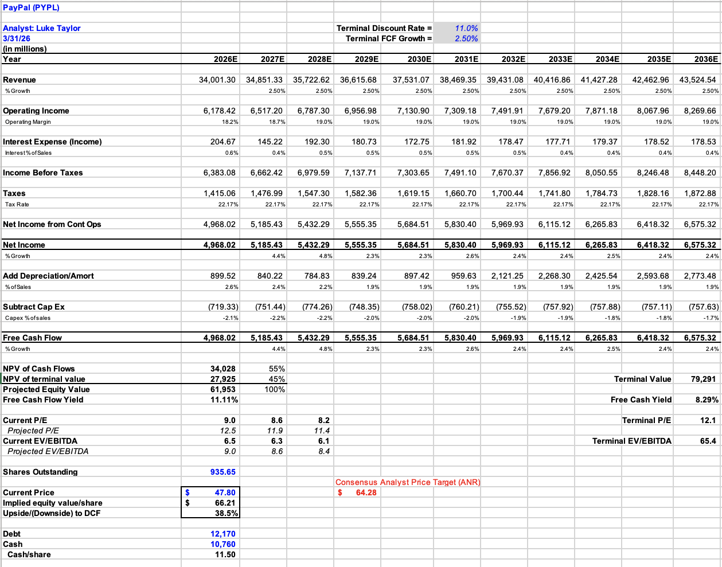
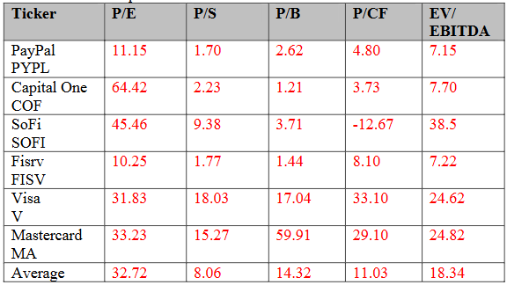
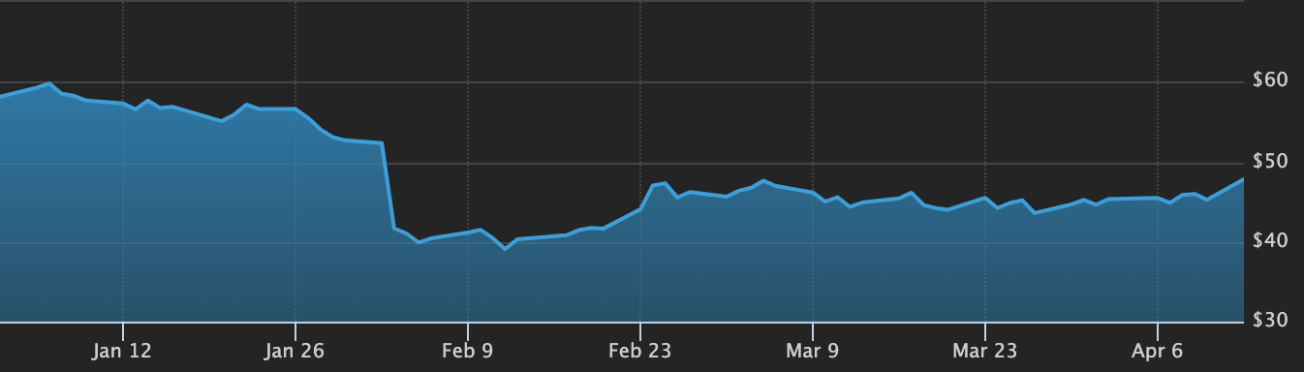
PayPal (PYPL) Appendix

Slide 9
Bank of America (BAC) - Rationale for Trim
TRIM
Why We're Trimming -100 bps
Why We're Not Selling Entirely
Profit-Taking: +65% gain from cost basis ($31.42 → $52). Taking partial profits into Q1 earnings (Apr 15).
Lower ROTCE: ~10% ROTCE vs JPM's 20%. Less differentiated franchise among large-cap banks. Efficiency ratio ~58% vs JPM 48.5%.
NII Headwinds: BAC is more asset-sensitive than JPM. If rates decline further, NII compression disproportionately affects BAC.
Capital Reallocation: Proceeds fund higher-conviction, higher-upside positions in GPN (+74%) and PYPL (+44%).
DCF Upside: Sid's DCF implies $79.18/share (+52% upside). Morningstar fair value estimate of $88.
Improving Fundamentals: NII growing as deposit betas stabilize. CashPro app usage +20% YoY. Consumer balance sheets remain healthy.
Earnings Catalyst: Q1 reports Apr 15. Consensus EPS $0.99 (+10% YoY). If results surprise, remaining 291 bps position participates.
Retain 291 bps: Still our 3rd-largest Financials position. Trim, don't exit - preserves optionality if thesis improves.

Slide 10
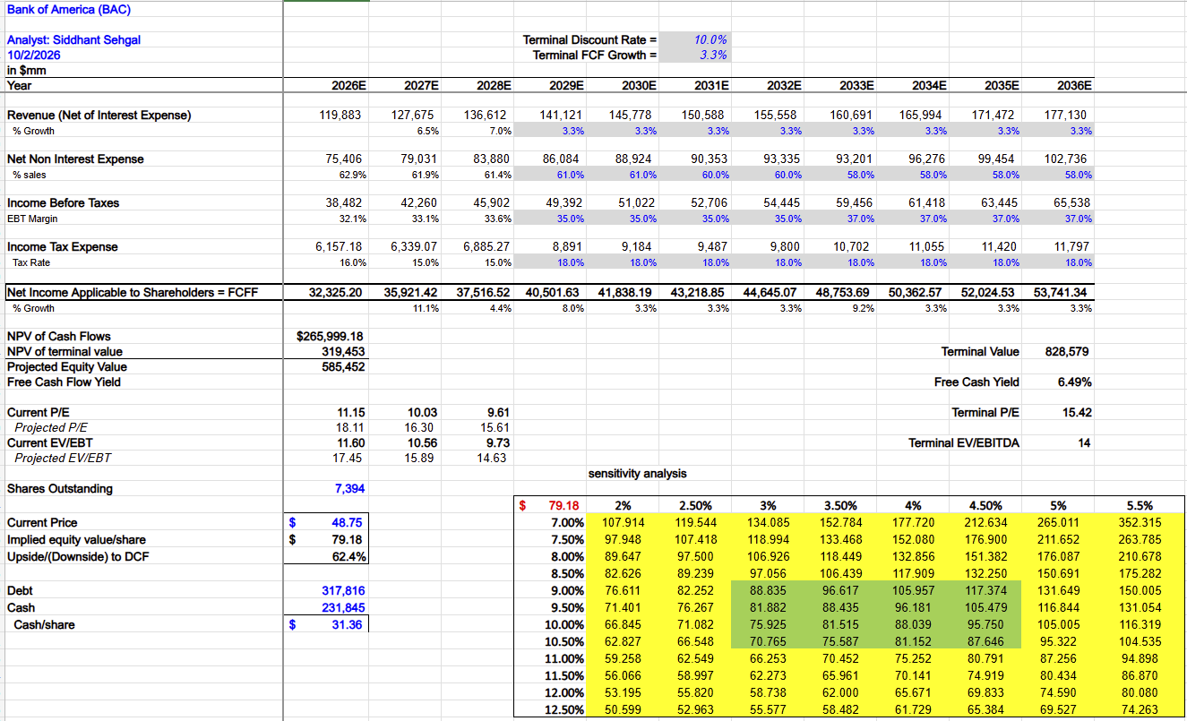
Bank of America (BAC) - Appendix

Slide 11
Comparative Valuation - All Holdings
Metric | JPM | BAC | V | PYPL | GPN | S&P 500
P/E (TTM) | 14.7x | 12.1x | 27.7x | 8.3x | 10.8x | 21.6x
EV/EBITDA | N/A* | N/A* | 26.0x | 6.5x | 10.3x | 15.3x
P/B or P/TBV | 2.66x | 1.55x | 17.0x | 2.62x | 0.83x | ~4.5x
ROE / ROTCE | 20% | ~10% | 52% | 25.7% | ~7% | ~18%
Div. Yield | 2.1% | 2.4% | 0.9% | 1.2% | 1.6% | 1.3%
YTD Return | -9% | -8% | -18% | -42% | -12% | -5%
Our Target | $345 | $79 | $380 | $66 | $115 | -
Expected Return | +12% | +52% | +24% | +38% | +74% | -
*Banks: EV/EBITDA not applicable for financial institutions; P/TBV is the primary balance-sheet metric for banks.
Key Insight: PYPL and GPN trade at extreme valuation discounts to peers and to their own historical averages - the primary catalyst for our add recommendations.

Slide 12
FINAL RECOMMENDATION
Financials Sector • Slight Overweight • April 2026
Stock | Price | Curr. Wt (bps) | Rec | Prop. Wt (bps) | Δ bps | Target | Exp. Return | Primary Catalyst
JPM | $308 | 472 | HOLD | 472 | 0 | $345 | +12% | IB fee recovery + Apple Card
BAC | $52 | 391 | TRIM | 291 | -100 | $79 | +52% | Take profit; lower ROTCE
V | $306 | 298 | HOLD | 298 | 0 | $380 | +24% | Cash→digital + VAS 28%
PYPL | $46 | 92 | BUY | 142 | +50 | $66 | +38% | 44% mkt share, deep discount
GPN | $66 | 186 | BUY | 236 | +50 | $115 | +74% | Worldpay + 4.8x fwd P/E
TOTAL |  | 1,438 |  | 1,438 | Net 0 |  |  | OW +187 bps vs S&P
Key Risks
1. Recession / GDP slowdown reducing transaction volumes and credit losses
2. Rapid Fed cuts compressing bank NII faster than expected
3. GPN Worldpay integration risk; PYPL CEO transition uncertainty
4. FinTech / stablecoin disruption; regulatory changes (credit card caps, Basel III)
BUSFIN 4228 • Student Investment Management • April 2026

Slide 13
Appendix A - DCF Summary for All Holdings
DCF Parameter | JPM | BAC | V | PYPL | GPN
Terminal Disc. Rate | 10.0% | 10.0% | 8.5% | 11.0% | 10.0%
Terminal FCF Growth | 3.0% | 3.3% | 3.5% | 2.5% | 4.0%
NPV of Cash Flows | $491.0B | $266.0B | $229.4B | $34.0B | $16.3B
NPV of Terminal Value | $547.2B | $319.5B | $389.0B | $27.9B | $11.2B
Projected Equity Value | $1,038B | $585B | $610B | $62.0B | $27.6B
Shares Outstanding | 2,782M | 7,394M | 1,966M | 936M | 237M
Implied Value/Share | $373.21 | $79.18 | $314.52 | $66.21 | $116.71
Upside to DCF | +21% | +52% | +3% | +38% | +77%
Consensus ANR PT | $328 | N/A | $397 | $63 | $96
Valuation Method | P/TBV + DDM (primary) | DCF (10-yr) | DCF + Rel. Multiples | DCF (10-yr) | DCF + P/E + EV/EBITDA

Slide 14
Appendix B - DuPont ROE Decomposition
Component | JPM | BAC | V | PYPL | GPN
Net Profit Margin | 35.5% | 27.0% | 50.1% | 15.8% | 18.2%
Asset Turnover | 0.047x | 0.028x | 0.45x | 0.42x | 0.12x
Equity Multiplier | 12.1x | 13.0x | 2.3x | 3.9x | 3.2x
= ROE | ~20% | ~10% | ~52% | ~26% | ~7%
ROTCE (banks only) | 20% | ~10% | N/A | N/A | N/A
Efficiency Ratio | 48.5% | ~58% | N/A | 81.7% | ~77%
JPM vs BAC
JPM's ROE lead (20% vs 10%) is driven by superior net profit margin (35.5% vs 27.0%), reflecting its 48.5% efficiency ratio vs BAC's ~58%. On similar leverage, JPM earns roughly 2x the return per dollar of equity - this justifies the P/TBV premium and our trim of BAC.
Visa - Quality Compounder
V's 52% ROE comes from an industry-leading 50.1% net margin on minimal leverage (2.3x). The asset-light model generates exceptional returns without balance sheet risk - validating the premium multiple and our HOLD.
PYPL & GPN - Re-Rating Candidates
PYPL's 26% ROE at 8x P/E is a disconnect - the market prices it as if returns will deteriorate, but operating leverage could expand margins. GPN's 7% ROE reflects Worldpay drag; as synergies drive margins from 21% → 23%+ and asset turns improve, ROE should rise to 10-12%, supporting P/E re-rating from 4.8x toward 8-10x.

Slide 15
Appendix C - Technical Analysis: Action Names
GPN
BUY +50 bps
PYPL
BUY +50 bps
BAC
TRIM -100 bps
Current: $66
Current: $46
Current: $52
Support & Resistance
Support & Resistance
Support & Resistance
Support: $62.45 (52-wk low) → $58
Resistance: $75 → $82 → $91 (52-wk hi)
Support: $40 (psychological) → $38.46 (52-wk low)
Resistance: $50 → $55 → $60 (Q4 gap)
Support: $48 (breakout level) → $45 (200-DMA)
Resistance: $53.50 → $57 (52-wk hi) → $60
Technical Indicators
Technical Indicators
Technical Indicators
RSI(14): ~38, near oversold
50-DMA: ~$68 (below)
200-DMA: ~$78 (well below)
Volume rising on down days
RSI(14): ~35, near oversold
50-DMA: ~$47 (below)
200-DMA: ~$58 (well below)
Death cross late Jan 2026
RSI(14): ~48, neutral
50-DMA: ~$50 (above)
200-DMA: ~$49 (above)
No distribution pattern
Assessment
Assessment
Assessment
BEARISH near-term but at support floor. Favorable entry for fundamental buyers.
BEARISH technically. Support at $40 limits downside to ~13%; upside 44%. Asymmetric risk/reward.
NEUTRAL technically. Consolidating in $48-$54 range. Trim into relative strength ahead of Apr 15 earnings.

