Slide 2
Energy Presentation Summary
Team Introduction
3
Size Of The Energy Sector (Within The S&P 500)
4
Financial Analysis Snapshot & Main Verticals
5
Energy Sector YTD Vs. 1-Year Index Performance
6
Companies Driving Returns In The Energy Sector
7
Business Analysis
8
Economic Analysis
9
Valuation Analysis
10

Slide 3






SP26 Energy Sector Team Introductions
Drew Lohchab
MBA
Elijah Douglass
Senior
Matt Erdman
Senior
Maria Gogin
Senior
Cody Goodnight
Junior
Nate Gray
Senior

Slide 4
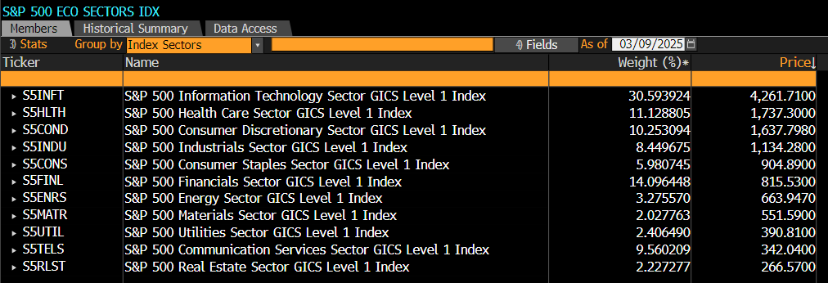
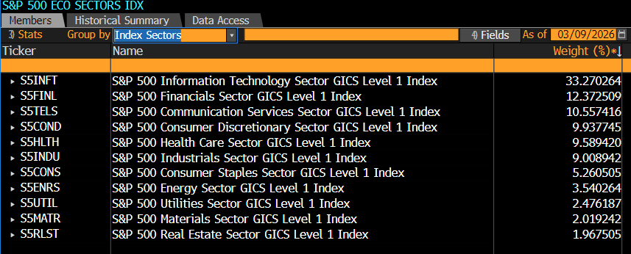
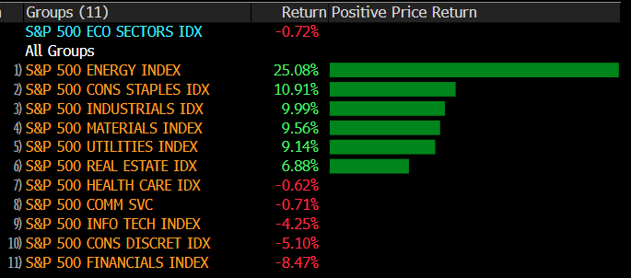
Energy Market Overview (Size Of S&P 500)
Energy stocks have been at the forefront of global markets since 2026, driven by geopolitical risks and price fluctuations

Slide 5

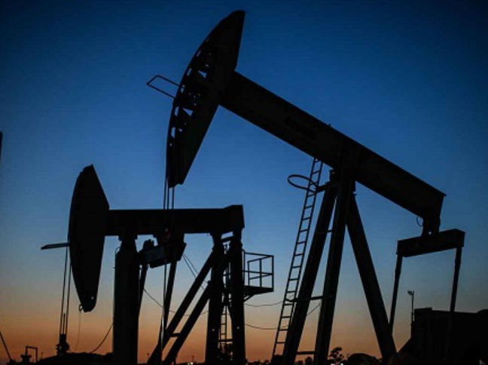
Financial Analysis Snapshot & Main Verticals
Oil, Gas And Consumable Fuels
Energy Equipment And Services
20.20x
P/E Ratio
$209B
Enterprise Value
$0.26
EPS
18.57x
Total Debt-To-Equity
4.15%
Revenue Growth
3.60%
Dividend Yield

Slide 6
Energy Sector YTD Vs. 1-Year Index Performance
Energy stocks have driven S&P 500 (total) returns in 2025 & 2026, primarily driven by volatility in Oil prices, strong earnings growth and increases in refining activity
Year-To-Date (QTD) Total Return Performance – Index Value
+ 25.08%
YTD Performance
1-Year Total Return Performance – Index Value
+ 36.75%
YTD Performance

Slide 7







Companies Driving Returns In The Energy Sector
U.S. refineries have driven returns since January 2026, riding the tailwinds from U.S. foreign policy associated with seizing sanctioned oil
U.S. LNG producers have also provided attractive returns as alternatives to traditional Oil & Gas refineries, giving additional conviction in the strength of the sector
Barrel prices ripping over ~$100 due to closure of Port of Hormuz signaling a continuance of strong sector performance due to an increase in demand paired with large supply constraints
2025 saw strong top & bottom line growth driven by increase in demand and strong domestic policy around energy, overall oil prices remained less volatile in 2025, however energy companies have seen above average growth
Margins remain steady with most of the sector generating strong cash flow, however Capex and D&A are a huge component as these business are extremely capital intensive

Slide 8
Business Analysis
Profitability and Pricing
External Factors that Influence Demand
Both profitability and pricing are directly tied to global supply and demand.
Product Segmentation:
Upstream – exploration and production of oil and gas
Midstream – transportation, storage, and processing infrastructure
Downstream – refining and distribution of petroleum products
Oilfield services – drilling and support services
Geopolitical events: current wars and trade disputes
Government regulation: Climate policies, emissions standards
Technological advancements: Electric vehicles, renewable energy
Energy security: countries prioritizing domestic energy production
Weather patterns: heating and cooling demand influence consumption
Phase of Industry Life Cycle
Mature
Classification by Business Cycle
Highly Cyclical
Users and Geography
Transportation, industrial, electricity, heating
Substitutions
Solar, Wind, Hydro, Nuclear
Barriers to Entry
Very High
Input - Output
Critical input for every industry

Slide 9
Economic Analysis
Energy stocks have driven S&P 500 (total) returns in 2025 & 2026, primarily driven by volatility in Oil prices, strong earnings growth and increases in refining activity
Volatile Oil Prices Are Leading To A Surge In Uncertainty Around Energy Affordability
Trailing 1-year Performance WTI Spot Vs. S&P 500 Total Energy Returns
Crude oil prices are nearing 3-year highs as geopolitical tensions in the Middle East continue to rise
  G7 spokespeople have signaled that the International Energy Agency is looking to release ~300 – 400M barrels of oil from reserves to ease global energy prices⁽¹⁾
While WTI / Brent Crude spot prices are surging, pushing average gasoline pump prices to $3.48 per gallon
  This could cause larger macro uncertainty from a consumer spending perspective, along with heightened risk of stagflation – risking the Fed to keep rates steady
While oil prices remain elevated, refineries and producers have driven sector returns and S&P 500 returns, suggesting heavy tailwinds to follow

Slide 10
Sector Valuation Analysis
Energy companies in the U.S. remain at heightened valuations from a relative perspective, while underlying fundamentals may disagree
Multiples Comparison Chart
Why Valuations Differ
Metric
Energy Sector
S&P 500
Energy Earnings are cyclical and linked to oil prices
Industry demands large capital
Long term uncertainty due to possible energy transition
P/E
20.2x
27.2x
Cody
EV/EBITDA
6.5x
13.5x
P/CF
7.5x
16.1x
Subsector Differences
Valuation Outlook
Upstream (E&P)
Midstream
Integrated Majors
Multiples Expanded Post COVID as high oil prices boost cash flow
Sector still trades at a discount to market
Valuation will remain below market but stable due to increased capital discipline
Sensitive to Oil Prices changes
Earnings Volatility
Pipeline and Infrastructure
Stable Fee based revenue
Diversified Operations across value chain
Large Scale with Dividend payout

Slide 11
Our Team’s Recommendation
The SIM fund should be overweight energy stocks, while assets and commodities remain very volatile, easing tensions in the Middle East, along with new commitments from OPEC+ and strategic releases of barrels from G7 countries, there are strong indicators that oil / LNG will continue to aid their supporting firms to maintain attractive valuations
Theme | Favorable / Uncertain
Business Analysis | Favorable
Financial Analysis | Favorable
Economic / Macroeconomic Analysis | Uncertain
Sector Valuation | Favorable
News | Uncertain
Our Recommendation: Overweight

Slide 12
Notes:
We will tally on the board or something

