Slide 1
Consumer Staples
By: Eric Cid Valdez, John Corr, Cullen Brown, Anthony Calleri, Ting An Chen
Notes:
Good evening, everyone. My name is Eric, and this is John, Cullen, Anthony, and Ting, and today we’ll be giving our analysis on the consumer staples sector.
Eric

Slide 2
Agenda
Overview
Business Analysis
Economic Analysis
Financial Analysis
Valuation Analysis
Recommendation/Class Vote
Notes:
This is our agenda for today. We’ll first go over a sector overview, then we’ll look at the business analysis, and following that, we’ll dive into the economic analysis. Afterwards, we’ll talk about our financial analysis and finish it off with our valuation analysis to conclude with a recommendation/class vote.
Eric

Slide 3
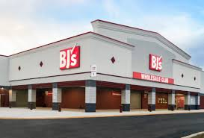
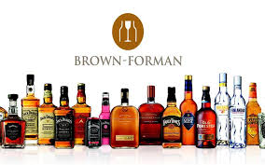

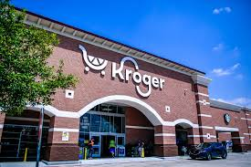
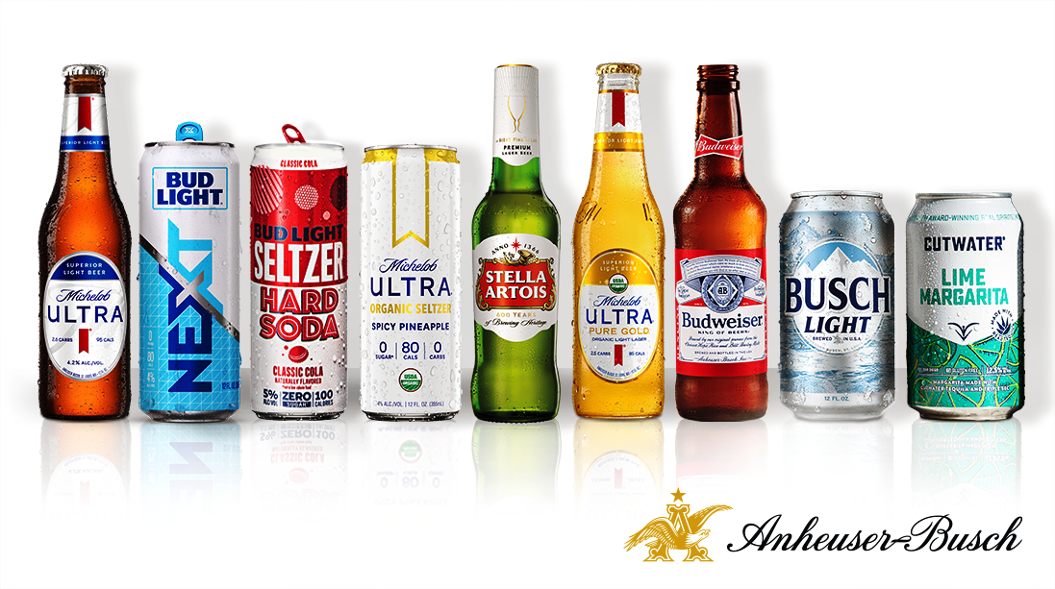
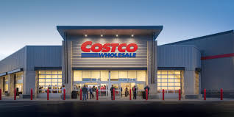

Sector Overview
Consumer Staples: Essential products within the food, beverages, tobacco, personal products, and household goods industries that are considered non-cyclical due to constant demand (lower sensitivity to market fluctuations), steady growth, and consistent dividends.
Notes:
To start, I’d like to define consumer staples. Consumer staples are essential products within the food, tobacco, personal care, and household industries. On the slide, you can see I put some recognizable companies, including some that we ourselves analyzed for our discounted cash flow models, like Target and Brown Forman. The stocks in this section are characterized as non-cyclical (constant demand), steady growth, low sensitivity to market fluctuations, and have consistent dividends.
Eric
Largest Companies in the Sector

Slide 4
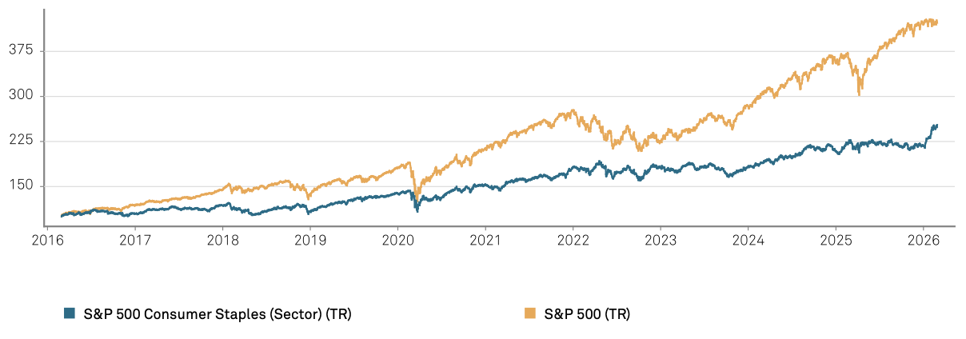
Sector Size
Number of stocks in S&P 500: 36 (5.43% weight of S&P 500)
Market Capitalization: $3.75 Trillion
Average Stock Market Capitalization: $104.20 Billion
Average Dividend: 2.76%
1 MO | 3 MO | YTD | 1 YR | 3YR | 5 YR | 10 YR
7.92% | 14.20% | 16.18% | 11.16% | 12.10% | 11.09% | 8.82%
Notes:
To get a better glimpse of the sector, this slide shows the comparison between the consumer staples sector and the S&P 500, along with the total net returns it has produced over several investment horizons. Breaking down the sector within the S&P 500, currently, there are 36 stocks in the S&P 500 (7.16%), and it has a market capitalization of $3.75 Trillion. Looking at some important averages that are consistent with the previous statements about the characteristics of consumer staples stocks, we can see the average market cap is $104.20 Billion and the average dividend yield is 2.76%. And now I’ll now pass it on to John to talk about the business analysis.
Eric
Total Net Returns

Slide 5
Business Analysis
Demand
Mature, non-cyclical sector with stable demand
Consumers buy food and household products regardless of economic conditions
Population growth and demographic trends support long-term demand
Supply
High barriers to entry
Walmart, Costco, and Amazon have strong buyer power
Private label products from these powerhouses are gaining market share
Gross margins are 30–45%
Profitability & Pricing
Sector dominated by large brands operating at scale
Main materials are agricultural commodities and packaging materials
Companies often have 6–18 months of supply to reduce cost volatility
Notes:
John

Slide 6
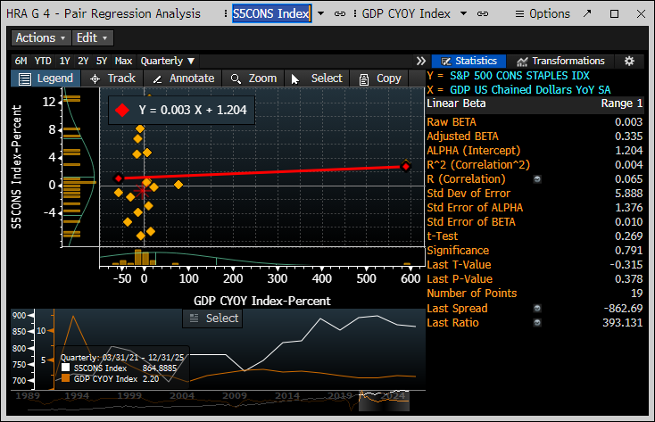
Economic Analysis
Regression Analysis - Consumer Staples vs GDP Growth
Low R^2 - .004
Low Beta - .003
Low correlation - Defensive sector and less Cyclical than the broader market
Notes:
https://www.snoqap.com/posts/2019/9/30/macroeconomic-factors-and-performance-of-consumer-staples-and-consumer-discretionary-sectors
John

Slide 7
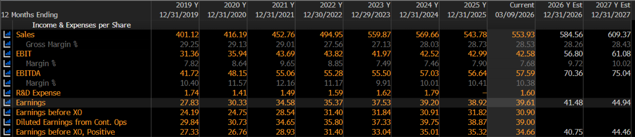
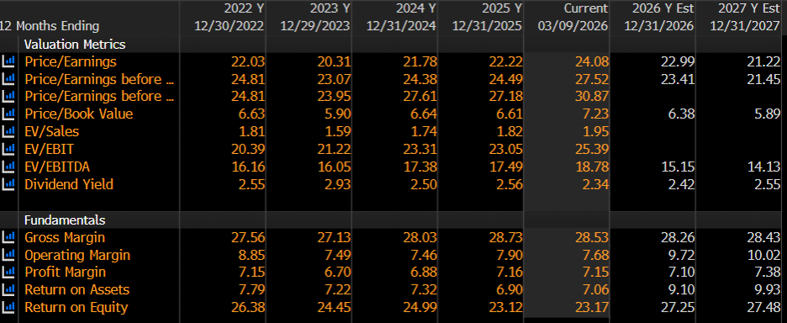
Sector Financials
ROE: 23.27%
Sales Growth: avg: 4.86%
(-4.54% last year)
Earnings Growth:
Avg: 5.27%
(-0.71% last year)
Operating Margin: 7.68
Profit Margin: 7.15
Notes:
Consistent growth- but bad year last year due to tariffs and rising costs of inputs in an industry where the margins are already low
Consistent margins but are seeing a slight decline from the end of last year until now

Slide 8
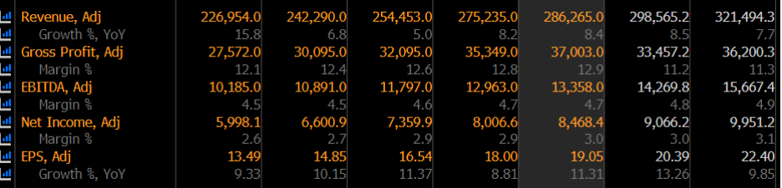
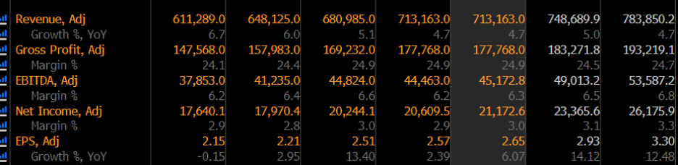
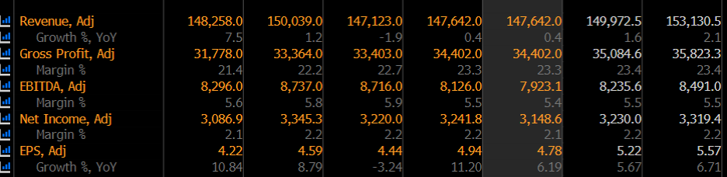
Major Companies Financials
Costco
Walmart
Kroger
Sales Growth: avg: 8.84% (8.4% last year)
Net Income margin: 3%
P/E: 52.77
Sales Growth: avg: 5.44% (4.7% last year)
Net income margin: 3%
P/E: 46.93
Sales Growth: avg: 1.62% (0.4% last year)
Net income margin: 2.1%
P/E: 15.35

Slide 9
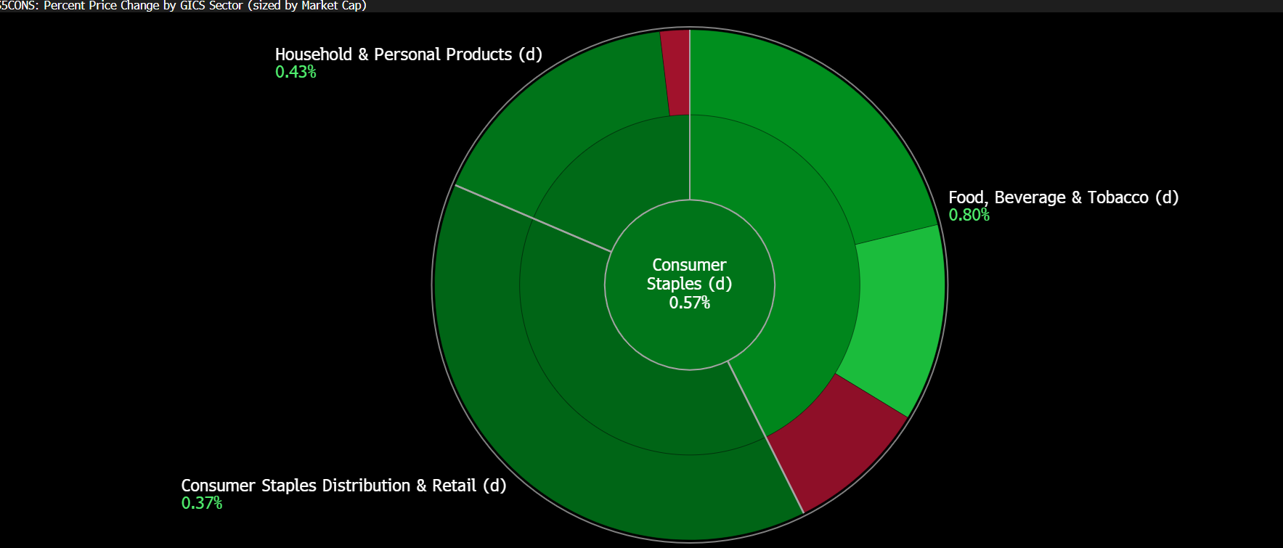
Industry Financials
Food beverage and tobacco (42,65%)- 2nd most Revenue- largest market cap
Household and personal products (38.77%)
And consumer staples distribution and retail (18.58%)-- most revenue

Slide 10
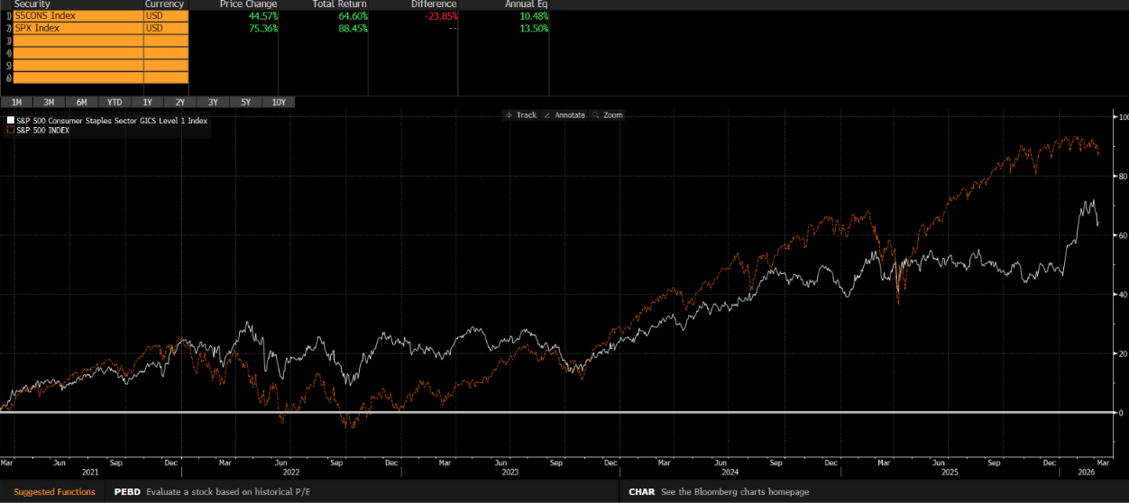
Compared To SP 500
Sector | SP 500 | Consumer Staples
Operating Margin | 15.20 | 7.68
Profit Margin | 13.97 | 7.15
5-year Return % | 88.45 | 64.60
Annual Return Eq | 13.50 | 10.48
Notes:
Low volatility- outperformed market in covid
Slower growth- less susceptible to huge swings in the market

Slide 11
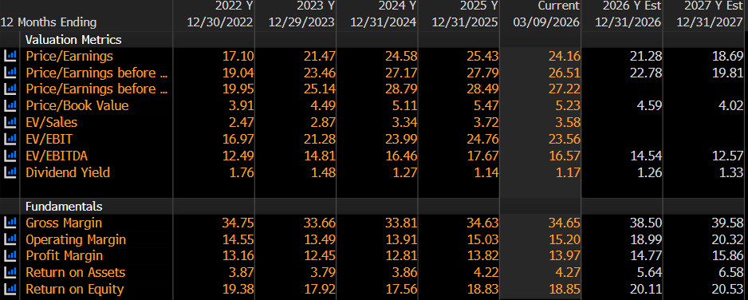
Comparison to S&P 500
Consumer Staples
Lower Margins
Higher ROE
Higher ROA
SP 500
Higher Margins
Notes:
Lower margins in consumer staples except for ROE and ROA
Consumer Staples varies between contracting and year to year but many have declined but remained steady

Slide 12
Sector Turnover
Consumer Staples
SP 500
Consumer staples companies sell high-volume, frequently purchased goods
Lighter asset bases
Low reliance on heavy fixed assets—volume-based model
Notes:
so they generate more revenue per dollar of assets than the average company in the S&P 500.

Slide 13
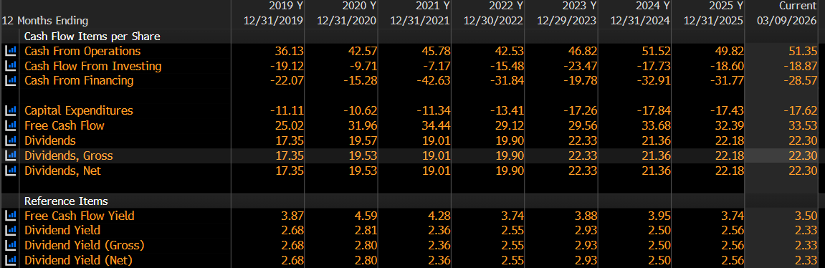
Cash Flows
Consistent and stable cash flows- minor contraction currently
Higher free cash flow yield than the SP 500 over the past 4 years

Slide 14
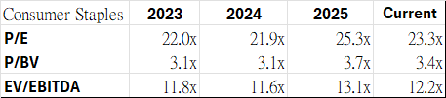
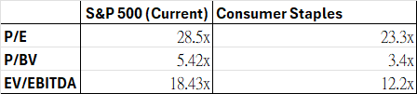
Valuation Analysis

Slide 15
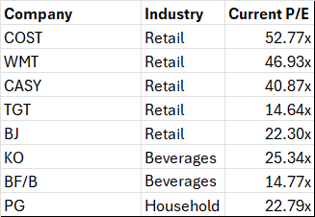
Consumer Staples P/E Multiples

Slide 16
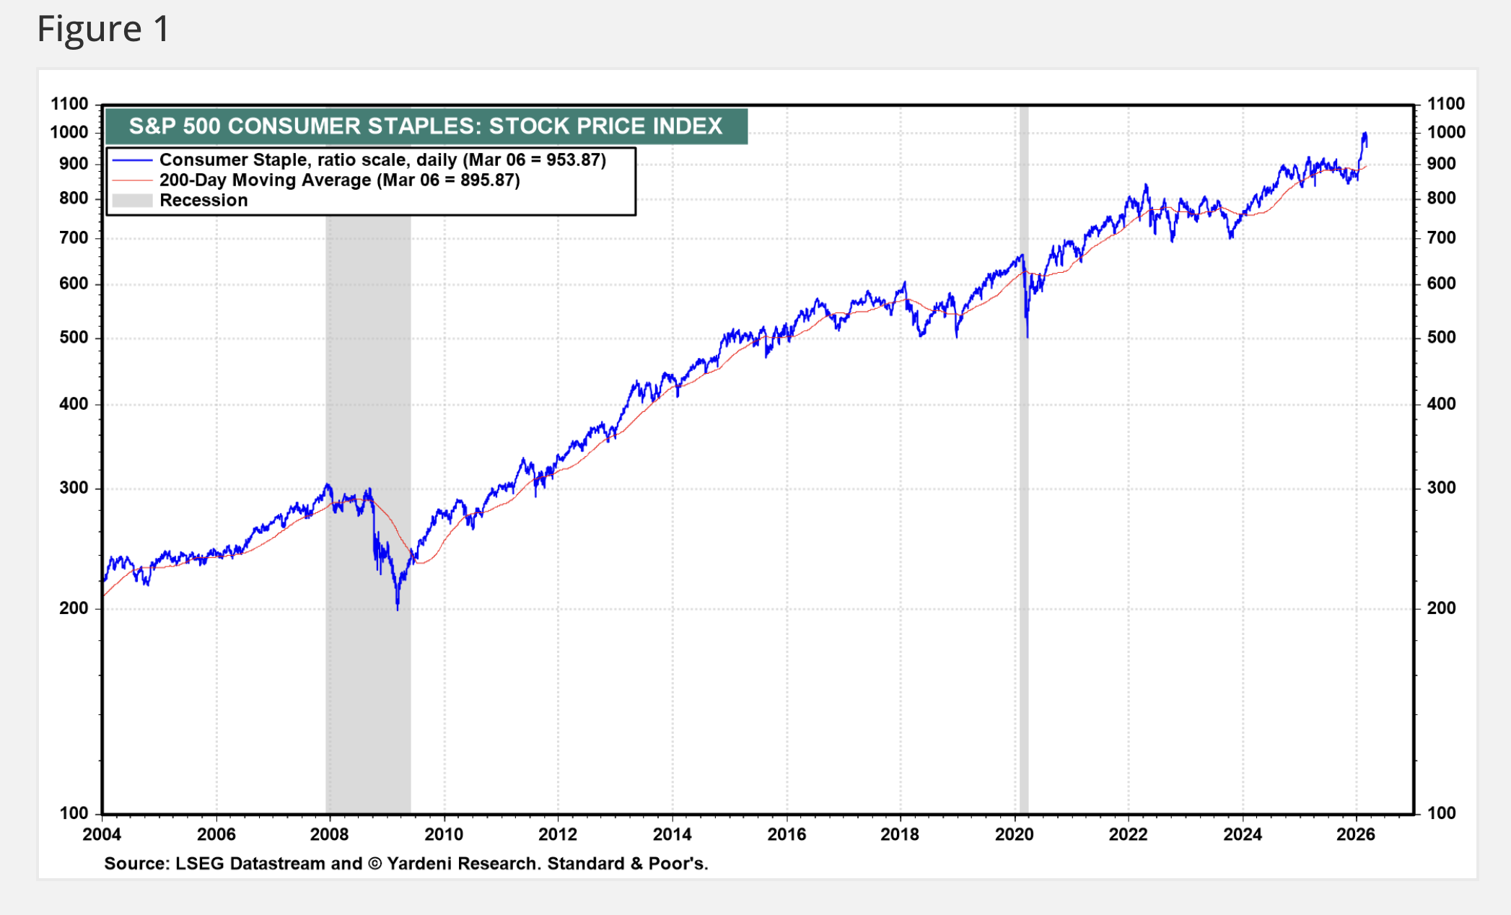
Recommendation/Class Vote
Overweight Consumer Staples
  Class Portfolio Weight: 7.51%
  S&P 500 Weight: 5.43%
2.08% overweight position reflects defensive positioning and stable cash flows.
Provides stable earnings, dividend income, and downside protection during economic uncertainty.
Slower growth vs broader market, input cost inflation, regulatory and tax risks.
Hold: Defensive investment.
Notes:
Cullen
8/9: https://yardeni.com/charts/consumer-staple/

Slide 17
Sources
https://www.investopedia.com/terms/c/consumerstaples.asp
https://www.bloomberg.com/markets/sectors/consumer-staples
https://stockanalysis.com/stocks/sector/consumer-staples/
https://www.spglobal.com/spdji/en/indices/equity/sp-500-consumer-staples-sector/#overview
https://yardeni.com/charts/consumer-staple/
https://en.macromicro.me/series/20538/s5cons-trailing-twelve-months-dividend-yield

