Slide 1
BUSFIN 4228 - Consumer Discretionary Sector - Stock Recommendations
April 7, 2026
Members: Kun (Quinn) Bai, Reed Andrews, Kailyn Amadio, Tyler Axelsen, William Bertin

Slide 2
SIM Portfolio - Consumer Discretionary Overview
We repeat our recommendation of remaining underweight in the consumer discretionary sector because high consumer debt, weak savings and sentiment, inflationary pressures, and rising input costs increase the risk of reduced discretionary spending and margin compression across the sector.
Consumer Discretionary
Notes:
Growth names (Amazon, Tesla) account for over half of the sector’s market capitalization, creating significant concentration risk
Mature names (Marriott, McDonald’s) can still create value via pricing power and franchising
Firms sell non-essential goods and services
Spending is highly dependent on disposable income and consumer confidence
Highly cyclical and highly competitive
One of the first sectors to suffer in downturns and one of the first to recover
Contains both mature legacy firms and high growth evolving firms

Slide 3
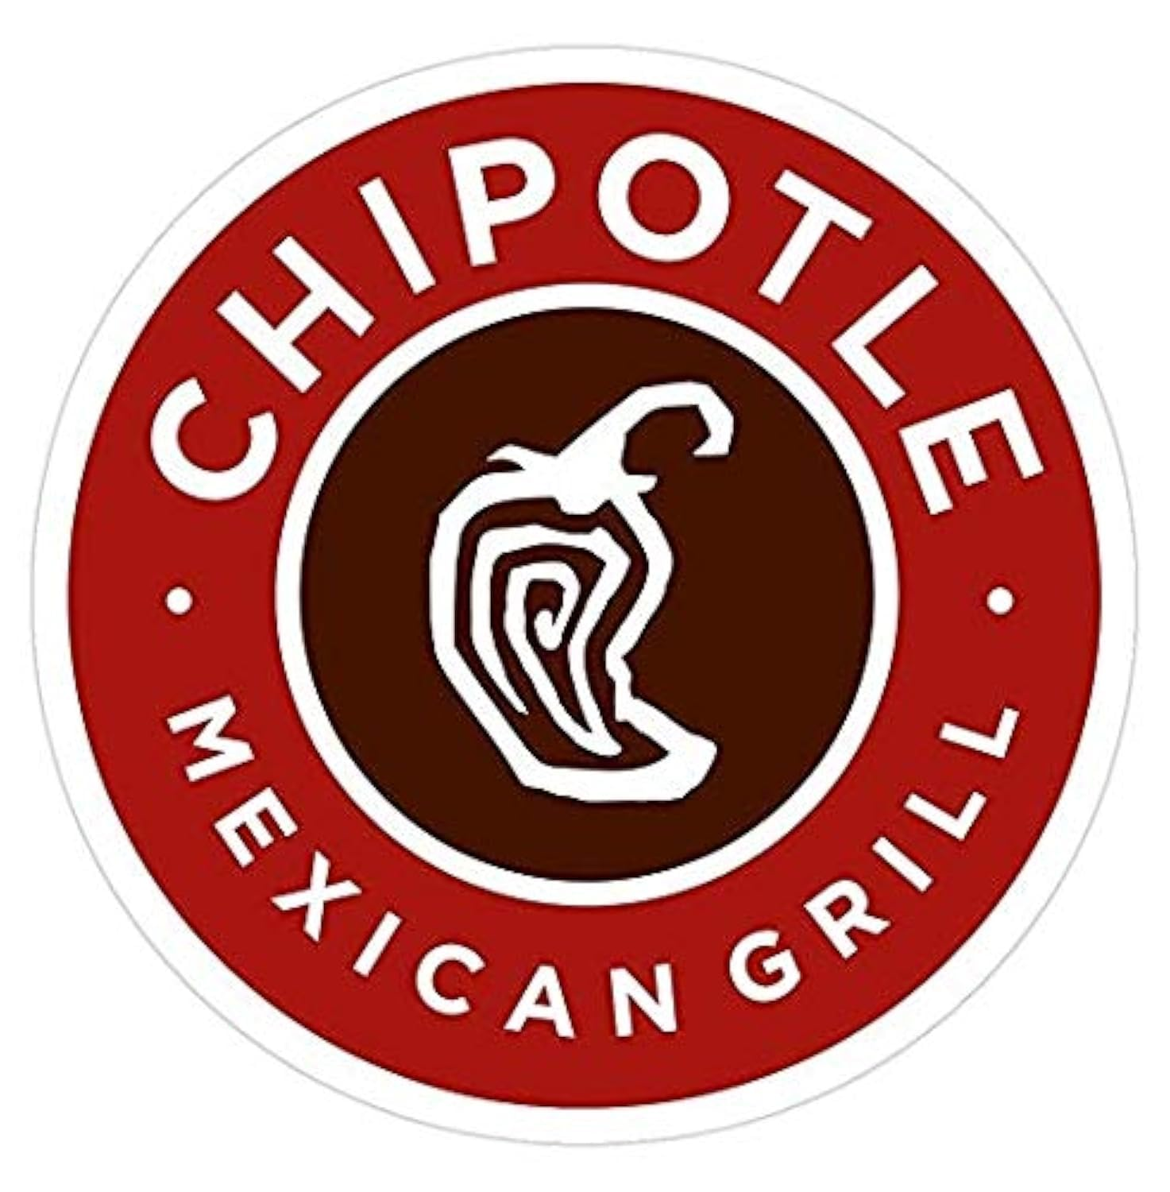
CMG Overview
Chipotle is a leader in the fast casual dining industry, with restaurants featuring a menu of burritos, burrito bowls, and others
Operates 4,045 restaurants with 3,940 in the U.S. and 105 internationally
“Cultivating a Better World” mission focuses on sustainable food sourcing, ethical agricultural practices, and community support
99.5% of revenue stems from Food & Beverage, while Delivery Service accounts for 0.5%
Consumer Discretionary
Notes:
Growth names (Amazon, Tesla) account for over half of the sector’s market capitalization, creating significant concentration risk
Mature names (Marriott, McDonald’s) can still create value via pricing power and franchising
Firms sell non-essential goods and services
Spending is highly dependent on disposable income and consumer confidence
Highly cyclical and highly competitive
One of the first sectors to suffer in downturns and one of the first to recover
Contains both mature legacy firms and high growth evolving firms

Slide 4
Business Analysis
Chipotle only operates two main business segments, physical Food & Beverage and Delivery Service
Holds a simple but powerful operational model, which has led to high restaurant level margins and double-digit same store sales and earnings growth until recently
Facing significant traffic decline since 2025 due to aggressive pricing (30% increase) from 2021 to 2024 and a weakened consumer
Focusing on new unit expansion domestically and internationally to rebuild earnings, which is capital intensive as part of “Recipe for Growth” strategy
2025 showed four quarters of SSS decline, Chipotle’s first annual decline in almost 20 years with management expecting flat SSS for FY2026
Consumer Discretionary
Notes:
Growth names (Amazon, Tesla) account for over half of the sector’s market capitalization, creating significant concentration risk
Mature names (Marriott, McDonald’s) can still create value via pricing power and franchising
Firms sell non-essential goods and services
Spending is highly dependent on disposable income and consumer confidence
Highly cyclical and highly competitive
One of the first sectors to suffer in downturns and one of the first to recover
Contains both mature legacy firms and high growth evolving firms

Slide 5
Financial Analysis
Chipotle’s financial performance in FY2025 was unimpressive compared to historically
Restaurant level margins are compressing, traffic is declining, and earnings growth is slipping fast
Performance heavily reliant on a healthy consumer, especially consumers in 25-35 year old < $100,000 household income demographic (responsible for 25% of CMG’s sales)
Management deliberately holding price increase at 1-2% against 3-4% food inflation, compressing margins further
Facing stifling competition from CAVA, whose SSS and restaurant level margins are growing faster
Consumer Discretionary
Notes:
Growth names (Amazon, Tesla) account for over half of the sector’s market capitalization, creating significant concentration risk
Mature names (Marriott, McDonald’s) can still create value via pricing power and franchising
Firms sell non-essential goods and services
Spending is highly dependent on disposable income and consumer confidence
Highly cyclical and highly competitive
One of the first sectors to suffer in downturns and one of the first to recover
Contains both mature legacy firms and high growth evolving firms

Slide 6
Valuation
Traded at a high premium historically due to high SSS growth, restaurant level margins, and double-digit earnings growth
Hard to justify now that these criteria no longer hold
Consensus price target of $45.03
Recommendation
SELL
Consumer Discretionary
Notes:
Growth names (Amazon, Tesla) account for over half of the sector’s market capitalization, creating significant concentration risk
Mature names (Marriott, McDonald’s) can still create value via pricing power and franchising
Firms sell non-essential goods and services
Spending is highly dependent on disposable income and consumer confidence
Highly cyclical and highly competitive
One of the first sectors to suffer in downturns and one of the first to recover
Contains both mature legacy firms and high growth evolving firms

Slide 7

Business Overview
Nike, Inc. designs, develops, markets, and sells athletic footwear, apparel, equipment, accessories, and services worldwide. Products are sold through two primary channels: wholesale and direct-to-consumer (DTC). Nike is also a sponsor of athletes', leagues, and artists around the world.
Consumer Discretionary
Notes:
Growth names (Amazon, Tesla) account for over half of the sector’s market capitalization, creating significant concentration risk
Mature names (Marriott, McDonald’s) can still create value via pricing power and franchising
Firms sell non-essential goods and services
Spending is highly dependent on disposable income and consumer confidence
Highly cyclical and highly competitive
One of the first sectors to suffer in downturns and one of the first to recover
Contains both mature legacy firms and high growth evolving firms

Slide 8
Business Overview, Continued
Strategic Pivot
Previous reduction of retail accounts led to lost-shelf space and discovery, over-promotion on nike.com which led to deteriorating margins, lost market share
Under Hill’s “Win Now” strategy, North America has experienced healthier channel dynamics, a rebuilt innovation pipeline, significant progress on franchise management for the Classics line, and returned to positive growth in running.
Nike has actively rebuilt its wholesale partnership with DSW and Macy’s, as well as returning to direct sales on Amazon in May 2025 after a six-year hiatus.
Upcoming Catalysts
2026 FIFA World Cup, hosted across major cities in the NA market. Nike’s sponsorships of national teams position it to benefit directly from tournament merchandise and footwear demand.
2028 Summer Olympics in Los Angeles: Nike has historically seen significant volume uplift in the 12–18 months surrounding Olympic Games
New product launches are poised to drive DTC growth margin, in particular Greater China
Market Share
Nike currently dominates in the Apparel, Footwear & Accessories industry. With revenue of $46.3 billion in FY2025, Nike is more than double the size of its nearest competitor, Adidas.
According to RBC Capital Markets, Nike and Adidas together account for approximately 25% of global sportswear market share, with Nike leading Adidas (Source: RBC Capital Markets via Business of Fashion, 2024)
Consumer Discretionary
Notes:
Growth names (Amazon, Tesla) account for over half of the sector’s market capitalization, creating significant concentration risk
Mature names (Marriott, McDonald’s) can still create value via pricing power and franchising
Firms sell non-essential goods and services
Spending is highly dependent on disposable income and consumer confidence
Highly cyclical and highly competitive
One of the first sectors to suffer in downturns and one of the first to recover
Contains both mature legacy firms and high growth evolving firms

Slide 9
Financial Analysis & Valuation
Consumer Discretionary
Notes:
Growth names (Amazon, Tesla) account for over half of the sector’s market capitalization, creating significant concentration risk
Mature names (Marriott, McDonald’s) can still create value via pricing power and franchising
Firms sell non-essential goods and services
Spending is highly dependent on disposable income and consumer confidence
Highly cyclical and highly competitive
One of the first sectors to suffer in downturns and one of the first to recover
Contains both mature legacy firms and high growth evolving firms

Slide 10
Financial Analysis & Valuation, Continued
Recommendation: HOLD
Consumer Discretionary
Notes:
Growth names (Amazon, Tesla) account for over half of the sector’s market capitalization, creating significant concentration risk
Mature names (Marriott, McDonald’s) can still create value via pricing power and franchising
Firms sell non-essential goods and services
Spending is highly dependent on disposable income and consumer confidence
Highly cyclical and highly competitive
One of the first sectors to suffer in downturns and one of the first to recover
Contains both mature legacy firms and high growth evolving firms

Slide 11

AMZN Overview
Amazon.com, Inc. is a global technology and e-commerce company that operates across online retail, cloud computing (AWS), digital streaming, and digital advertising.
The company has built a highly diversified business model, generating revenue through first-party retail, third-party seller services, subscription offerings such as Prime, advertising, and AWS.
Amazon’s scale, logistics network, and data-driven capabilities support its competitive advantage and position it as a dominant player across both consumer and institutional markets.
Ticker | Market Sector | Industry | Market Cap | Shares Outstanding
AMZN | Consumer Disc. | Retail | $2.27T | 10.73B
Current Price | Target Price | Upside | Recommendation
$212.11 | $268.18 | 26.4 % | BUY
Consumer Discretionary
Notes:
Growth names (Amazon, Tesla) account for over half of the sector’s market capitalization, creating significant concentration risk
Mature names (Marriott, McDonald’s) can still create value via pricing power and franchising
Firms sell non-essential goods and services
Spending is highly dependent on disposable income and consumer confidence
Highly cyclical and highly competitive
One of the first sectors to suffer in downturns and one of the first to recover
Contains both mature legacy firms and high growth evolving firms

Slide 12

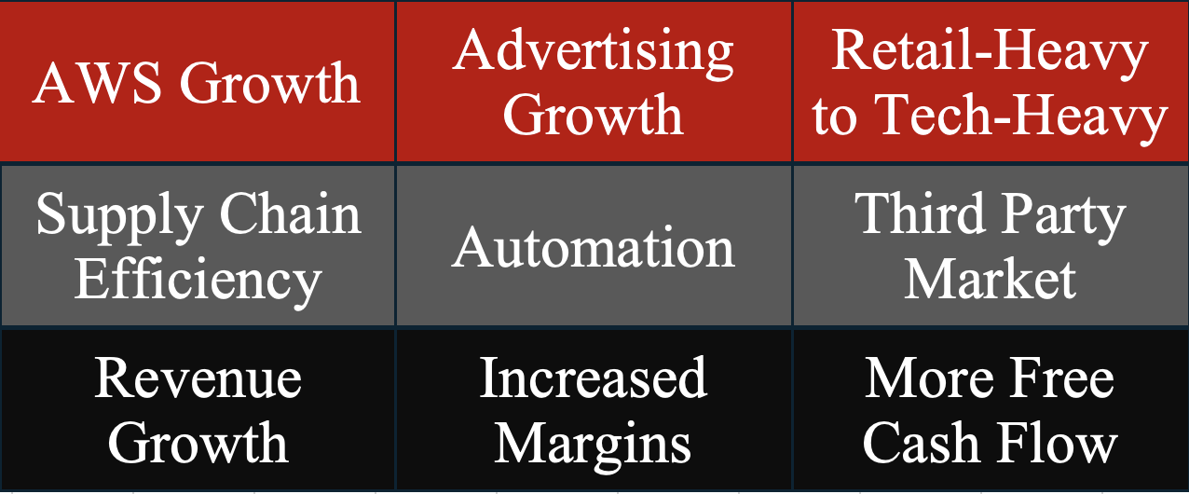
Business Analysis
Amazon’s stock performance is driven by several fundamental factors that influence revenue growth, profitability and valuation. The main fundamental drivers are:
AWS growth drives about 51% of Amazon’s stock price. This is fueled by AI demand, cloud migration, and enterprise spending
Advertising growth drives about 20% of Amazon’s stock price. This high-margin business propels website traffic and increases revenues.
Moving from low margin business initiatives such as retail and focusing on higher margin business segments such as AWS and Advertising will continue to drive Amazon’s stock price. This will take Amazon from a retail-heavy business to a technology prominent player in the market.
Key:
Red = Revenue Drivers
Gray = Operational Drivers
Black = Financial Outcomes
Consumer Discretionary
Notes:
Growth names (Amazon, Tesla) account for over half of the sector’s market capitalization, creating significant concentration risk
Mature names (Marriott, McDonald’s) can still create value via pricing power and franchising
Firms sell non-essential goods and services
Spending is highly dependent on disposable income and consumer confidence
Highly cyclical and highly competitive
One of the first sectors to suffer in downturns and one of the first to recover
Contains both mature legacy firms and high growth evolving firms

Slide 13

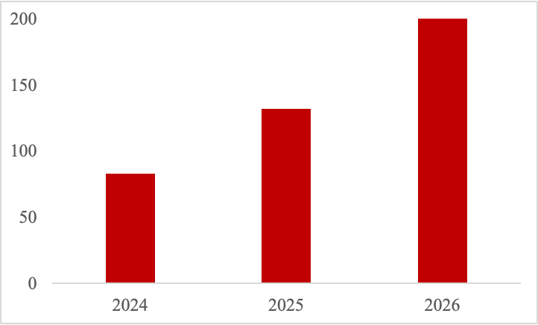
Financial Analysis
Income Statement Projections:
Revenue Growth: $716.9B (2025) → $988.6B (2028), steady moderate-high growth
Operating Income: $79.9B → $93.9B; margins stabilize ~9.5%
Vs. Consensus: Greater margin stability and persistent operating leverage driven by a shift towards higher-margin business segments (AWS and advertising)
Margin Comparisons:
Gross Margin: 50.3% — above Nike (41.1%) & below Lululemon (58.4%)
Implication: Strong contribution from high-margin segments (AWS, advertising)
Operating Margin: 11.2% — below sector peers (McDonald’s 46.1%, Royal Caribbean 27.4%)
Takeaway: High gross margins, but operating margins still impacted by high capex
Amazon Capital Expenditures ($ Billions)
Consumer Discretionary
Notes:
Growth names (Amazon, Tesla) account for over half of the sector’s market capitalization, creating significant concentration risk
Mature names (Marriott, McDonald’s) can still create value via pricing power and franchising
Firms sell non-essential goods and services
Spending is highly dependent on disposable income and consumer confidence
Highly cyclical and highly competitive
One of the first sectors to suffer in downturns and one of the first to recover
Contains both mature legacy firms and high growth evolving firms

Slide 14
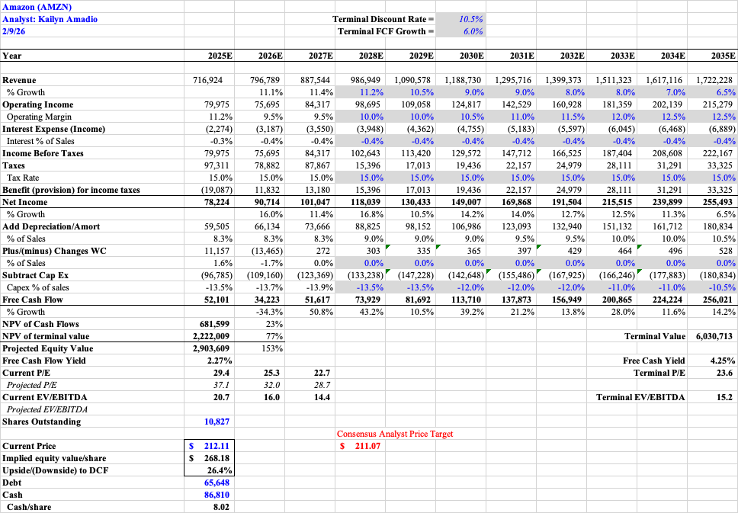
Valuation
DCF Valuation: Implied value ≈ $268/share vs. $212 current (~26% upside). BUY
Key Assumptions: 10.5% discount rate, 6.0% terminal growth
FCF Growth: ~$52B (2025) → $250B+ (2035)
Absolute Basis | High | Low | Average | Current
P/E | 252 | 30 | 104 | 33.8
P/B | 9.5 | 3.5 | 6.5 | 6.9
P/S | 4.5 | 1.75 | 3 | 3.7
P/EBITDA | 28 | 15 | 21.5 | 16.48
Consumer Discretionary
Notes:
Growth names (Amazon, Tesla) account for over half of the sector’s market capitalization, creating significant concentration risk
Mature names (Marriott, McDonald’s) can still create value via pricing power and franchising
Firms sell non-essential goods and services
Spending is highly dependent on disposable income and consumer confidence
Highly cyclical and highly competitive
One of the first sectors to suffer in downturns and one of the first to recover
Contains both mature legacy firms and high growth evolving firms

Slide 15
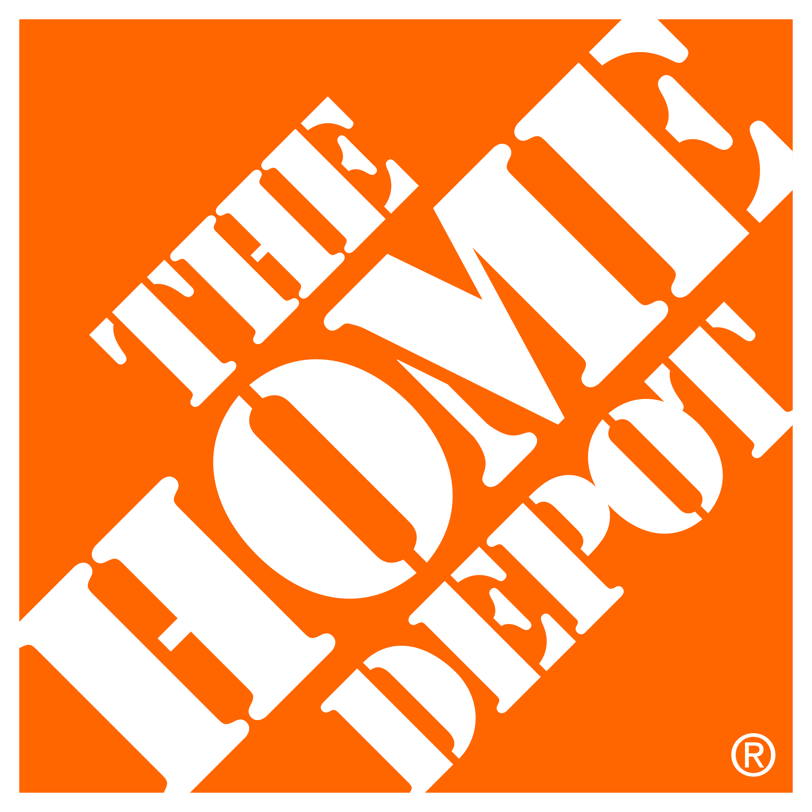
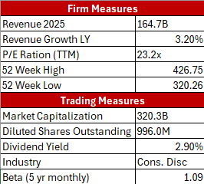
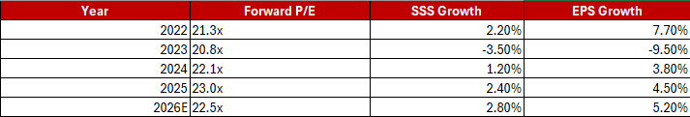
HD Overview
Home Depot is the largest home improvement retailer in North America serving both DIY customers and professional contractors
The company operates more than 2,300 stores across the United States, Canada and Mexico and generates revenue from in-store sales, online sales and professional contractor services
Home Depot benefits from strong brand recognition, scale advantages, and supply chain efficiency, allowing the company to keep stable margins and consistent free cash flow generation
Home Depot operates primarily through two key customer segments, DIY customers and Professional (Pro) contractors, with Pro customers representing the largest long-term growth opportunity
The company maintains a strong operational model supported by scale, supply chain efficiency and vendor relationships, allowing for stable margins and consistent free cash flow generation
Growth slowed following COVID-19 driven demand as higher interest rates and weaker housing activity reduced large renovation spending and pressured same store sales
Home Depot is focusing on expanding Pro customer services, supply chain investments and delivery capabilities to drive long-term revenue growth
Management expects moderate same store sales growth going forward, supported by aging housing stock, repair demand and continued Pro segment expansion
Consumer Discretionary
Notes:
Growth names (Amazon, Tesla) account for over half of the sector’s market capitalization, creating significant concentration risk
Mature names (Marriott, McDonald’s) can still create value via pricing power and franchising
Firms sell non-essential goods and services
Spending is highly dependent on disposable income and consumer confidence
Highly cyclical and highly competitive
One of the first sectors to suffer in downturns and one of the first to recover
Contains both mature legacy firms and high growth evolving firms

Slide 16
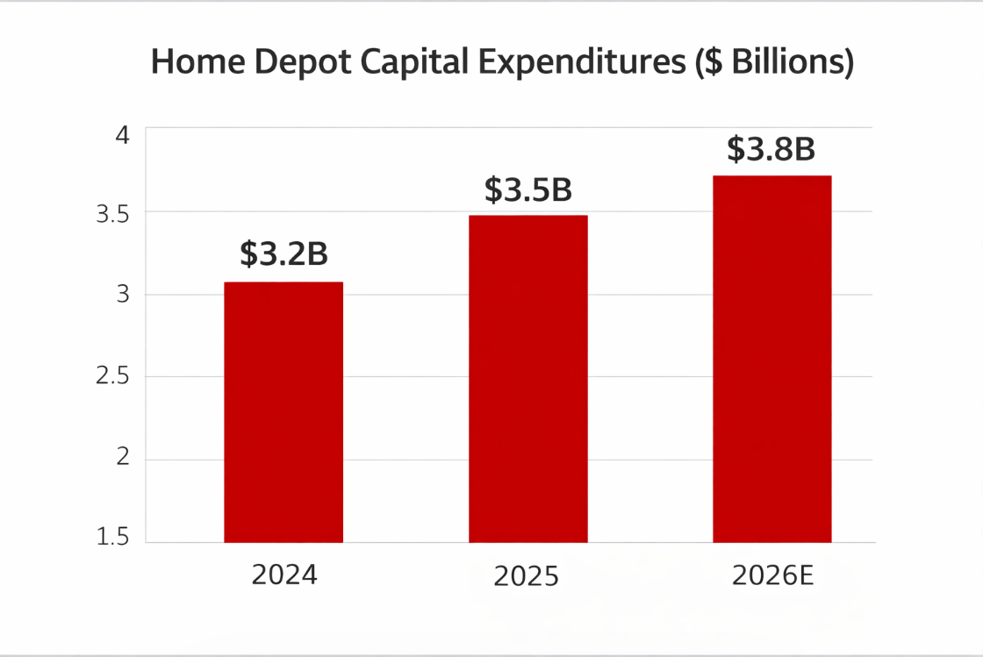
Financial Analysis
Income Statement Projections:
Revenue Growth: $171.2B (2026) → $232.8B (2036), steady low-single digit growth
Operating Income: $22.3B → $30.3B; margins stable ~13%
Vs. Consensus: Stable growth expectations driven by Pro customer expansion, supply chain investments and aging housing stock demand
Margin Comparisons:
Gross Margin: ~33.5% — below Nike (41.1%) & Amazon (50.3%)
Implication: Lower margins reflect retail-heavy business and product-based revenue model
Operating Margin: ~13.0% — above Lowe’s (~12%) and consistent with large retail peers
Takeaway: Stable operating margins supported by scale advantages and pricing power
Consumer Discretionary
Notes:
Growth names (Amazon, Tesla) account for over half of the sector’s market capitalization, creating significant concentration risk
Mature names (Marriott, McDonald’s) can still create value via pricing power and franchising
Firms sell non-essential goods and services
Spending is highly dependent on disposable income and consumer confidence
Highly cyclical and highly competitive
One of the first sectors to suffer in downturns and one of the first to recover
Contains both mature legacy firms and high growth evolving firms

Slide 17
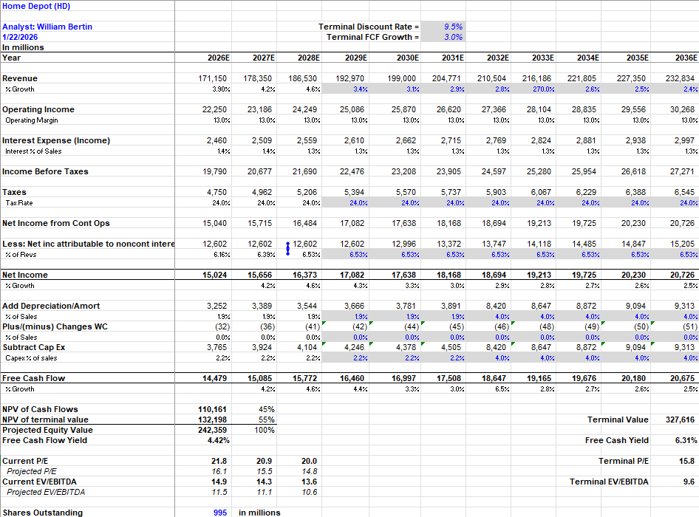
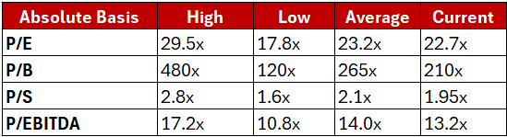
Valuation
DCF Valuation:
Implied value ≈ $243.58/share vs. $318.77 current (~-23% downside). SELL
Key Assumptions:
9.5% discount rate, 2.5% terminal growth
FCF Growth:
$14.5B (2026) → $20.7B (2036)
Recommendation: SELL
Consumer Discretionary
Notes:
Growth names (Amazon, Tesla) account for over half of the sector’s market capitalization, creating significant concentration risk
Mature names (Marriott, McDonald’s) can still create value via pricing power and franchising
Firms sell non-essential goods and services
Spending is highly dependent on disposable income and consumer confidence
Highly cyclical and highly competitive
One of the first sectors to suffer in downturns and one of the first to recover
Contains both mature legacy firms and high growth evolving firms

Slide 18
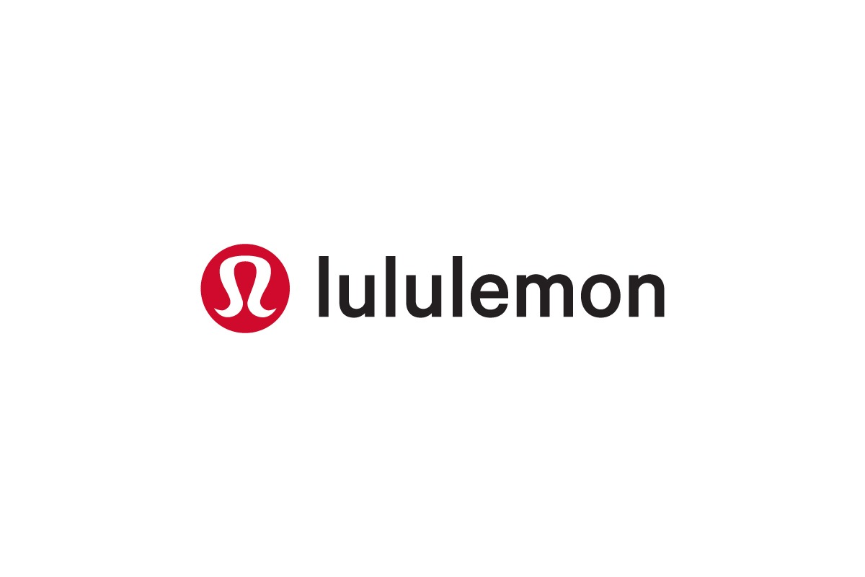
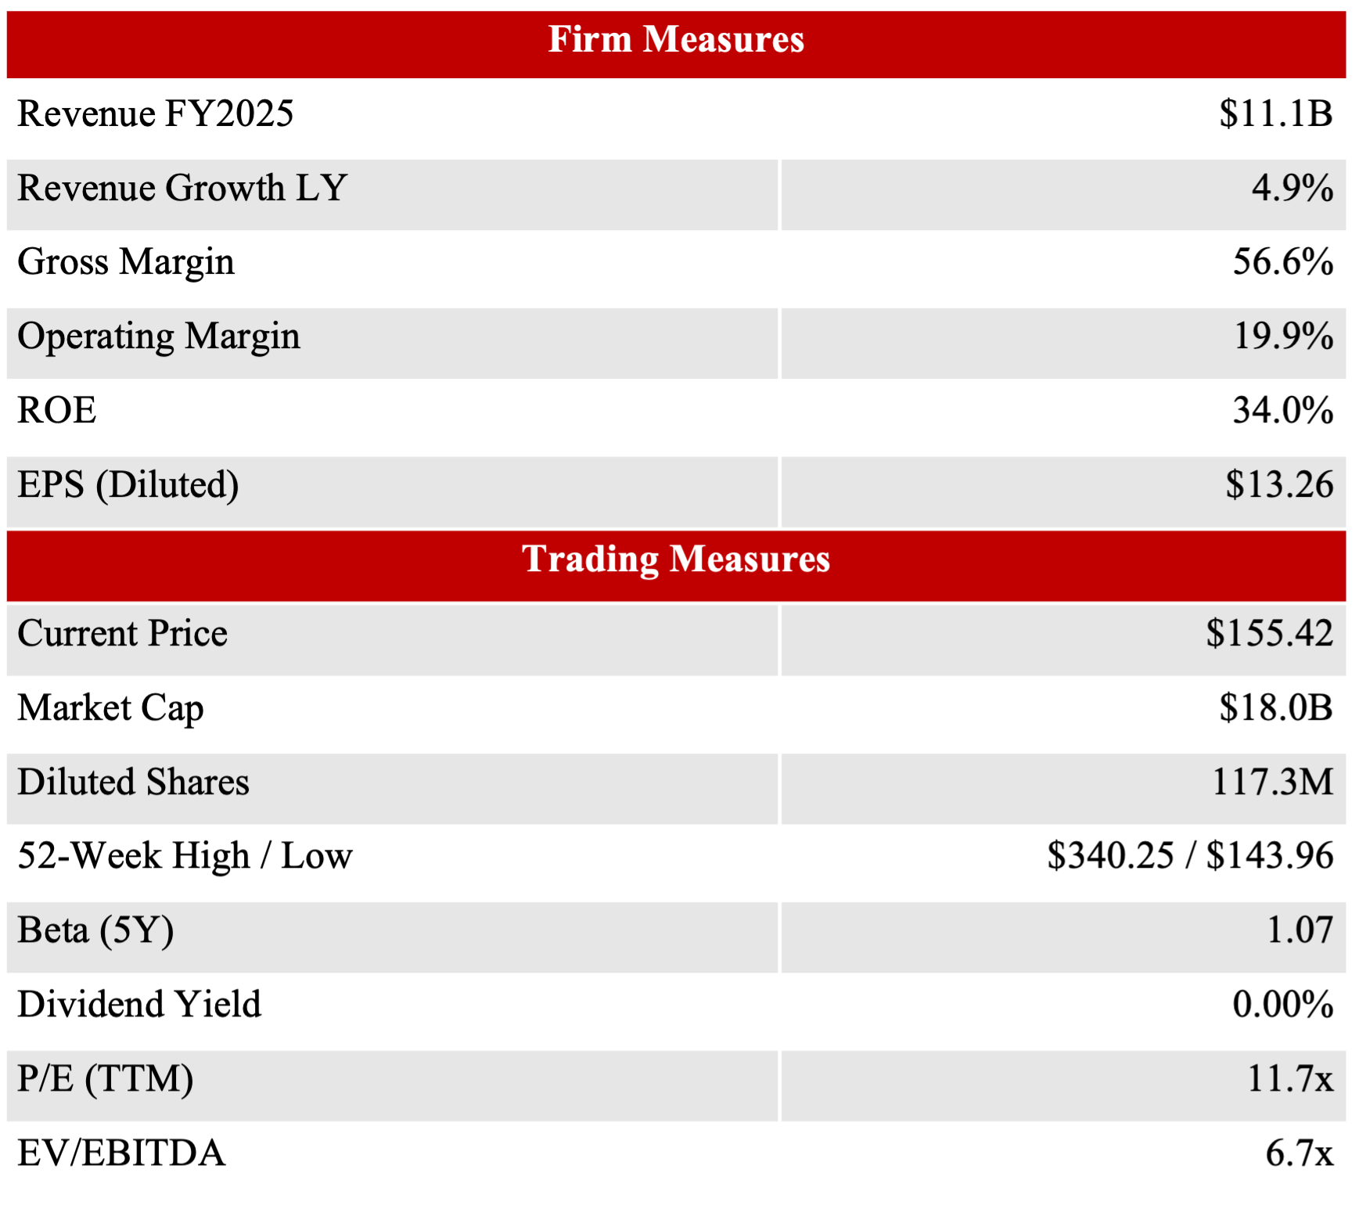
LULU Overview
• Lululemon athletica is a global designer, distributor, and retailer of premium technical athletic apparel, footwear, and accessories
• Founded in 1998 in Vancouver, Canada; pioneered the athleisure category and is the #1 women's activewear brand in the U.S.
• Core products include leggings (the flagship category), pants, tops, jackets, and accessories for yoga, running, and training, plus a growing footwear line launched in 2022
• Operates 811 company-operated stores across ~30 countries with ~39,000 employees globally
• Direct-to-consumer model: >90% of revenue from owned stores and e-commerce, supporting industry-leading margins and pricing control
• Reports three segments: Americas (71% of revenue), China Mainland (16%), and Rest of World (13%)
• Not currently held in SIM portfolio
Consumer Discretionary
Sources: Lululemon 10-K FY2025, Yahoo Finance (April 6, 2026)
Notes:
Mention 52- week high / low
Summarize

Slide 19
Business Overview
~41%
25%
+29%
11.7x
1-Year Stock Decline
Return on Invested Capital
China Revenue Growth FY2025
P/E Ratio
vs. peer average ~14%
vs. 10-yr median of 37x
Near-term headwinds
Meanwhile, international growth is accelerating
- CEO Calvin McDonald departed in Dec 2025; founder Chip Wilson launched a proxy fight and Elliott Management built a >$1B activist stake, creating governance noise in the middle of a turnaround.
- FY2025 tariffs reduced gross profit by ~$275M, compressing margins and driving down the stock price.
- Americas sales declined 3% in FY2025 and management expects a further 1-3% decline in FY2026
- China Mainland grew 29% in FY2025 and generates a 40% operating margin, LULU's highest-margin segment and well above the 33% Americas margin (per the 10-K).
- With just 172 stores in China vs. thousands for Nike and Adidas, LULU has a multi-year runway to continue compounding international revenue.
- Management has guided to ~20% China growth in FY2026 with the majority of new store openings planned in this market, gradually shifting the mix toward higher-margin, higher-growth geographies.
Consumer Discretionary
Sources: Lululemon 10-K FY2025, Yahoo Finance (April 6, 2026)

Slide 20
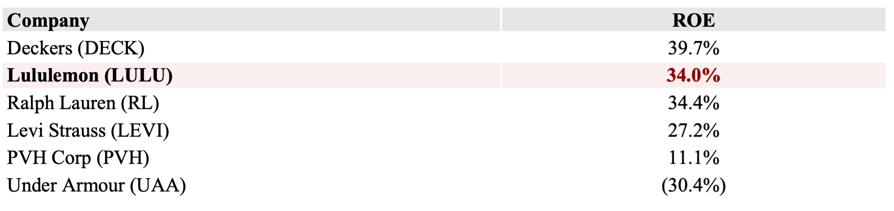
Financial Analysis
FY2025 marked a clear inflection point: revenue growth slowed from 10.1% to 4.9%, gross margin compressed 260 bps to 56.6%, and EPS declined ~9% from $14.64 to $13.26. The deterioration was driven primarily by a $275M tariff hit (per the 10-K) and weakening Americas sales. Management has guided FY2026 to continued near-term pressure: 2-4% revenue growth and EPS of $12.10-$12.30.
($ in millions) | FY2023 | FY2024 | FY2025 | FY2026 Guide | FY2027 Cons. | FY2028 Cons.
Total Revenue | 9,619 | 10,588 | 11,103 | $11,350-11,500 | — | —
Revenue Growth | 18.6% | 10.1% | 4.9% | 2.2%-3.6% | — | —
Gross Profit | 5,609 | 6,271 | 6,284 | — | — | —
Gross Margin % | 58.3% | 59.2% | 56.6% | ~55.4% | — | —
Operating Income | 2,133 | 2,506 | 2,211 | — | — | —
Operating Margin % | 22.2% | 23.7% | 19.9% | — | — | —
Diluted EPS | $12.20 | $14.64 | $13.26 | $12.10-12.30 | $12.32 | $13.38
ROE vs. Peer Group (FY2025)
Key Takeaways
Quality is intact: 34% ROE achieved with no financial debt — among the highest in the peer group, and uniquely free of leverage risk.
Headwinds are concentrated and identifiable: the entire FY2025 EPS decline traces to tariffs and Americas softness. China grew 29% with a 40% segment operating margin — the international business is accelerating, not deteriorating.
Consumer Discretionary
Sources: Lululemon 10-K FY2025, Yahoo Finance (April 6, 2026)

Slide 21
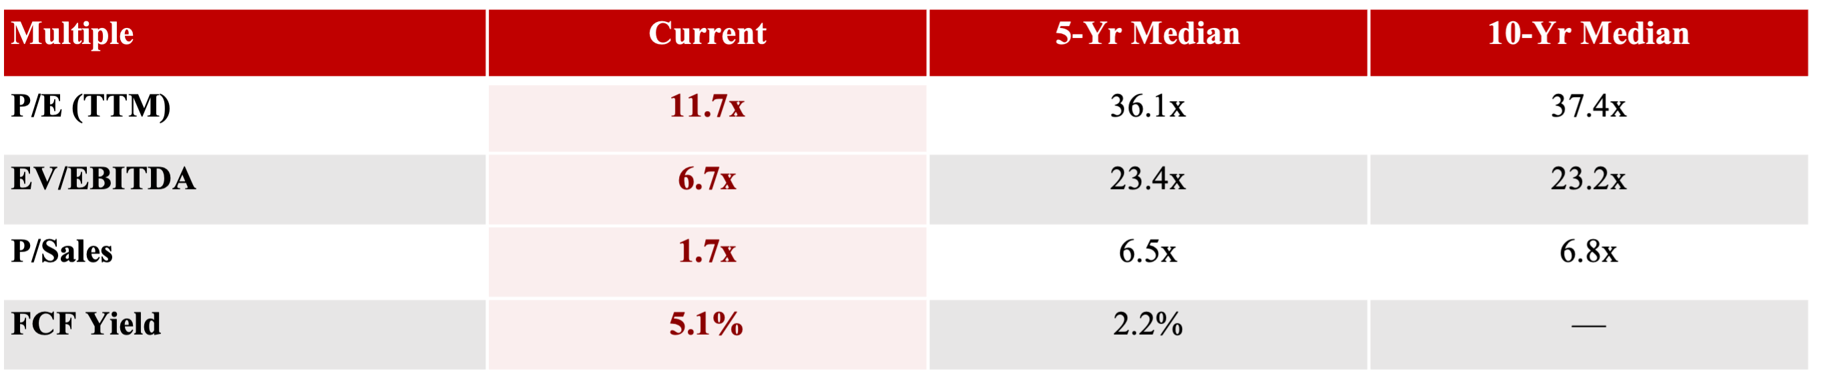
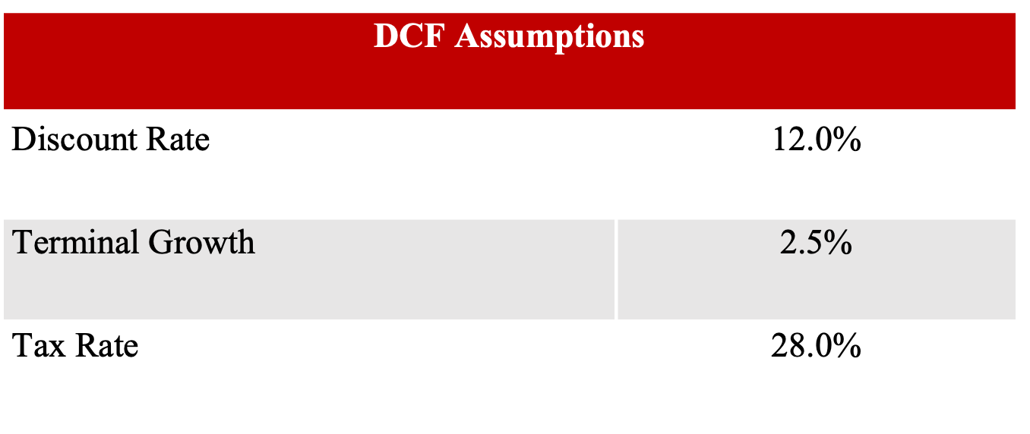
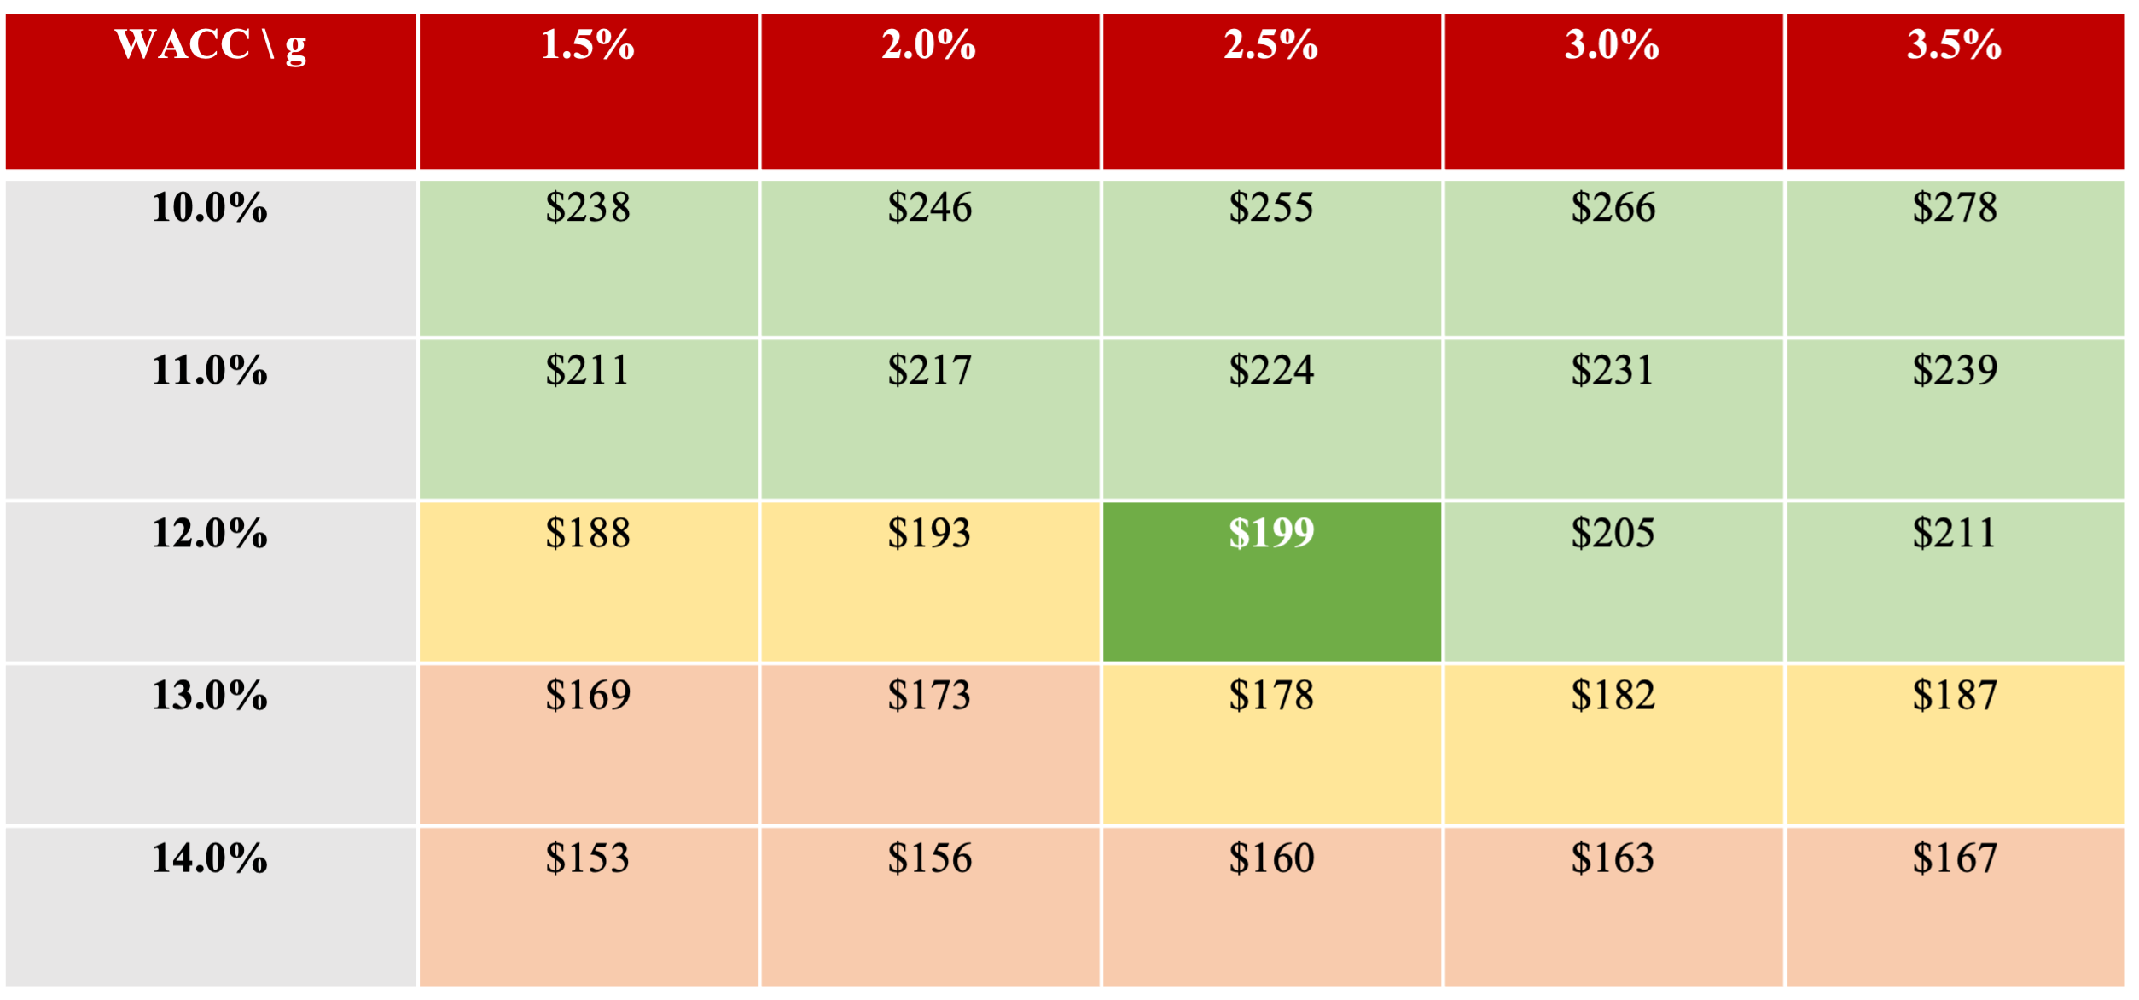
Valuation & Recommendation
Sensitivity Analysis: Implied Equity Value Per Share
Recommendation
BUY
Current Price | $155.42
Target Price (DCF) | $199.00
Upside | +28.0%
Street Consensus | ~$184
Current SIM Weight | 0 bps
Proposed Weight | 100 bps
Consumer Discretionary
Sources: Lululemon 10-K FY2025, Yahoo Finance (April 6, 2026)

Slide 22
Recommendation Summary
AMZN
Current Price: $212.11
Current Weight: 4.88%
Recommendation: BUY + 100bps
New Target Weight: ~5.9%
Target Price: $268.18
Expected Return: 26.4%
Risks: Increased capex could reduce FCF & delay margin expansion.
CMG
Current Price: $32.56
Current Weight: 1.03%
Recommendation: SELL
New Target Weight: 0.75%
Target Price: $29.14
Expected Return: -10.5%
Risks: Consumer confidence rebounds growing traffic & new unit growth succeeds in driving higher sales.
LULU
Current Price: $155.42
Current Weight: 0.00%
Recommendation: BUY + 100bps
New Target Weight: ~1.00%
Target Price: $199.00
Expected Return: 28.0%
Risks: CEO search, proxy fight, tariffs & Americas weakness may persist longer than expected.
NKE
Current Price: $42.69
Current Weight: 1.25%
Recommendation: HOLD
New Target Weight: 1.25%
Target Price: $54.93
Expected Return: 28.66%
Risks: Weaking consumer demand and downward pressures in household discretionary spending; Greater China EBIT failing to improve, petro-chemical derived materials prices stay elevated through 2026.
HD
Current Price: $318.77
Current Weight: N/A
Recommendation: SELL
New Target Weight: 0.00%
Target Price: $243.58
Expected Return: -23.6%
Risks: Elevated mortgage rates and higher home prices leading to limiting spending on home improvement; weakening consumer demand, and tariff uncertainty persist.
Consumer Discretionary
Notes:
Growth names (Amazon, Tesla) account for over half of the sector’s market capitalization, creating significant concentration risk
Mature names (Marriott, McDonald’s) can still create value via pricing power and franchising
Firms sell non-essential goods and services
Spending is highly dependent on disposable income and consumer confidence
Highly cyclical and highly competitive
One of the first sectors to suffer in downturns and one of the first to recover
Contains both mature legacy firms and high growth evolving firms

Slide 23
Appendix 1: NKE DCF
Consumer Discretionary
Notes:
Growth names (Amazon, Tesla) account for over half of the sector’s market capitalization, creating significant concentration risk
Mature names (Marriott, McDonald’s) can still create value via pricing power and franchising
Firms sell non-essential goods and services
Spending is highly dependent on disposable income and consumer confidence
Highly cyclical and highly competitive
One of the first sectors to suffer in downturns and one of the first to recover
Contains both mature legacy firms and high growth evolving firms

