Slide 1
BUSFIN 4228 - Consumer Discretionary Sector Overview
March 10, 2026
Members: Kun (Quinn) Bai, Reed Andrews, Kailyn Amadio, Tyler Axelsen, William Bertin

Slide 2
Agenda
Consumer Discretionary Overview 3
Economic Analysis 4
Valuation Analysis 9
Business Analysis and Outlook 11
Recommendation 16
Consumer Discretionary

Slide 3
Consumer Discretionary Overview
Consumer Discretionary Distribution and Retail (15)
Amazon
Home Depot
TJX
Lowe’s
Consumer Services
(18)
McDonald’s
Booking Holdings
Starbucks
Marriott
Automobiles & Components (4)
Tesla
General Motors
Ford
Consumer Durables and Retail (15)
Nike
Garmin
Lululemon
Consumer Discretionary
Sources: Bloomberg
Notes:
Growth names (Amazon, Tesla) account for over half of the sector’s market capitalization, creating significant concentration risk
Mature names (Marriott, McDonald’s) can still create value via pricing power and franchising
Firms sell non-essential goods and services
Spending is highly dependent on disposable income and consumer confidence
Highly cyclical and highly competitive
One of the first sectors to suffer in downturns and one of the first to recover
Contains both mature legacy firms and high growth evolving firms

Slide 4
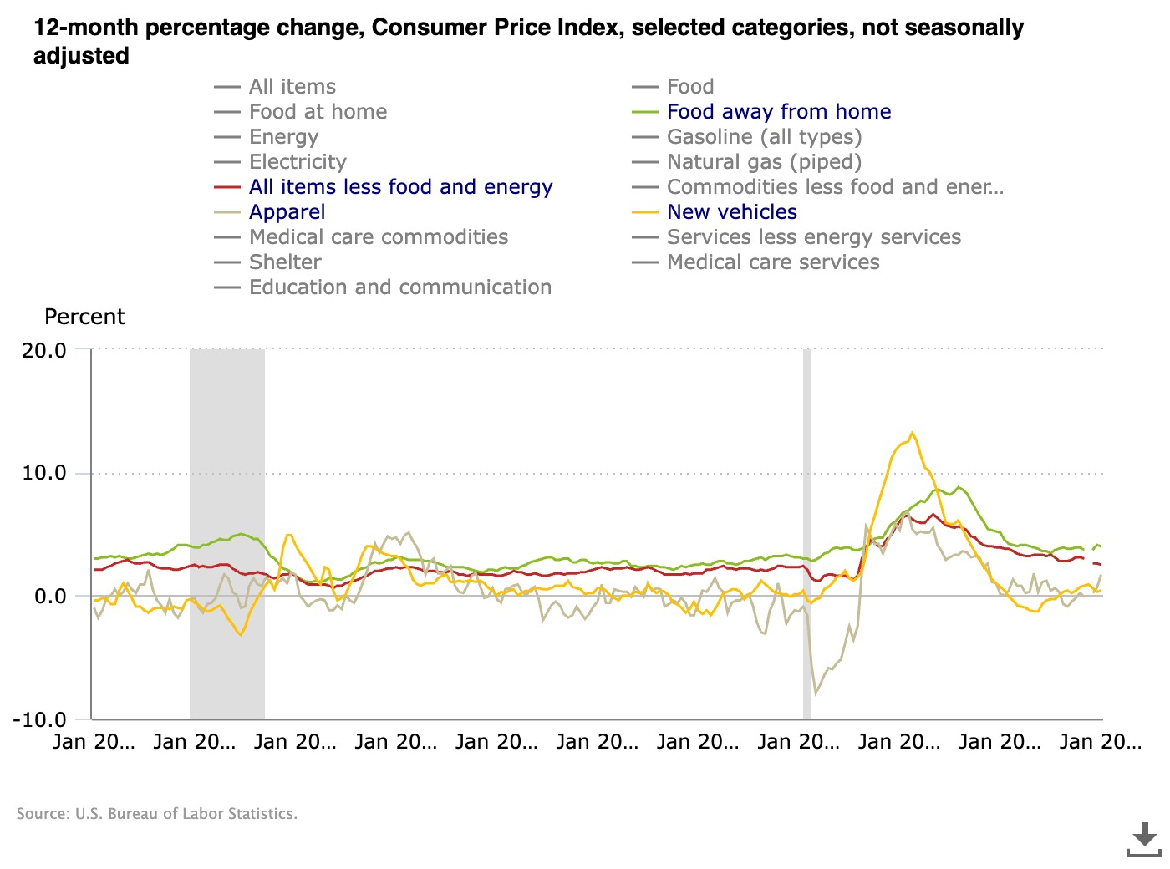
Economic Analysis - Consumer Price Index (CPI):
During periods of high inflation, demand for discretionary spending decreases:
Increase in cost of necessities erode consumers’ purchasing power for discretionary goods and services
High inflation lowers consumer sentiment, and with greater uncertainty, consumers pull back on big purchases
Rising prices creates higher input costs, pressuring margins and reducing a firm's profitability:
Costs are sometimes passed onto consumer to mitigate rising input costs
Firms may hold prices constant while lowering quality or quantity
Consumer Discretionary
Sources: U.S. Bureau of Labor Statistics

Slide 5
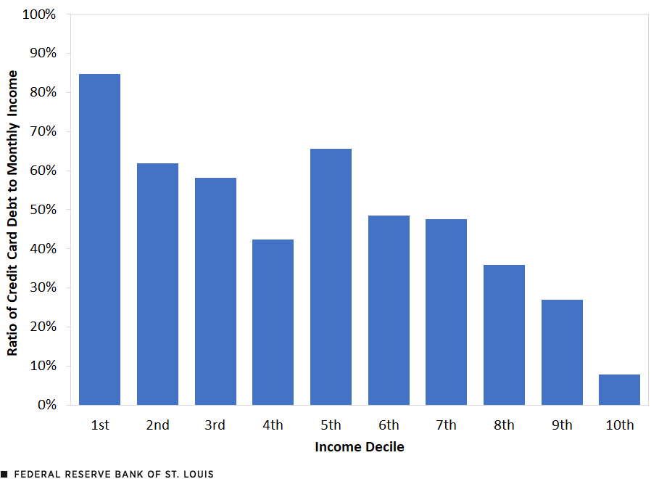
Economic Analysis: Factors Affecting Demand
Personal Savings
Personal savings rate: 3.6%, December 2025
Deloitte finds that tariff driven inflation is expected to push core PCE to 3% in 2026, paired with a loosening labor market may slow real consumer spending growth
Credit Card Debt
Q4 2025, credit card balances hit $1.277T
Bloomberg finds average interest rate on existing credit card debt is 19.6%
Nearly two-thirds of debtors have delayed or avoided major financial decisions
Consumer Confidence
The University of Michigan Sentiment Index was 56.6 in Feb 2026, 40% below January 2025 level
Real Income Growth
Indeed Hiring Labs notes that only 57% of workers saw wages outplace inflation in mid 2025
Consumer Discretionary
Sources: Bloomberg, University of Michigan, Deloitte, Indeed Hiring Labs, Federal Reserve Bank of St. Louis

Slide 6
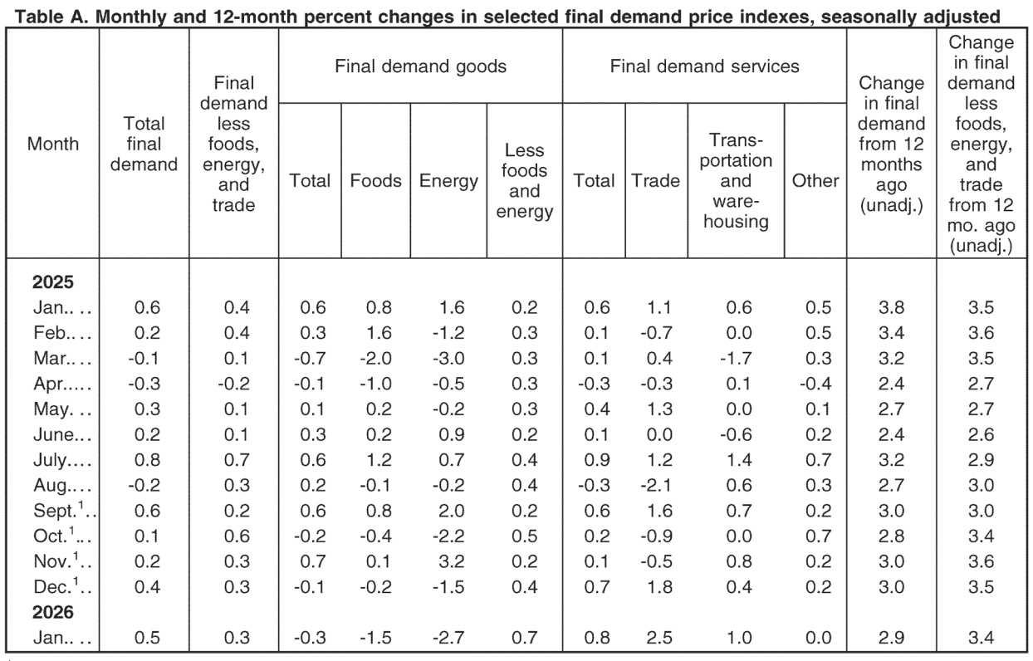
Economic Analysis: PPI and Factors Affecting Production
Measures price increases at production and wholesale level, before goods reach consumer:
Signals future margin pressure for firms before showing up in earnings
Foreshadows future CPI increases that dampen consumer demand
Current potential risk factors:
Tariffs and their legal fluidity create uncertainty for long term business planning and raises the question of who absorbs the costs
Geopolitical conflict in Iran with Strait of Hormuz responsible for 20% of global oil supply traffic, recently raising global oil prices by 25%
Consumer Discretionary
Sources: U.S. Bureau of Labor Statistics via FRED

Slide 7
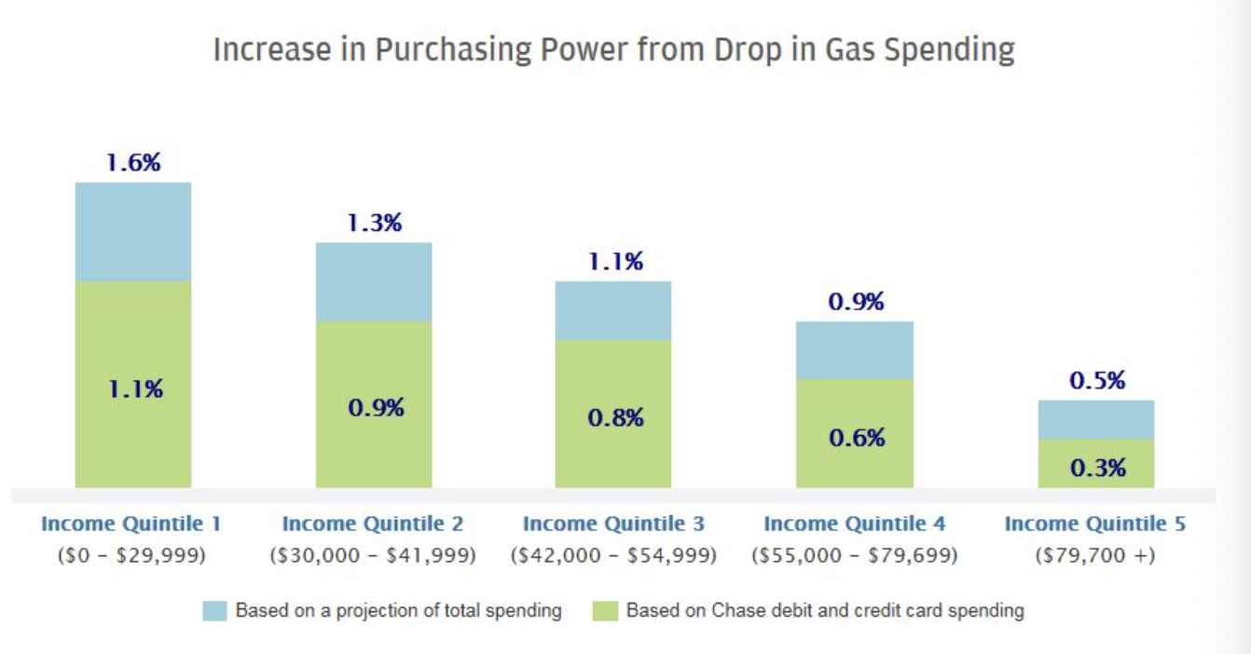
Economic Analysis: Cyclicality and Oil
Consumer discretionary business model is reliant on consumers having surplus income and confidence, making the sector highly sensitive to the economic cycle:
Apparel, luxury goods, hardline retail follows holiday and seasonal demand
Late cycle characteristics such as high valuations, elevated consumer debt, stretched margins are present
External shocks such as energy spike, trade uncertainty, and geopolitical fears
Consumer confidence already depressed before Iran conflict
Some of the factors above signal an increased probability of a cyclical slowdown.
Oil prices directly affect transportation and logistics costs, increasing expenses for retailers, airlines, hotels and restaurants
JPMorgan finds that a $1/gallon increase in gas can cost households roughly $100 more per month, whereas lower prices can boost consumer spending by 80%
Consumer Discretionary
Sources: JPMorgan

Slide 8
Economic Analysis
Key: Red - S&P 500 Consumer Discretionary, Blue - S&P500, Yellow - CPI YOY, Pink - PPI XYOY
Consumer Discretionary
Sources: Bloomberg
Notes:
Mention Large Dip From Liberation Day

Slide 9
Valuation Analysis – Sector
Consumer Discretionary
Sources: Bloomberg

Slide 10
Valuation Analysis – Company
Consumer Discretionary
Sources: Bloomberg

Slide 11
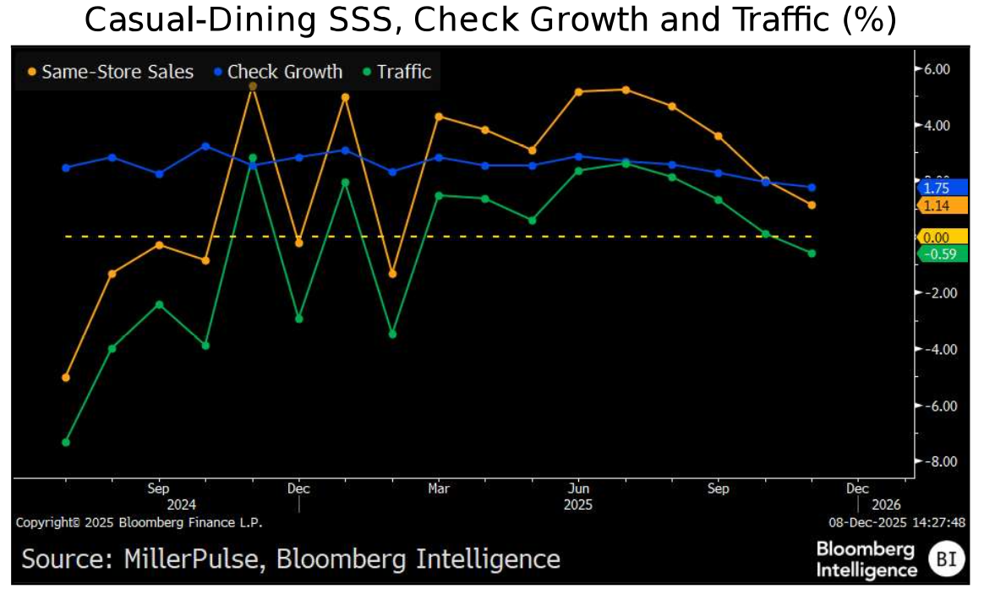
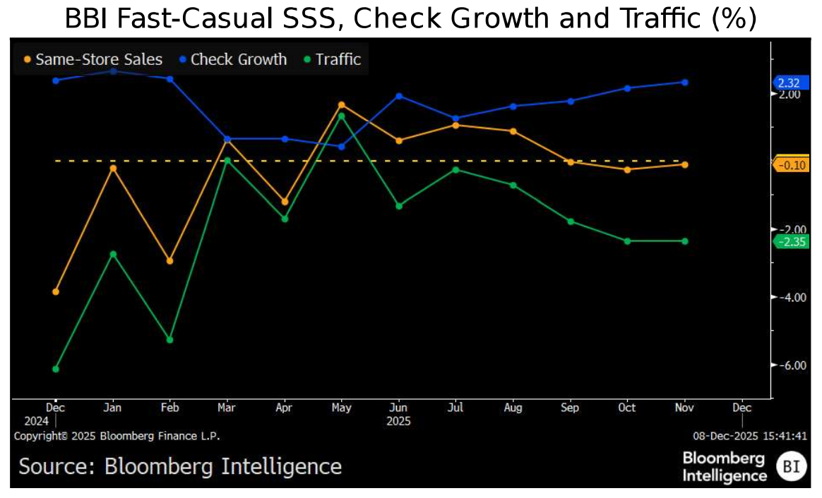
Business Analysis and Outlook – Restaurants
Consumer Discretionary
Sources: Bloomberg, Bloomberg Intelligence

Slide 12
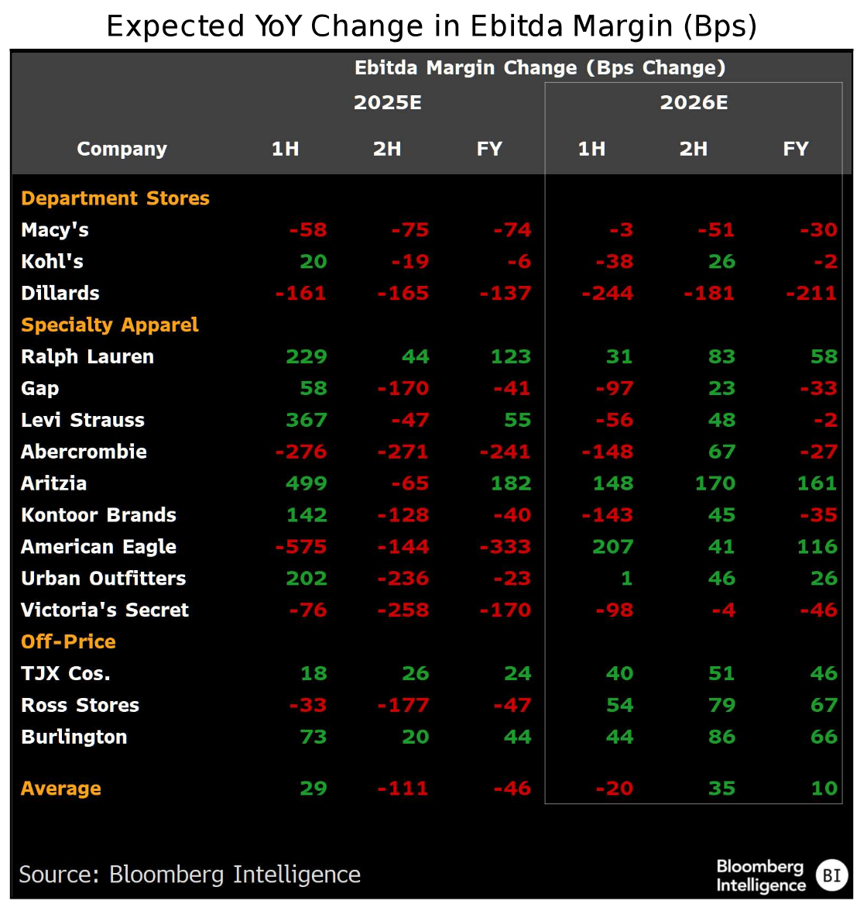
Business Analysis and Outlook – Apparel
Consumer Discretionary
Sources: Bloomberg, Bloomberg Intelligence

Slide 13
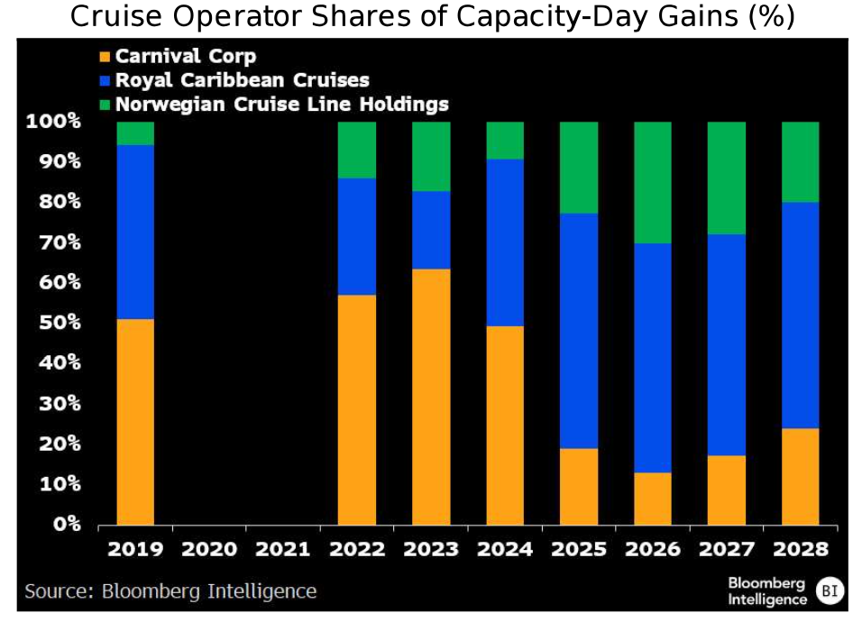
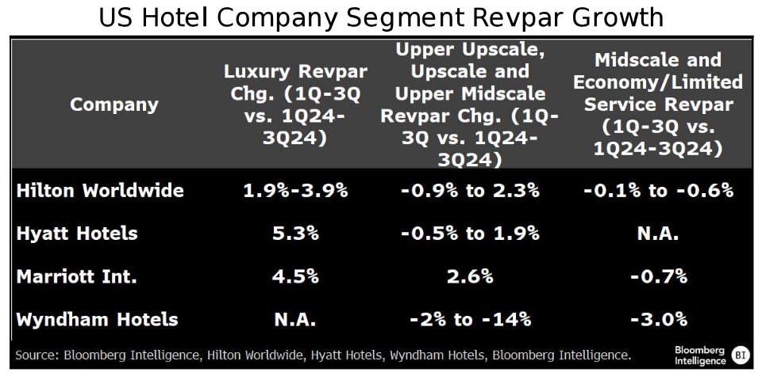
Valuation and Outlook - Lodging
Consumer Discretionary
Sources: Bloomberg, Bloomberg Intelligence

Slide 14
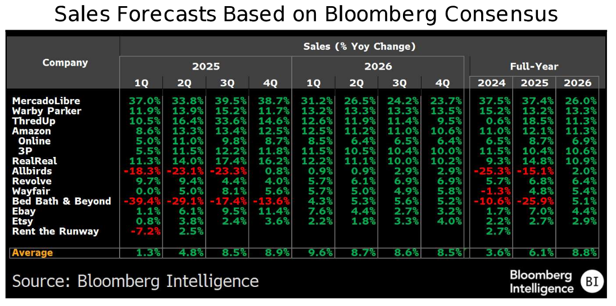
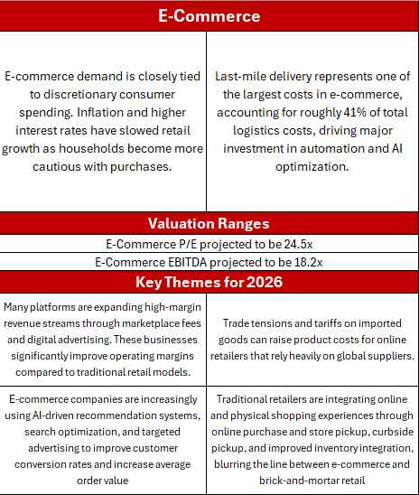
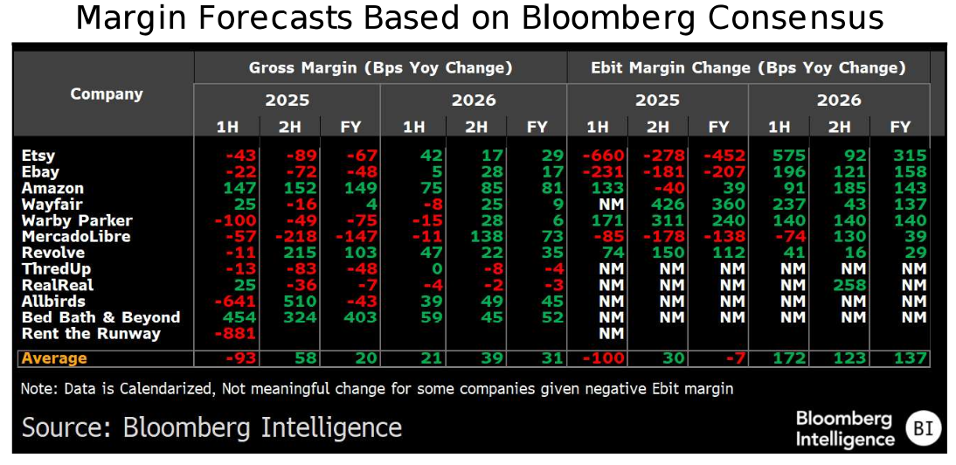
Valuation and Outlook – E-Commerce
Consumer Discretionary
Sources: Bloomberg, Bloomberg Intelligence

Slide 15
Valuation and Outlook – Auto-Parts Suppliers and Hardline Retail
Consumer Discretionary
Sources: Bloomberg, Bloomberg Intelligence

Slide 16
Recommendation
We recommend remaining underweight in the consumer discretionary sector because high consumer debt, weak savings and sentiment, inflationary pressures, and rising input costs increase the risk of reduced discretionary spending and margin compression across the sector.
Key Risks
Consumer confidence at 56.6 (UMich), 40% below Jan 2025; credit card debt at $1.277T with 19.6% avg rates
Iran/Strait of Hormuz disruption raising oil +25%; JPMorgan estimates $1/gal gas increase costs households ~$100/month
Tariff uncertainty raising input costs and compressing margins; Deloitte expects core PCE to reach 3% in 2026
Personal savings rate at 3.6% leaves consumers with minimal buffer; only 57% of workers saw wages outpace inflation
Late-cycle characteristics: stretched valuations, elevated debt, and margin pressure suggest cyclical slowdown risk
Potential Upside
Faster-than-expected resolution of Iran conflict could ease oil prices and boost consumer spending
Fed rate cuts could lower borrowing costs and re-accelerate housing/durable goods demand
Strong labor market resilience could sustain spending despite headwinds
Industry Positioning vs. S&P 500
Overweight within sector:
Consumer Services (Restaurants/Lodging): Pricing power via franchising models (MCD, SBUX); pent-up travel demand benefits lodging (MAR, RCL)
Broadline/Discount Retail: Trade-down effect benefits off-price retailers (TJX) and value-oriented e-commerce (AMZN) in a weakening consumer environment
Underweight within sector:
Automobiles & Components: Tariff exposure on imported parts, high ticket prices deter consumers with stretched budgets; elevated auto loan delinquencies
Textiles/Apparel & Luxury Goods: Highly discretionary; weakening consumer sentiment and falling real wages create direct demand risk; tariffs on imports pressure margins
Household Durables: Big-ticket items (appliances, furniture) are first to be deferred when budgets tighten; housing market slowdown adds pressure
Consumer Discretionary

Slide 17
Sources
NY Fed Q4 2025 Household Debt Report — https://www.newyorkfed.org/microeconomics/hhdc
CFPB / Bankrate Credit Card Interest & Minimum Payments — https://www.bankrate.com/finance/credit-cards/minimum-payment-stats/
Bankrate Credit Card Debt Impact Survey — https://www.bankrate.com/finance/credit-cards/credit-card-debt-survey/
BEA Personal Savings Rate (December 2025) — https://www.bea.gov/data/income-saving/personal-saving-rate
Bankrate Savings Rate Analysis — https://www.bankrate.com/banking/savings/average-savings-rate/
Goldman Sachs / Oxford Economics 2026 Consumer Outlook — https://www.goldmansachs.com/insights/articles/us-consumer-outlook-2026
NY Fed Auto Loan Delinquency Q3 2025 — https://www.newyorkfed.org/microeconomics/hhdc
Experian State of the Automotive Finance Market — https://www.experian.com/automotive/auto-finance-market-report
TransUnion Consumer Credit Industry Insights — https://www.transunion.com/blog/consumer-credit-report
BLS Real Earnings Summary — https://www.bls.gov/news.release/realer.nr0.htm
EPI Nominal Wage Tracker — https://www.epi.org/nominal-wage-tracker/
FRED Real Average Hourly Earnings — https://fred.stlouisfed.org/series/AHETPI
University of Michigan Consumer Sentiment (Feb 2026) — https://data.sca.isr.umich.edu
Conference Board Consumer Confidence — https://www.conference-board.org/topics/consumer-confidence
Morning Consult Consumer Sentiment Tracker — https://morningconsult.com/consumer-sentiment-tracker
Producer Price Index (FRED) - https://fred.stlouisfed.org/series/PPIACO
JPMorgan Research
Bloomberg Intelligence Outlooks
Consumer Discretionary

