Slide 1
Communication Services
Ashley Saunders, Jacob Schottenstein, Jack Schroeder, Lee Rwema

Slide 2
Sector Overview
S&P 500 Weighting | SIM Weighting | +/-
10.06% | 12.85% | 2.79%
Description:
Comprised of companies that enable communication, connectivity, and the distribution of information and media
Industries: Telecommunications, media, entertainment, social media, streaming, and internet platforms
Plays a critical role in facilitating global connectivity, digital interaction, and information sharing between individuals and businesses
Key drivers: Growth in data consumption, 5G expansion, digital advertising, streaming demand, and platform engagement
Revenue streams vary across subsectors, including subscription-based models, advertising, and service fees
Highly influenced by technological disruption, regulation, and shifts in consumer behavior toward digital content

Slide 3

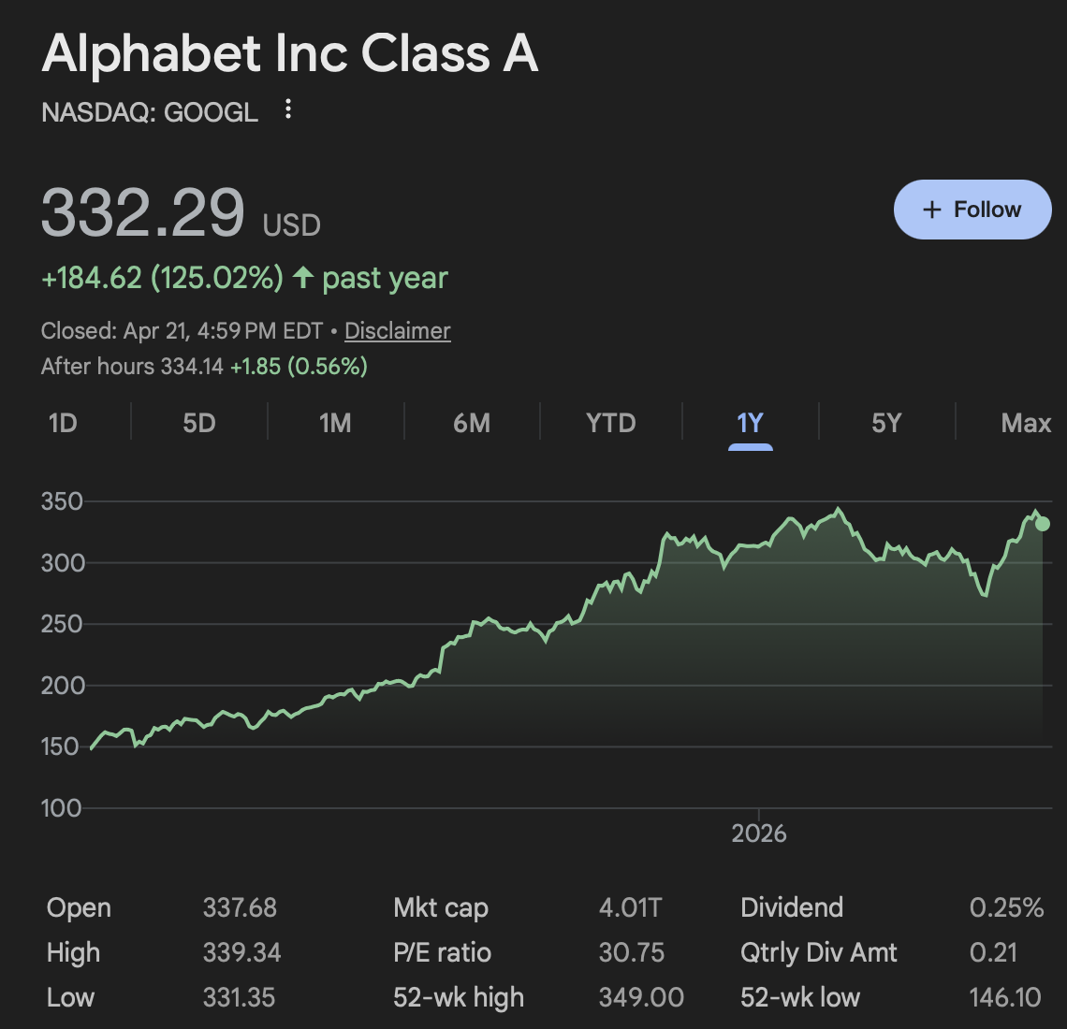
Alphabet Inc, Class A
Overview:
Alphabet operates as a global technology platform company built around its core Google ecosystem. Through its main segments, it delivers products and services across search, digital advertising, YouTube, cloud infrastructure, AI solutions, software, and consumer platforms used by billions of people worldwide.
Alphabet’s revenue is heavily driven by advertising, primarily through Google Search and YouTube, though it is increasingly diversifying into high-growth areas like cloud computing and artificial intelligence.
Risks:
Google’s core business is heavily reliant on advertising, making it highly sensitive to economic slowdowns and reductions in corporate ad spending.
Rising AI-related capital expenditures could pressure margins if revenue growth does not keep pace with increased infrastructure spending.
Ongoing antitrust and regulatory scrutiny could force structural changes to Google’s business model, impacting its competitive advantage and long-term growth.
Sector: | Communication Services
Industry: | Interactive Media & Services
Price: | $332.29
Beta: | 1.13
Market Cap: | 4.133T
Shares Outs. | 5.82B

Slide 4
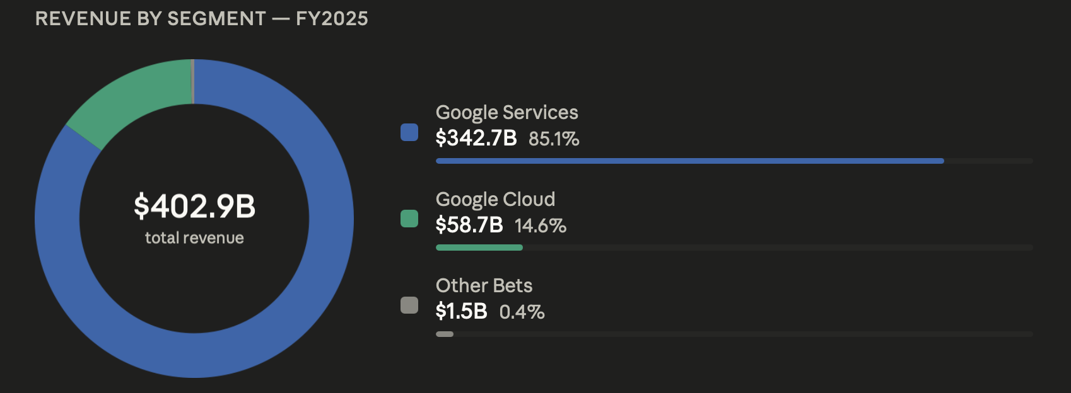
Business Analysis
3 Business Segments
Google Services: Google Cloud: Other Bets:
Core products include Search, YouTube, Android, Chrome, Gmail, and Maps
Driven primarily by advertising and consumer platforms
Foundation of Alphabet’s ecosystem and competitive moat
Provides infrastructure, data, and AI solutions (GCP, Workspace, Vertex AI)
Benefiting from rising enterprise demand for AI and cloud computing
Fastest-growing segment with strong revenue and margin expansion
Smallest segment with minimal revenue contribution
Includes long-term investments like Waymo
Currently operates at a significant loss
Focused on innovation and future growth opportunities
High upside potential but high execution risk

Slide 5
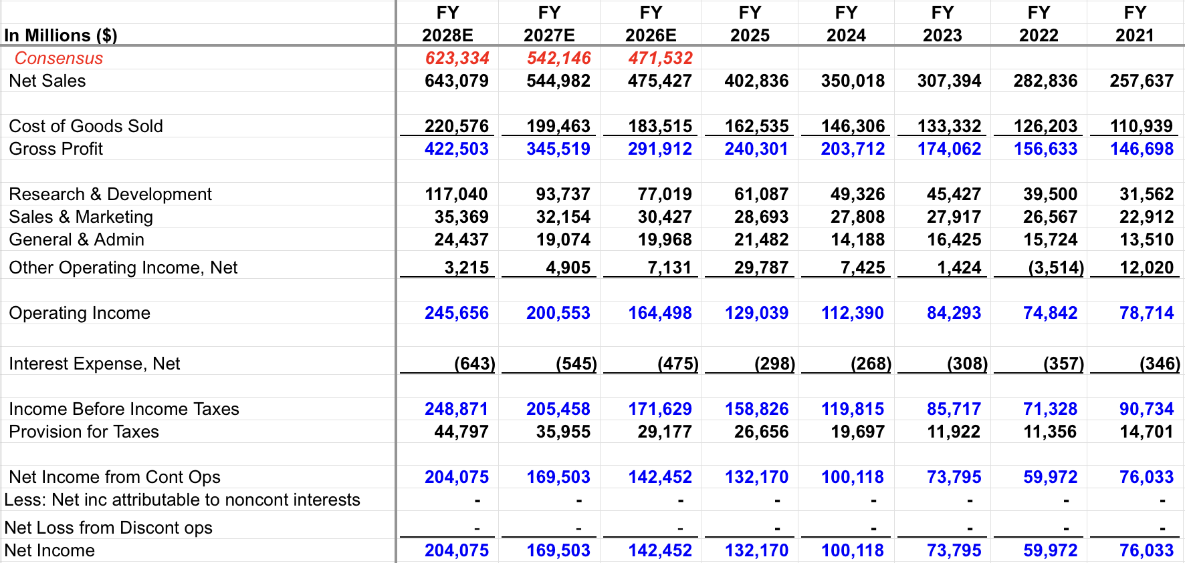
Financial Analysis
Strong revenue growth expected, with sales projected to grow at a double-digit rate in the near term
Consistent expansion in operating income driven by scale and improving cost structure
Operating margins continue to improve over time, reflecting better efficiency and profitability
Alphabet Meta
ROE | 34.52% | 30.13%
Revenue Growth (5yr Avg.) | 17.16% | 18.51%
EBITDA Margin | 38.1% | 40.1%
Price to Earnings (P/E) | 33.39x | 29.21x
EV/EBITDA | 21.68x | 13.09x
Alphabet shows strong profitability with higher ROE (34.52%) than Meta (30.13%), indicating efficient use of capital
Meta leads slightly in revenue growth and EBITDA margins, but Alphabet remains highly competitive
Alphabet trades at a higher P/E and EV/EBITDA, reflecting expectations for future growth (AI + Cloud)

Slide 6
Valuation
Absolute Basis | High | Low | Average | Current
P/E | 61.37x | 17.07x | 29.04x | 33.39x
P/B | 12.5x | 4.2x | 7.5x | 10.55x
P/S | 15.8x | 3.5x | 8.21x | 10.76x
P/EBITDA | 35.48x | 14.26x | 22.3x | 23.4x
Current valuation sits within historical ranges, suggesting the stock is neither significantly overvalued nor undervalued
Some multiples reflect a discount to historical averages, indicating potential upside if growth expectations are met
Overall pricing suggests the market is taking a balanced view on future performance and risk
Strong upside exists if the company executes well on growth and margin expansion initiatives
Base expectations point to steady, moderate returns supported by core business strength
Downside risk appears manageable, indicating a favorable overall risk-reward profile
Scenario | Terminal Growth Rate | WACC | Implied Stock Price | Upside/Downside
Best Case | 6.5% | 9.0% | $646.20 | 92.30%
Base Case | 5.5% | 10.0% | $379.60 | 14.23%
Worst Case | 4.5% | 11.0% | $275.70 | -17.95%
*Current price as of 4/21/26: $332.29

Slide 7
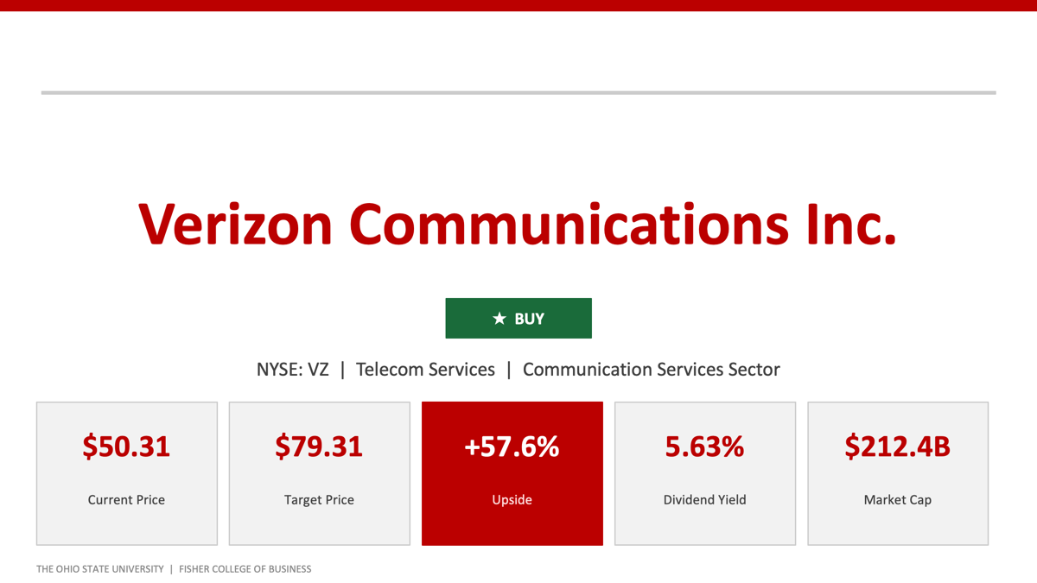
Verizon Communications Inc.
★ BUY

Slide 8
Verizon Communications INC
Verizon Communications Inc. is one of the largest telecommunications, offering wireless services, broadband internet, and enterprise communications. It operates a massive nationwide mobile network and generates the majority of its revenue from postpaid wireless customers, along with growing contributions from broadband and business services.
The company is known for its strong, stable cash flows and defensive business model, supported by high customer retention and recurring subscription revenue. It is also a major dividend payer, typically offering a yield around the mid-5% range, which makes it attractive to income-focused investors.
In recent years, Verizon has focused on improving network quality and expanding its 5G infrastructure, including investments in fiber and fixed wireless access (FWA) to compete more effectively in broadband. While growth is relatively modest compared to high-growth tech companies, its appeal lies in consistent earnings, strong market positioning, and reliable shareholder returns.

Slide 9
Verizon Communications Inc.
Sector | Communication Services
Industry | Telecom Services
Market Cap | $212.44B
Current Price | $50.31
Target Price | $79.31
Dividend Yield | 5.63%
Diluted Shares | 4,218M
Rating | BUY
Investment Thesis
Deeply Undervalued
DCF implies $79.31/share vs. $50.31 current — 57.6% upside using a conservative 11% discount rate and 1% terminal FCF growth.
Frontier Acquisition
Adds 15M locations (9M fiber-ready), expanding Verizon beyond the northeast. Synergies expected 2026–2028 through consolidation and bundling.
Fixed Wireless Growth (FWA)
Adds $50–60/month per subscriber with near-zero marginal cost on existing 5G network. Record Q4 2025 subscriber adds; mgmt targets 8–9M subs by 2028.
Dividend Fortress
19 consecutive years of dividend growth at 5.63% yield. ~55% FCF payout ratio; BBB+ rated — more attractive than investment-grade bonds.
THE OHIO STATE UNIVERSITY | FISHER COLLEGE OF BUSINESS

Slide 10
Financial Analysis
Key Income Statement Metrics ($M)
 | FY2025E | FY2026E | FY2027E
Total Revenue | $126,006 | $131,046 | $134,978
Operating Inc. | $55,443 | $57,005 | $59,256
Op. Margin | 44.0% | 43.5% | 43.9%
Net Income | $55,884 | $57,451 | $59,701
EPS (Diluted) | $13.25 | $13.63 | $14.15
Key Takeaways
Peer Multiples Comparison
Company | P/E | EV/EBITDA | P/S | P/CF
VZ (Verizon) | 12.3x | 7.9x | 1.56x | 9.4x
T (AT&T) | 14.8x | 6.8x | 1.05x | 8.2x
TMUS (T-Mobile) | 26.1x | 12.4x | 3.87x | 21.5x
Revenue CAGR of ~3.5% FY2025–27E driven by wireless service growth and Frontier synergies
Operating margins improving from 44.0% to ~43.9% as FWA mix shift and cost consolidation take hold
EPS growth of ~$13.25 → $14.15 supports continued dividend coverage at ~55% of FCF
VZ trades at a discount to T-Mobile (26.1x P/E vs. 12.3x) — significant re-rating potential
THE OHIO STATE UNIVERSITY | FISHER COLLEGE OF BUSINESS

Slide 11
Valuation & Risks
DCF Valuation Summary
Key Risks
Assumption | Value | Output | Value
Discount Rate | 11.0% | NPV of Cash Flows | $217,571M
Terminal FCF Growth | 1.0% | NPV of Terminal Val. | $116,605M
Revenue Growth | 3–4% p.a. | Projected Eq. Value | $334,176M
Current Price | $50.31 | Implied Price/Share | $79.31
Elevated Leverage
$200.6B total debt (3.6x EBITDA). CEO targets 2.25x within 18 months; FCF pressure or a rating downgrade would delay deleveraging.
Competitive Intensity
T-Mobile's rural expansion and aggressive promotions pressure VZ's postpaid base and ARPU. AT&T fiber buildout adds further strain.
Sensitivity Analysis — Implied Share Price
Frontier Integration Risk
(Discount Rate vs. Terminal FCF Growth Rate)
Network consolidation, billing migration, and synergy timelines of 18–24 months represent key operational execution risk.
DR \ FCF Gr. | 0.5% | 1.0% (Base) | 1.5% | 2.0%
10.0% | $85.30 | $87.23 | $89.38 | $91.81
11.0% (Base) | $77.86 | $79.31 | $80.91 | $82.68
12.0% | $71.71 | $72.82 | $74.03 | $75.37
Interest Rate Sensitivity
Rising 10-year rates increase refinancing costs and compress the relative appeal of VZ's 5.63% dividend yield.
RECOMMENDATION: BUY | Target $79.31 | +57.6% Upside | +63.2% Total Return
THE OHIO STATE UNIVERSITY | FISHER COLLEGE OF BUSINESS

Slide 12

Meta Platforms, Inc
Overview
Founded in 2004, headquartered in Menlo Park, CA
World's largest social media company by daily active users
Operates Facebook, Instagram, WhatsApp, Messenger, Threads, and Meta AI
Two business segments: Family of Apps (FoA) and Reality Labs (RL)
FoA generates ~99% of total revenue through digital advertising
As of 2025, reaches ~3.58 billion daily active people (~40% of global population)
$200.97B
Revenue (TTM)
$1.50T
Market Cap
29.21x
P/E Ratio
1.28
Beta (5yr)
3.58B
DAP
0.40%
Div Yield
Key Risks
AI CapEx may not deliver ROI on schedule → margin pressure
Heavy reliance on advertising (~97% of revenue) → macro sensitivity
Regulatory / legal risks: youth safety, EU ad restrictions

Slide 13
Financial Analysis
Revenue Growth (USD Billions)
Key Metrics - META vs. Peers
 | META | GOOGL | MSFT
Op. Margin | 41.3% | 31.6% | 47.1%
Net Margin | 30.1% | 32.8% | 39.0%
ROE | 30.2% | 34.5% | 35%
ROA | 16.2% | 15.1% | 14%
Rev Growth | +22.2% | +15% | +16%
ROE Breakdown
30.1%
Net Profit Margin
Strong Profitability
0.54x
Asset Turnover
Efficient asset use
1.87x
Equity Multiplier
Moderate Leverage
30.2%
ROE
Strong Return

Slide 14
Valuation
Relative Multiples - META vs. Peers
DCF Summary
 | P/E | P/B | P/S | EV/EBITDA
META | 29.21 | 8.60 | 9.01 | 16.31
GOOGL | 33.39 | 10.55 | 10.76 | 23.40
AMZN | 28.64 | 5.36 | 3.10 | 13.52
MSFT | 23.90 | 7.25 | 9.33 | 14.89
Avg | 28.79 | 7.94 | 8.05 | 17.03
NPV of Cash Flows | $580.3B
NPV of Terminal Value | $1,347.0B
Projected Equity Value | $1,927.3B
Shares Outstanding | 2,517M
Implied Value / Share | $765.70
Current Price | $676.64
Upside | +13.2%
META trades roughly in line with its digital advertising peers on P/E
EV/EBITDA of 16.3x is slightly below peer average, suggesting cash flow support
P/B and P/S premium reflects strong margins and scale vs. peers
Trades at a discount to Alphabet despite comparable ad market dominance
Scenario Analysis
Bear
Base
Bull
$521
$766
$819
Base case: 10.0% WACC, 2.5% terminal FCF growth, 15-16% revenue growth, 36-40% op. margins
-23.1%
+13.2%
+20.9%

Slide 15
Technical Analysis
META 12-Month Price Performance
Porter’s Five Forces
New Entrants
LOW
Suppliers
LOW
Buyers
MEDIUM
Substitutes
MEDIUM
$796.25
$479.80
$676.64
-15%
52-Wk High
52-Wk Low
Current
vs. Peak
Stock pulled back ~15% from peak on AI spending concerns - not fundamental deterioration. Q4 2025 revenue +24% YoY; Q1 2026 guidance implies +30%.
Rivalry
HIGH

Slide 16

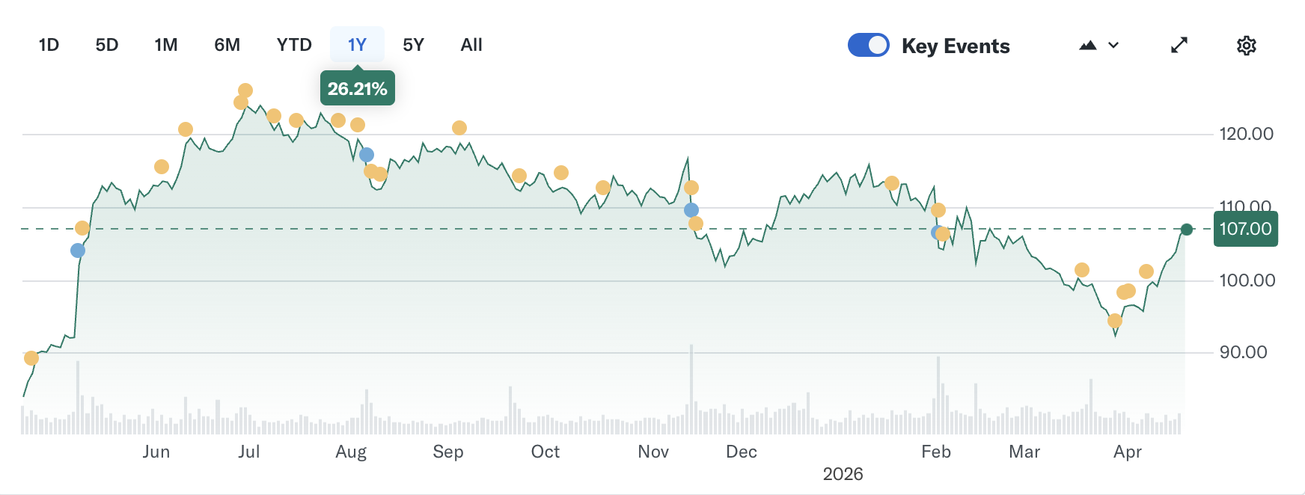
Walt Disney Co (DIS)
Overview:
Disney is a global entertainment leader containing a diversified business model separated out between entertainment, sports, and experiences. Between the different business segments, it brings in revenue through ways such as streaming, film and TV production, sports media, and experiences consisting of theme parks, cruises, and resorts internationally.
One of Disney's biggest assets, its intellectual property, makes it easy to monetize content and well-known characters across different platforms and revenue streams.
Thesis and drivers:
Disney has high margin expansion driven by its success in streaming
Experiences segment in Disney generating impressive year over year growth and profit
A very strong and growing cash flow and impressive balance sheet
Stock trading at a historical discount in comparison to peers and itself
Sector: | Communication Services
Industry: | Entertainment
Price: | $106.97
Beta: | 1.44
Market Cap: | 176.28B
Shares Outs. | 1.81B

Slide 17
Financial Analysis
Strong projected revenue growth $94.4B to $109B or 4-6% annual growth
EPS projected increase from $5.93 to $8.14 over time, double digit growth
Operating cash flow projected at around $19B, supporting reinvestment
Experiences segment driving about 57% of total operating income
Revenue & EPS Projections
Segment Operating Income Breakdown (FY25)
Disney vs Netflix
Disney P/E Ratio of about 16.8x vs Netflix P/E ratio of about 27x indicating that Disney trades at a discount with broader revenue streams
Netflix features operating margin of about 30% compared to Disney at 15%, showing that Netflix is currently more profitable, but Disney is still competitive
Disney features a diversified business model providing stable long-term cash flow vs Netflix single segment

Slide 18
Valuation
Historical vs. Current Multiples & Outlook
DCF Summary
Metric | Historical Avg | Current | vs. Hist. | Outlook
P/E | 18.5x | 16.8x | Discount | Expand ↑
P/B | ~3.5x | ~1.7x | Discount | Expand ↑
EV/EBITDA | ~14x | ~11.7x | Discount | Expand ↑
P/S | ~2.8x | 2.13x | Discount | Expand ↑
Discount Rate | 9.0%
Terminal Growth Rate | 1.8%
Shares Outstanding | 1.81B
Implied Value / Share | $122.45
Current Price | $106.97
Upside | +12.5%
Disney valuation has compressed in recent times showing that multiples are undervalued across the board (P/E ratio of 16.8x vs 18.5x historical average)
Current pricings reflect concerns related to macro uncertainty vs fundamentals
Stock is supported by stable assets and diversified revenue base
Current valuations allow for an attractive entry point with support from the multiples normalization as well as intrinsic value projections
P/S ratios

Slide 19
Final Recommendation
Stock | Current Price | Current Weighting | Buy/Sell/Hold | Weighting after Recc | Target Price | Expected Return
Alphabet (GOOGL) | $332.29 | 7.44% | Buy 50 BPs | 7.94% | $379.60 | +14.23%
Meta (META) | $676.64 | 4.04% | Buy 50 BPs | 4.54% | $765.70 | +13.2%
Walt Disney (DIS) | $106.97 | 0 | Buy 50 BPs | 0.50% | $122.45 | +12.5%
Verizon (VZ) | $50.31 | 0 | Buy 25 BPS | 0.25% | $79.31 | +57.6%
Primary Catalysts
GOOGL:
Strong Cloud growth and AI monetization upside
Trades within historical average multiples
META:
Ad revenue still growing; 3.58B daily active people
DCF implies 13% upside at base case
DIS:
Streaming now profitable; parks driving record revenue
Trading at a discount to historical multiples
VZ:
Deeply undervalued; DCF implies 57.6% upside
Frontier acquisition expands fiber footprint
Primary Risks
GOOGL:
Heavy AI capex spend could pressure margins near-term
Ongoing antitrust scrutiny and regulatory risk
META:
AI capex may not deliver ROI on schedule
Heavy reliance on advertising revenue (~97%)
DIS:
CEO succession uncertainty and linear TV decline
Macro uncertainty weighing on discretionary consumer spending
VZ:
Elevated leverage ($200.6B debt)
Competitive pressure from T-Mobile and AT&T

Slide 20
Appendix

Slide 21
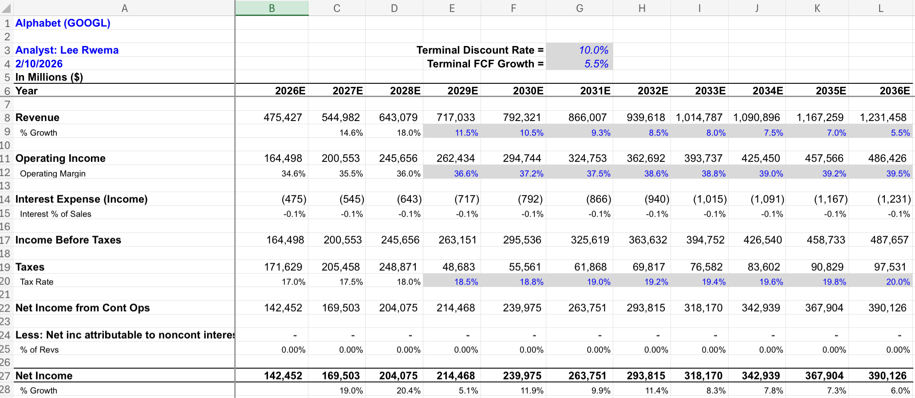
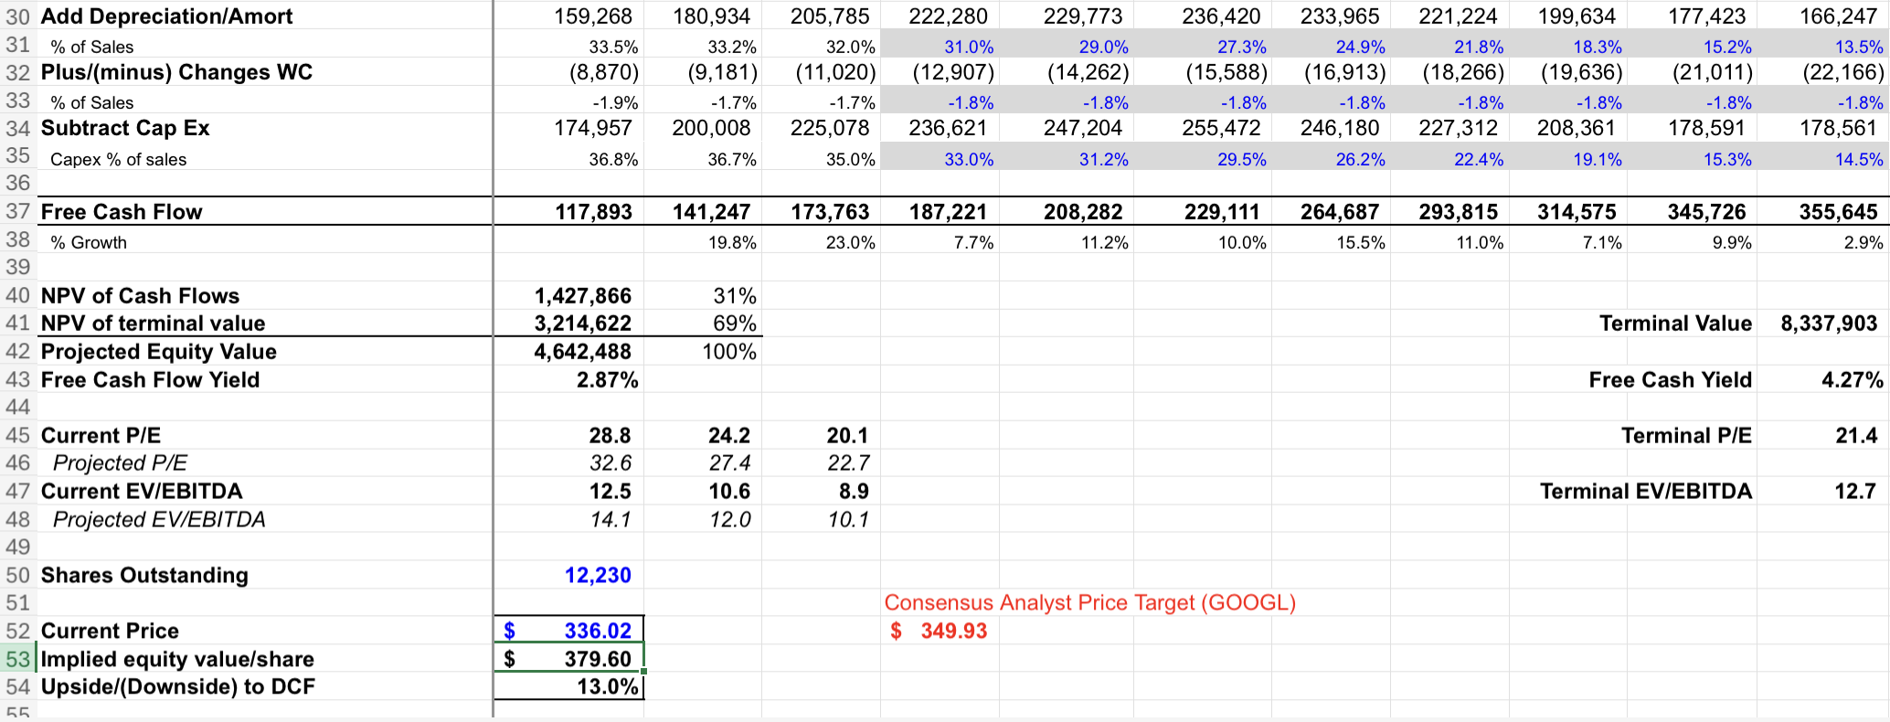
Alphabet DCF

Slide 22
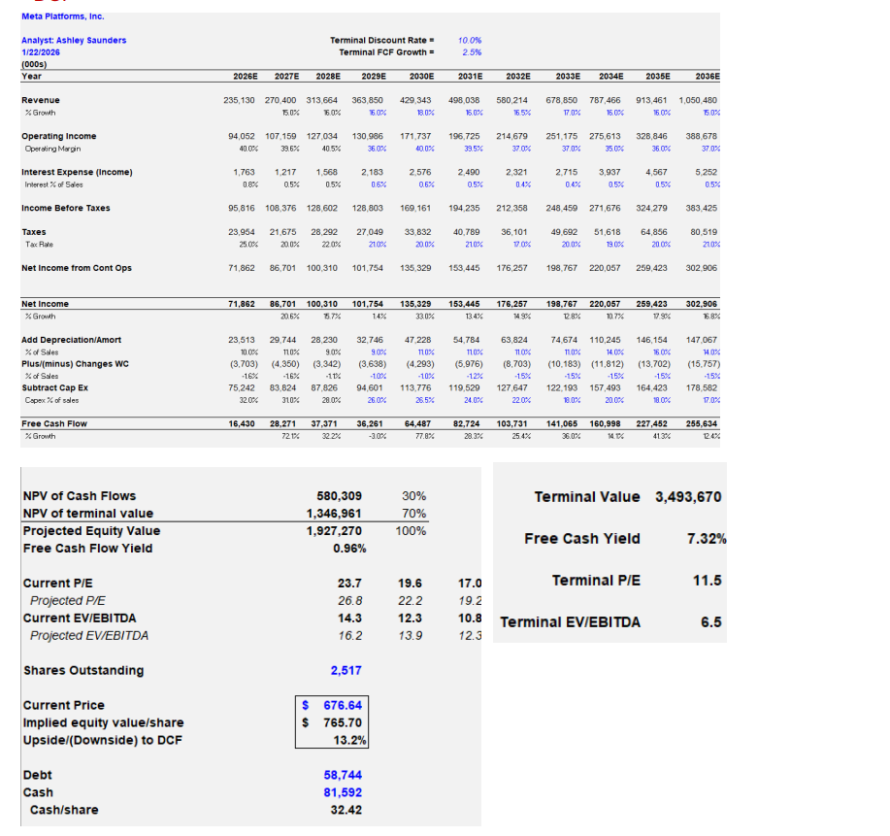
Meta DCF

Slide 23
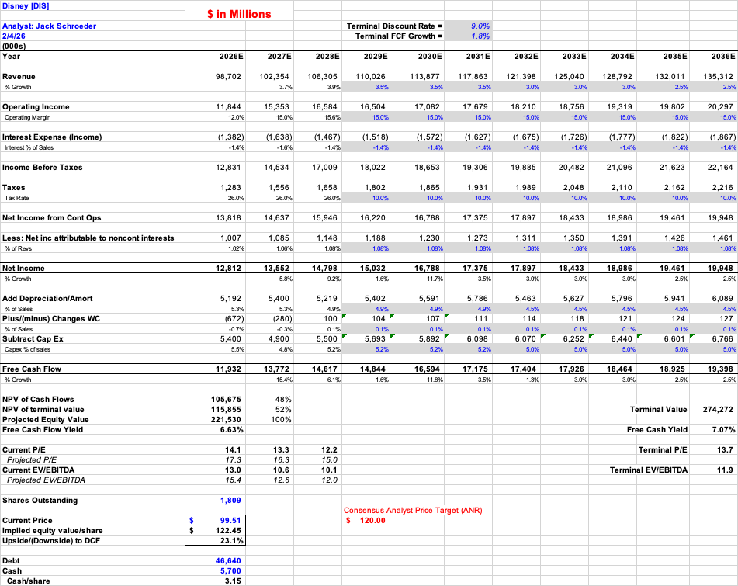
Disney DCF

Slide 24
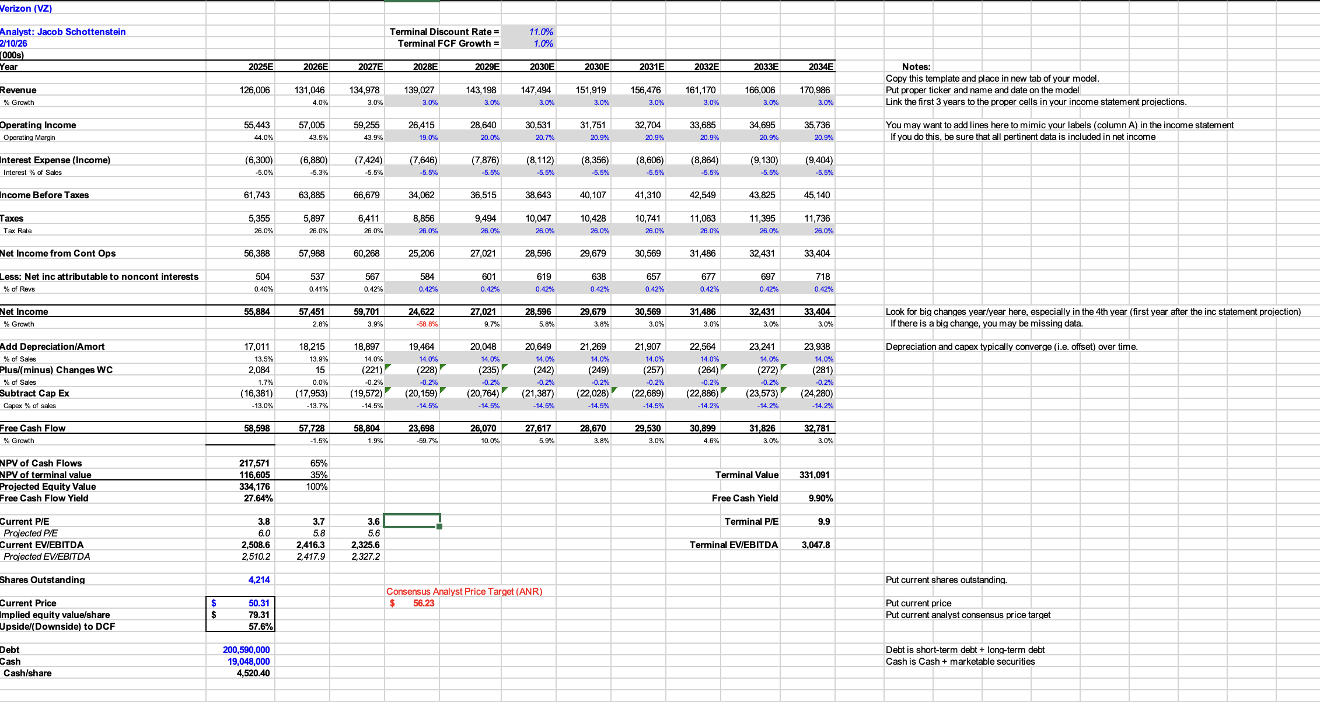
Verizon DCF

