Slide 1
Communication Services
Ashley Saunders, Jacob Schottenstein, Jack Schroeder, Lee Rwema

Slide 2
Ashley Saunders | Jacob Schottenstein | Jack Schroeder | Lee Rwema
Sector Overview — Size & Composition
8.9%
26
$26.2B
25.31x
of S&P 500
Market Cap
S&P 500
Constituents
XLC Net Assets
(Mar 23, 2026)
XLC P/E Ratio
(TTM)
What is Communication Services?
Formed in September 2018 via GICS reclassification, the Communication Services sector unifies companies from legacy Telecom, Technology, and Consumer Discretionary into one sector. It spans three broad industry groups: (1) Interactive Media & Services — Alphabet, Meta; (2) Entertainment & Media — Netflix, Disney, EA; and (3) Telecom Services — AT&T, Verizon, T-Mobile. The sector's index weight is heavily concentrated: Alphabet and Meta alone account for around 40% of XLC's weighting.
Source: State Street / XLC fact sheet, S&P Dow Jones Indices, as of March 23, 2026

Slide 3
Ashley Saunders | Jacob Schottenstein | Jack Schroeder | Lee Rwema
Industries Within the Sector
Interactive Media
& Services
Entertainment
& Media
Telecom
Services
~60% of XLC
~20% of XLC
~20% of XLC
Search & Digital Advertising
Social Networking Platforms
AI-Powered Products & Services
Online Content Platforms
Streaming Video (OTT)
Video Game Publishers
Film & Television Studios
Music Streaming
Wireless Carriers
Broadband & Cable
Satellite Communications
Fiber-Optic Networks
Key Holdings: GOOGL, META
Key Holdings: NFLX, DIS, EA, WBD, FOX, PSKY
Key Holdings: TMUS, T, VZ, CMCSA
O
Source: GICS / S&P Dow Jones Indices sector classification

Slide 4
Ashley Saunders | Jacob Schottenstein | Jack Schroeder | Lee Rwema
Largest Companies in the Sector
As of Market — March 23, 24, 2026
Company
Ticker
Close Price
Mkt Cap (approx.)
XLC Weight
Industry Group
Alphabet Inc.
GOOG/GOOGL
$299.02
$3.88T
19.9%
Interactive Media
Meta Platforms
META
$593.66
$1.50B
18.65%
Interactive Media
Netflix Inc.
NFLX
$92.588
$388B
5.5%
Entertainment
AT&T Inc.
T
208.76
$204B
4.8%
Telecom Services
T-Mobile US
TMUS
$213.42
$200B
2.8%
Telecom Services
Walt Disney
DIS
$97.47
$172B
2.2%
Entertainment
O
Source: Yahoo Finance, Investing.com — prices as of March 23, 24. 2026. XLC weights are approximate. T-Mobile close price not confirmed at time of publication.

Slide 5
Ashley Saunders | Jacob Schottenstein | Jack Schroeder | Lee Rwema
Sector Performance — YTD & Historical Returns
XLC Close (Mar 23, 2026)
XLC Annual Total Returns
$117.75
+0.73% today
+50%
+52.8%
XLC YTD Total Return
+34.7%
-3.75%
as of Mar 23, 2026
+25%
+23.10%
2025 Full Year Return
+23.10%
vs S&P 500 +23.3%
2024 Full Year Return
0%
+34.7%
#1 sector in 2024
2023 Full Year Return
-25%
+52.8%
Post-bear market snap-back
XLC P/E Ratio (TTM)
-37.6%
25.31x
Reasonable vs growth history
2022
2023
2024
2025
Source: Yahoo Finance, State Street SPDR. XLC YTD return as of March 23, 2026 market close ($117.75). Annual returns are total return net of fees.

Slide 6
Business Analysis
Phase of Life Cycle
Business Cycle Classification
High
Stable/defensive
Introduction
Growth
Maturity
Decline
Demand Stability
Telecom
Defensive floor
Cyclical
Comm. Services
Ad Revenue
Cyclical Exposure
Low
Economic Sensitivity
Low
High
The sector is in a mature phase, characterized by large, established firms and slower structural growth, but continued innovation in AI, streaming, and digital platforms is sustaining expansion and preventing decline.
Classified as cyclical, as performance is positively correlated with economic growth, particularly through advertising and media revenues, while still supported by stable demand for essential telecom and communication services.

Slide 7
Porters 5 Forces Analysis
Threat of New Entrants (Low)
Massive capex requirements for telecom infrastructure Network effects (Meta, Google) make user bases nearly impossible to replicate Established brands create near-unbreakable barriers to entry
Bargaining Power of Buyers (Moderate-High)
Low switching costs across streaming and social platforms Advertisers can shift spend across platforms easily Dominant platforms offset this through deep user engagement and bundling power
Bargaining Power of Suppliers (Moderate)
Content creators, cloud providers, and chipmakers hold some leverage Large platforms (Meta, Google, Netflix) use scale to negotiate favorable terms Telecom firms depend on equipment suppliers but retain leverage through size
Threat of Substitutes (High)
Many alternative platforms compete for attention (TikTok, YouTube, streaming, gaming) Consumers can easily switch between entertainment and communication options Constant innovation increases substitute pressure
Industry Rivalry (High)
Intense competition among Meta, Google, Netflix, Disney, and major telecoms Two distinct battlefields: telecoms compete on price/infrastructure, digital platforms compete for attention and ad dollars Continuous innovation and content spending create relentless margin pressure

Slide 8
PESTEL Analysis
Political
Economic
Sociological
Regulation and antitrust scrutiny of Meta and Google
Government control over telecom expansion (spectrum, broadband funding)
Ad revenue and streaming demand tied to economic cycles
High interest rates pressure capital-heavy telecom firms
Shift to digital media and short-form content consumption
Growing concerns around misinformation and screen time
Technological
Environmental
Legal
AI transforming advertising, content, and user engagement
5G and platform innovation driving new growth opportunities
High energy demand from data centers and network infrastructure
Increasing ESG pressure for sustainability and efficiency
Data privacy laws and content regulation increasing compliance costs
Ongoing antitrust and platform liability risks

Slide 9
Supply and Demand
Supply
Demand
Ongoing 5G infrastructure buildout expanding network capacity globally
Rapid data center expansion driven by AI and cloud computing demand
Spectrum availability and government funding support new capacity
High capital requirements limit supply growth to large incumbents
Growing demand driven by streaming, mobile usage, and AI-powered platforms
Asia-Pacific and emerging markets are the fastest-growing regions
Enterprise demand rising for cloud communication, cybersecurity, and 5G connectivity
US demand is mature but supported by device upgrades and bundled services
Demand is global and expanding, while supply remains concentrated among firms with the capital to invest, reinforcing barriers to entry.

Slide 10
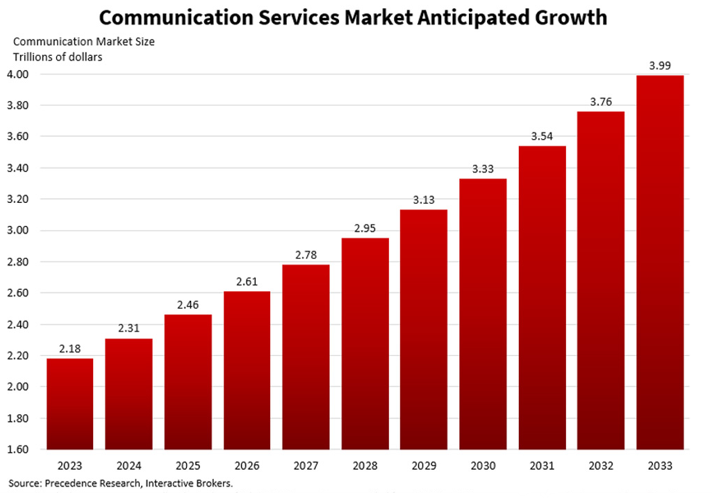
Profitability and Growth Outlook
Sector outperformed the S&P 500 in 2025 (~24% vs ~18%), driven by AI-exposed firms like Alphabet and Meta Performance was concentrated in large-cap platforms benefiting from AI integration and monetization Telecom and cable firms lagged due to limited exposure to AI-driven growth Profitability increasingly tied to digital advertising and platform-based business models
Projected to reach ~$3.99T by 2033 (~6.23% CAGR), supported by continued digital adoption AI is the primary long-term growth driver across advertising, platforms, and content ecosystems Gaming emerging as a high-growth segment as AI enhances development and user engagement Sector remains resilient, with consistent demand for connectivity, media, and digital services even in downturns

Slide 11
Segmentation and Concentration
Telecom
Stable, subscription-based demand
AT&T, Verizon, Comcast
Media & Entertainment
Source: Yahoo Finance
Content and streaming driven
Netflix, Spotify, Disney
Sector includes around 26 firms, but performance is concentrated in a small number of mega-cap companies
Large platform firms (Alphabet, Meta) anchor sector returns, particularly through AI-driven growth
Interactive Media & Services
Platforms, search, social, AI
Alphabet, Meta

Slide 12
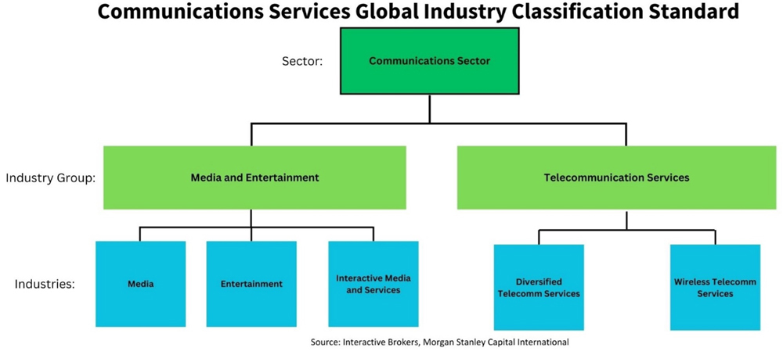
Economic Analysis
Communication Services is a combination of growth-focused media companies & defensive telecom
Sector is overall more growth sensitive due to media, entertainment , & interactive services (Cyclical)
Interactive media & services has the largest weight of XLC (39.12%); Responsible for driving most of the growth
Key economic drivers: GDP growth, advertisement spending, business & consumer confidence

Slide 13
Financial Analysis
Current Communication Services trends
23.10%
XLC's overall return in the 2025 calendar year
12.5%
Q4 sector blended earnings growth
$15.35
XLC's trailing 12-month cash flow per share;
Supports strong cash generation
10.64%
Estimated 3–5-year EPS growth rate
13.1%
Q4 sector blended revenue growth
13.8%
Q3 2025 net profit margin for the sector
Vs 12.8% for the S&P
Meta & Alphabet are massive contributors to growth combining to 38% of XLC, showing a concentration on a few digital powerhouses

Slide 14
Absolute Valuation Analysis
Absolute Metrics:
P/E ≈ 25.31
P/S ≈ 5.09
P/B ≈ 5.84
Valuations vary widely within Communication Services due to the different fundamental economics:
  Interactive Media & Services: Higher margins and scalable unit economics which support higher P/S, P/E, P/B
  Entertainment & Media: Depends on the company as Netflix might have higher multiples due to having higher margins because of their streaming business model and growth expectations. Whereas companies like Paramount might have lower multiples due to asset heavy business model and low growth expectations
  Telecom Services: These companies such as AT&T, Verizon, and T-Mobile have the lowest multiples due to low growth and their capital-intensive business models

Slide 15
Relative Valuation Analysis
Relative Metrics:
P/E ≈ .91
P/S ≈ 1.48
P/B ≈ 1.05
Why valuations have expanded over time:
  Platform Businesses: Asset light and high margin from the largest companies in the sector, Alphabet, Netflix, Meta
  AI + Digital Advertising Tailwinds: The hype over AI has investors pricing in strong future growth
How we think valuation multiples will behave in the future:
  Valuations will likely stay the same or slightly contract
  They are already trading at historical highs
  Growth expectations are priced in
  Other sectors in the market are catching up

Slide 16
SIM Recommendation
Major Positives
Major Risks
AI Monetization
Digital Advertising
High Margins
Strong Balance Sheets
Valuation Risk
Concentration Risk
Regulatory Risk
Interest Rate Risk
Final Recommendation
Keep an overweight on the sector
  Specifically, within Interactive Media & Services and Entertainment & Media
    Companies such as Alphabet & Meta
    Maybe opening a position on Netflix
  Underweight Telecom Services

