Slide 1

Spring 2025 Student Investment Management
Stock Recommendations:
Materials Sector
Bill Gu, Jack Guenther, Victoria Hacker, and Ben Hallis

Slide 2
Sector Overview

Slide 3
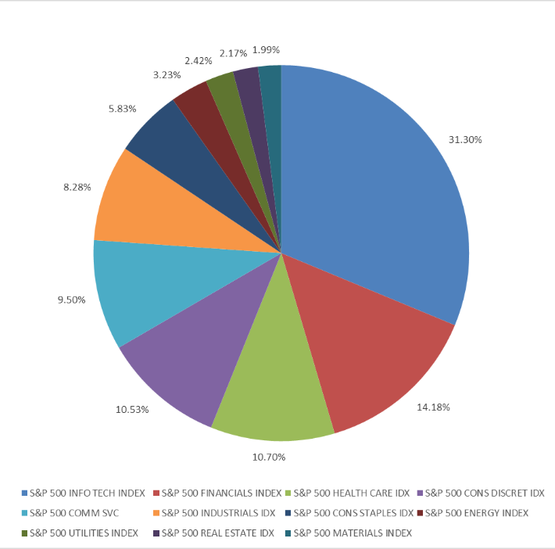
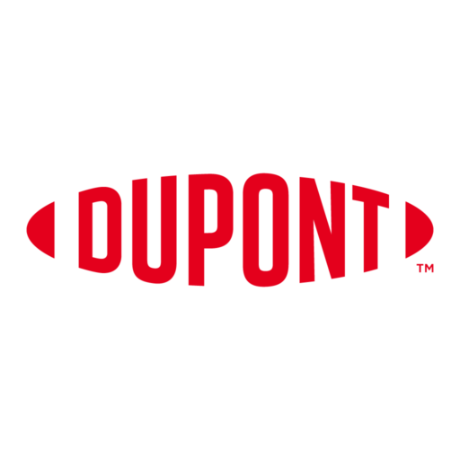


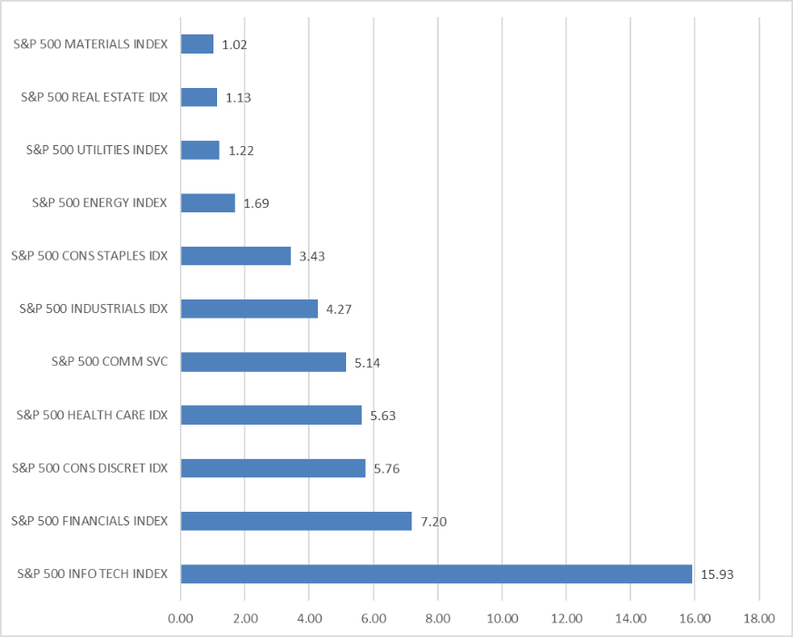






Sector Overview:
Recap
Materials Sector Overview
Materials sector is broken up into five industries including:
Chemicals
Metals & Mining
Containers & Packaging
Construction Materials
Paper & Forest Products
Materials Current Weight in the S&P 500 is 1.99% and is valued at $1.02T
Notes:
Makes up 1.99% of the SP 500 with a mkt cap weight of just over 1 trillion

Slide 4
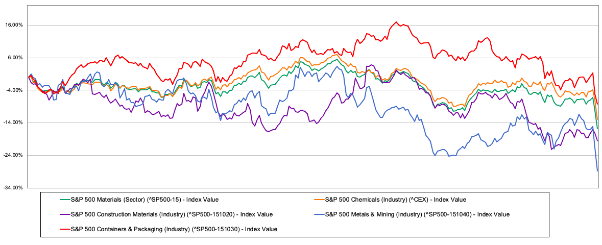
Sector Overview:
1-Year Performance
Notes:
Makes up 1.99% of the SP 500 with a mkt cap weight of just over 1 trillion

Slide 5
SIM Holdings & Recommendation Overview

Slide 6
SIM Portfolio: Holdings and Recommendations
Stocks (Ticker) | Unit Cost | Market Price | Unrealized P/L | Portfolio Weight | Recommendation
Dupont De Nemours Inc. (DD) | 57.21 | 67.78 | $34,873 | 1.24% | HOLD
FMC Corp. (FMC) | 58.18 | 36.90 | -$36,170 | 0.67% | SELL
Crown Holdings, Inc. (CCK) | - | 78.47 | - | - | BUY
Notes:
Makes up 1.99% of the SP 500 with a mkt cap weight of just over 1 trillion

Slide 7
Stock Analysis

Slide 8

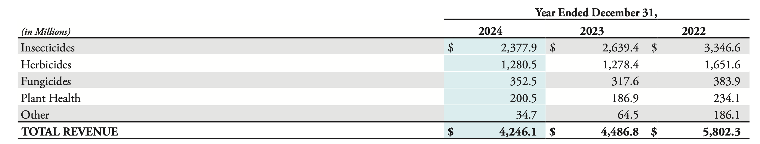
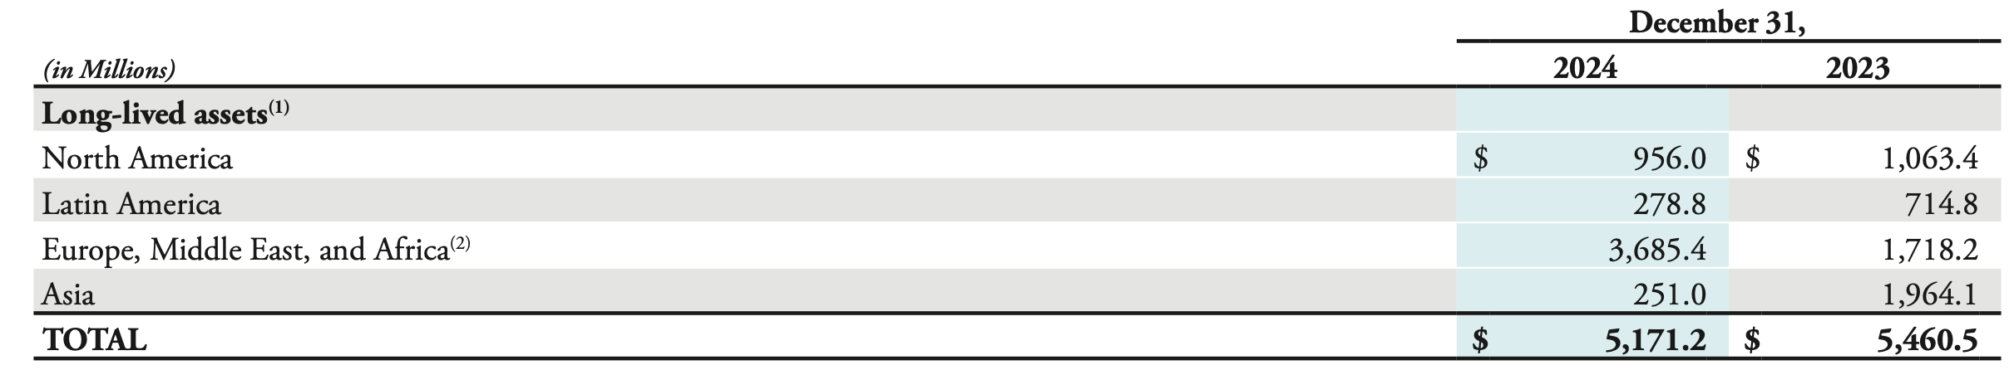
FMC Corp (FMC)
Overview
Food Machinery Corporation (Ticker FMC):
Sustained Competitive Advantages
FMC is an agricultural sciences company specializing in the production of agricultural solutions
  Crop protection, pest control, and specialty chemicals
Research and Development (R&D)
  Ability to create new efficient and environmentally sustainable products
Global Distribution Network
  Build and explore strategic partnerships
Source: FMC Corporation 2024 Annual Report
Annual Revenue from Various Products

Slide 9
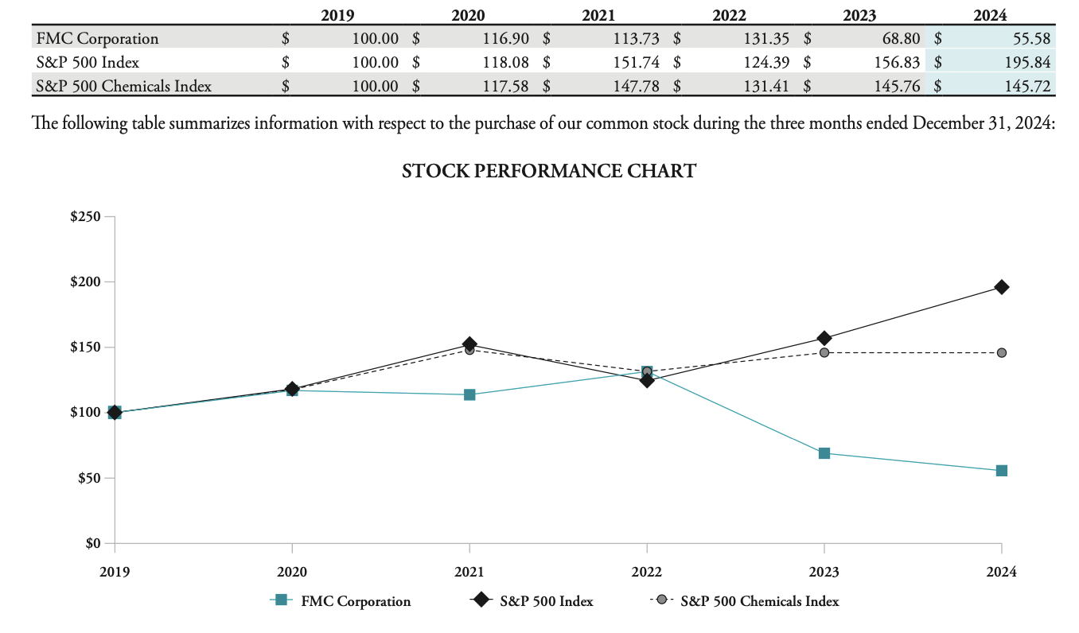
FMC Corp (FMC)
Business Analysis
S&P 500 Chemicals performance as of April 1st:
YTD Return: (-5.83%)
Top Performers in the Agricultural Chemicals Space (Peers):
  UPL LTD (+ 29.99%)
  Nufarm LTD (+12.15%)
Key Business Drivers:
Need for agricultural materials
Commodities prices (corn. soybeans, cotton, etc.)
  Higher commodities prices incentivize farmers to produce more
Seasonal needs for farming
  Include percentage
Sustainable crop-protection
  Ever changing laws and regulations surrounding crop chemical usage
**Mkt Cap: $4.43 B
**EPS (TTM): 3.34
**Beta: 0.82
Market Price: | $35.48
Shares Outstanding: | 124.9 M
P/E: | 10.61
Source: FMC Corporation 2024 Annual Report
Notes:
Peers are for agricultural chemicals producers (numbers as of last Friday, April 4th)
- 1 year return for SP 500 chemicals index is -13.00%
Why has stock performed poorly compared to peers?
UPL and Nufarm have been able to capture revenue growth through increased sale prices in parallel to an increasing demand for crop protection products
FMC Corp is still dumping a lot of cash into R&D, as well as consolidating its business into a single business segment as they are more focused on long term growth and developing environmentally friendly products to reflect future growth prospects (they forecast yield gains needed for food consumption from emerging markets).

Slide 10
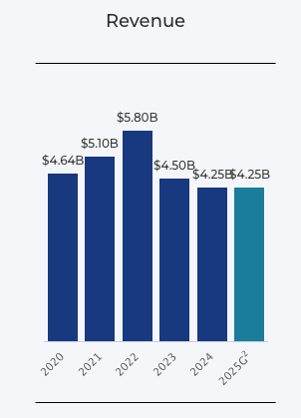
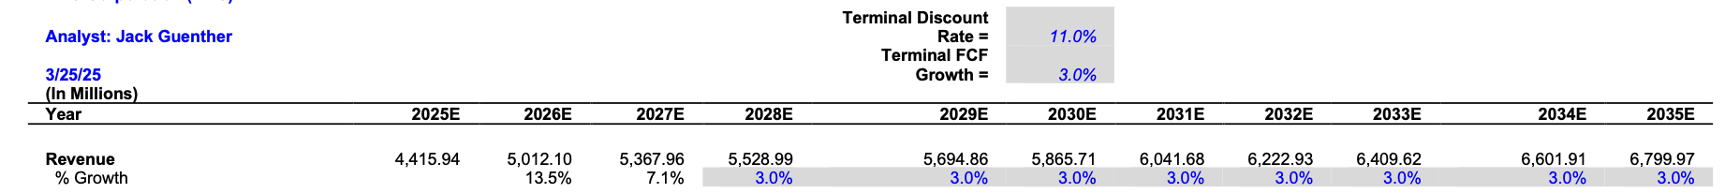

FMC Corp (FMC)
Financial Analysis
**EPS down (-3.67%) over the last year; 2025 outlook gives us a decrease (year over year) of (-1.75%)
**P/E FY1 and FY2 are 11.38, and 9.42, respectively
**ROA down from 11.44% in 2023 to 2.89% in 2024, forecasts estimate 4.40% in 2025
FMC Corp: | Median Among Peers:
EV/EBITDA: | 10.5
P/E: | 10.61
P/FCF: | 7.33
8.75
10.61
5.65
Dividend Yield: | 6.56%
1.83%
FMC ROE: 7.60%
Peer Average: (5.95%)
  Strong long-term financials as a result of long-term business strategy
  ROE is boosted even with higher dividend yield
Comparing the Past and Future:
Given two consecutive years of poor performance, and FMC’s market position we assume a terminal growth rate of 3%
Environment will not improve for FMC until an opportunity (increased yield gains for farmers) allows them to deploy their new products and increase sales margins
Source: FMC Corporation
Notes:
Market position (middle of the pack)
Going to take another 2-3 years at least to reach revenue growth similar to 2020-2022, at which point FMC was performing just on par with the SP 500
Expected future earnings for the next two years are down, hence another reason why the price is lower
EPS is expected to trend down, and while FY1 for PE is higher than the current PE, that number is due to fluctuate; FY2 forecast isn’t promising

Slide 11
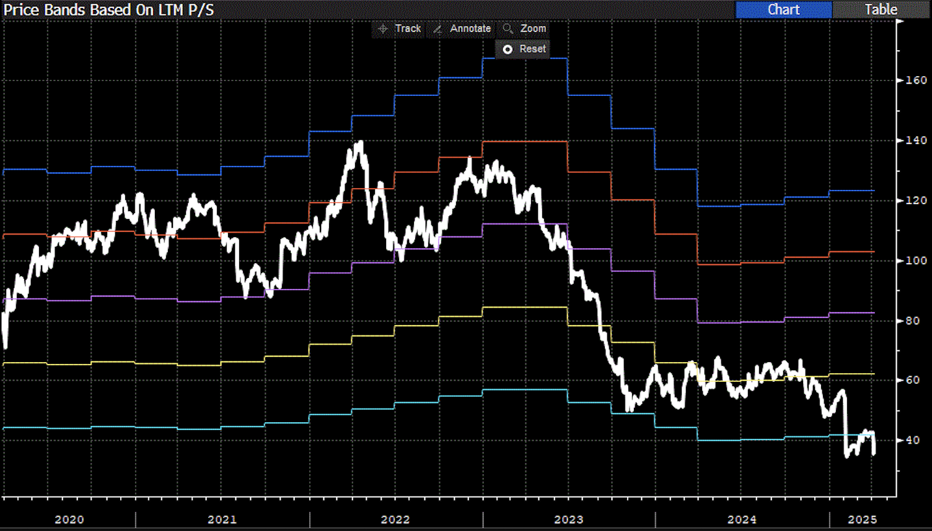
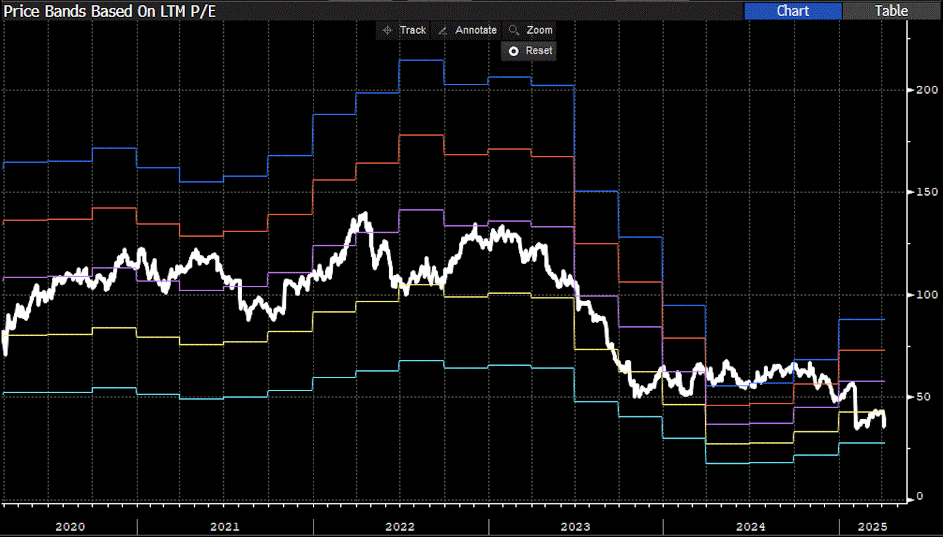
FMC Corp (FMC)
Valuation
Strengths to Recommendation:
Slow growth environment, won’t see sufficient returns for awhile
FMC’s forecast for this year is the same as last years
Will clear up space to allow for reallocation
Expectations for P/E and EPS will remain the same for the upcoming year; contracting valuation ratios are evident
Risks to Recommendation:
Potentially losing out on long-term gains
Selling while cheap
Will no longer receive high dividend
Ignore future high growth prospects for the industry
52 Week Price Range/Performance:
52-week-High | $68.72
52-week-Low | $33.80
YTD Change (%) | -19.89%
Recommendation:
Stock Holding | SELL
Current Price | $38.94
Target Price | $50.95
Implied Upside | 27.88%
Source: Goldman Sachs Analyst Price Forecast
Source: Bloomberg
Notes:
Reasons for recommendation? A whole lot of the same
ROA is trending downward as well, from 11.44 in 2023 to 2.89 in 2024, and currently has a ttm average of 3.56%
Slower expected growth as shown by contracting ratios

Slide 12

DuPont de Nemours, Inc. (DD)
Financial Analysis
DuPont de Nemours, Inc. (DD) Overview
DuPont is a global innovation leader specializing in electronics, industrial technologies, water solutions, and protective materials.
Company Snapshot
Market Cap | 24180.8 Million
Shares Outstanding | 418.5Million
P/E | 33.41
EV/EBIDA | 11.39
52 Week Range | $54.32 - $90.06
EPS | 1.67
Current Price | $57.78
Business High Light
Strong growth in Electronics Co
  Electronics segment increasing by 7%
  EBITDA growth by 19%,driven by rising demand in AI and semiconductors.
Upcoming Spin-off of ElectronicsCo with new CEO Jon Kemp
Valuation upside via SOTP Analysis: Higher Combined valuation for business
Risk Factor
PFAS Liability
Flat Growth in IndustrialsCo: flat sales and EBITDA in 2024, Weak Market
Trade Policy Headwinds

Slide 13
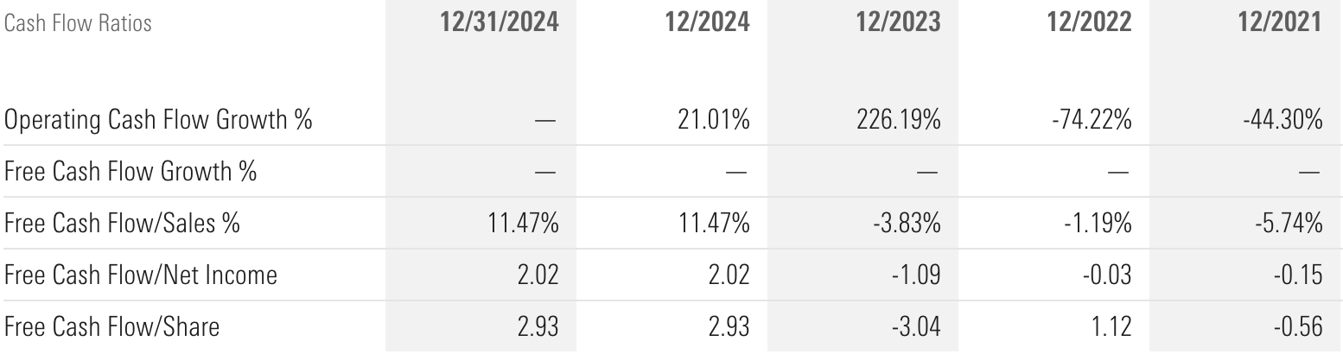
Dupont De Nemours Inc. (DD)
Overview
Recommendation
Current Price | $57.78
Target Price | $76
Imply upside | 33.8%
Stock Holding | Hold

Slide 14

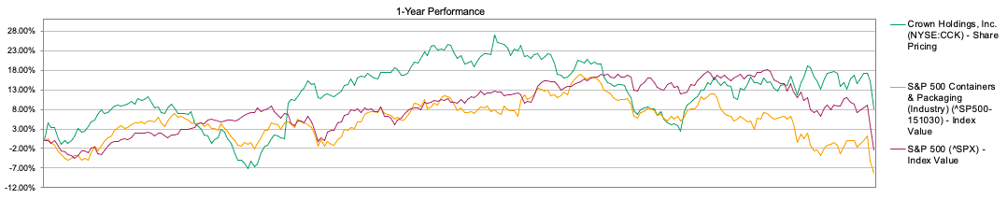
Crown Holdings Inc. (CCK)
Overview
CCK is a global leader and producer of steel and aluminum cans, ends, and closures for the soft drink, food, brewing, and personal care products industries. Markets Served include Beverage, Food, General Industrial, Health & Beauty, Household, Luxury Goods, & Metals. Founded in 1892.
Sales by Geographic Area:
US & Canada (44%)
Europe, Middle east, & North Africa (24%)
Asia Pacific (13%)
Central & South America (19%)
Company Snapshot
Market Cap | 9.7 Billion
Shares Outstanding | 116.2 Million
52 Week Range | $70.84 - $98.46
EPS | 6.41
Current Price | $78
1-Year Return (As of 4/7/25) | +5.3%
Dividend Yield | 1.2%
Sales by Business Segments:
Americas Beverage (44%)
European Beverage (18%)
Asia Pacific (10%)
Transit Packaging (18%)
Other (10%)
Sales by Product:
Beverage Cans (67%)
Food Cans & Closures (9%)
Transit Packaging (18%)
Other (6%)

Slide 15
Crown Holdings Inc. (CCK)
Business Analysis
Key Drivers
Risks
Sustainability and ESG trends
Aligns with CCK's 100% recyclable aluminum and steel cans
Expansion into High Growth Markets
New Plants opened in Asia, the Middle East, and Latin America to capture growth in faster growing markets
Long-Term Contracts
Contracts with key beverage & food manufactures provide pricing stability and revenue visibility. Some customers are consumer defensive companies.
Share Buyback plan
Aggressive buyback program ($2B through 2027)
Long Term Adaptations
Post Covid-19: Local sourcing and diversified supplier base
Material Cost Volatility and Tariffs
CCK is exposed to increased costs of aluminum and steel (accounts for 50% of COGS). May squeeze margins if pass-through is delayed or incomplete
Customer Concentration
Beverage and food industry is highly concentrated, leading to customer risks for CCK if contracts are lost
Debt Levels
Although decreasing, CCK carries high debt amounts following acquisitions. Most of debt maturing in 2026
Industry Cyclicality
Although packaging is somewhat defensive discretionary beverages may fluctuate with economic condition uncertainty

Slide 16
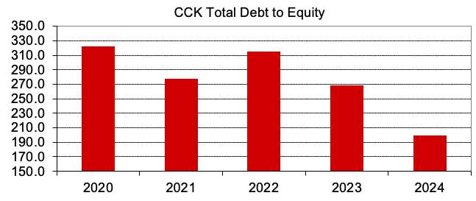
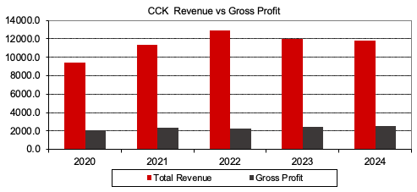
Crown Holdings Inc. (CCK)
Financial Analysis
Deleveraging: Achieve net debt/EBITDA of 3.0x by 2026.
(3.8x in 2023 to 3.4x in 2024)
 | CCK | 4-yr Avg | Peer Avg
ROE | 18.4% | 16.98% | 19.73%
ROA | 6.3% | 3.65% | 7.3%
Gross Margin | 21.5% | 20.18% | 20.37%
Operating Margin | 12.3% | 7.58% | 7.64%
Inventory Turnover | 6.1x | 5.53x | 5.82x
Revenue decline due to sell of European Tinplate business segment to private equity. Gross Margin continues to increase indicating more profitability.
Projected Sales (in $ millions)
2025 | 2026 | 2027
12,096 | 12,398 | 12,708

Slide 17
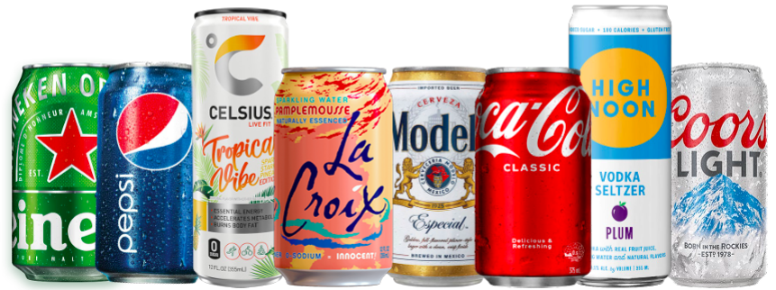
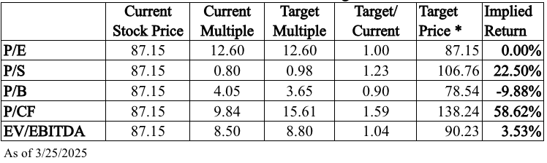
Crown Holdings Inc. (CCK)
Valuation
DCF Model
Summary
Recommendation | BUY (50 bps)
Current Price (As of 4/8/2024) | $78.47
Target Price | $100
Implied Upside | +28%
Sales Growth = 2.5%
Terminal Growth Rate = 2.0%
Discount Rate = 8.5%
Implied Target Price = $100
Assumption: Gross Margin may compress for 2 to 3 years from tariffs. Derivative hedging and pass-throughs may offset input cost increase. After 3 years, margins expected to return to regular levels as inventories have now post Covid-19.
Relative Valuation
Relative Target Price Range:
$78.54 - $138.24
Average = $100.18

Slide 18
Recommendation Summary

Slide 19
Recommendation Summary
Stocks (Ticker) | Current Price | Current Weight | Recommendation | Weight Post Recommendation | Target Price | Expected Return
Dupont De Nemours Inc. (DD) | $56.80 | 1.20% | HOLD | 1.20% (120 bps) | 76 | 33.8%
FMC Corp. (FMC) | $35.95 | 0.81% | SELL | 0% (0 bps) | $50.95 | -
Crown Holdings, Inc. (CCK) | $78.47 | - | BUY | 0.50% (50 bps) | $100 | 28%
Total SIM Current Weight: 2.21% (221 bps)
Total SIM Weight Post Recommendation: 1.70% (170 bps)
vs S&P 500 Current Weight: 1.99% (199 bps)
Current Prices As of April 7th 11:15 AM Current Weight As of March SIM Portfolio Appraisal

Slide 20
Appendix

Slide 21
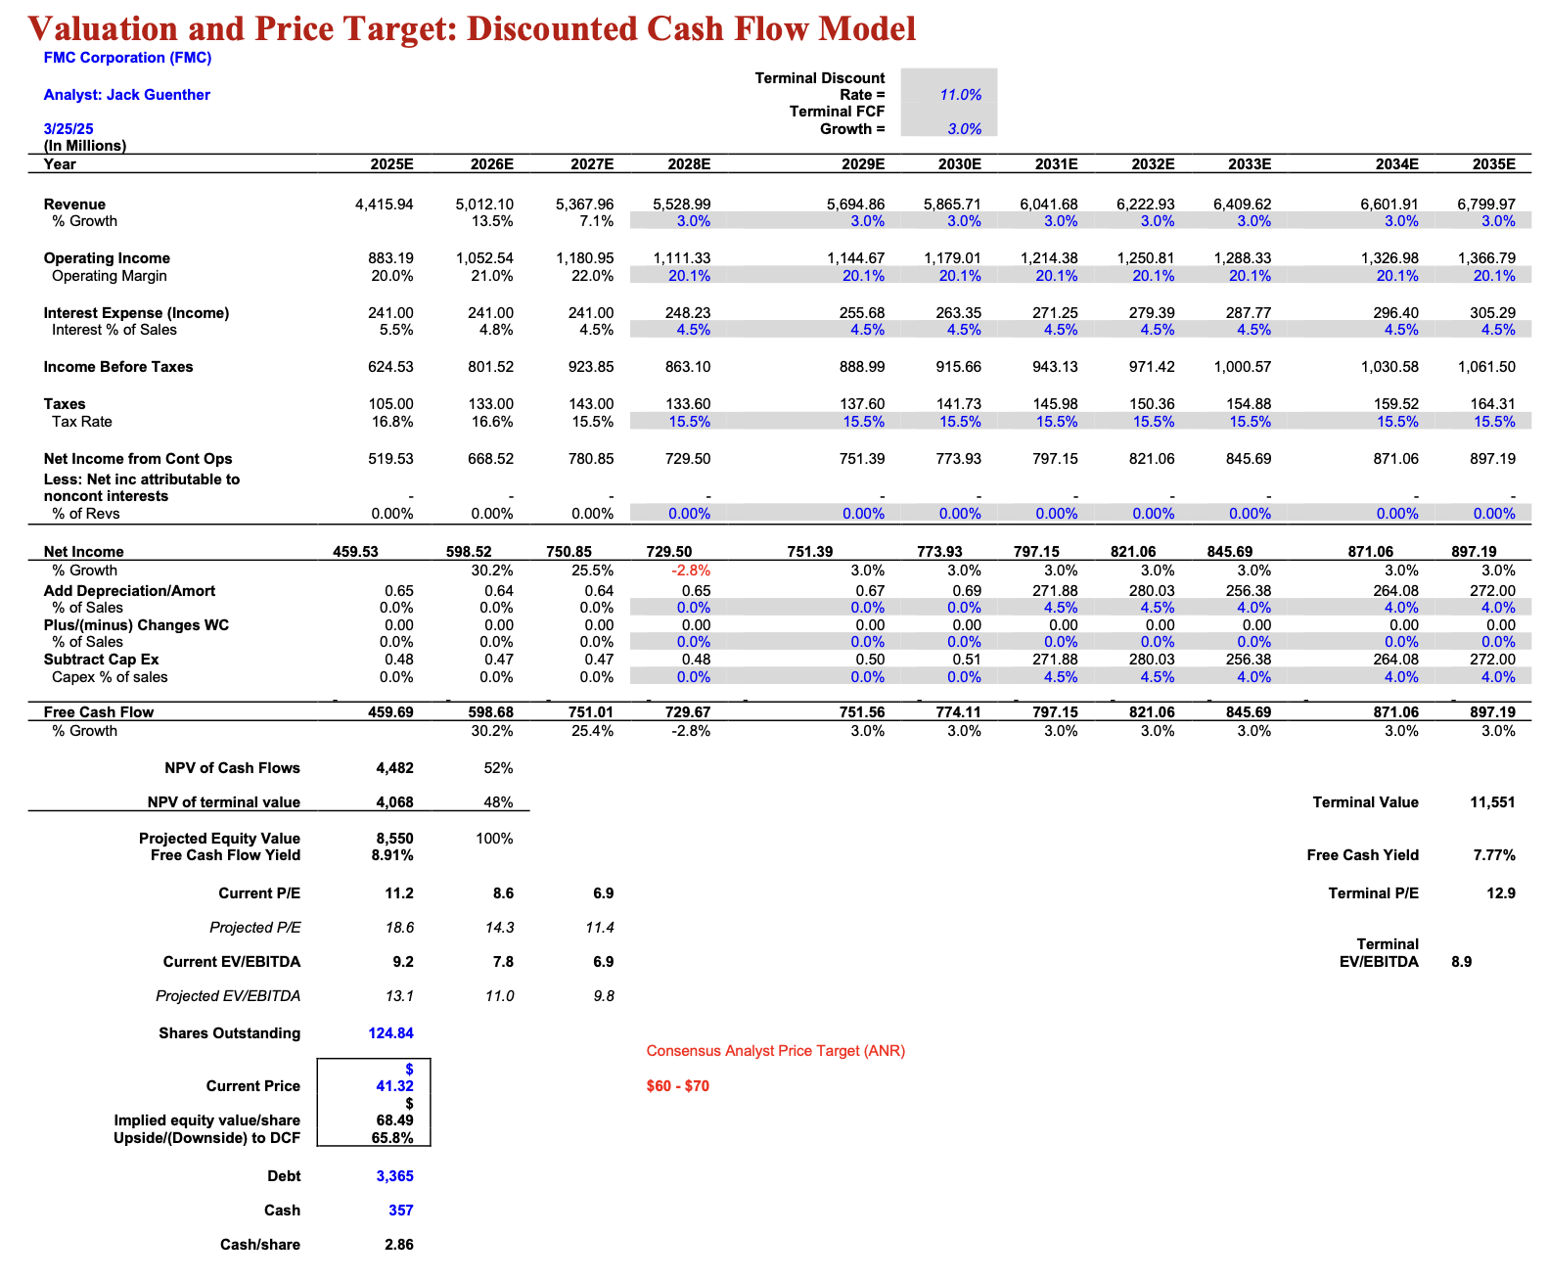
FMC
Discounted Cash Flow Model

Slide 22
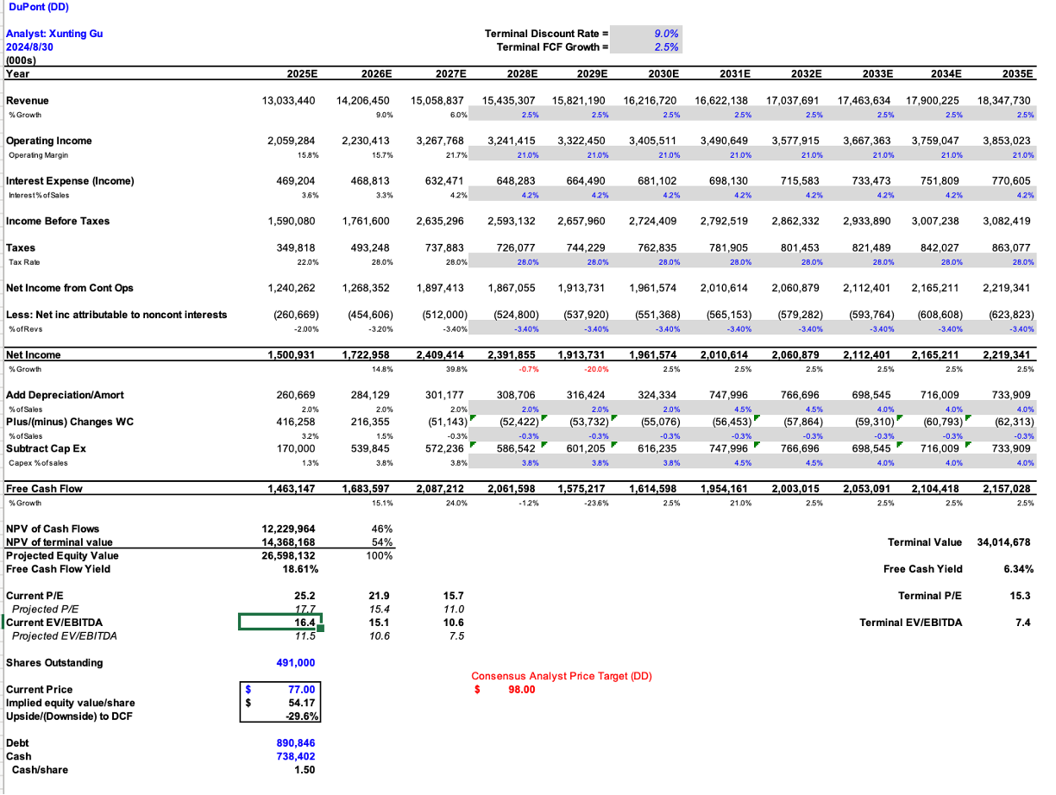
DD
Discounted Cash Flow Model
6406945c-fd83-4206-a134-4ef53fc16e1a

Slide 23
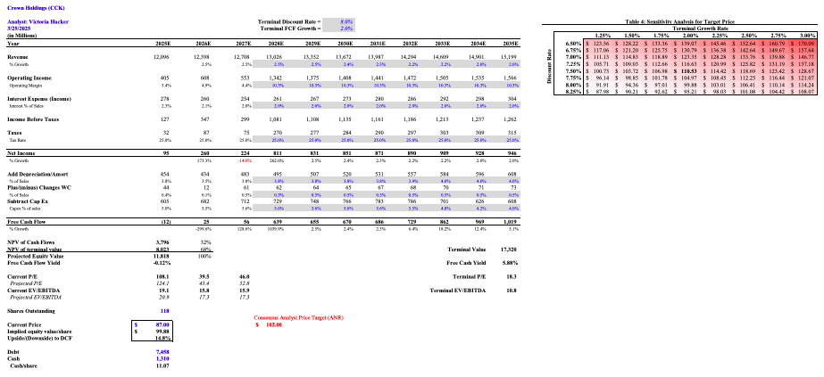
CCK
Discounted Cash Flow Model

