Slide 1
Materials Sector Recommendations
Zayne Jaber, Brian Kray, ShengHui Li, Shane Knezovic,

Slide 2
Sector recommendation recap
Moderately underweight the S&P 500 Materials sector overall (relative to the index weight)
Positives: structural demand for critical minerals (EV's, grid storage, electric), packaging sector has defensive characteristics (can outperform in volatile market)
Negatives: Chinese property demand uncertainty, macroeconomic risks, past performance
Overweight: Paper/packaging (defensive), metals/mining
Underweight: Chemicals, construction / raw materials

Slide 3
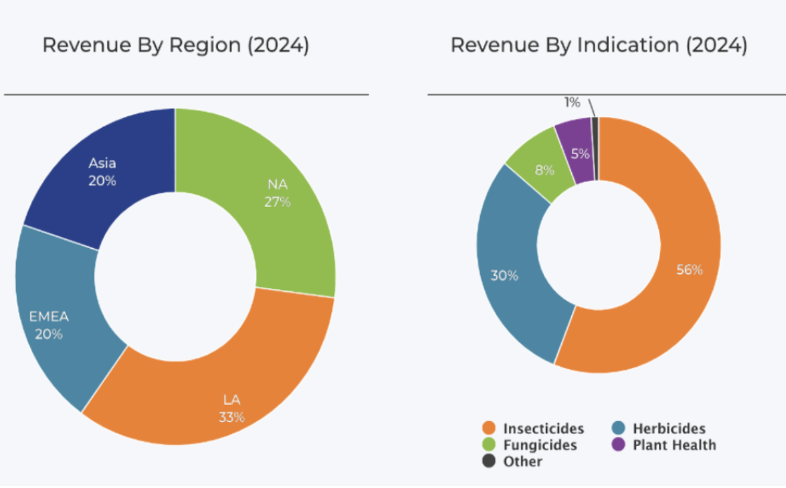
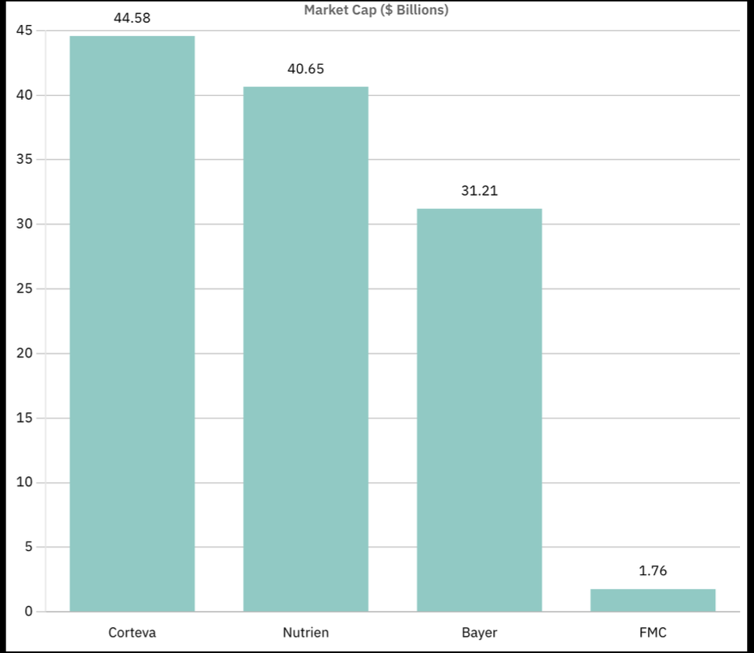

Overview
Agricultural Science company focused on the development and production of crop chemicals.
Operating in over 100 Countries FMC Corp exists as one of the five largest patented crop protection companies worldwide.
Acquired Cheminova in 2015 DuPont in 2017 which provided essential patented products.
Primary advantage of FMC comes from their intangible assets. IE: patents on their various crop protection products for which secures that for 20 years.

Slide 4
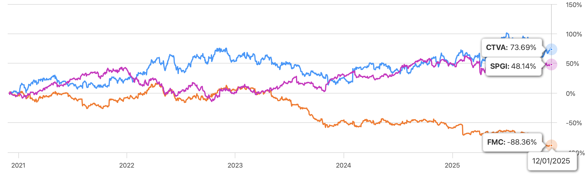
Financial Analysis

Slide 5
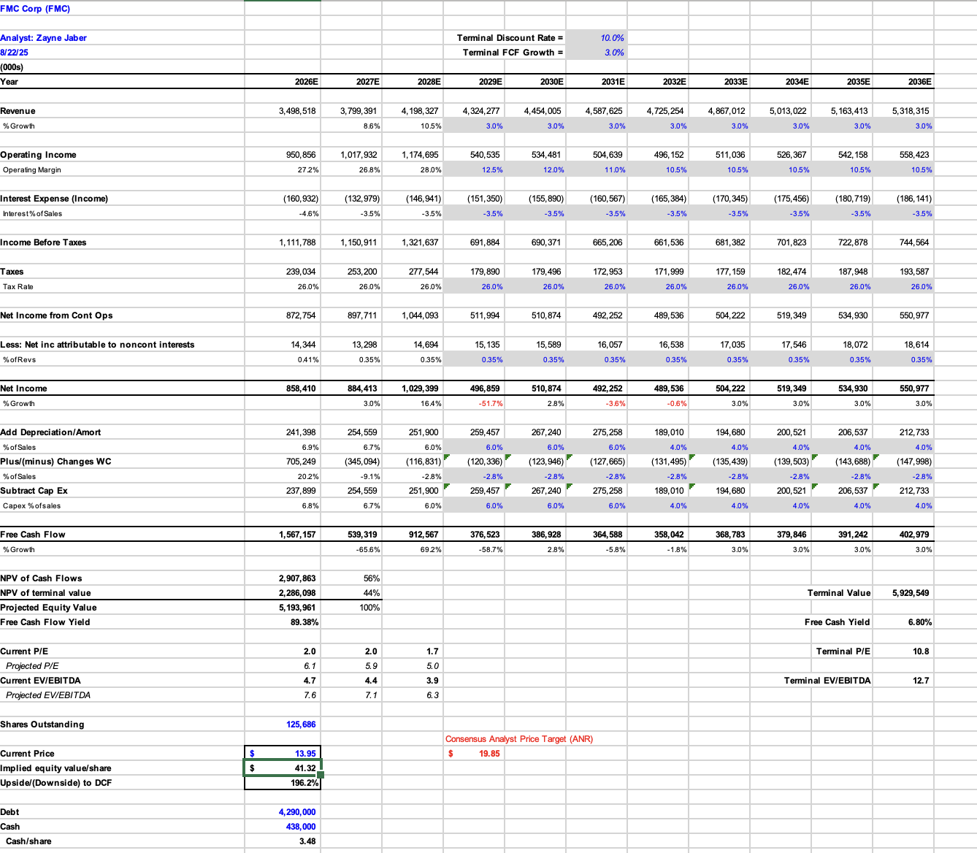

Slide 6
Recommendation: Sell
Upside aimed at recovering losses in the Long term:
Price $13.95
Skepticism of significant performance due to a string of missed earnings results in us not advising an increased position.
Current and Future Risks:
Forced divestment from Indian market
Aggressive analyst downgrades analysts from Wells Fargo have slashed their price target by 61% from $41 to $16. Morningstar likewise has fallen from $95 to $60.
Patent Cliff and generic competition, particularly for diamide products
Q3 missed earnings resulting in 44% drop in shares on October 30th
Elevated Debt levels with an adjusted EBITDA ratio of 4.94 using the covenant calculation, concerningly close to the limit of 5.25.
Negative free cash flow makes FMC look less attractive.
Dividend reduced by 86% to conserve cash.
Potential upsides:
Pivot into Biologicals is projected to produce $2 Billion in earnings
Integration of new ingredients such as Fuindapyr and Isoflex. FMC estimates they will bring in approximately $250 million by the end of 2025.
However, it will take likely take 3-4 years to see a significant gain, and more than that to see a positive return on investment.

Slide 7

Overview
Ticker: IP
Industry: Packaging
Market Cap: 19.5 B
Stock Price: 37.79 (Dec 2 close)
Shares Outstanding: 535.7 M
52-week range: 37.01- 60.36
Dividend yield: 5.09%

Slide 8
Business Analysis
Competitive advantage in large-scale operating model (vertically integrated)
Leader in sustainable and renewable packaging
80/20 approach and simplified business segments
Recent DS Smith Merger presents opportunities and risk
Risk of demand remaining soft and increased use of GLP-1s impacting food and beverage corrugated demand

Slide 9
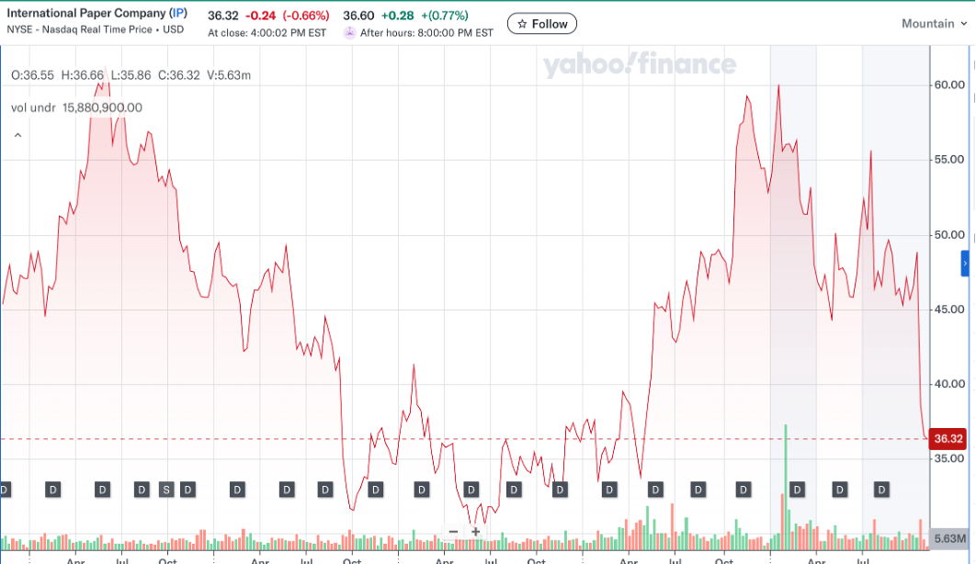

Slide 10
Valuation Analysis
Ticker | P/E | P/S | P/B | P/CF | EV/ EBITDA
IP | 38.15 | 0.91 | 1.34 | 1.56 | 15.99
Peers
Packaging Corp of America (PKG) | 21.55 | 2.24 | 4.19 | 2.47 | 11.91
Smurfit Westrock (SW) | 12.56 | 0.79 | 1.33 | 1.23 | 10.15
Amcor (AMCR) | 25.69 | 0.87 | 1.62 | 2.21 | 18.74
Average | 24.48 | 1.21 | 2.12 | 1.86 | 14.19

Slide 11
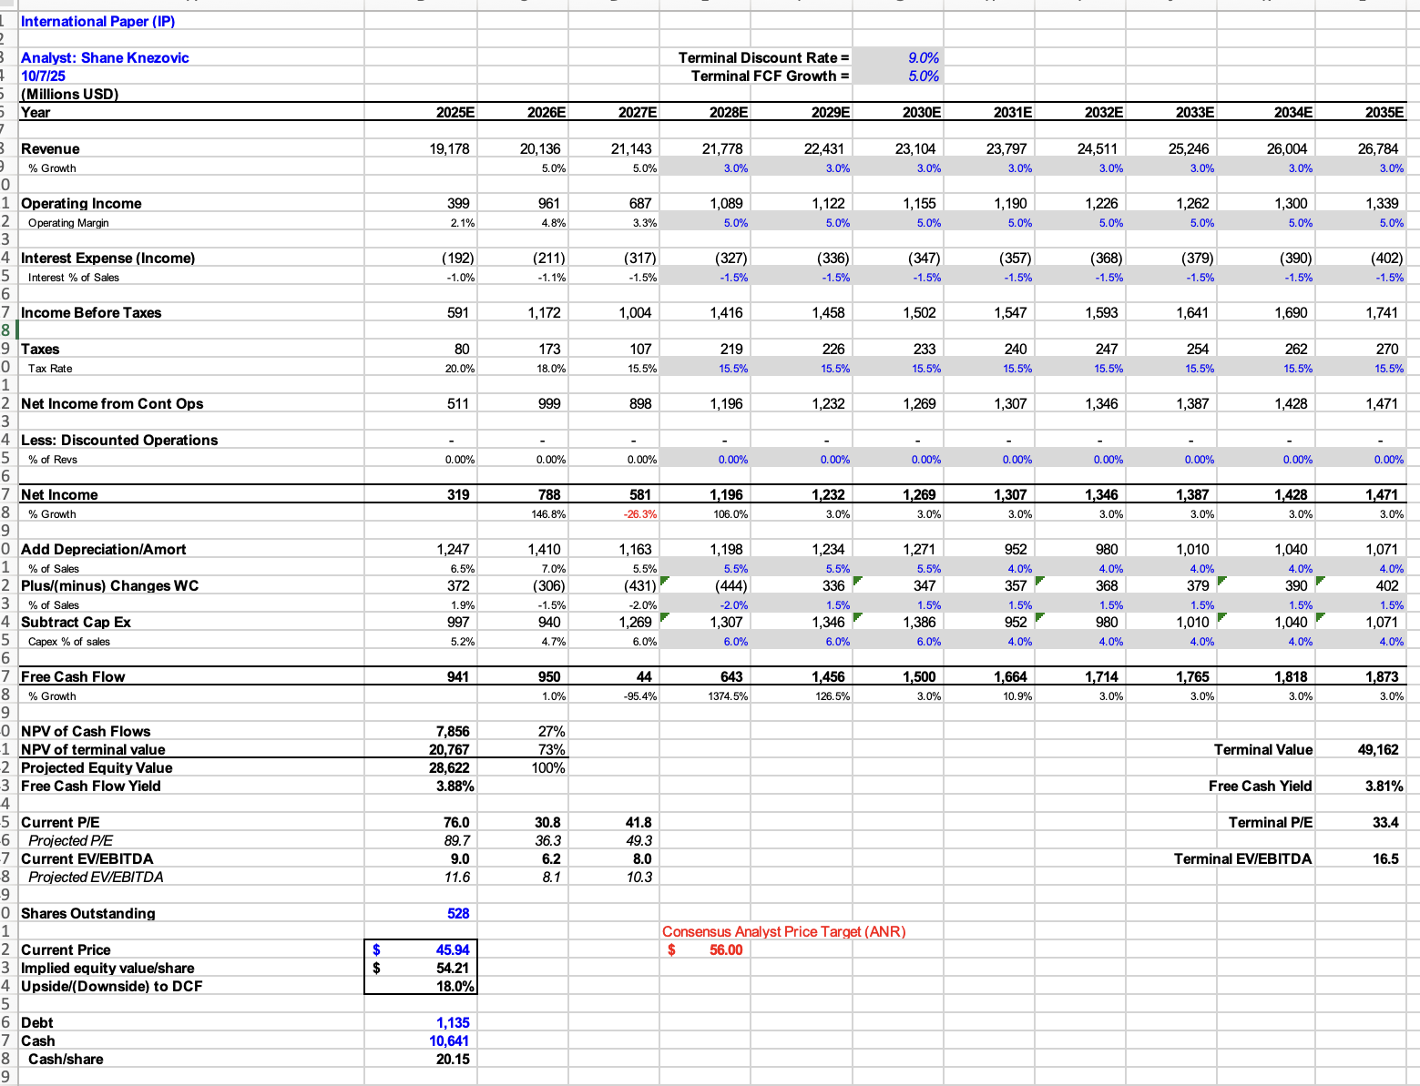

Slide 12
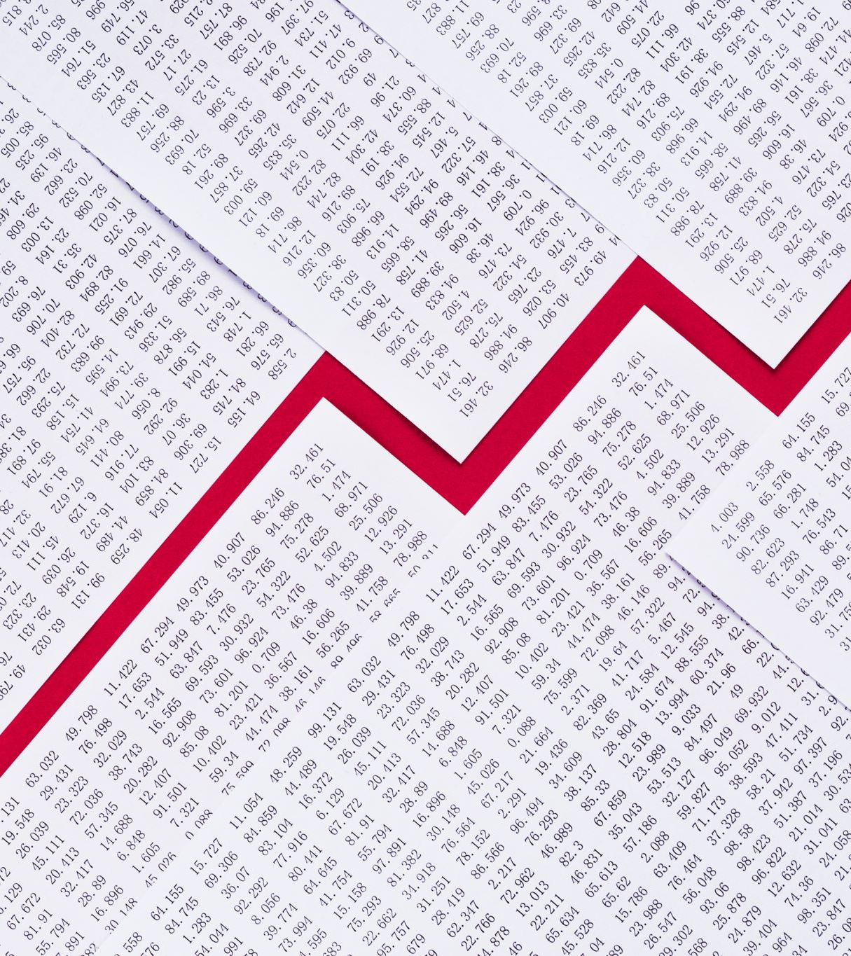
International Paper Recommendation - BUY
Well, positioned for recovery and growth given merger and emphasis of efficiency
Currently trading near a historical resistance level
Stock has performed poorly due to recent earnings misses (Q3 miss was largely driven by balance sheet related to merger)
$54.21 per share intrinsic value compared to current price of $37.79

Slide 13
Vulcan Materials Company
Vulcan Materials Company produces and supplies construction aggregates in the United States. It operates through three segments: Aggregates, Asphalt, and Concrete. The company provides crushed stone, sand and gravel, sand, riprap and jetty stones, and other aggregates for use in construction and maintenance of highways, streets, and other public works, as well as in the construction of housing and commercial, industrial, and other nonresidential facilities; asphalt mix; asphalt construction paving services; and ready-mixed concrete products.
Overview
Sector | Basic Materials
Industry | Building Materials
Market Cap | 36.693B
Current Price (updated 12/1) | $291.85
Dividend Yield | 0.67%
52-week Range | $215.08-$311.74
Diluted Shares Outstanding | 132,200,000
Beta (5Y monthly) | 1.07

Slide 14
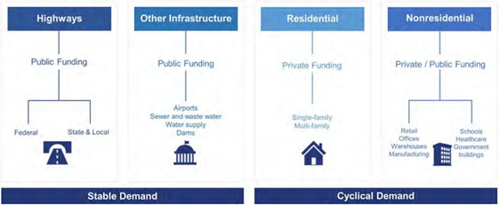
Business Analysis
They are the largest producer of construction aggregates in the United States, giving them a dominant position and providing pricing leverage, expansive geographic coverage, and the ability to serve major infrastructure and construction markets.
Quarries are location specific, heavily regulated (facing zoning, permitting, and environmental challenges), require significant capital investment, and careful logistics to operate profitably.
Their market is heavily influenced by infrastructure investment, residential and commercial construction cycles, and regional economic growth trends.
The company’s core aggregates business addresses an estimated $35-40 billion in the United States construction market.
  Public infrastructure is the largest and most stable, and accounts for nearly half of all domestic aggregate consumption. Federal programs such as the IIJA, CHIPS and Science Act, and the current Inflation Reduction Act and working to inject hundreds of billions of dollars into long-term transportation, energy, and construction projects.

Slide 15
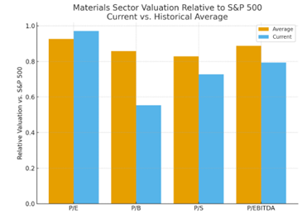
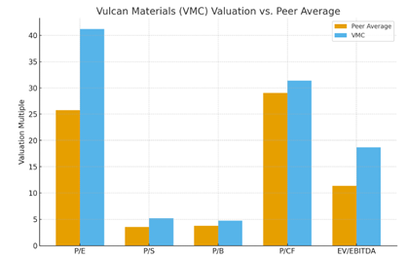
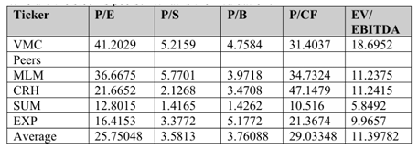
Financial Analysis
Our valuation framework indicates that Vulcan Materials currently trades at a premium relative to both its historical averages and sector peers.
Vulcan Materials posted Q3 2025 earnings on October 30, 2025, reporting an EPS of $2.84, which topped the consensus estimate of $2.72 by $0.12. Quarterly revenue rose 14.4% year-over-year to $2.29 billion, above analysts' expectations of $2.28 billion. With a trailing EPS of $8.42 and a P/E Ratio of 40.77, Vulcan Materials' earnings are expected to grow 11.85% next year, from $8.69 to $9.72 per share.

Slide 16
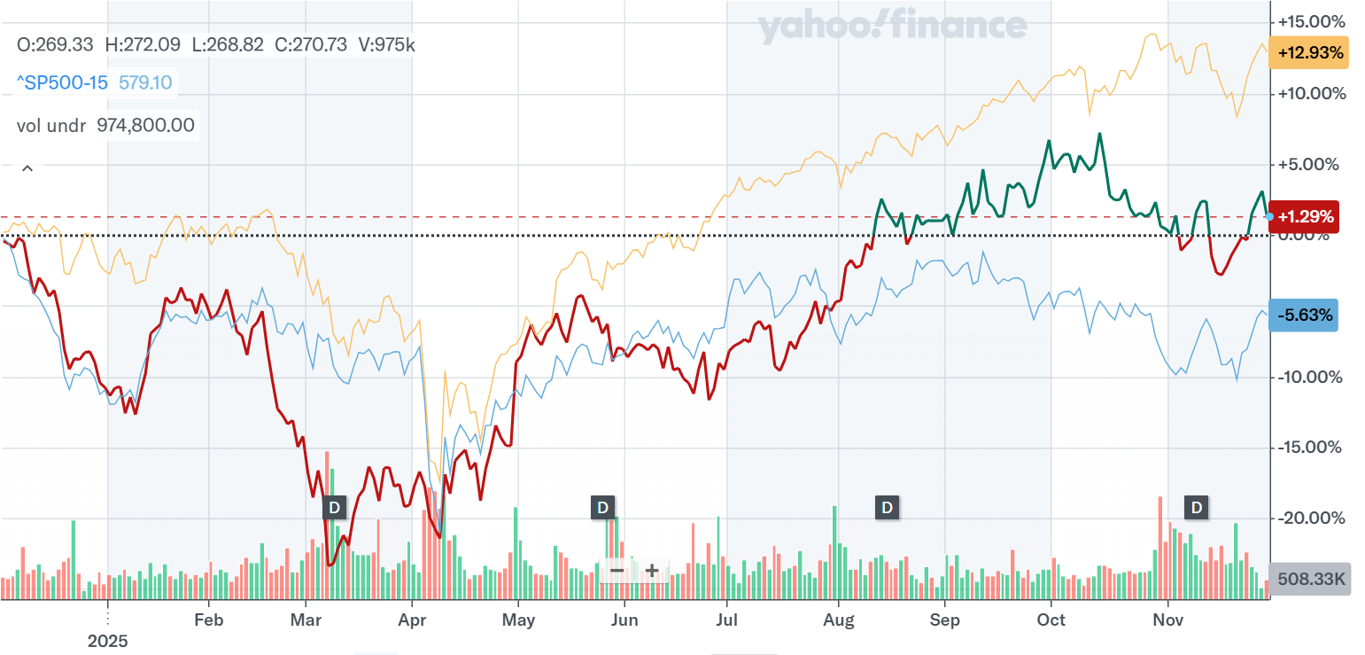
Financial Analysis
S&P 500
Materials Sector
VMC

Slide 17

Recommendation
While we do recognize slight upside potential, we are recommending a hold position at 0%.
Potential is in a long-term hold, better growth opportunities available in the fund.
Short term variability too high to justify potential gains.

Slide 18
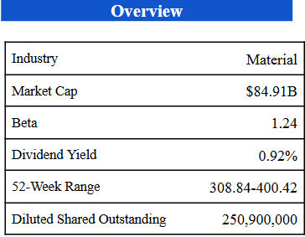

The Sherwin-Williams Company
Sherwin-Williams is a global manufacturer and a distributor in the paints and coatings business. They are a vertical integrated company that spans manufacturing, distribution, and retail which give them control over quality and pricing. With more than 5,000 company operated stores and branches, along with more than 130 manufacturing and distribution facilities, it allows them to operate across 120 countries and employing more than 64,000 employees worldwide.

Slide 19
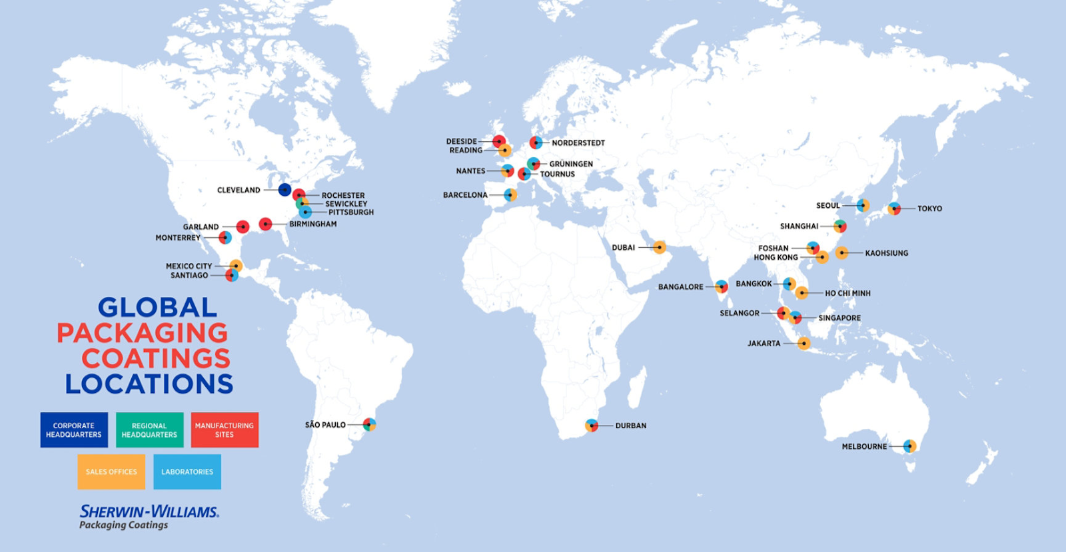
Business Analysis
One of the largest Paint and Coating Company
Dominates North America Market with it scale and brand recognition
Sherwin-Williams operates through three main segments:
Paint Store Group, main driver of revenue through the 5,000 plus stores and branches, selling to contractors and DIY consumers.
Performance Coating Group, provides protective finishes and coatings for industrial equipment, automotives, aerospace, coil, and packaging.
Consumer Brand Group, supplies paint and coatings to general retailers like Home Depot, Lowes, and other hardware and big box stores.
Competitive Advantage
Vertically Integrated, own their own manufacturing, and distribution facilities
Strong customer loyalty from quality products and continuous innovation on their products
Premium Pricing Power, being able to charge more due to its premium nature.
Key Risks
Cyclical and senitive to rates and housing market
Raw material cost volatility (Trade Wars/Tariffs)
Overall
With its strong moat, housing market slowly stabilizing, and potential future rate cuts it has a positive long-term outlook

Slide 20
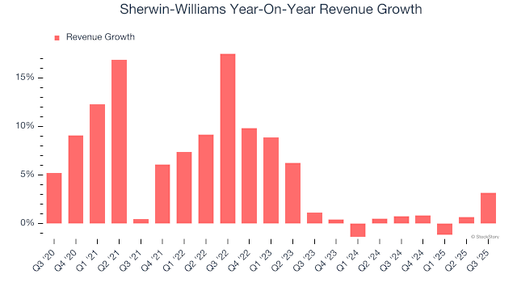
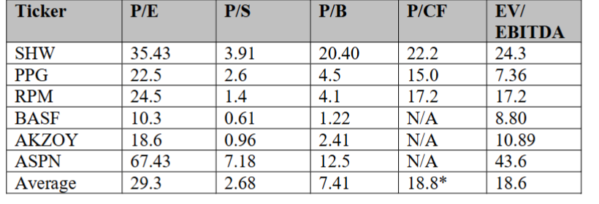
Financial Analysis
FY25 Q3 Earnings
Revenue $6.36B vs Expected $6.32B BEAT +0.6%
Adjusted earnings per share (EPS) $3.59 vs analyst estimate of $3.45 BEAT +4%
The revenue growth for Sherwin-William has been on a decline since Q4 of 2022; However, the company is seeing signs of recovery as well as some promising growth in Q3 2025. Analysts are also generally positive on the outlook of the company and have optimistic views on improvement of the housing market and strengthening of consumer sentiment.
Sherwin-Williams trades at a clear premium compared to its peers, but the premium reflects their position in the market driven by its superior margin and vertical integration

Slide 21
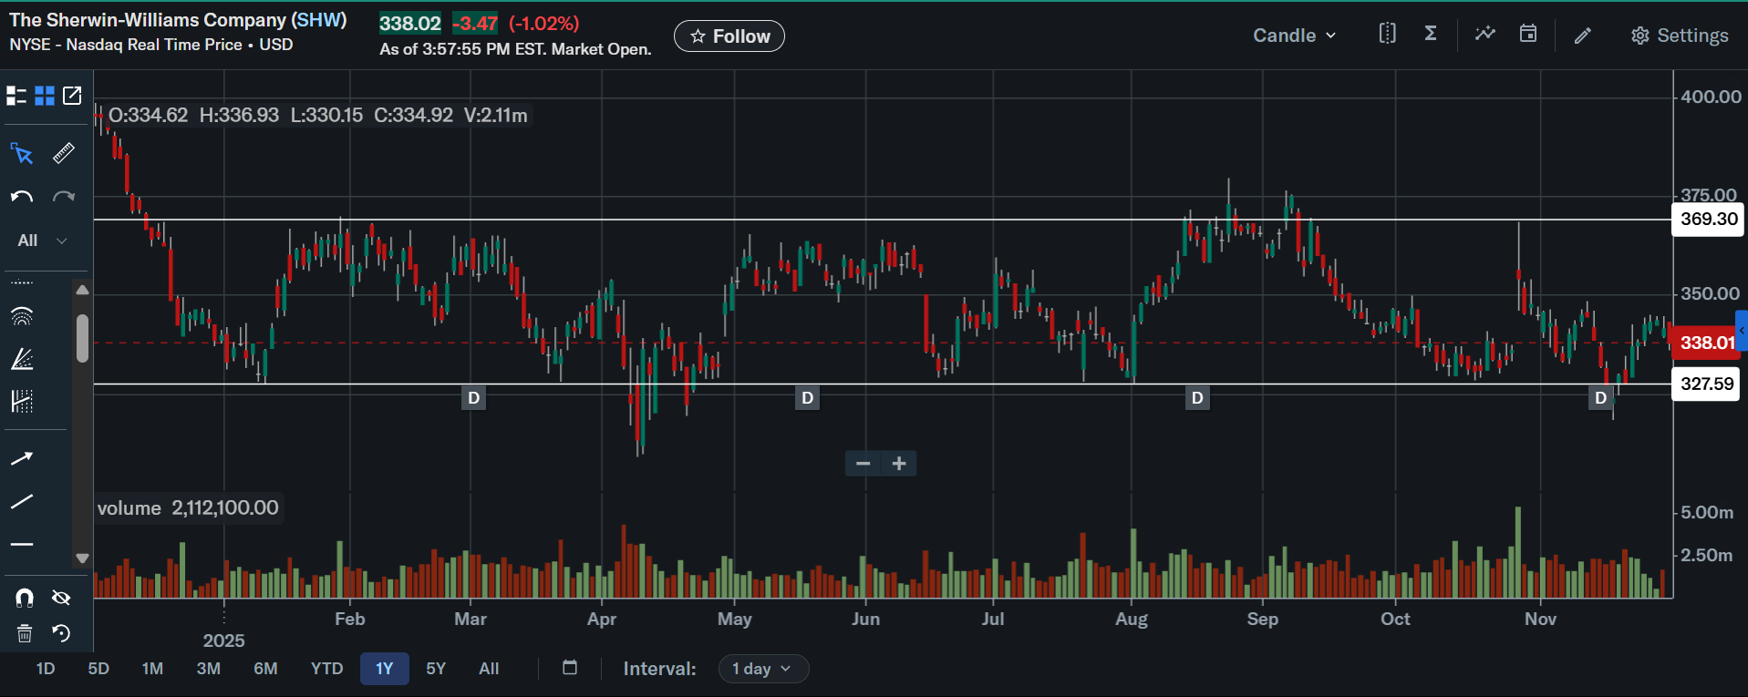
Technical Analysis
Strong Support Around $327 level (Break below $327 could signal trend shift bearish)
Resistance Around $370 level (Break above $370 could signal bullish continuation)
The strong support around the $327 level signifies that the investors see the stock as fair value or cheap at that price and the resistance around $370 signifies that investors see the stock as stretched valuation.

Slide 22

Recommendation
We assign a Moderate Buy rating on Sherwin-Williams with a consensus price target of $387 (NYSE: SHW)
The company continues maintains its premium pricing power and remains a dominant force in its industry in capturing market share with consistent cash generation through its three sectors. With positive outlook on the housing market and potential future rate cut Sherwin-Williams remains favorable in the long-term.

Slide 23
Recommendations
Company: | FMC Corp | IP | VMC | SHW
Current Price | $13.95 | $39.20 | $291.85 | $336.17
Current Weighting | 0.53% | - | - | -
Buy/Sell/Hold | Sell | Buy | Hold | Moderate Buy
Weighting (New) | -
Target price | - | $54.21 | $312.32 | $387
Upside/Downside | -69.51% | 53.21% | 7.01% | 15.12%

