Slide 1

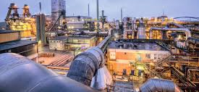
Sector Presentation - Materials
Shane Knezovic, Zayne Jaber, Brian Kray, Shenghui Li

Slide 2
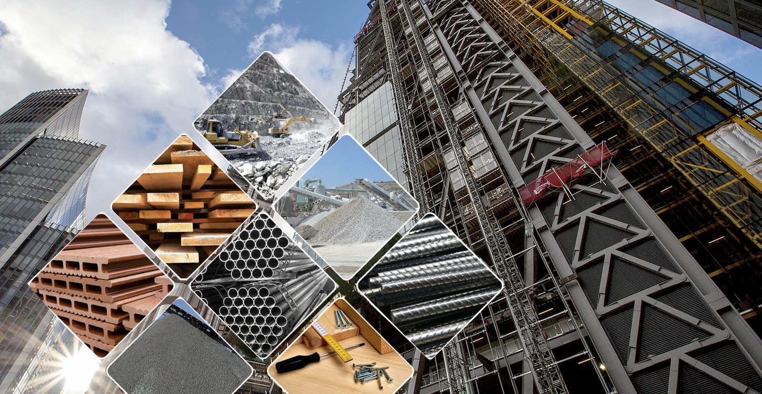
Agenda
Overview
Business Analysis
Economic Analysis
Financial Analysis
Valuation Analysis
Recommendation

Slide 3




Sector Overview
The Materials Sector has a market cap of roughly 2.34 T and encompasses about 1.66% of the SP500 (1.42% in SIM portfolio)
Industries in the sector include chemicals, gold, copper, building / construction materials, lumber / paper etc.
The largest companies in the sector include: Linde (LIN) 220 B; Sherwin-Williams (SHW) 85 B, EcoLab (ECL) 78 B, Freeport-McMoRan (FCX) 65 B

Slide 4
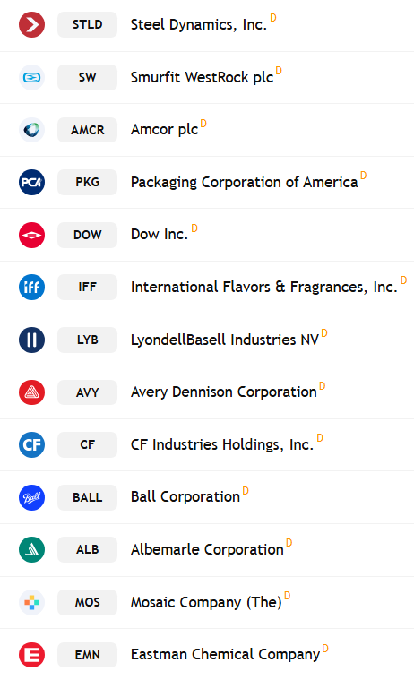
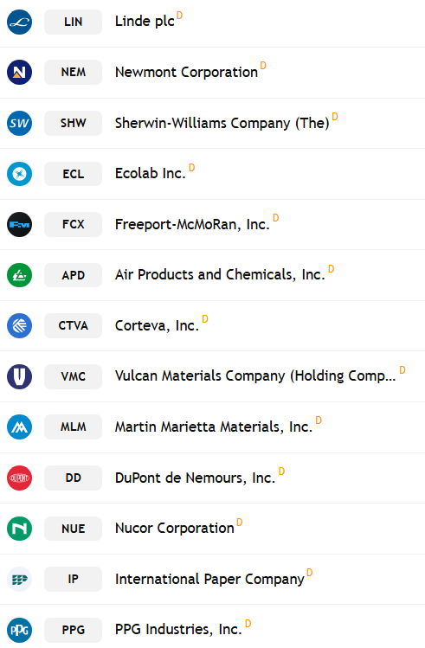
Materials Sector full list
Subsectors represented:
Chemicals
Construction Materials
Containers & Packaging
Metals & Mining
Paper & Forest Products

Slide 5
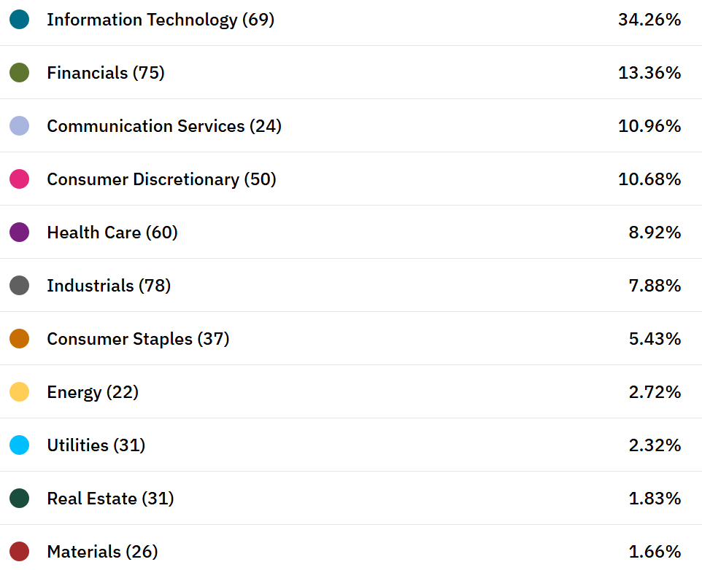
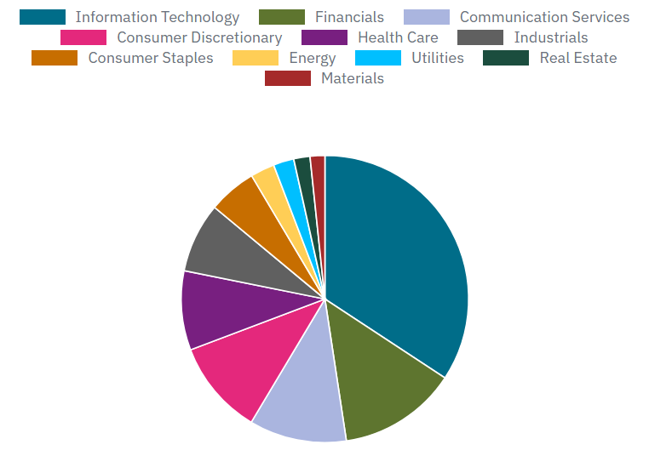
S&P 500 Sector Weighting

Slide 6

Business Analysis
"These industries operate in global markets, and demand for these goods tends to be highly dependent on the state of the global economy. For example, construction materials are likely to be in higher demand when the economy is booming. For that reason, materials are inherently a cyclical sector—rising and falling with the strength of demand for these goods in the US and globally."
"One uncertainty that may impact the sector in the year ahead is tariff policy, given the incoming administration’s proposal to levy new tariffs on all Chinese imports, and given China’s importance as a key consumer of materials. While it can be difficult to make predictions about the ramifications of public policy, especially since outcomes are often quite different than expected, I aim to monitor developments carefully and manage risk accordingly."
-Fidelity
​

Slide 7
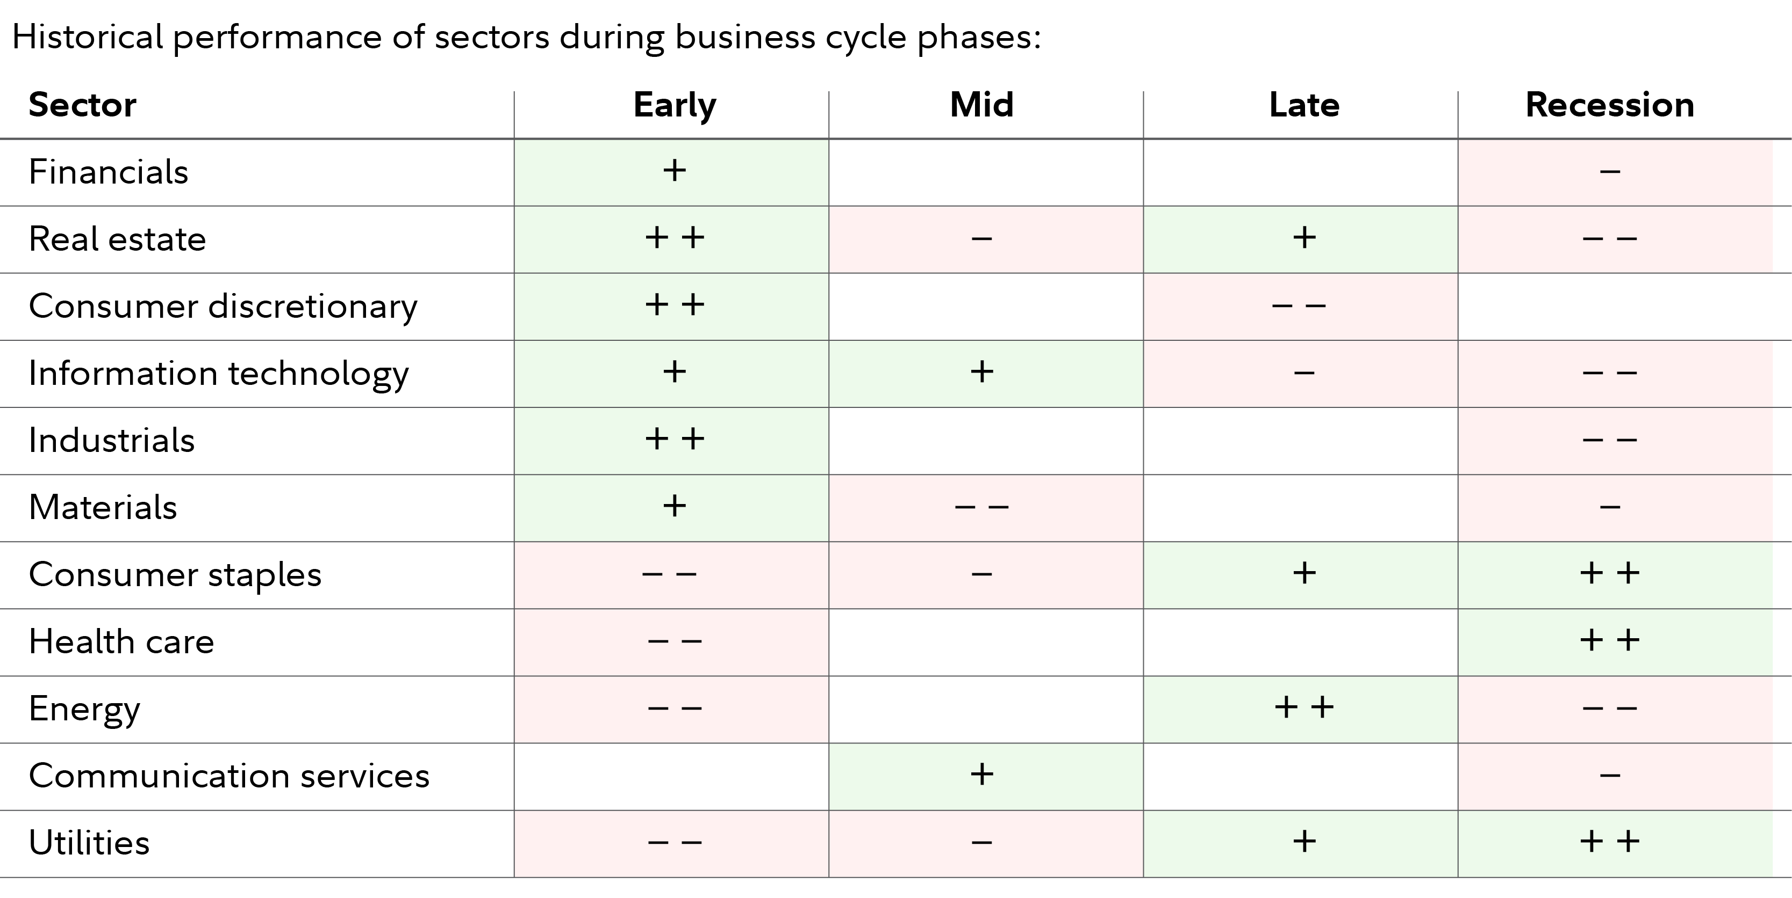
Business Analysis:
Demand Analysis
Highly Cyclical
Mature (Ex: metals, chemicals, etc.)
Low demand in recessions
High demand during Economic expansions
High Sensitivity
Affected greatly by external forces
Tariffs

Slide 8
Business Analysis
Supply analysis
Continuous, yet lagging investment due to high capital expenditure and lead times.
Resilient Supply chains (Mostly)
Production costs highly dependent on energy costs and labor
Profitability Drivers
Commodity pricing
Commodity materials which carry a lower pricing power (Ex: steel, many industrial chemicals)
Specialty and niche materials which carry a higher pricing power (Ex: Industrial gases)

Slide 9

Competitive Landscape: Porter's 5 Forces
Ease of Entry- Low, ease of entry due to large upfront capital investments, strict regulations, and large scale needed to compete.
Strength of Suppliers- Moderate, while suppliers have a large amount of bargaining power due to the limited number available, many corporations in the sector produce their own raw materials. Supplier power is much more situational based on which materials are being discussed.
Substitution- High, firms will always attempt to substitute a material for a cheaper and just as efficient material. EX: plastics replacing glass and paper.
Competition- High, competition is on a global scale resulting in firms needing to be constantly innovating to reduce costs and bolster efficiency.
Strength of Customers- High, overall product differentiation between firms is low, with little difficulty when it comes to switching supplier. Especially due to many buyers being bulk price sensative buyers

Slide 10
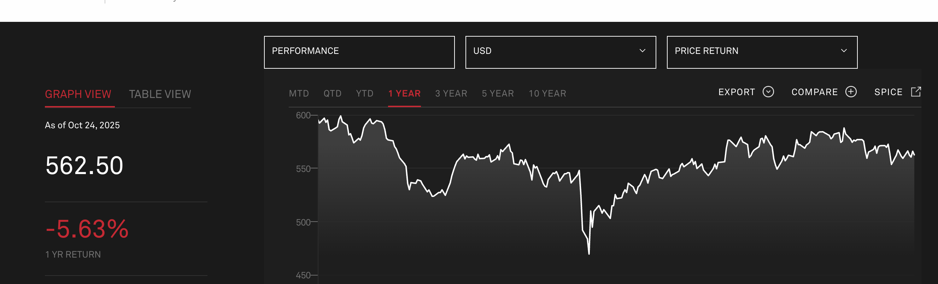
Economic Analysis
Materials sector – 5.63% return over the last year
6.18% return YTD
Compared to SP500 16.63% return in the last year and 15.73% return YTD
-1.44% return Quarter to Date

Slide 11
Economic Analysis
Cyclical sector in nature
Some industries are heavily sensitive to commodities prices
Structural Demand in some industries
Housing demand impacting raw materials sector

Slide 12
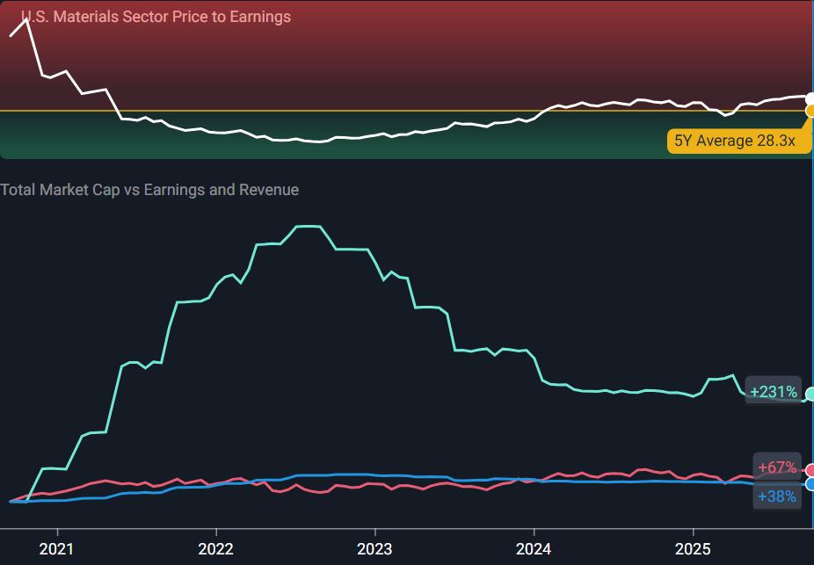
Financial Analysis
Current Industry PE
  Investors are optimistic on the American Materials industry, and appear confident in long term growth rates.
  The industry is trading at a PE ratio of 34.2x which is higher than its 3-year average PE of 28.3x.
  The industry is trading close to its 3-year average PS ratio of 1.8x.
Past Earnings Growth
  The earnings for companies in the Materials industry have declined 20% per year over the last three years,
  Revenues have also declined 4.3% per year.
  This means overall sales from these companies are declining and profits are subsequently falling as well.

Slide 13
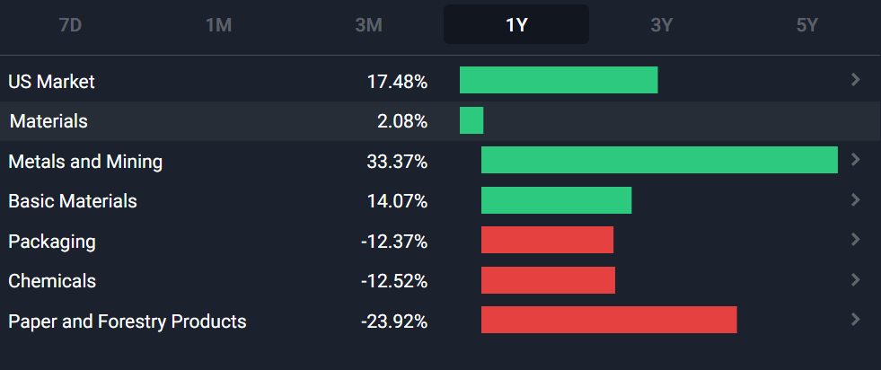
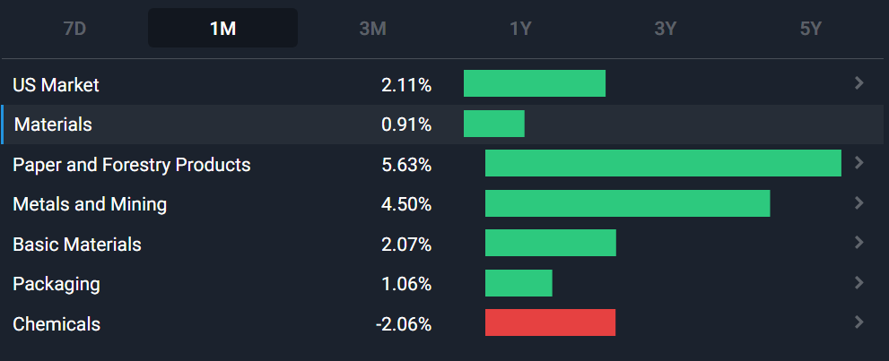
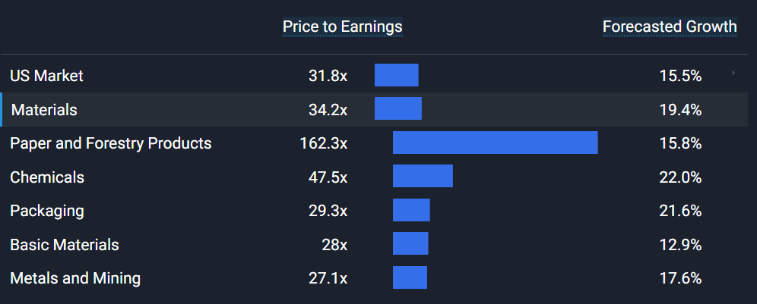
Financial Analysis – Industry Trends
Returns show cyclical nature and volatility of the sector
  Differences in returns of sub sectors between 1-year (top) and 1-month (middle) charts
Investors seem to be most optimistic on Paper and Forestry Products, and most pessimistic on Metals and Mining Industry (bottom chart)

Slide 14
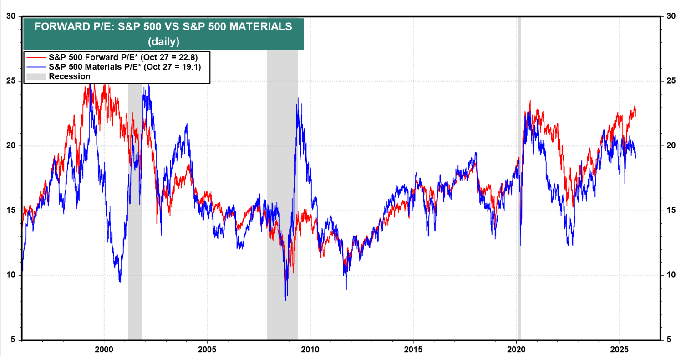
Valuation Analysis: Sector
S&P 500 Material Sector S&P 500
P/E (Trailing): 33.27 28.8
P/E (Forward): 20.18 23.57
P/B: 2.8
P/S: 2.2
P/CF: 31.52
(End of September)
These metrics shows the average P/E, P/B, P/S, and P/CF across the material sector.
The material sector and its different industries are fundamentally mature but will follow cyclical trend and causes fluctuation in profitability.
Though fundamentally mature, the valuation varies from industry to industry in the material sector, for example, following a rate cut the Containers and Packaging Industry doesn't really get affected because they aren't really affected by rates, slight uptick from consumer spending but generally stable, but the Construction Materials Industry would benefit from this because they benefit from lower interest rates and it would stimulate the housing market.
As a sector trading above historic levels, elevated valuation

Slide 15
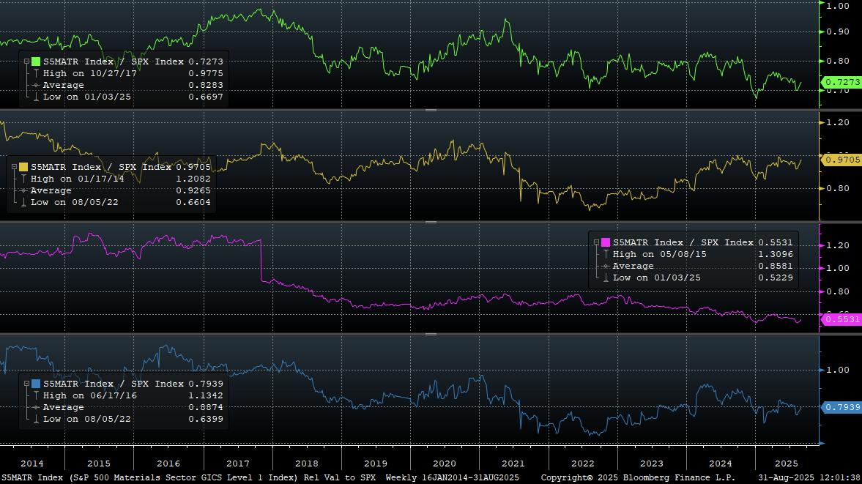
Valuation Analysis
P/S
P/E
P/B
P/EBITDA

Slide 16
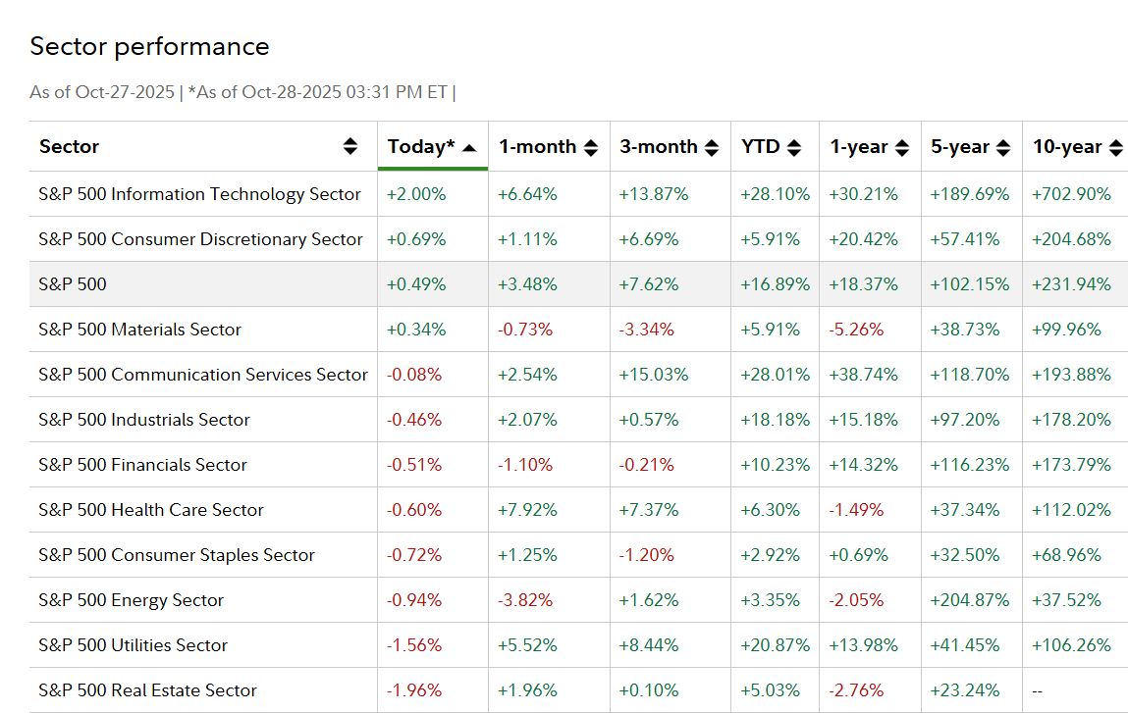
Sector Performance Compared to Other Sectors of the S&P 500
Outlook: Contraction is expected, due to the elevated valuation of the sector as well as macro and international headwinds and trade complications with China as many of sector performance ties to raw materials and commodity prices.
A situation where we will see possible expansion is an increase in infrastructure spending, rate cuts, hike in housing demand, and or trade deals on raw material import/exports.

Slide 17
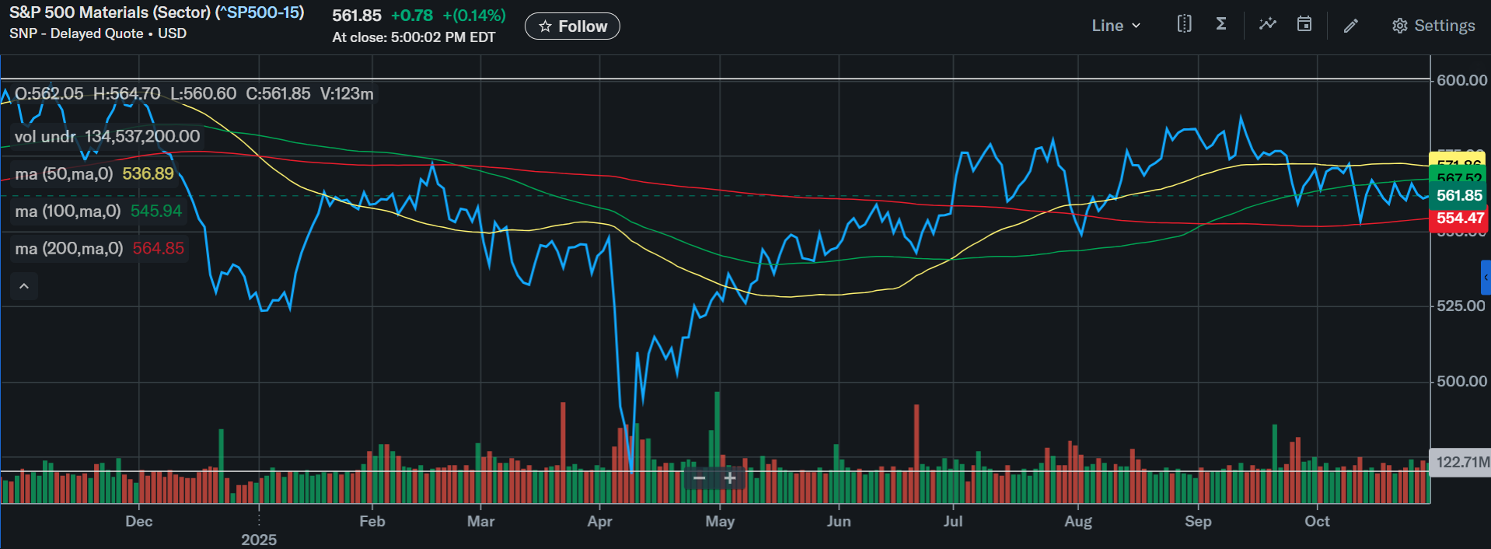
Technical Analysis

Slide 18
Recommendation
Moderately underweight the S&P 500 Materials sector overall (relative to the index weight)
Positives: structural demand for critical minerals (EV's, grid storage, electric), packaging sector has defensive characteristics (can outperform in volatile market)
Negatives: Chinese property demand uncertainty, macroeconomic risks, past performance
Overweight: Paper/packaging (defensive), metals/mining
Underweight: Chemicals, construction / raw materials

Slide 19
References
S&P 500 Materials Components – SP:S5MATR Stocks — TradingView
S&P 500 Companies By Sector
Materials sector outlook 2025 | Materials stocks | Fidelity
U.S. Materials Sector Analysis

