Slide 1
Information Technology SIM Recommendation
By Matthew Mullee, Ethan Liang, Jian Liu, Jack Mckenna

Slide 2
Sector Overview
Information Technology Sector
The IT sector is the largest and strongest driver of S&P 500 performance, supported by long-term tech trends like AI, cloud computing, semiconductors, and software. It holds the highest index weight at about 35 percent and includes major industries such as semiconductors, software, consumer electronics, IT services, hardware, and communication equipment. Key companies include Apple, Microsoft, Nvidia, Alphabet, and Broadcom.
The sector has outperformed the S&P 500 over the past 1, 3, and 5 years, showing strong revenue and earnings growth, high margins, strong ROE and ROIC, and significant cash generation. IT valuations tend to rise when interest rates fall, making the sector highly rate-sensitive. Currently, valuations are elevated due to AI optimism and margin expansion, and technical indicators show a strong uptrend with room for additional upside.
Recommendation: Overweight the Information Technology sector due to superior earnings growth, global digital transformation, and long-term structural demand.
Positives: Strong secular tailwinds (AI, cloud, cybersecurity), heavy R&D investment, global and recurring demand.
Risks: High valuations, heavy concentration in mega-cap firms, and regulatory or geopolitical exposure.
Sub-Sector Positioning: Overweight semiconductors and software/services. Underweight hardware and equipment due to slower growth and thinner margins.

Slide 3
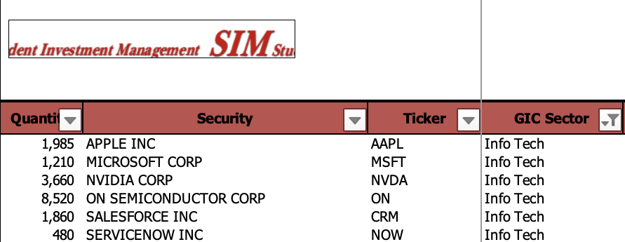
SIM Current IT Holdings

Slide 4
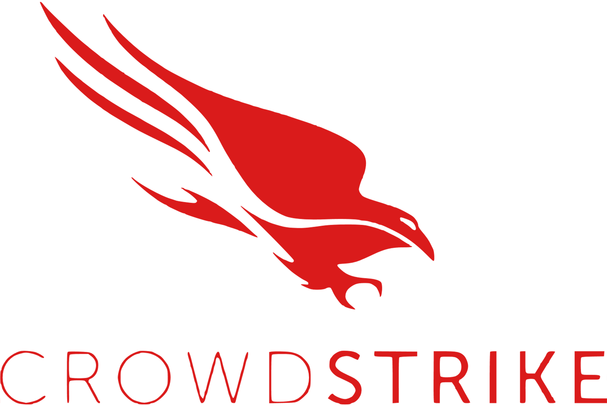
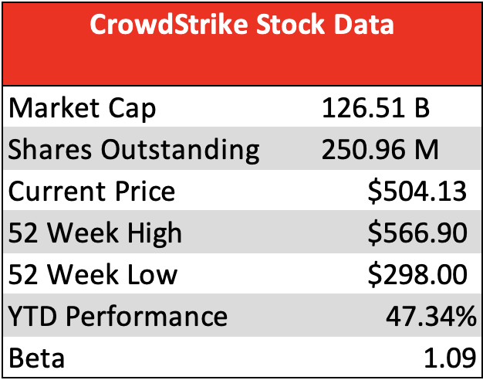
CrowdStrike Holdings Inc. (CRWD)
Overview
CrowdStrike:
Global cybersecurity company that provides cloud-delivered protection across endpoints, workloads, identities, and data
Solutions include threat intelligence, endpoint security, identity protection, and cloud workload defense, all delivered through the Falcon platform
CrowdStrike leverages artificial intelligence, behavioral analytics, and real-time threat detection to prevent breaches before they occur
Serves a range of clients which includes enterprises, governments agencies and small to mid- sized business across all industries worldwide
CrowdStrike was founded in 2011, is headquartered in Austin, Texas and has over 10,000 employees
Business Segments: Professional Services (6.05%) & Software Subscription (93.95%)

Slide 5
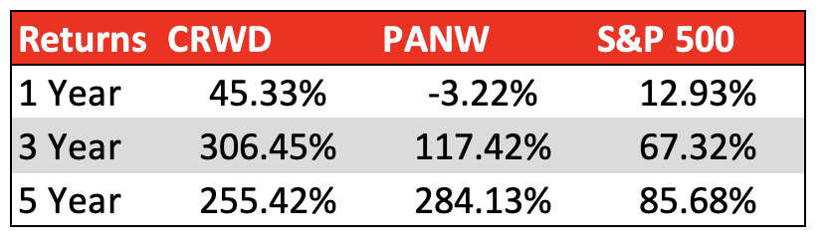
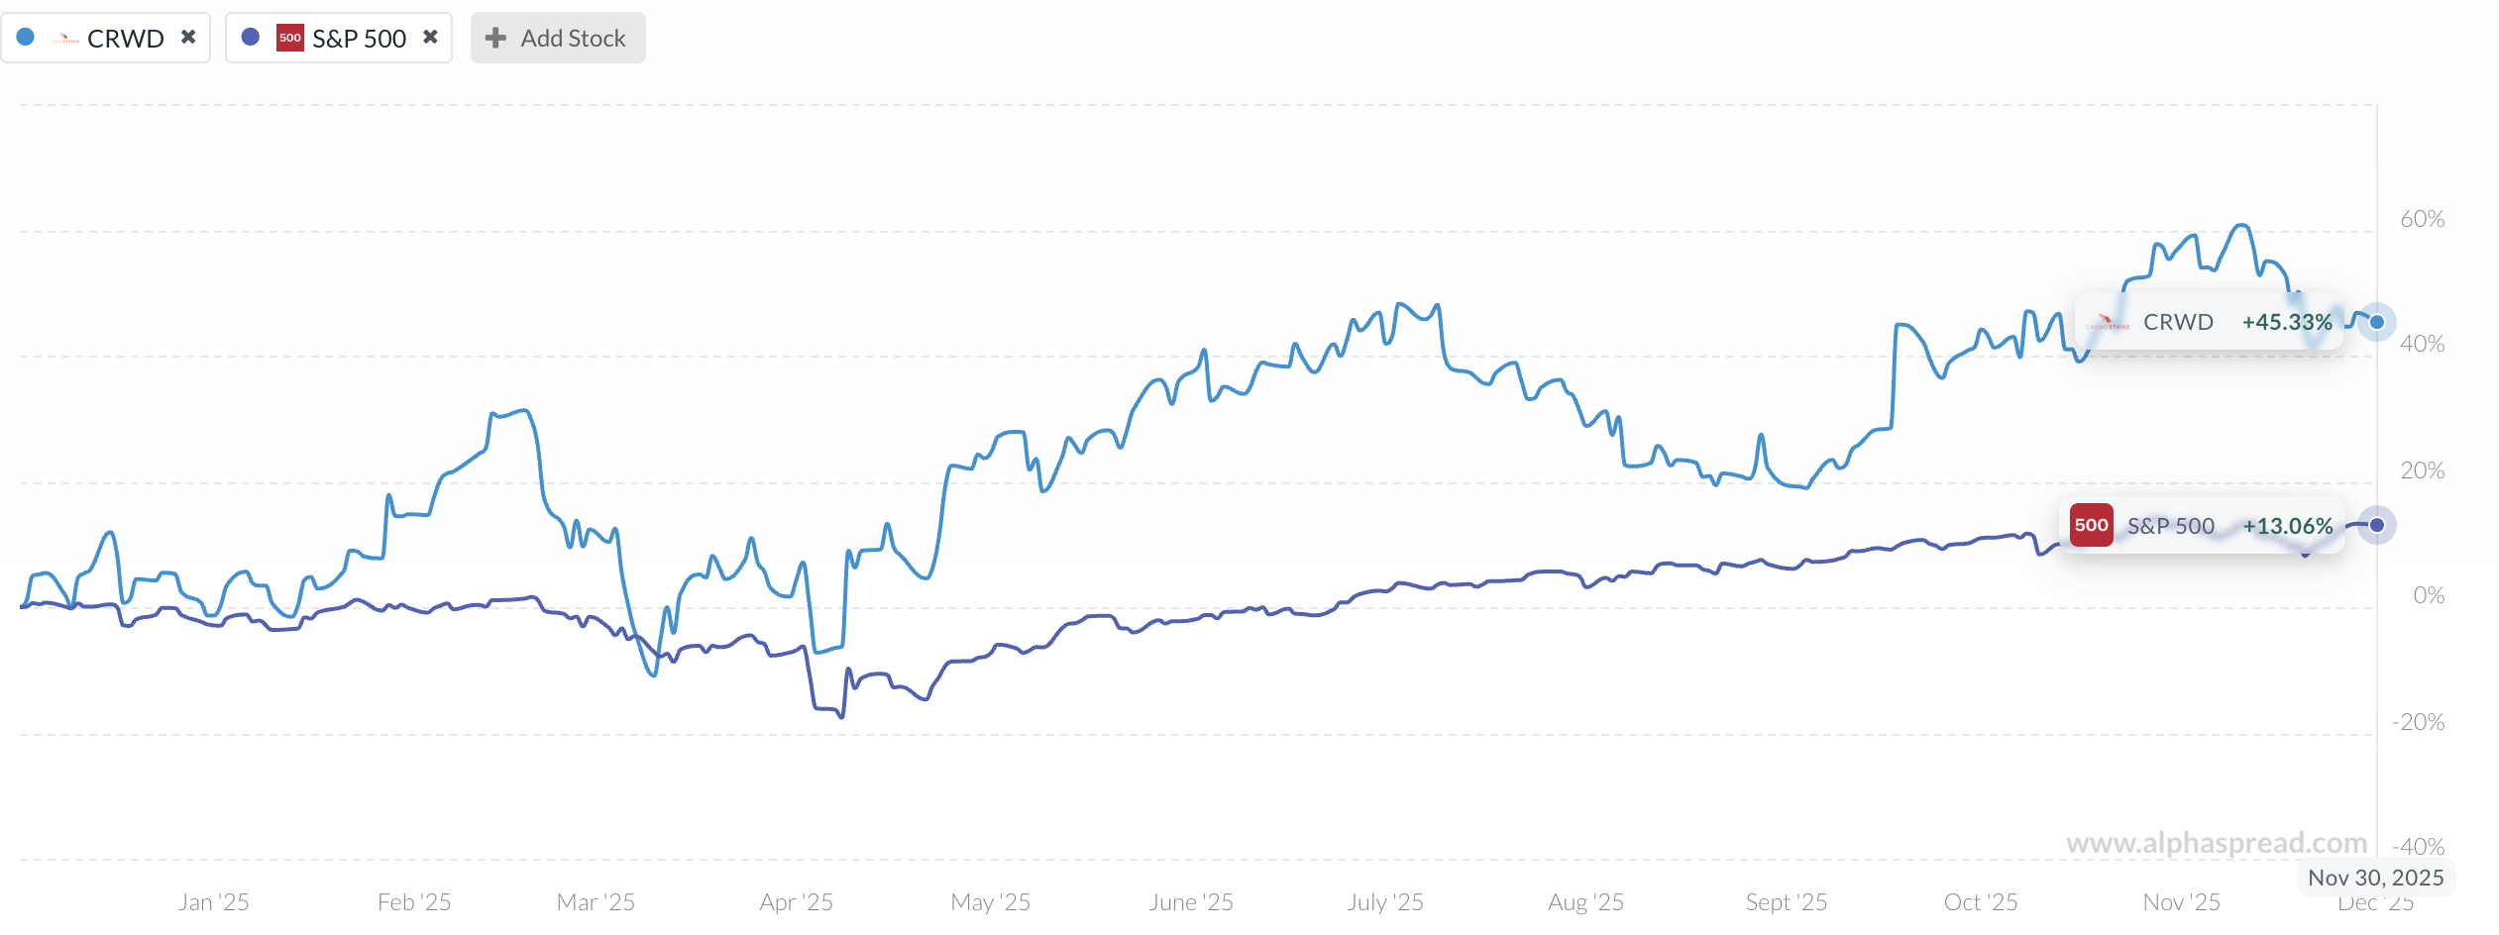
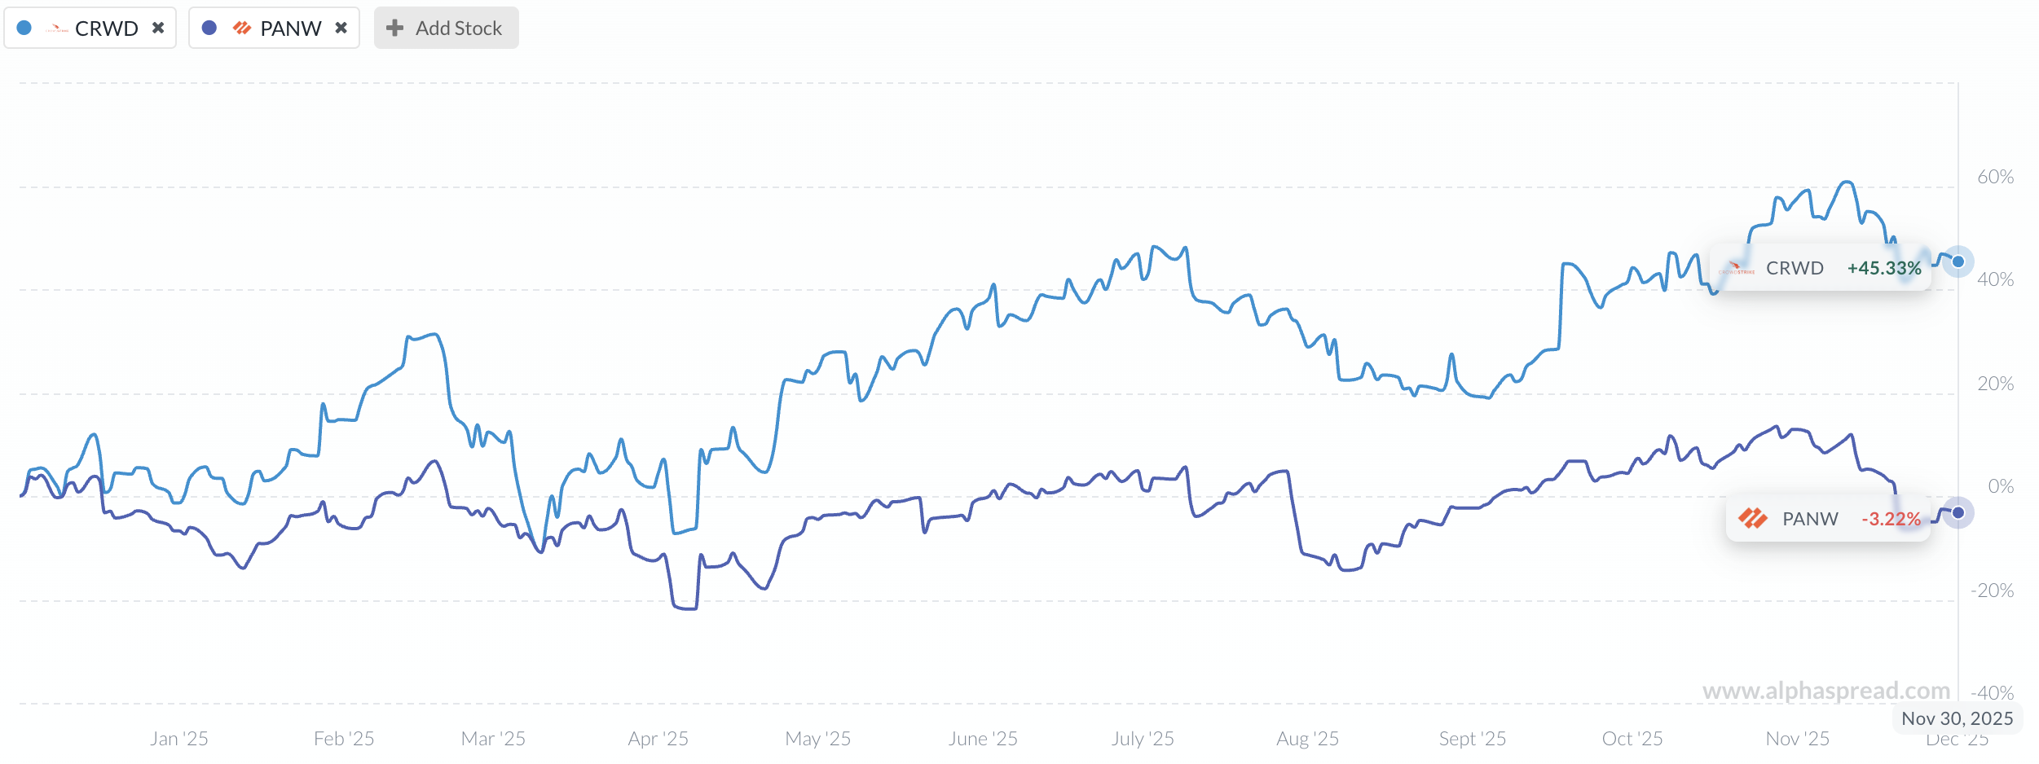
CrowdStrike Holdings Inc. (CRWD)
Returns
CRWD vs S&P 500
CRWD vs PANW

Slide 6
CrowdStrike Holdings Inc. (CRWD)
Industry Factors
Tailwinds
The market shifted away from over-bought AI stocks while CrowdStrike maintained perspective as a “defensive growth” opportunity
Cybersecurity industry is projected to grow 12% annually from 2025 to 2035 increasing from $215 billion to ~$697 billion
Despite struggles and outages, Q2 of 2026 reported customer retention of over 97%
Competitive advantage with cloud-based Falcon Platform, allowing for speed, efficiency, constant improvement, and innovation comparatively to old, unreliable platforms that struggle to keep up with the sophistication of cyber-attacks
High-margin, high-recurring ARR business, benefiting from operating leverage as modules scale
Headwinds
2024 global outage revealed “single-point-of-failure” concerns, regulators question centralized endpoint security infrastructure and the risk
Government inquiries and hearings following the outage increase scrutiny over software update governance and testing
Potential for tighter federal cybersecurity regulation may raise compliance costs and slow deployment cycles
Global macro uncertainty (geopolitical tension, higher inflation, FX volatility) can affect multinational clients’ cybersecurity budgets and purchasing decisions.

Slide 7
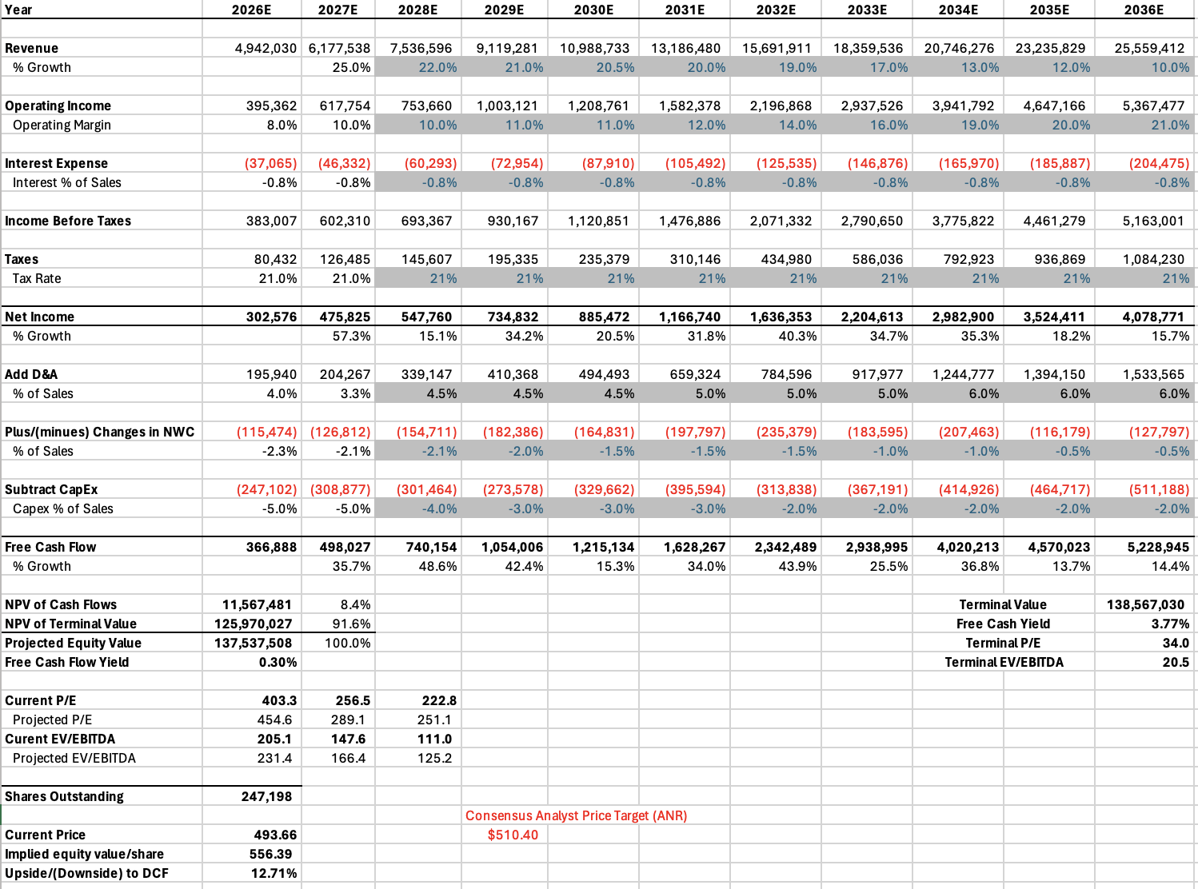
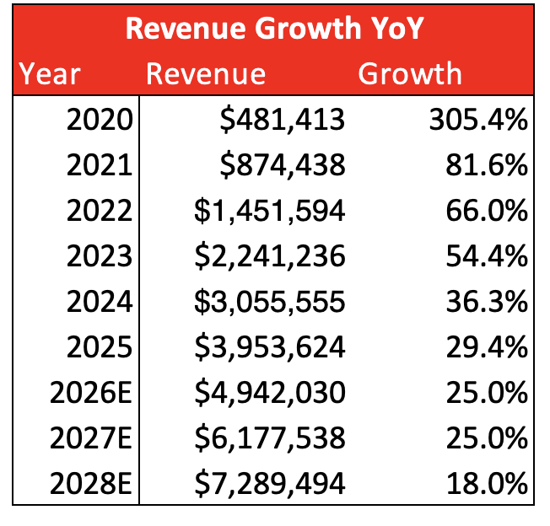
CrowdStrike Holdings Inc. (CRWD)
Financial Analysis

Slide 8
CrowdStrike Holdings Inc. (CRWD)
Rating: BUY
Recommendation
Sensitivity Analysis
Base Case:
  Discount Rate: 10.00%
  Growth Rate: 6.00%
  Target Price: $556.39
  Upside: 12.71%
Discount Rate:
Bearish Case:
  Discount Rate: 11.00%
  Growth Rate: 6.00%
  Target Price: $447.71
  Downside: -9.31%
Bullish Case:
  Discount Rate: 9.50%
  Growth Rate: 6.00%
  Target Price: $633.49
  Upside: 28.33%
Growth Rate
Bearish Case:
  Discount Rate: 10.00%
  Growth Rate: 5.00%
  Target Price: $450.62
  Downside: -8.72%
Bullish Case:
  Discount Rate: 10.00%
  Growth Rate: 6.50%
  Target Price: $631.01
  Upside: 28.01%
Final Recommendation:
  Target Price: $546.60
  Upside: 10.72%
  Current Weighting: 0.00%
  Recommended Weight: 2.50%

Slide 9
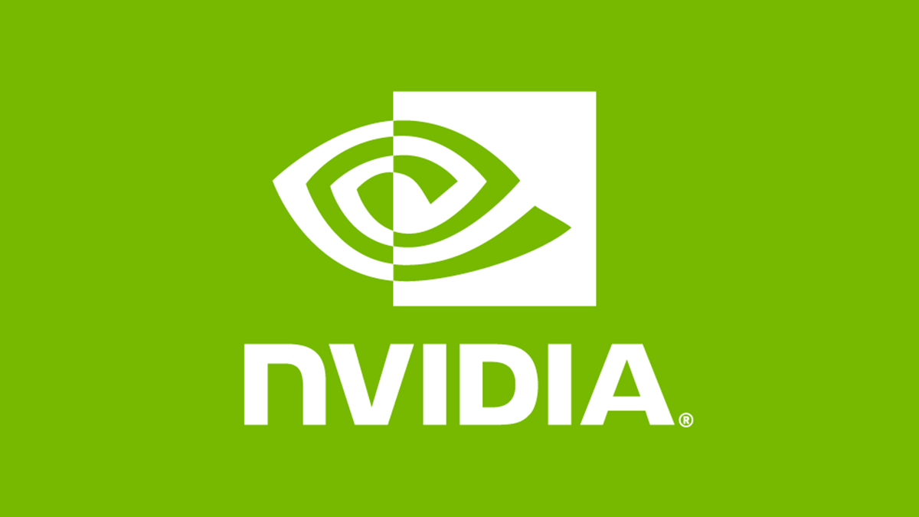
NVIDIA Corporation (NVDA)
Business Analysis
Industry: Semiconductors
What they do: Designs graphics processing units (GPUs), systems on chips (SoCs), and application programming interfaces (APIs) which are sold across their 4 main business segments
NVIDIA Stock Data
Market Cap | 4.388 T
Shares Outstanding | 24.35 B
Current Price | 180.34
52 Week High | 212.19
52 Week Low | 86.62
YTD Performance | +30.08%
Dividend Yield | 0.02%
Segment | Percentage of Revenue (Q3 2026) | Percentage of Revenue (Q3 2025)
Data Centers | 90.12% | 87.95%
Gaming | 7.50% | 9.37%
Professional Visualization | 1.34% | 1.39%
Automotive | 1.04% | 1.28%

Slide 10
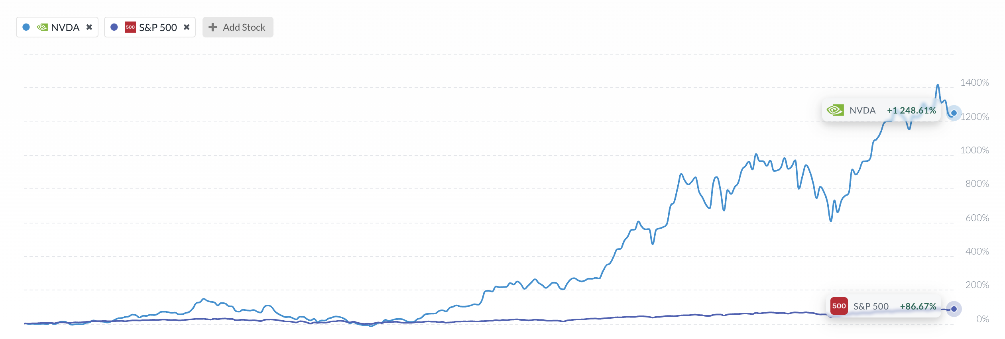
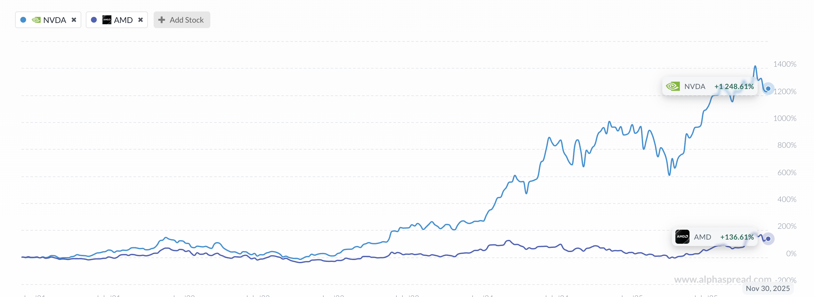
NVIDIA Corporation (NVDA)
5 Year Comparison
Vs S&P 500
Returns | NVDA | AMD | S&P 500
1 Year Return | 29.78% | 54.7% | 12.93%
3 Year Return | 951% | 183.63% | 23.35%
5 Year Return | 1226.84% | 137.24% | 86.67%
Vs Advanced Micro Devices (Competitor in AI Space)

Slide 11
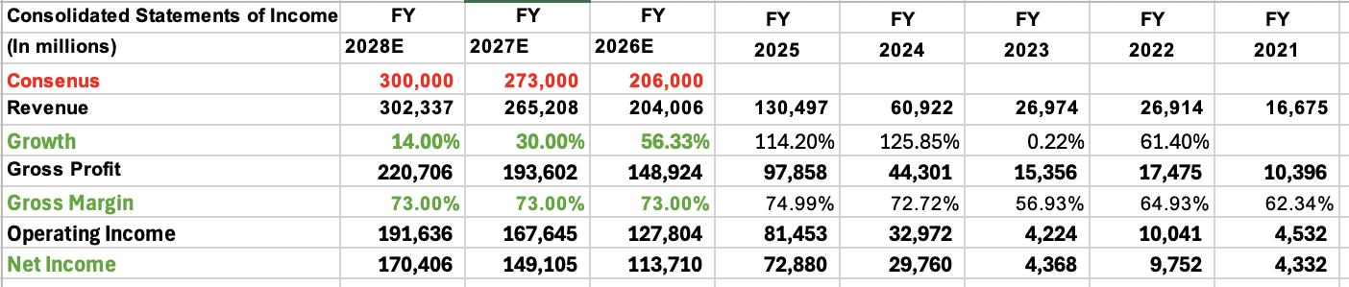
NVIDIA Corporation
Financial Analysis
Income Statement 3 Year Projections
Continued Revenue Growth, Slowed down from 2024-2025.
Revenue Projected to nearly double from FY2025 to FY2028, driven by sustained AI and Data Center demand
Stable Gross Margins around 73%
Operating income expansion reflects NVIDIA’s efficiency in scaling production and infrastructure
Beat Previous Quarter (Q3 2026) Earnings Estimate in November

Slide 12
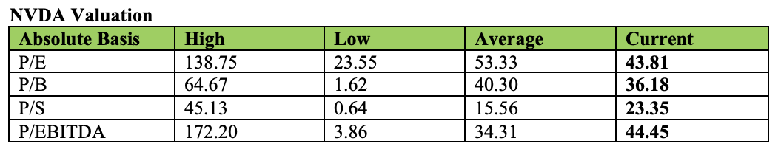
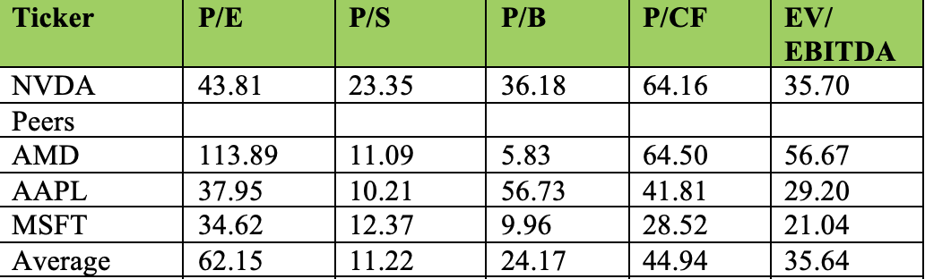
NVIDIA Corporation
Valuation
Current Multiples hovering around historic averages
Higher P/S compared to historic average showing revenue is aggressively priced for NVIDIA
Lower P/E compared Peer’s averages, skewed because of AMD
Again, very high P/S compared to peers in Info tech Sector
Above the average Price/Book, Price/CF, and EV/EBITDA

Slide 13
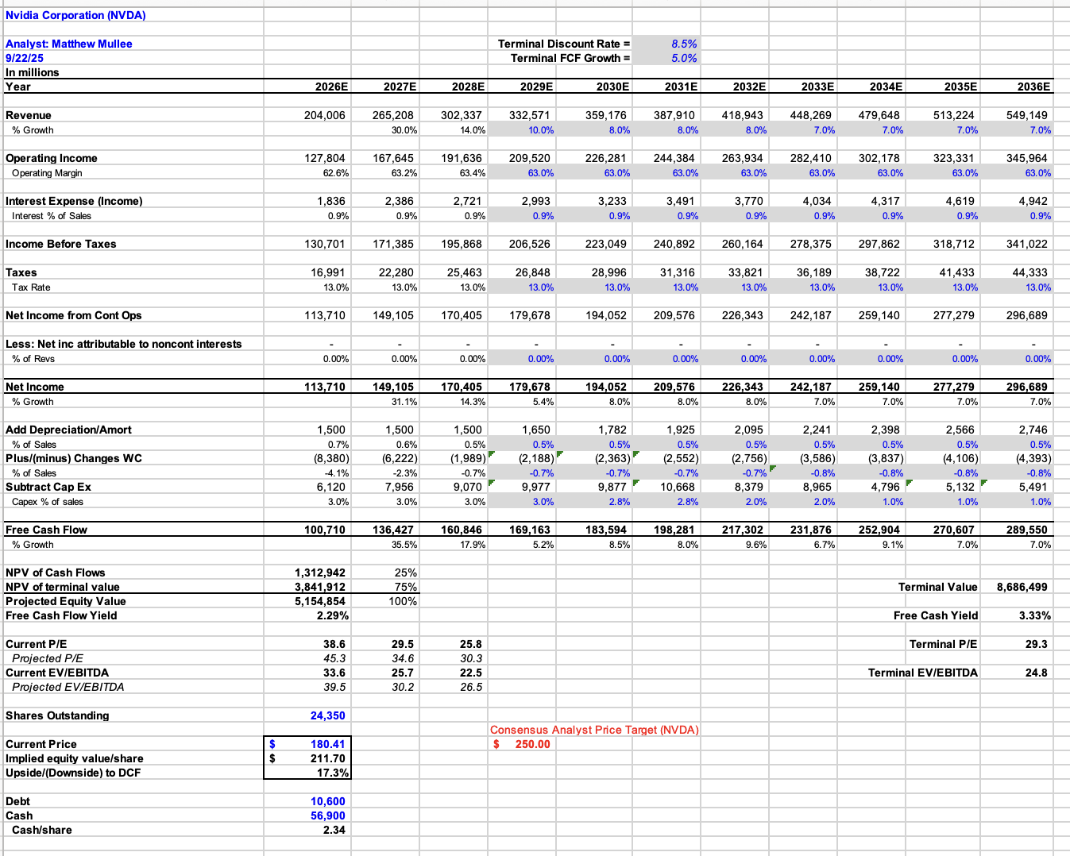
NVIDIA Corporation
Discounted Cash Flow
Terminal Discount Rate: 8.5%
Terminal FCF Growth: 5%
Current Price: 180.34
Current P/E: 43.81
Implied Equity Value/Share: 211.70
Upside to DCF: 17.3%
Terminal P/E: 29.3

Slide 14
NVIDIA Corporation
Recommendation
SELL
Catalysts:
Increased demand for Artificial Intelligence
Supply Chain Control, secured around 70% of TSMC advanced chipmaking capacity
NVIDIA’s CUDA Software ecosystem has created developer loyalty and set them up as the default option for AI development.
Risks:
Geopolitical Tension, Currently not able to sell their advanced chips to China
Potential AI Bubble, skepticism comes from massive AI infrastructure spending and circular investments inflating valuations.
Customer Concentration,6 Customers made up 85% of their Revenue last quarter
Current Weight in SIM : 7.33%
Recommendation:
Sell 233 Basis Points to fulfill the 5% max concentration, limits current exposure to AI Bubble while maintaining substantial weight for growth
Recommended Weight: 5.00%

Slide 15
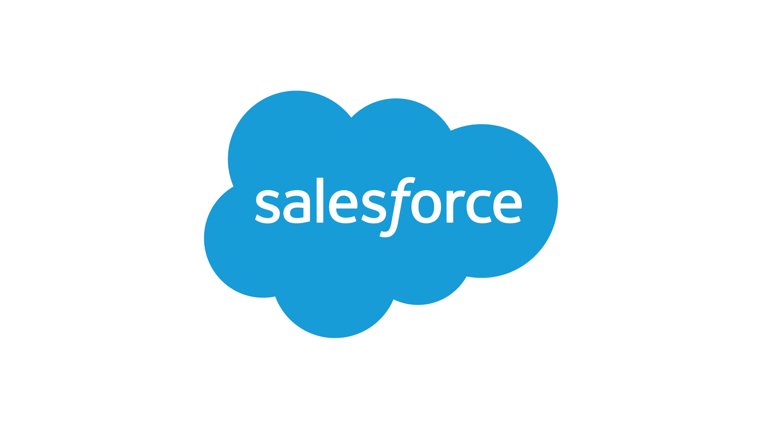
Salesforce Inc. (CRM)
Overview
Rating: BUY
CRM Stock Data
Market Cap | 219.47B
Shares Outstanding | 952M
Current Price | 232.83
52 Week High | 369.00
52 Week Low | 221.96
YTD Performance | -30.06%
Dividend Yield | 0.72%
Company Overview: Salesforce is the world’s leading provider of enterprise cloud computing solutions, specializing in Customer Relationship Management (CRM).
Business Model: The business operates primarily on a Software-as-a-Service (SaaS) model, generating over 90% of its revenue from recurring subscriptions with high retention rates.
Diversified Portfolio: Revenue is distributed across key segments including Service Cloud (24%), Sales Cloud (22%), Platform & Other (19%), and Integration/Analytics (15%).
Strategic Shift: The company has transitioned from a focus on hyper-growth to operational efficiency, prioritizing margin expansion and free cash flow generation.

Slide 16
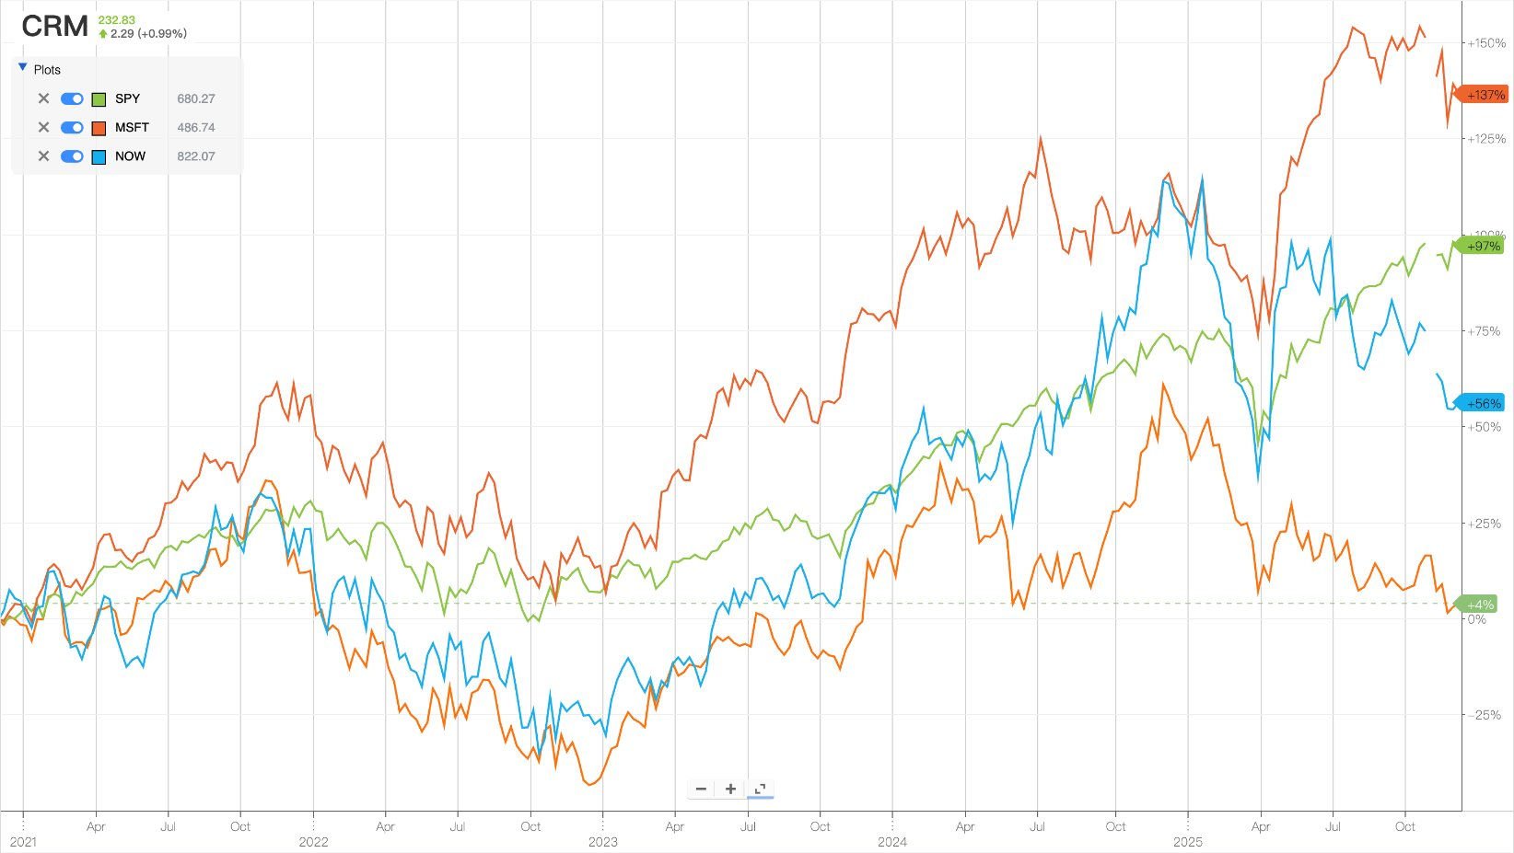
Salesforce Inc. (CRM)
Business Analysis
Rating: BUY
5-Year Performance Comparison (S&P/MSFT/NOW/CRM)
Reasons CRM stock underperforms:
MSFT +137%
Revenue growth deceleration vs. peers as core clouds matured, leading to valuation multiple compression.
Weaker AI narrative relative to MSFT/NOW, with slower perceived monetization from Agentforce and Data Cloud.
Lingering investor skepticism from past large M&A deals and integration challenges, despite recent margin improvements.
S&P +97%
NOW +56%
CRM +4%

Slide 17
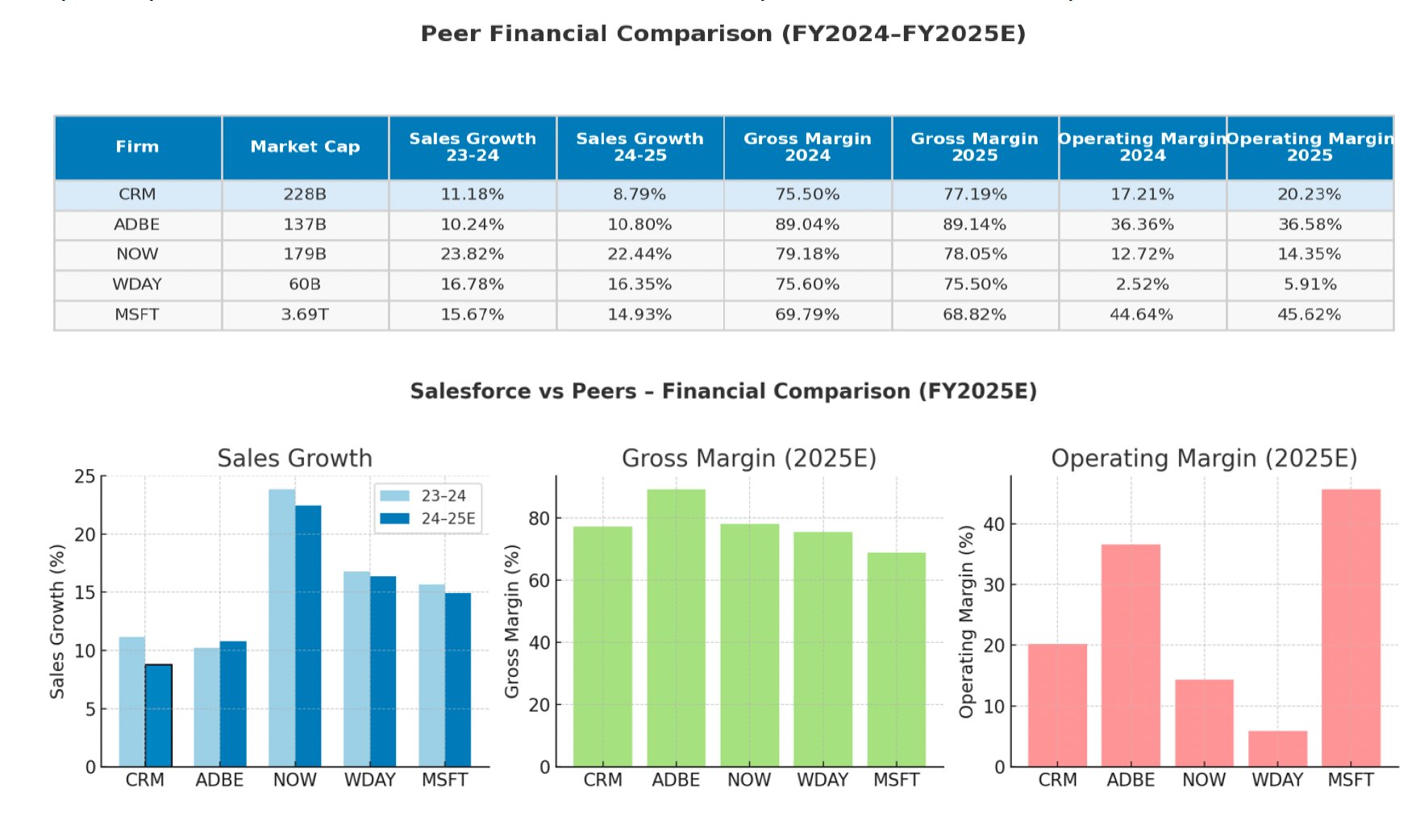
Salesforce Inc. (CRM)
Financial Analysis
Rating: BUY
Compared with peers, Salesforce shows mid-pack financial performance.Its revenue growth is noticeably lower than high-growth platforms such as ServiceNow, and also trails Workday and Microsoft.
On profitability, Salesforce maintains a solid gross margin, although still below Adobe and slightly below ServiceNow.
Overall, Salesforce delivers stable fundamentals but lacks the growth momentum of NOW or the margin strength of ADBE and MSFT.

Slide 18
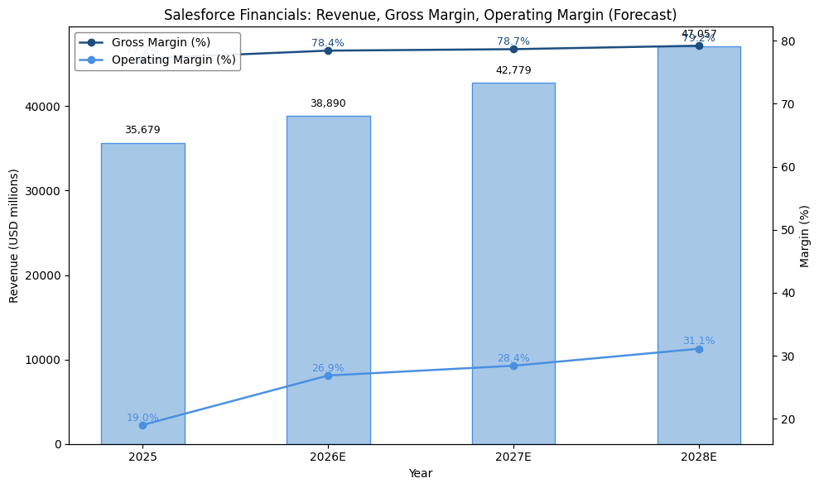
Salesforce Inc. (CRM)
Financial Analysis
Rating: BUY
Salesforce’s revenue outlook suggests a return to double-digit growth as the demand environment stabilizes and platform adoption broadens across clouds.
At the same time, operating leverage continues to build: the company is expanding margins through a leaner cost structure, more efficient go-to-market, and higher contribution from subscription revenue.
Overall, Salesforce is positioned for steady top-line acceleration and ongoing margin improvement over the next several years.

Slide 19
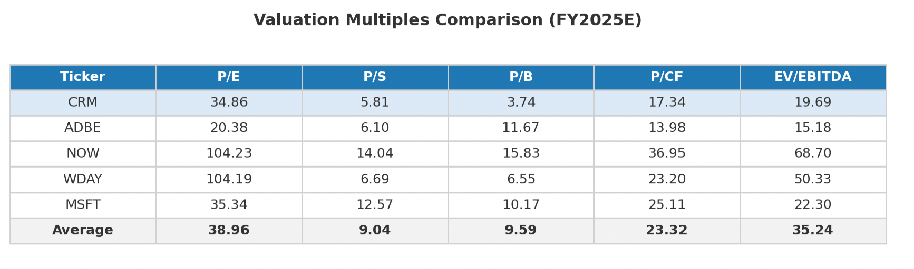
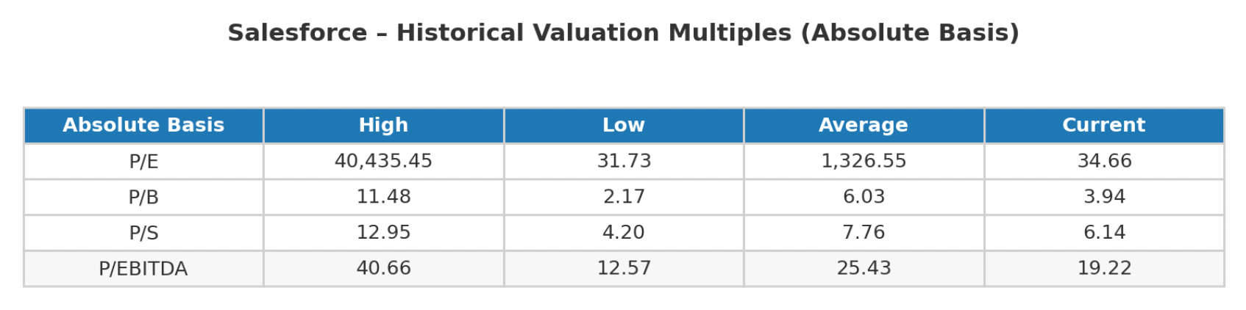
Salesforce Inc. (CRM)
Valuation Analysis
Rating: BUY
From a multiples perspective, Salesforce trades at a discount to peers on forward EV/EBIT and EV/FCF metrics, despite delivering comparable revenue growth and stronger margin expansion. I view this valuation gap as unjustified given the company’s improving profitability trajectory and robust free cash flow generation.
Salesforce also appears undervalued relative to its own long-term trading history. In my view, this compression in valuation multiples reflects temporary sentiment weakness rather than structural deterioration. As operating margins continue to expand and AI-driven revenue growth becomes more visible, I expect Salesforce’s trading multiples to be re-rated

Slide 20
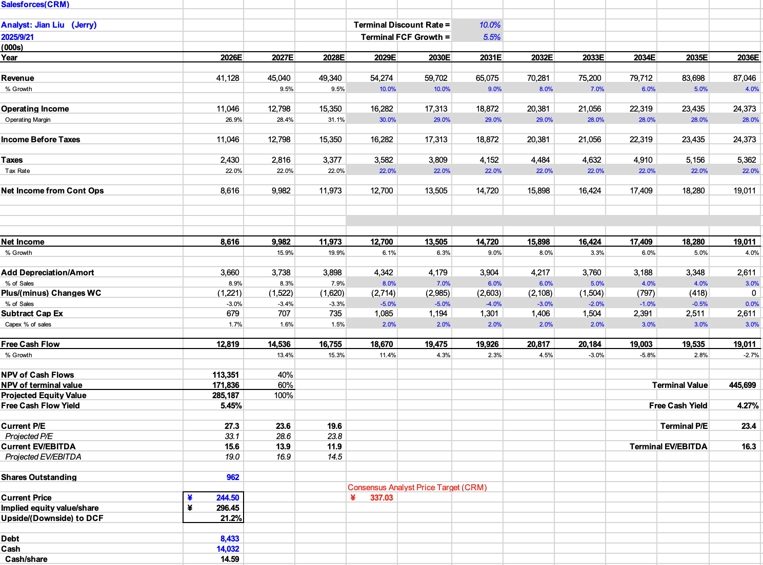
Salesforce Inc. (CRM)
Valuation Analysis
Rating: BUY
Current Price: $232.83
Target Price: $296.45
Potential Upside: 27.32%
Consensus Analyst Price Target: $337.03

Slide 21
Salesforce Inc. (CRM)
Recommendation
Rating: BUY
Stock: Salesforce (CRM)
Current Price: $243.23
Current Weighting: 4.8%
Recommendation: BUY +20 bps
New Weighting: 5.0%
Target Price: $296.45
Expected Return: +21.9%
Primary Catalysts
Return to double-digit revenue growth:Driven by improving IT spending environment and early adoption of Data Cloud + Agentforce, which increase expansion opportunities across the installed base.
Valuation discount vs peers:
CRM trades at a meaningful discount to ADBE, NOW, and MSFT despite superior near-term margin momentum and strong FCF (~30%+ margin), offering re-rating potential.
Primary Risks
Enterprise AI monetization may scale slower than expected:
Adoption of Data Cloud and Agentforce depends on customers’ internal data integration and implementation capacity.
Competitive pressure from large platform vendors:Microsoft and ServiceNow are expanding into overlapping workflows, which may affect win rates and pricing power.

Slide 22
Final Recommendations
 | Current Weighting | +/- Basis Points | Recommended Weighting
CrowdStrike Holdings Inc. (CRWD) | 0.00% | +250 Basis Points | 2.50%
NVIDIA Corporation (NVDA) | 7.33% | -233 Basis Points | 5.00%
Salesforce Inc. (CRM) | 4.8% | +20 Basis Points | 5.00%

