Slide 1

Information Technology Sector
By Matthew Mullee, John Mckenna, Ethan Liang, and Jerry Liu

Slide 2
Agenda
Overview of the S&P 500 and Sector
Business Analysis
Economic Analysis
Financial Analysis
Valuation Analysis
Our Recommendation

Slide 3
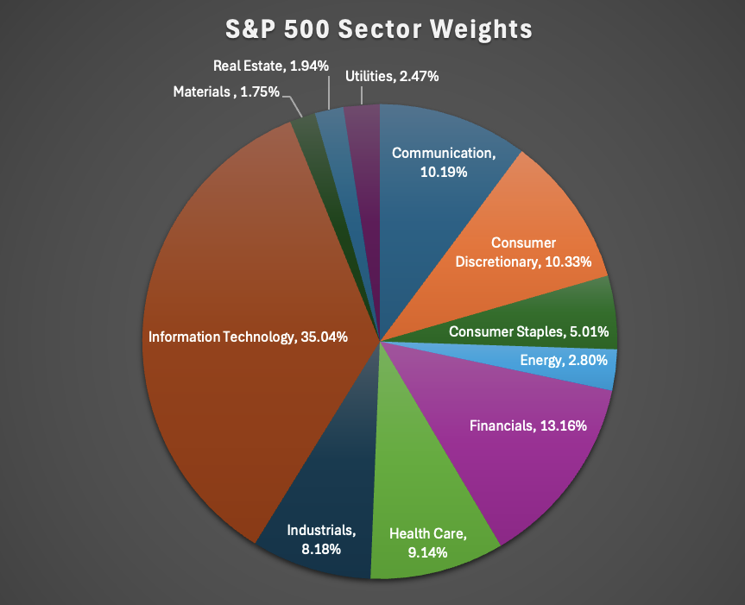
S&P 500
Sectors in S&P 500
Communication Services
Consumer Discretionary
Consumer Staples
Energy
Financials
Health Care
Industrials
Information Technology
Materials
Real Estate
Utilities
5 Sectors with the most weight
Information Technology, 35.04%
Financials, 13.16%
Consumer Discretionary, 10.33%
Communication, 10.19%
Health Care, 9.14%
Source: https://digital.fidelity.com/prgw/digital/research/sector/detail/info-tech

Slide 4
What industries are included in our sector?
Semiconductors – 32.79% Sector Weight. Ex. NVDA, AMD, INTC, AVGO
Software – Infrastructure - 26.67% Sector Weight. Ex. MSFT, ORCL
Consumer Electronics – 16.38% Sector Weight. Ex. AAPL
Software – Application - 10.56% Sector Weight. Ex. UBER, CRM
Information Technology Services – 3.31% Sector Weight. Ex. IBM
Semiconductor Equipment – 2.56% Sector Weight. Ex. AMAT
Computer Hardware – 2.32% Sector Weight. Ex. DELL
Communication Equipment – 2.29% Sector Weight. Ex. CSCO
Electronic Components – 1.87% Sector Weight. Ex. APH
Scientific and Technical Instruments – 0.89% Sector Weight. Ex. GRMN
Source: https://finance.yahoo.com/sectors/technology/

Slide 5





What companies make up the Information Technology Sector?
S&P 500 Weight 7.25% | % Change YTD 39.69% | Market Cap 4.40T
S&P 500 Weight 6.44% | % Change YTD 10.13% | Market Cap 3.91T
S&P 500 Weight 6.32% | % Change YTD 30.22% | Market Cap 3.84T
S&P 500 Weight 2.68% | % Change YTD 57.27% | Market Cap 1.63T
S&P 500 Weight 1.30% | % Change YTD 70.91% | Market Cap 790.07B
Source: https://stockanalysis.com/list/sp-500-stocks/

Slide 6
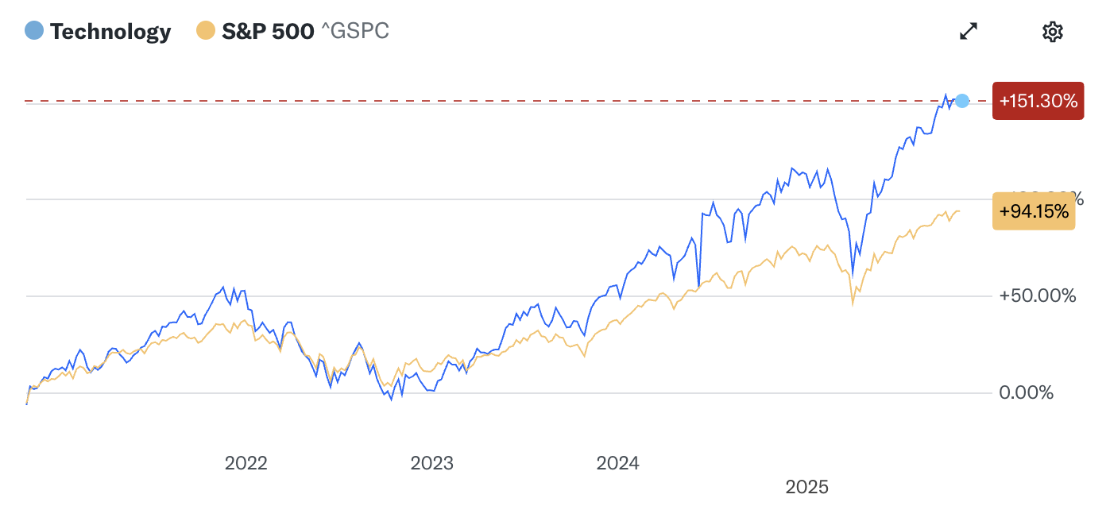
Information Technology Performance
Information Technology Sector Performance
1 Year Return +22.21%
3 Year Return +144.15%
5 Year Return +150.45%
S&P 500 Performance
1 Year Return +14.64%
3 Year Return +83.41%
5 Year Return +95.70%
Source: https://finance.yahoo.com/sectors/technology/

Slide 7
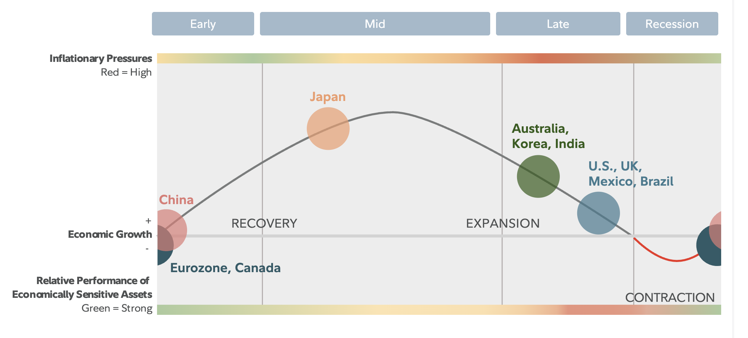
Global Business Cycle
Source: https://institutional.fidelity.com/app/item/RD_13569_40890/business-cycle-update.html?pos=T

Slide 8
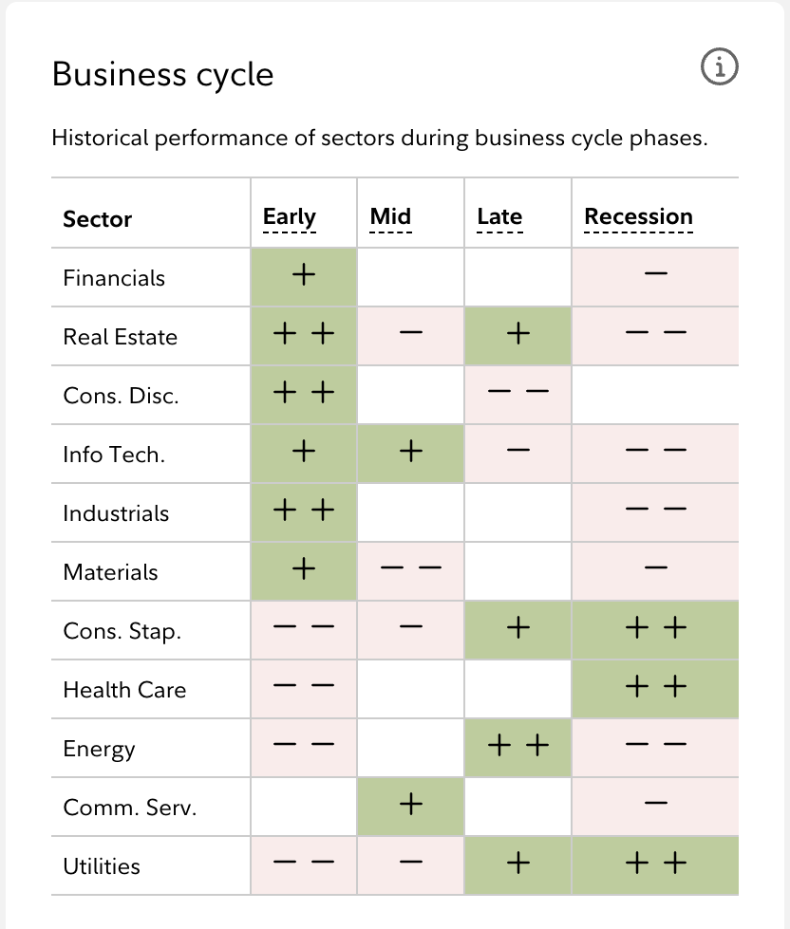
How does IT perform in the Late Cycle?
Late Cycle lasts an average of 18 months
Information Technology Sector does not perform well in the Late phase of the business cycle
Cyclical Sectors historically underperform in the Late phase
Some industries in the sector are less sensitive to the Business Cycle, but the sector is considered mostly cyclical
Source:https://digital.fidelity.com/prgw/digital/research/sector/detail/info-tech

Slide 9
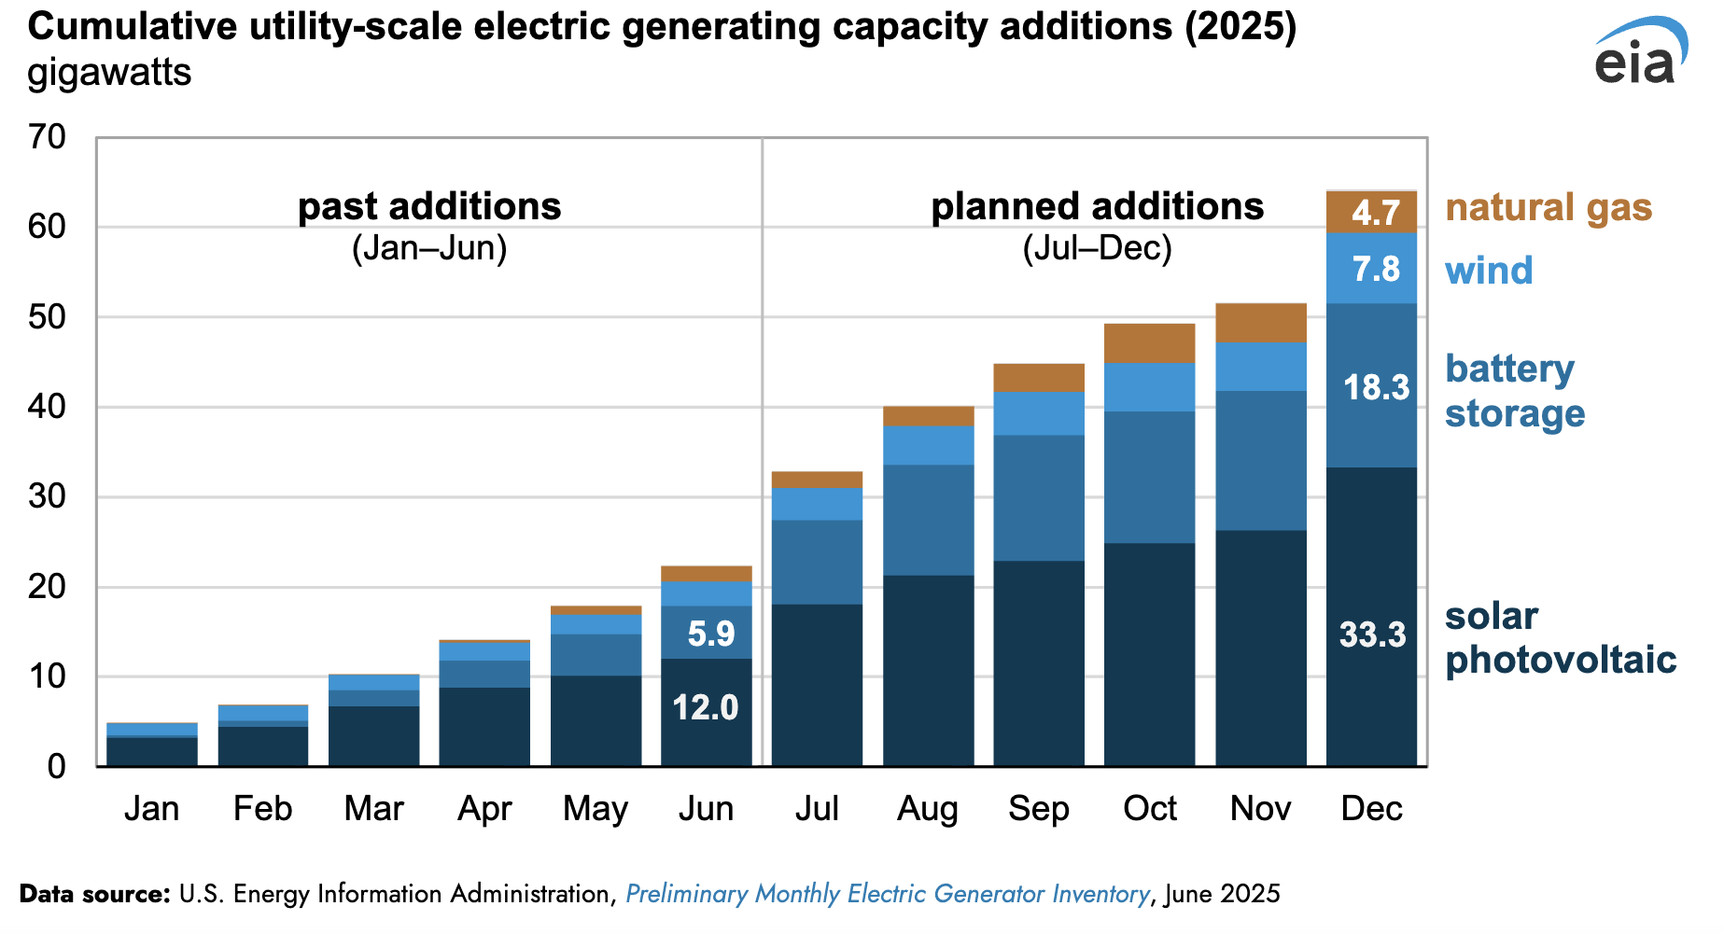
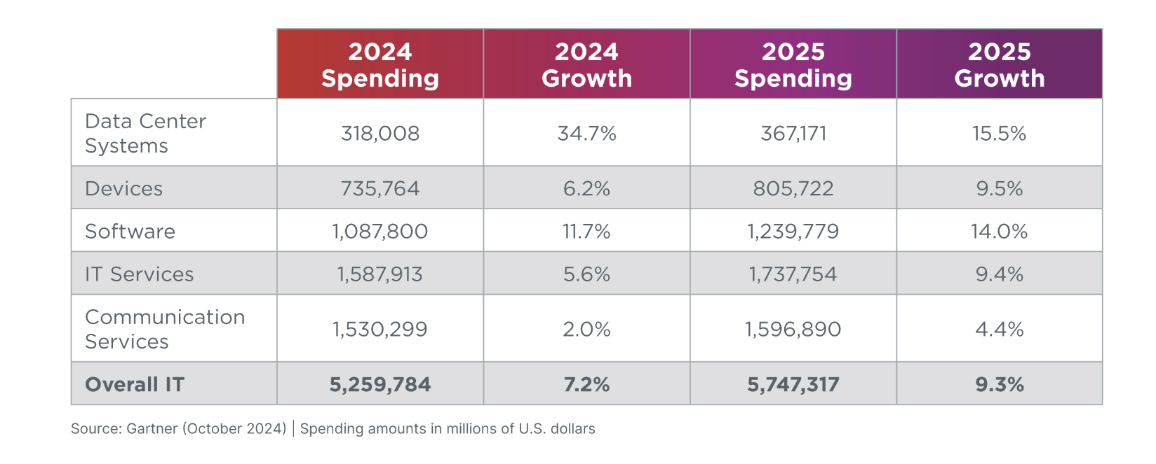
Supply Availability for the Sector
New Capacity Additions
In Millions (Worldwide)
Source: Gartner
Notes:
Important for industries like semiconductors and software – infrastructure that have a rapid demand for energy.

Slide 10
Porter’s 5 Forces Analysis
Porter’s 5 Forces Analysis | Intensity | Why?
Threat of New Entrants | Low | High Capital Requirements and there are barriers of trust for certain brands
Supplier Power | Moderate to Low | High competitive environment for suppliers, excluding semiconductor and other high-end chip suppliers where supplier power increases.
Buyer Power | Moderate to High | Alternatives for consumers / Low switching cost in software industry
Industry Rivalry | High | Many major players, continuous innovation, and a global reach
Threat of Substitutes | Low | Challenging to create such powerful technology/ Digital Infrastructure is now essential

Slide 11
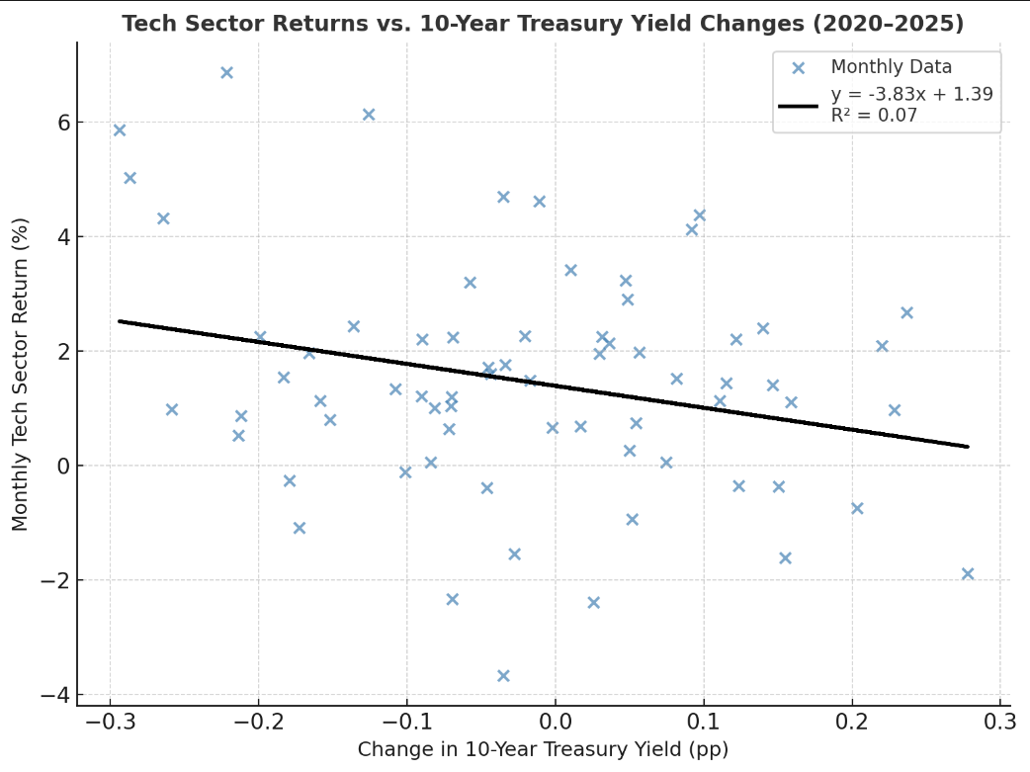
Economic Analysis

Slide 12
Regression
When yields increase, Tech valuations decline due to higher discount rates.
When yields fall, Tech valuations expand — especially for growth-oriented firms.
Rate sensitivity stronger than in defensive sectors (e.g., Utilities, Staples).
Reflects future-oriented earnings streams and investor risk appetite.
Regression validates that Fed rate shifts directly influence Tech equity prices.

Slide 13
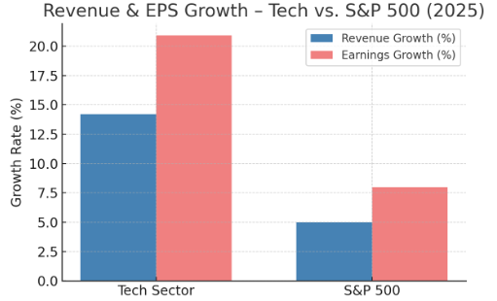
Financial Analysis
Revenue Growth (y/y %) – e.g., +14.2% (FactSet Q3 2025)
Earnings Growth (EPS y/y %) – e.g., +20.9% (highest among S&P 500 sectors)
5-Year Average Growth Comparison – shows acceleration vs. history

Slide 14
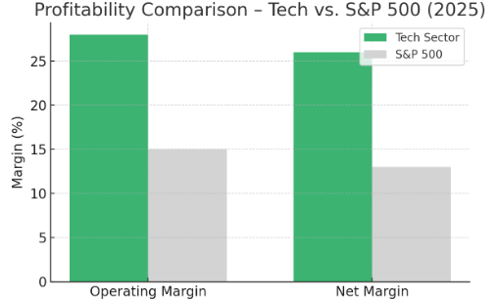
Profitability Metrics
Operating Margin: ~27–28% (record highs in 2025)
Net Margin: ~26% vs. S&P 500 ~13%
ROE (Return on Equity): ~35–40% average (Software/Hardware vary)
ROIC (Return on Invested Capital): ~30–40% (Software > Semiconductors)
R&D as % of Sales:
Software: 15–20%
Hardware: 7%
Services: 2–3%

Slide 15
Cash Flow and Capital Allocation
Free Cash Flow Margin (% of sales): 20–25% sector average
CapEx (% of sales): 5–7% (higher for semis/foundries)
Cash Usage: Share buybacks, R&D reinvestment, acquisitions
Net Cash Flow Trend: Positive → Tech is a net generator of cash

Slide 16
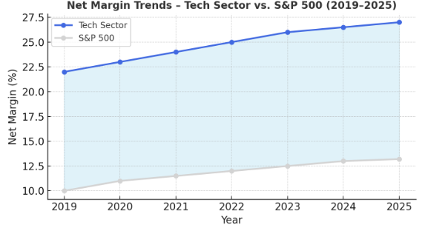
Margin Trend over Time
Tech margins rose steadily from 22% → 27%, while S&P 500 margins grew modestly from 10% → 13%.
The widening gap highlights Tech’s structural advantages: scalable software models, automation, and strong pricing power.
Margin expansion aligns with digital transformation, cloud growth, and AI adoption since 2020.
Visual reinforces your earlier regression story — Tech fundamentals remain strong despite macro headwinds.

Slide 17
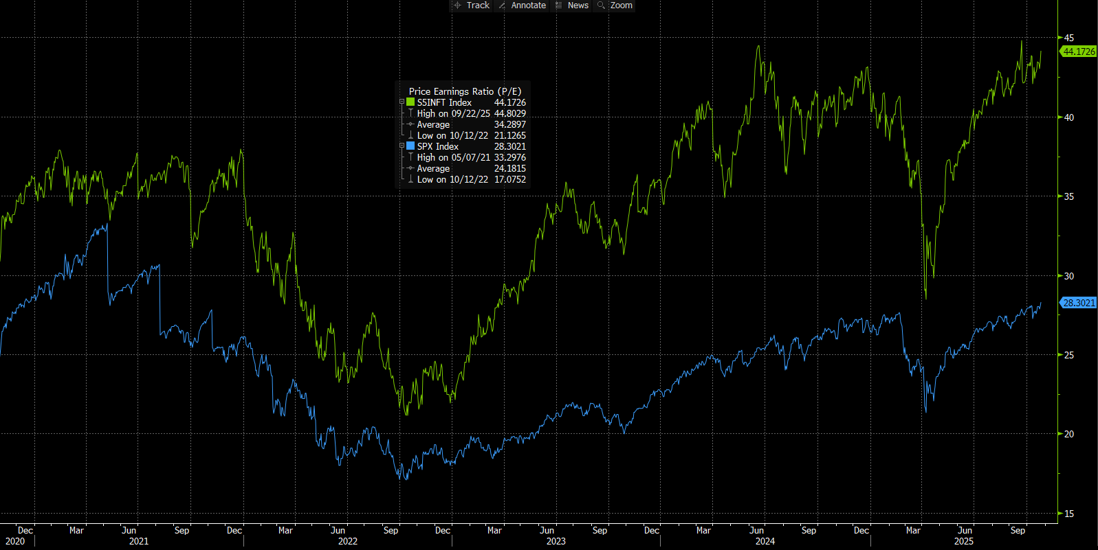
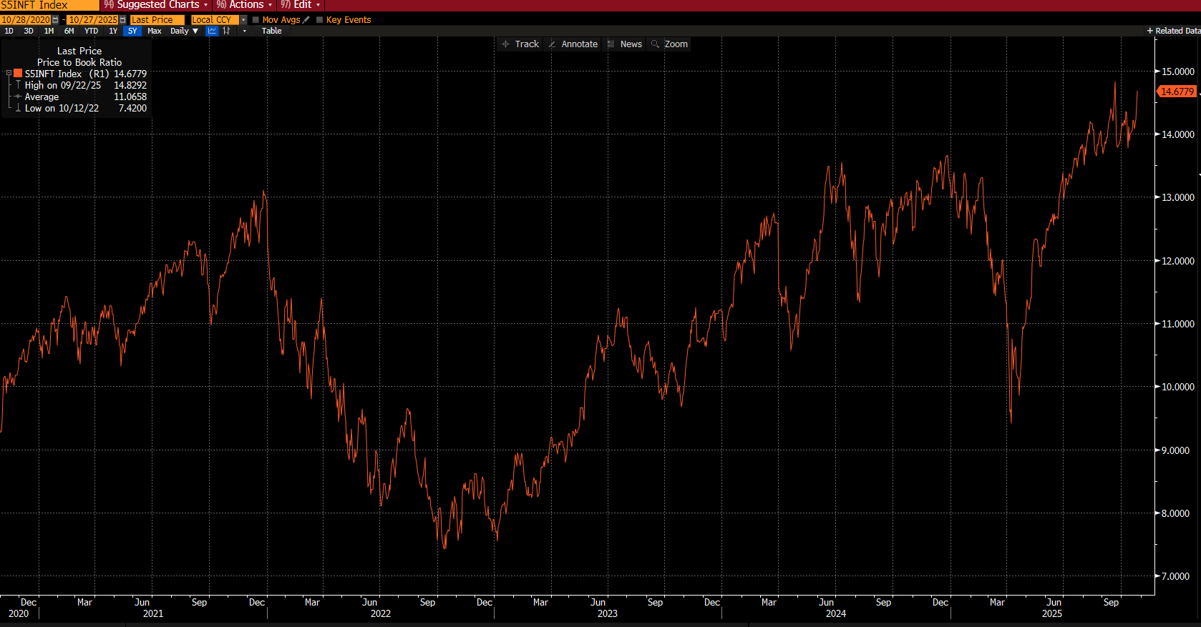
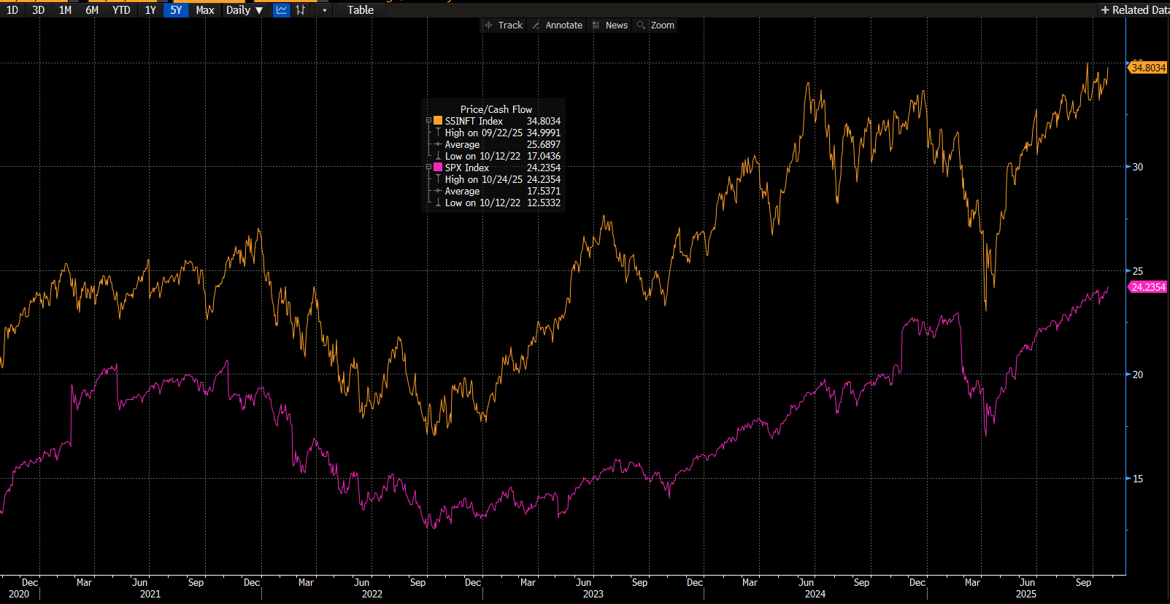
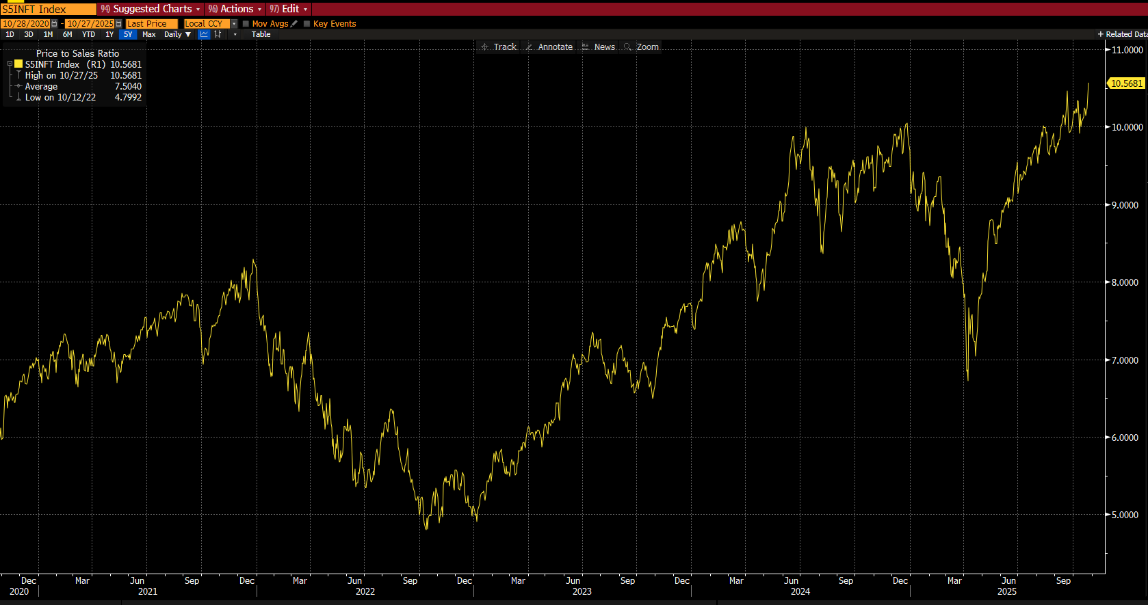
Valuation Analysis
P/E
P/B
P/CF
P/S

Slide 18
Valuation Analysis
Historical Trend
Outlook
Valuations expanded steadily since 2023, near record highs.
Temporary pullback in Apr 2025 amid tariff headlines.
Expansion driven by AI optimism, margin recovery, and rate cuts.
Multiples likely to remain elevated vs. market.
AI monetization and easing policy support further expansion of the multiples, though earnings normalization may limit upside.

Slide 19
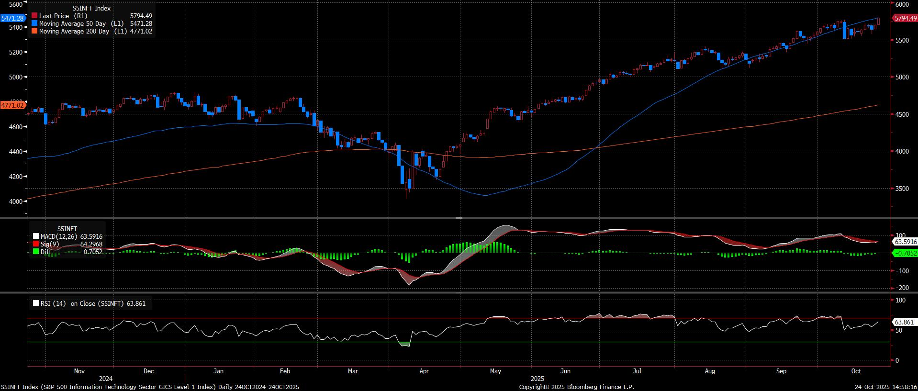
Technical Analysis
The sector remains in a strong upward trend, trading well above both its 50-day and 200-day moving averages.
The MACD line (63.6) stays slightly above the signal line (64.3), indicating neutral-to-positive momentum after a brief slowdown.
The RSI (63.9) is below the overbought threshold (70), showing the sector is not yet overextended. This implies there is room for further upside, though short-term consolidation is possible.

Slide 20

Recommendation
Should SIM be Overweight or Underweight the Info Technology Sector?
Earnings Growth
  Consistently deliver above consensus earnings
  Operate with high margins, strong cash flow and scalable business models
  In 2024 over $4.7 trillion dollars spent, projected to be $5.74 trillion in 2025
Digital Transformation
  Core of global digitization – cloud computing, AI, enterprise software & digital infrastructure
  Companies in all sectors rely on IT to drive efficiency, productivity and growth
  Allows for technology sector to become less cyclical
Growth Versus S&P 500
  Technology Sector incudes 3/7 Magnificent 7 – most of any sector
  Continuously outperformed the S&P 500 over 5-, 10-, and 15-year horizons
  Largest performance driver of index – underweighting can lead to significant tracking error

Slide 21

Positives & Risks
Positives
Risk
Secular Tail Winds
  Long-term, structural drivers – AI, cloud, cybersecurity, semiconductors – fuel steady resilient growth
  Companies' ability to achieve efficiency relies on the advancement of technology
  Global digitization and connectivity as emerging markets began to adopt IT’s global reach
Innovation Engine
  Companies reinvesting heavily in R&D
  Development of cutting-edge technology
  Innovations are competitive advantages
Global Demand
  Broad, global application across every industry
  IT solutions are mission-critical
  Creates non-cyclical, recurring demand
Valuation Risk
  Many IT companies are trading at elevated earnings multiples (P/E, P/S)
  High valuations expose sector to macro shocks
Concentration Risk
  Small group of companies dominates IT index performance (AAPL, NVDA, MSFT)
  Any underperformance can drag down the entire sector and index
  Increases volatility and reduces diversification benefits
  Concentration can magnify upside and downside moves
Regulatory & Geopolitical
  IT companies operate globally and face scrutiny from multiple governments
  Antitrust actions or new regulations can limit business models
  Geographic concentration risks. Ex: Taiwan for advanced chips through Taiwan Semiconductor Manufacturing Company

Slide 22

Sub-Sector Recommendation
What Industries within IT should be underweight or overweight?
Semiconductors & Semiconductor Equipment ✅
  Core driver of the AI revolution – huge demand for advanced chips, data centers & machine learning
  High operating margins once manufacturing scale is achieved allowing earnings to grow fast
  Chips are embedded in virtually every modern technology from phones to renewable energy
Software & Services ✅
  Cloud computing, AI integration, and enterprise software modernization are long-term secular trends
  Recurring revenue models allow for predictable strong cash flow supporting premium valuations
  High switching costs make it expensive for enterprises to switch providers
Hardware & Equipment ⚠️
  Hardware demand is tied to new product cycles like new smartphones, PC or enterprise buildouts
  More commoditized than software and chips, therefore, operates at thinner margins
  Hardware companies are more mature and slower-growing, limits revenue acceleration and growth

