Slide 1
Stock Presentation:
Info Tech
Adam Kwan, Anna Lagergren, Ava Kadro, Kurt Joshi, Leo Kleban, Ruta Kanhere, and Shivani Sharma

Slide 2
Overview

Slide 3
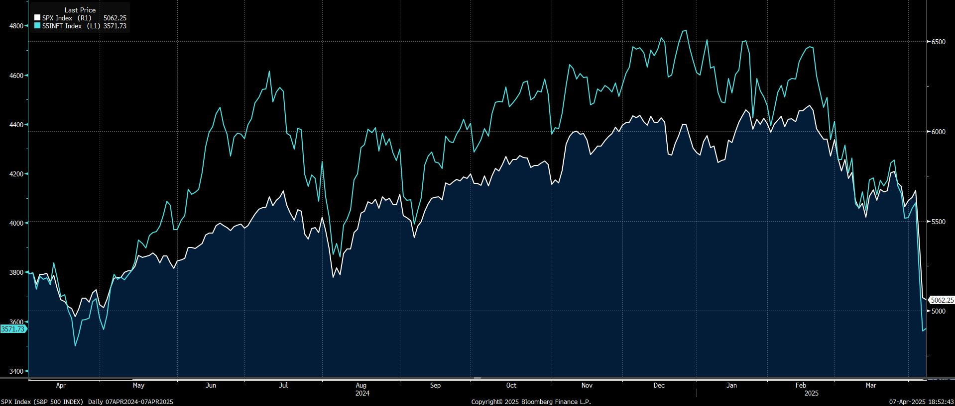
Sector Performance
YTD Info Tech vs. S&P 500

Slide 4
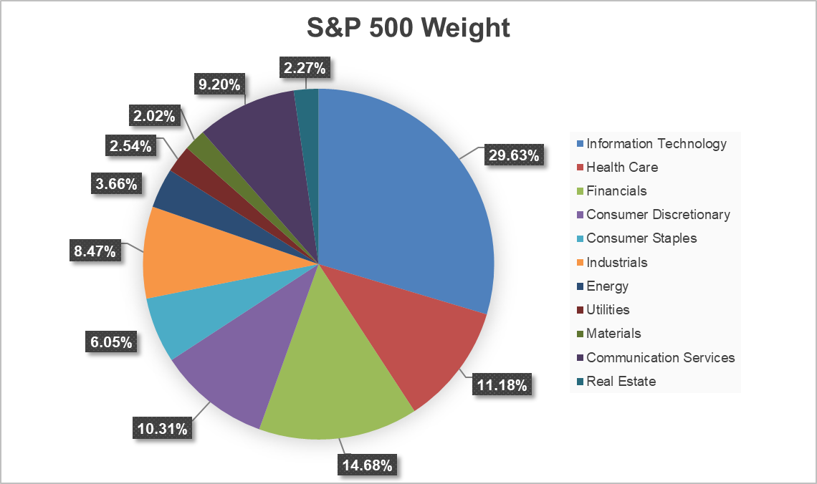
SIM Portfolio Holdings & Allocation
Portfolio
(put pie graphs of allocations)

Slide 5
Sector Recommendation Summary
Overweight
Underweight
Software
Hardware
Semi-Conductors

Slide 6
Stock
Information

Slide 7

Sell:
IBM

Slide 8
International Business Machines (IBM)
Recommendation: SELL (50bps)
Business Analysis:
Current SIM | 4.28%
Recommended SIM | 3.78%
Current Stock Price | $225.78
SIM Target Price | $165.51
Consensus Target Price | $255.71
Dividend Yield | 2.96%
Potential Upside/Downside | (26.70%)
52 Week Price Range | $162.62-$266.45
Market Capitalization | $226.13B
Diluted Shares Outstanding | 927.26M
P/E | 35.43
ROE | 24.25%
Overview
International Business Machines (“IBM”) is a global technology company that provides hardware, software, infrastructure, and consulting services. It focuses on serving enterprise and government clients across various industries with its innovative hybrid cloud and AI solutions.
Key Business Drivers
YoY, Red Hat software revenues have increased by 12% and Red Hats revenue doubled since its acquisition (Software).
Around 50% of IBM’s revenue comes from overseas (Tariffs)
AI & Watsonx demand in finance, healthcare, and government
IBM Consulting revenues headwind from DOGE and Government intervention

Slide 9
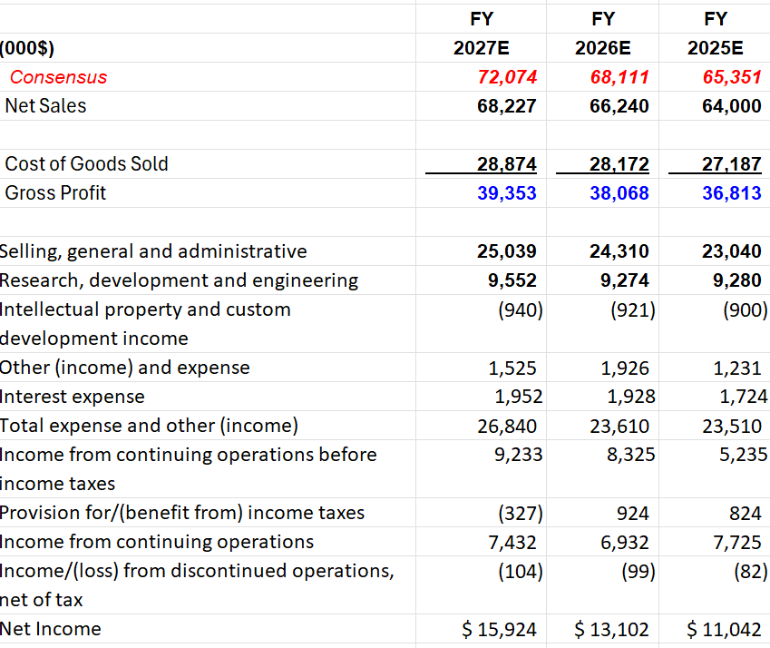
IBM: Financial Analysis
Recommendation: SELL (0.50bps)
IBM posted just 1.4% earnings growth in 2024. Its 5-year annual sales growth a meager 1.7%.
With fierce competition in the infrastructure segment from AWS and Microsoft Azure (21% of revenue), IBM has struggled to obtain cloud computing market share and has seen a YoY revenue decline of (2.70%).
IBM ran an analysis of a 10% adverse change in the exchange rates relative to the USD and found that it would decrease their financial instruments by about $1.3B
IBM's Net Income decreased 19.7% YoY. Net Income has been on a declining trend since 2012 suggesting that they are struggling to adapt and innovate in the rapidly evolving digital transformation market

Slide 10
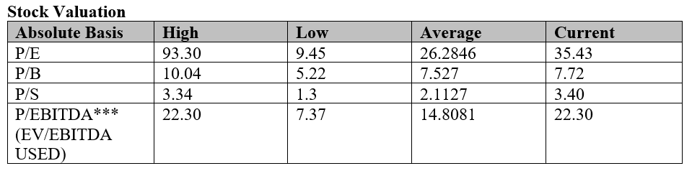
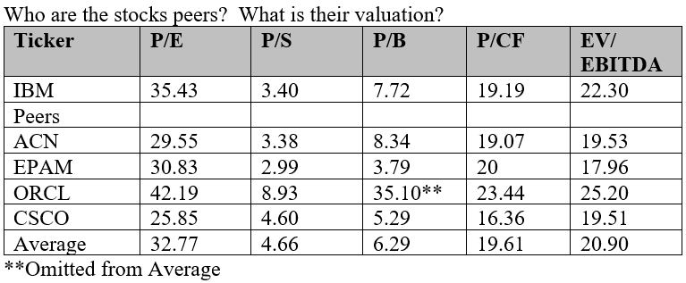
IBM: Valuation
Recommendation: SELL (0.50bps)
Valuation Compared to Competitors

Slide 11


Hold:
Microsoft (MSFT)
Amphenol (APH)

Slide 12
Microsoft (MSFT)
Recommendation: HOLD
Business Analysis:
Current SIM (3/31/25) | 5.81%
Recommended SIM | 5.85%
Current Stock Price (4/7/25) | $357.86
SIM Target Price | $537.98
Potential Upside | 50.33%
Consensus Target Price | $505.84
Dividend Yield | 0.92%
52 Week Price Range | $344.79-$468.35
Market Capitalization (4/7/25) | $2.68 T
Diluted Shares Outstanding | 7.469 B
P/E (4/7/25) | 28.84
ROE | 34.29%
Overview
MSFT develops and supports software, services, devices, and solutions worldwide. The main sources of revenue are through three segments: Productivity Business Processes, Intelligent Cloud, and More Personal Computing.
Key Business Drivers
Quantum computing potential (Majorana 1).
Resilience of Productivity Business Process Segment.
Decreased outlook in cloud computing growth.
Lowered investments in AI and Data Infrastructure.

Slide 13
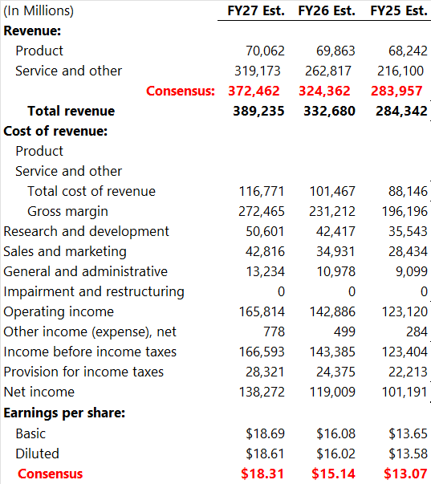
Microsoft: Financial Analysis
Key Takeaways
Decreased outlook in Cloud Computing may lower future revenue .
  43% of total revenue FY24
Increased investments into AI and Data Infrastructure will drastically increase short-term CapEx.
Gross Margin has consistently been near 70% for the last 5 Fiscal Years.
Operating Margin has been between 30-43% over the last 10 years.

Slide 14
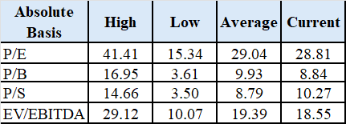
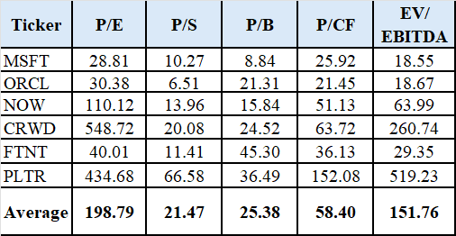
Microsoft: Valuation
Recommendation = HOLD
Target Price = $537.98
MSFT Valuations are currenting in line with averages due to the recent selloff from tariff concerns.
  Stock peer averages are inflated due to CRWD and PLTR.
Valuations expected to expand due to increased demand for data infrastructure and software.

Slide 15
Amphenol
Recommendation: HOLD
Business Analysis:
Current SIM | 2.04%
Recommended SIM | 2.04%
Current Stock Price | $63.14
SIM Target Price | $62.55
Consensus Target Price | $70
Dividend Yield | 1.12%
Potential Upside | -0.93%
52 Week Price Range | $54.72$79.39
Market Capitalization | $75.86B
Diluted Shares Outstanding | 1.2B
P/E | 26.45
ROE | 26.71%
Overview
Amphenol is one of the largest companies that produces interconnect, sensor and antenna solutions. These products are delivered and provide to facilities of Automotive, Broadband Communications, Commercial Aerospace, Defense, Industrial, and more.
Key Business Drivers
65% of revenue is internation and around 22% are from China which is exposed to tariffs
AI, automotive, and defense had a growth of 1.4B$ increase in the communication segment sales
Communication segment also had a decreases in broadband communication of 65M$

Slide 16
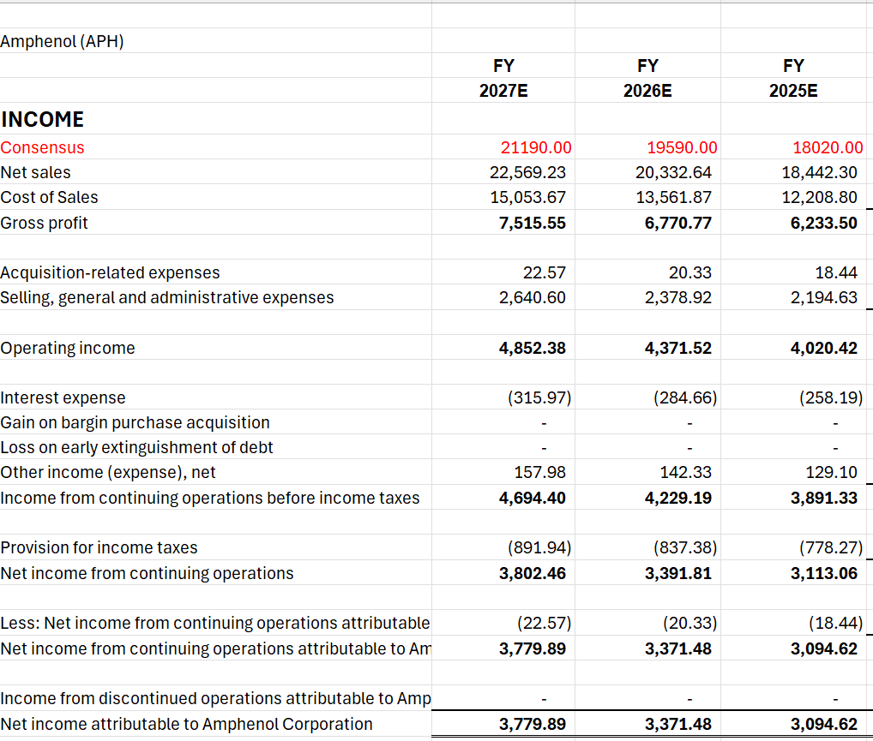
Amphenol: Financial Analysis
Thesis
Revenue grew 13.9% in 2024 reaching $15.4B from the increase of AI and automotive. Sales are expected to reach $18B in 2025 and 21.2B in 2027.
Operating income grows from $4.0B to $4.85B, with a steady margin of 21%
Net Income growing from $3B to $3.8B
Increase in Tariffs gives uncertainty

Slide 17
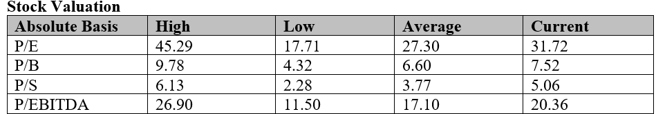
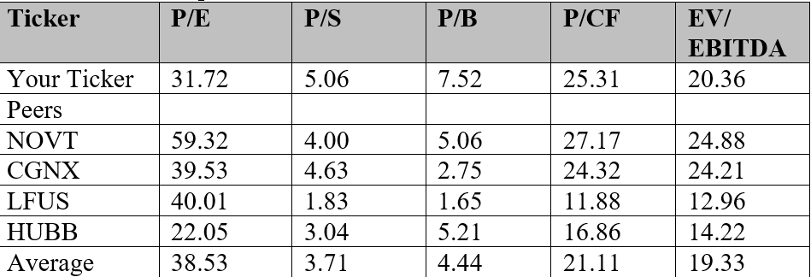
Amphenol: Valuation
Valuation
Target Price: $62

Slide 18


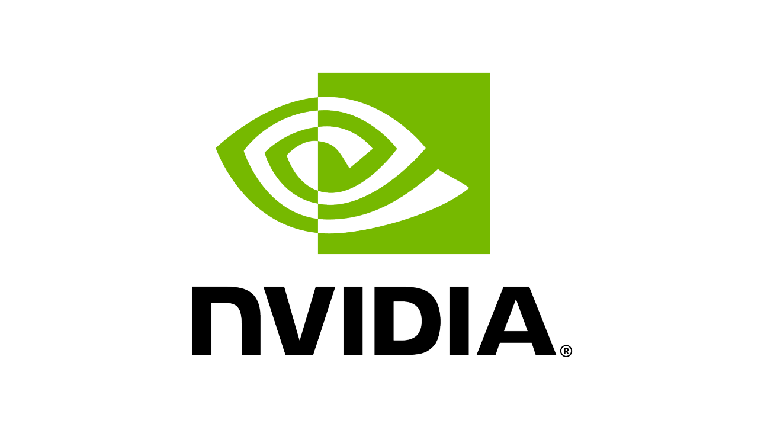

Buy:
Apple
ON
Nvidia
Salesforce

Slide 19
Apple
Recommendation: BUY 25 bps
Business Analysis:
Current SIM | 4.42%
Recommended SIM | 4.67%
Current Stock Price | $181.46
SIM Target Price | $194.26
Consensus Target Price | $244.93
Dividend Yield | 0.55%
Potential Upside | 7.65%
52 Week Price Range | $260.09 to $164.08
Market Capitalization | $2.73T
Diluted Shares Outstanding | 15,408
P/E | 28.85
ROE | 164.59%
Overview
Apple Inc. is a technology company, known for designing, manufacturing, and marketing consumer electronics, computer software, and online services. They are renowned for products like the iPhone, iPad, and Mac computers.
Key Business Drivers
Apple has developed an ecosystem of products are services that encompass one’s lifestyle and make it very hard for them to switch to other brands.
The services segment is their fastest growing segment (over 15% YoY) and has become a focal point.
They are developing new products and built in AI for them to lead the next generation of mobile innovation

Slide 20
Apple: Financial Analysis
Thesis
Projections
Apple will have a near term decline in their revenue growth. Products could see a decline in sales as there might be sharp price increases and Apple will focus on their high growth software and services portion.
50% + tariffs on China have cause their stock price to significantly decline so Apple will increase Capex to focus on nearshoring and moving their manufacturing to lower tariffed countries reducing their operating margin down to 40%.
These operational shifts will decrease their long-term profitability but will allow them to maintain their long -term revenue growth rate of about 3 ~ 4% per year.
A recession this year will hurt consumers and their ability to spend on new phones but future consumer spending is still strong and Apple can recover from this setback

Slide 21
Apple: Valuation
Analysis
APPLE VALUATION
Absolute Basis | High | Low | Average | Current
P/E | 41.86 | 10.42 | 28.34 | 28.80
P/B | 68.54 | 3.92 | 35.13 | 40.88
P/S | 9.98 | 2.25 | 6.83 | 7.02
EV/EBITDA | 29.2 | 6.8 | 20.1 | 20.3
Price target for Apple stock (APPL) based on a DCF is projected to be $194.46.
Apple’s absolute valuation is near it’s historical average but has receded a lot from the peak.
Apple stock is down over 25% in the past month due to tariff sanctions and uncertain economic conditions.
Valuation with adjustments for increased capex, lower margins, and decreased product sales growth values the stock above current levels.
Under current conditions Apple will increase Capex and try to work with US manufacturers as well as countries with lower tariffs going forward.
COMPARABLES
Ticker | P/E | P/S | P/B | EV/ EBITDA
AAPL | 28.8 | 7.02 | 40.88 | 20.3
MSFT | 28.8 | 10.3 | 8.8 | 18.55
GOOG | 18.2 | 5.3 | 5.5 | 13.3
DELL | 11.76 | 0.54 | -- | 7.6
HP | 8.41 | 0.5 | -- | 6.53
SONY | 16.8 | 1.38 | 2.3 | 7.15
Average | 18.8 | 4.2 | 14.37 | 12.2
Apple stock is down over 25% in the past month due to tariff sanctions and uncertain economic conditions
Valuation with adjustments for increased capex, lower margins, decreased product sales growth values the stock above current levels.
Under current conditions Apple increase Capex and try to work with US manufacturers as well as countries with lower tariffs going forward.
Price target for Apple stock (APPL) is projected to be $194.46
Include the DCF’s for your companies (either in the presentation or in the appendix to the presentation).
Review the valuations in light of historical price ratios—have the ratios expanded/contracted/stayed the same over the years?
The price ratios for Apple have gone down significantly recently, after steady increases over their history
Review the valuations relative to the industry, sector (if available), and S&P 500—have the ratios expanded/contracted/stayed the same over the years?
Review your expectations for future valuations—will the ratios expand/contract/stay the same going forward?
Review the results of technical analysis

Slide 22
Nvidia
Recommendation: +50 bps
Business Analysis:
Current SIM | 4.52%
Recommended SIM | 5.02%
Current Stock Price | $97.64
SIM Target Price | $116.19
Consensus Target Price | $170.67
Dividend Yield | 0%
Potential Upside | 19%
52 Week Price Range | $75.606-$153.13
Market Capitalization | $2.382T
Diluted Shares Outstanding | 24.4B
P/E | 33.19
ROE | 119.2%
Overview
Nvidia is a semiconductor devices company with two reportable segments: Compute & Networking (~80%) and Graphics (~20%). It has leveraged its GPU architecture to create platforms for accelerated computing, AI, scientific computing, data science, AV, robotics, metaverse, and 3D internet applications.
Key Business Drivers
Dominance in the GPU Market
AI and Data Center Demand
Advancements in AI Chip Architecture (Blackwell Architecture)
Expansion into the Automotive Sector
Software and Services Growth
Notes:
Nvidia’s business model is expanding beyond hardware to include software and services, further diversifying its revenue streams. One notable example is Nvidia Omniverse, a platform for simulation and virtual collaboration in industries like gaming, design, and manufacturing
Nvidia is expanding its reach into the automotive sector with its Drive platform, which provides advanced solutions for autonomous driving, in-car entertainment, and AI-powered safety features.
Autonomous Vehicles: Nvidia’s Drive Orin platform is helping to drive the adoption of autonomous driving technology. The platform processes vast amounts of sensor data to help vehicles navigate safely and efficiently.
In-Car AI Solutions: The Nvidia Drive platform is being used by several major automakers, including Mercedes-Benz, BMW, and Volkswagen, for AI-based infotainment and safety systems.
Blackwell AI Chips: These chips are optimized for large-scale AI workloads, making them essential for industries adopting AI technologies. The enhanced computational power of the Blackwell chips has already led to significant sales growth in the AI segment

Slide 23
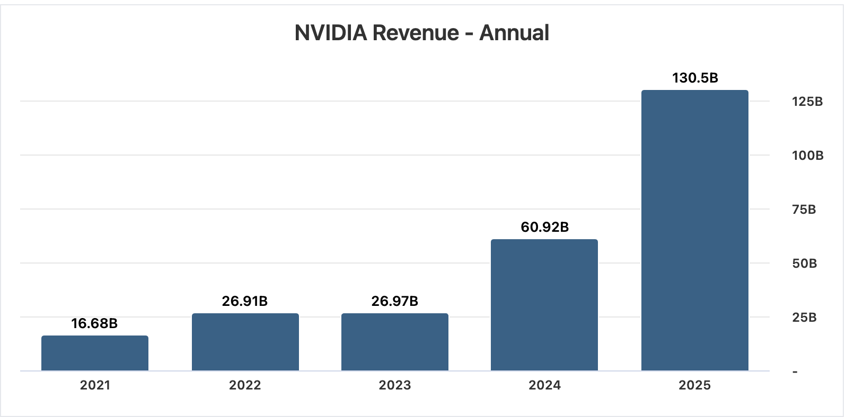
Nvidia: Financial Analysis
Thesis
Revenue Growth
Revenue has skyrocketed 383% in the past two years
Nvidia is the clear leader in graphic processing units (GPUs), with an over 80% market share.
Products are becoming more versatile, with their applications expanding.
Notes:
Its revenue has skyrocketed 383% in the past two years, going from $27 billion in fiscal 2023 to $130.5 billion in fiscal 2025 cause prices of all their products went up
products are becoming more versitile, with thier applications expanding
2. Nvidia's business has a wide moat
Nvidia is the clear leader in graphic processing units (GPUs), with an over 80% market share.

Slide 24
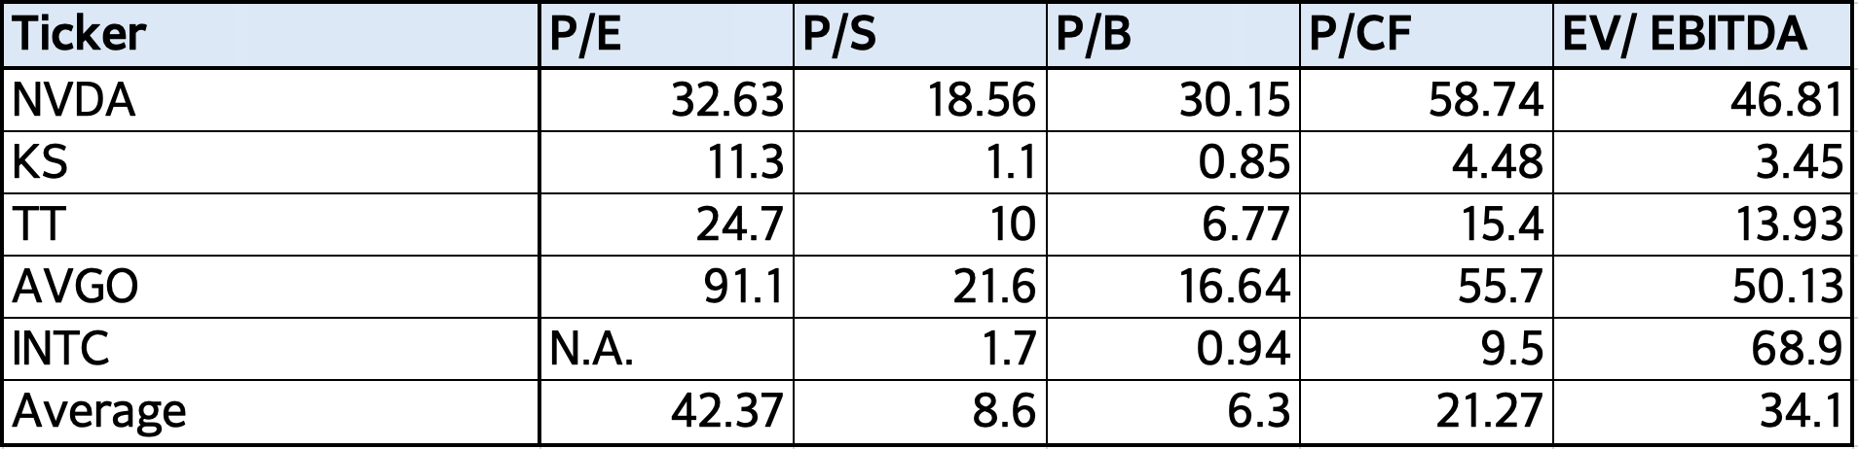
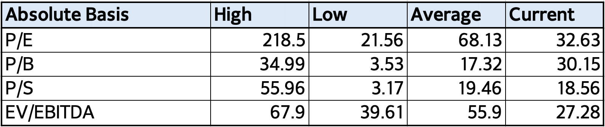
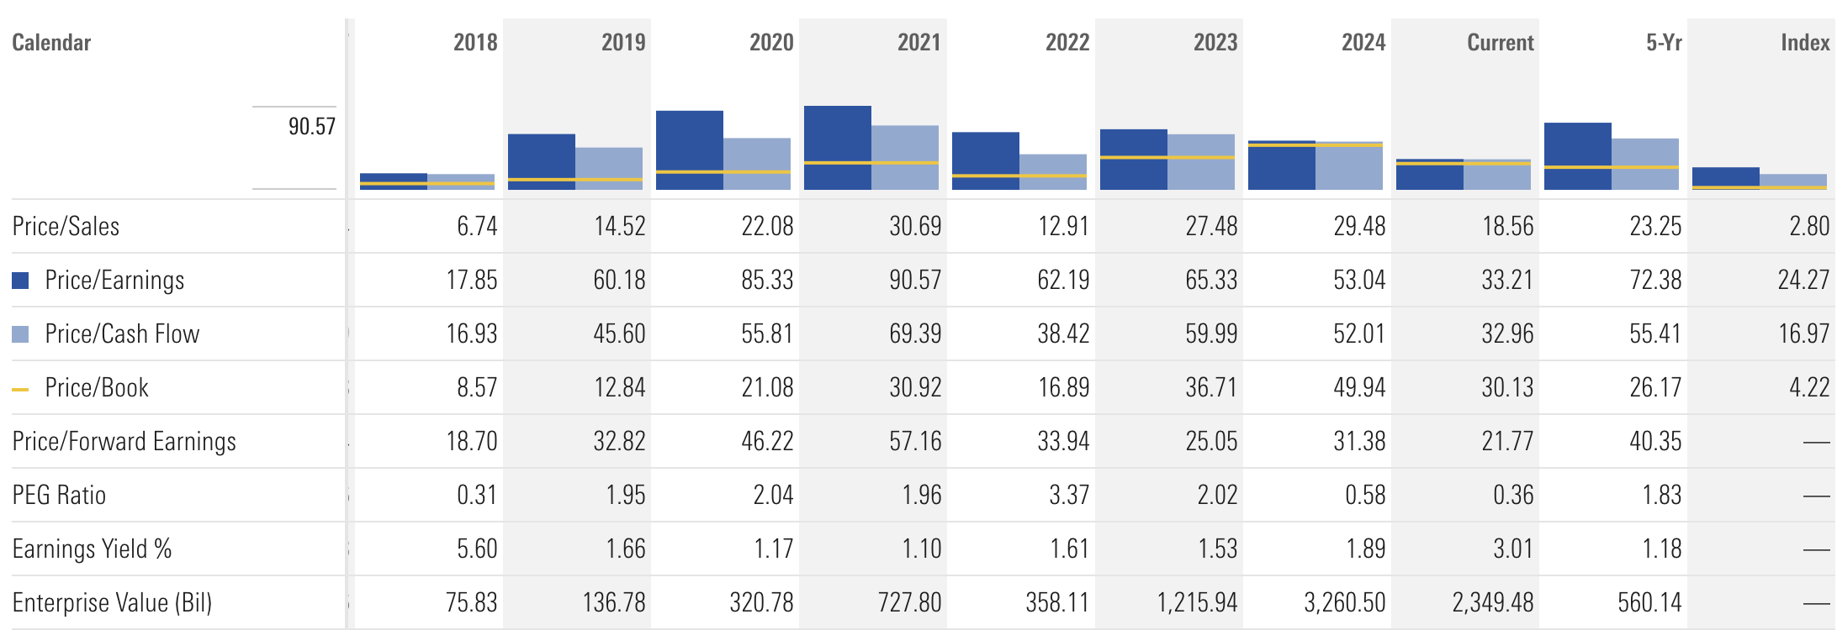
Nvidia: Valuation
Notes:
it shows that the price is low relative to expected future earnings.

Slide 25
ONSemi
Recommendation: +100 (50 from IBM)bps
Business Analysis:
Current SIM | 2.13%
Recommended SIM | 3.13%
Current Stock Price | $ 35.08
SIM Target Price | $ 87.25
Consensus Target Price | $ 86
Dividend Yield | 0 %
Potential Upside | 149%
52 Week Price Range | $33.21 - $ 80.0
Market Capitalization | $ 14.8 Bil
Diluted Shares Outstanding | 422.04 Mil
Forward P/E | 13.37
ROE | 18.95%
Overview
ON Semiconductor engages in the design, manufacture, and marketing of portfolio of semiconductor components. It operates through three Business segments: Power Solutions Group, Advanced Solutions Group, and Intelligent Sensing Group.
Key Business Drivers
Power Solutions Group - 47% of the total revenue
Demand Drivers - Enhancement of the current electrical infrastructure driven by demand for green energy, electrification of powertrains in EVs and HEVs, and increased power demands from AI
Analog and Mixed-Signal Group - 37% of the total revenue
Demand Drivers – Automotive, Industrial, Computing, and Mobile end-market
Intelligent Sensing Group - 16% of the total revenue
Demand Drivers – Automotive and Factory automation and applications powered by AI

Slide 26
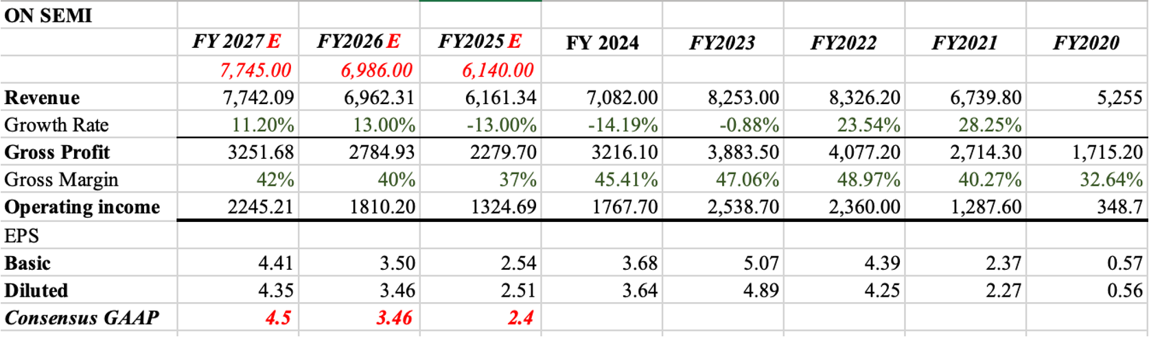
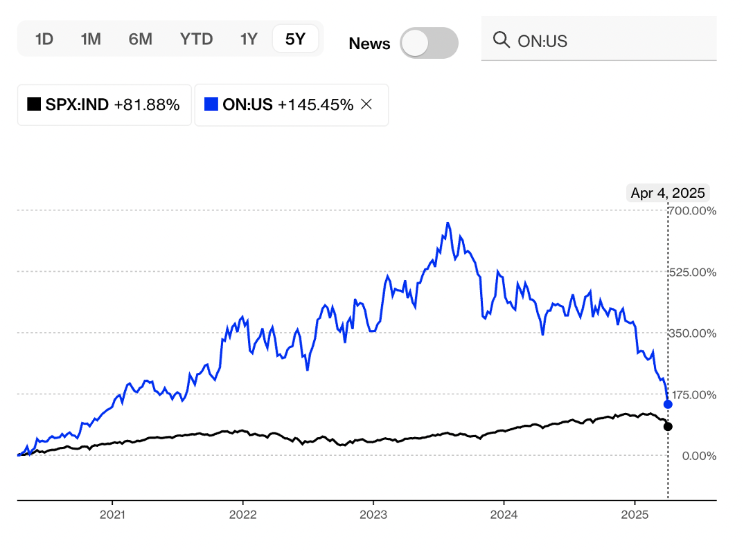
ONSemi: Financial Analysis
Thesis
Projections
The current decline in the stock price of ONsemi is greatly influenced by the current trade war, especially between U.S. and China and market is reacting negatively to the news.
The revenue is projected to decline in near future however ONsemi has taken strategic decision to remain profitable including acquisition of technology and other companies to expand market opportunity.
Currently the stock is trading at almost 57.2% lower than its 52-week high of $ 78.74 from July 2024 however over last 5 years it has a return rate higher relative to the return of S&P 500.
ONsemi had a steady growth in the past and is expected to grow eventually with a consistently high-profit margin. The current macroeconomic fluctuations are the key reason for the drastic plunge in its share price.
Key Financial Data
Revenue | $ 7.08 B
Revenue Growth (Y/Y) | -14.19%
Gross Margin | 45.41%

Slide 27
ONSemi: Valuation
Analysis
ON (10Y) | HIGH | LOW | MEDIAN | CURRENT
P/E | 57.42 | 7.91 | 19.83 | 13.37
P/B | 6.97 | 1.35 | 3.36 | 1.67
P/S | 5.64 | 0.82 | 1.82 | 2.11
EV/EBITDA | 21.15 | 5.41 | 10.92 | 5.7
TICKER | MKT CAP | P/E | P/B | P/S | EV/EBITDA
ADI | 84.98B | 22.88 | 2.42 | 9.15 | 21.83
STM | 16.58B | 23.32 | 0.97 | 1.34 | 3.64
TXN | 140.13B | 27.25 | 8.29 | 9.05 | 19.38
MPWR | 23.39B | 29.07 | 7.44 | 10.81 | 39.15
NXP | 41.41B | 13.74 | 4.51 | 3.34 | 11.13

Slide 28
Salesforce
Recommendation: BUY (50bps)
Business Analysis:
Current SIM | 2.4%
Recommended SIM | 2.9%
Current Stock Price | $244.2
SIM Target Price | $355
Consensus Target Price | $376
Dividend Yield | 0.52
Potential Upside | 45%
52 Week Price Range | $212-$369
Market Capitalization | $231.37 B
Diluted Shares Outstanding | 961 M
P/E | 38.14
ROE | 10.26%
Overview
Salesforce is a cloud-based customer relationship management (CRM) platform that helps businesses manage sales, marketing, customer service, and other business activities, ultimately aiming to improve customer relationships and drive business growth.
Key Business Drivers
We recommend a BUY because of:
Dominance in CRM and strong pricing power
Cloud adoption and highly integrated ecosystem
Profitable growth and margin expansion

Slide 29
Salesforce: Financial Analysis
Macroeconomic Factors
Financial Analysis
Global IT Spending is projected to reach 5.74 Trillion in 2025. Leading technology giants, including Amazon, Alphabet, Microsoft, and Meta, are set to invest over $300 billion in AI infrastructure.
The SaaS industry is projected to grow at a 12.5% compound annual growth rate (CAGR), reaching an estimated $332.2 billion by 2026, up from $152.2 billion in 2020. This growth is fueled by businesses increasingly shifting to cloud-based solutions to enhance efficiency while reducing infrastructure costs.
Salesforce has dominance in the CRM space. Last year they implemented a 9% increase in prices of core products. They were able to do so without customer attrition, capitalizing on their deeply integrated solutions and high switching costs.
Their highly integrated system results in strong operational efficiencies. They work with Lennar, Pfizer, Amazon, Alibaba etc.
Margin Analysis:
  Gross Profit Margin: 75.5% in FY24 to 77.19% in FY25.
  Operating Margin: 5.93% in FY23 to 17.21% in FY24, and reaching 20.23% in FY25
  Net Profit Margin: 0.66% in FY23 to 11.78% in FY24 and 16.35% in FY25

Slide 30
Salesforce: Valuation
Peer Operating Margin Analysis
Peer Gross Margin Analysis

Slide 31
Final
Recommendation

Slide 32
Final Recommendation
Stock | Weight (Current) | Current Price | Target Price | Expected Return | Recommendation | Change | Weight (after)
IBM | 4.28% | $225.78 | $165.51 | -26.70% | SELL | -50 bps | 3.78%
Microsoft | 5.81% | $357.86 | $537.98 | 50.33% | HOLD | 0-5 bps | 5.85%
Amphenol | 2.04% | $63.14 | $62.55 | -0.93% | HOLD | 0 bps | 2.04%
Apple | 4.42% | $181.46 | $194.26 | 7.65% | BUY | 25 bps | 4.67%
Nvidia | 4.52% | $97.64 | $116.19 | 19% | BUY | 50 bps | 5.02%
ON | 2.13% | $35.08 | $87.25 | 149% | BUY | 100 bps (50 from IBM) | 3.13%
Salesforce | 2.40% | $244.2 | $355 | 45% | BUY | 50 bps | 2.90%

Slide 33
Appendix

Slide 34
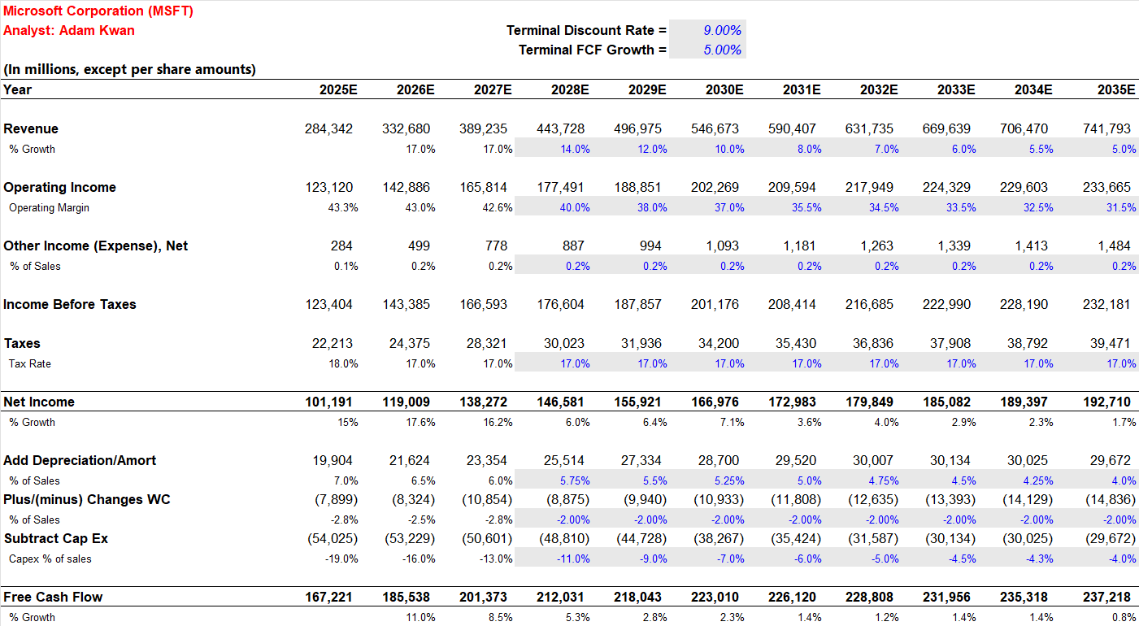
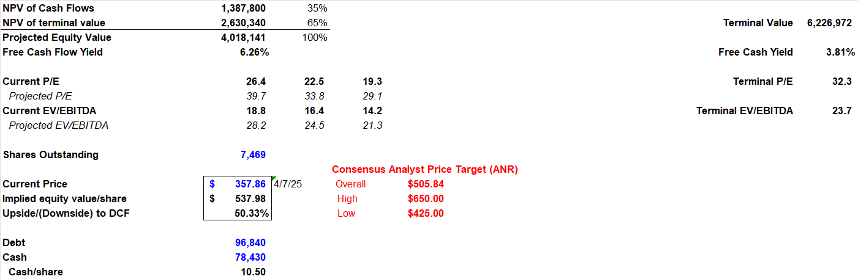
DCF Model (MSFT)

Slide 35
DCF Model (AAPL)

Slide 36
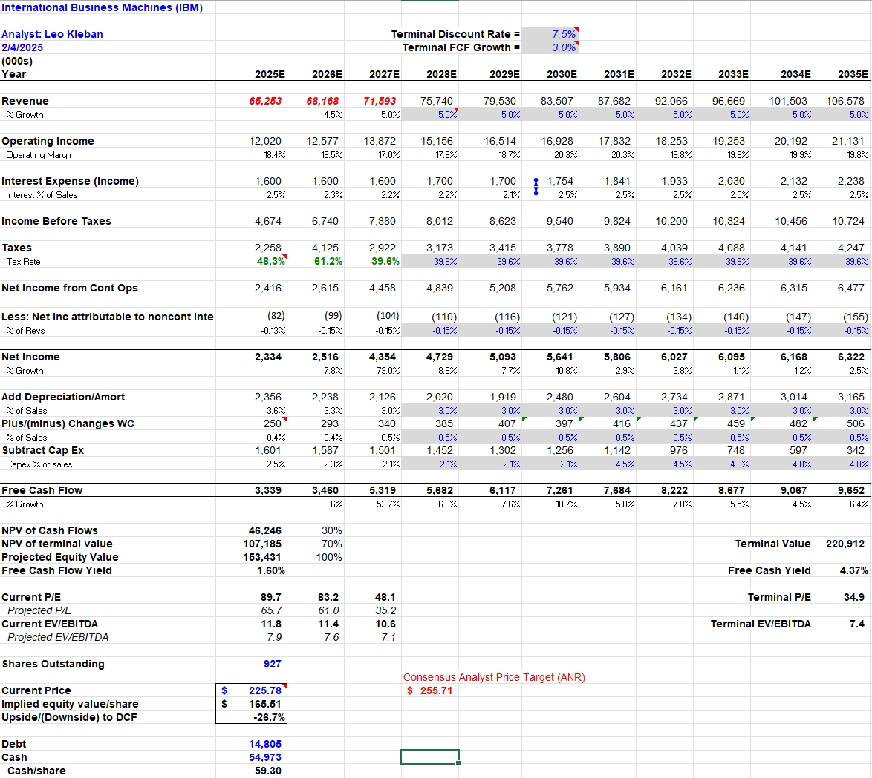
DCF Model (IBM)

Slide 37
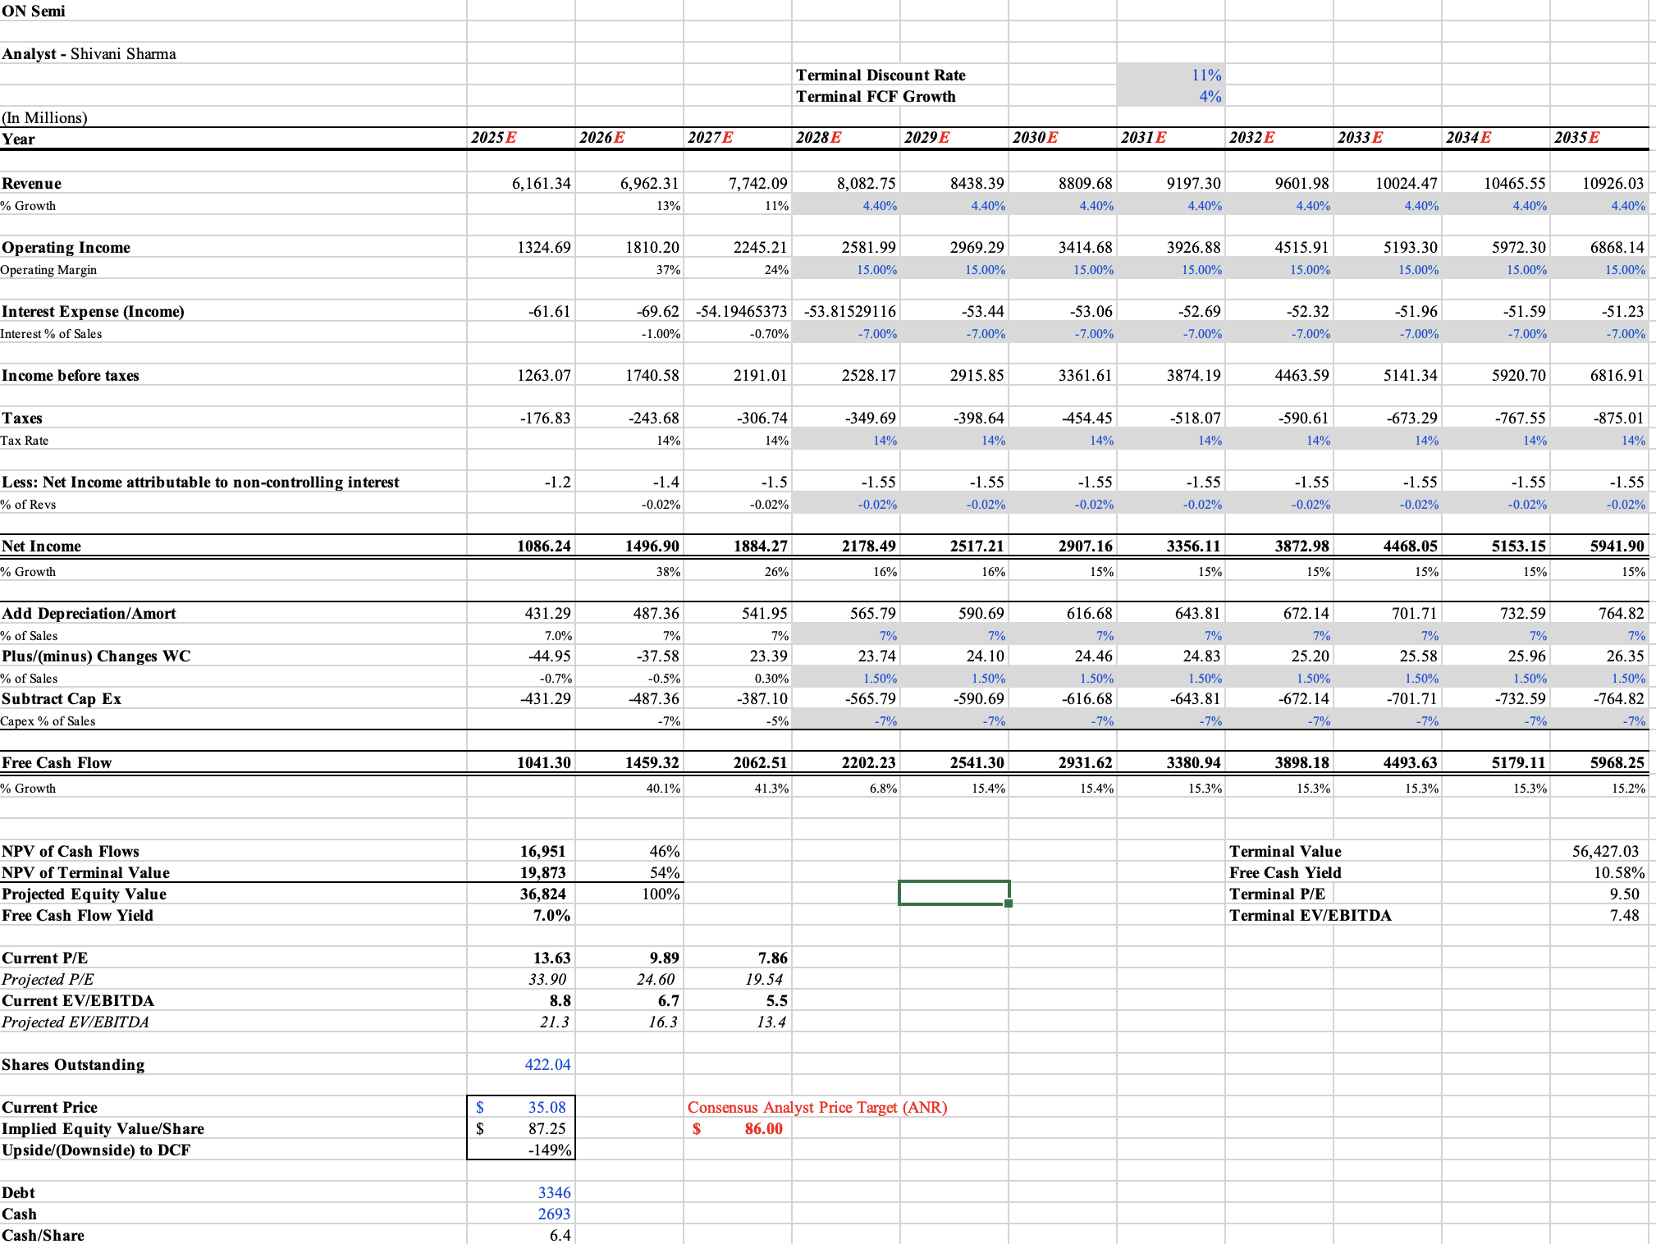
DCF Model (ON)

Slide 38
DCF Model (CRM)

Slide 39
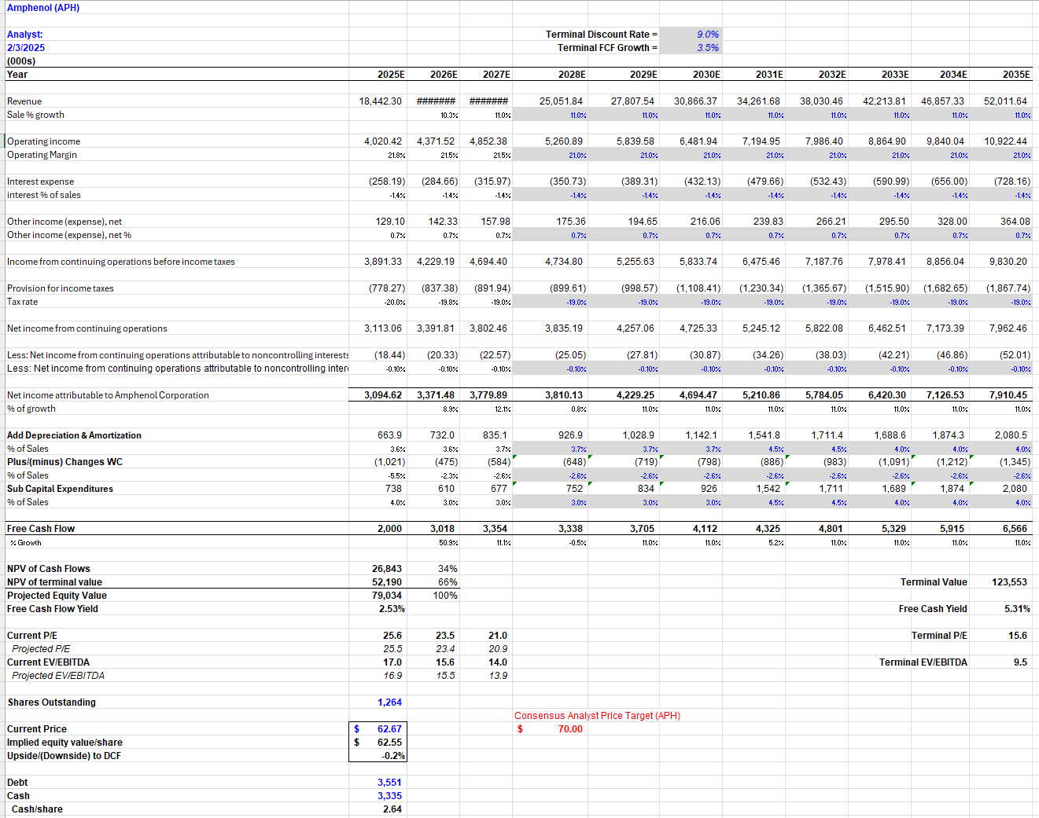
DCF Model (APH)

Slide 40
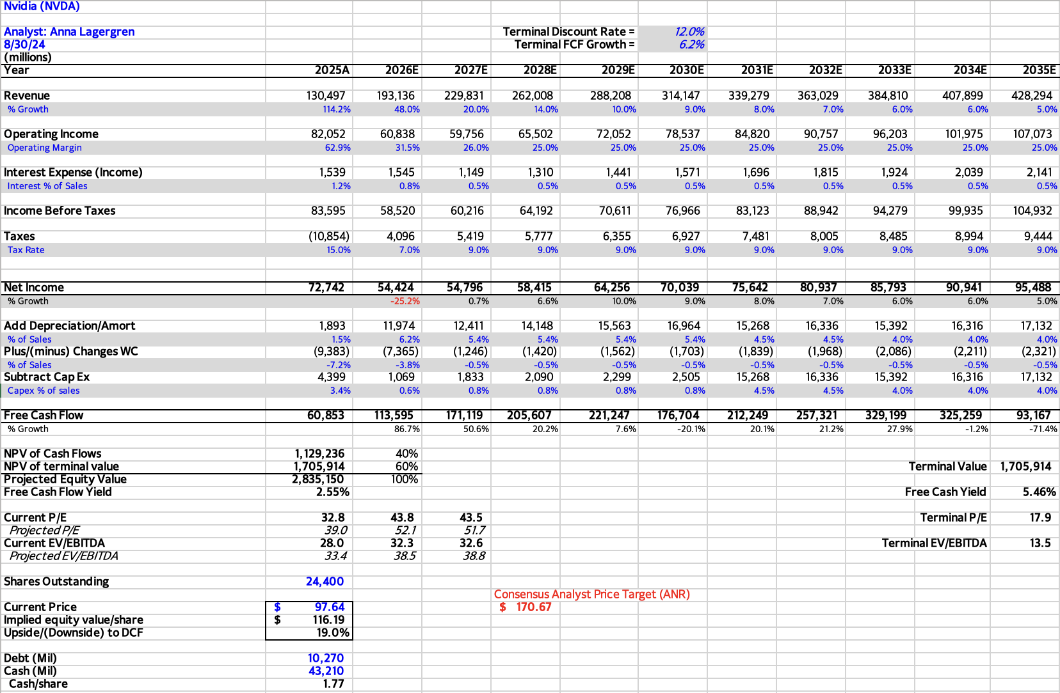
DCF Model (NVDA)

