Slide 1
Info Tech
Anna Lagergren, Ava Kadro, Leo Kleban, Kurt Joshi, Ruta Kanhere, Adam Kwan, and Shivani Sharma

Slide 2
Overview

Slide 3
Overview
Notes:
What is the size of the sector? As a percent of the S&P 500? 4181.66
Graphic depicting it
47.455 T – SP 500

Slide 4
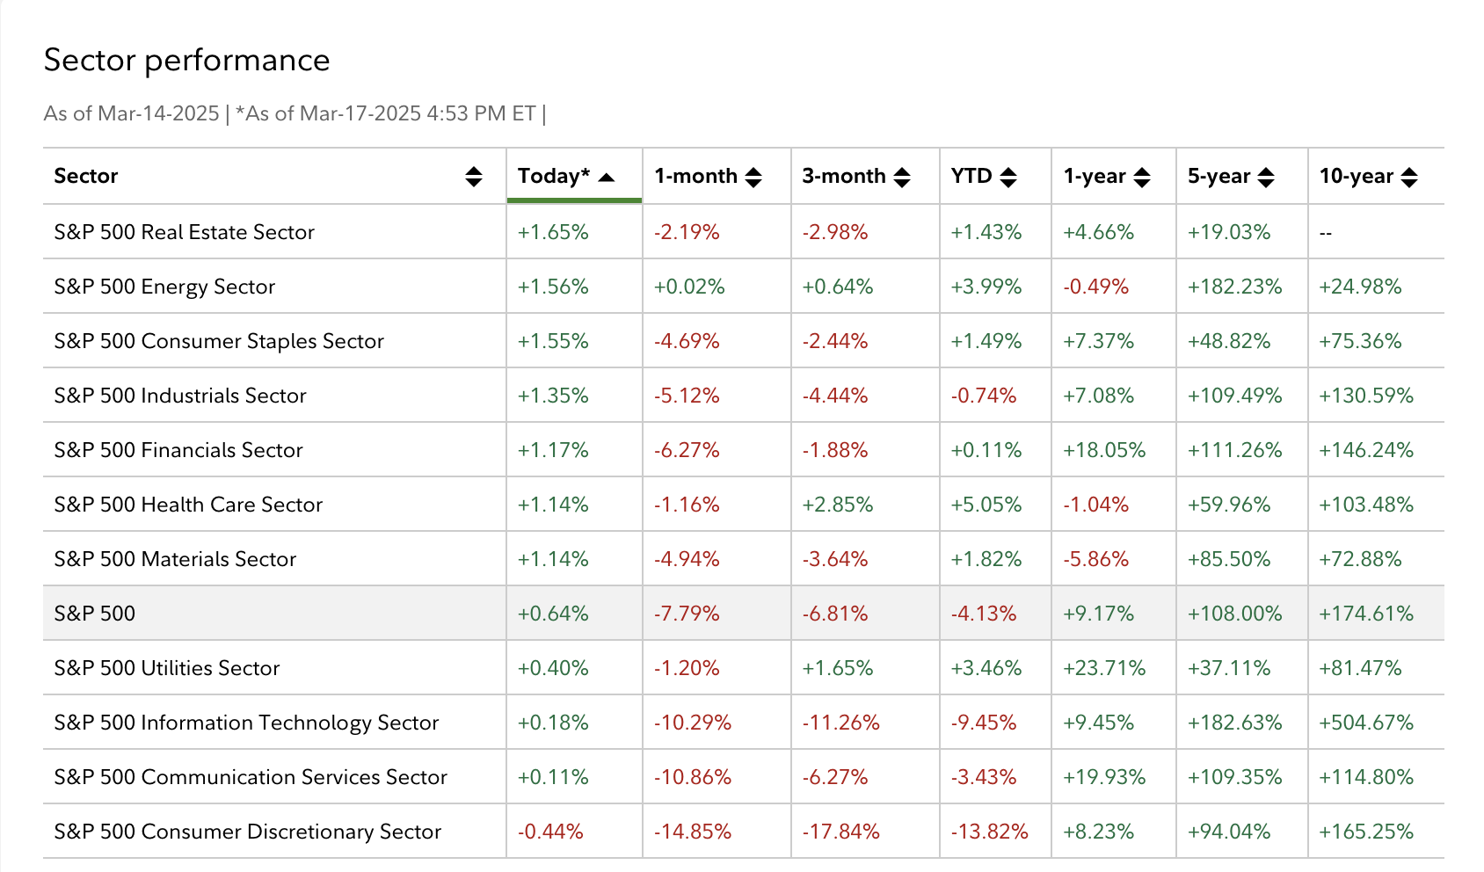
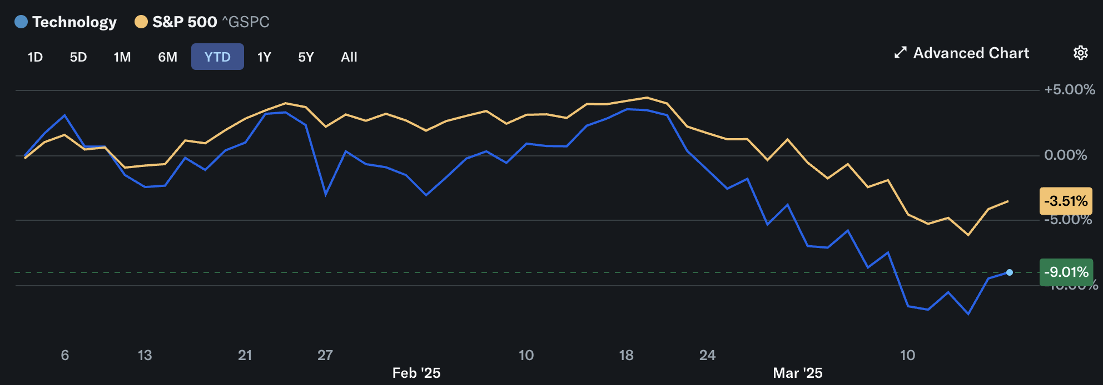
Overview

Slide 5














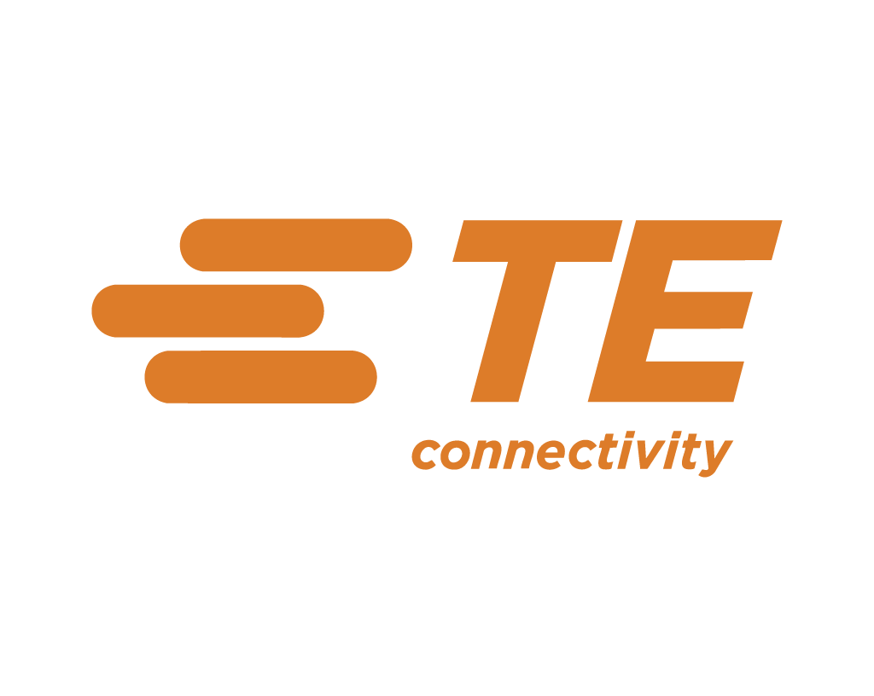

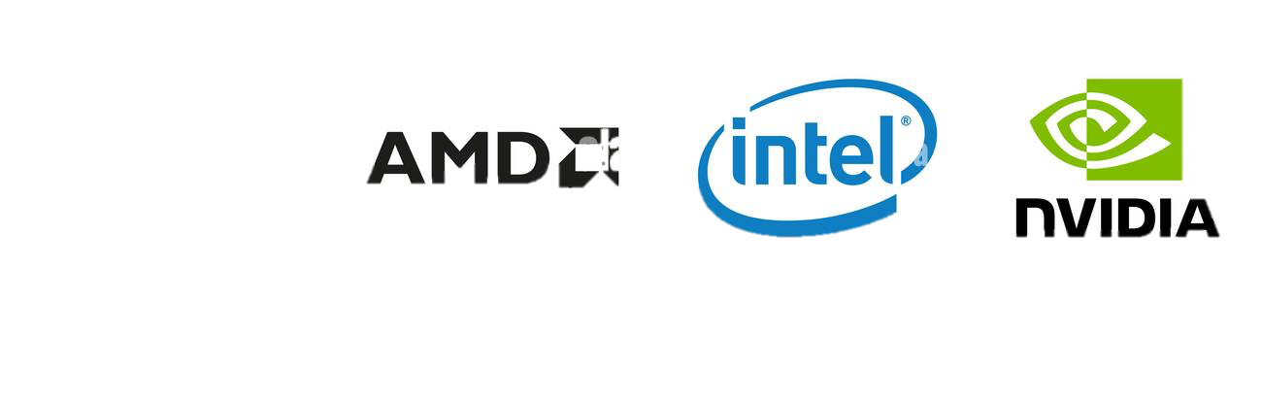


Subsectors and Major Players
S&P 500 Tech
Software and Services
Applications Software
System Software
IT Consulting & Other Services
Internet Services & Infrastructure
Technology Hardware & Equipment
Communications Equipment
Technology Hardware, Storage & Peripherals
Electronic Equipment, Instruments & Components
Semiconductors & Semiconductor Equipment
Semiconductors
Semiconductor Equipment
What are the various industries within the sector?
• What are the largest companies in the sector?
S&P 500 Tech
  Software and Services
    Applications Software
    System Software
    IT Consulting & Other Services
    Data Processing & Outsourced Services
  Technology Hardware & Equipment
    Communications Equipment
    Technology Hardware, Storage & Peripherals
    Electronic Equipment, Instruments & Components
  Semiconductors & Semiconductor Equipment
    Semiconductors
    Semiconductor Equipment

Slide 6
Business Analysis

Slide 7
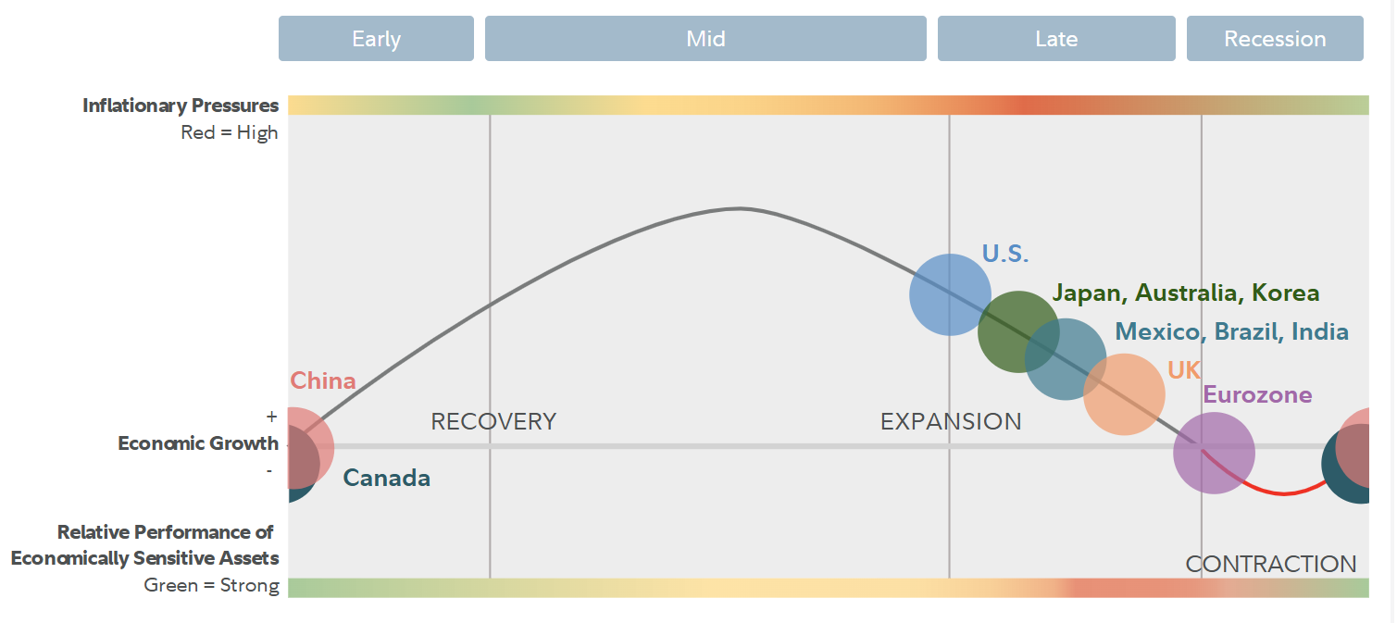
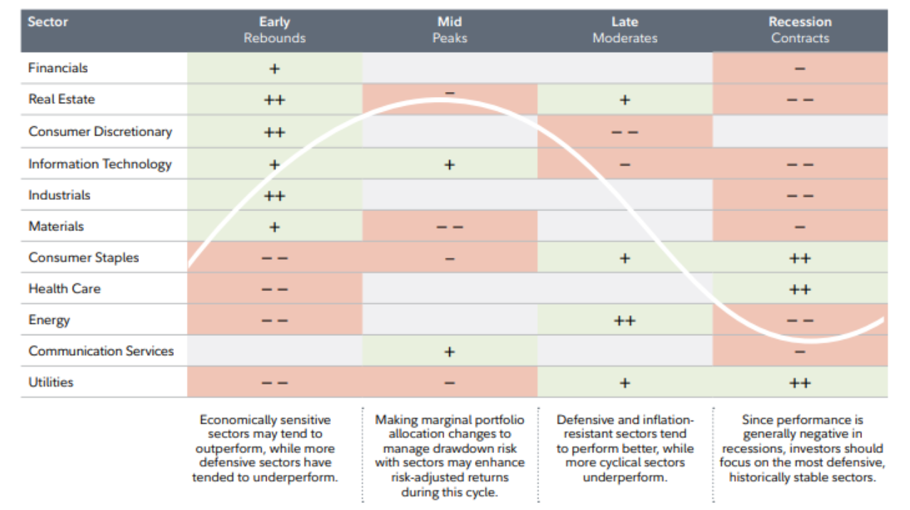
Business Analysis

Slide 8
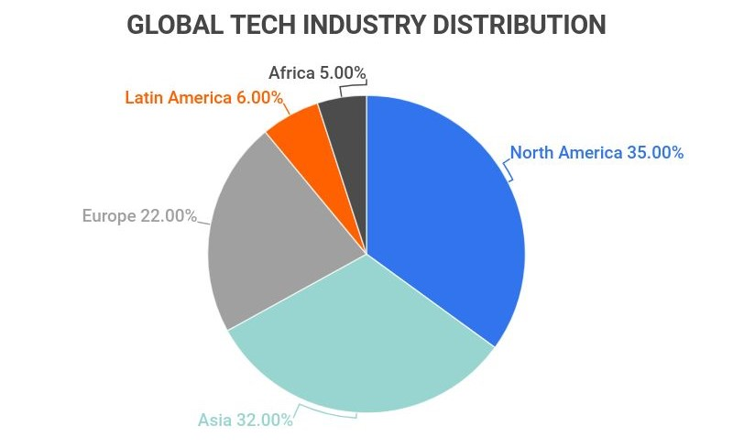
Impact of U.S & Foreign Economies
U.S Economy:
Recession fears
Gov investment (CHIPS Act)
Foreign Economies:
China (Deepseek R1, Baidu Ernie X1)
Trade Wars

Slide 9
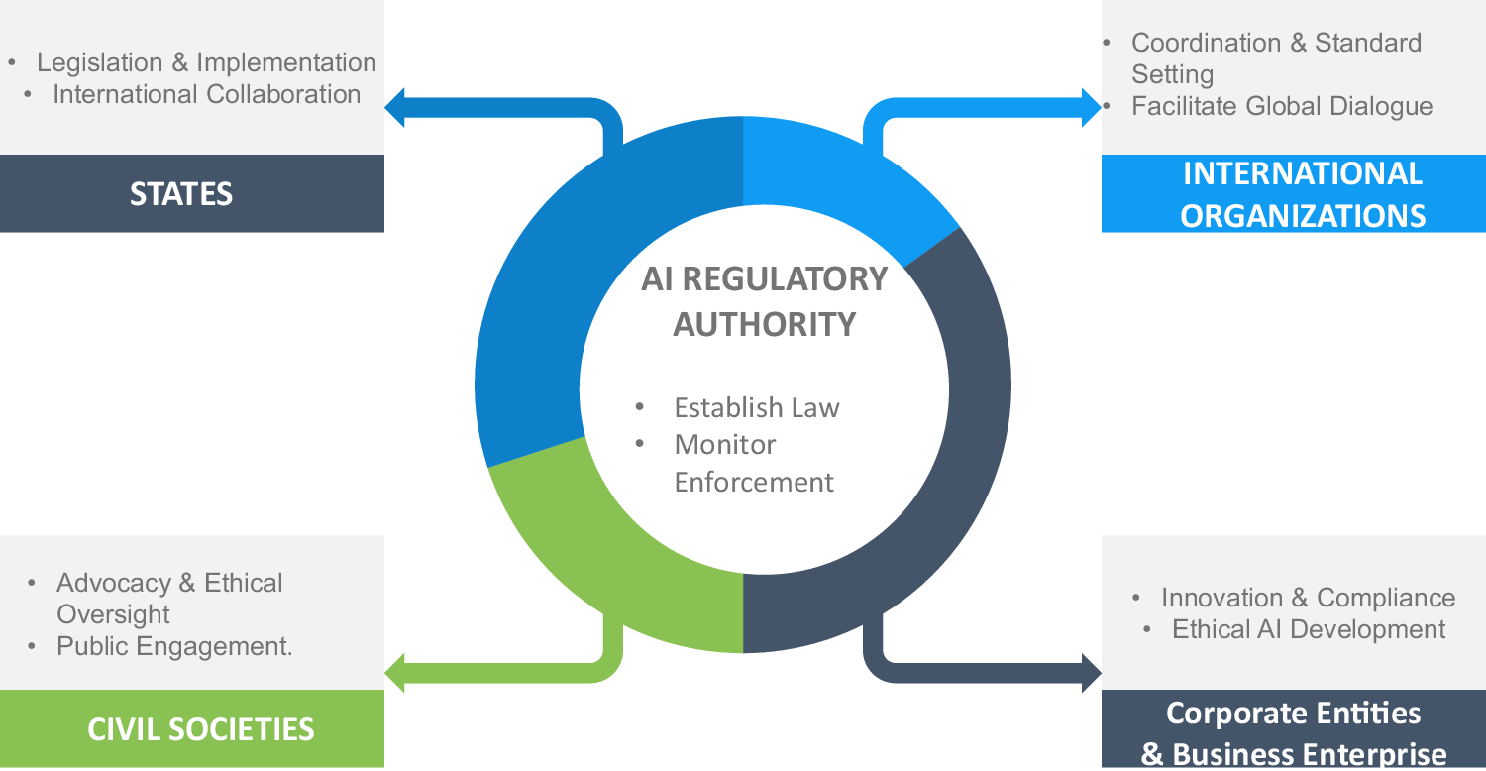
External Factors
Macroeconomic
Inflation
GDP growth
Tariffs
Regulation
Antitrust Regulation
Data Policy (GDPR)
Industry disruptions
Energy costs (data center electricity consumption)
Enviromental Concerns

Slide 10
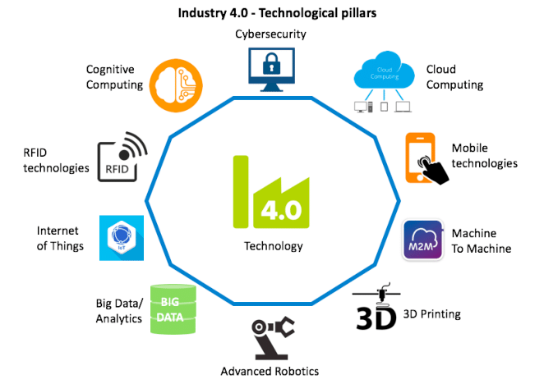
Supply Capacities
New Capacity Additions:
Infrastructure
Data Centers
GPU's
AI Chips
Cloud Computing
Digital Transformation (Integration)
Enterprise Software (SaaS, CRM)
Quantum computing
Processing Power
Increased Capabilities

Slide 11
Threat of Substitutes
LOW TO MODERATE
Higher consumer loyalty makes retaining market share easier
MODERATE TO HIGH
Barriers to Entry
Competition
HIGH
High costs, specialized skills, market competition, regulations, and limited resources restrict entry
High internal competition for market share, new technological developments and highly skilled workforce
PORTER'S 5 FORCES
Buyer’s Power
Supplier's Power
LOW
MODERATE
Major players dominate market share due to large-scale purchasing power as well as tech and capital intensity
Suppliers in the upstream supply chain hold some leverage over industry participants, allowing them some influence on price and availability of inputs

Slide 12
Economic Analysis

Slide 13
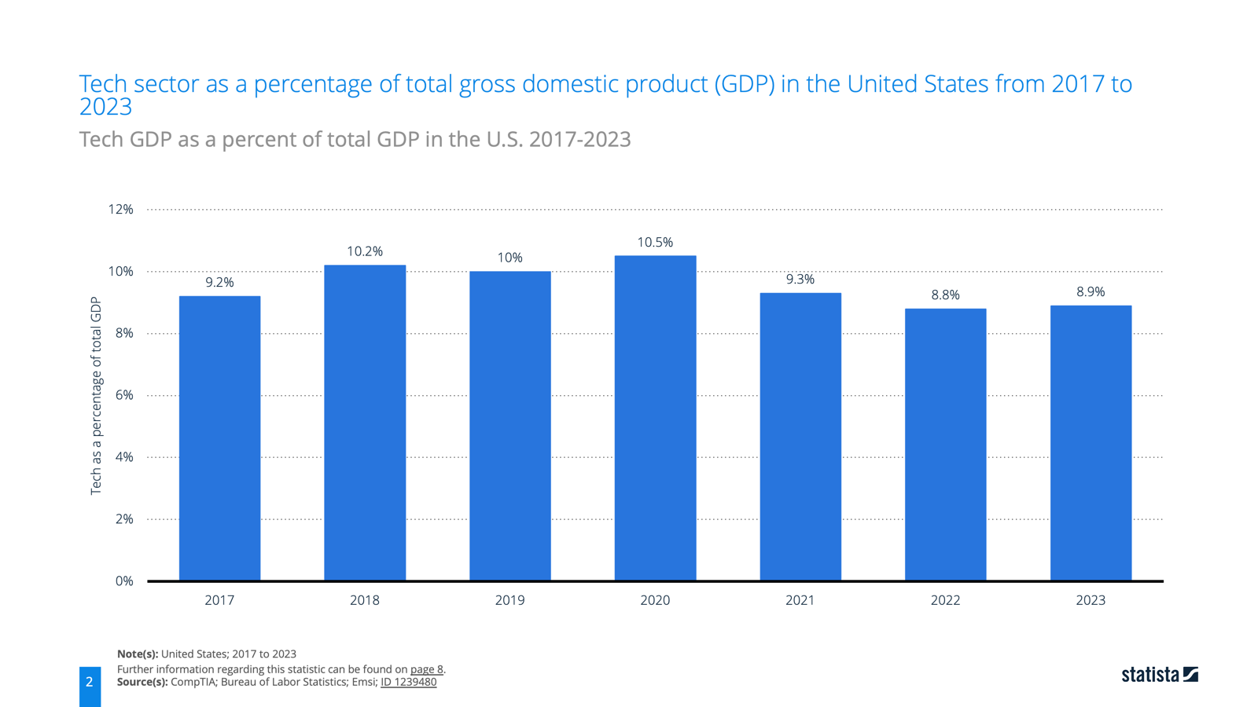
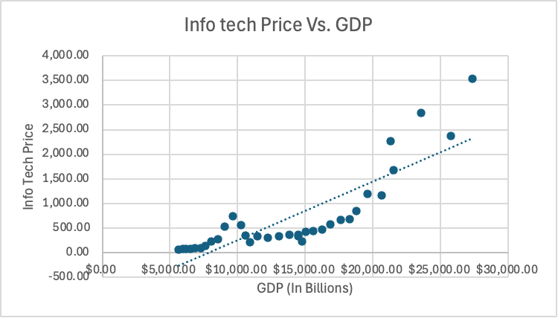
Economic Analysis - GDP

Slide 14
Economic Analysis - GDP
MODEL SUMMARY
Multiple - R | R-Square | Adjusted R-Square | Standard Error
0.845 | 0.714 | 0.706 | 455.00
GDP has a significant relationship with the Info-Tech Sector price in a long term
The result indicate that over the long term, Info-Tech Sector price follows the same pattern of growth as of the GDP
The relationship between Info-Tech Sector price and GDP is validated by higher value of Multiple-R derived by the regression analysis model
An R-Square of 0.714 indicates that Info-Tech Sector price is explained by the GDP at a level of 71%
*U.S. GDP – Independent variable
Info Tech Price – Dependent variable
Data of year 1989 to 2023 (35 years)

Slide 15
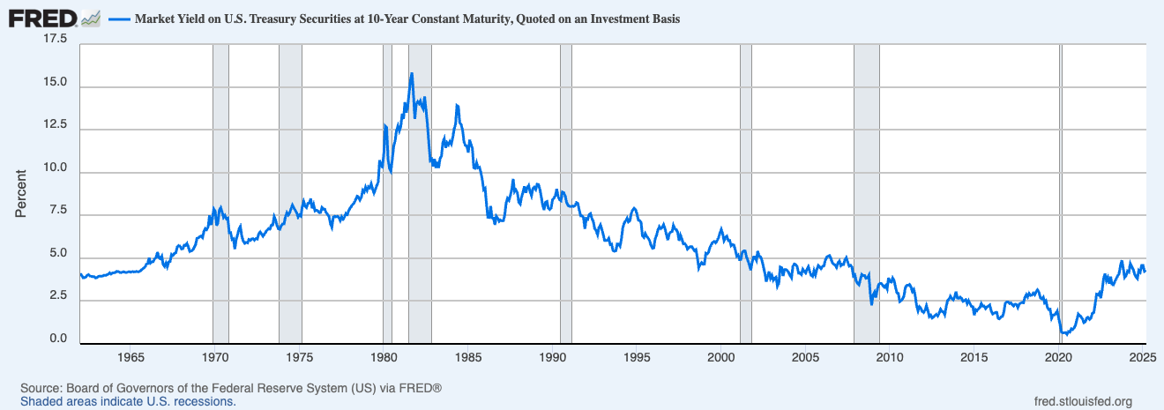
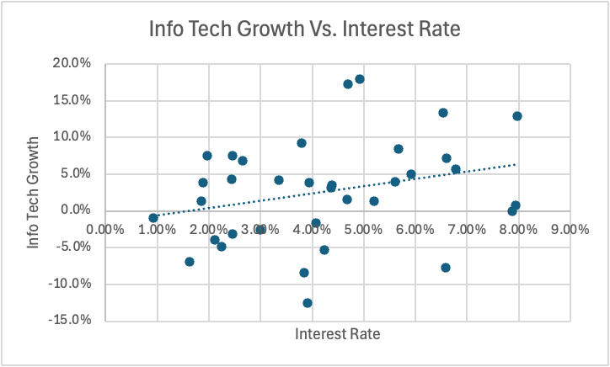
Economic Analysis – Interest Rate

Slide 16
Economic Analysis – Interest Rate
MODEL SUMMARY
Multiple - R | R-Square | Adjusted R-Square | Standard Error
0.275 | 0.076 | 0.048 | 0.019
In equity market, the link between interest rates and growth is not as direct and obvious. The effect of interest rates depends on the overall sector as well as on wider macroeconomic context.
6 out of the 11 sectors that make up the S&P 500 are shown to be sensitive to changes in monetary policy, together accounting for 65% of the index, including Information technology.
The result indicate that over the long term, Info-Tech Sector growth is sensitive to change in interest rates but not very significantly
It was validated with the Technology sector performance in 2023 where firms enjoyed significant gains suggesting other dynamics offset the interest rate burden
*Market Yield on U.S. Treasury Securities at 10 years Constant
Maturity – Independent variable
Info Tech Price – Dependent variable
Data of year 1989 to 2023 (35 years)

Slide 17
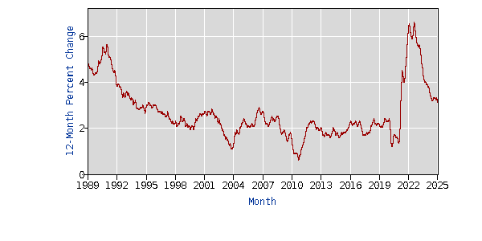
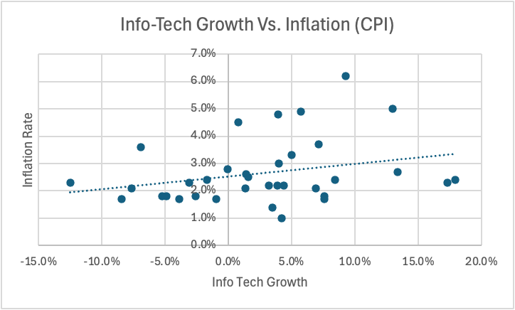
Economic Analysis – Inflation

Slide 18
Economic Analysis – Inflation Rate
MODEL SUMMARY
Multiple - R | R-Square | Adjusted R-Square | Standard Error
0.277 | 0.077 | 0.049 | 0.011
Inflation rate affects nearly every sector to a greater or lesser extent. Nominal stock returns react negatively to inflation in the U.S. and several industrialized countries
The movements in the stock returns are often observed to be negatively correlated with the prevailing equity market volatility
*Consumer Price Index for all Urban Consumer (CPI-U) –
Independent variable
Info Tech Price – Dependent variable
Data of year 1989 to 2023 (35 years)

Slide 19
Financial Analysis

Slide 20
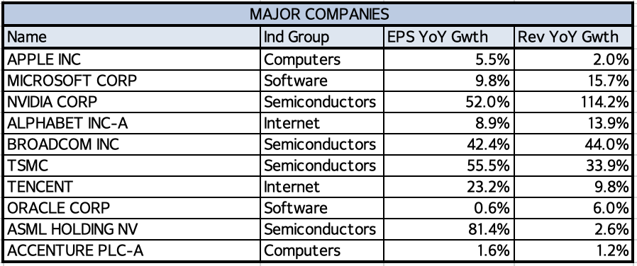
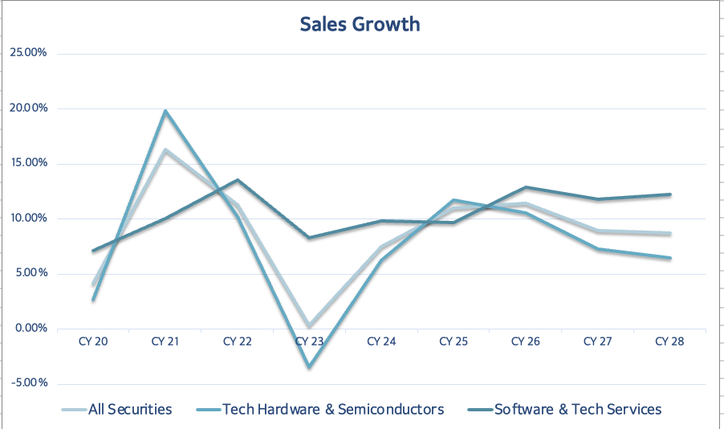
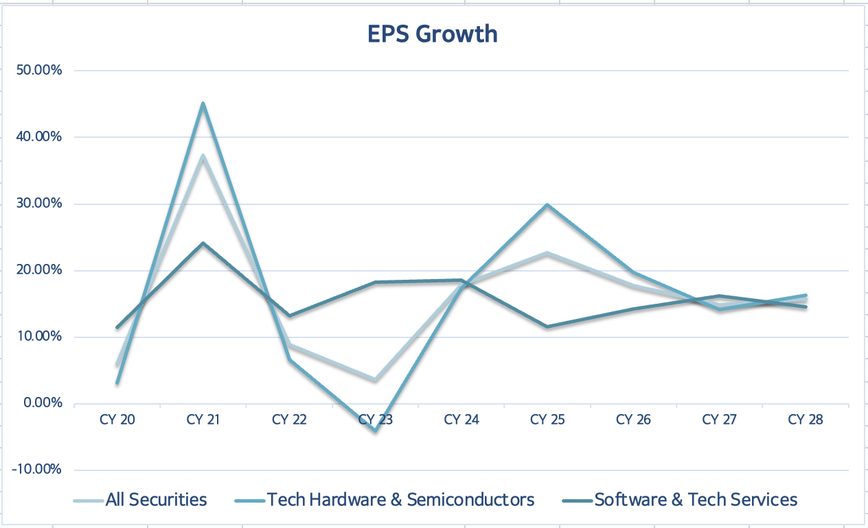
Sales & Earnings Growth Rates
Tech hardware & Semiconductors vs Software & Tech Services
High variations across industries
Notes:
Tech hardware more volatile than software because: 1-hardware is more cyclical and sensitive to price fluctuations 2-hardware has defined lifecycles of rapid growth and then decline, where as software has more steady longer lifecycles 3- hardware is sensitive to geopolitical risks like trade wars & is very capital intensive
major companies: a trend of higher growth with semiconductors (besides ASML’s rev yoy growth, as it has been greatly affected by geopolitical tensions and supply chain constraints)
predictions for EPS see the two segments merging, whereas for sales software is supposed to take the lead

Slide 21
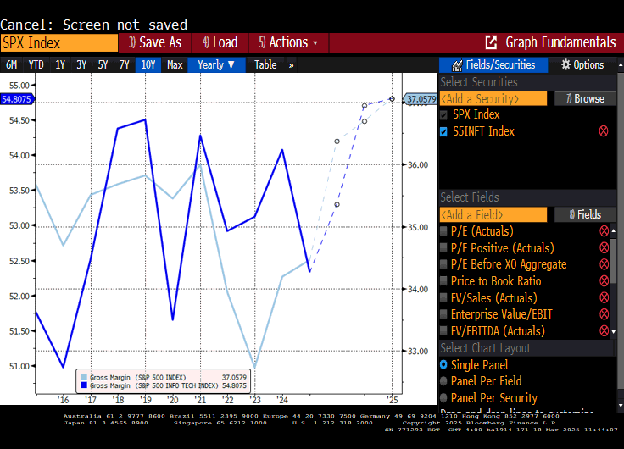
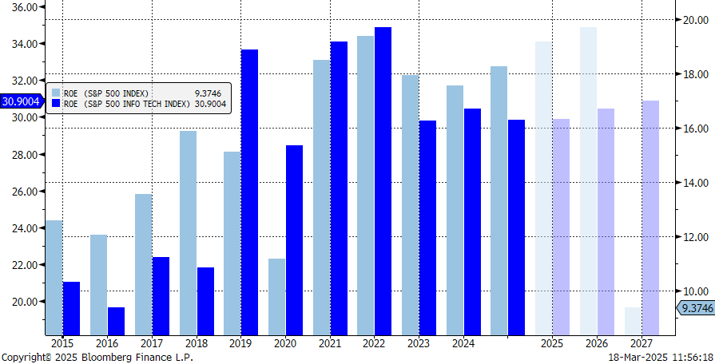
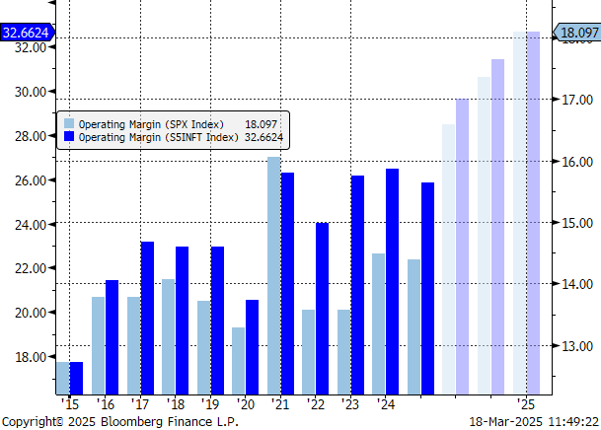
Key Ratios
ROE of Info Tech predicted to increase despite a steep drop in S&P 500 ROE
Margins expecting a steady increase
Gross Margin
ROE
Operating Margin
Notes:
ROE for S&P 500 is much lower, with the gap widening in future predictions. this is partially because of the rapid growth of technology and the hype surrounding semiconductor stocks.
info tech also has higher gross and operating margins, with a jump of around 7% estimated for 2025.

Slide 22
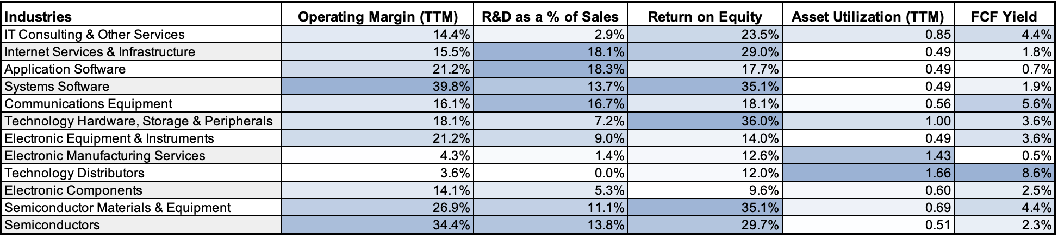
Industry Data
Systems Software stands out with high operating margins, R&D, and ROE
Technology Hardware, Storage & Peripherals has a high ROE
Semiconductors and their materials also score highly in terms of operating margin and ROE
Notes:
technology hardware storage and peripherals has an odly high return on equity considering its lower operating margin not correlating with the ROE, i believe this could be because of the new need for storage by semiconductor companies (the new high performing chips require cooling with water, whereas the old didnt require water cooling)
As expected by recent hype surrounding semiconductors, semiconductor s and their materials score highly in terms of operating margin and ROE, although still slightly lag behind technology hardware, storage and peripherals.

Slide 23
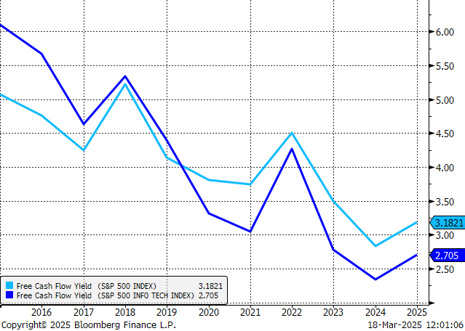
Cash Flow & Margin Trends
Generally, a net generator of FCF
Margin expansion is a common trend, especially for the semiconductor industry
Free Cash Flow Yield

Slide 24
Valuation Analysis

Slide 25
Do Valuations Vary Industry to Industry?
Industries:
  Software / Services
  Technology Hardware
  Semiconductors
Overall, valuations can widely vary from industry to industry
  InfoTech Valuations are typically higher than Market Valuations.

Slide 26
Valuations of InfoTech vs Market​
InfoTech Valuations (S5INFT)
Market Valuations (SPX)
P / E = 36.61
P / S = 8.29
P / B = 11.80
P / CF = 27.94
P / E = 24.29
P / S = 3.01
P / B = 4.88
P / CF = 19.36
Valuations have expanded due to:
Fast growth in AI / Cloud Computing
Increased demand for:
  Semiconductors
  Data infrastructure

Slide 27
Valuations of Each Industry
Software / Services (SPSISS)
Market Valuations (SPX)
Technology Hardware (SPSICH)
Semiconductors (SPSISC)
P / E = 27.42
P / S = 3.44
P / B = 4.99
P / CF = 24.78
P / E = 35.98
P / S = 1.50
P / B = 3.09
P / CF = 17.23
P / E = 52.65
P / S = 4.77
P / B = 3.65
P / CF = 40.94
P / E = 24.29
P / S = 3.01
P / B = 4.88
P / CF = 19.36

Slide 28
Future Valuations
Valuations will continue to expand due to:
  Continued growth and innovation in AI / Cloud Computing
  Increasing demand for:
    Semiconductors
    Data infrastructure
    Software / Hardware

Slide 29
Recommendation

Slide 30
Recommendation
We recommend adding more into the SIM weight to balance it with the S&P 500 weight
Positive
  Largest Sector in the S&P 500
  Growth in new opportunities
  High Cash flow
Risk
  Interest rate risk
  Inflation
  Supply chain risk
Overweight:
  Semiconductor
  IT/Services
Underweight
  Technology Hardware

Slide 31
Q&A

