Slide 1

Information Technology Sector Analysis
Ethan Adkins, David Anderson, Sid Balasubramanian,
Conor Brobston, Aidan McDonald

Slide 2
Agenda
Overview
Sector Performance
Economic Analysis
Business Analysis
Financial Analysis
Valuation Analysis
Recommendations

Slide 3
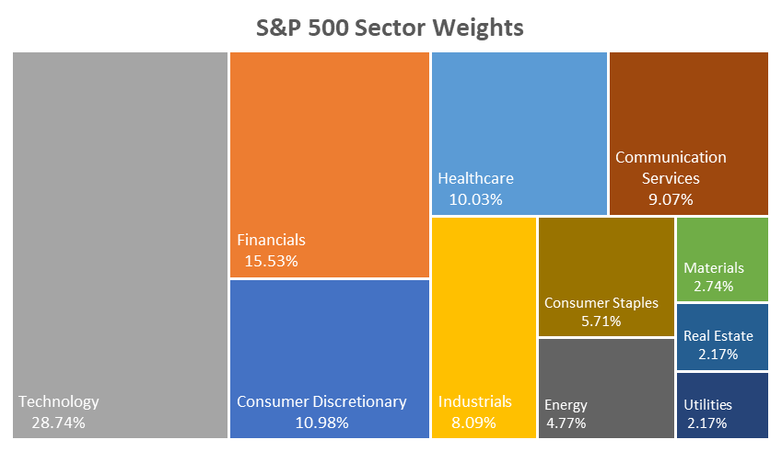




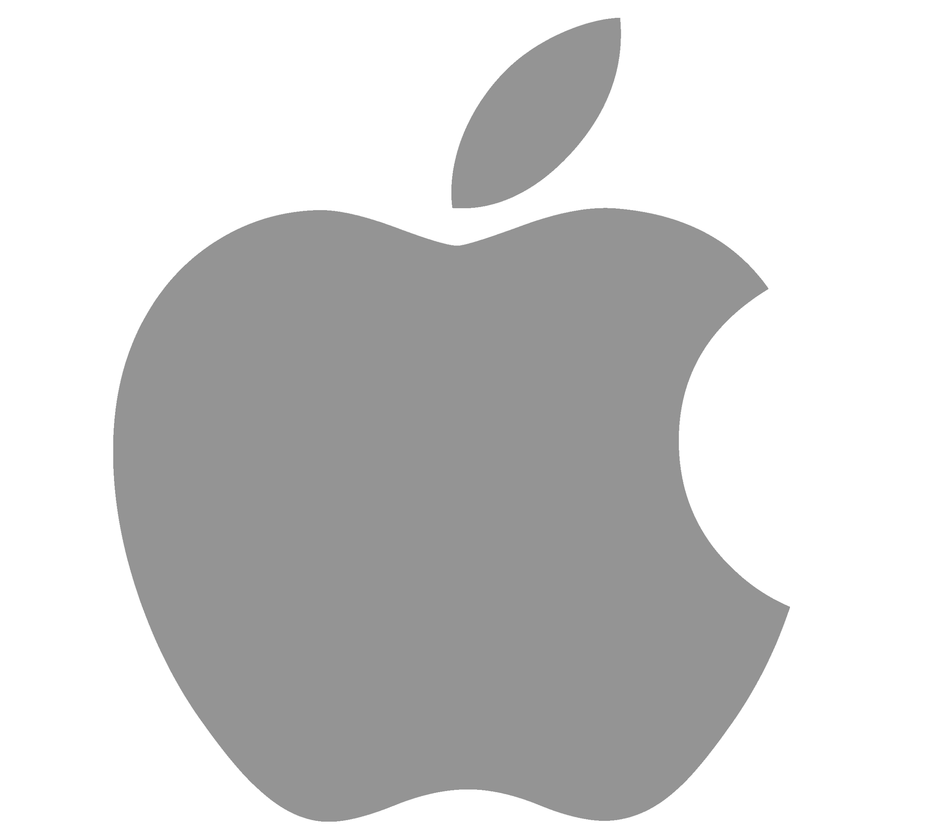

Overview
Info-tech is the largest sector, making up ~30% S&P 500's market cap
Major Industries:
  Semiconductors
  Software – Infrastructure
  Software – Application
  Consumer Electronics
  Information Technology services
Industry | Stocks | Market Cap (in $ T) | PE Ratio | Profit Margin | Div Yield
Semiconductors | 67 | 7.07 | 49.69 | 24.1% | 0.95%
Software - Infrastructure | 155 | 5.6 | 46.08 | 23.2% | 0.19%
Consumer Electronics | 18 | 3.08 | 29.91 | 20.2% | 0.39%
Software - Application | 226 | 2.96 | 67.16 | 11.7% | 0.39%
Information Technology Serv. | 71 | 0.99 | 30.88 | 7.4% | 0.85%
Source: Fidelity Investments, Stockanalysis.com
Notes:
Relationship between Market Cap and Profit margin suggests that that Profitability influences valuation within this sector. Higher profit margins are generally valued more by the market.

Slide 4
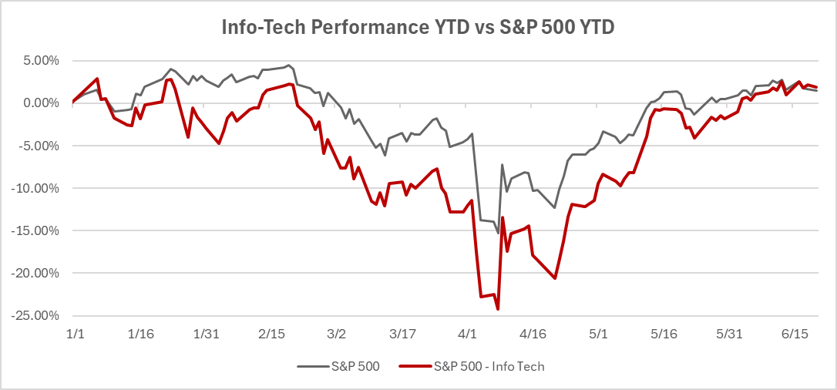
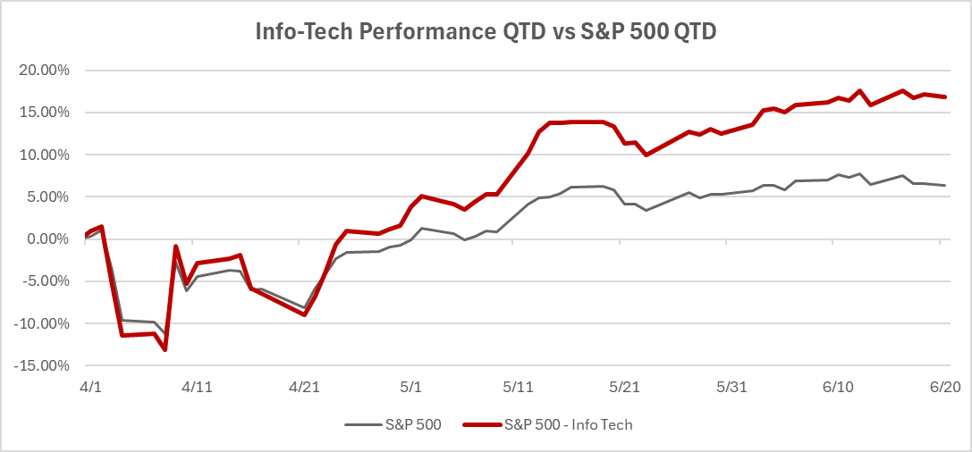
Sector Performance
1.91%
16.86%
1.47%
6.34%
Influence on S&P 500 – Info Tech is disproportionately weighted at ~30%. This is evident in how the sector's performance influences S&P 500.
Sector Volatility due to Concentration Risk – Handful of companies dominate this sector. Sector underperformed most of 2025 since AAPL, NVDA and MSFT posted negative returns.
Macro-sensitivity - This sector is sensitive to macro-economic shifts such as interest rates, international trade policies and geopolitical events. This is evident in the negative performance in Q1.
Strong Long-term projections – Despite short-term macroeconomic pressures, long-term projections remain strong, which is evident in the strong rebound (16.86%). This sector will continue to surge the S&P 500 index once the pressures ease.
Source: Fidelity Investments

Slide 5
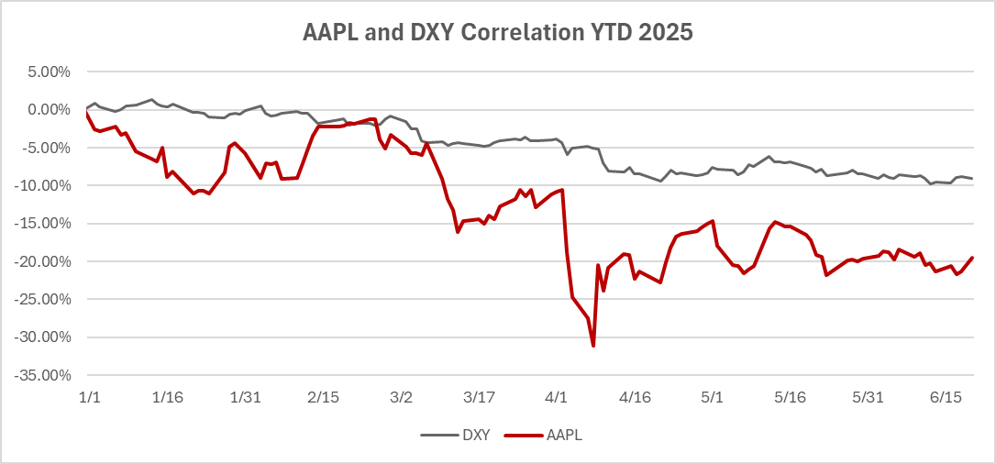
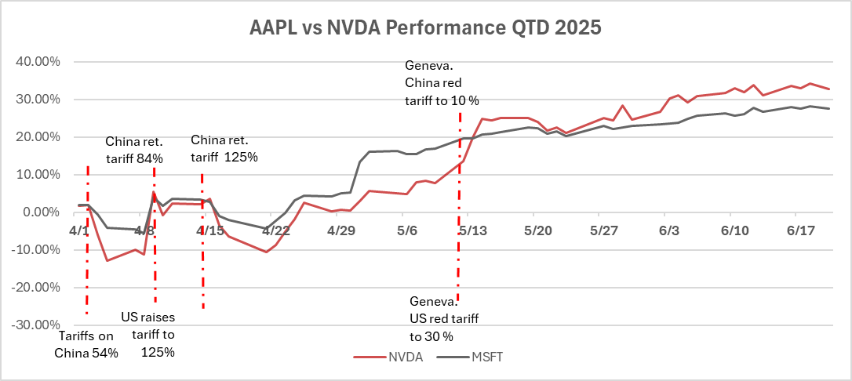
Economic Analysis
R² | 0.74
F value | 291.85
p-value | 2.45 × 10⁻³³
Sector Performance correlation to Interest rate - Historically negative but there has been a mild positive correlation since 2020 which continues in 2025.
AAPL and US Dollar Index (DXY) - Historical relationships have been negative since large portions of AAPL earnings are overseas. However, In 2025, the relationship has been strongly positive, likely reflecting a changing global risk sentiment or investor sentiment.
NVDA and AAPL have a strong correlation to US-China Trade policy – When Q2 performance of AAPL and NVDA are investigated against changing US-China trade policies, it is evident that any favorable policies helps boost the stock performance of both these firms.
MSFT and NVDA correlations with Enterprise/AI cloud spending and interest rates - Through February, large firms in the Info-Tech sector revealed their growing CapEx toward AI which drives NVIDIA chip sales and Microsoft Azure.
Source: Forget the New iPhone. For Apple, It’s All About the Dollar. - The New York Times, Nvidia takes $5.5 billion hit as Trump tightens export restrictions in China trade war | CNN Business,
Designed in US, made in China: Why Apple is stuck in tariff tussle , Tech megacaps to spend more than $300 billion in 2025 to win in AI
Notes:
Interesting since it has evolved with time. Previously, they have had strong negative correlation or even no correlation since a weaker Dollar can boost AAPLs international earnings.

Slide 6
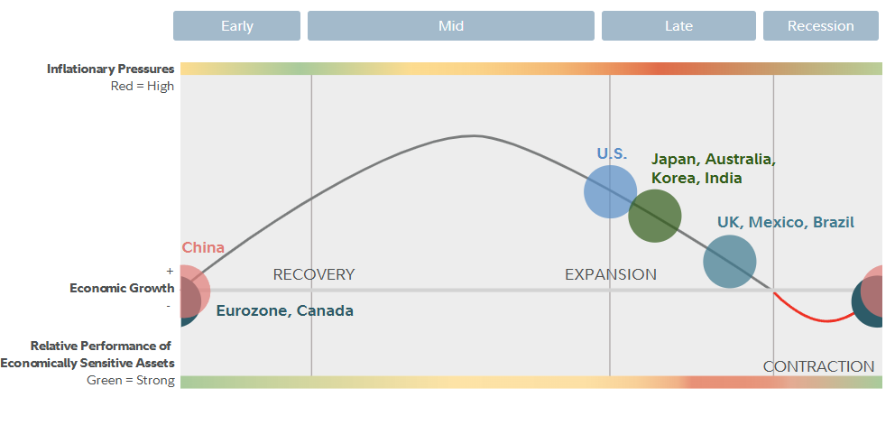

Business Analysis
Source: Fidelity Investments

Slide 7
Business Analysis
Industry | Stocks | Market Cap | Div Yield | PE Ratio | Profit Margin
Semiconductors | 67 | 7,069.90 | 0.95% | 49.69 | 24.15%
Software - Infrastructure | 155 | 5,602.13 | 0.19% | 46.08 | 23.20%
Consumer Electronics | 18 | 3,082.88 | 0.39% | 29.91 | 20.25%
Software - Application | 226 | 2,964.82 | 0.39% | 67.16 | 11.66%
Information Technology Services | 71 | 999.86 | 0.85% | 30.88 | 7.43%
Semiconductor Equipment & Materials | 30 | 743.82 | 0.64% | 28.79 | 22.36%
Communication Equipment | 50 | 505.53 | 1.00% | 34.69 | 7.99%
Computer Hardware | 34 | 371.6 | 1.15% | 28.47 | 5.66%
Electronic Components | 46 | 309.01 | 0.52% | 43.58 | 4.95%
Scientific & Technical Instruments | 32 | 187.5 | 0.46% | 28.43 | 13.01%
Solar | 24 | 35.66 | 0.87% | - | -12.57%
Electronics & Computer Distribution | 10 | 28.57 | 0.70% | 16.38 | 1.41%
Multiple sources including Deloitte and Fidelity despite the current business cycle for the US has Info Tech positioned for Growth in 2025 and beyond.
  AI
  Cloud Computing
  Block Chain
  Virtual Reality
Market believes sector is poised for growth as well with the relative PE Ratios
Other valuation ratios also support market beliefs as well

Slide 8
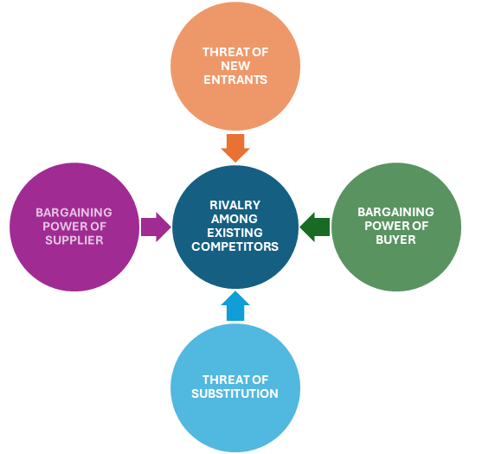
Business Analysis
Porters Five Forces
Threats of New Entrants
  High
    New ideas and new products are being tested every day
Competition
  High
    Some of the most recognized brands in the market are from the Tech Sector
Supplier Power
  Moderate
    Many Customers
Customer Power
  Moderate
    Different Products and companies to choose from
Threat of Substitutes
  High
    Many Companies vying for market share
    Short life cycles

Slide 9
Financial Analysis
Earnings: 5-year EPS Growth Rate of the Technology sector 29.38% with a forecasted 18.72% EPS Growth Rate for the next 5 years. The 5-year S&P 500 EPS Growth Rate (9.12%)
Sales: 5-year Sales Growth Rate of the Technology sector 22.27%, leading all sectors (S&P 500 ~ 4.5%) (NVDA sales growth rate 114% since beginning of 2024, 126% since beginning of 2023)
Margins: Operating margin (24.38%) higher than the sector’s average (19.19%), experienced contraction compared to previous quarter. Typically, higher than the S&P 500 average margin
Note: More sustainable growth rates since 2023 (Post-COVID rebound)
Free Cash Flow: Large Tech companies are modest (1%-5%) yields compared to small caps (5%-7%) (dividends/buybacks). Inconsistent FCF trends across sub-sectors (Semiconductors are cyclical vs. Software show similar patterns)
Performance
 | Day | YTD | 1Y | 3Y | 5Y
S&P 500 | -0.22% | 1.03% | 8.76% | 62.40% | 90.59%
Technology | 0.01% | 1.11% | 10.43% | 101.85% | 151.28%
Source: csimarket.com, Yahoo Finance

Slide 10
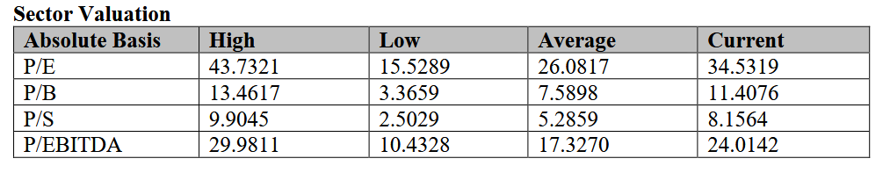
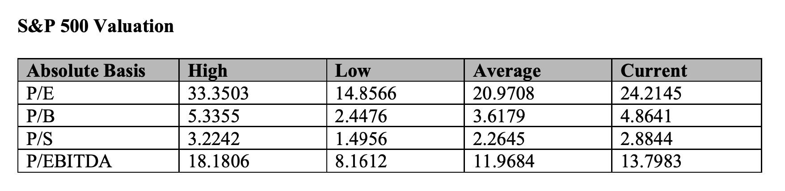
Valuation Analysis
*Each multiple is currently at a premium compared to the S&P 500

Slide 11
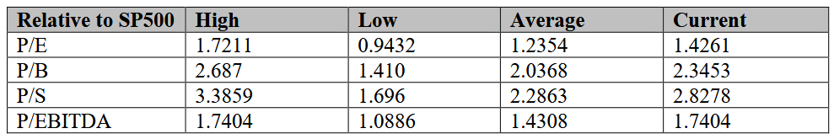
Valuation Analysis
Each multiple for the Info Tech sector is currently above the 10-year average.
High growth is driven by the high P/E valuation.
Because the Info Tech sector makes up about 30% of the S&P 500, the S&P 500 typically moves in the same direction.
Currently, the Info Tech sector is driving the growth of the S&P 500.
We can conclude that Info Tech is over performing in both sector valuation and relative to the S&P 500.

Slide 12
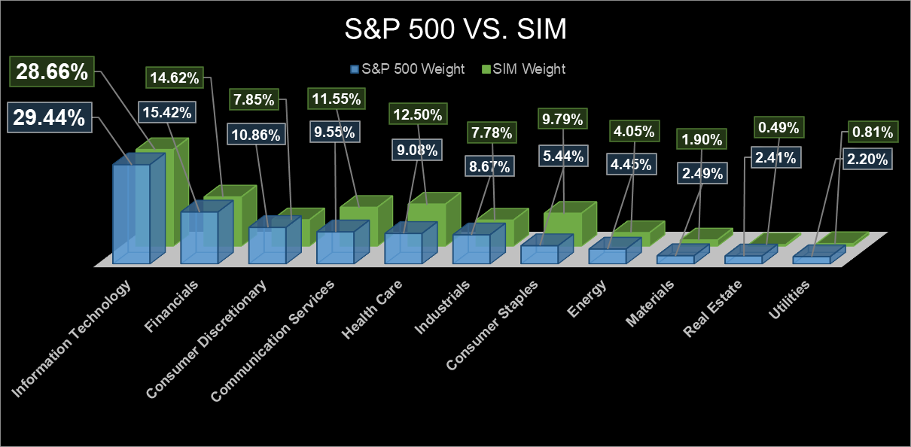
Recommendation
Notes:
6/18 Done - DA

Slide 13
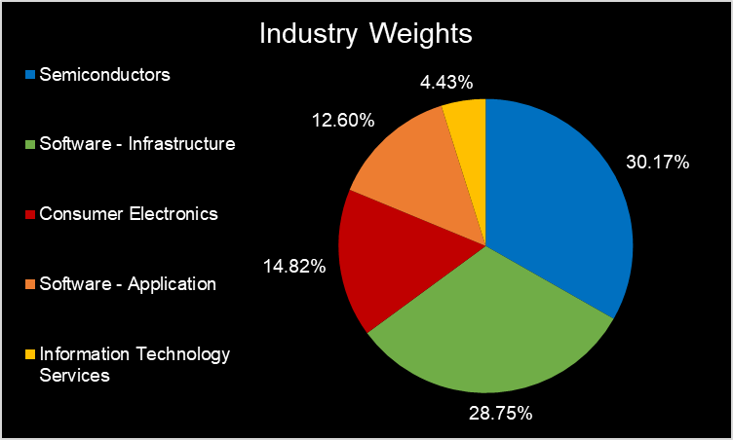
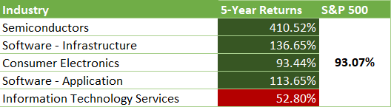
Recommendation – Industry Weights
Weight of top 5 largest industries for information technology: 90.77% or ~91% of total sector.
5-Year Returns:
Recommendation:
Underweight:
Semiconductors
Software - Infrastructure
Information Technology Services
Equal Out:
Consumer Electronics
Software - Application
Overweight:
None
Top 5 Largest Weighted Industries – Information Technology Sector
Source: https://finance.yahoo.com/sectors/technology/

Slide 14
Recommendation – Sector Weight
Recommendation: Given Information Technology’s 0.78% current underweight relative to the S&P 500, we recommend equaling weight to the S&P 500
Risks:
Macroeconomic environment – correlative trade with large market cap businesses in significant contribution industries vulnerable to policy.
Competitive exposure – Porter’s assessment reveals significant, multifaceted pressure within the sector.
Business cycle performance – Current business cycle position is unfavorable to sector, despite current contrary metrics.
Rewards (Positives):​
Continued growth potential – Analyst expectations, 5-year industry returns, and premium metrics.
Revenue generation – Cross-sector sales growth demonstrates industries’ ability to earn and increase revenue.
Disproportionate gains – S&P 500 and Sim weightings contribute a greater proportion of earnings within both portfolios.

Slide 15
Closing Remarks, Q&A
Thank you !
Questions ?

