Slide 1
Stock Recommendation
Industrials
BUSFIN 4228
July 2025
Presented by
Hunter Sprankle
Josh Vlack
Mia Welms
Industrials
Q2 / July
2025

Slide 2
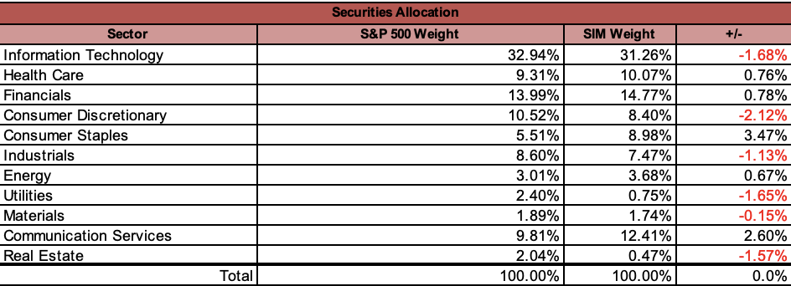
Sector Overview
S&P 500 Weight: 8.60%
SIM Weight: 7.47%
Difference: -1.13%
This indicates that the Industrials sector is underweighted in the SIM portfolio compared to the S&P 500 by 1.13 basis points.
Industrials
Q2 / July
2025

Slide 3
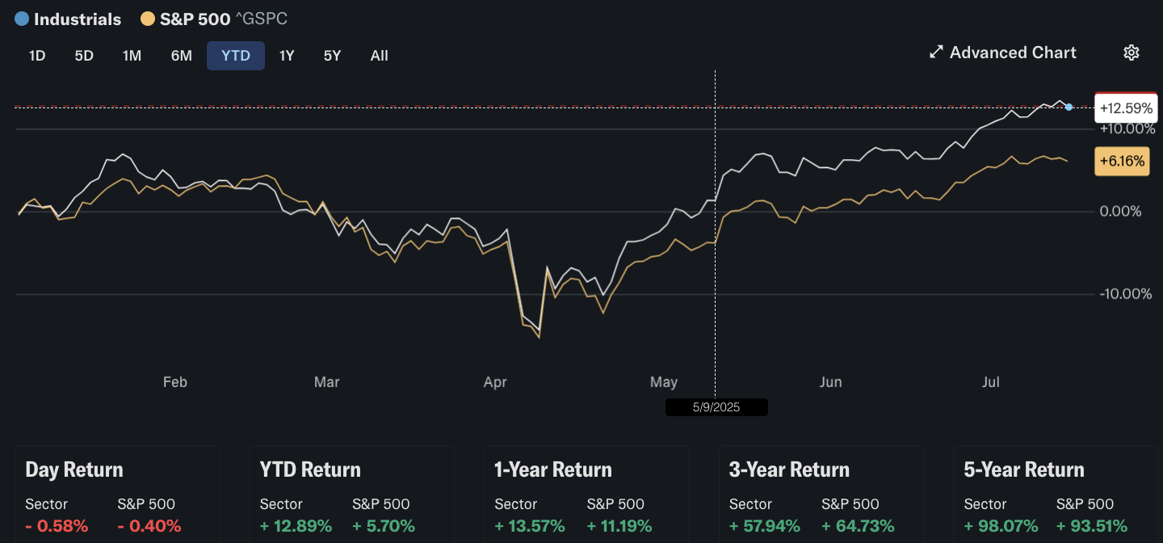
Sector Performance
Short-term (YTD, 1-Year): Industrials are outperforming the S&P 500.
Long-term (3-Year): Slight underperformance.
Very long-term (5-Year): Industrials have outperformed.
Industrials
Q2 / July
2025

Slide 4
Business Analysis
Industrials
Q2 / July
2025

Slide 5
FedEx
RTX
Global logistics, transportation, and e-commerce solutions provider.
Stock Price: $230.66
Shares Outstanding: 239.6 million
Business Drivers: Shipping volume growth, macroeconomic environment, cost efficiency
Risks: Execution risks, competitive pressure, labor/union risk
Leading aerospace and defense company headquartered in Arlington, Virginia. It serves commercial, military, and government clients globally through three main business segments:
Stock Price: $148.68
Shares Outstanding: 1,340 million
Business Drivers: Defense segment and the growth potential of its commercial aerospace segments, allows it to perform well in various economic conditions
Risks: supply chain disruptions, potential cuts in defense spending, the possibility of quality or performance issues with key programs and geopolitical tensions
Industrials
Q2 / July

Slide 6
Financial Analysis
Industrials
Q2 / July
2025

Slide 7

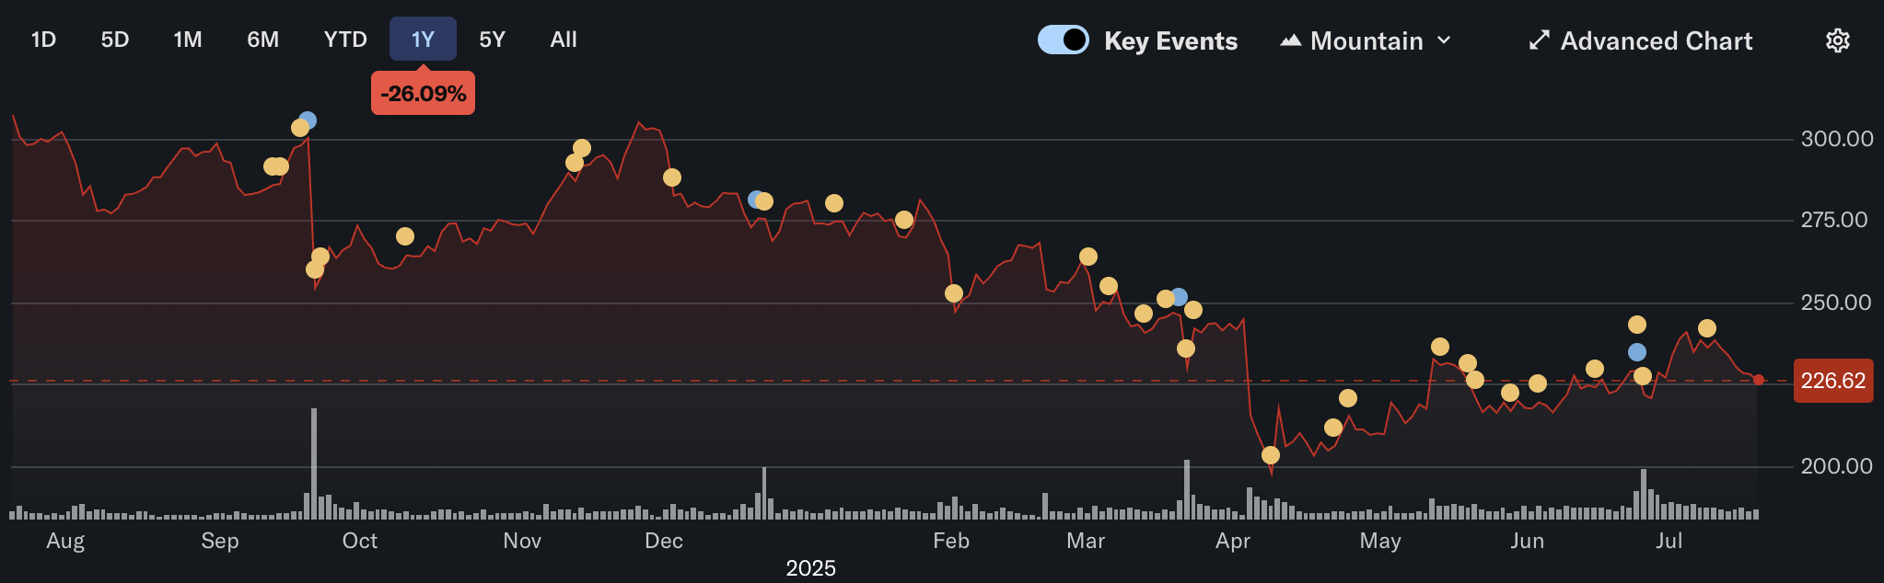
Currently Down -26.09%
EPS: 16.82
ROE: 15.10%
FY 2025 Revenue: ~$87.9 billion
2026 Revenue Consensus: ~$89.58 billion
Industrials
Q2 / July
2025

Slide 8

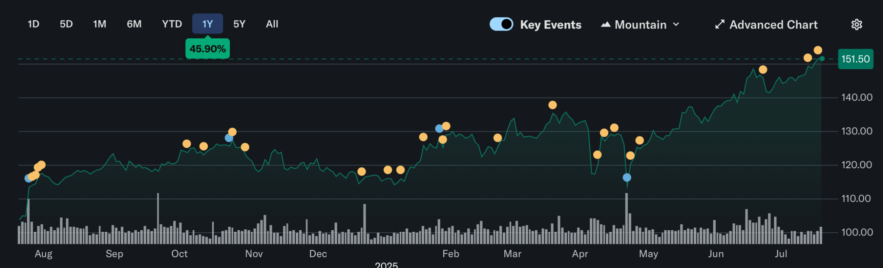
Currently Up 45.90%
EPS: 3.41
ROE: 7.40%
FY 2025 Revenue: ~$84 billion
2026 Revenue Consensus: ~$89.31 billion
Industrials
Q2 / July
2025

Slide 9
Valuation
Industrials
Q2 / July
2025

Slide 10

Valuation vs Industry
P/E
P/S
EV/EBITDA Estimate
FedEx: 12.4x
RTX Corp: 24.7x
S&P 500: 19.5x
FedEx: 0.6x
RTX Corp: 2.3x
S&P 500: 2.5x
FedEx: 7.4x
RTX Corp: 17.7x
S&P 500: 13.0x

Slide 11
Future Valuation
S&P 500 Forward P/E:~22.30x
FedEx
RTX Corp
Forward P/E: ~12.50x, Indicates a low valuation, suggesting the market expects modest earnings growth or is pricing in risk.
Undervalued Signal: Compared to the broader market and peers, this may imply FedEx is undervalued or facing near-term challenges.
Cyclical Sensitivity: Reflects exposure to economic cycles, fuel costs, and global trade dynamics, which can impact investor sentiment.
Forward P/E: ~24.81x, Investors are paying nearly 25x expected earnings, reflecting moderate optimism about RTX’s earnings growth.
Valuation Normalizing: This is lower than RTX’s historical averages, suggesting the stock may be more reasonably priced now.
Industry Comparison: Still considered a premium stock in the aerospace and defense sector, but more attractively valued than in recent years.

Slide 12
Recommendation
RTX
Current price: $148.68
Current weighting: 2.57%
Sell 150 bps
Future weighting: 1.07%
FDX
Current price: $230.66
Current weighting: 2.65%
Buy 150 bps
Future weighting: 4.15%
Year

Slide 13
Thank you

Slide 14
Appendix:
DCF Valuations

Slide 15
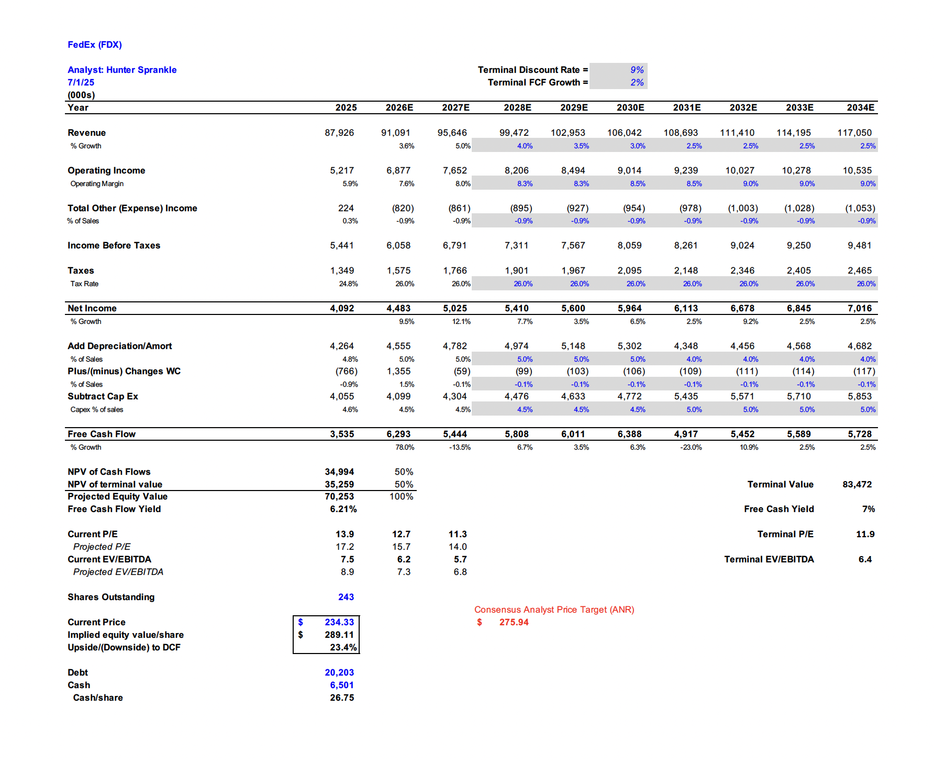
FedEx
DCF:

Slide 16
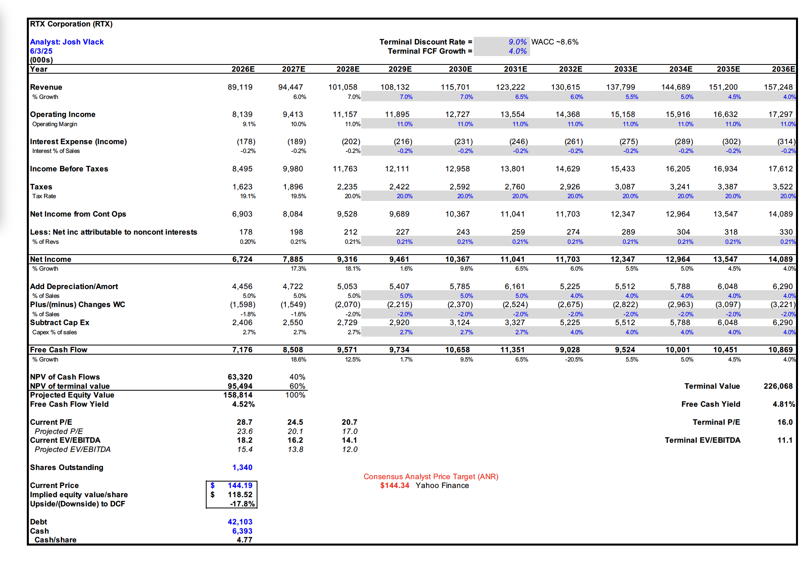
RTX Corp
DCF:

