Slide 1
Industrials Sector
BUSFIN 4228
Q2 / June 2025
Presented by
Josh Vlack
Yash Verma
Mia Welms
Hunter Sprankle
Industrial Sector
Q2 - June
Y2025

Slide 2
Content
1
Industrial Sector Overview
2
Business Analysis - Supply & Demand
3
Profitability & Pricing
4
Economic Analysis
5
Financial & Valuation Analysis
6
Recommendation
Industrial Sector
Q2 - June
Y2025

Slide 3

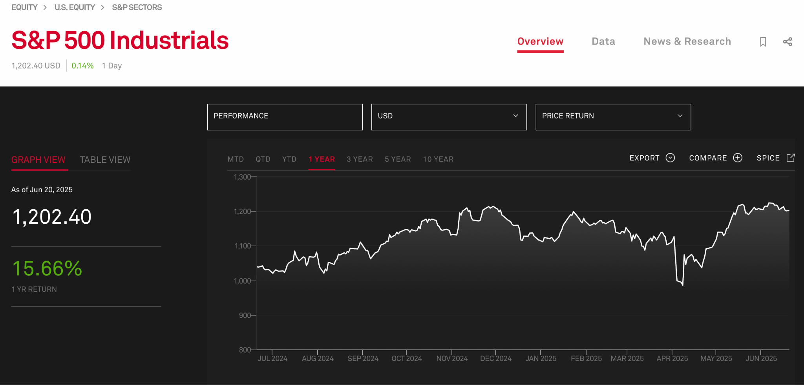
Weight: 8.7% of S&P 500
Industries: Aerospace & Defense, Machinery, Transportation, Commercial Services, Professional Services, …
  Largest Companies:
    GE Aerospace
    RTX Corp. (Formally, Raytheon Technologies Corporation)
    Caterpillar
    Boeing
    Honeywell
    UPS
    S&P 500 Industrials YTD
Industrial Sector Overview:
Industrial Sector
Q2 - June
Y2025

Slide 4

Supply:
Demand:
Business Analysis - Supply & Demand:
Life‑Cycle Phase: Mature core with high‑growth adjacencies (electrified equipment, autonomous logistics)
Business‑Cycle Classification:
  Positioned in early‑mid expansion; is cyclically levered, sector beta rises with ISM PMI > 50
    Reflects rising manufacturing activity and CapEx growth.
Economic Sensitivity: +1 pt move in ISM PMI ≈ +0.3 pp sector return; USD strength a revenue headwind (~35% ex‑US sales)
  Strong dollar reduces foreign earnings in USD and global competitiveness.
External Factors: Infrastructure stimulus, reshoring incentives, tariff policy, and defense outlays drive incremental demand
User & Geography: North America capex up‑cycle; emerging‑market airport & port upgrades support OEM equipment sales.
Input/Output: Steel & energy costs impact margins; suppliers passing through ~70% of cost inflation to OEMs.
  Helps mitigate margin erosion, but pricing power varies.
Mature core: growth in EV & automation
Early‑mid expansion in business cycle
ISM (Institute for Supply Management) and PMI (Purchasing Managers’ Index) sensitive;
  Highly correlated with U.S. Manufacturing trends
  Sector depends heavily on global capital expenditures.
Stimulus & reshoring bolster orders:
  Government spending boosts demand for industrial goods.
  U.S. companies relocating manufacturing back to U.S. increases demand for factory equipment, automation, and construction.
~35% External US revenue exposure:
Industrial Sector
Q2 - June
Y2025

Slide 5
Profitability & Pricing:
Operating Margins:
Industrial sectors averages ~11% vs. ~14% for the S&P 500
Indicates slightly lower profitability compared to the market
Pricing Power
Strong in defense OEMs due to government contracts and specialized products
Machinery firms are successfully passing on cost increases through surcharges
Industry Concentration
Top 10 companies account for 45% of the sectors total market capitalization
Suggests moderate concentration with dominant players influencing pricing trends
Barriers to Entry
High capital requirements, strict certification processes, and complex supply chains make it difficult for new entrants
These barriers help protect existing firms and support long-term profitability
Customer & Supplier Dynamics
Airlines are consolidated and have strong bargaining power as customers
Tier-1 suppliers are fragmented, giving OEMs more leverage in negotiations
Industrial Sector
Q2 - June
Y2025

Slide 6
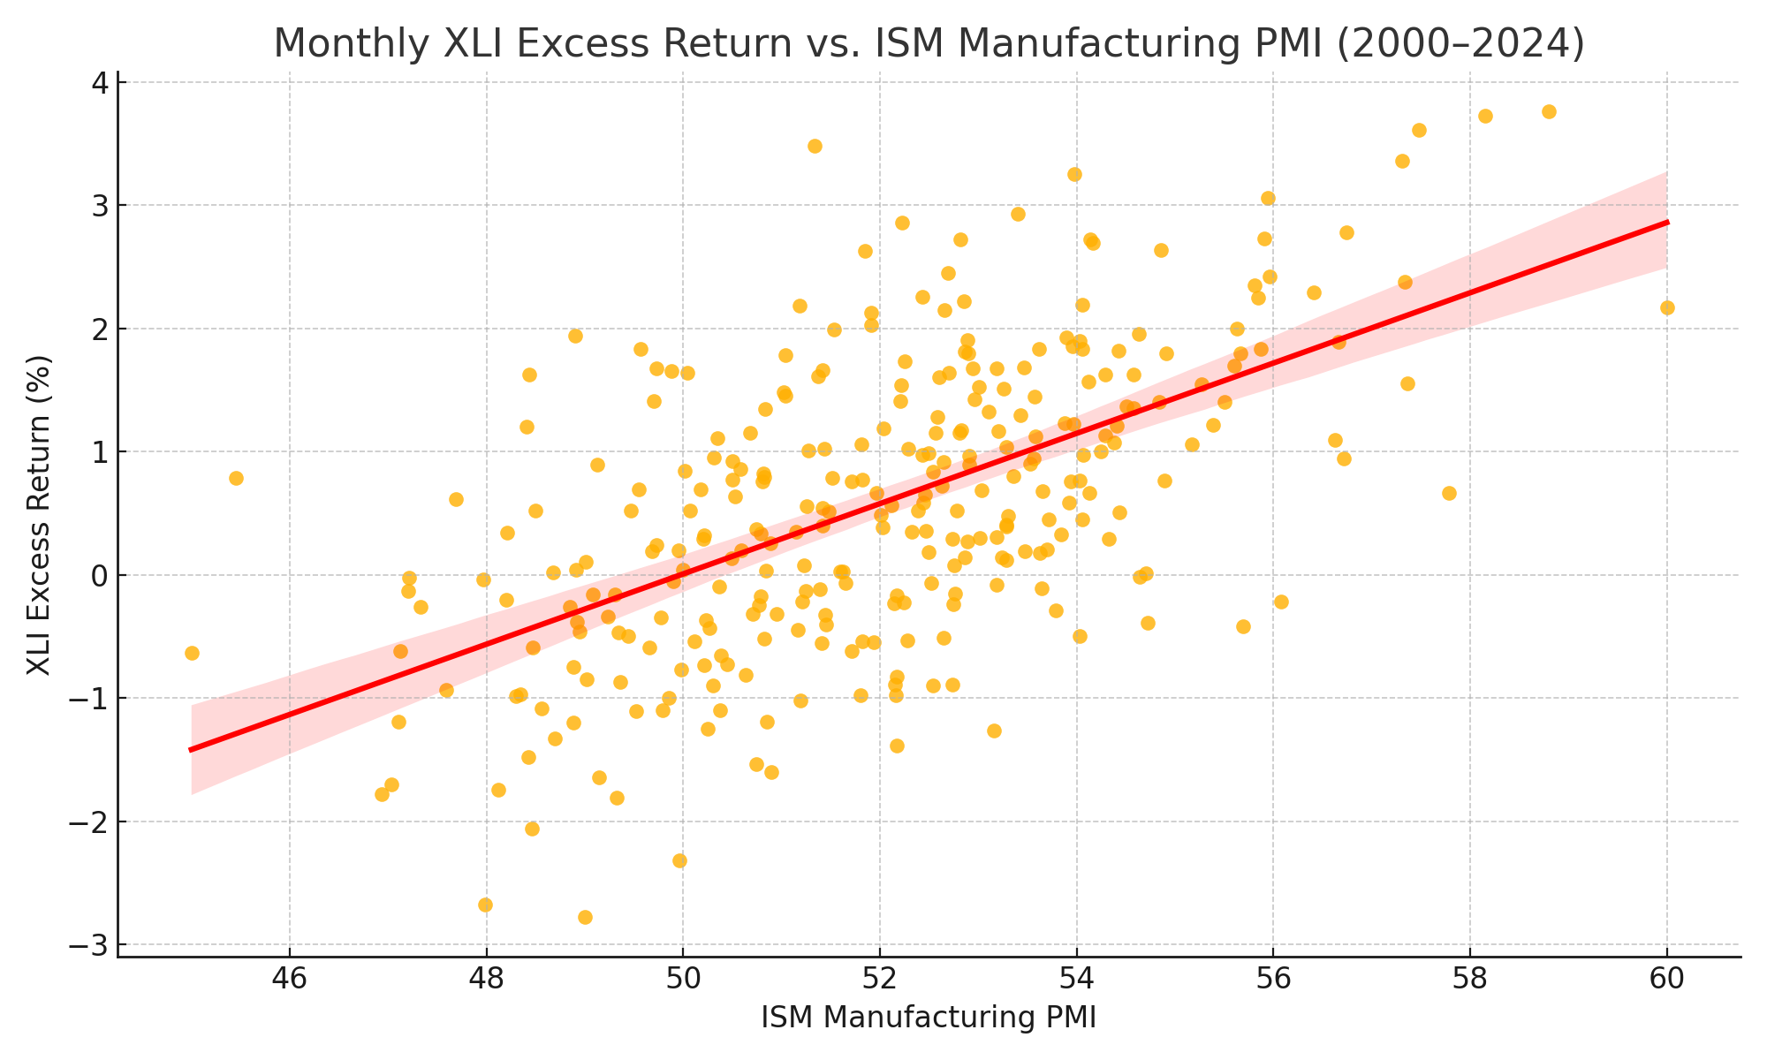
Economic Analysis
Regression Insights
R² = 0.48, β = 0.30
  Regression of monthly XLI excess return vs. ISM Manufacturing PMI (2000-2024)
Industrials outperform when PMI > 50
  Signals expansionary environment
  Also favored during steepening yield curve phases
Key Leading Indicators
Core capital-good orders (non-defensive, ex-aircraft)
Global PMI trends
Diesel demand (proxy for freight activity)
Industrial Sector
Q2 - June
Y2025

Slide 7
Financial & Valuation Analysis:
Sales & Earnings Growth
2025E sales growth +6% vs. +4% for S&P500
2025E EPS growth +12% vs. +10% for S&P500
Indicates stronger expected top- and bottom-line performance than the market
Margins & Returns
Operating margin: 11% (5-year average improvement of +40 bps
R&D Investment: ~3% of sales, showing commitment to innovation
Return on Equity (ROE): 18%, consistent with long-term averages
Cash Flow
Free Cash Flow Yield: 3.9% vs. 2.8% for the market
Machinery and logistics firms exceed 5% highlighting strong cash generation
Valuation Metrics
FWD P/E: 24.2z vs 21.3x for S&P5–; 10 year sector avg. 21x
P/S 2.1x | Price/Book: 4.6x | EV/EBITDA 15x
Premium valuation reflects reshoring investments and defense backlog growth
Valuation multiples tend to compress when PMI falls below 50
Technical View
XLI ETF trading near all-time highs at $145
Breakout above $144 coust target $155
Support level at 200-day moving average: $132
Industrial Sector
Q2 - June
Y2025

Slide 8
Industrials Positioned for Outperformance: Overweight +2%
Recommendation:
Portfolio Stance
Recommend overweighting industrials by +2% relative to the S&P 500 benchmark
Reflects confidence in sectors growth outlook and strategic tailwinds
Key Positives
: infrastructure spending continues to drive demand for industrial goods
Defense sector is in an up-cycle, supporting long-term revenue visibility
Automation and reshoring capex are boosting equipment and software demand
Strong free cash flow
Risks to Monitor
Tariff policies and supply chain disruptions could pressure margins
PMI rollover may signal slowing manufacturing activity
Valuations are elevated, leaving less room for error
Industry Positioning
Overweight: Aerospace & Defense, Industrial Software, Heavy Machinery
Underweight: Air Freight & Logistics, Building Products(due to margin pressure)
Industrial Sector
Q2 - June
Y2025

