Slide 1

Industrials
Colton Heery, Braden Heitman, Nathanael Hess

Slide 2


 | Recommendation | Current SIM Weight | Recommendation | Current Upside
 | Buy | 1.2% | 2.0% | 27.5%
 | Hold | 4.34% | 4.34% | 8.6%
 | Buy | 1.88% | 2.0% | 16.26%

Slide 3
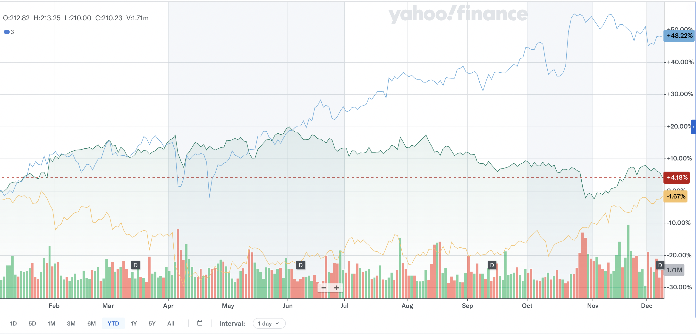
Insert pic of combined all 3 stocks ytd preformace
RTX WM FDX

Slide 4
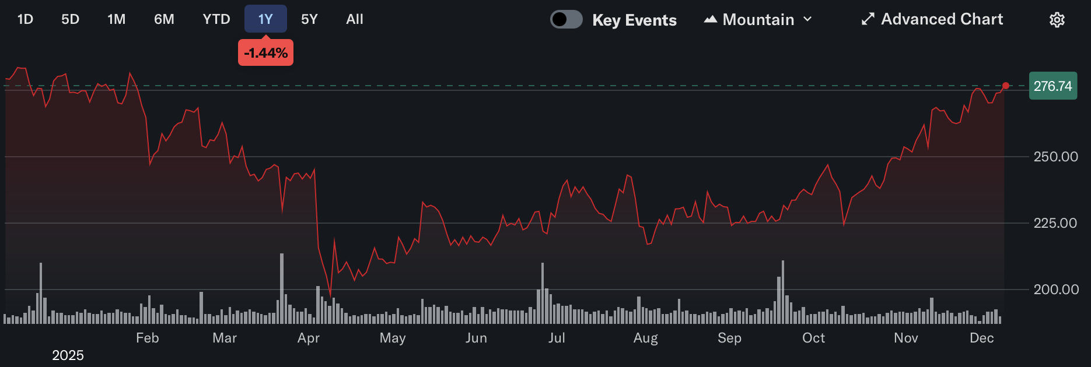
Current Stock Price: $276.64 | Recommendation: HOLD
Target Price: $300 | Target Return 8.44%
52-Week (High-Low) $295.24 – $194.26 | Market Cap. 65,274 Mm
Diluted Shares Out. 243M | Dividend Yield 2.21%

Slide 5
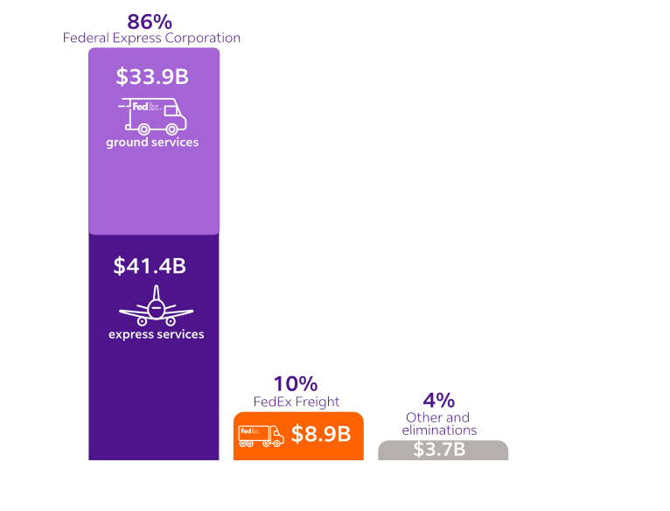

Description:
FedEx is a global transportation and logistics company that delivers packages, through freight, and supply-chain solutions worldwide. It provides express air shipping, ground delivery, freight services, and logistics support to businesses and consumers, enabling fast and reliable movement of goods across the globe.
NEW Business Segments:
FedEx “One Consolidation Plan” Merges FedEx Ground & Corporate Services (DRIVE)
Federal Express
-Global air‐express transportation.
-Time-sensitive international and domestic shipping.
-Largest revenue generator historically.
FedEx Freight
-Less Than Truckload (LTL)
“Corporate, Other and eliminations”
-FedEx Data works
-FedEx Office
-FedEx Logistics

Slide 6
Tailwinds (+)
Headwinds (-)
E-commerce Growth Growing Demand for Supply Chain & Logistics Services -More customers are outsourcing logistics. -FedEx Supply Chain and Services benefit from increased complexity of global trade. Network Optimization & Cost-Cutting Initiatives -The DRIVE transformation program aims to reduce billions in costs. -Improved integration between Ground and Express networks increases efficiency.
Intense Competition -UPS -Amazon Fuel Price Volatility -Current Geopolitical Risks (Tariffs) UPS plane crash (MD-11) -Grounding 9%-10% of Fleet

Slide 7
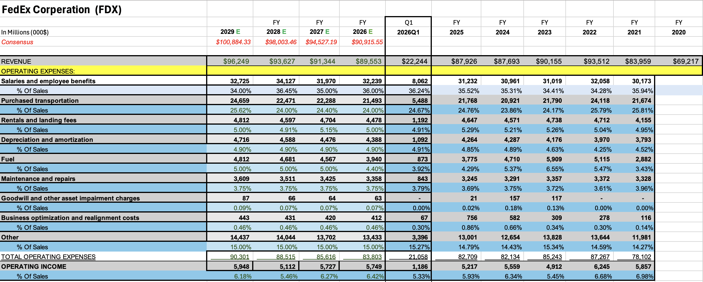
Financial Analysis
Steady Growth YoY / Revenue Growth YoY 1.62%
Largest expense is Employees and salaries
“Caution” looking forward could be Fuel expense and purchase of new planes

Slide 8
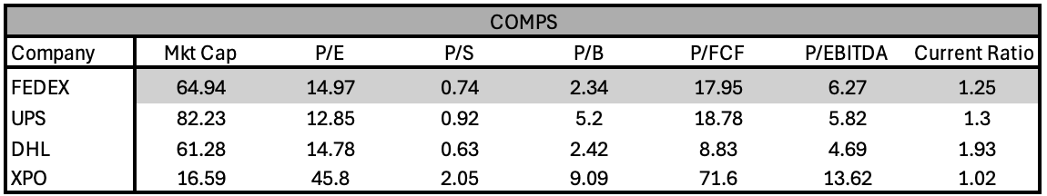
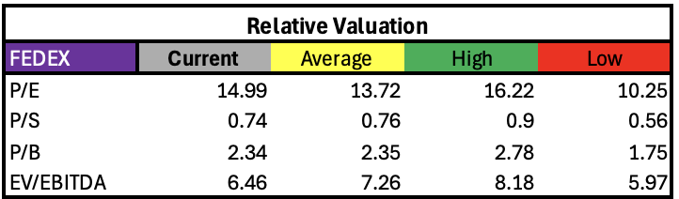
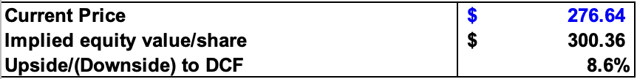
Valuation Analysis
-FedEx sits in a middle-to-low valuation range versus comps, this suggesting relatively attractive pricing, particularly vs UPS and XPO.
- FedEx is currently cheap on an operating cash flow basis, one of the strongest arguments for value opportunity.

Slide 9


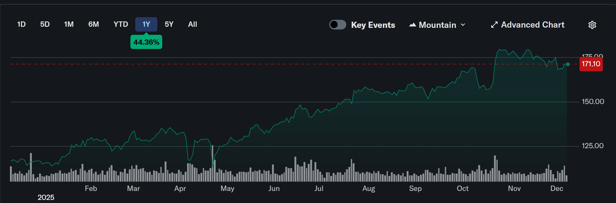
Stock Price: $171.10 | 52 Week Price Range: $112.27 - $181.31
Target Price: $206.07 | Market Capitalization:
Total Upside: 20.44% | Dividend Yield: 2.60%
Recommendation: BUY | Diluted Shares Outstanding: 1,343.60 M

Slide 10
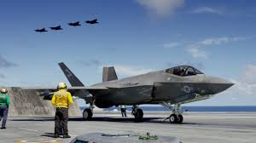
Description:
RTX Corporation (RTX) is an aerospace and defense company in the Industrials GICS
sector. They specialize in the design, manufacture, and support advanced technologies for both
commercial aviation and military systems. RTX serves both commercial and government defense
needs across the globe.
Business Segments:
Collins Aerospace
Pratt & Whitney
Raytheon
Tailwinds:
Projected increase in consumer air travel.
Increase in airframe Capex spending
Existing backlog of production
Increased global military spending
Headwinds:
Regulatory issues (e.g., metal powder in P&W Boeing engines, Boeing production cap, various export and bribery charges)
Consumer sentiment concerns decreasing future capex spend from airlines.

Slide 11
Financial Information
Sales have been consistently showing sustained double-digit growth (normalized without the P&W metal powder effects).
We project that operating profit will continue to improve as well.

Slide 12
Valuation Information
The valuation approach was based off of a mosaic between the multiples and the DCF model.
RTX has a balance sheet make-up that is stronger than their peers.
RTX is also fairly priced relative to comps.
RTX sits in a unique space within the sector that can capture more value relative to competitors, leading to the higher price target.
Targeting a price of $206.07 with strong double-digit upside returns.

Slide 13
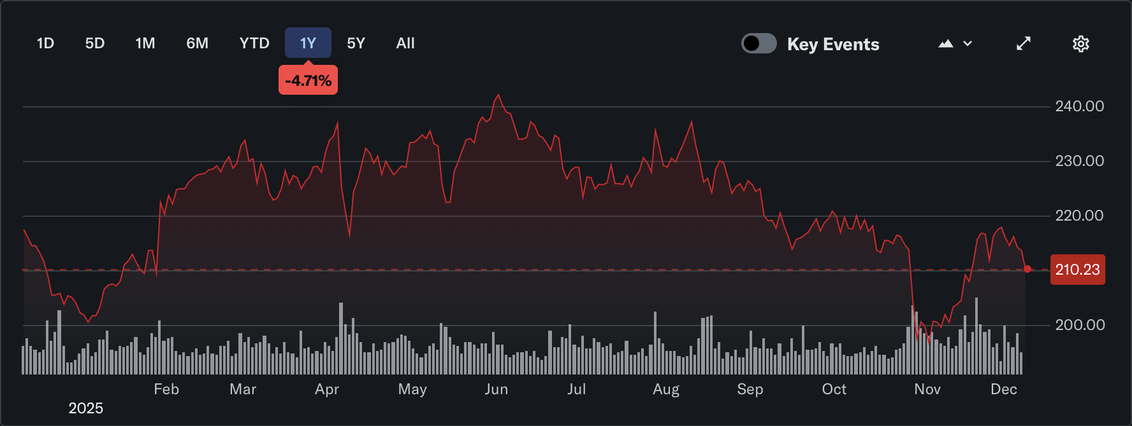
Stock Price: $ 210.23 | 52-week price range: $194.11 - $242.58
Target Price: $244.42 | Market Cap: 84.695B
Total Upside: 16.26% | Dividend Yield: 1.63%
Recommendation: BUY | Diluted Shares Outstanding: 404 M

Slide 14
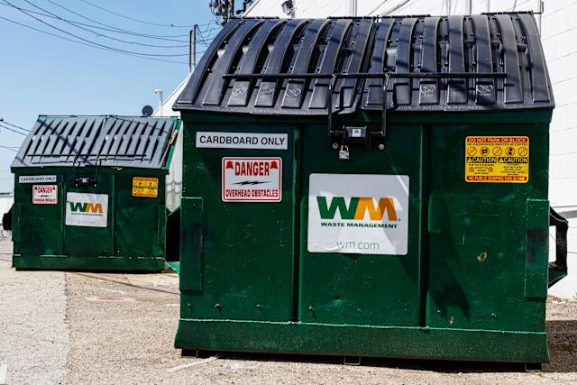
Description: Waste Management Inc. (WM) is the largest waste services provider in North America, offering collection, recycling, transfer, and disposal for residential, commercial, industrial, and municipal customers. Based in Houston, the company also develops and operates landfill gas-to-energy facilities that turn waste into renewable natural gas and electricity, positioning WM as a leader in sustainable waste solutions.
Business Segments:
Collection & Disposal
Recycling Processing
WM Renewable Energy
WM Healthcare (Stericycle)
Tailwinds:
Strong, Recurring Revenue from Core Collection Business
Sustainability & Renewable Energy Growth
AI & Automation Improving Margins
Headwinds:
Regulatory & Environmental Pressure
Commodity Price Volatility

Slide 15
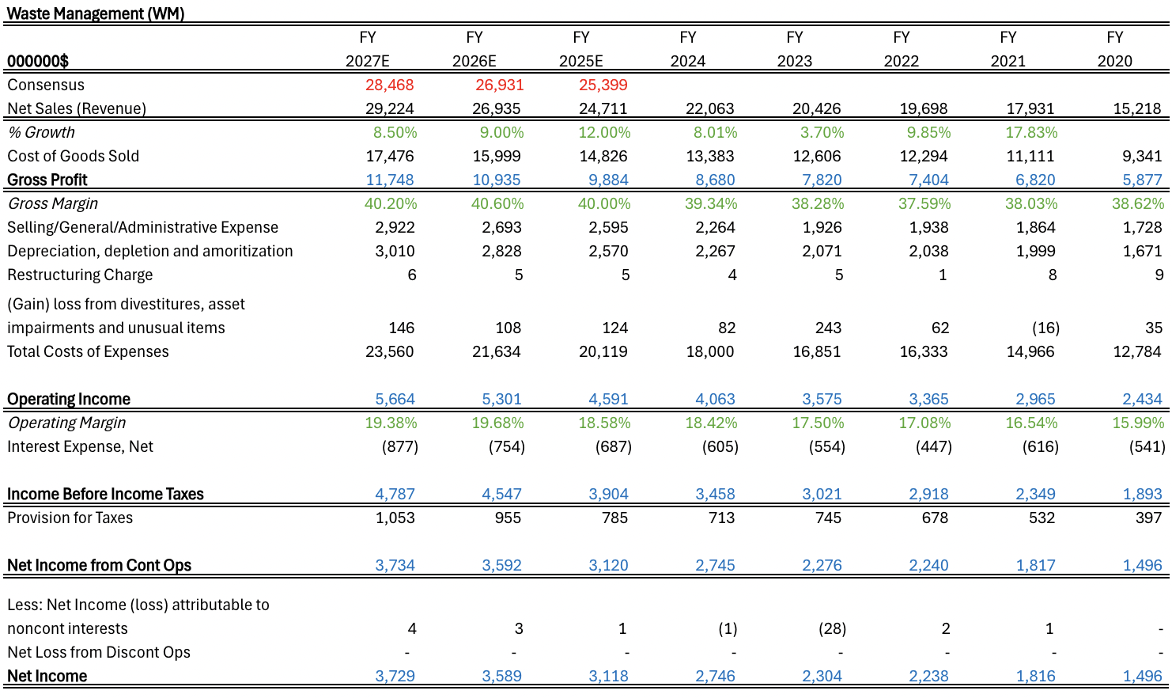
Financial Analysis
Sales have been steady other than a down year in 2023, and we project them to continue at a steady rate
Gross Profit is expected to reach 40% and hopefully keep increasing
Operating Margin has increased a ton from 2020, and we expect it to continue to grow.

Slide 16
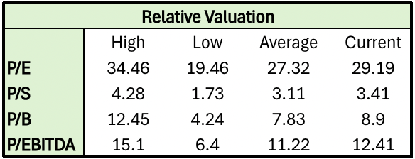
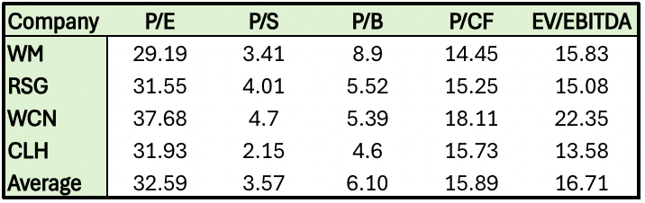


Valuation Analysis
WM trades at a fair premium: Current P/E is slightly above its historical average but still below peers making it fair value.
Competitive EV/EBITDA: WM is in line with its competitors
Solid relative positioning: P/S and P/B remain near historical averages and competitive with peers
DCF supports upside: Using a 7.5% discount rate and 4% growth, DCF implies a value of $244.42/share. 16% Upside from the current price of $210.23, pointing to attractive long-term return potential.

Slide 17
 | Recommendation | Current SIM Weight | Recommendation | Current Upside
 | Buy | 1.2% | 2.0% | 27.5%
 | Hold | 4.34% | 4.34% | 8.6%
 | Buy | 1.88% | 2.0% | 16.26%

Slide 18
Thank You!
Questions?

Slide 19
Appendix-1
Income forecast

Slide 20
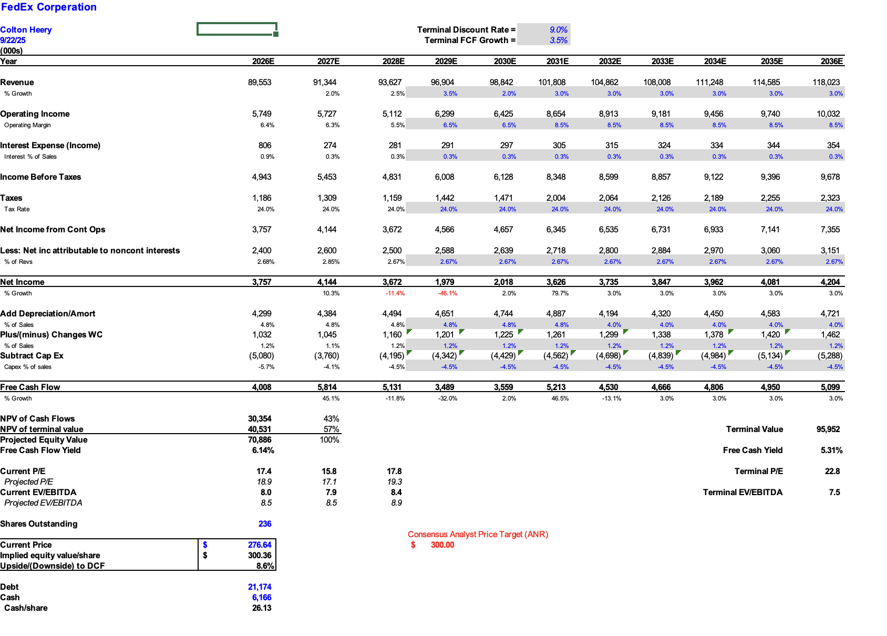
Appendix 2
DCF

Slide 21
Appendix #1-Income Statement

Slide 22
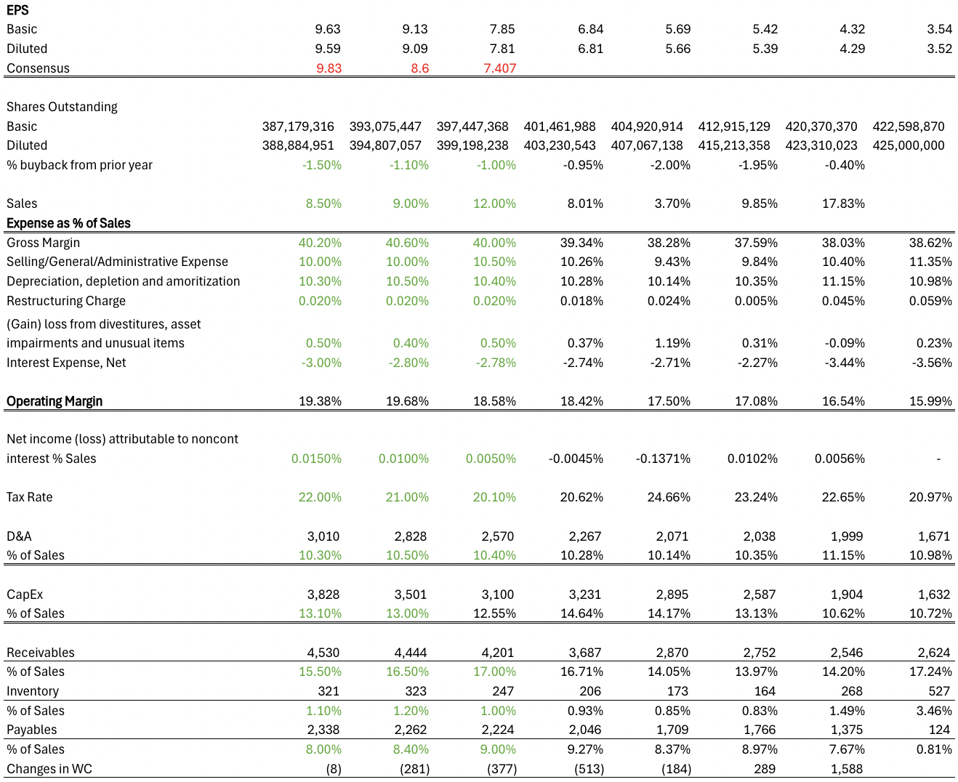
Appendix #2-Income Statement Part 2

Slide 23
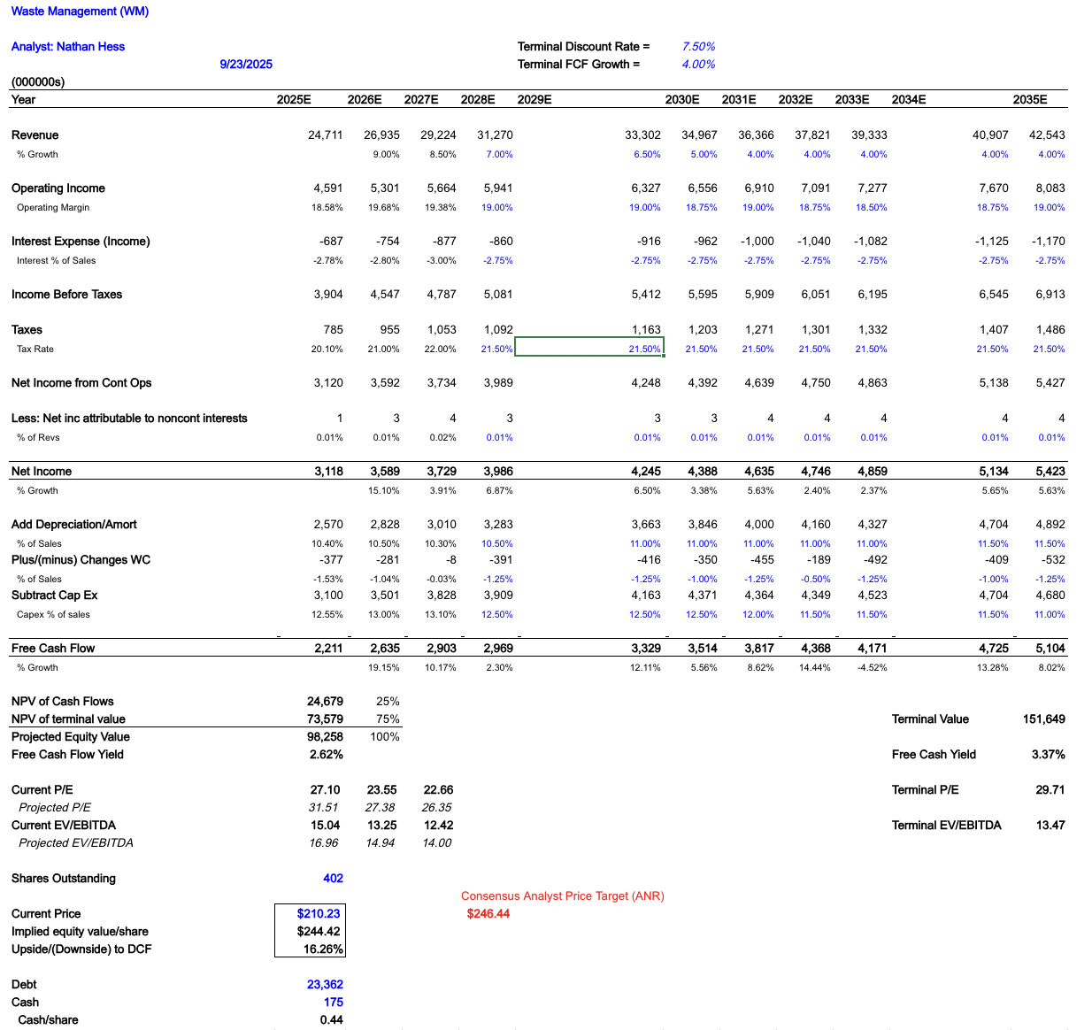
Appendix #3-DCF

Slide 24
Appendix #1 – Income Statement

Slide 25
Appendix #2 – Sum of Parts Analysis

Slide 26
Appendix #3 – DCF

