Slide 1

Industrial Sector
Colton Heery, Nathan Hess, Braden Heitman

Slide 2
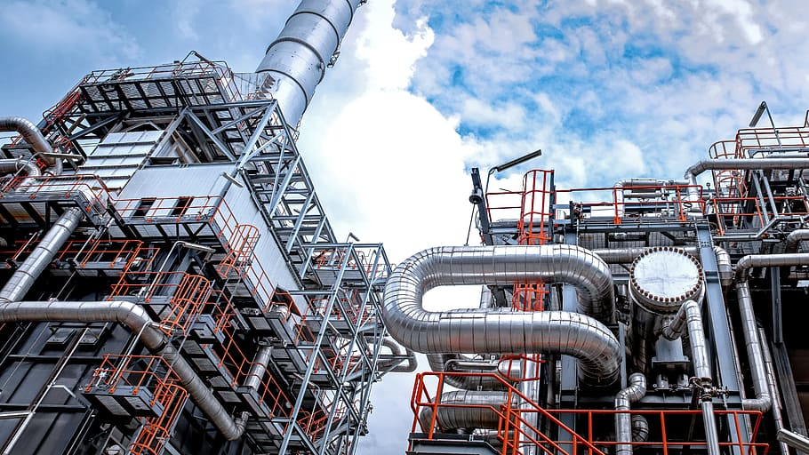
Table of Contents
Agenda
Overview
Business Analysis
Economic Analysis
Financial Analysis
Valuation Analysis
Recommendation

Slide 3
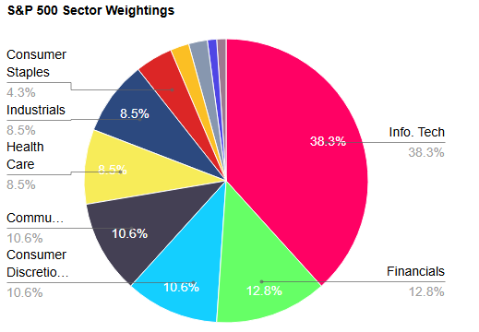
Overview
-Current Sector Weighting 8.12% (6th largest) of 11
-SIM Weighting 7.33%
Notes:
So for the sector overview , the current Industrials sector weighting of the s&p 500 is 8.12% which is the 6th largest out of the 11 sectors(shown in pie chart).
For the Sim weighting its currently 7.33% so slightly Underweight the S&P and the current companies that are in the SIM that we ae following are Fedex, RTX, WM

Slide 4









14 Industries
79 Companies
Aerospace & Defense
Air Freight & Logistics
Airlines
Building Products
Commercial Service & Supplies
Construction & Engineering
Electrical Equipment
Industrial Conglomerates
Machinery
Marine
Professional Services
Road & Railways
Trade Companies & Distribution
Transportation Infrastructure
Notes:
The industrials sector currently contains 17 industries and 79 companies, that fall into a broad array of sub-sector industries including (READ LIST).
It’s a sector that is made up of a ton of different businesses and widely diversified with some of the more prominent being Noted on the next slide. ( Next Slide)

Slide 5









Largest Companies
Notes:
(GE, Caterpiller, RTX, Boeing, Eaton, Union pacific, Honeywell, Lockheed maritn, and john deere)
as you can see this sector covers a large array of different areas, with the different companies that It holds.

Slide 6
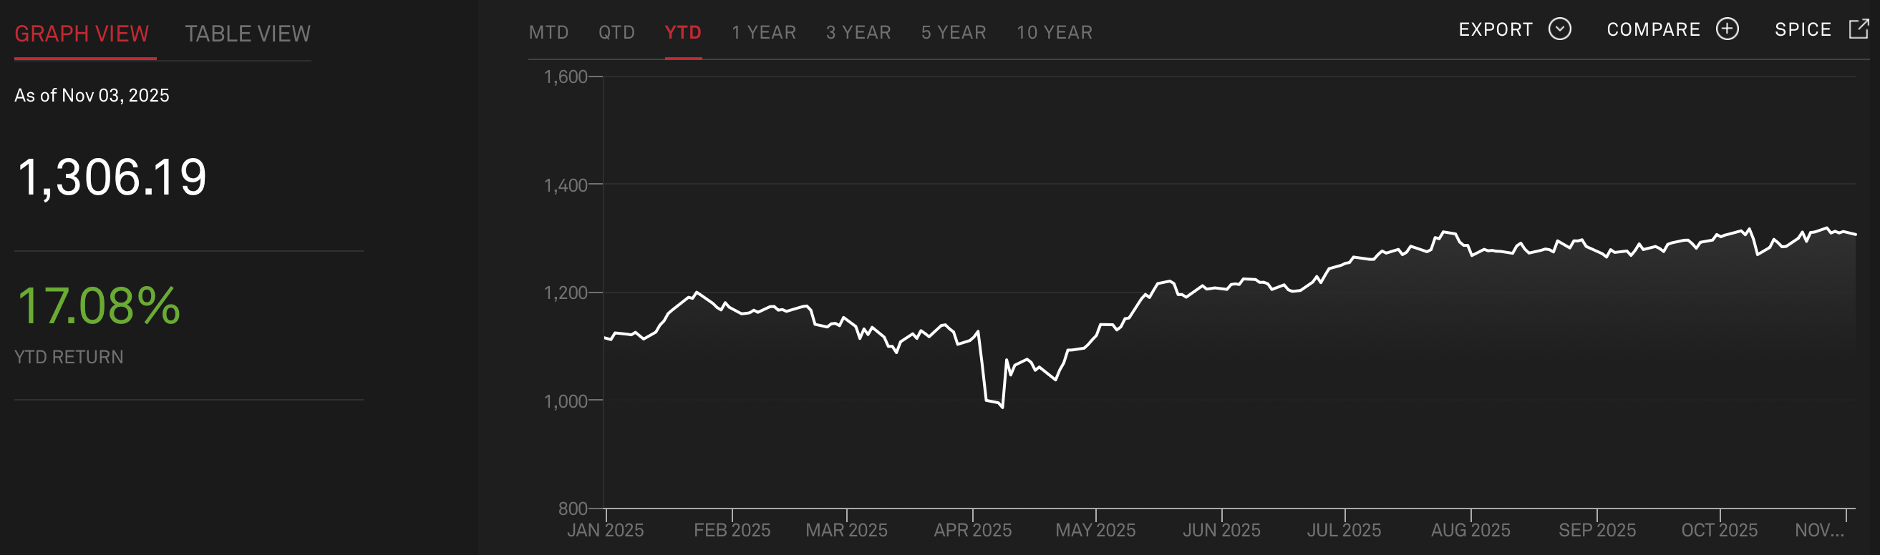
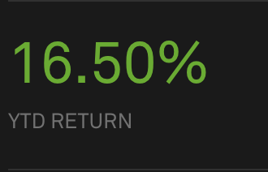
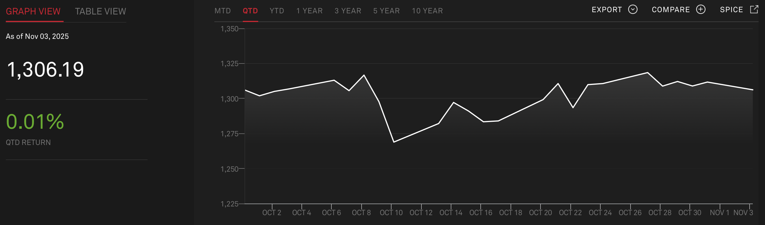
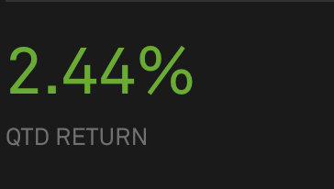


Industrials Sector
S&P 500
YTD
QTD
Notes:
Okay so as we look at the industrials sector compared to the S&P 500 benchmark, our sector YTD return has been 17.08%, compared to the YTD return for the S&P 500 of 16.50% so just in line with the benchmark.
On the other hand, the quarter to date return is just one BIP which is lower than the QTD of the S&P by 2.43 %

Slide 7
Business Analysis

Slide 8
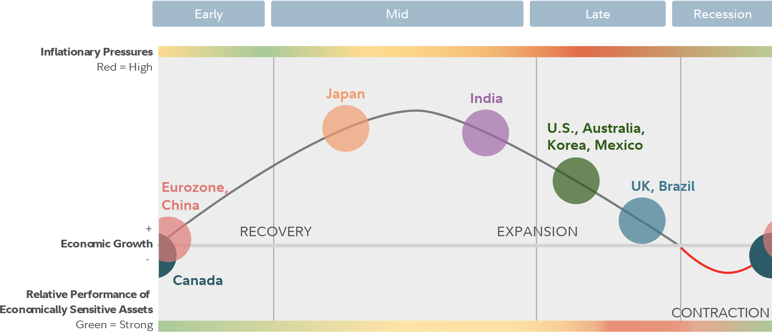
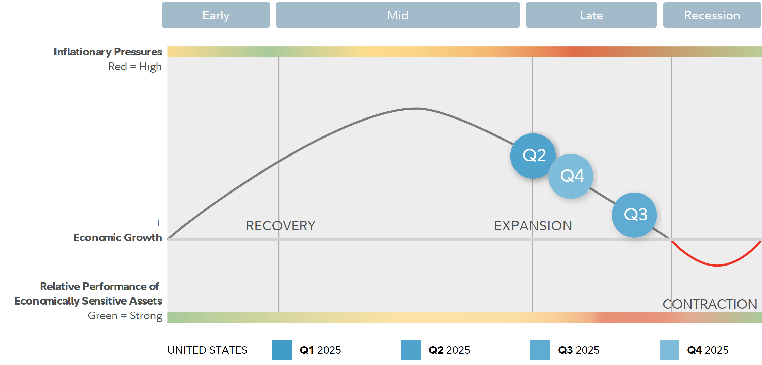
Business Cycles
International
U.S. QTR

Slide 9
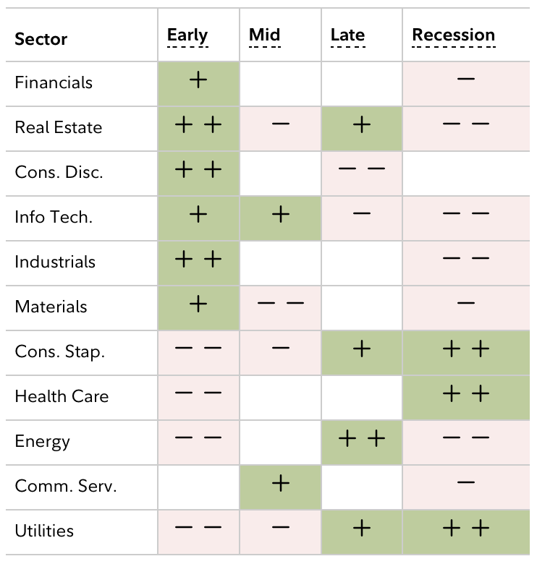
Sector Performance
-Cyclical
-Easily influenced by consumer spending cycles
-Struggles during downturns in the economy

Slide 10
Structure and Drivers of Sector
Structure:
This industry is diversified, mix of manufacturing, logistics, and capital goods
Lot of Mature companies
Capital Intensive and cyclical
Demand tied to GDP
Key Drivers:
Energy & raw materials affect this industry
Tariffs have affected this industry as well especially supply side
Companies becoming more sustainable
Technology, Automation, AI, and robotics to improve efficiency

Slide 11
Porters 5 Forces
Threat of New entrants is Moderate: High capital needs and regulation limit entry, though reshoring incentives ease the barriers.
Supplier Power is Moderate to High: Dependence on key materials and energy gives suppliers moderate-high leverage.
Buyer Power is High: Large industrial clients command strong pricing power due to volume purchasing.
Threat of Substitutes is Low: Few direct alternatives, but new materials and tech pose gradual disruption risk.
Industry Competition is High: Intense global competition and thin margins drive efficiency and innovation focus.

Slide 12
Economic Analysis

Slide 13
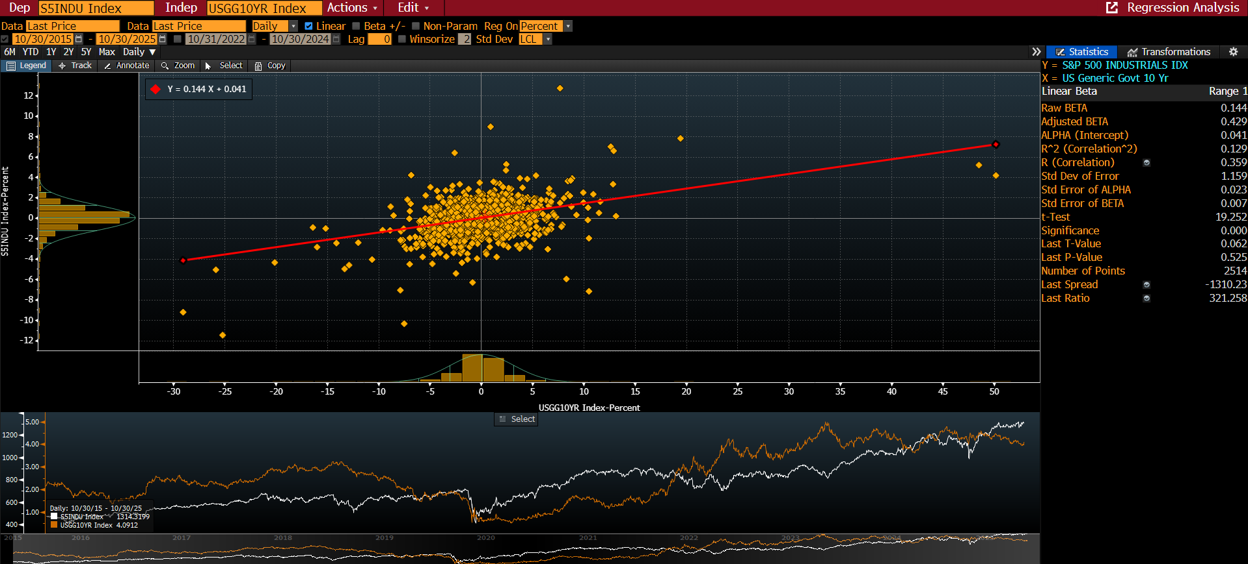
Regression: Industrials vs 10 Yr Treasury (Daily)

Slide 14
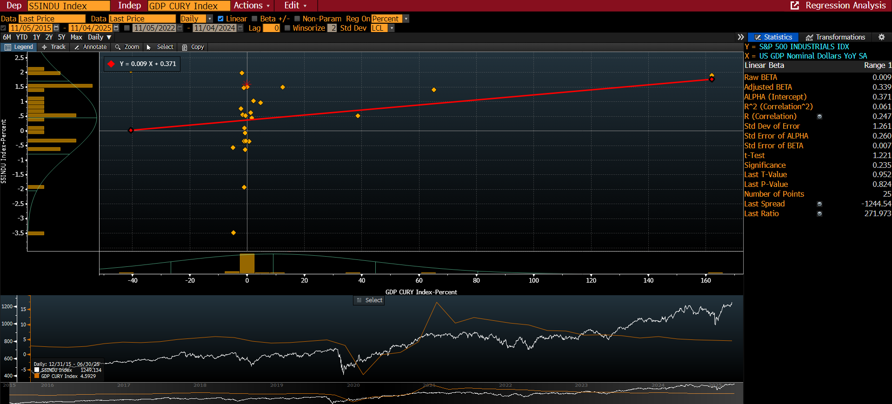
Regression: Industrials vs GDP (Monthly)

Slide 15
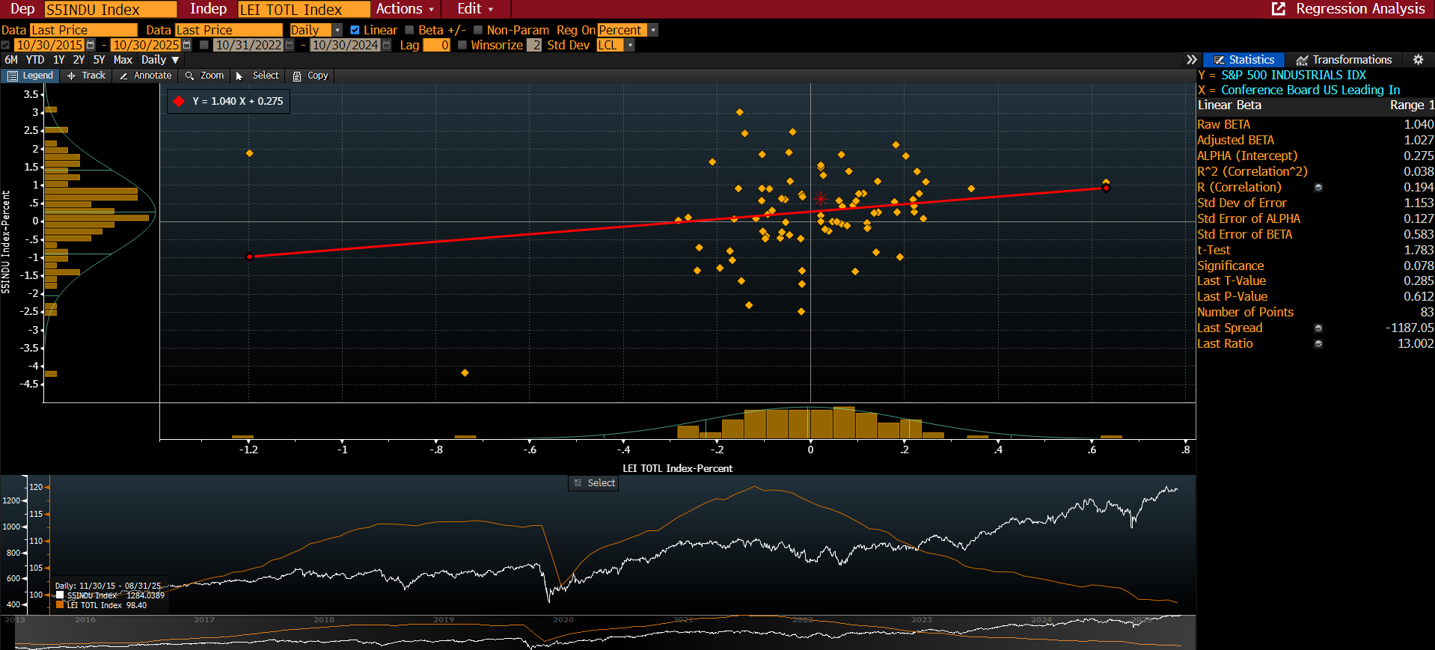
Regression: Industrials vs LEI Index (Daily)

Slide 16
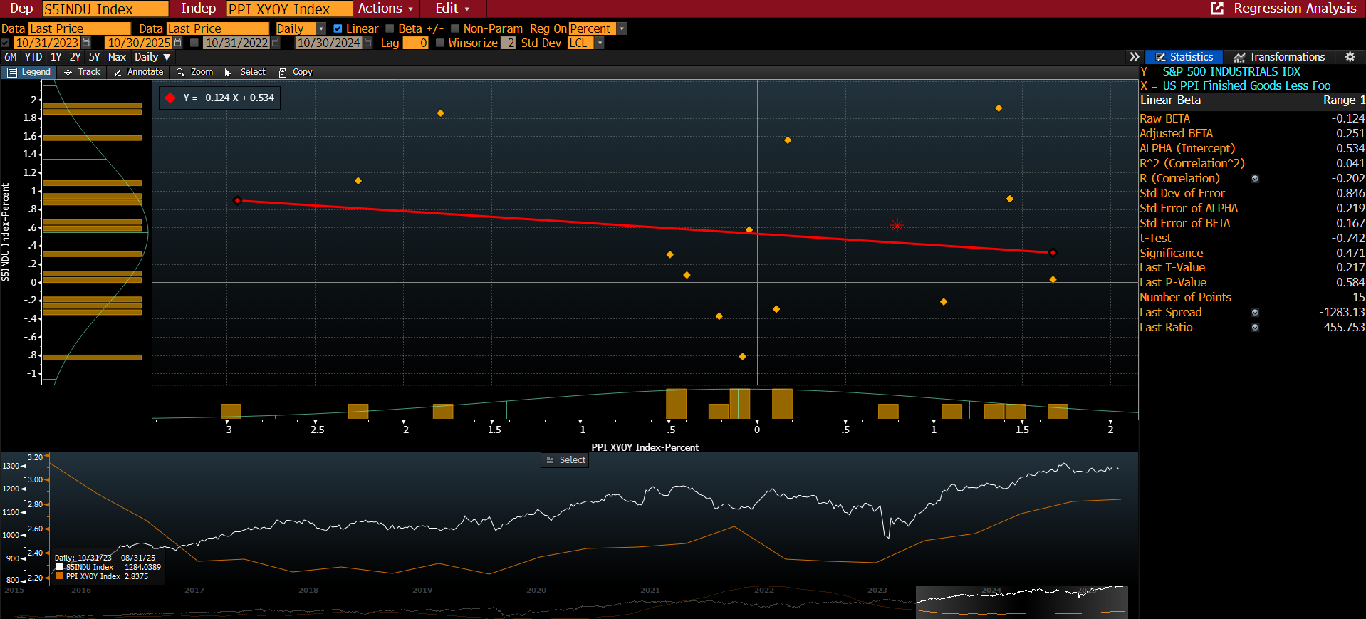
Regression: Industrials vs PPI Index (Daily)

Slide 17
Financial Analysis

Slide 18
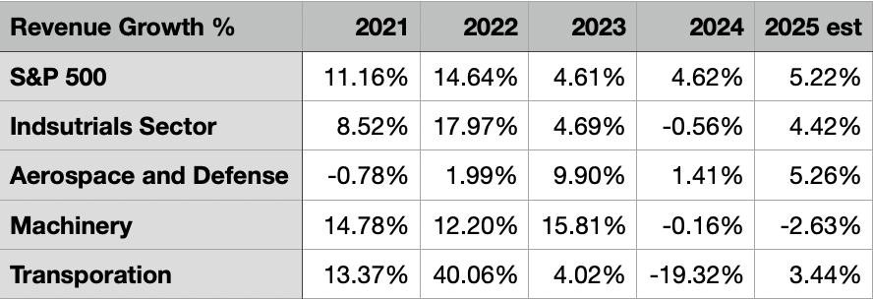
The Industrials sector saw strong post-pandemic growth in 2022 but has since slowed, with a slight contraction in 2024. Looks like it is making a recovery in 2025.
Subsector performance is mixed: Machinery and Transportation show more volatility, while Aerospace & Defense demonstrates steady and resilient growth.
Source: Bloomberg

Slide 19
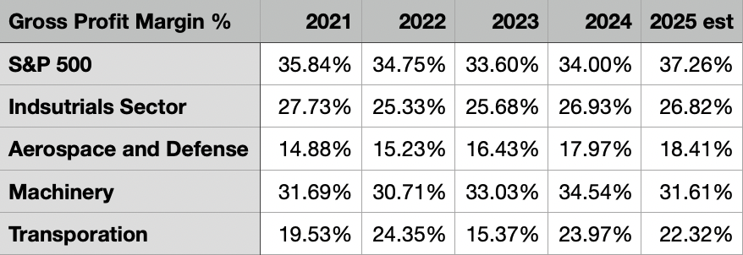
The Industrials sector maintains lower gross margins than the S&P 500, averaging around 26–27% due to it being a capital-intensive sector.
Margins have improved across most subsectors, with Machinery leading in profitability and Aerospace & Defense showing gradual recovery.
Source: Bloomberg

Slide 20
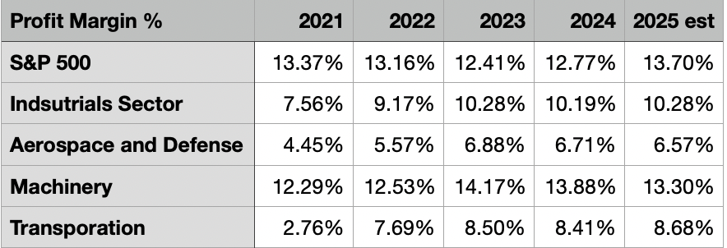
Profit margins in the Industrials sector have steadily improved from about 7.5% in 2021 to around 10% by 2025, closing the gap with the S&P 500
Machinery is the most profitable sub sector, with Aerospace & Defense, Transportation growing
Source: Bloomberg

Slide 21
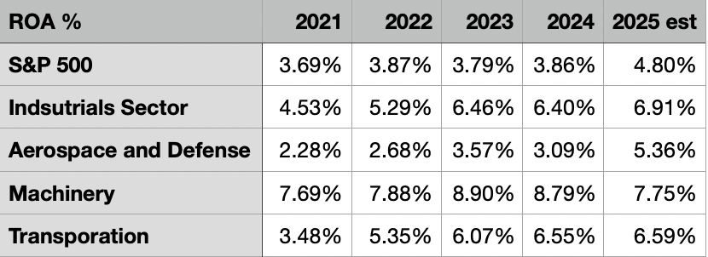
The Sector and sub sectors are all doing better than the S&P 500.
higher ROA reflects strong operational efficiency and effective use of physical assets compared with the broader market
Source: Bloomberg

Slide 22
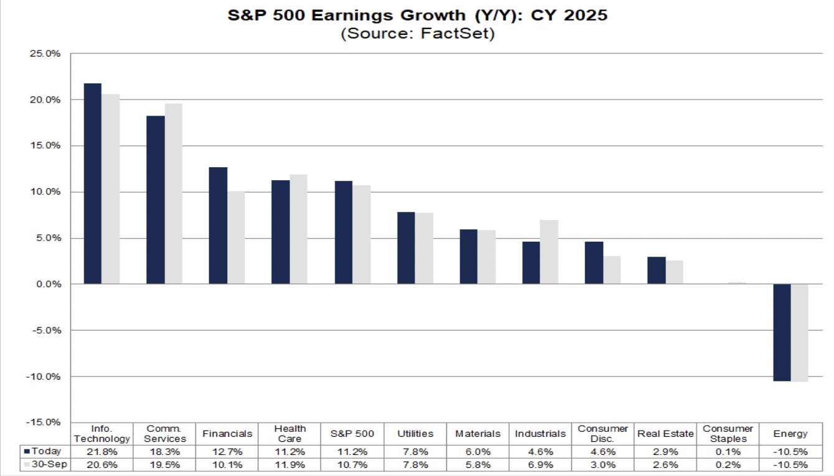

Slide 23
Valuation Analysis

Slide 24
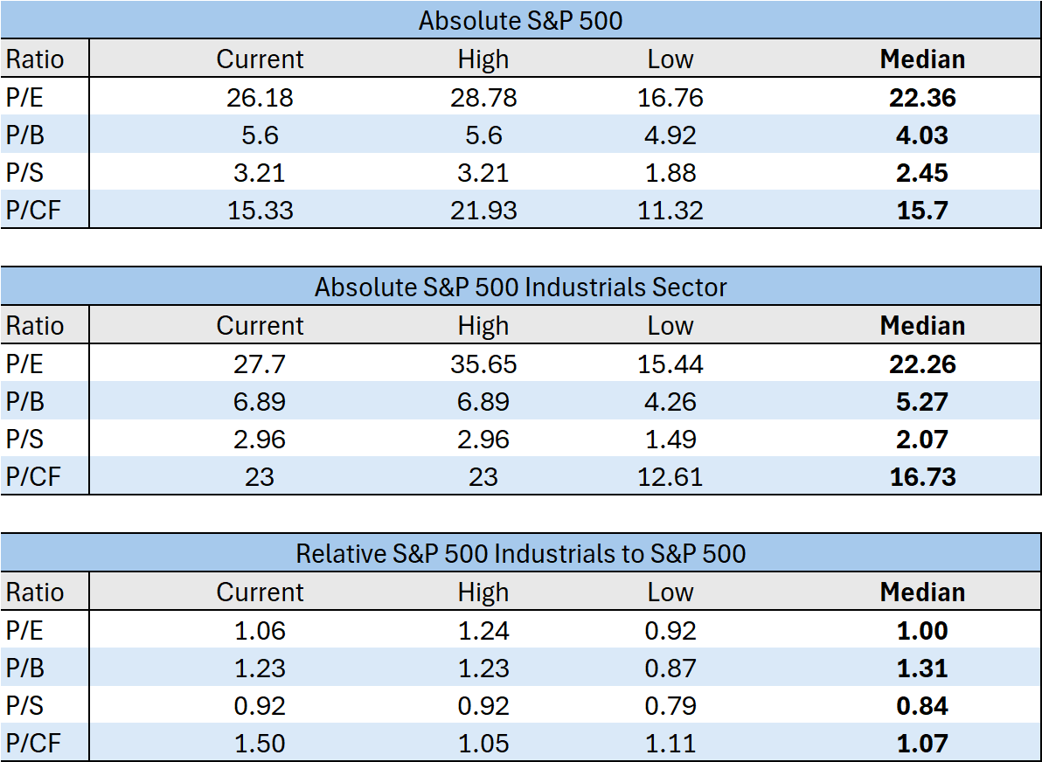
Multiples Analysis
We can see that the Industrials sector is fairly in-line with valuations, relative to the S&P 500.
Every Industrials multiple is elevated above its median.
  Similar to the S&P 500.
Valuations for both Industrials and the S&P 500 are close to or at their highs.

Slide 25
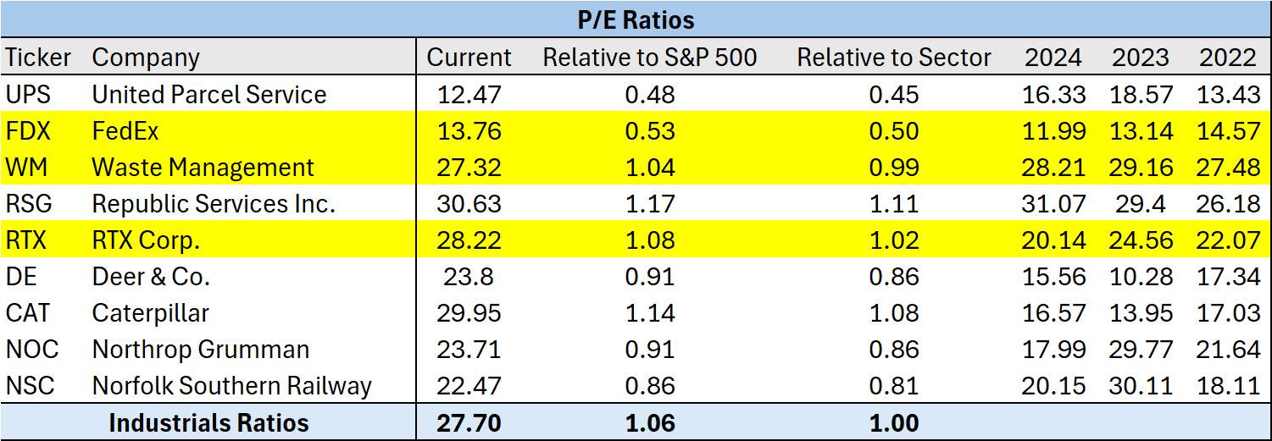
P/E Ratios

Slide 26
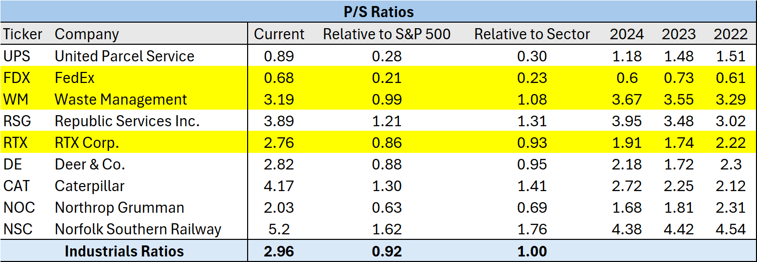
P/S Ratios

Slide 27
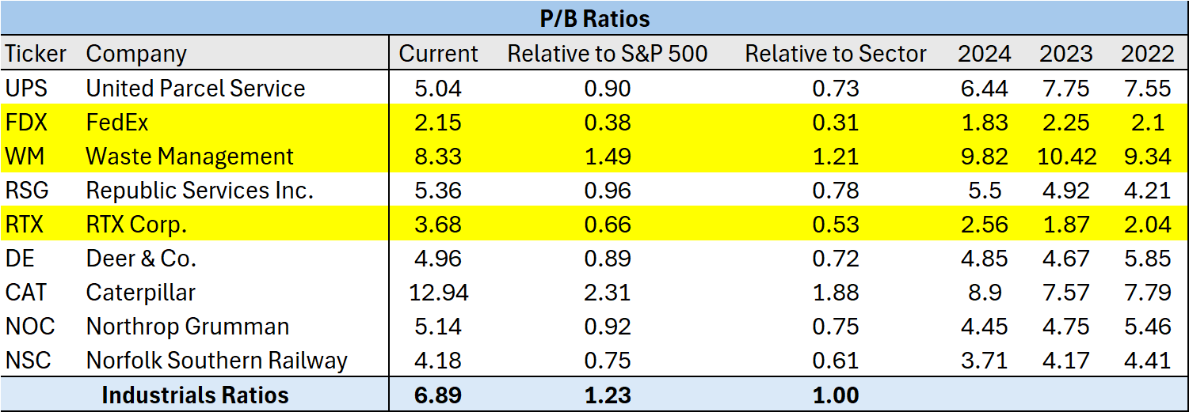
P/B Ratios

Slide 28
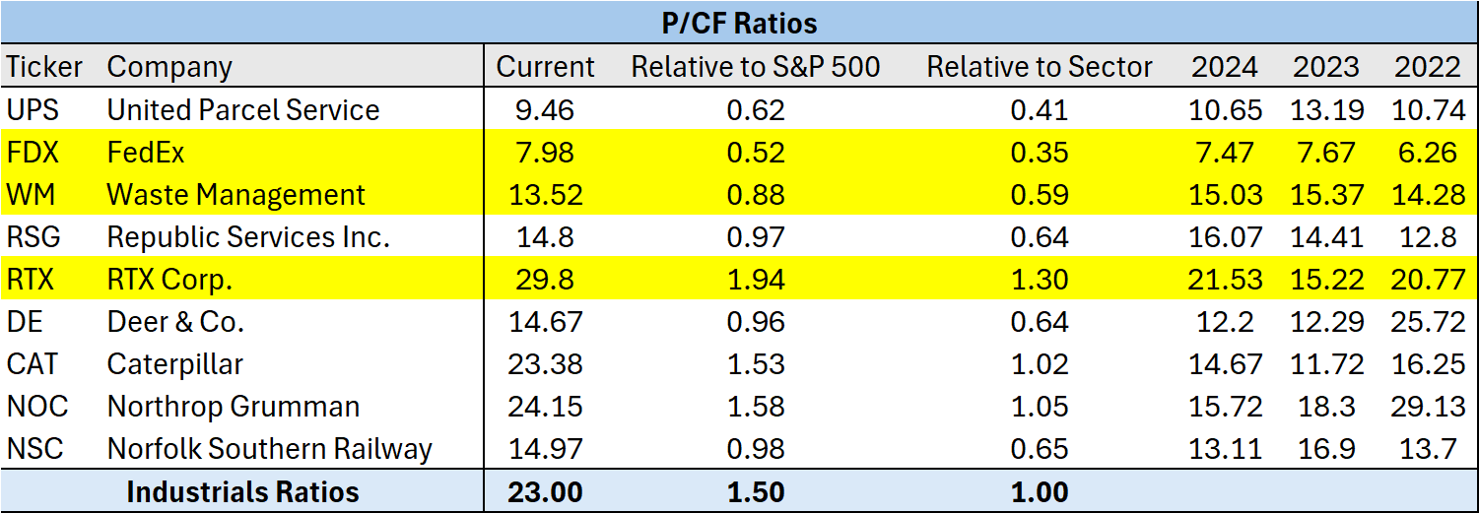
P/CF Ratios

Slide 29
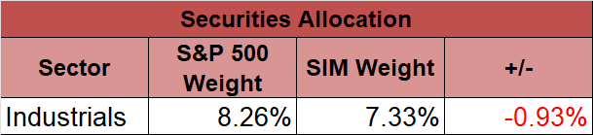
Recommendation
We recommend to maintain our underweighting on the industrials sector, relative to the S&P 500.
Mainly due to lower expected returns compared to the S&P 500, high multiples, and current late business U.S. business cycle.

Slide 30
References
https://advantage.factset.com/hubfs/Website/Resources%20Section/Research%20Desk/Earnings%20Insight/EarningsInsight_103125.pdf
Bloomberg

