Slide 1
Industrials Sector
Joe Hendrix, Manav Jain, Carter Jensen, Luke Maynard
Notes:
Hello everyone! This is our presentation on the Industrials sector recommendation. I'll start by introducing the team, beginning with myself—my name is Manav Jain.

Slide 2




Current Holdings
Company | Ticker | Total Cost | Market Value | Unrealized gain/loss | % of assets
FedEx | FDX | 195,290 | 275,471 | +80,181 | 3.12%
Boeing | BA | 267,627 | 272,880 | +5,253 | 3.09%
RTX | RTX | 161,946 | 225,182 | +63,236 | 2.55%
United | UAL | 43,336 | 70,431 | +27,095 | 0.80%
S&P 500 Weight | SIM Weight | Overweight/Underweight
8.47% | 9.56% | 1.09%

Slide 3
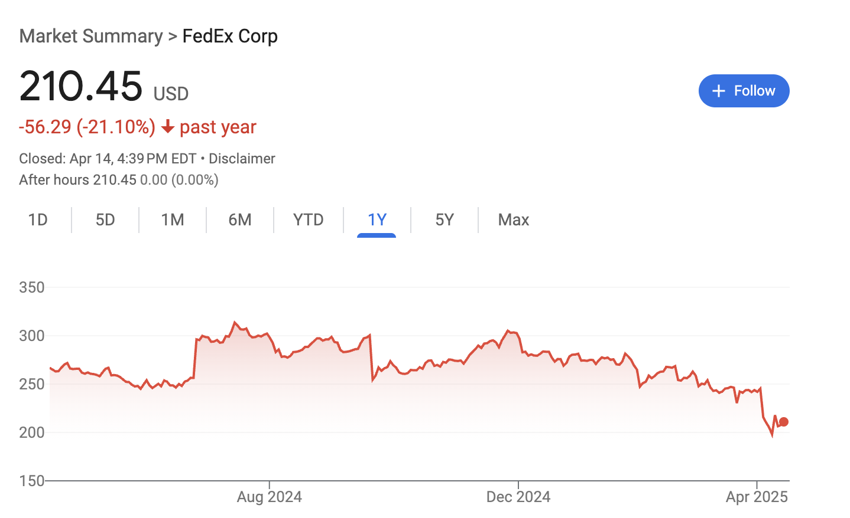
FedEx - Overview
Stock Price: $210.45 | Target Price: $279
Recommendation: HOLD | Implied Upside: 32.5%
Diluted Shares Outstanding: 239.6M | 52-week Range: $194.30 - $313.30
Market Cap: $49.78B | Dividend Yield: 2.66%
Segments: Express, Ground, Freight, Office, Dataworks, Services Growth Drivers: E-commerce growth, Network 2.0, customer segment growth

Slide 4
FedEx - Financial
FedEx’s revenue and net income have fluctuated over the years, income peaking in 2021 Operating Expenses have increased, but operating income has kept pace Network 2.0 aims to increase efficiency and decrease OpEx
, | 2021 | 2022 | 2023 | 2024 | 2025E | 2026E
Revenue | $83,959 | $93,512 | $90,155 | $87,693 | $87,466 | $90,045
Gross Profit | $17,954 | $20,167 | $19,166 | $18,952 | $10,484 | $10,888
Operating Income | $5,050 | $6,865 | $5,373 | $6,241 | $6,069 | $6,525
Net Income | $5,231 | $3,826 | $3,972 | $4,331 | $4,212 | $4,528

Slide 5
FedEX – Price Target
 | P/E | EV/EBITDA | P/B | EV/Sales
FedEx | 10.50 | 6.00 | 1.90 | 0.90
UPS | 12.60 | 7.70 | 5.10 | 1.20
Deutche Post AG | 11.20 | 5.60 | 1.80 | 0.70
Yunda Holding | 8.20 | 3.60 | 1.00 | 0.40
SF Holding | 17.10 | 7.10 | 2.30 | 0.70
Average | 11.92 | 6.00 | 2.42 | 0.78
Current Price | $210.45
Target | $279.00
Upside | 32.6%
Recently cut earnings projections for 2025 Relatively on par with peers Recommendation: HOLD

Slide 6
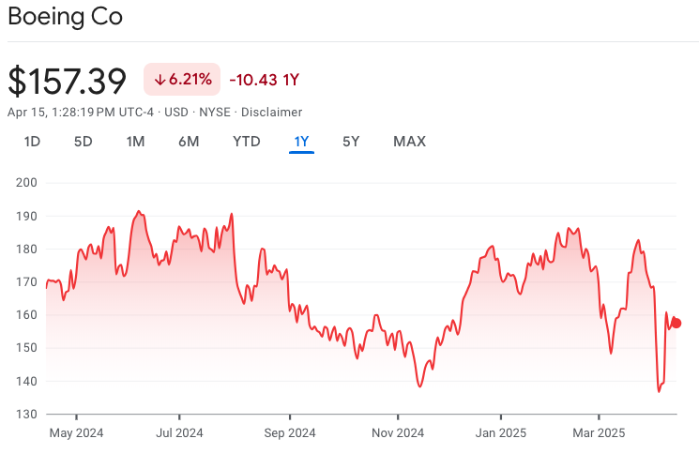
Boeing - Overview
Stock Price: $157.39 | Target Price: $149.07
Recommendation: SELL | Implied Downside: -6.41%
Diluted Shares Outstanding: 747.8M | 52-week Range: $128.88 - $196.95
Market Cap: $118.5B | Dividend Yield: 0.00%
Boeing designs, manufactures, and services aerospace products for commercial air travel, defense, and space flight 3 primary segments: Commercial Airplanes Defense and Space Global Services Plagued by crisis after crisis (737 MAX, Starliner, AF1 delay, strike) Kelly Ortberg named CEO in 2024, tasked with turnaround $500B backlog

Slide 7
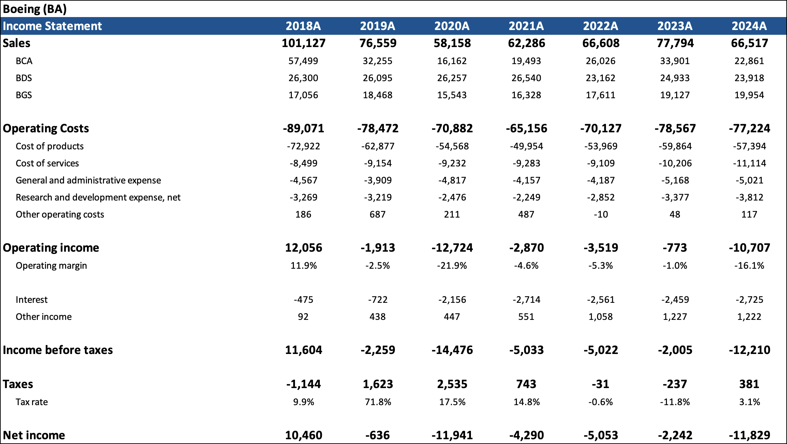
Boeing - Financial
Revenue peaked in 2018 over $100B
In 2024, revenue fell to $66.5B
Operating income fell to -$10B in 2024, down from $12B in 2018

Slide 8
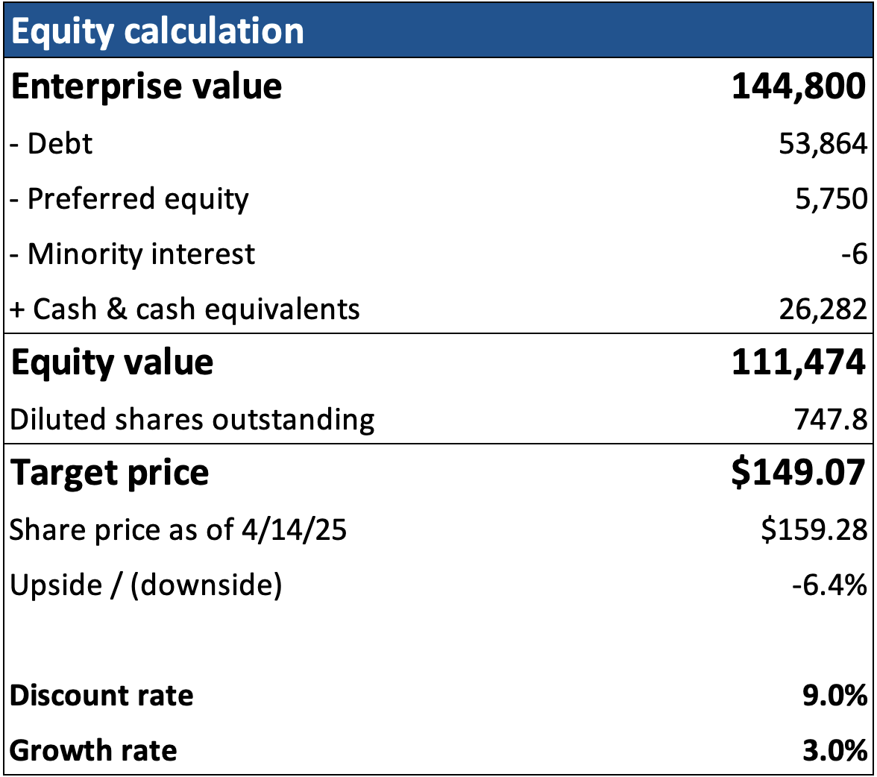
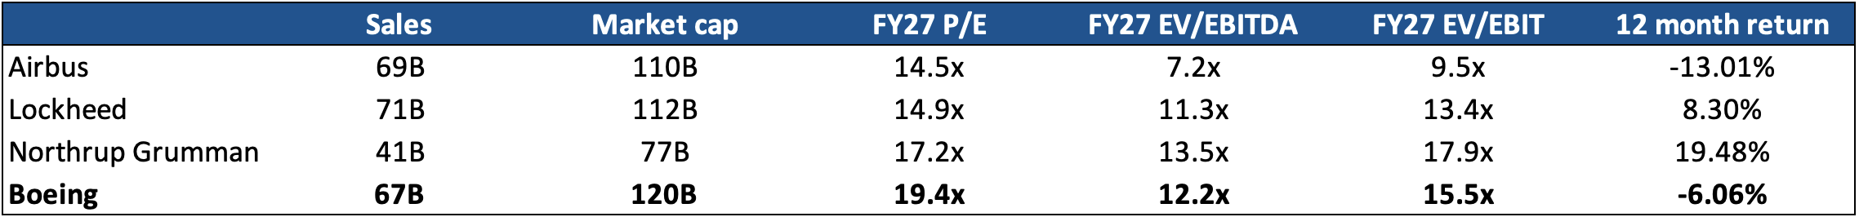
Boeing - Valuation
Sales will grow double digits over the next 3 years
Operating margins will expand to 10% but not all the way back to 2018 level
Too much must go right to justify current price

Slide 9
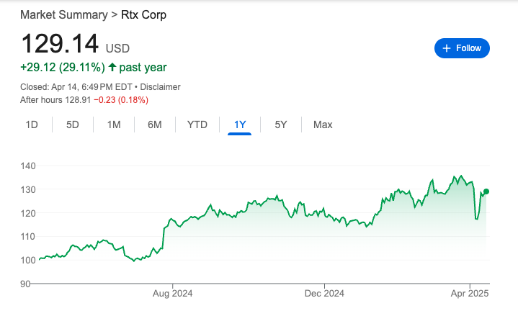
RTX - Overview
Stock Price: $129.14 | Target Price: $150
Recommendation: HOLD | Implied Upside: 16.2%
Diluted Shares Outstanding: 1.34B | 52-week Range: $99.07 - $136.17
Market Cap: $171.24B | Dividend Yield: 1.95%
Segments: Raytheon, Collins Aerospace, Pratt & Whitney Growth Drivers: Geopolitical tension, aircraft demand growth, MRO demand

Slide 10
RTX - Financials
Projecting consistent 6% sales growth Operating profit increasing steadily Powder Metal matter is in the past
EPS | FY2025E | FY2026E | FY2027E
Basic | 5.12 | 5.71 | 6.38
Diluted | 5.08 | 5.67 | 6.32
Consensus | 4.97 | 5.74 | 6.6
 | 2027E | 2026E | 2025E | 2024 | 2023 | 2022 | 2021
Total Net Sales | 96,160 | 90,717 | 85,582 | 80,738 | 68,920 | 67,074 | 64,388
Total Costs and Expenses | 87,506 | 82,553 | 77,880 | 74,068 | 65,445 | 61,690 | 59,675
Operating Profit | 9,039 | 8,527 | 8,045 | 6,538 | 3,561 | 5,504 | 5,136
Operating Income | 8,558 | 8,074 | 7,617 | 6,194 | 3,836 | 6,117 | 5,109
Net Income | 7,205 | 6,797 | 6,413 | 4,774 | 3,195 | 5,216 | 3,897

Slide 11
Rtx - valuation
Relatively undervalued to peer average in all multiples Could be affected by consumer confidence Recommendation: HOLD
 | P/E | P/S | P/B | P/CF | EV/EBITDA
RTX | 23.51 | 2.13 | 2.70 | 16.37 | 16.24
Transdigm | 34.72 | 9.89 | - | 38.38 | 24.65
GD | 16.75 | 1.62 | 3.25 | 23.66 | 14.54
Lockheed | 17.24 | 1.71 | 16.67 | 14.69 | 12.74
GE | 24.60 | 2.97 | 10.75 | 31.71 | 2.89
Boeing | 36.90 | 1.47 | - | 21.84 | 111.56
Average | 25.62 | 3.30 | 8.34 | 24.44 | 30.44
Current Price | $129.14
Implied equity value/share | $150.21
Upside/(Downside) to DCF | 16.3%

Slide 12
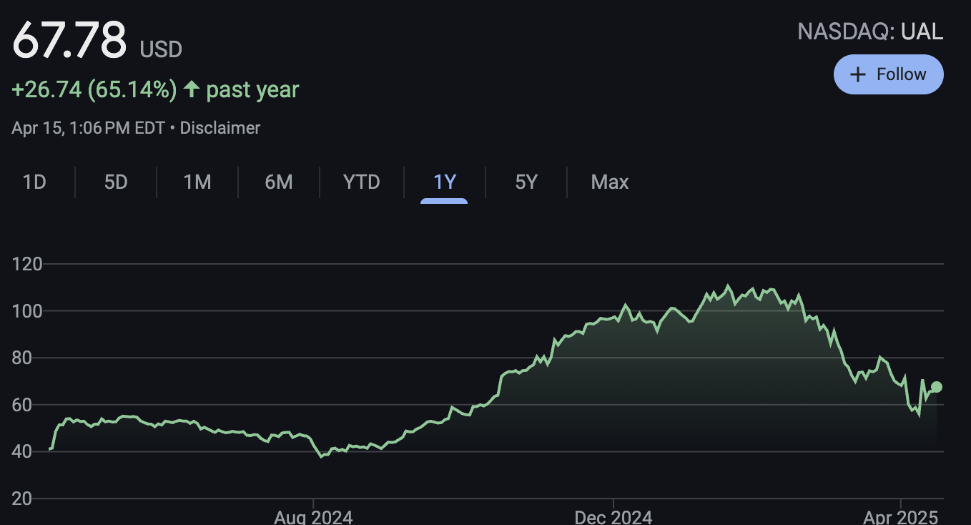
United Airlines - Overview
Stock Price: $67.78 | Target Price: $76.33
Recommendation: SELL | Implied Upside: 13.2%
Diluted Shares Outstanding: 328.8M | 52-week Range: $37.02 - $116.00
Market Cap: $21.53B | Dividend Yield: 0.00%
Segments: Passenger (Domestic & International), Cargo, Loyalty (MileagePlus), Regional Partners Business Drivers: Recovery in international travel demand, fleet modernization initiatives. Growth remains highly cyclical and tied to consumer spending trends. Recent Underperformance: UAL has declined ~20% amid increased market volatility and fears of softening consumer demand; unlike RTX, which benefits from defense stability, UAL is more directly exposed to discretionary travel trends and short-term macro shocks.

Slide 13
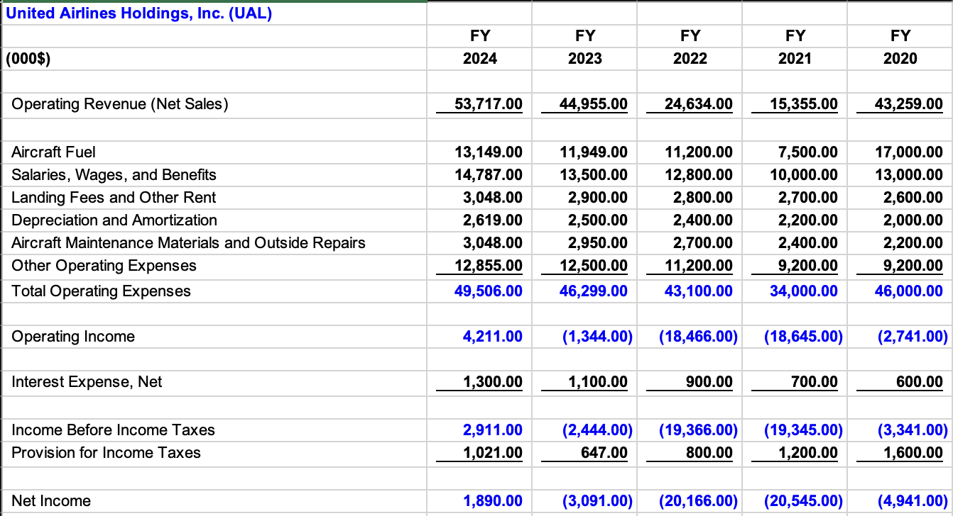
United Airlines – Financials
UAL returned to profitability in 2024 ($1.89B net income) after four straight years of losses, but OP margins remain thin at ~8%. Earnings growth is heavily tied to consumer demand and fuel volatility. Despite revenue recovery, we see limited further upside, as current valuation already prices in much of the near-term earnings rebound.

Slide 14
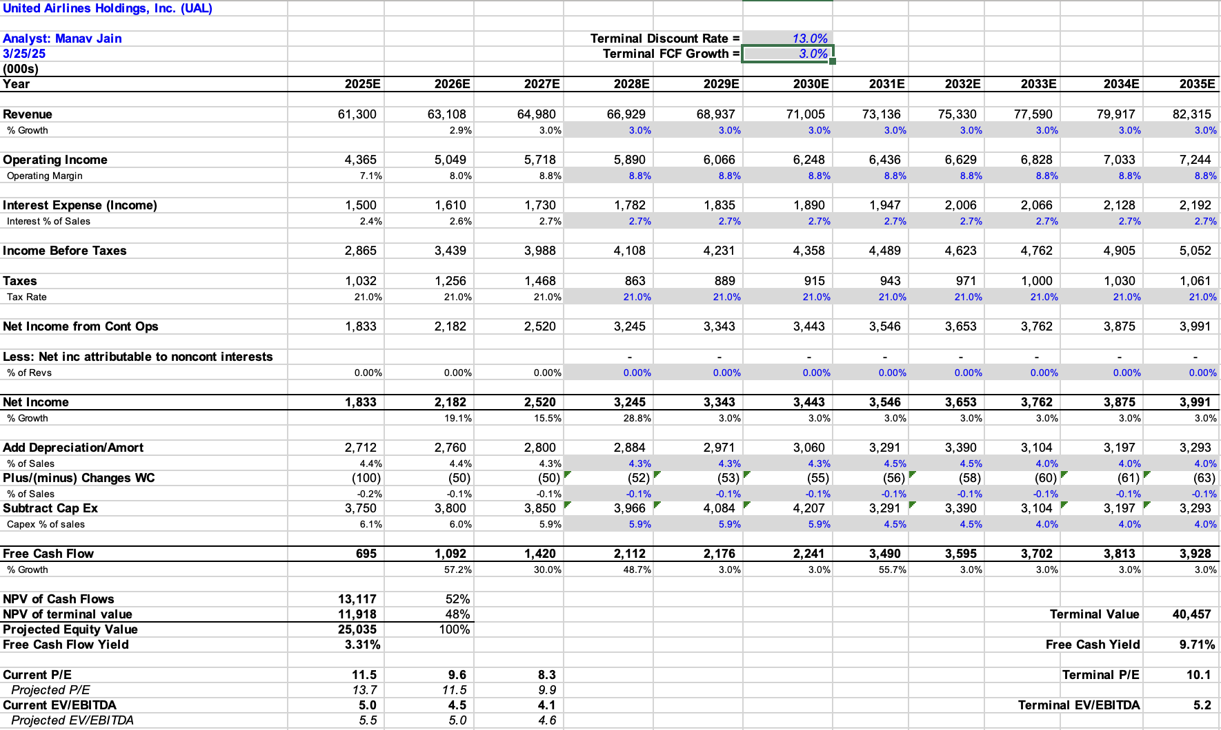
United Airlines – Valuation

Slide 15
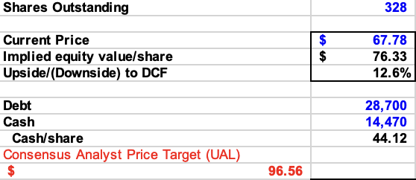
United Airlines – Valuation
Company | P/E | EV/EBITDA
United Airlines (UAL) | 6.94 | 4.78
Southwest Airlines (LUV) | 34.46 | 6.50
Alaska Air Group (ALK) | 14.86 | 7.51
American Airlines (AAL) | 7.80 | 6.92
DCF yields fair value of $76.33/share, but we believe the valuation already prices in a full earnings recovery, leaving limited room for further upside in the near term. UAL trades at 6.9x P/E and 4.8x EV/EBITDA, below peers like ALK (7.5x) and LUV (6.5x), indicating that the market is already discounting its higher risk and cyclical exposure Given normalized valuation multiples, a full post-COVID rebound, and increasing macro uncertainty, we recommend locking in gains and reallocating to more stable, less cyclical names.

Slide 16
Who is Waste Management (WM)?
Industry Leader: Largest provider of waste management services in North America.
Core Services: Recycling, landfill management, collection, and disposal.
  Operates 263 landfills, 332 transfer stations, and extensive recycling facilities.
Recent Growth: Acquired Advanced Disposal (2020) and Stericycle (2024) which allowed them to expand into medical waste.
Why WM for the SIM Portfolio?
  They provide essential services with consistent demand, they have strong financials, and its stock is insulated from economic downturns.

Slide 17
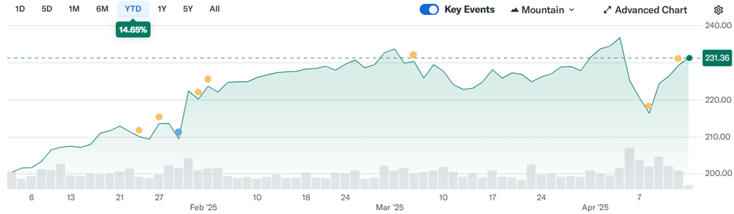

Slide 18
Strong Financials Drive Stability
Revenue Growth: 2024 revenue [$20.06B] and the company is projecting EBITDA growth of 15% in 2025
Profitability: 18.8% operating margin compared to an industry average of 7% in 2024.
Valuation: 34 P/E ratio compared to an industry average of 30.
Dividend: pays 1.34% yield. Paid quarterly.

Slide 19
Why Buy Waste Management?
Competitive Advantages: Regulatory barriers prevent competitors from operating landfills [High costs, Regulatory hurdles, and Local pushback]. WM has a complex route system that their competitors can’t match.
Growth Drivers: Rising waste volumes, recycling demand and waste-to-energy initiatives. [Roughly 6% CAGR for industry through 2030].
Sustainability Focus: Making investment into automation, renewable gas, and ESG compliance to further innovation.
Resilience: The Stock is up 14.5% while the S&P is down nearly 8% for the year.
Consensus Support: average price target of $260.

Slide 20
A Safe Bet with Growth
Waste Management combines stability, growth, and sustainability. This is ideal for the SIM portfolio as it faces high volatility right now.
Risk: High debt [2.9 debt to equity]. However, this is below industry average.
Recommendation: Buy WM for its defensive qualities, consistent dividends, exposure to green trends, and its growth capabilities.
Target Price: Through our DCF, $270 [20% upside].
Size of position: 1.00%

Slide 21
Final recommendations
Stock | % Weight | Current Price | Recommendation | % Change | New Weight | Target Price | Upside/Downside
FedEx (FDX) | 3.12% | $210.45 | HOLD | N/a | 3.12% | $279.00 | 32.5%
Boeing (BA) | 3.09% | $159.28 | SELL | 150 bps | 1.59% | $149.07 | -6.41%
RTX (RTX) | 2.55% | $129.14 | HOLD | N/a | 2.55% | $150.21 | 16.3%
United (UAL) | 0.80% | $67.45 | SELL | 80 bps | 0.00% | $76.33 | 13.2%
Waste Management (WM) | 0.00% | $232.30 | BUY | 100 bps | 1.00% | $270 | 16.2%
S&P 500 Weight | New SIM Weight | Overweight/Underweight
8.47% | 8.26% | - 0.21%

Slide 22
Appendix

Slide 23
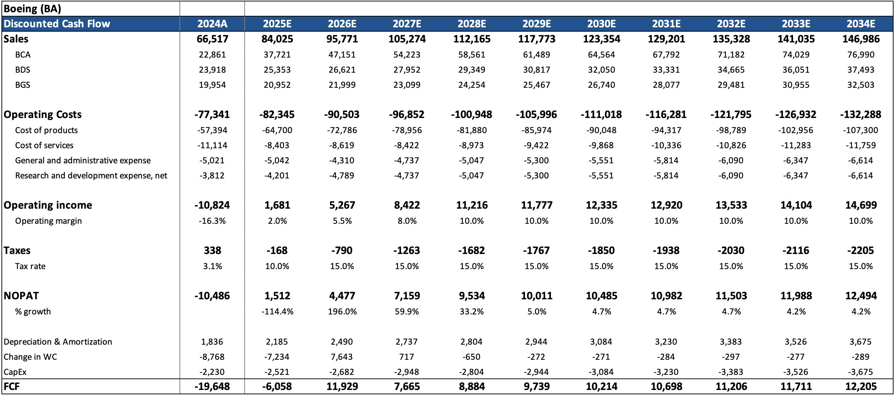
Boeing DCF

Slide 24
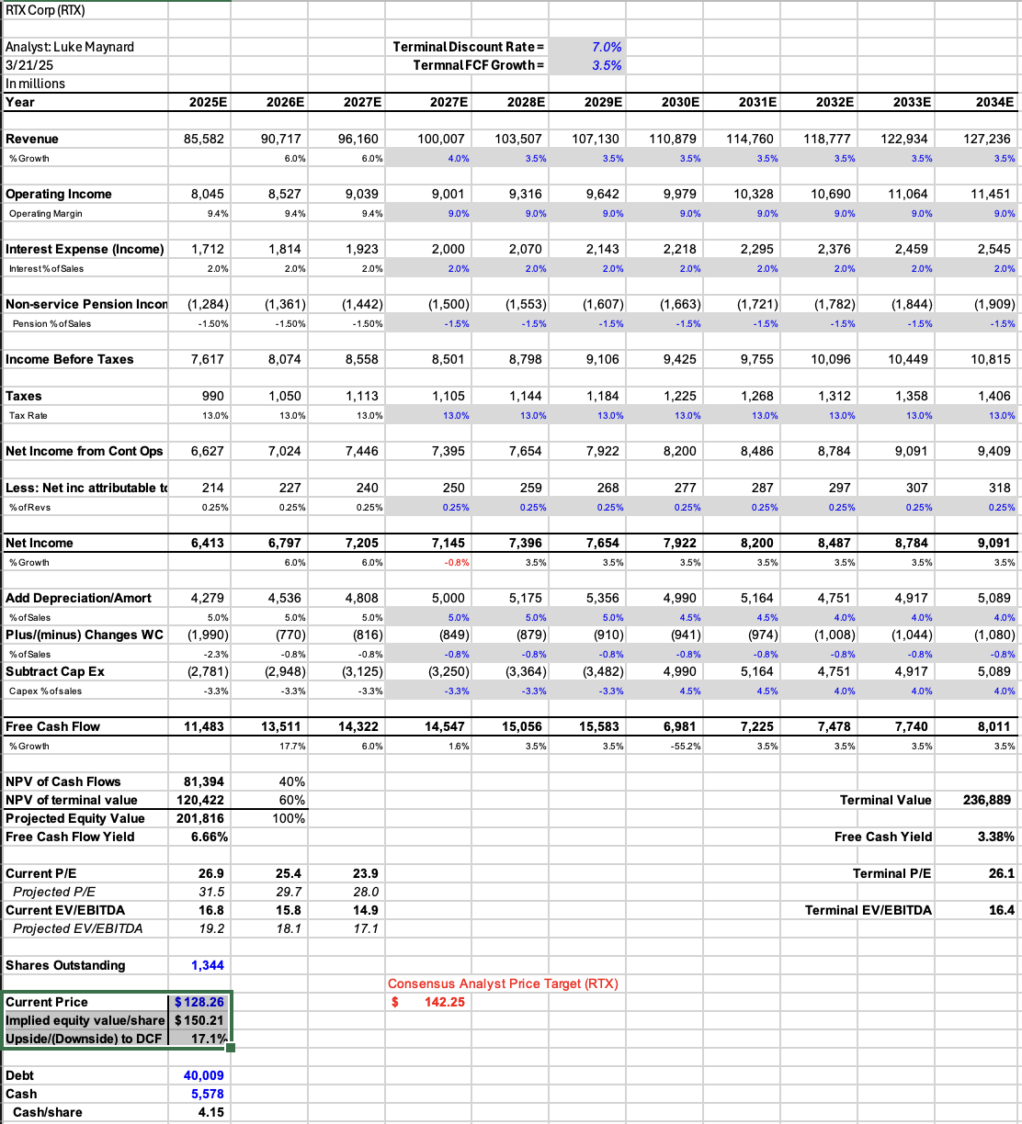
RTX DCF

Slide 25
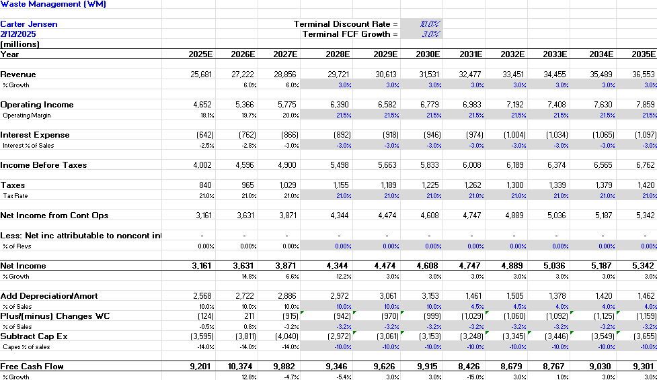
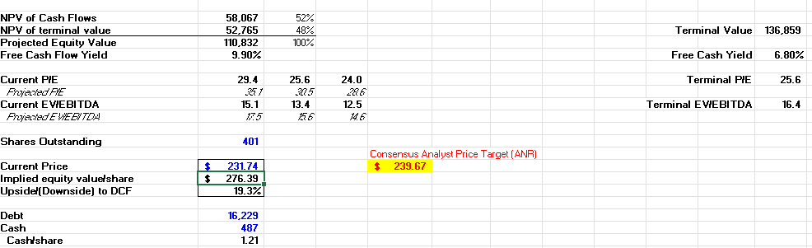
Waste Management DCF

Slide 26
United DCF

