Slide 1
Industrials Sector
Joe Hendrix, Manav Jain, Carter Jensen, Luke Maynard
Notes:
Hello everyone! This is our presentation on the Industrials sector recommendation. I'll start by introducing the team, beginning with myself—my name is Manav Jain.

Slide 2
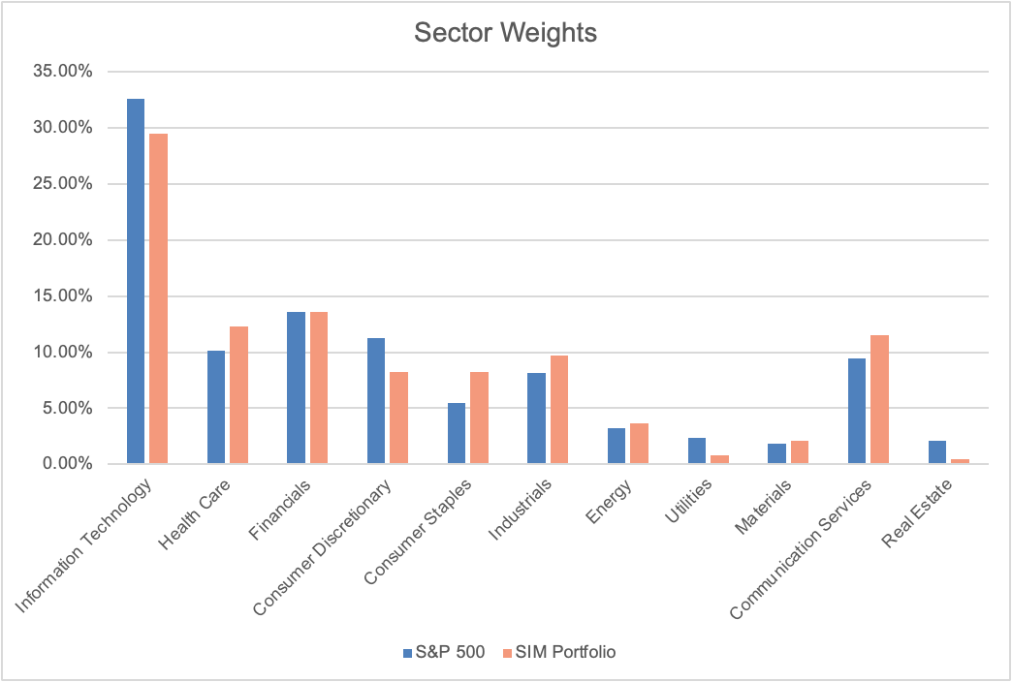
Overview
Sector Weight Comparison
Notes:
Here, we have a graph comparing the Industrials sector’s market cap against other sectors within the S&P 500, expressed as a percentage. It also shows the sector weightings in the SIM portfolio relative to the index. In some cases, like Financials, both the SIM and the index have similar weightings, whereas in IT, the SIM is underweight. For Industrials, however, the SIM is overweight, which is the key discrepancy we will analyze.

Slide 3






Overview
Notable Companies
Notes:
Diving deeper into the sector, the key leaders become clear. The largest Industrials by market cap include GE, Caterpillar, RTX, Union Pacific, and Honeywell. I’ve also included an honorable mention—Lockheed Martin—because, as we’ll see on the next slide, they play a major role in the cash flow-heavy Aerospace & Defense industry.

Slide 4
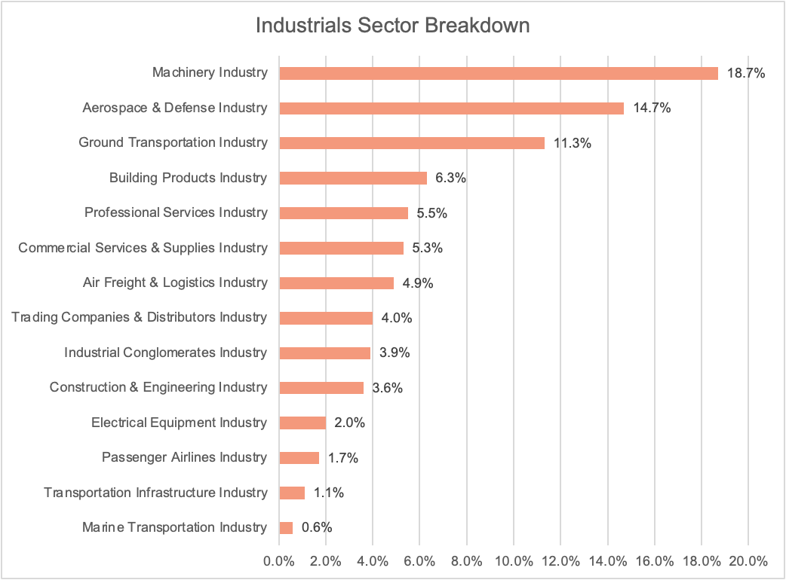
Overview
Sector Breakdown
Notes:
This graph breaks down the industries that exist within the Industrials sector. As we can see, the three largest industries are Machinery, Aerospace & Defense, and Ground Transportation. Machinery leads at around 20%, driven by heavy equipment manufacturers like Caterpillar, who are essential to mining and infrastructure projects. Aerospace & Defense follows at around 15%, supported by companies like Lockheed Martin and RTX, which benefit from government contracts and defense spending. Ground Transportation accounts for about 11%, reflecting the importance of rail and freight services, with Union Pacific as a key player in this space. Now, let’s take a look at how these industries contribute to the sector’s overall returns.

Slide 5
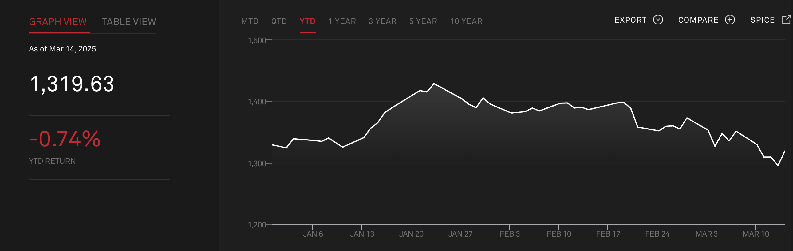
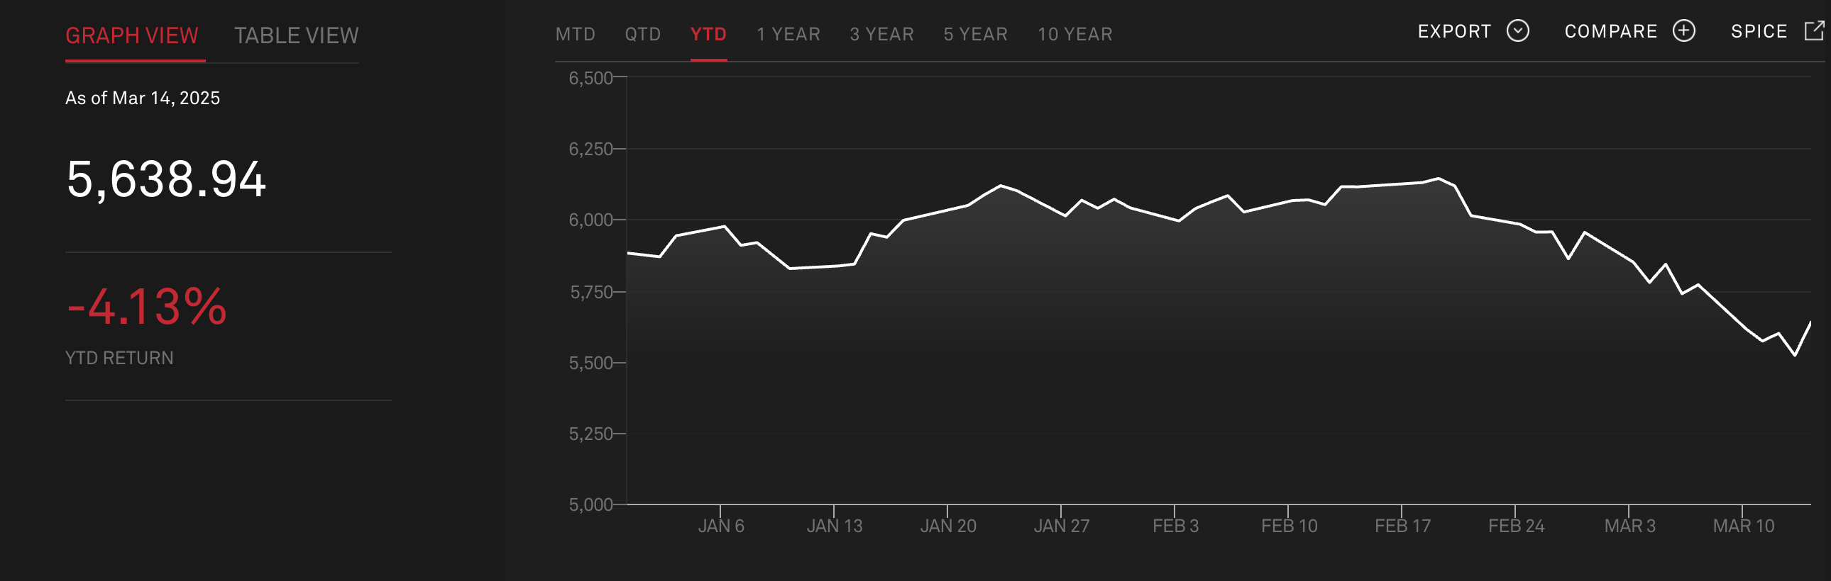
YTD/QTD Returns
  Industrials sector YTD/QTD return of -0.74% has outperformed the broader S&P 500 at -4.13%.
  Industrials showed some stability despite its cyclical nature, likely due to strong defensive segments like aerospace and defense.
  The sector’s relative strength highlights its role in economic cycles and infrastructure demand.
  We are in the first quarter, so YTD and QTD are the same.
Notes:
Looking at year-to-date returns, the Industrials sector has outperformed the broader S&P 500. Industrials are down -0.74%, while the S&P 500 has declined -4.13%. This relative strength highlights the sector’s ability to hold up better during market downturns, likely due to its exposure to more defensive industries like Aerospace & Defense. Additionally, Industrials tend to play a crucial role in economic cycles and benefit from infrastructure demand, which provides stability even in uncertain conditions. Note that since we are still in the first quarter, YTD and QTD returns are the same. Now, I will pass it on to Carter to do the business analysis.

Slide 6
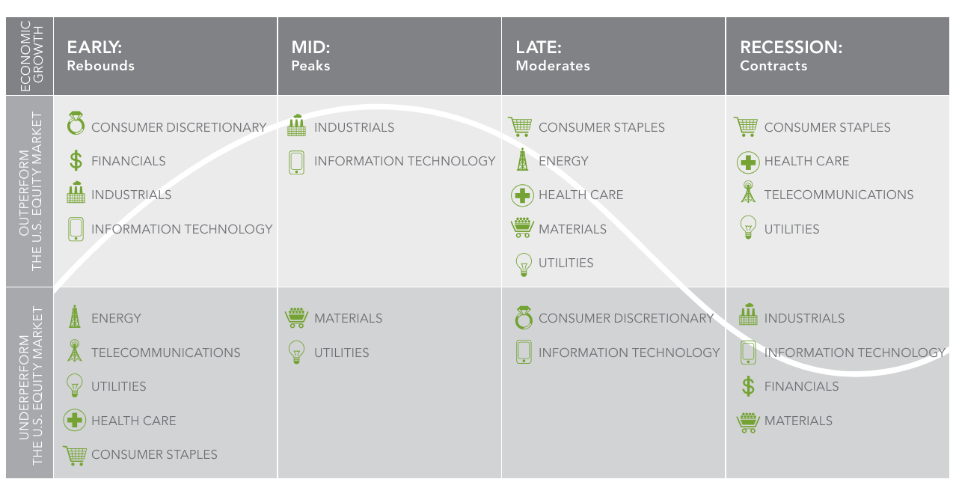
Business Analysis
Life Cycle
  Industrials are very cyclical.
    Reliant on high spending and consumer confidence
  Factors that can also determine performance
    Government Spending
    Technological advancements
    Commodity Prices
    Environmental Regulations

Slide 7
Business Analysis
Input/output
Within the Industrials Sector
  Very interconnected and the various industries in the sector heavily rely on each other.
Between other sectors
  Very interconnected as the sector provides a lot of resources to other sectors.

Slide 8
Business Analysis
Supply/capacity additions
  Supply Trends are currently mixed.
    Manufacturing has been expanding rapidly since 2022, and more capacity is currently under construction
    Supply chain issues from 2020 have eased but some remain.
    The current tariff fiasco leaves a lot of industrial companies unsure about future trends as they import many goods used in their businesses.
Capacity additions.
    General Electric Aerospace – investing $1 billion into their leap engine in 2025
    Intel – Invested around $20 billion into a new manufacturing facility here in Columbus.

Slide 9
Business Analysis pricing and profitability
Ease of Entry
  Extremely Low
Strength of Suppliers
  High
Competition
  Very High
Substitutes
  Low

Slide 10
Economic Analysis
Regression Analysis of three key economic indicators over the last 10 years
GSCPI
Global Supply Chain Pressure Index
U.S. GDP
Monthly real GDP data
U.S. Trade Balance
Monthly Exports less Imports

Slide 11
GSCPI
Regression Analysis
  GCPI measures 27 variables used to gauge the current pressures on the supply chain, i.e.
    Cost of shipping materials
    Backlogs
    Delivery times
  High GCPI indicates more pressure
  Current GCPI is at -0.07 st. deviations
Adj R² = .011

Slide 12
U.S. GDP
Regression Analysis
    Monthly GDP measures the total market value of goods and services produced within the U.S. every month
    Very high correlation with the price of the industrial sector
    GDP in Dec was $23.482 trillion

Slide 13
U.S. Trade Balance
Regression Analysis
    U.S. imports have exceeded exports every month since 1975
    May seem counterintuitive, but inexpensive imports fuel industrials
    Deficit rose sharply to 131.38 billion in January

Slide 14
Financial Analysis

Slide 15
Financial Analysis

Slide 16
Financial Analysis

Slide 17
Financial Analysis

Slide 18
Financial Analysis

Slide 19
Absolute Valuation
Valuations have come down since their peak in November
However, valuations remain slightly above their 10-year average
Increase in valuation began in Q3 of 2022, like the S&P 500 as a whole
P/S | 2.5x
P/E | 22.3x
P/B | 5.7x
P/CF | 17.4x

Slide 20
Relative Valuation
Compared to the S&P 500, the industrials sector is slightly more expensive
However, relative valuation is in line with the 10-year average
Relative valuation has stayed the same through pullback seen last week
P/S | 0.86
P/E | 1.06
P/B | 1.31
P/CF | 1.14

Slide 21
Industry Valuation
Industry | P/E
Commercial services | 31.9x
Professional services | 24.9x
Construction/engineering | 24.8x
… | …
Aerospace & defense | 17.2x
Air freight & logistics | 17.0x
Passenger airlines | 6.2x
Service based industrial companies trade at a premium
Airline related industries are out of favor
Passenger airlines especially trade at steep discount (Delta and United are the only industrial companies trading below 10x)

Slide 22
Recommendation
Instead of a broad scope, selective weighting in resilient industries like special machinery or infrastructure stocks allows for upside while mitigating risk.
The Industrial sector has shown relative stability but still lags the S&P 500 in key financial metrics like revenue growth and margins.
The sector’s mid-to-late cycle positioning present potential challenges, even as GDP growth is expected to improve.
Considering the SIM current overweight position in Industrials (9.66% vs. 8.13%), a slight reduction in exposure may payoff.
Notes:
Based on our analysis, here’s our recommendation. While the Industrials sector has shown relative stability, it continues to lag behind the S&P 500 in key financial metrics like revenue growth and margins. Furthermore, the sector’s mid-to-late cycle positioning brings potential headwinds, even with expected GDP growth. Given that the SIM portfolio is already overweight in Industrials at 9.66% compared to the 8.13% weighting in the S&P 500, a slight reduction in exposure could be beneficial. Instead of broad exposure, we recommend a more selective approach, focusing on resilient industries like specialized machinery or infrastructure stocks. Adding to positions in CAT or Honeywell and being cautious with other Industrial companies could provide upside while managing risk

Slide 23
THANK YOU
Questions?

