Slide 1
Healthcare Stock Selection
Pranav Vallam, Vik Visurakapalli, Adrian Tucker, Tyler Winzeler, Benjamin Ye

Slide 2
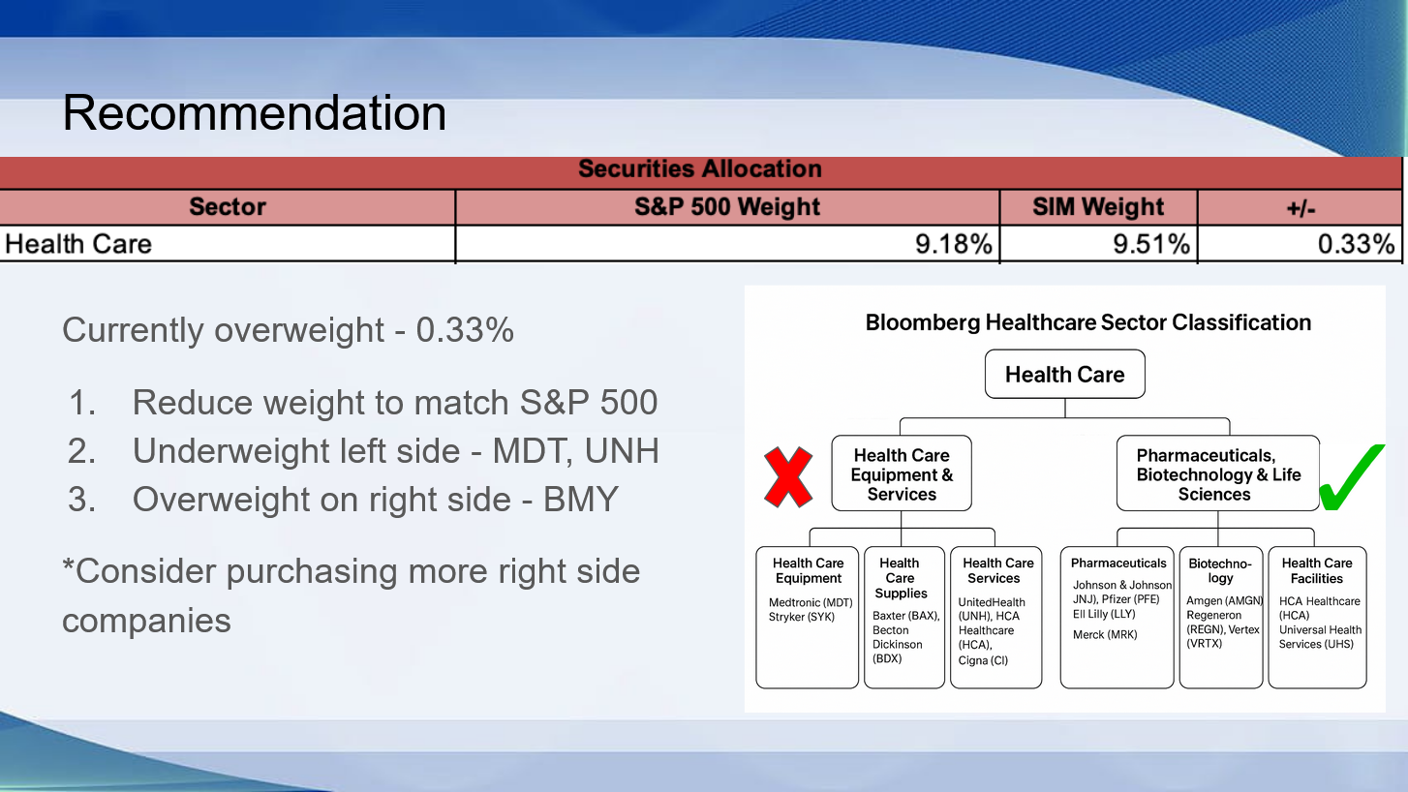
Sector Presentation Recap

Slide 3
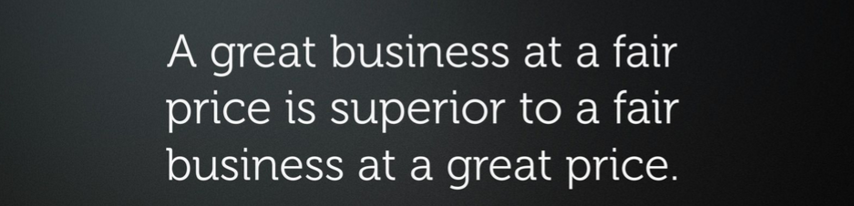
Stock Selection Philosophy

Slide 4
Assumptions
Forecast FCF 2 Years
Apply FCF Exit
Discount Everything by WACC
FCF
As a starting point, we used Bloomberg’s estimate for FCF over the next 2 years as a starting point, then tweaked it depending on what we thought was reasonable
Efficiency
Instead of trying to forecast 10 years or using a perpetual growth rate, we decided to use a FCF exit with some P/FCF. This makes the DCF and valuation more efficient
WACC
Because we are only forecasting 2 years, the discount rate doesn’t have too much effect. However, we discounted everything at WACC and did a sensitivity table for the FCF exit and the Discount rate

Slide 5
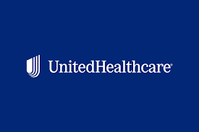
Medtronic (MDT)
Company Overview, Financial Analysis, DCF Model, Recommendation

Slide 6
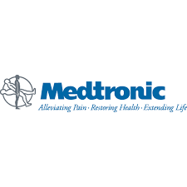
MDT SIM Review (Nov)
Symbol | Value | Total Cost | Gain/(Loss) | Weight
MDT | $233,832.60 | $177,275.58 | ($56,557) | 2.32%

Slide 7
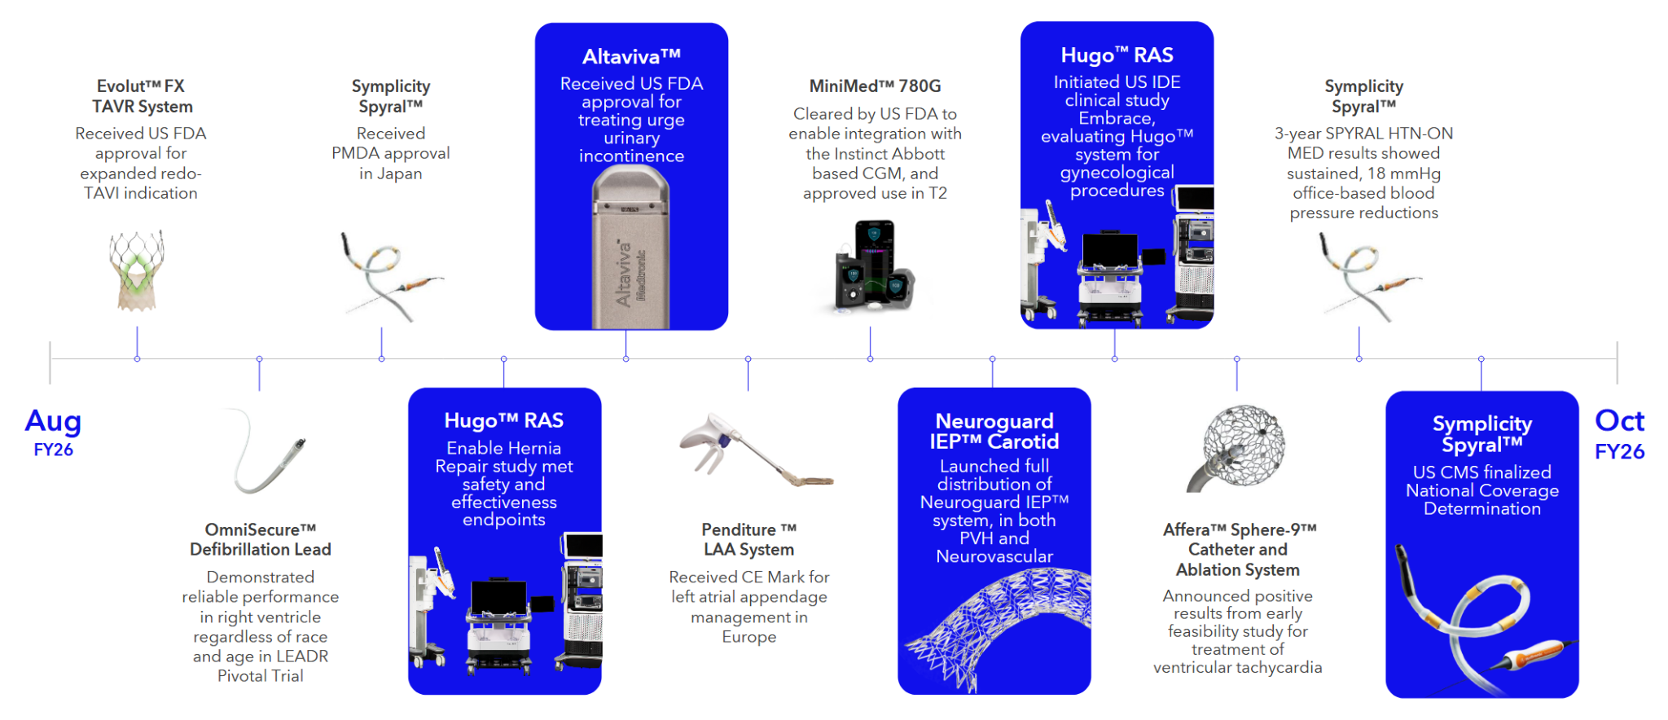
Medtronic (MDT) Overview
MDT is a Global leader in Medical devices, serving cardiovascular, neuroscience, surgical, and diabetes markets
Primary Sales Channel is typically hospitals, surgical centers, and healthcare providers, not directly to patients

Slide 8
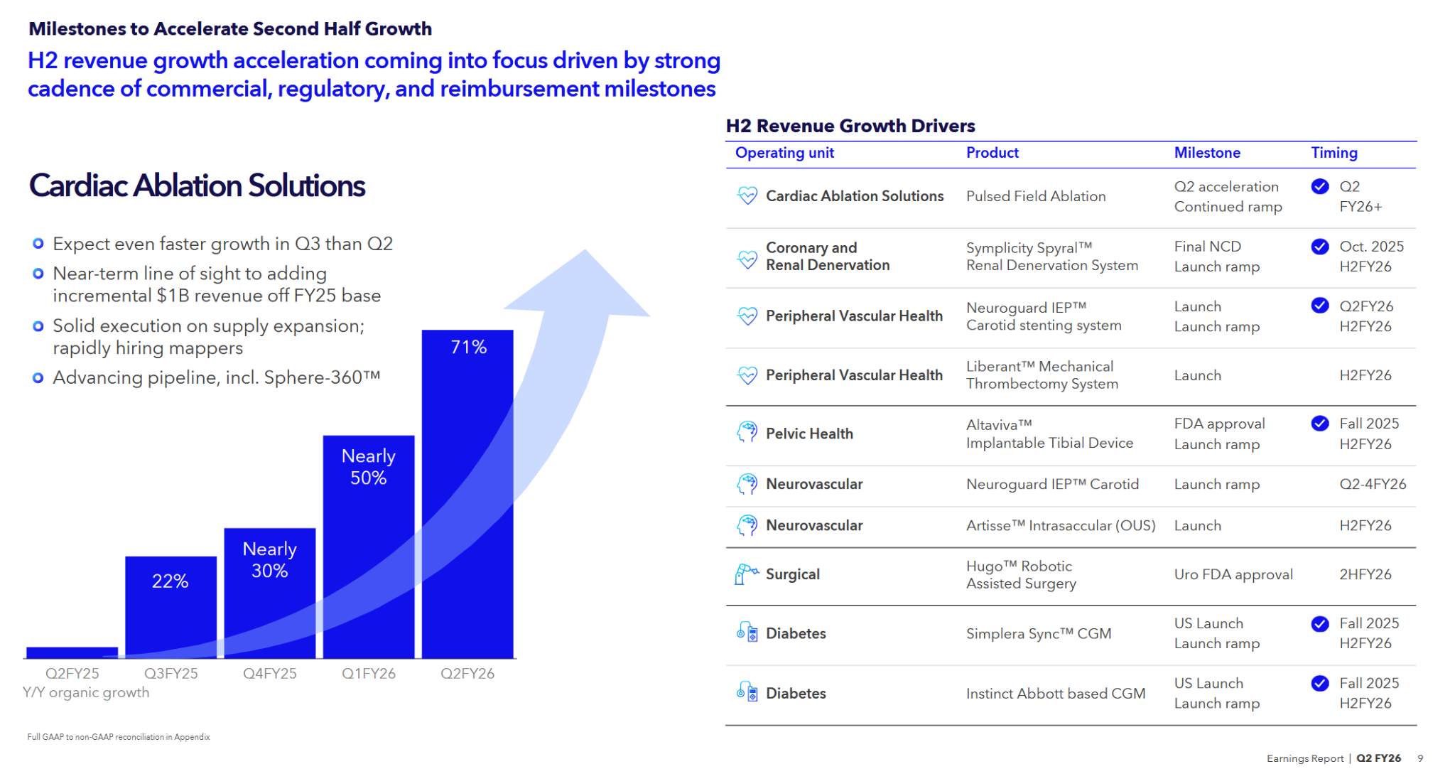
Medtronic (MDT) Growth Drivers
MDT is a Global leader in Medical devices, serving cardiovascular, neuroscience, surgical, and diabetes markets
Primary Sales Channel is typically hospitals, surgical centers, and healthcare providers, not directly to patients

Slide 9
Competitor Analysis
Company | Core Focus Care | Key Competitive Strengths | Weaknesses/ Risks | Differentiation vs MDT | Valuation/ Growth
Medtronics | Cardiovascular, Diabetes, Surgical, Monitoring | Broadest Portfolio, global distribution, strong R&D | Slower Growth vs peers, complex portfolio, regulatory lag | Scale + breadth, not as specialized or fast moving as peers | Among cheaper valuations: reflects a mature diversified business with stable growth
Abbott | Diagnostics, vascular, structural heart, diabetes | Large diagnostics business, diversified, strong diabetes tech | Device segment smaller vs MDT. Diagnostic cyclicality | Diagnostic + consumer health strength, less reliant on implantables | Higher valuation/ growth then ABT: reflects higher expectations for diagnostics/ product base
Boston Scientific | Interventional cardiology, peripheral, neuromodulation, endoscopy | Fast innovator, strong M&A execution, high growth areas | Smaller scale, less diversified, some categories highly competitive | Focused procedural specialist, more agile than MDT | Growth narrative due to higher expected procedural growth, innovations, and M&A potential

Slide 10
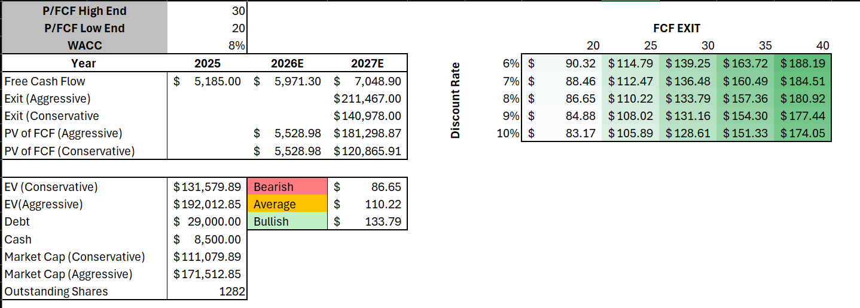
Consensus DCF

Slide 11
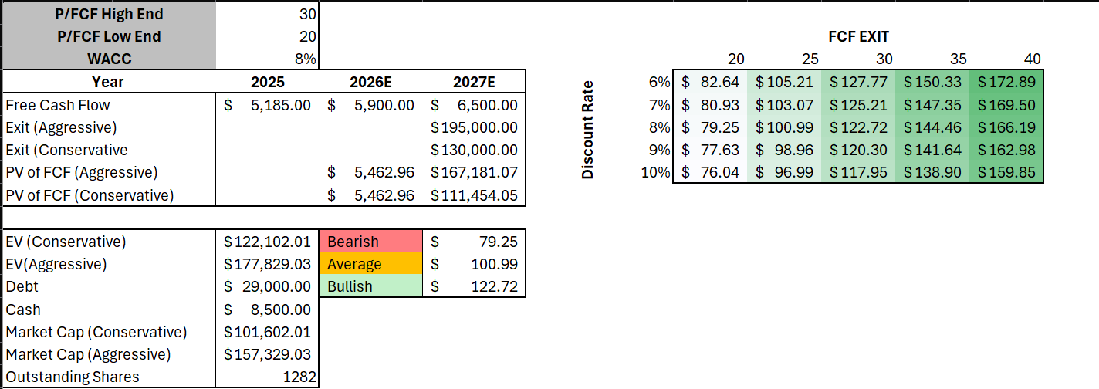
Forecasted DCF: Selective Buy around $90 to $99
Expecting lower FCF than expectations (due to competitive nature of business)
P/FCF exit of around 25 as a base: lower than competitors and around the range where P/FCF has remained

Slide 12
United Healthcare
(UNH)
Company Overview, Financial Analysis, DCF Model, Recommendation

Slide 13
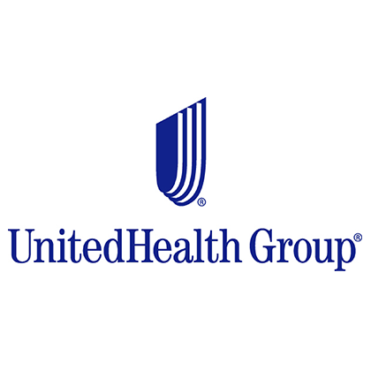
UNH SIM Review (Nov)
Symbol | Value | Total Cost | Gain/(Loss) | Weight
UNH | $329,770.00 | $457,244.92 | ($127,475) | 3.27%

Slide 14
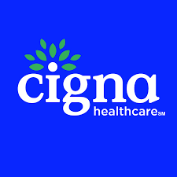
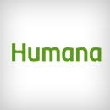
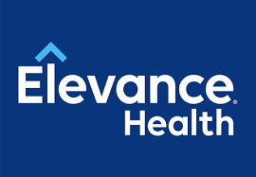
UNH Overview
UnitedHealthcare (UNH) vs. Competitors [Cigna (CI), Humana (HUM), Elevance Health (ELV)]
UnitedHealthcare (UNH): Health Insurance + Health Services (Optum)
  Pros: Massive scale, Optum creates a competitive price moat.
  Opportunities: Aging population, rising chronic diseases.
  Challenges: Regulatory scrutiny, medical cost volatility.
Competitors: Health insurance providers & diversified health service companies
  Humana (HUM): Second largest, specializes in Medicare Advantage.
  Cigna (CI): Owns largest PBM, competes with OptumRx.
  Elevance Health (ELV): Strong regional presence via Blue Cross Blue Shield.

Slide 15
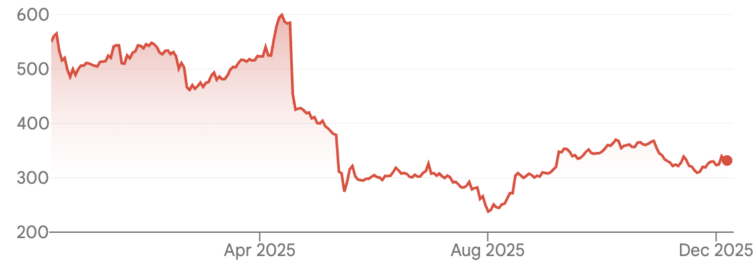
UNH Business Analysis
Key Business Drivers
●Economic: Defensive stability, healthcare spending trends
●Supply/Demand: Aging demographics, chronic diseases
●Margin: Cost management, high-margin innovation (Optum)
UNH Stock Performance
●1-Year Performance: -39.79% due to Medicare Advantage pricing challenges, DOJ scrutiny, and executive leadership changes
●Technical Analysis: Recent uptrend but momentum has slowed and stock is trading near support
UNH 1-yr Performance
1-yr return = -39.79%

Slide 16
UNH Financial Analysis
Key Takeaways
P/E
UNH trades at premium due to scale, vertical integration, and consistent long-term growth
UNH Compared to Competitors
Competitors are more value priced but due to lower growth visibility, margin pressures, and ongoing regulatory risks there is uncertainty.
Investors are willing to pay more for UNH’s stability and diversified growth drivers.
Ticker | P/E | P/S | P/B | P/CF | EV/ EBITDA
UNH | 17.5 | 0.8 | 4.6 | 17.0 | 12.4
CVS | 11.2 | .03 | 1.1 | 6.5 | 7.5
CI (Cigna) | 12.0 | .4 | 1.6 | 7.0 | 8.0
HUM (Humana) | 16.8 | .6 | 2.5 | 11.0 | 11.5
ELV (Elevanve) | 14.8 | .7 | 3.0 | 10.0 | 10.5
Average | 13.7 | .6 | 2.2 | 8.6 | 9.4

Slide 17
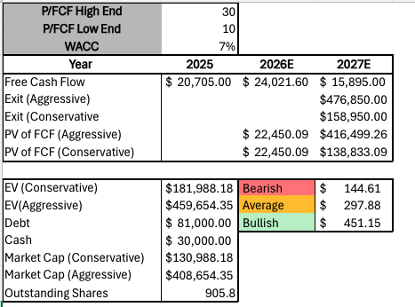
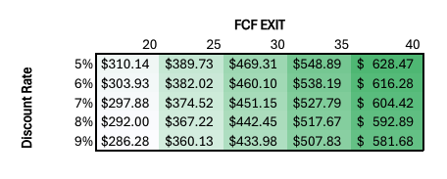
UNH Consensus DCF
Key Model Inputs
WACC: 7%
Exit Multiple (P/FCF): 30×
2027 Free Cash Flow: ~$15.895B
Shares Outstanding: ~905.8M
What This Means
Valuation reflects:
  Valuation range is highly sensitive
  Varied expectations
  Long-term growth
Indicates the stock is currently trading near “average”

Slide 18
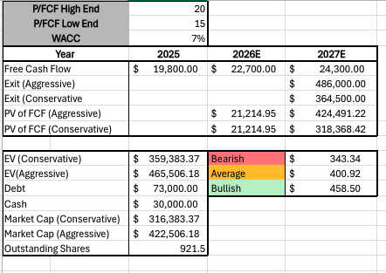
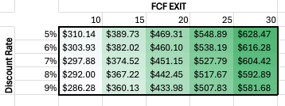
UNH Forecasted DCF
Key Model Inputs
WACC: 7%
Exit Multiple (P/FCF): 20× (conservative)
2027 Free Cash Flow: ~$24,300B
Shares Outstanding: ~921.5M
What This Means
Valuation reflects:
  Narrower range
  Positive expectations
  Long-term growth
Indicates the stock is currently trading slightly below intrinsic value

Slide 19
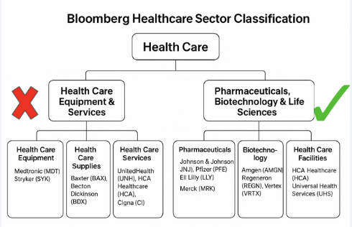
UNH Recommendation SELL
High Regulatory Risk
UNH faces intense, ongoing regulatory and legal scrutiny (DOJ)
Antitrust Concerns
UNH is both a provider (Optum) and Payer (UnitedHealthcare)
Solution
Reallocate to Pharmaceuticals/Biotechnology
(To be discussed)

Slide 20
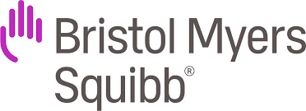
Bristol Myers Squibb
(BMY)
Company Overview, Financial Analysis, DCF Model, Recommendation

Slide 21
BMY SIM Review (Nov)
Symbol | Value | Total Cost | Gain/(Loss) | Weight
BMY | $428,040 | $522,892.73 | ($94,853) | 4.24%

Slide 22
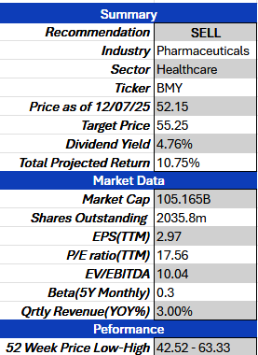
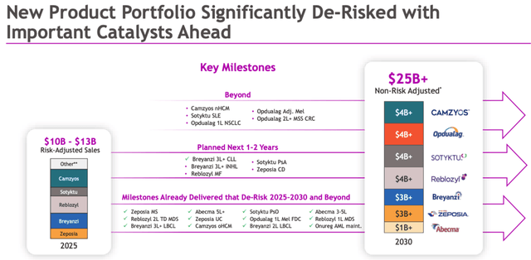
Overview
Bristol-Myers Squibb Company is a global biopharmaceutical company. The Company develops, manufactures, and sells pharmaceutical and nutritional products.
Focuses on products and experimental therapies address cancer, heart disease, diabetes, and psychiatric disorders.

Slide 23
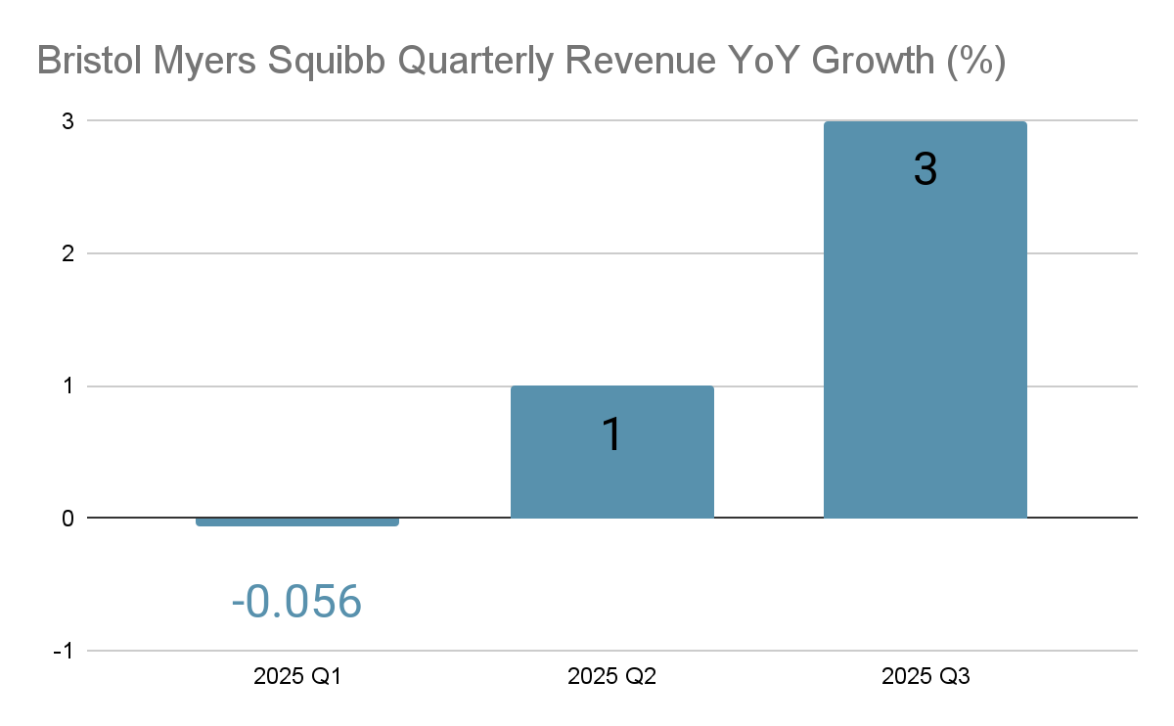
Problems with BMY
Q1 2025: Revenue decreased by 5.6% largely driven by lower acquired IPR&D expenses in 2025.
Q3 2025: Revenue increased by 3%
Overall, BMY hasn’t been as productive as its other competitors .

Slide 24
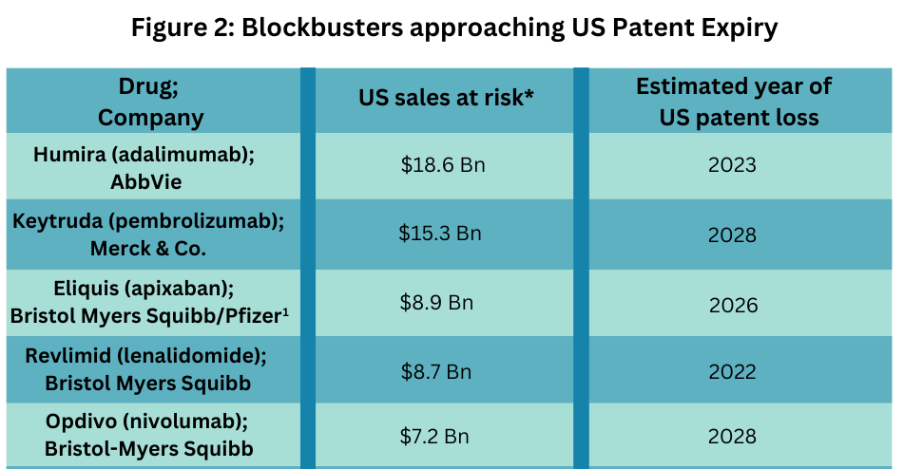
Problems with BMY
Relative valuation: Attractive P/E ratio
Undervalued - Lower P/E ratio suggests the stock might be undervalued and have a potential opportunity for future growth.
Pessimistic - Lower P/E suggest that the stock may have slow growth or there’s underlying risk.
Company | P/E(TTM) ratio
BMY | 17.56
Average | 20-21
Concerns: Patent expirations for major revenue drivers, including Eliquis (blood thinner) and Opdivo (cancer treatment), which are set to lose exclusivity later this decade.
This will result in a overall revenue decline

Slide 25

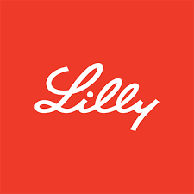

Competitor analysis
Company | Overview | Strengths | Weaknesses | Future Growth
AbbVie Inc | Research-based biopharmaceutical company that treats autoimmune diseases. | Strong base in immunology Skyrizi & Rinvoq | Reliant on new products to be successful to negate revenue erosion | Stable growth Driven by its immunology and neuroscience portfolios.
Eli Lilly | Develops, manufactures, and sells pharmaceutical products for humans and animals. | Leadership position in the fast-growing obesity and diabetes markets. Monjuaro & Zepbound | Revenue is highly contingent on GLP-1 drug class. | High Growth With Eli Lilly’s 2026 Drug Pricing & Access Expansion Allows medications used to treat obesity and diabetes more accessible
Johnson & Johnson | Engages in the research and development, and sale of a broad range of products in the healthcare field. | Diverse company that is organized into two business segments: Medicine and MedTech. | Faces ongoing patent cliffs and significant legal/regulatory challenges. | Modest steady growth

Slide 26
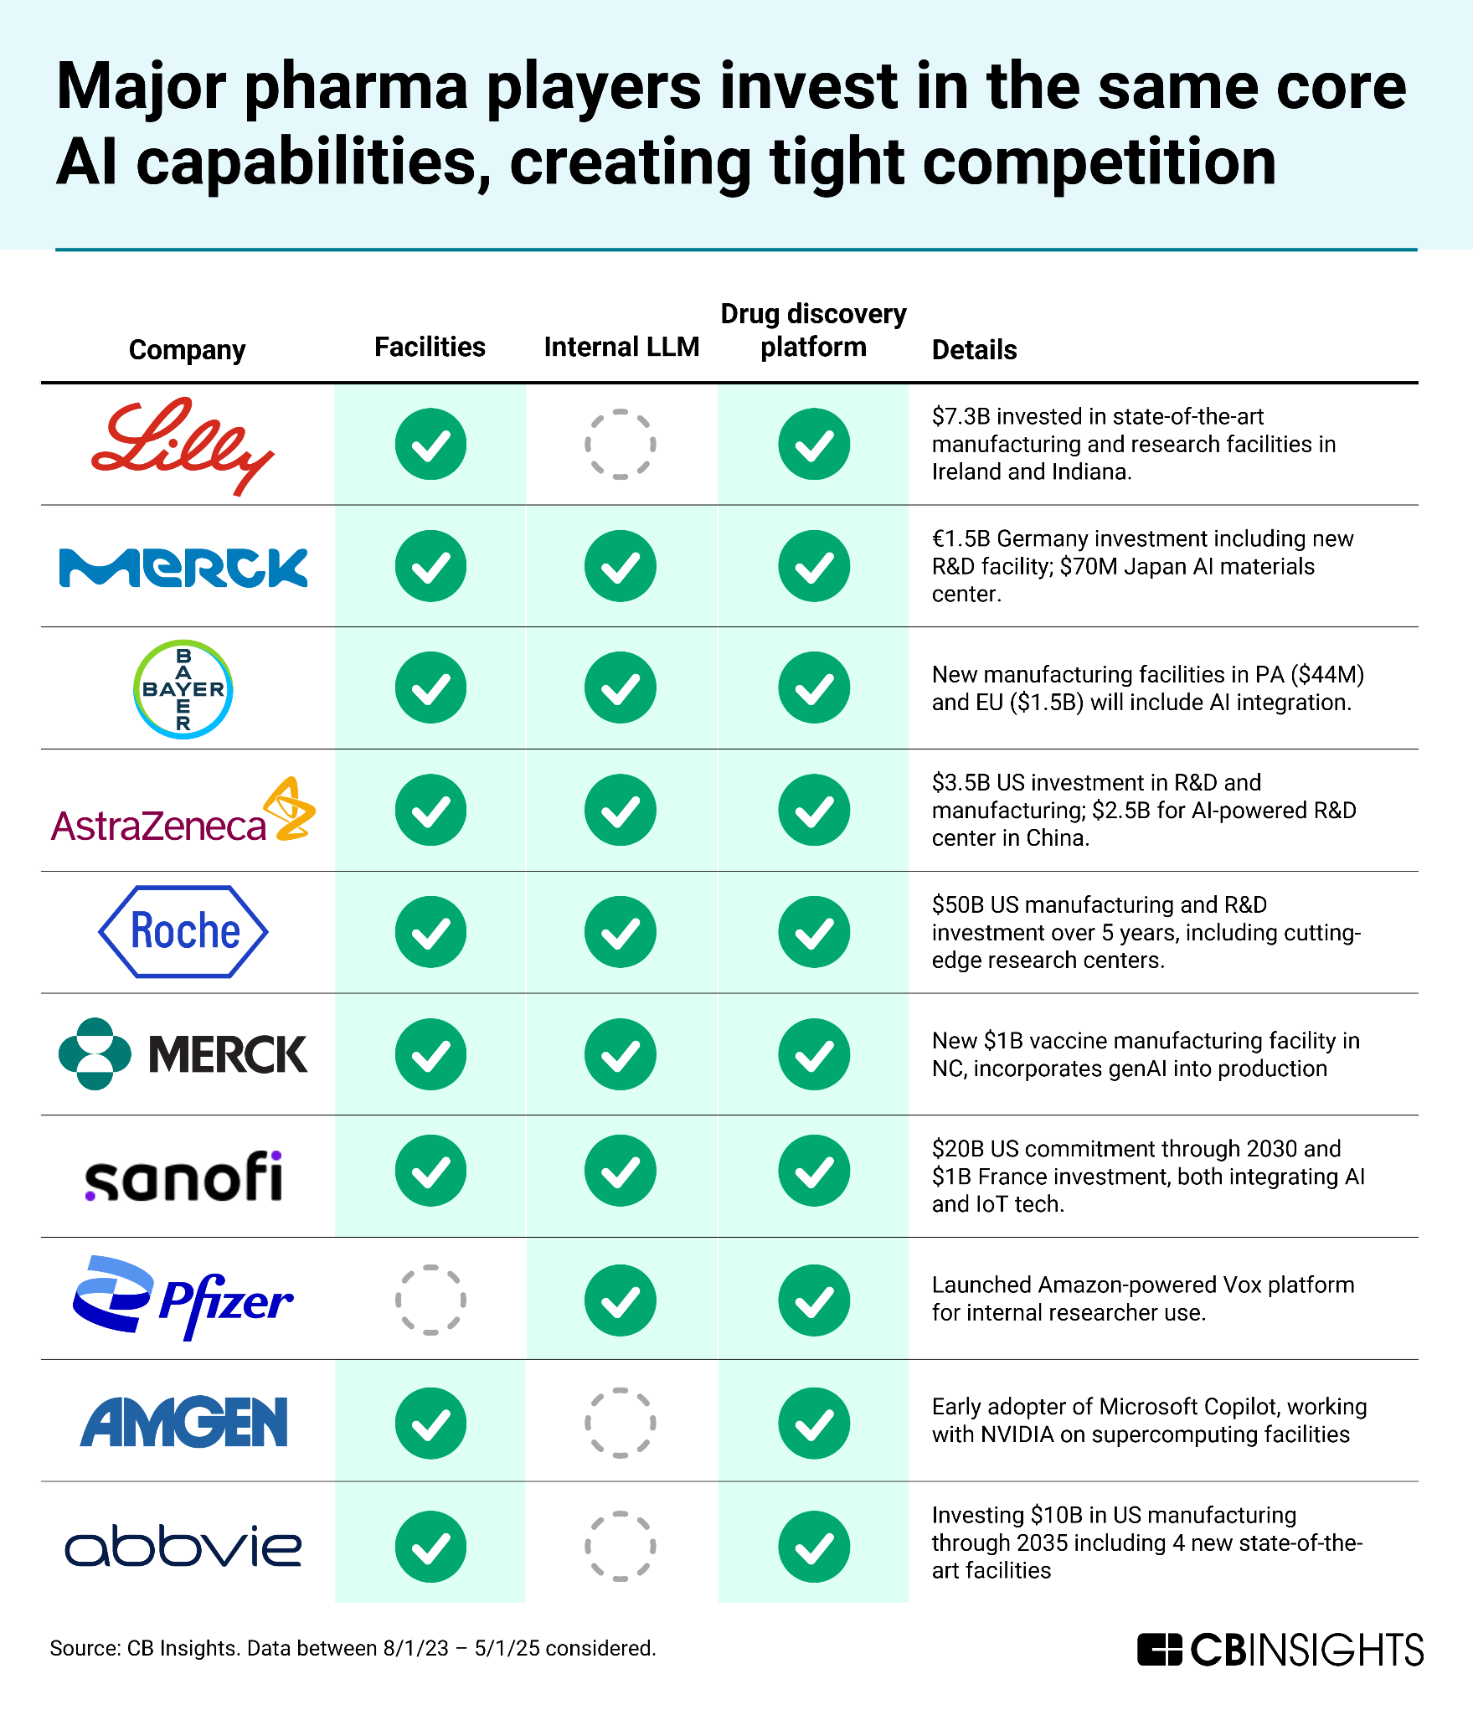
What makes a pharma company succeed long term?
Robust R&D Capabilities: The ability to develop new drugs to a market that is vital for long-term competitiveness
Effective Intellectual Property (IP) Management
Strategic Market Access and Commercialization (Sales)

Slide 27
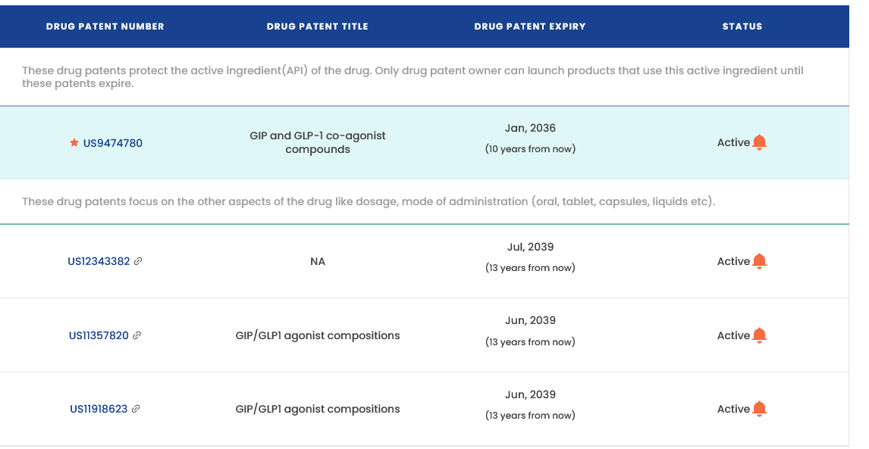
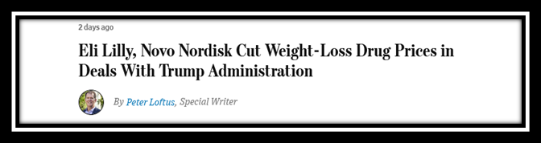
Eli Lilly proper substitute
Robust R&D Capabilities: Ranks among top pharma spenders with strong efficacy in their metabolic drugs.
Effective Intellectual Property (IP) Management: Eli Lilly’s patent on glp-1 drugs are set to expire 10 years from now
Strategic Market Access and Commercialization (Sales): Price cuts to glp-1 drugs will provide access for ~40 million Americans on government insurance

Slide 28
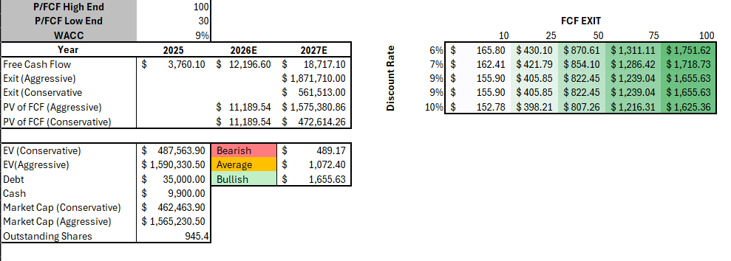
Consensus DCF
Current price: $995.45
Current P/FCF - 75

Slide 29
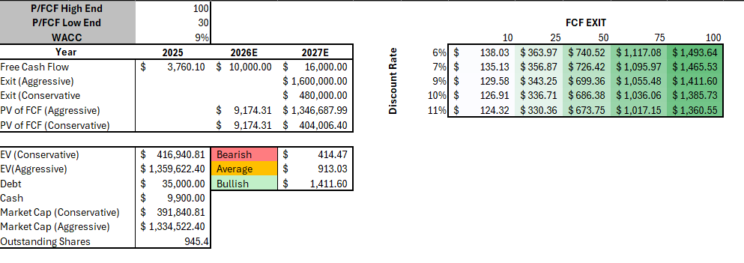
Forecasted DCF:
Bearish & Bullish < Current market price
Due to P/FCF varies a lot with the company

Slide 30

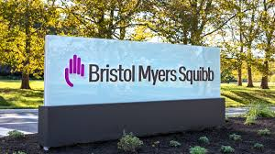
Recommendation for BMY
Recommendation: SELL
Substitute LLY
Why
BMY underperforming
LLY long-term growth strategy

Slide 31
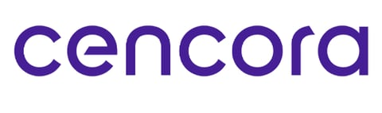
Cencora (COR)
Company Overview, Financial Analysis, DCF Model, Recommendation

Slide 32
Company Overview
Pharmaceuticals distributor
  Buy drugs from manufacturers and deliver to hospitals, pharmacies, clinics, etc.
Specialize in specialty pharmaceuticals
  GLP-1
  Cancer
  Cell and gene therapy
Operates one of the largest healthcare logistics networks in the country
  Investing over $1 billion in new U.S. distribution centers and infrastructure
Acquired 85% stake in Retina Consultants of America for ~$4.5 billion
  Doubling down on their specialty health care services

Slide 33
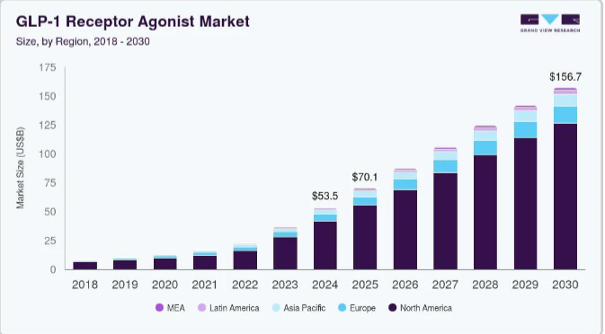
Specialty Healthcare Growth Trends
Specialty healthcare is the largest growing sector of healthcare
Over 30% growth from 2024-2025
Expected to over double by 2030

Slide 34
Competitor Analysis
Company | Business Focus | Competitive Strengths | Weakness/ Risks | Future Growth Plans | Projected Return
Cencora | Specialty drug-distribution, oncology network services | #1 in specialty drug distribution | Exposure to specialty drug reimbursement changes | Expand in specialty, global logistics, rare disease and cell/gene therapy | 15%
McKesson | Broad drug distribution, oncology networks | Largest market share in overall distribution | Drug pricing, thin margins, litigation risks | Grow in oncology and specialty, invest in data/tech | 15%
Cardinal Health | Drug distribution, large medical products segment | Strong hospital supply chain | Low margins, lower market share | Restructure medical segment | 7%

Slide 35
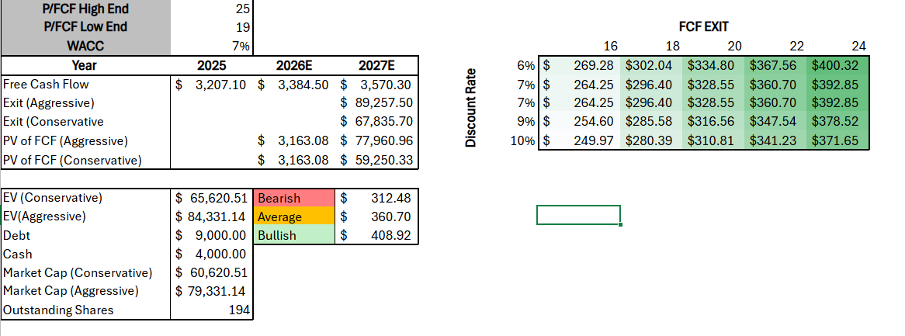
Consensus DCF
Current Price: $337.64
Current P/FCF ~21
Average consensus target price: $392 - 16% upside

Slide 36
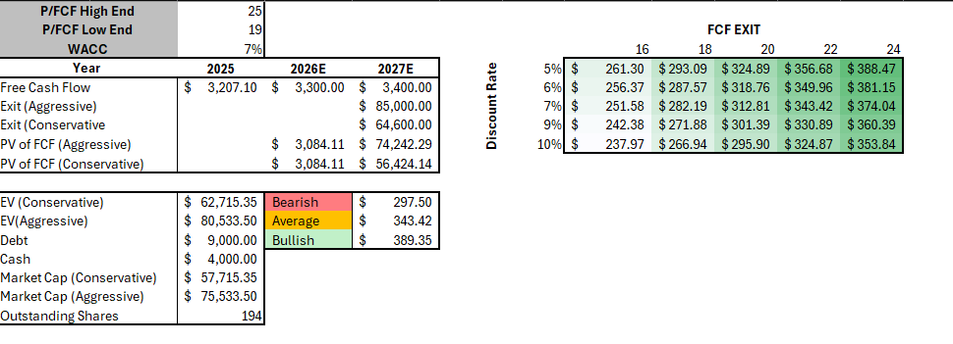
Forecasted DCF (Conservative)
Current Price: $337.64
Current P/FCF ~21
Average consensus target price: $392 - 16% upside

Slide 37
Recommendation BUY
I recommend to buy Cencora
#1 specialty pharmaceuticals distributor
  Specialty pharmaceuticals are the fastest-growing part of healthcare
  Far more profitable than regular pharmaceuticals
Best out of competitors
  Mckesson has the largest market share but their margins are razor thin.
  While McKesson is shifting to increase their exposure to specialty drugs, Cencora has already established that hold on the market. If McKesson were to overtake them in that field, it won’t be until years in the future.

Slide 38
Final Recommendation
Adjustments
BMY (Sell): -3.00%
LLY (Buy): +3.00%
UNH (Sell): -1.50%
COR (Buy): +1.50%
New Overall %
BMY: 1.24%
LLY: 3.00%
UNH: 1.77%
COR: 1.50%
MDT: 2.32%

