Slide 1
Healthcare
Sector
By: Griffin Turner, Annika Spoor, Larry Zhang, Kaihang Zhou, Jordan Cafiero

Slide 2

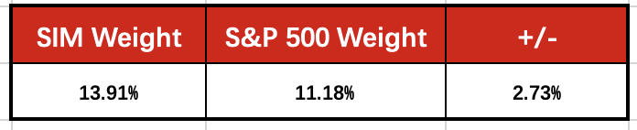
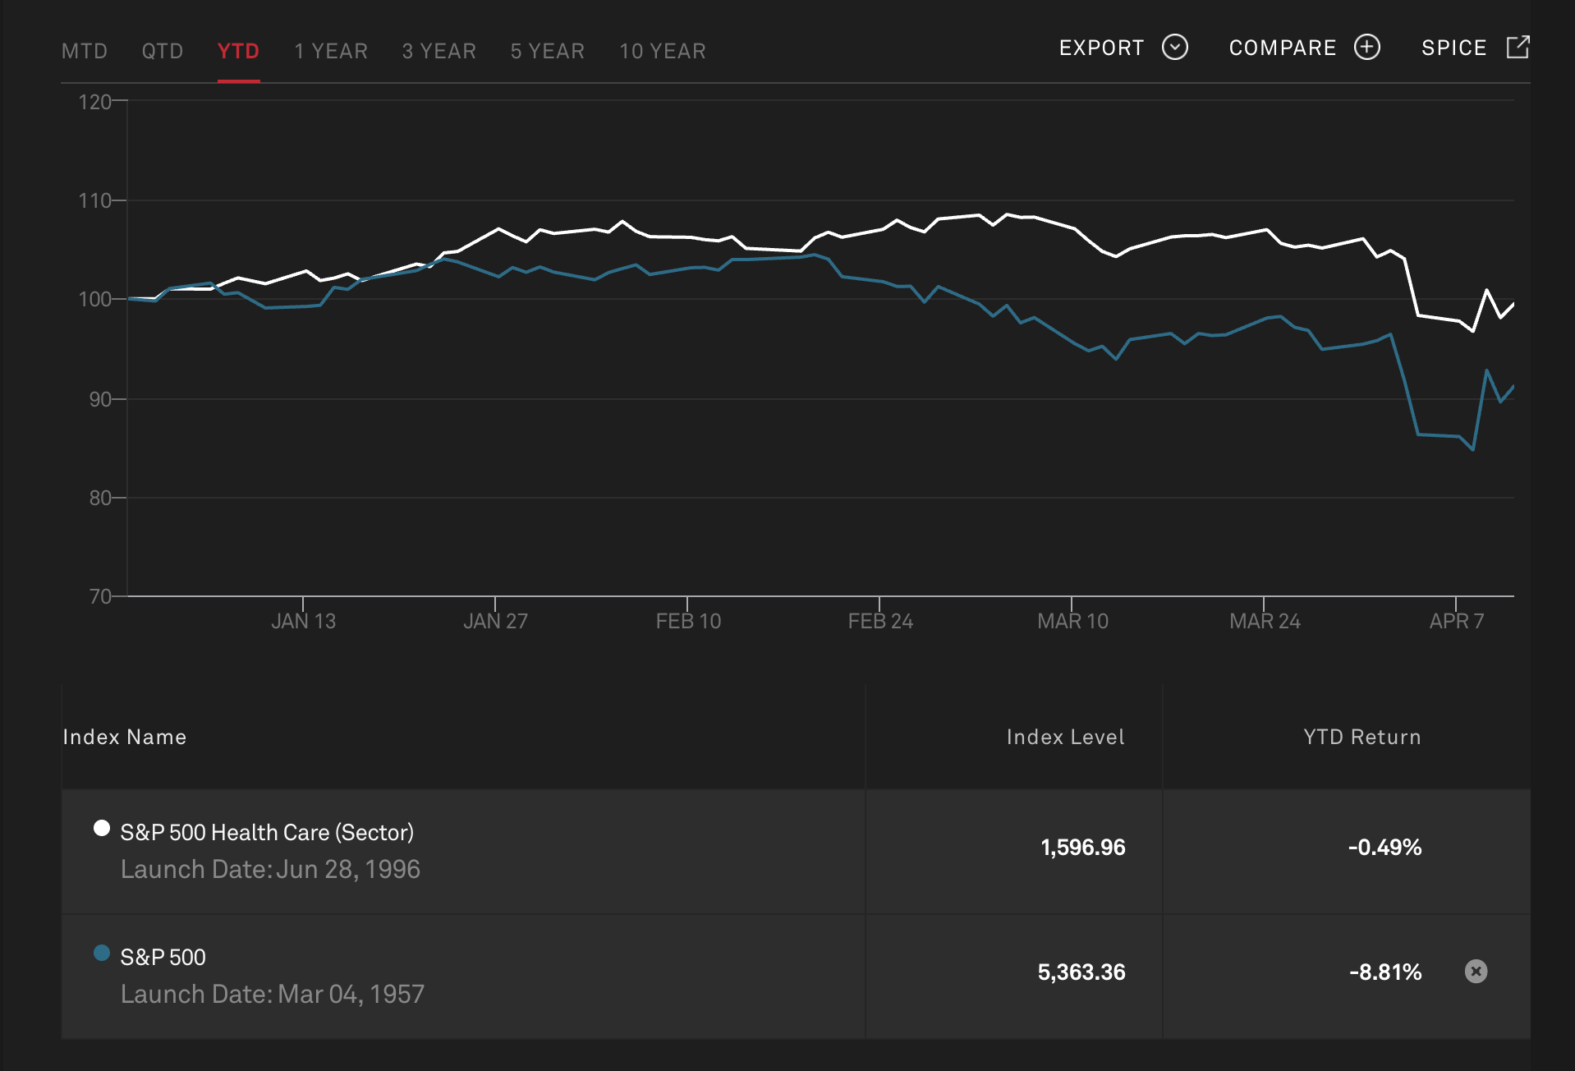
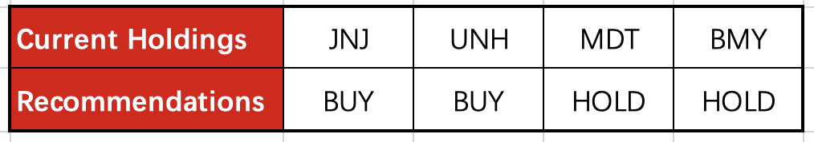
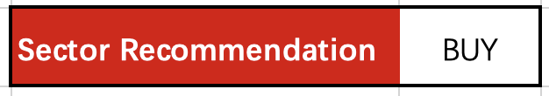
Sector Recommendation
The SIM portfolio is currently Overweight in the Health Care sector

Slide 3
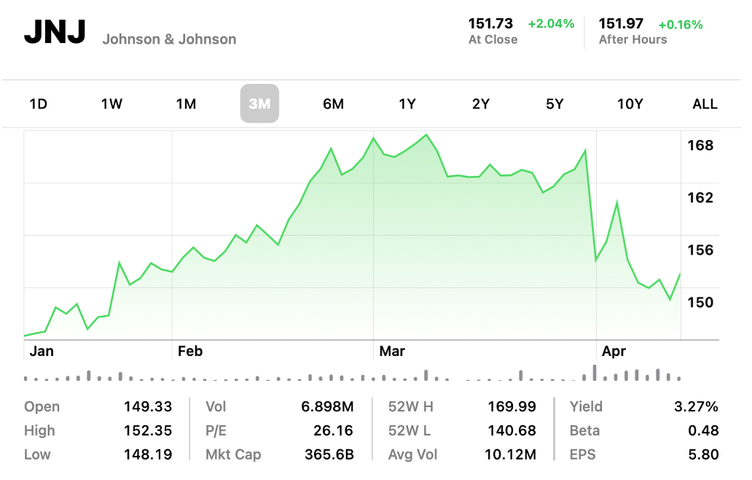
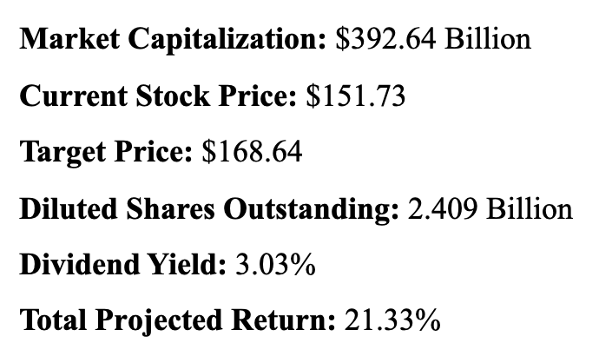
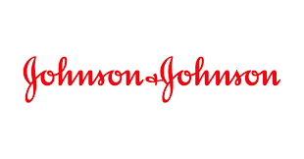
Johnson & Johnson (JNJ)
BUY

Slide 4
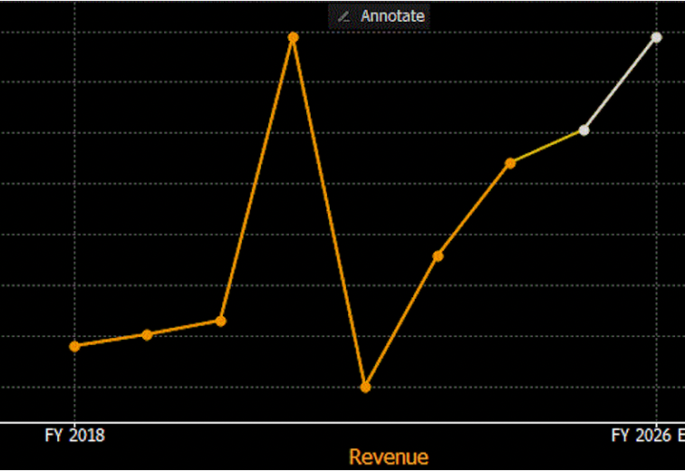
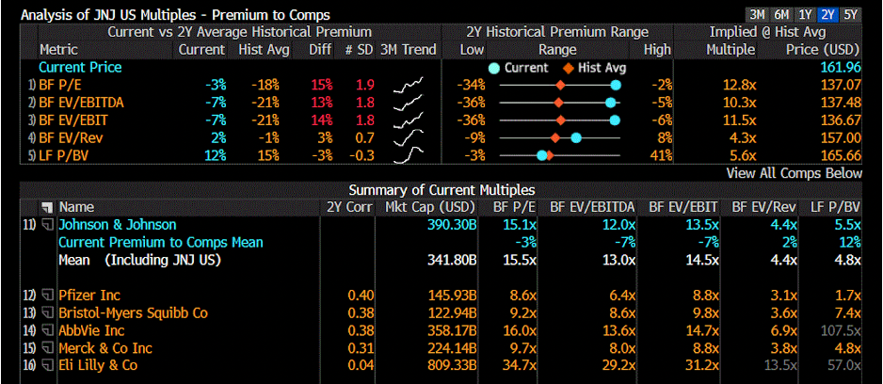
Financial Analysis - JNJ
• JNJ has beat or met earnings estimates 8 quarters in a row
• 2025-2026 outlook: Projected continued growth via biologics facility expansion, acquisitions, and a robust product pipeline
• Trades at a P/E of 15.1x, slightly below the industry average of 15.5x
• Ideal for long-term, risk-averse investors, though not as attractive for growth-focused ones

Slide 5
Valuation - JNJ
SIM
  Shares Owned: 660 Shares
  Unit Cost: $161.01
  Percentage Assets: 1.24%
  Lowest holding in healthcare
BUY
  +0.50%
  DCF calculates 27.1% upside
  Target price for JNJ is $168.64
  Favorable macroeconomic conditions

Slide 6
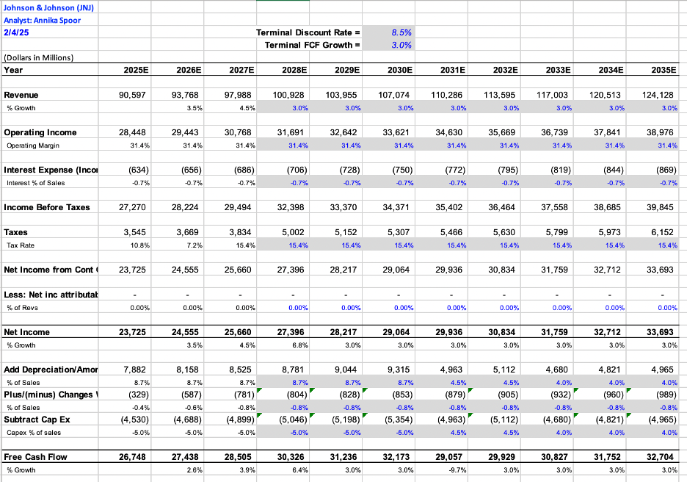
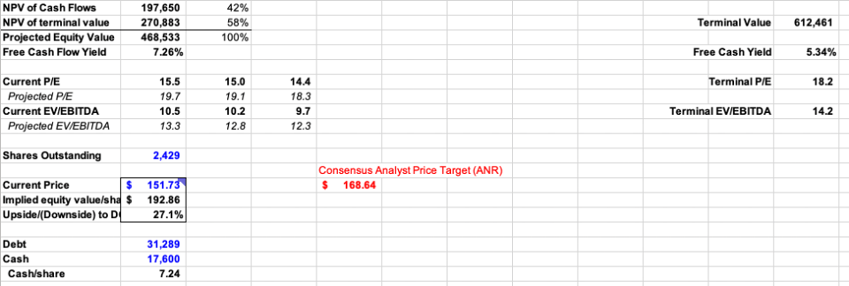
Discounted Cash Flow - JNJ

Slide 7
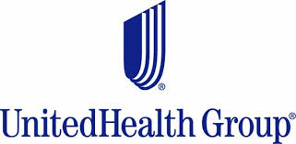
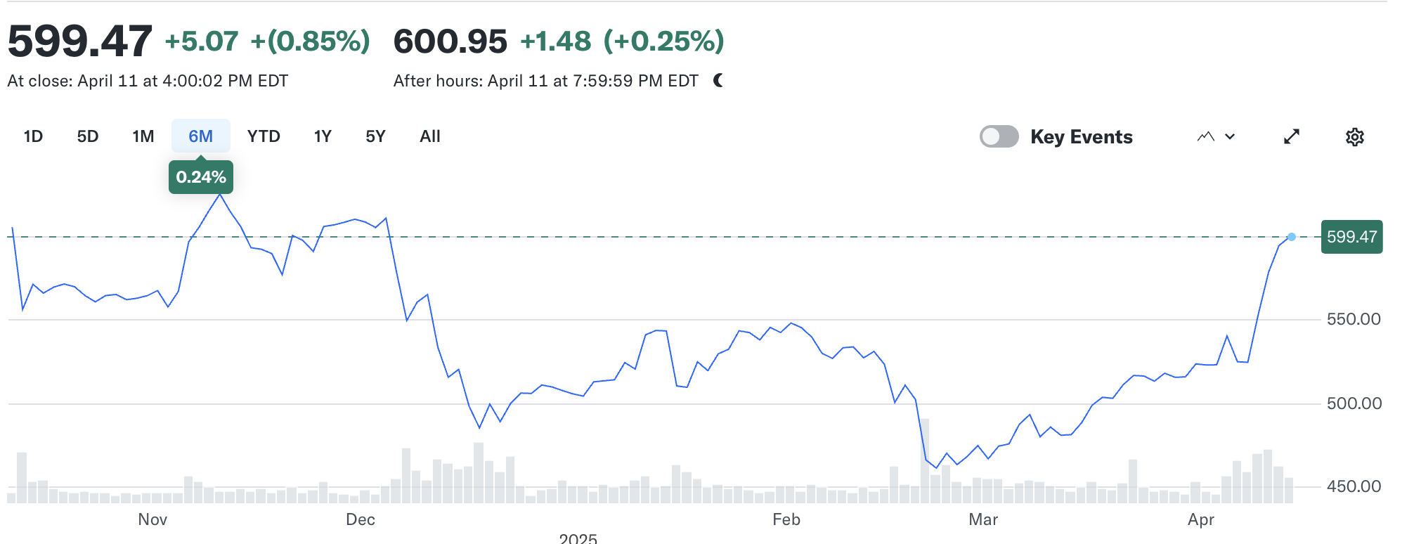
UnitedHealth Group (UNH)
BUY
Market Cap: 548.342B
Current Price: $600.95
Target Price: $635.20
Diluted Shares Outstanding: 914.71M
Dividend Yield: 1.64%
Total Projected Yield: 24.54%

Slide 8
Financial Analysis - UnitedHealth Group (UNH)
UNH has beat or met earnings estimates 9 quarters in a row
2025–2026 outlook:
  Continued growth
  Driven by expansion in Optum services
  Medicare Advantage enrollment
Trades at a P/E of 18.3x
  Strong investor confidence
  Earnings stability and growth potential
Ideal for long-term, risk-averse investors
  consistent cash flow and defensive positioning
  premium valuation may deter value-focused buyers

Slide 9
Valuation: UnitedHealth Group (UNH)
SIM:
Mkt. Value: $413,763
Percent of Assets: 4.69%
Shares Owned: 790
Unit Cost: 508.65
Total Cost: $401,833.02
Unrealized Gain: $11,929
BUY:
+0.31%
Final portfolio weight: 5%
DCF
Upside: 44.5%
Target price: $635.20

Slide 10
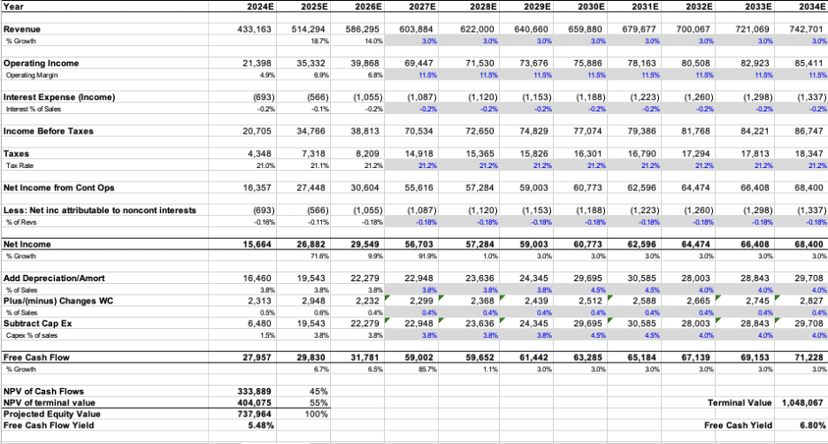
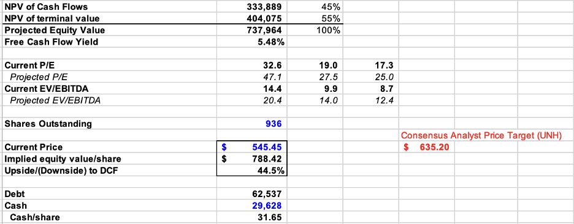
DCF - UnitedHealth Group (UNH)

Slide 11
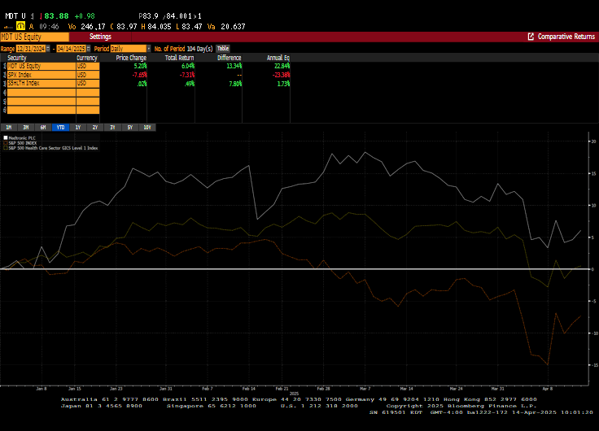
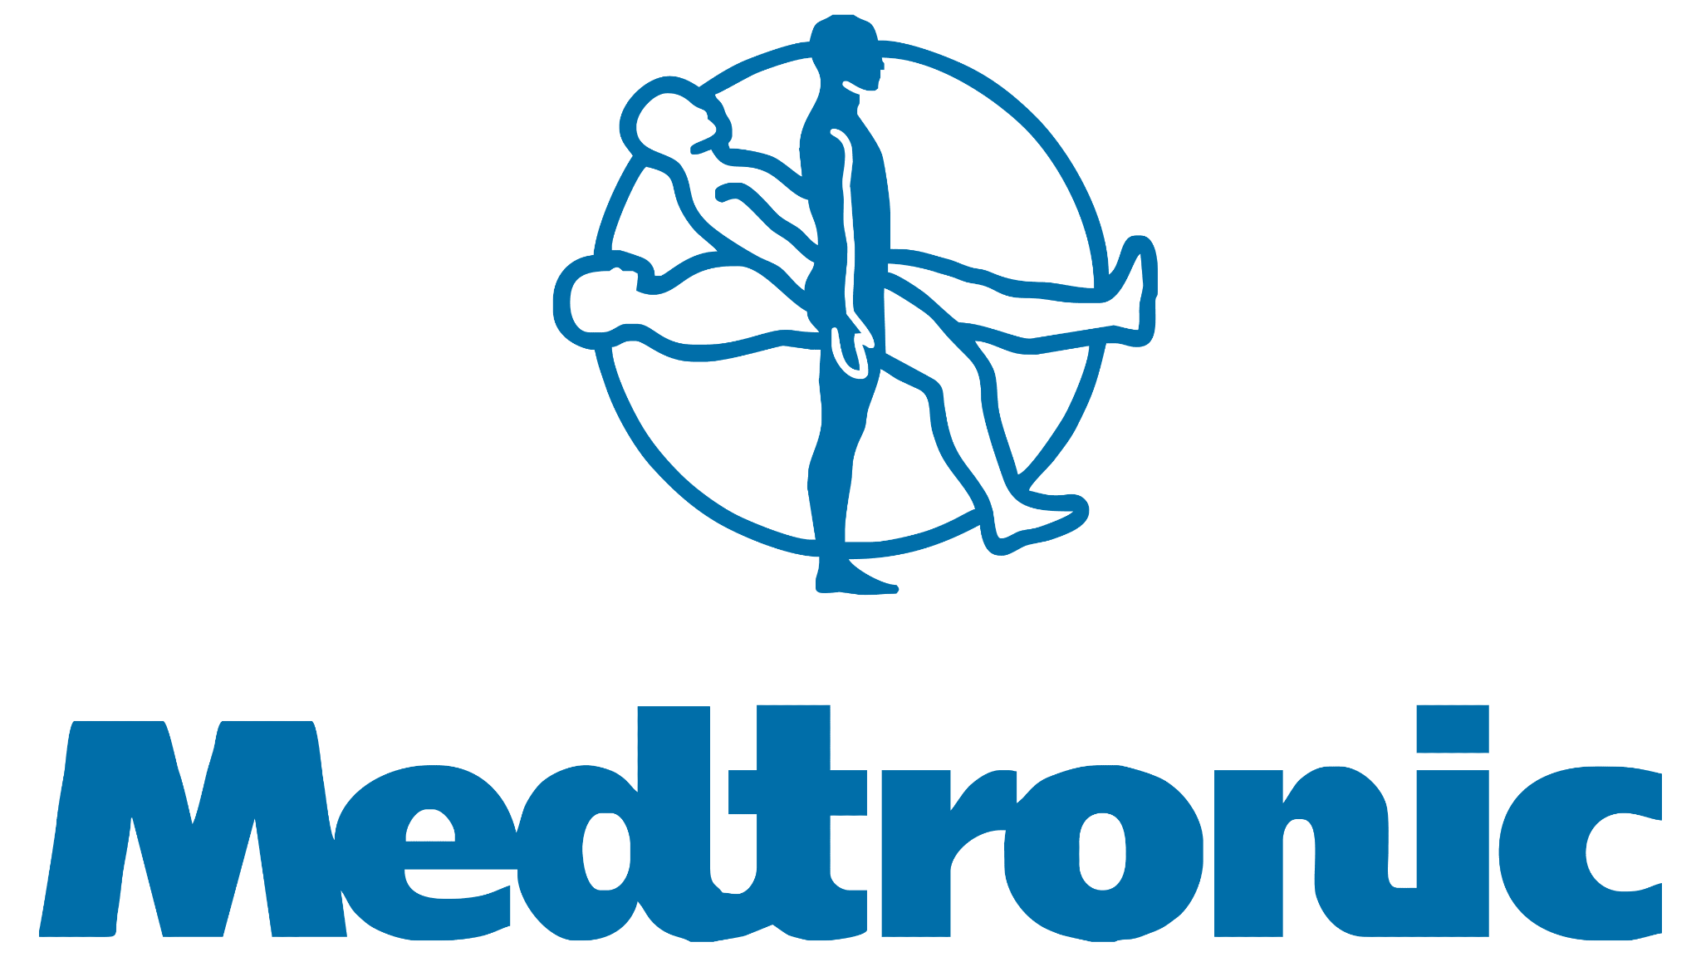
Medtronic (MDT)
HOLD
Market Capitalization: $106.32B
Current Price: 84.22
Target Price: 101.39
Shares Outstanding: 1.28B
Dividend Yield: 3.38%
Total Projected Return: 20.4%
Business Segement Portfolios (% Rev)
Cardioascular (36%)
Medical Surgical (25%)
NeuroScience (30%)
Diabetes (9%)

Slide 12
Financial Analysis - MDT
Earnings: MDT has had 9 straight quarters of consistent organic revenue growth (4.1% growth last Q). They have beaten or met their EPS estimates the last 16 of 17 quarters (6.9% Growth Last Q).
Margins and Efficiency
  Gross Margin Improvement: Adjusted gross margin increased by 50 basis points (0.5%) compared to last year.
  Operating Margin Improvement: Operating margin rose by 100 basis points (1%) from the prior year.
Liquidity
  Current ratio: 2.0
  Quick Ratio: 1.3
High Interest coverage
  EBIT covers interest expense 7.2x - low default risk & financial stability
Outlook for FY 2025: They’re projecting organic revenue growth between 4.75%- 5% for the full year — slightly better than previous Q of 4.1%.
Weakness
Modest ROE and ROA (ROE: 8.4%, ROA: 4.7%)
  Only generating moderate returns on shareholders’ equity and total assets.
  Could limit investors appeal if growth slows.
Low Asset Turnover
  Generates only $0.40 in revenue for every $1 in assets.
  Common in med- tech, but still a drag on efficiency.

Slide 13
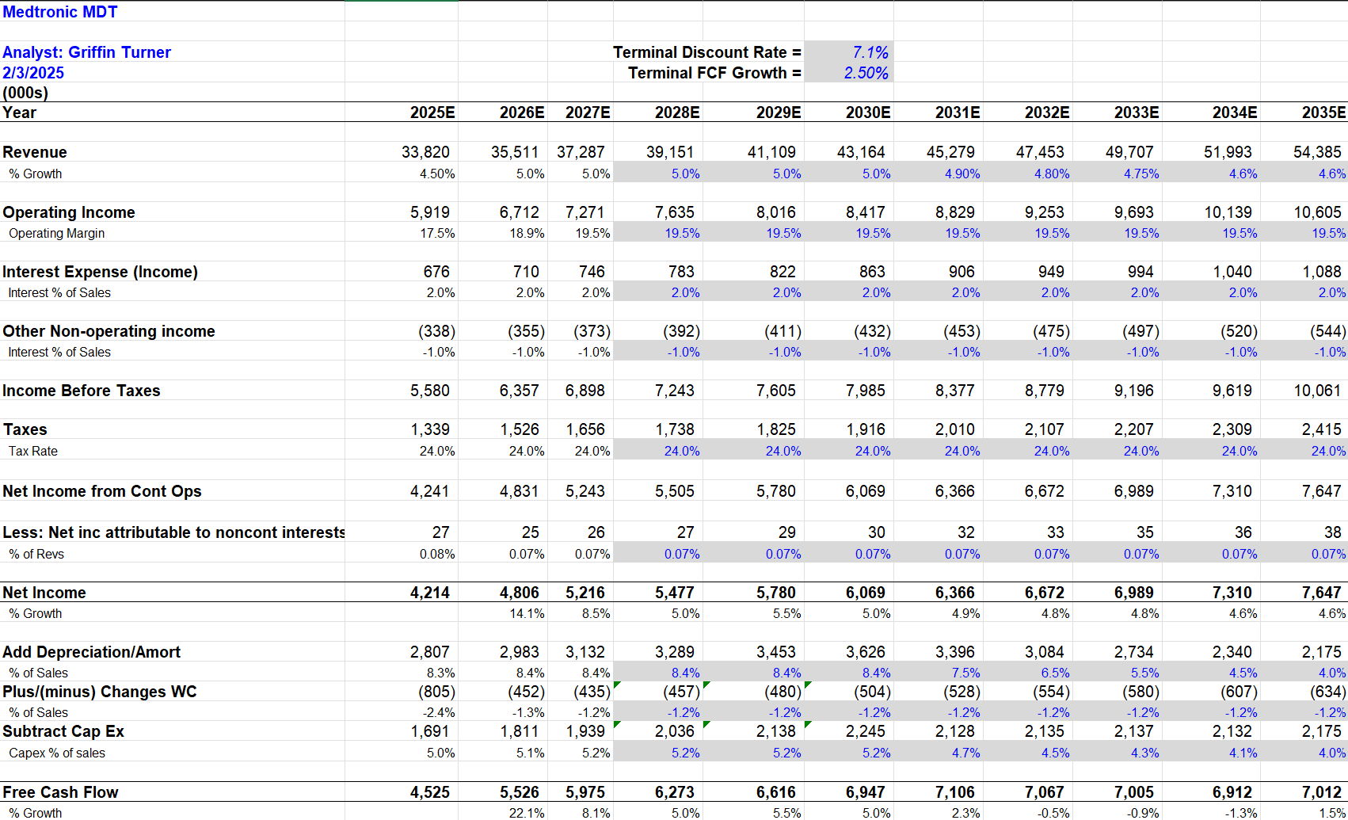
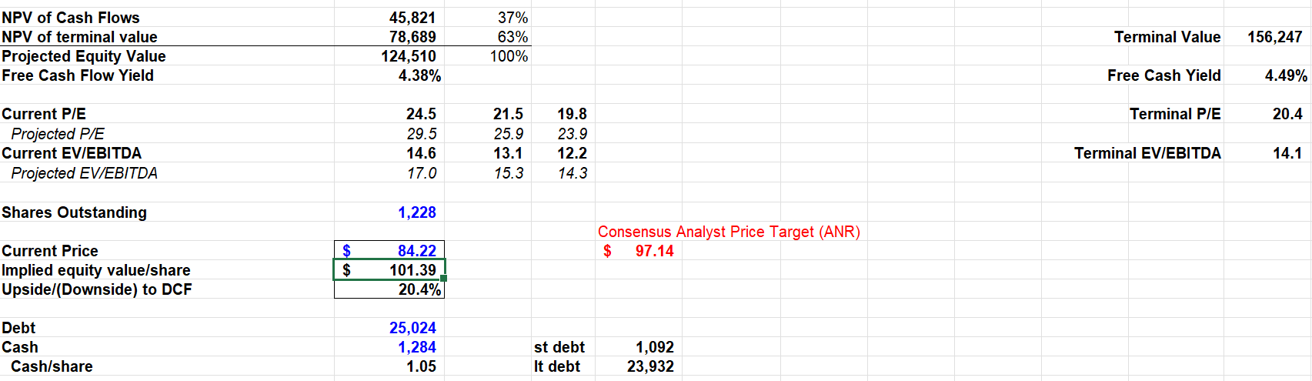
Valuation Analysis- MDT
SIM
  Shares Owned: 2,360 Shares
  Unit Cost: $79.85
  Percentage of Assets: 2.4%
HOLD
  DCF 20.4% upside, Consensus upside 15.3%
  DCF Target price: $101.39, Consensus: $97.14
  Discount Rate 7.1% & Terminal Growth Rate of 2.5%
Risks
  2025 Distributer Issues
  Although Medtronic is leading the industry in terms of revenue with $32.4B in 2024, J&J is closely trailing with 31.8B in 2024.

Slide 14
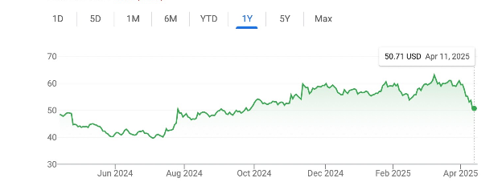

Bristol Myers Squibb
Recommendation: HOLD
Current Price: $50.71
Price Target: $57.52
Upside: 13.4%
Shares Outstanding: 2,032
Dividend Yield: 4.89%

Slide 15
BMY Business Analysis
Economic Outlook
  Increasing long-term demand for healthcare due to aging US population
  Increased regulation in the sector
  Increased spending in Healthcare, especially in emerging markets that suffered during Covid
Growth Drivers
  Approval of new drug Cobenfy, an innovative drug used to treat mental disorders
  Blockbuster patented drugs such as Eliquis and Opdivo
  Strategic acquisitions of multiple companies such as MyoKardia and Celgene that expand its size and scope,
Inhibitors of Growth
  High Costs of production
  Expiring Patents of Eliquis and Opdivo

Slide 16
BMY Financial Analysis
Ticker | P/E | P/S | P/B | P/CF | EV/ EBITDA
BMY | 13.69 | 2.43 | 6.73 | 7.68 | 44.99
Peers
Eli Lilly | 56.46 | 16.35 | 49.41 | 110.67 | 61.93
AbbVie | 22.48 | 5.46 | 50.17 | 18.36 | 16.52
J&J | 19.34 | 4.08 | 5.08 | 14.23 | 12.86
Pfizer | 14.16 | 2.51 | 1.64 | 13.38 | 16.93
Average | 27.61 | 7.1 | 26.575 | 39.16 | 27.06
Operating Margin of -17.35%
ROI of -13.86%
Projected 6% growth for 2026
Trades at a cheap multiple relative to peers at 13.69
  High Dividend Yield and defensive stock
14.07% decrease in stock price has increased its potential upside
Attractive stock but low upside and potential market risk leads to questionable outlook

Slide 17
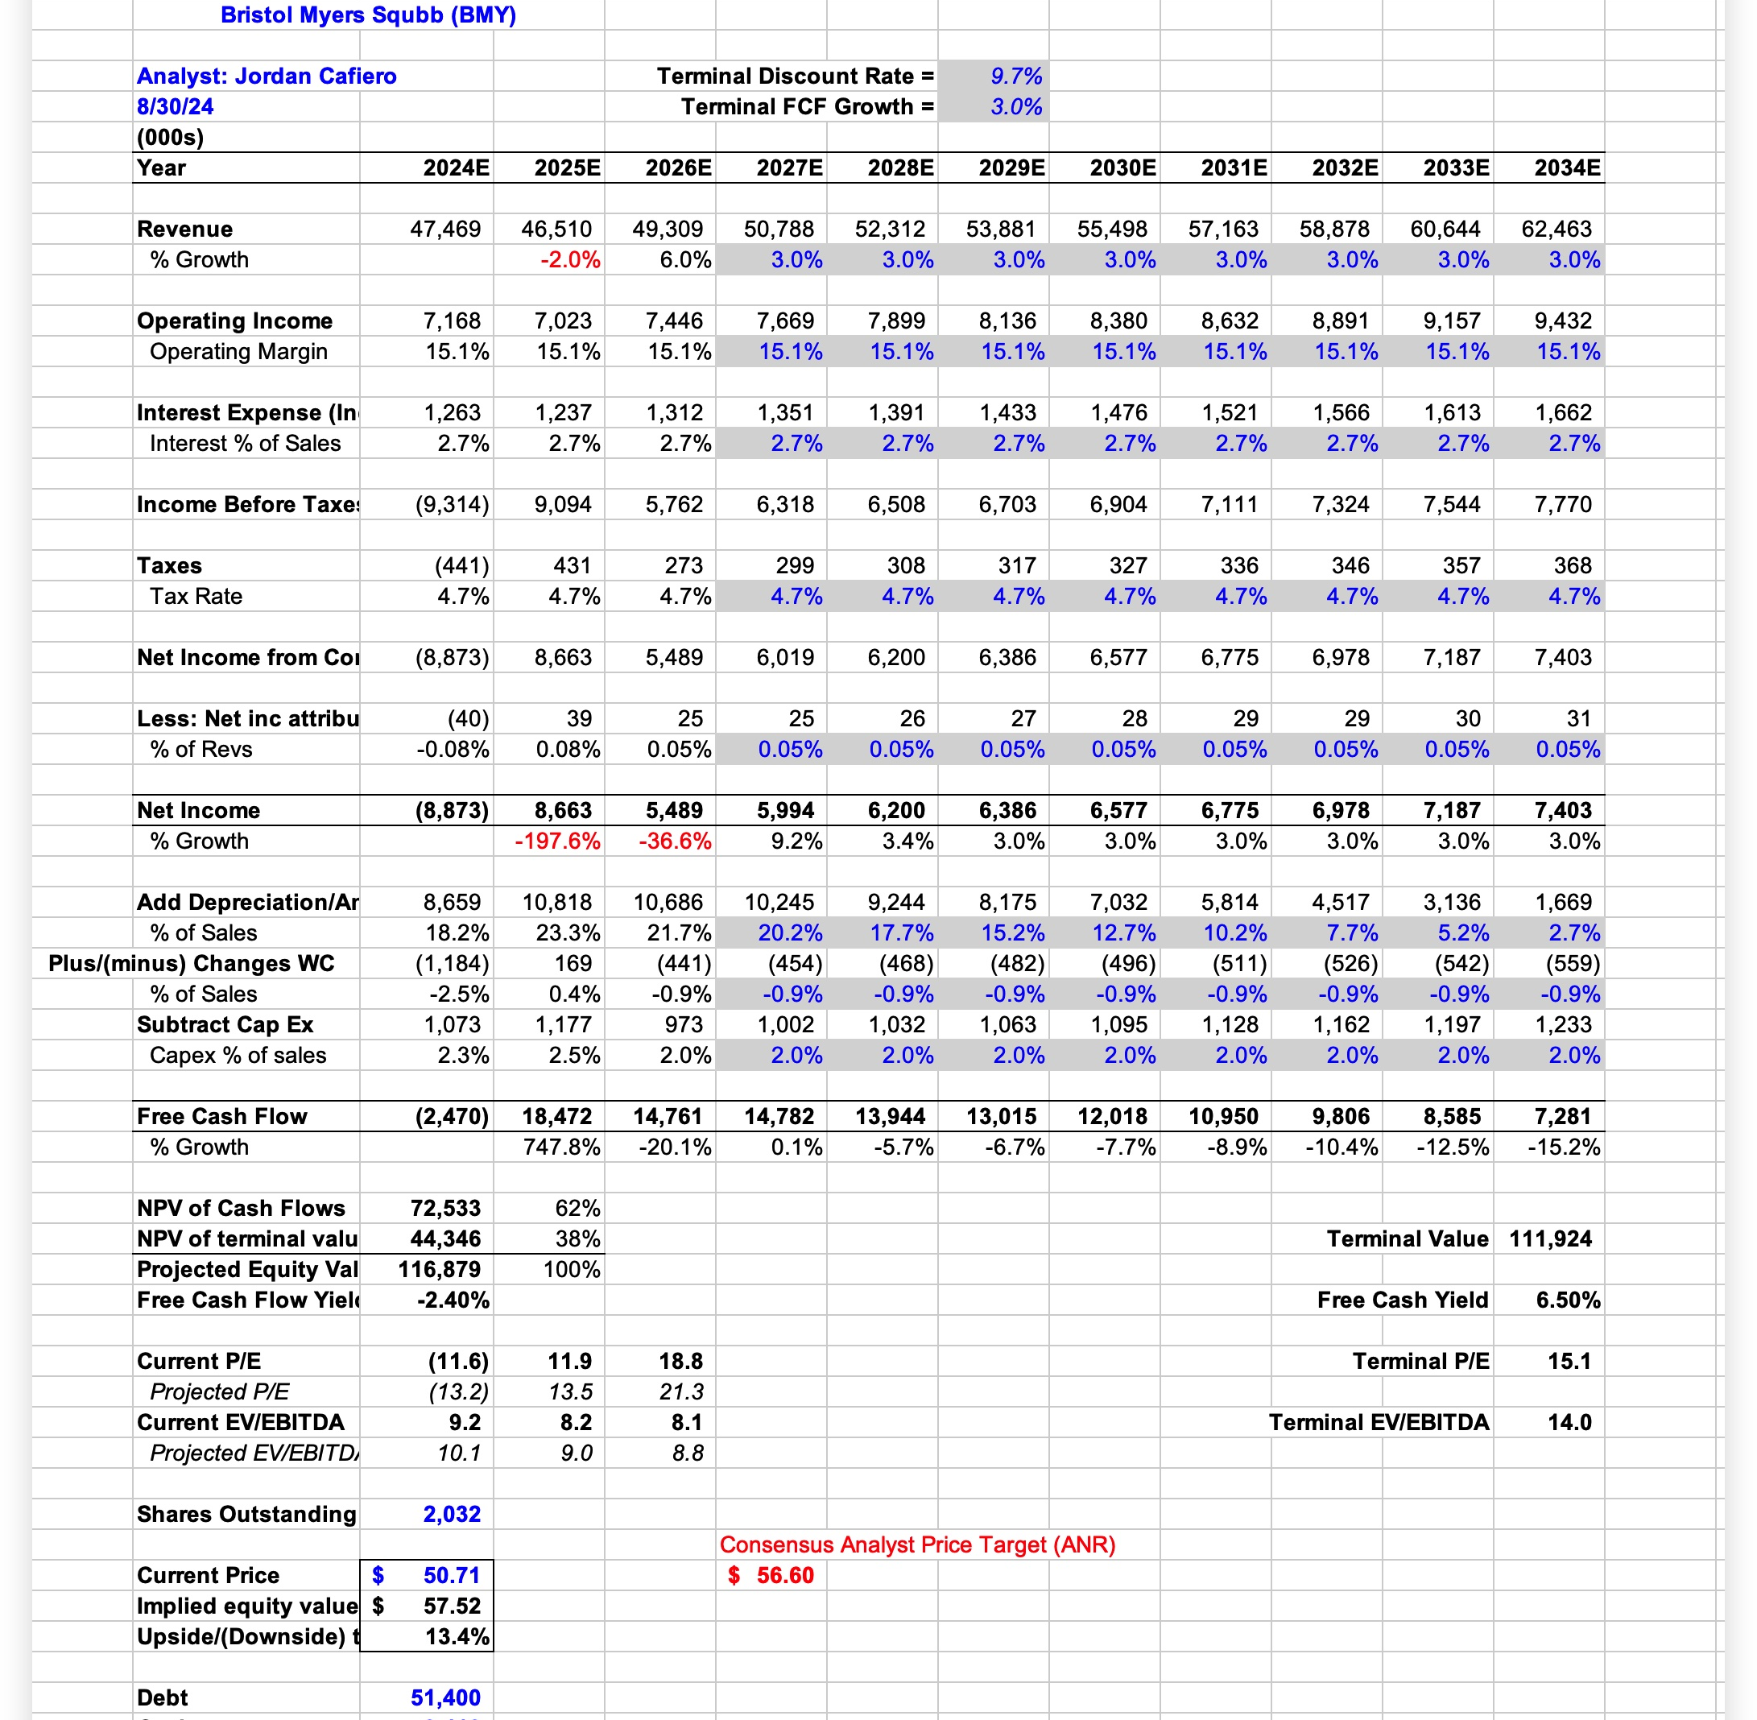
BMY DCF
Despite positive upside, I am recommending that we maintain the stock weight at 558 bps

Slide 18
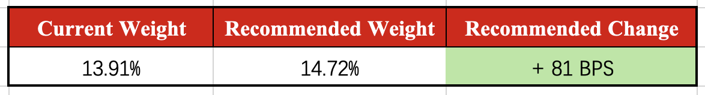
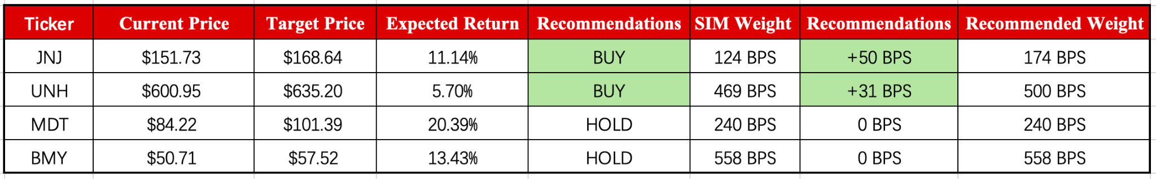
Stock Recommendations
Overall, we see the Healthcare sector weighting increasing in the SIM portfolio from 13.91% to %14.72, an increase of 0.81%.

Slide 19
Questions?

