Slide 1
Sector Presentation Healthcare
By: Griffin Turner, Annika Spoor, Larry Zhang, Kaihang Zhou, Jordan Cafiero

Slide 2








Sector Overview
Industries:
Drug Manufacturers - General
Medical Devices
Healthcare Plans
Biotechnology
Diagnostics & Research
Medical Instruments & Supplies
Medical Care Facilities
Medical Distribution
Drug Manufacturers - Specialty & Generic
Health Information Services
Pharmaceutical Retailers
The Market (via Yahoo Finance):
10.30% of the market
+3.11% YTD returns
+1.49% Quarter to Date returns, as of 3/16/25
Market Cap: 6.512T
Biggest Companies (Market Cap):
Eli Lilly & Co. (731.576B)
Unitedhealth Group (449.697B)
Johnson & Johnson (391.985B)

Slide 3
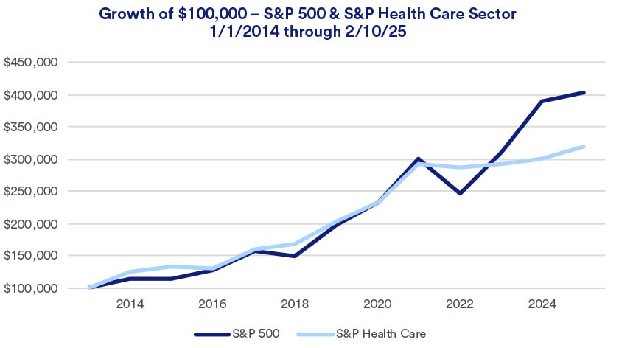
Business Analysis
The Healthcare Sector is in the growth phase of the business cycle
  Due to an aging population
  Increasing technological innovation within the sector
  High demand for products and services
Historically, Healthcare is a defensive sector that performs that is not as affected by economic downturns, as demand for services remains relatively high
  However, innovation in biotech and health technology industries would be negatively impacted as investments in these areas decrease during downturns

Slide 4
Business Analysis
External Factors:
  Regulation from Governments at home and abroad
  Potential changes in Coverages for Americans, specifically in repeals of certain aspects of the Affordable Care Act (ACA)
  Healthcare for different regions such as rural, suburban, and urban demographics
Inputs
  Include the pharmacies, workforce, research and development, and the technology used in products and service
Outputs
  Include the service of care provided, the drugs produced, and the Insurance plans and coverages

Slide 5
Business Analysis
Supply Factors Impact Analysis
  Regulatory oversight and approvals make it difficult to increase supply within the sector
  Maintaining a skilled and large labor force within the sector is pertinent for proper diagnosis, innovation, and research
  Investments in R&D also limit supply within the sector as large sums of money is required to fund research and studies
  Emerging Markets across the world are increasing the supply, due to covid, many governments abroad have increased their investment in healthcare to match the levels seen in the United States

Slide 6
Business Analysis
Pricing and Profitability
Demand in Healthcare has remained stable, while supply has fluctuated as a result of Covid and low ease of entry for emerging companies
Different industries within the sector provide differing effects on product margins and prices, whether it be Pharmaceutical, Insurance, BioTech, Patient Care, or Hospitals
Despite low easy of entry in Healthcare, competitive prices are created by the high concentration of companies
Buyers in the sector have low negotiating power, thus keeping prices high
As Healthcare is needed by all, through good times and bad, there is low substitution worries for industries such as Insurance, however, there is a higher threat of substitution for Researchers as patent protections can expire and similar drug treatments become more available

Slide 7
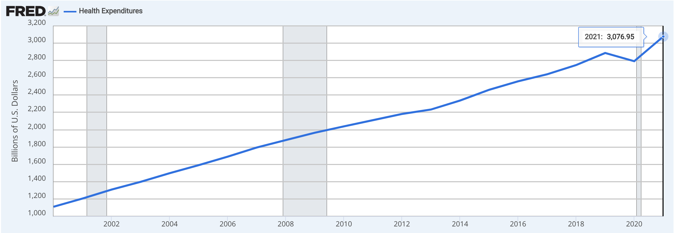
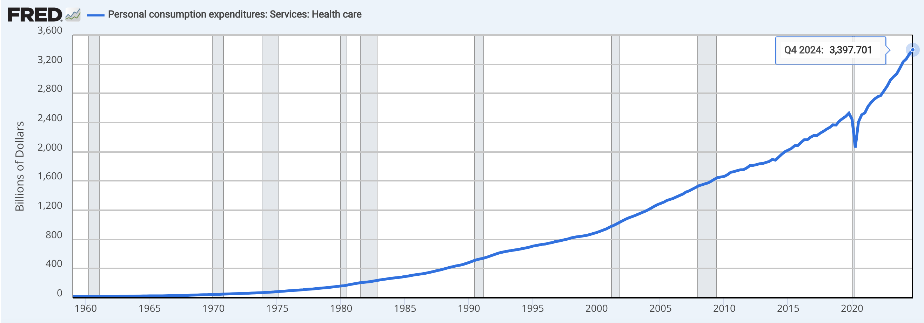
Economic Analysis
Key Macroeconomic Factors That Impact the Sector:
  GDP Growth
  Interest Rates
  Inflation
  Employment Levels
  Government Spending on Health Care
US Government Spending on Health Care per year
US Personal consumption expenditures: Services: Health care

Slide 8
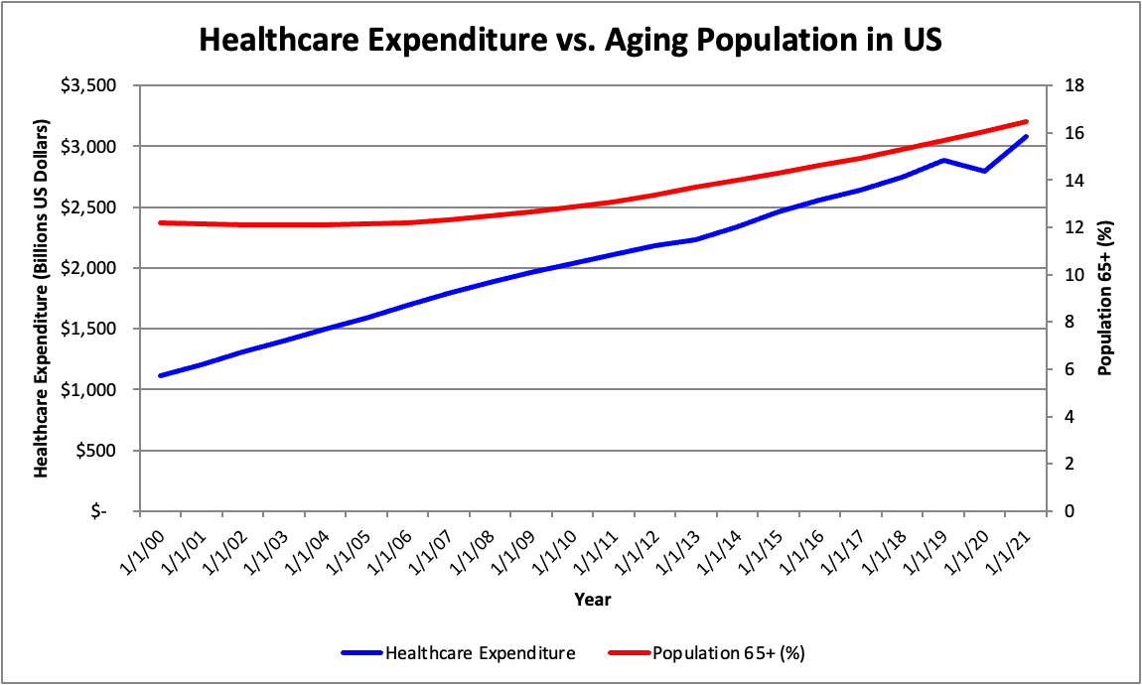
Economic Analysis
Regression Analysis
  Dependent Variable: US health care expenditures
  Independent Variable: Population ages 65 and above for US
Regression Statistics
Multiple R | 0.956131345
R Square | 0.914187149
Adjusted R Square | 0.909670683
Standard Error | 165.4273836
Observations | 21

Slide 9
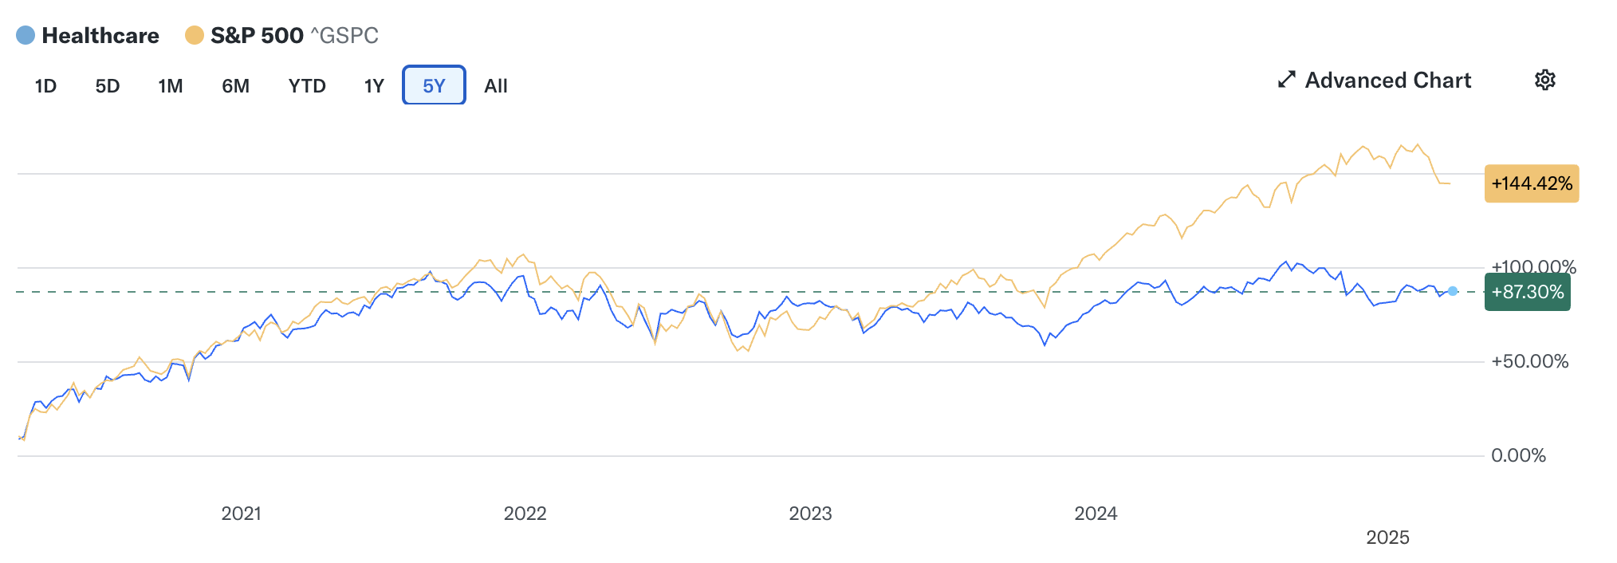
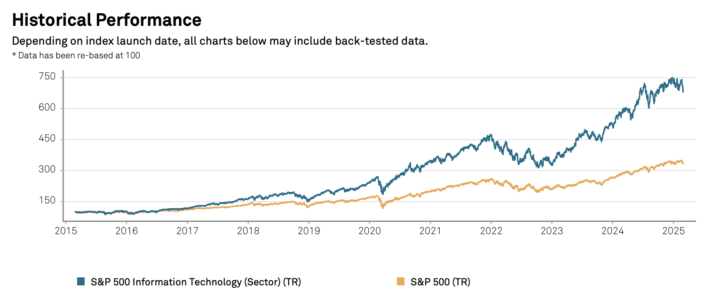
Financial Analysis
Healthcare sector ( defensive) underperformed broader market.
Notable gap emerged post-2024, reflecting investor shift toward growth/tech.
Huge fluctuation around 2021 due the Covid-19

Slide 10
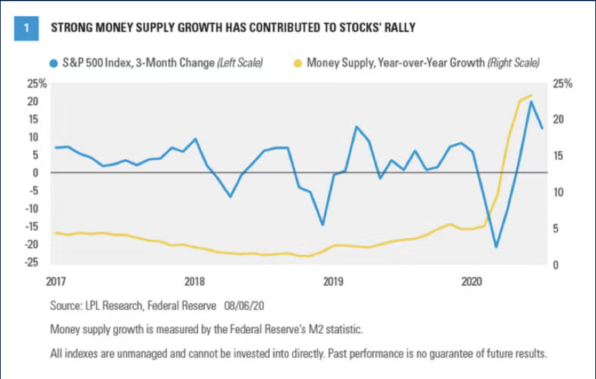
Financial Analysis
Positive relationship between money supply and stock market
Aggressive money supply policy
Inflation
Lower Interest Rate
Investing In Stock Market

Slide 11
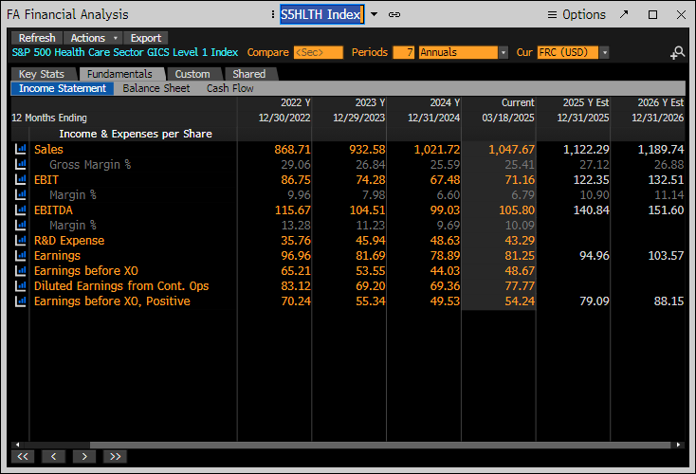
Financial Analysis
Sales growth rate relatively stable
R&D expenses increasing from $35.76 to $45.94 (2022-2023), demonstrating continued innovation focus
Earnings gradually decreased after Covid-19

Slide 12
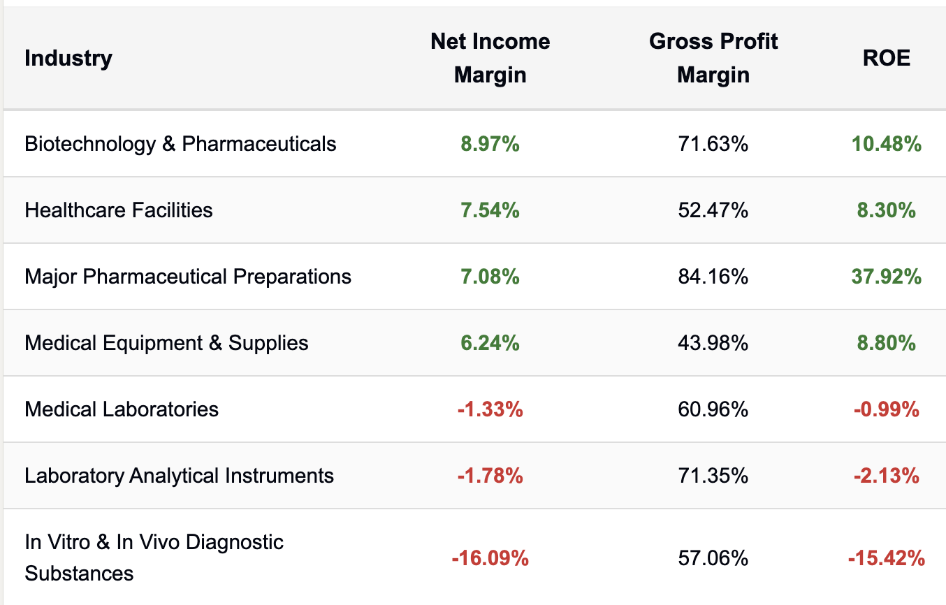
Financial Analysis
Diversity within healthcare—from capital-heavy facilities to high-margin pharmaceuticals.
Each sub-industry’s net income margin, gross profit margin, and return on equity (ROE) differ based on business models, cost structures, and capital intensity.

Slide 13
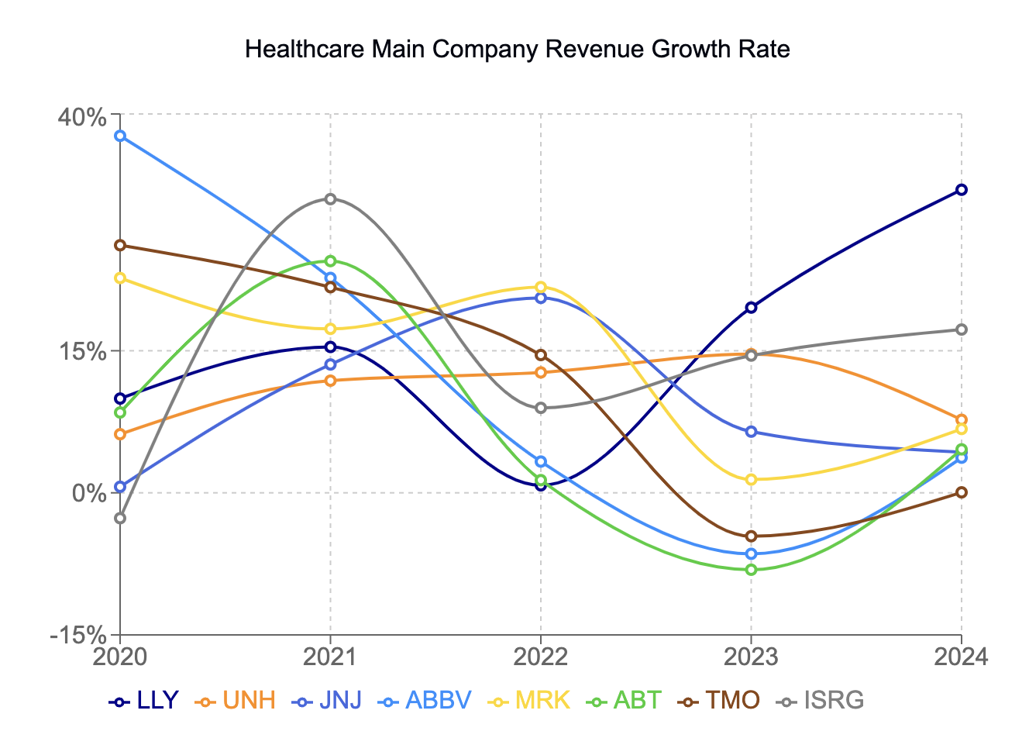
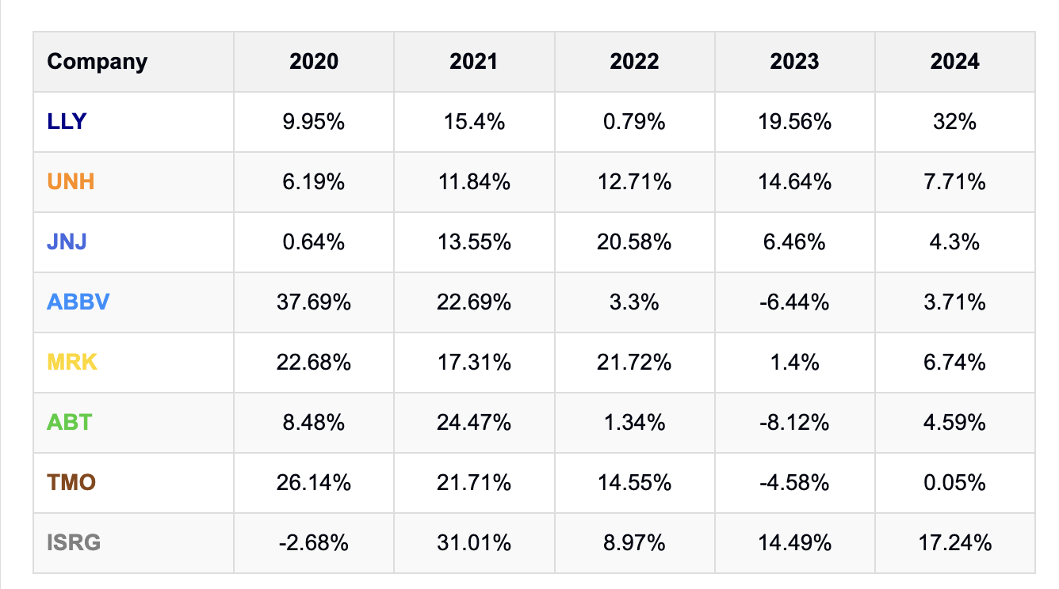
Financial Analysis
Shows a mix of growth patterns with an average sector growth rate hovering around 7-10% annually despite volatility
The sector-wide growth surge during 2021 (pandemic peak) followed by normalization in 2022-2023, showing healthcare's cyclical aspects despite being traditionally defensive

Slide 14
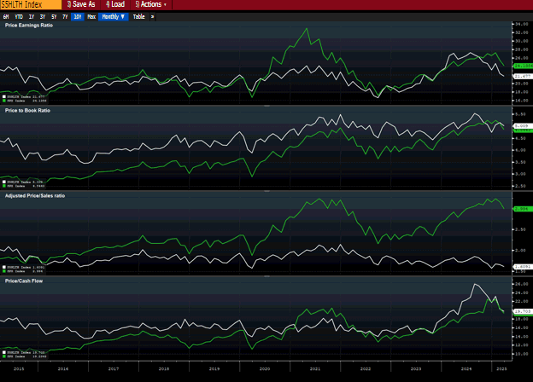
Valuation
S&P 500 Valuation
Absolute Basis | High | Low | Average | Current
P/E | 32.98 | 16.65 | 21.69 | 24.08
P/B | 5.25 | 2.62 | 3.75 | 4.83
P/S | 3.24 | 1.69 | 2.38 | 2.99
P/ CF | 22.46 | 10.08 | 14.65 | 19.18
Healthcare Sector
Absolute Basis | High | Low | Average | Current
P/E | 27.20 | 16.60 | 21.16 | 21.61
P/B | 5.53 | 3.44 | 4.49 | 4.99
P/S | 2.14 | 1.57 | 1.81 | 1.60
P/CF | 25.99 | 13.48 | 16.62 | 19.64
Relative to S&P500 | High | Low | Average | Current
P/E | 1.32 | .67 | .99 | .90
P/B | 1.56 | .91 | 1.22 | .93
P/S | 1.14 | .51 | .79 | .56
P/CF | 1.62 | .75 | 1.16 | 1.02
Source: Bloomberg

Slide 15
Valuation
Industry vs. Market Valuations
Valuations are generally higher than the broader market
Historical Valuation Trends
Defensive Nature
Future Valuation Outlook
Bear or bull market?
Industry | P/E | P/B | P/S | P/CF
Healthcare Equipment & supplies | 30.14 | 5.83 | 5.42 | 27.15
Healthcare providers & services | 15.99 | 26.10 | .66 | 32.87
Biotechnology | 25.27 | 20.60 | 5.37 | 17.74
Life Sciences tools & services | 31.94 | 4.92 | 5.26 | 22.06
Pharmaceuticals | 26.89 | 12.42 | 5.33 | 21.09
S &P 500 | 24.08 | 4.83 | 2.99 | 19.18
Source: Bloomberg

Slide 16
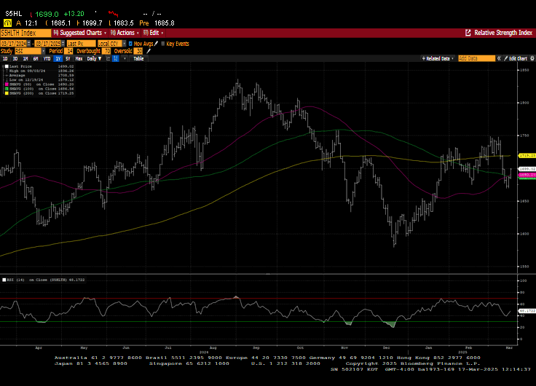
Technical Analysis
Source: Bloomberg RSI

Slide 17
Recommendation: Maintain Weight
SIM weight (as of 2/28/25): 12.67%
S&P 500 weight (as of 2/28/25): 10.77%
Overweight…
Biotechnology
  Advancements in gene therapy
Healthcare Providers
  Aging population – sustained demand
Digital Health
  Telehealth
  AI implementation in diagnostics
  Wearable health tech
Positives:
Defensive
  Demand relatively stable
Aging & Obese Demographics
  Higher risk of chronic illness
Economy Cycle
  Tend to seek health care regardless of economy
Underweight…
Pharmaceuticals
  Blockbuster drugs losing patent protection
  Governments/insurers looking to decrease drug prices
Health Information Services
  Increasing frequency of cyber attacks
Risks:
Government Regulations
  Medicare/Medicaid
Labor Costs
  Highly labor-intensive
Cyber Threats
  Sensitive patient data

Slide 18
Questions?

