Slide 1

Health Care Stock Recommendation Presentation
David Dudek, Anna Heiser, Evan D’Herete, Nathan Hoctor, Yifei Hong

Slide 2
Overview – Weighting and Size of Sector
 | Weight in Healthcare
S&P 500 | 9.31%
SIM | 10.07%
4th largest weight by sector (as of June 2025) in SIM
5th largest weight in S&P 500
Reduce Weight to S&P Weight
  Healthcare remains a defensive sector with inelastic demand, making it attractive amid economic uncertainty or potential slowdowns.
Risks
  Regulatory pricing pressures in the U.S. (e.g., IRA Drug Price Negotiations).
  Litigation risk for certain companies (e.g., opioid, talc cases).
  Macro factors like interest rates and global trade disruption

Slide 3
Overview - Current Holding
Company | Ticker | Current Price (7/21) | SIM Weighting
UnitedHealth Group | UNH | 282.14 | 2.55%
Johnson & Johnson | JNJ | 164.36 | 1.53%
Bristol-Meyers | BMY | 46.69 | 3.87%
Medtronic | MDT | 89.70 | 2.13%
Zimmer Biomet Holdings Inc. | ZBH | 92.59 | 0%
Portfolio |  |  | 10.07%

Slide 4
Business Analysis - JNJ
Growth Drivers
    Patent-protected pharmaceuticals with biologics focus.
    Expansion in MedTech with innovation in minimally invasive surgery.
    Emerging markets expansion and aging population tailwinds.
Risks:
    Patent cliffs on major drugs (e.g., Stelara 2025).
    Litigation risks (e.g., talc-related liabilities).
    Regulatory and pricing pressures globally.
Recent Strategic Actions:
    Kenvue spin-off enhanced focus on core healthcare business.
    Continued investment in R&D (>$14B annually).
Operate in 2 segments
  Innovative Medicine (-64% of revenue)
  MedTech (-36% of revenue)
  Indications – Main Drivers of Revenue
    Immunology (Stelara, Tremfya)–17.8M
    Oncology (Darzalex)– 20.8M
  Pipeline
    56.9M Worldwide
  Geography Split
    US –42M
    Intl –40M

Slide 5
Financial Analysis - JNJ
Metric | JNJ | Healthcare Peer Avg | Comment
Net Profit Margin | ~23% | ~18-20% | Superior margins due to Pharma segment dominance
Asset Turnover | ~0.5x | ~0.6x | Slightly lower due to large R&D base and cash reserves
Equity Multiplier | ~2.1x | ~2.5x | Conservative leverage strategy
ROE | ~24% | ~20% | Strong ROE driven by margins, not leverage
Operating Margin: ~27% — at the higher end of large-cap healthcare companies.
Free Cash Flow Yield: ~4% — robust cash generation supports dividend and buybacks.
Net Debt/EBITDA: ~1.3x — conservative balance sheet vs. sector avg ~2.0x.
Dividend Yield: ~2.9% with a 60-year+ dividend increase streak.

Slide 6
Valuation Analysis - JNJ
Valuation & Price Target
DCF Analysis: Using a 6.5% terminal discount rate and 2.5% terminal growth, the DCF implies an equity value of $169.18/share, aligning with consensus targets.
Relative Valuation: Current P/E of ~26x is justified by stable earnings and sector premium. EV/EBITDA of 14x is in line with peers.
Upside Potential: ~3% upside to the current price of $164.36, with catalysts including pipeline milestones and margin expansion.

Slide 7
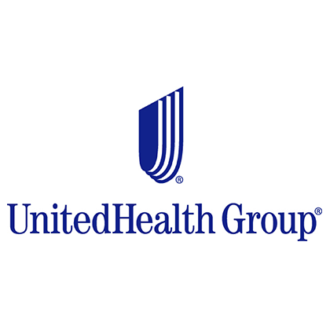
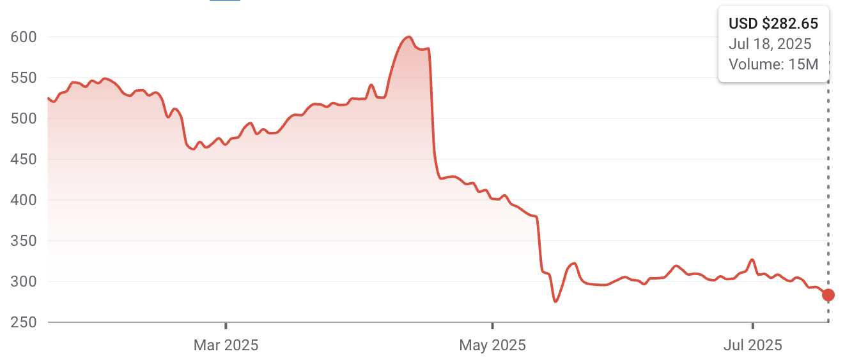
Business Analysis – UnitedHealth Group (UNH)
Total revenue in 2024 was $400,278 million, up 8% from the year prior
  UnitedHealthcare (54.11%)
    Health insurance arm
    Medicare makes up most of the revenue
    Provides plans globally to individuals, companies, communities, and states
  Optum (45.89%)
    Is split up into three more segments (Health, Insight, and Rx)
    Focused on providing care through data and analytics, tech, and pharmaceutical services
Higher-than-expected Medicare Advantage utilization & Unfavorable Optum Medicare dynamics
Performance Overview
Market Cap | $256.40B
Diluted Share Out. | 907.14M
52-Week High | $630.73
52-Week Low | $248.88
Dividend Yield | 3.13%

Slide 8

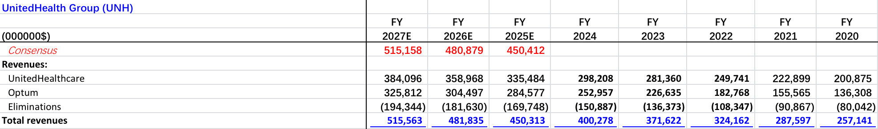
Financial Analysis - UNH
Expect revenues to continue to grow at a good pace.
Market share of 33.32% in 2024
EPS projected to go up because Medicare Advantage & Medicaid enrollments are still growing.

Slide 9
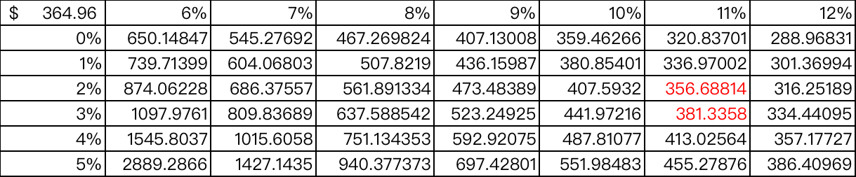


Valuation Analysis - UNH
Terminal Discount Rate = 11%
Terminal FCF Growth = 2.5%
Current Price = $282.14
Implied price = $264.96
Absolute Valuation | Current Stock Price | Current Multiple | Your Target Multiple | Target/ Current | Target Price * | Implied Return #
P/E | 282.14 | 13.5 | 16 | 1.19 | 335.75 | 19%
P/B | 282.14 | 3 | 3.2 | 1.07 | 301.89 | 7%
P/S | 282.14 | 1.3 | 1.4 | 1.08 | 304.71 | 8%
P/EBITDA | 282.14 | 9.3 | 11 | 1.18 | 332.93 | 18%
Ticker | P/E | P/S | P/B | P/FCF | EV/ EBITDA
Your Ticker | 13.5 | 3 | 1.3 | 11.34 | 9.3
Peers
CVS | 9.8 | 0.45 | 1.5 | 13.13 | 6.7
ELV | 8.39 | 0.65 | 2.1 | 18.47 | 8.9
CI | 10.71 | 0.6 | 1.8 | 13.84 | 7.8
HUM | 10.73 | 0.55 | 2 | 12.65 | 8.2
Average | 10.63 | 1.05 | 1.74 | 13.89 | 8.18
Weighted Average = $353.41
Current Price = $282.14
Upside: 25.3%

Slide 10
Recommendation – UNH - BUY
Valuation Method | Weighting | Price Target
DCF | 75% | $364.94
Ratio Average | 25% | $318.82
Final Price Target | 100% | $353.41
Recommendation:
I recommended a BUY on UNH with a target price of $353.41, which implies an equity upside of 25.26%.
UNH has a large competitive advantage, having the largest Medicare Advantage network.
Risk:
The stock price has fallen from 585.04 (4/16).
  Medicare Advantage costs surged as care activity was about 2x higher than expected, especially in physician and outpatient services.
  Lower-than-expected reimbursements from new Optus Medicare patients and recent Medicare funding cuts hurt revenue forecasts.
UNH aims to adapt to the new CMS risk model in 2025, rather than expecting a quick recovery.
Medical costs remain high, with the medical care ratio raised to 87.5% at the upper end.

Slide 11
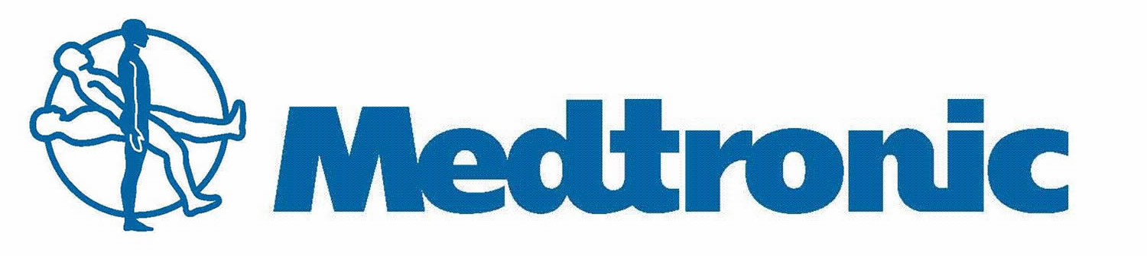
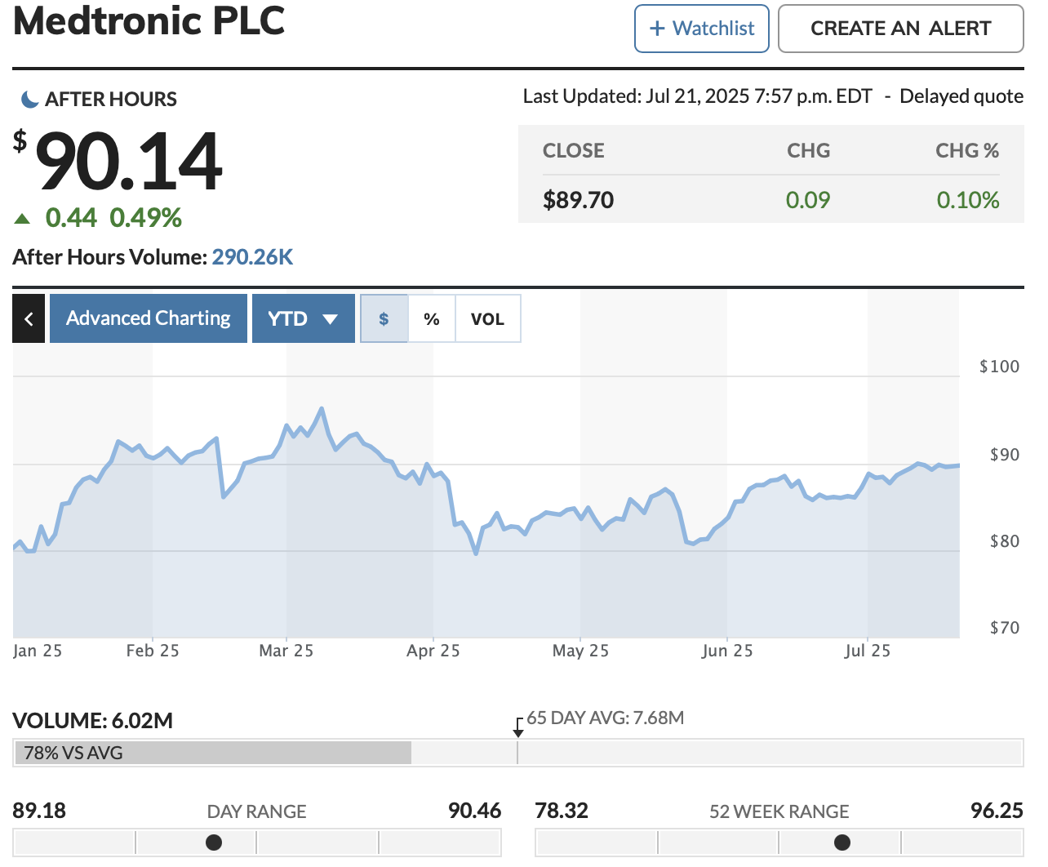
Business Analysis - MDT
Key business drivers
  Aging population and chronic disease
  Innovation and R&D pipeline
  Regulatory approvals and compliance
  Emerging market focus
  Strategic partnerships
Stock performance
  7.7% YTD
  Q4 spin-off news of most unprofitable sector, diabetes unit
  Tariff headwinds
  Correlates with JNJ
  Price target: $94.83

Slide 12
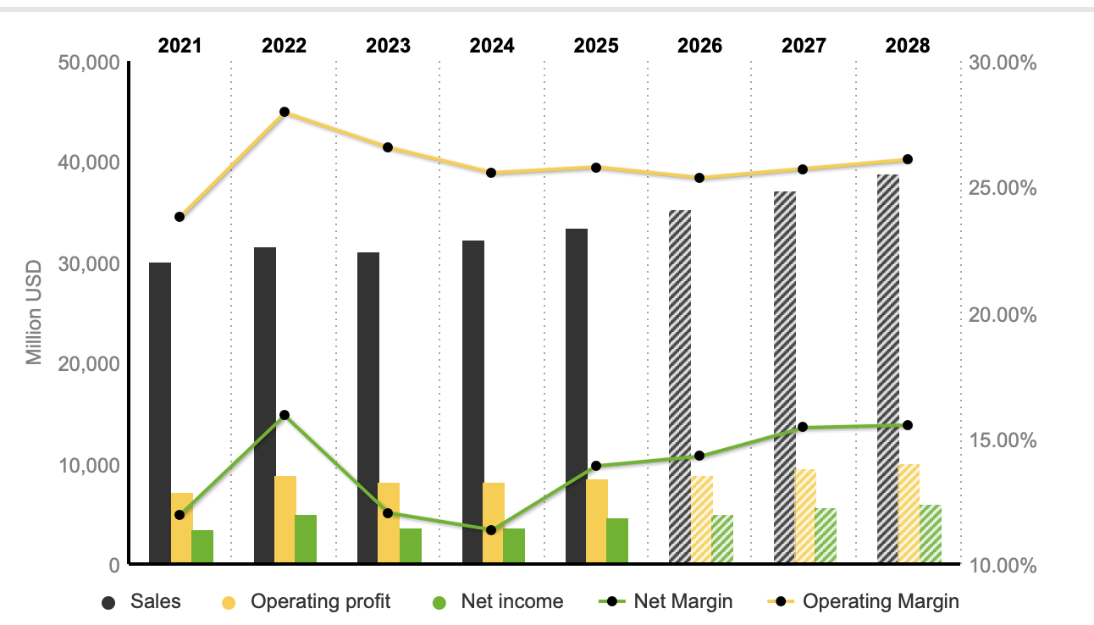
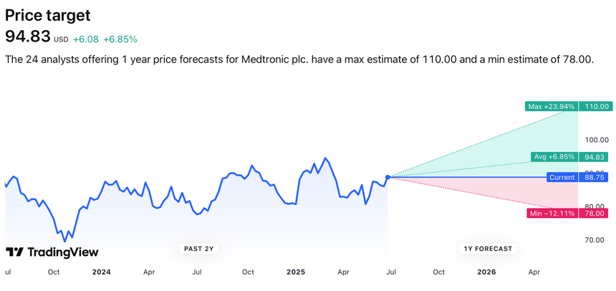
Financial Analysis - MDT
Sales are estimated to steadily increase to upwards of $37M in 2028
Net income is estimated to incrementally increase to around $5M in 2028
ROE started with 9.44% in 2020, dipped to 7.01% in 2021, and rebounded to 9.71% in 2025
Credit: Standard and Poor’s and Moody’s grade Medtronic’s long-term at A and A3 and short-term at P-2 and A-1
Consistent, balanced debt obligations reported out to 2050
Future Projections: ~6-9% CAGR medical device market, tech evolution, product pipeline, and organizational restructuring

Slide 13
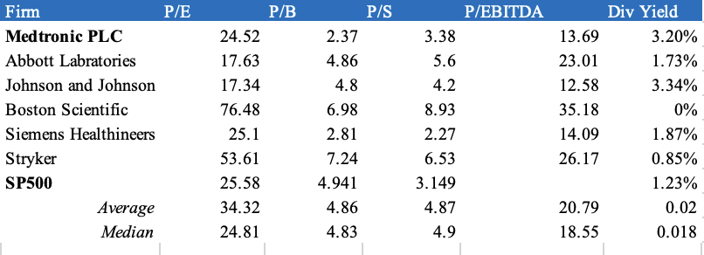
Valuation Analysis - MDT
Undervalued in terms of P/E, P/B, P/EBITDA
Historical price ratios context: P/E 25% below its 10-year average
Contracted from covid highs, a valuation reset
Moderate earnings expansion with uncertainty around tariffs, lower multiple than peers, and assumptions change in uncertain markets
Technical Analysis: current bullish sentiment, but @ base case price
Base Case Discount Rate: 7.2% TGR: 4% (Consensus Revenue and Operating %) | $95.37 (10.66% upside) The base case represents if growth rates and discount rates stay where they are projected to be. Current valuations are based on current marketable products, products to be FDA approved, and news of the Diabetes unit spin-off. Current growth is expected around 8%.
Bull Case Discount Rate: 8.3% TGR: 5% (% Increase on revenues & Improved Operating %) | $111.80 (29.72% upside) The bull case would represent increase in revenues as well as improved operating. There would be additional product approvals, realized synergies from recent acquisitions and product market growth as predicted in Medtronic’s strength area, Cardiac.
Bear Case Discount Rate: 6% TGR: 3% (Velocity of growth declines, increased operating %) | $73.46 (-14.75% downside) This would be scenario when revenues disappoint and operating costs have increased due to product recalls, FDA rejections, failure rates on clinical trials, tariffs in full swing, or several, smaller unknown disruptors emerge taking market share away from Medtronic.

Slide 14
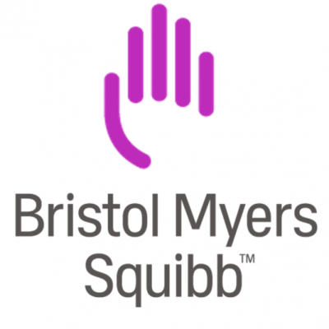
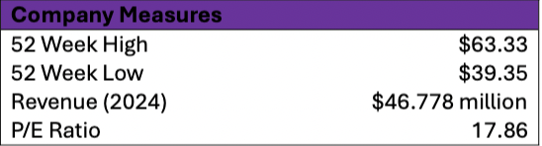
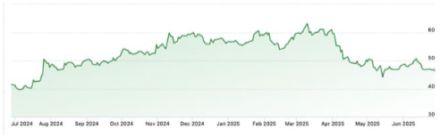
Business Analysis - BMY
Global Presence:
  23 facilities in 10 different countries
  16 R&D locations across 6 countries
Q1 2025 Market Share of ~5.90%
Operates across 6 therapeutic areas
    Solid Tumors
    Hematology
    Cell Therapy
    Immunology
    Cardiovascular
    Neuroscience
Growth Drivers:
  General Aging population
  Technological advancements in pharmaceuticals & healthcare
  More personalized treatment plans
  Emergence of growing middle class globally
Risks:
  Competition over intellectual property
  Lawsuits and legal conflicts
  Regulatory changes/restrictions
Recent Strategic Actions:
  Global collaboration with BioNTech to develop and distribute new
  solid tumor drug

Slide 15
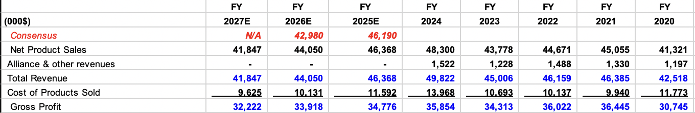
Financial Analysis - BMY
Net Sales predicted to decrease steadily by around 5%
next 3 years
Net Income projected to rebound from ($7,416) in 2024
to $12,615 by 2027
Extremely Volatile earnings reports
Consistently high dividend yield: currently 5.25%
~20% of revenues invested into R&D year over year
Substantial debt, sufficient cash to cover short-term obligations

Slide 16
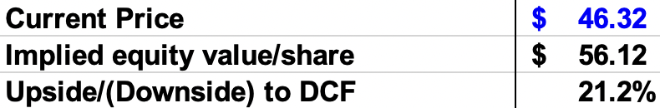
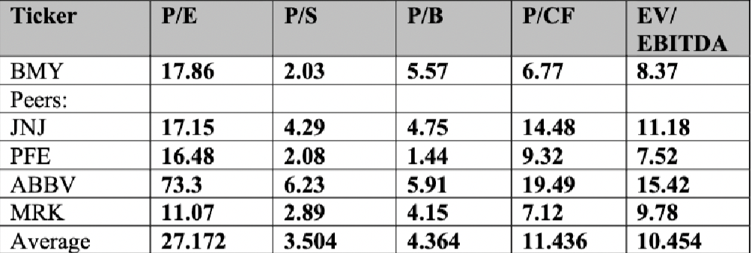
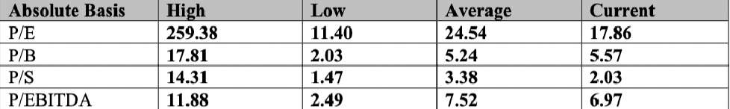
Valuation Analysis - BMY
Undervalued when reviewing P/E, P/S and P/EBITDA
Historical context: P/E is down ~27% from historical average
Comparison to industry competitors: P/CF and P/S trail the competition
Recent blows from economic performance, lawsuits, and trial failures
Lackluster earnings potential, but low multiples compared to historical and peers, restabilizing financials, and positive macroeconomic conditions for growth
Price target of $56.12
  a higher discount rate (due to perceived risk), of 9.5%, and low Terminal FCF Growth rate, of 1.0%, due to poor economic outlook and other factors

Slide 17
Business Analysis - ZBH
Growth Drivers
    Introducing 50+ new products over the next 3 years
    Expansion in ROSA robotics (anatomic and reverse replacements).
    Now offers a full surgical navigation suite
Risks:
    Intense market competition with companies like Medtronic and Stryker.
    Extremely high product concentration (~2/3 of sales in hip and knee implants)
    Regulatory and pricing pressures globally.
Recent Strategic Actions:
    Paragon acquisition ($1.1 billion). Adds foot and ankle implants to S.E.T. portfolio.
    Monogram technologies acquisition ($177 million). Integrates semi and fully autonomous robotic surgery.
Operate in 3 main categories
  Knee implants (41.3% of revenue)
  Hip implants (26% of revenue)
  Sports Medicine (24.3%)
  Other (8.3%)
  Number 1 in the world in both hip
  and knee implants
  Prominent Worldwide
  $4.8 billion in net sales in Americas (62.4%)
  $1.7 billion in net sales in EMEA (22%)
  $1.2 billion in net sales in Asia Pacific (15.6%)

Slide 18
Financial Analysis - ZBH
Metric | JNJ (2024) | Healthcare Peer Avg | Comment
Net Profit Margin | ~11.8% | ~18-20% | Inferior margins due to Pharma segment dominance (not involved in pharma)
Asset Turnover | ~0.35x | ~0.6x | Significantly lower due to large R&D base and cash reserves (normal for capital intensive medical device companies)
Equity Multiplier | ~1.75x | ~2.5x | Conservative leverage strategy
ROE | ~7.3% | ~20% | Weak ROE driven by leverage, not margins
Operating Margin: ~17% — In the 2nd quartile of large-cap healthcare companies
Free Cash Flow Yield: ~7.3% — robust cash generation supports dividend and buybacks.
Net Debt/EBITDA: ~3.2x — higher leverage and relatively aggressive vs. sector avg ~2.0x.
Dividend Yield: ~1.03%, relatively lower yield compared to most (~3%)

Slide 19
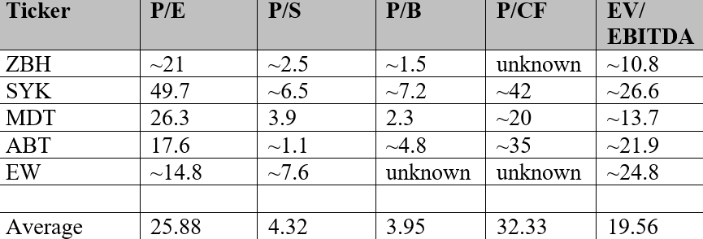
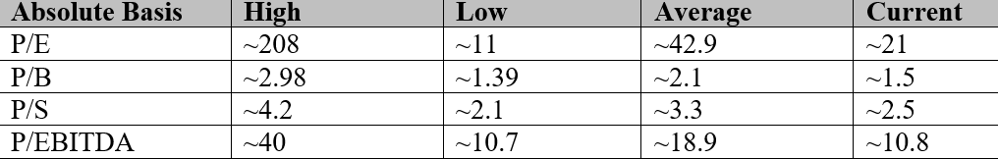
Valuation Analysis - ZBH
Undervalued when reviewing P/E, P/B, and P/S ratios
Each ratio is down anywhere from 20-50% from historical averages
Stryker has begun taking big chunks out of ZBHs market caps in implants
Sales are increasing very marginally (only 1-2% per year)
Stock is down 15% in past year
Bull Case: Stock has potential upside if robotics integration expands margins and encourages growth
Bear Case: If macroeconomic pressures continue to intensify and integration with recent acquisitions do not go smoothly, current ratios and pricing will likely stay the same.

Slide 20
Recommendation
Company | Ticker | Current Price | Target Price | Implied Premium | Recommendation | SIM Weighting | Recommended Weighting | Change in BPS
UnitedHealth Group | UNH | 282.14 | 353.41 | 2.1% | BUY | 2.55% | 3% | 45
Johnson & Johnson | JNJ | 164.36 | 169.18 | 3% | SELL | 1.53% | 0% | -153
Medtronic PLC | MDT | 90.14 | 95.37 | 5.8% | HOLD | 2.13% | 2.13% | 0
Bristol Myers & Squibb | BMY | 46.69 | 56.12 | 20.2% | BUY | 3.87% | 4.17% | 30
Zimmer Biomet Holdings Inc. | ZBH | 92.59 | 111.31 | 2.04% | HOLD | 0% | 0% | 0
Portfolio |  |  |  |  |  | 10.08% | 9.3%

Slide 21
Thank you!
We will now take any questions!

Slide 22
Works Cited
https://www.stock-analysis-on.net/NYSE/Company/Medtronic-PLC/Ratios/DuPont#:~:text=The%20Return%20on%20Equity%20follows,both%20asset%20utilization%20and%20leverage.
https://www.marketscreener.com/quote/stock/MEDTRONIC-PLC-20661655/finances/
https://www.briefing.com/story-stocks/archive/2025/4/17/unitedhealth-plunges-on-slashed-fy25-eps-guidance-due-to-unforeseen-medicarerelated-setbacks-(unh
https://stockanalysis.com/stocks/bmy/

