Slide 1
Financials Sector
Stock Recommendation Presentation
Animesh, Prasun, Ram, Vishal, Youssef

Slide 2
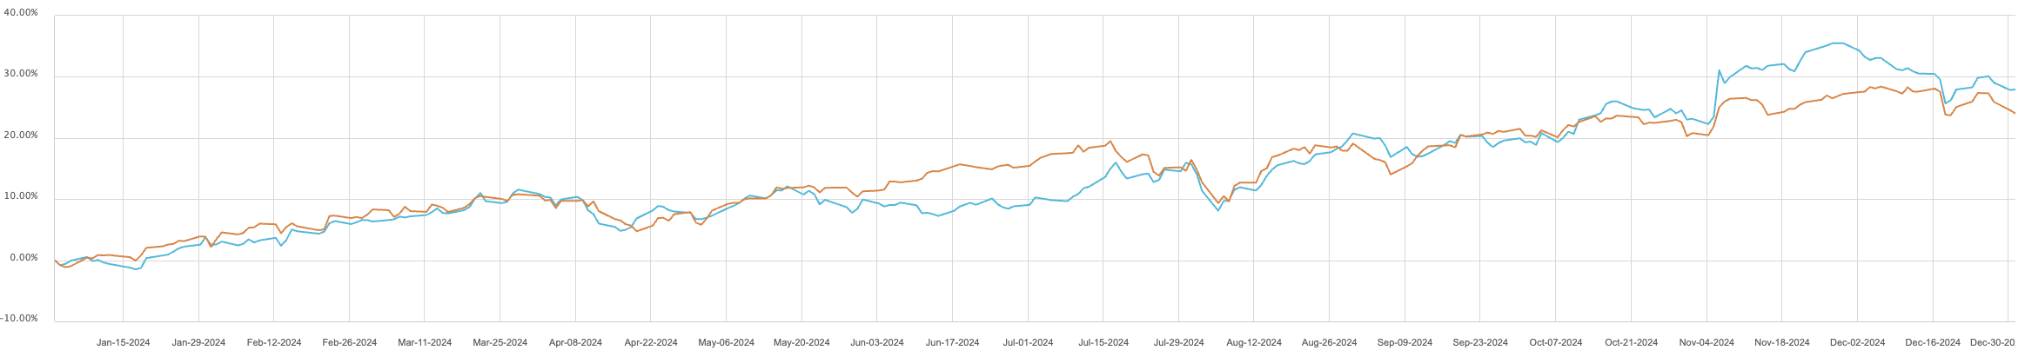
Sector Weight & Returns
Weight | S&P 500 | SIM | +/-
Current | 14.68% | 14.54% | -0.13%
Return | S&P 500 | S&P Financials | +/-
2024 | 24.01% | 27.93% | +3.92%
2025 YTD | -15.09% | -8.95% | +6.14%

Slide 3
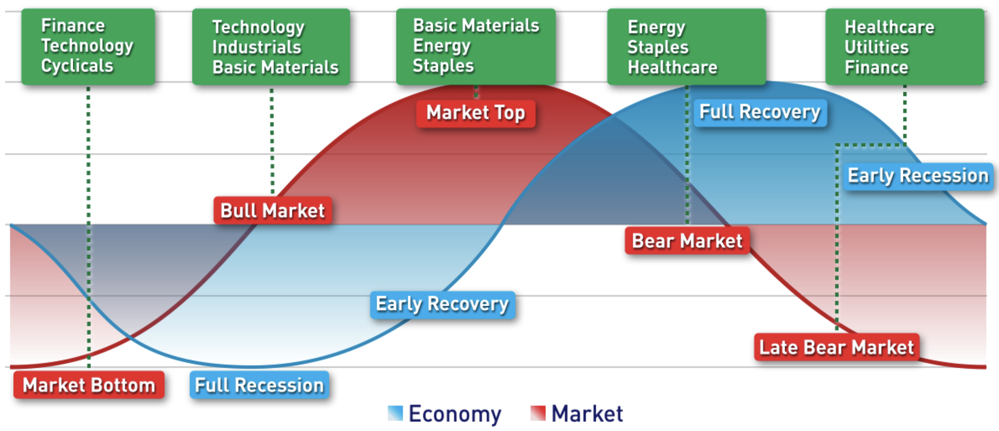
Sector Overview

Slide 4
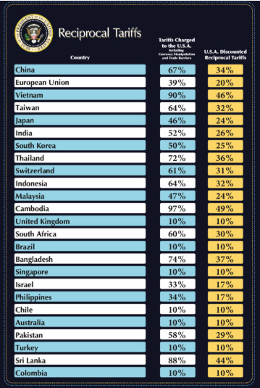
Macro Outlook and Risks
Tariffs squeeze margins, boost inflation risks
Slower growth weakens loan demand outlook
High deposit costs compress bank spreads
Deal slowdown impacts banking fee income
Sector faces stricter regulatory capital limits
Notes:
The macro environment poses significant challenges to the broader financial sector. Tariffs are raising input costs, fueling inflation and limiting the Fed’s ability to cut rates. Slower GDP growth is weakening credit demand—especially in commercial lending—impacting core revenue. Rising deposit costs are compressing net interest margins across banks, while volatile markets and cautious corporate sentiment are dragging down other income streams. Meanwhile, heightened regulatory scrutiny is tightening limits on capital returns industry-wide. With no clear catalyst for sector-wide outperformance, these pressures reinforce a cautious stance on financials until economic and policy conditions improve.

Slide 5
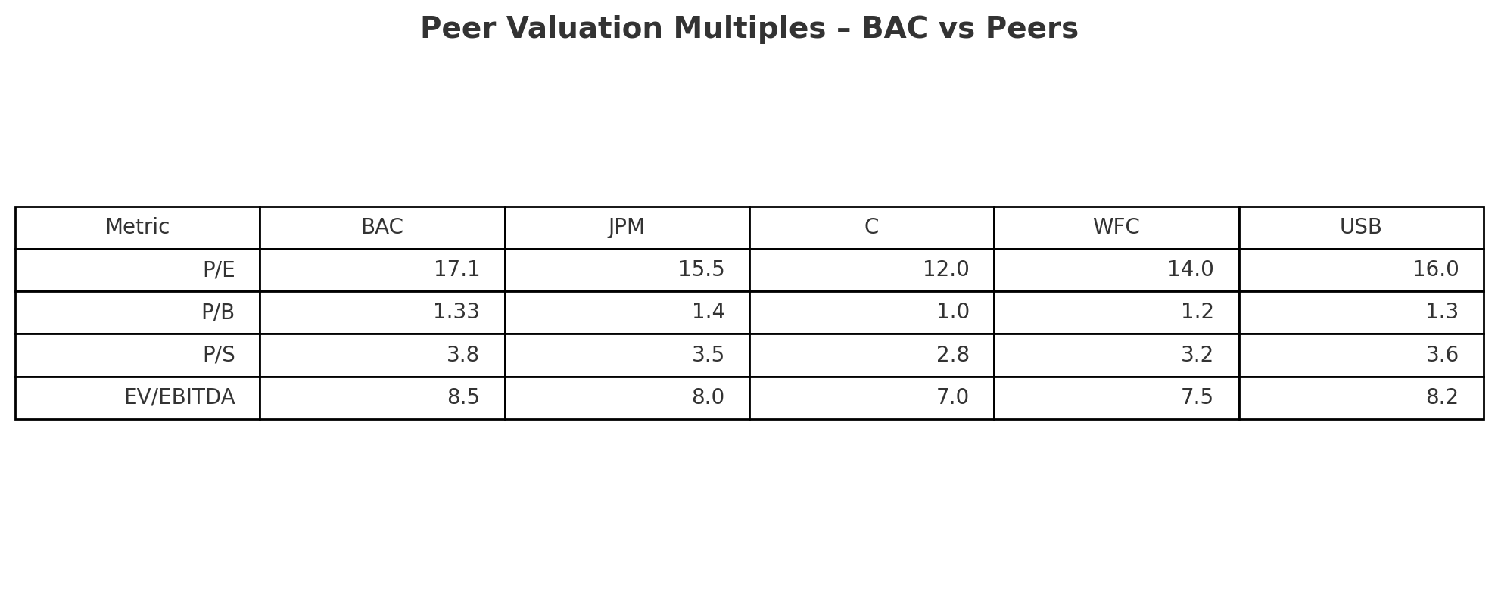
BAC (Hold): Recent Financial Performance & Guidance
Strong Q4 results beat analyst forecasts
Record high net interest income expected
Trading and investment banking revenues jump
Rising costs and loan loss provisions
Stock fairly valued with moderate upside
Notes:
So getting to BAC. Bank of America delivered strong Q4 results, beating earnings estimates with EPS of $0.82 versus the expected $0.77—exceeding by $0.05 or 6.5%. Net interest income is projected to reach record highs in 2025. However, rising expenses and growing credit provisions could compress margins. Trading near $36, BAC appears fairly valued with limited near-term upside. Our current position—10,730 shares—was up over $160K and represents 5.3% of the portfolio. Given this sizable exposure and the stock’s steady 2.9% dividend yield, we see no immediate need to increase allocation. With solid fundamentals, holding allows us to preserve gains while maintaining exposure to a stable, income-generating financial name.

Slide 6
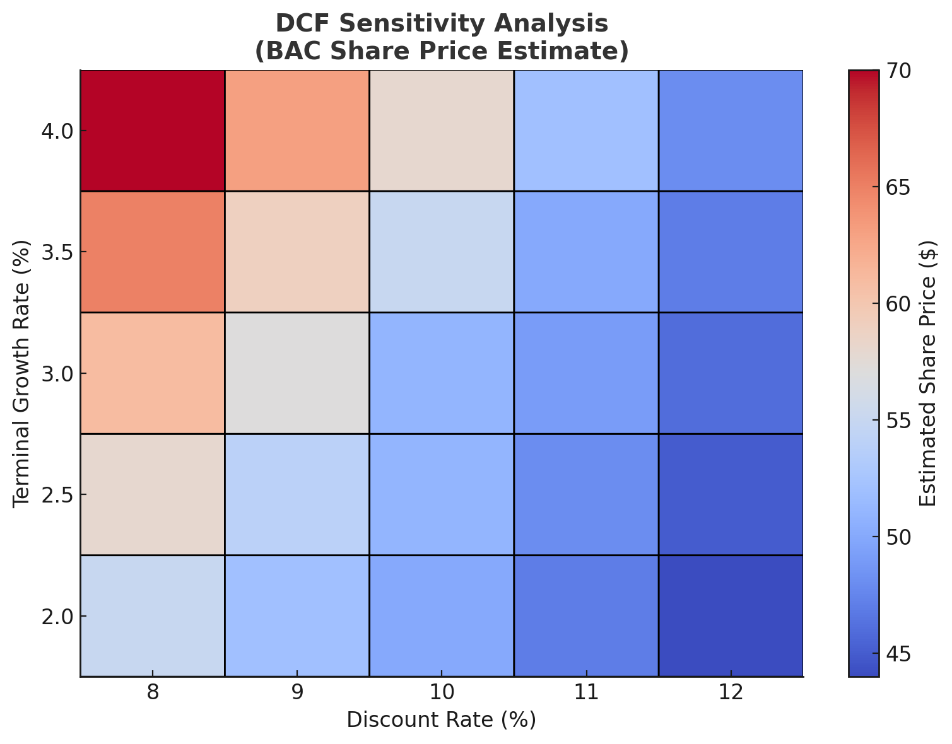
Business Strategy & Execution
Consumer banking reorganization signals steady evolution
No large-scale acquisitions or restructuring planned
Digital investments focused on incremental improvement
Dividend policy remains stable and reliable
Execution strong, but catalysts still limited
Recommendation: HOLD
Notes:
Bank of America’s strategy emphasizes stability over disruption. The consolidation under Holly O’Neill improves efficiency but doesn’t signal major strategic change. Management is focused on organic growth, with no large M&A or restructuring on the horizon. Digital initiatives like Erica (AI) enhance operations but lack transformative impact. While the 2.9% dividend supports income investors, the absence of innovation or near-term growth catalysts limits upside potential. BAC remains well-managed, but the current strategy offers little reason to expand our position. This reinforces a HOLD recommendation—maintaining exposure without increasing risk.

Slide 7

Overview
Regional bank focused on Midwest region
Delinquent loan losses comparatively high in past times
Comparatively higher deposit costs
Macroeconomic conditions could steer this regional bank in an unsatisfactory direction
Market volatility could prove to be disastrous for regional banks, and fee increases wouldn’t be able to compensate
Company Profile
Market Cap (USD) | $18.75B
Shares Outstanding | 1.46B
Float % | 98.6%
52 week high | $18.45
52 week low | $11.91
Beta 5Y | 0.92
Dividend Yield | 4.92%

Slide 8
Financial Analysis
Good capital allocation, capital ratios, and comfortable balance sheet
  ROE 11-13%
  Current ratio <1
3-5% revenue growth rate
Fee increases in place to boost fee revenue

Slide 9
Valuation
DCF implies $13.88, consensus at $14.90
P/E of 10.33, in line with regional and national banks
Discount Rate (WACC) | 10.0%
FCF Growth Rate | 2.0%
Recommendation: SELL

Slide 10

Overview
Company Profile
Market Cap (USD) | $8.03B
Shares Outstanding | 37.69M
Float % | 98.1%
52 week high | $296.68
52 week low | $186.84
Beta 5Y | 1.12
Dividend Yield | 1.40%
Fixed income exchange for institutions
  Trading services as well as pre- and post-execution services and data analytics
Leader in corporate e-trading (high yield)
New innovations – OT, PT/BT
AI – AutoX
Acquisitions – LE, MB
Somewhat countercyclical (credit spreads)

Slide 11
Financial Analysis
Revenue growth rate of 7-8%
No outstanding long-term debt
Very high margins
  Net income margin around 30-35%
High ROE
  20.45%
High current ratio
  Could benefit from some debt utilization

Slide 12
Valuation
DCF implies $245.48, consensus $260-$300
P/E of 29.25 (high), but closest competitor is around 65
Predict higher growth assuming greater penetration of US corporate credit
Benefit from high market uncertainty
Discount Rate (WACC) | 7.5%
FCF Growth Rate | 3.5%
Recommendation: BUY

Slide 13

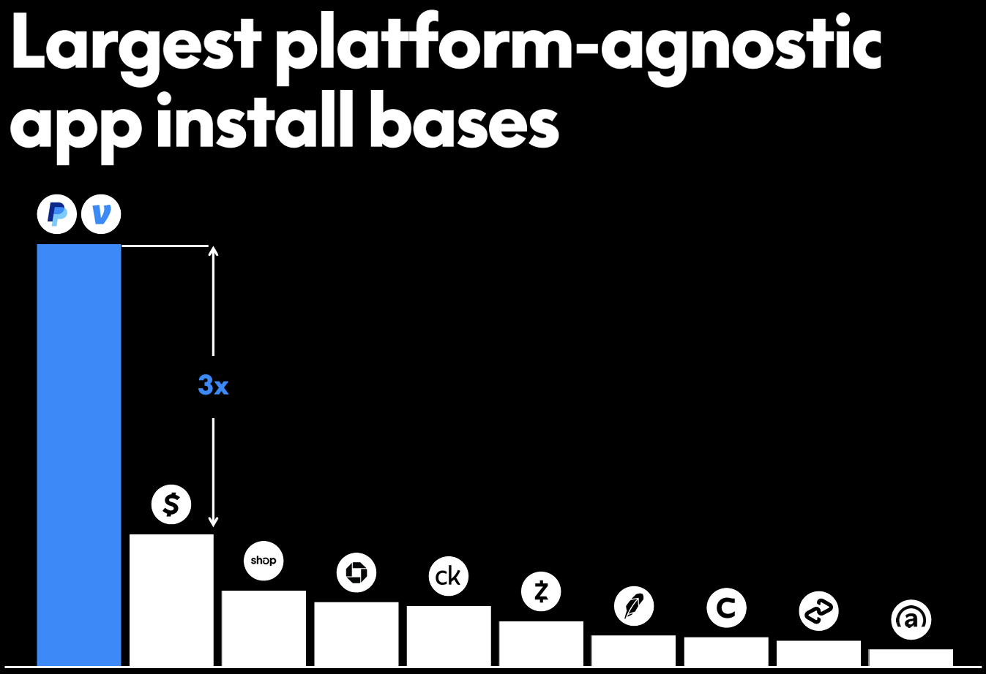
Growth Drivers
Largest open 2-sided platform agnostic service
Shift from payments company to commerce platform
Advertising and AI Powered Personalization for Higher Engagement – agentic platform
Branded Checkout Innovation and Increased Engagement
Merchant Growth and Ecosystem Expansion
Peer-to-Peer (P2P) and Venmo monetization
Financial Discipline and Capital Allocation
Company Profile
Market Cap (USD) | $70.2 billion
Shares Outstanding | 1,029 million
Float % | 99.7%
52 week high | $93.66
52 week low | $56.97
Beta 5Y | 1.53
Dividend Yield | 0%

Slide 14
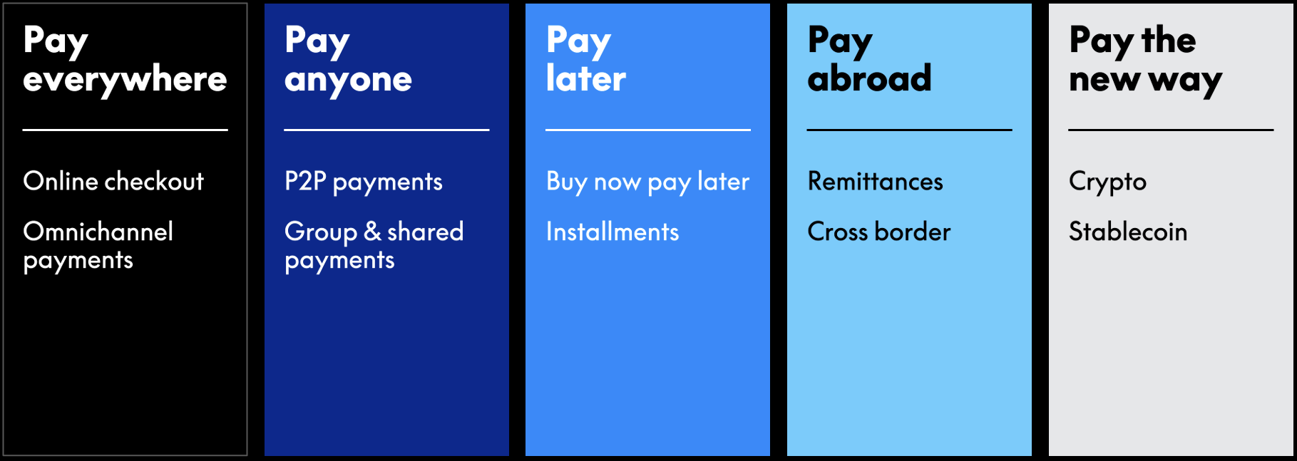
Competitive Positioning

Slide 15
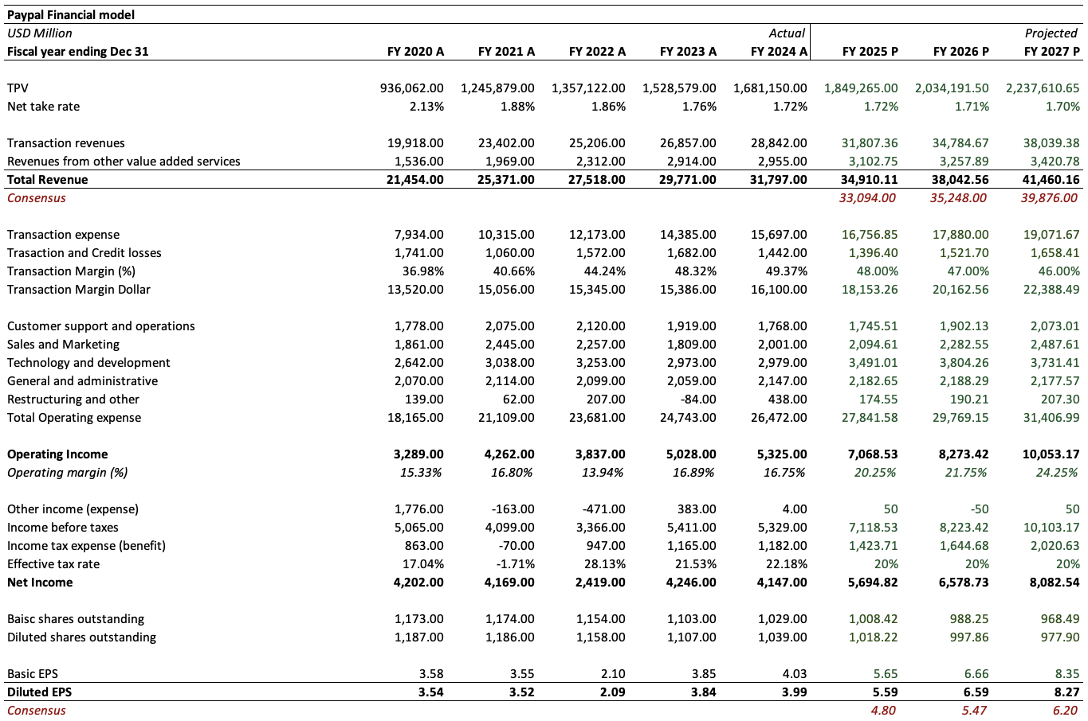
Financial Analysis
Fast growth in TPV, driven by Braintreee, Venmo & branded checkout expansions (10%)
9% revenue growth assumed, higher than 7% consensus estimate
TM$ turnaround in 2024, HSD growth till 2027 and 10%+ long term
Assumed 50 bps expansion YoY from cost efficiencies
EPS growth of low teens till 2027 and 20%+ long term assumed
$6 billion share repurchase guidance
Guided for capex of 2-3% of revenue in line with the last 3 years

Slide 16
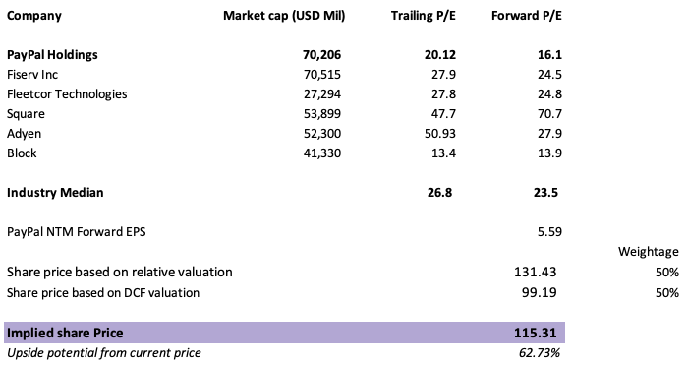
Valuation
Reverse DCF based on current price of $70.86 (before tariff selloff) - zero revenue growth till 2030
Lowest P/E multiple in company history currently
Current strategic direction not valued in
Blended approach of relative valuation and DCF valuation
Risks
Economic activity
Regulatory environment
Cybersecurity
Discount Rate (WACC) | 9%
FCF Growth Rate | 5%
Recommendation: BUY

Slide 17

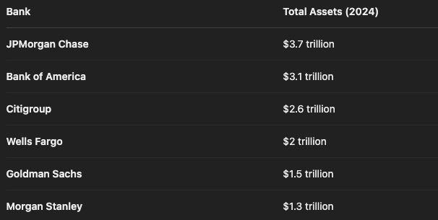
Growth Drivers
JPMorgan's strong balance sheet (over $3.7 trillion in assets) will allow it to weather economic uncertainties effectively
JPMorgan's diversified operations spanning retail banking, investment banking, asset management, and private banking
Strong performance in 2024, reported a 50% surge in net income during the fourth quarter of 2024, proven profitability in weak economic conditions as well
44% stock returns in 2024 – highest in banking industry
Increased deal-making (higher investment banking fees) and trading activities, contributed to substantial profit growth. JPM is currently the top investment bank in the US
Company Profile
Market Cap (USD) | $600.75 billion
Shares Outstanding | 2,800 million
Float % | 99.6%
52 week high | $280.25
52 week low | $179.20
Beta 5Y | 1.09
Dividend Yield | 2.66%

Slide 18
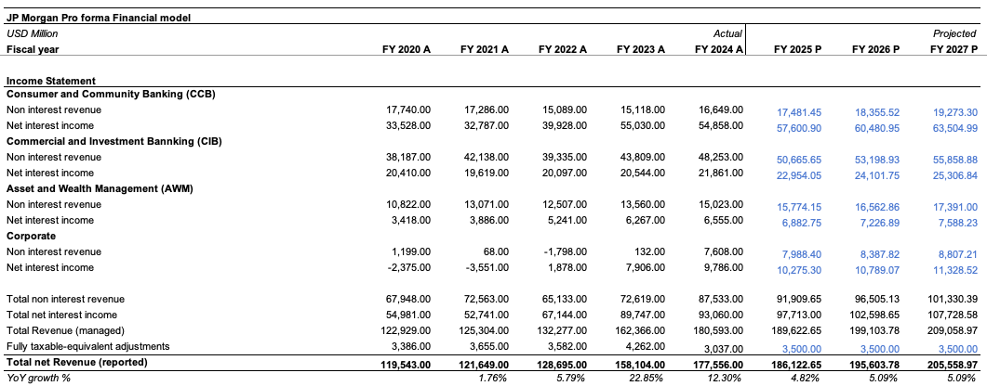
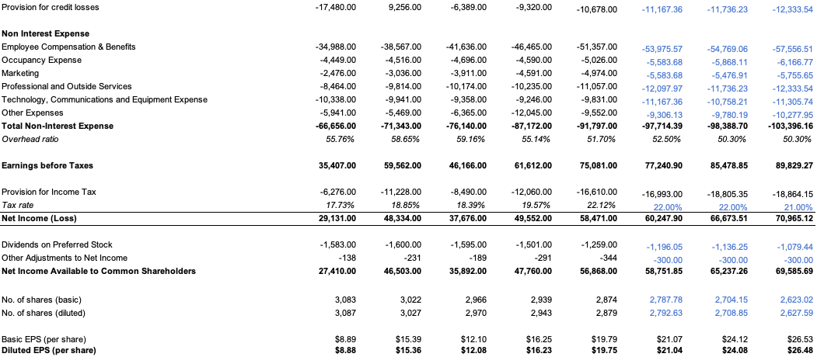
Financial Analysis
Assumed 5% growth in revenue over the long term, which is conservative
Interest income should increase in high inflation environment
Provision for credit losses were considered a little higher on economic uncertainty
Overhead ratio expansion as costs are on a larger base (40% EBIT margin long term assumed)
3% share repurchase assumed

Slide 19
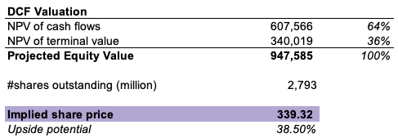
Valuation
Projected P/E multiple of 15x for 2025 and 14x for 2026
Implied growth rate CAGR for 2024-2030 was 5.7%
Healthy free cash flow generation given scale
Risks
Economic activity
Regulatory environment
Discount Rate (WACC) | 6.5%
FCF Growth Rate | 3%
Recommendation: HOLD

Slide 20

Visa (BUY/HOLD)
Overview
  3rd largest in the Financials sector, largest in credit services subsector
  Enable payments between consumers, merchants, financial institutions, and governments
  VisaNet
Key Drivers
  Diverse services and products
  Global Penetration
  Solid infrastructure and tech investments, staying ahead of the curve

Slide 21
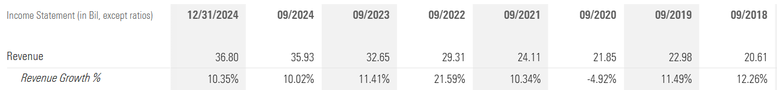
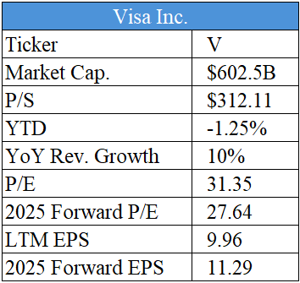
Financial Analysis
Source: Morningstar
Visa has an established history of achieving consistent YoY revenue growth while being a very mature company
Average of 10.32% since 2018
Visa has a higher P/E
Indicative of investor confidence
Indicative of an inflated price

Slide 22

Merits and Risks
Merits
  Large capital investments in their infrastructure, VisaNet
  Countless partnerships and acquisitions
  Earnings calls have shown ambition and growth with delivery on their promises
    Cooperating with global institutions and needs to seep into global penetration
Risks
  DoJ v. Visa anti-trust lawsuit
    As of 9/24/24
    Hearing with Visa and Mastercard in January
    New Trump Admin. figures
    Visa CEO calls the suit meritless
  Large chunk of Visa's value hinges on the outcome
Notes:
Feb 19, trump administration put in 3 new figures

Slide 23
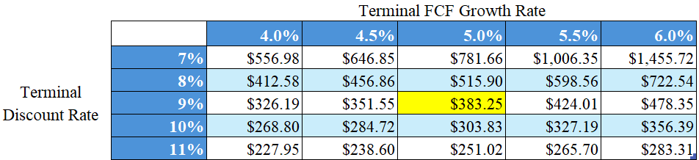
Valuation
This analysis assumes a 5% FCF growth rate; 9% discount rate
The target price of $383.35 is a 22.4% upside to the current $313.13
Recommendation: BUY/HOLD

Slide 24

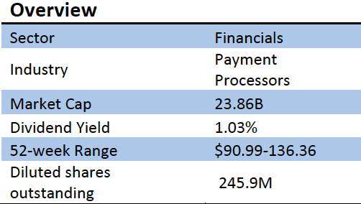
Growth Drivers
  Diversified Merchant Solutions and Issuer Solutions businesses
  Expanding footprint in sectors such as QSR, Education, Healthcare, Stadiums and Real Estate
  Increased cloud-based offerings with a healthy pipeline which runs through 2027
  Dual competitive moat as the company operates in both the Merchant Acquiring and Issuer Processing space
  GPN also has strong relationships with PayPal, Apple Pay and Google Pay

Slide 25
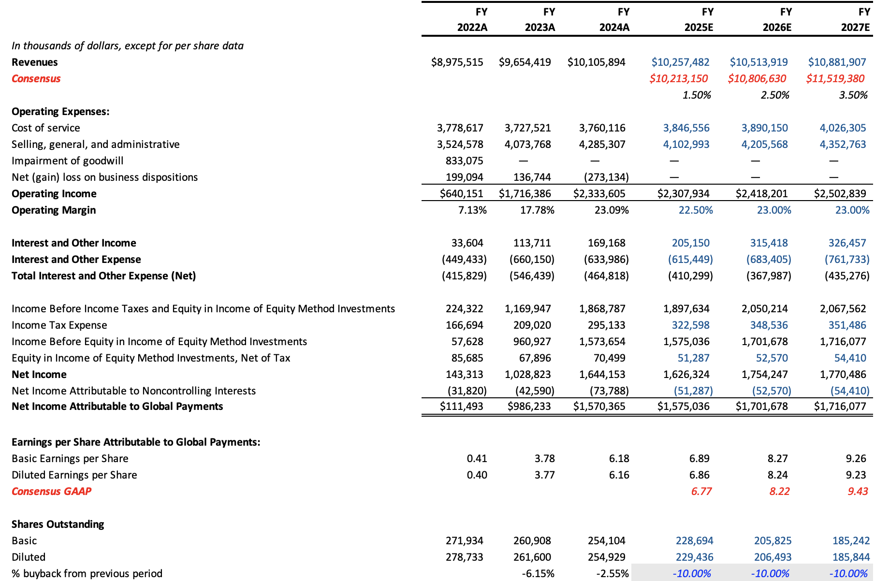
Financial Analysis
Revenue is forecasted to increase at a slower rate initially, but will pick up later
Reduction in expenses assumed as the company aims to streamline the Merchant Solutions business
No future business disposition is assumed
Company plans to return $7.5B to shareholders through FY27
Forecasted for marginal increase in CapEx as the company could consider acquiring smaller companies
EPS is forecasted to undergo double-digit growth through FY27

Slide 26
Valuation
TICKER | P/E | EV/EBITDA |  | Target P/E | Current P/E | Target/Current | Current Stock Price | Target Price
Fiserv (FI) | 32.29 | 16.35 |  | 20.00 | 14.10 | 1.42 | $95.86 | $135.97
Fidelity National Information Services (FIS) | 24.18 | 14.17
Broadridge Financial Solutions (BR) | 29.14 | 19.42
PayPal (PYPL) | 19.64 | 13.00 |  | Target EV/EBITDA | Current EV/EBITDA | Target/Current | Current Stock Price | Target Price
Average | 26.31 | 15.74 |  | 12.00 | 9.25 | 1.30 | $95.86 | $124.36
Current Price |  | $95.86 |  |  | Consensus Price Target |  | $131.26
Implied Price |  | $128.13
Upside/(Downside) to fair value |  | 33.67%
METHOD | TARGET PRICE
Target P/E | $135.97
Target EV/EBITDA | $124.36
DCF | $128.13
Average | $129.49
Target price is derived using DCF and target multiples
The stock trades at a significant discount to its peers on both P/E and EV/EBITDA basis
Discount rate of 8% and terminal growth rate of 2.50% was used in the DCF
DCF gives out TP as $128.13
Taking the average of all the prices from both approaches gives us a target price of $129.49
RECOMMENDATION | BUY

Slide 27
Sector Recommendation
TICKER | Projected upside (%) | CURRENT WEIGHTAGE (%) | CHANGE (bps) | PROPOSED WEIGHTAGE (%)
BAC | 39.3 | 5.07 | -100 | 4.07
HBAN | 9.2 | 0.96 | -96 | 0.00
JPM | 38.4 | 3.67 | 0 | 3.67
V | 22.4 | 4.84 | 0 | 4.84
PYPL | 62.8 | 0.00 | 150 | 1.50
GPN | 52.5 | 0.00 | 50 | 0.50
MKTX | 18.1 | 0.00 | 50 | 0.50
TOTAL |  | 14.54 |  | 15.08
Overall we believe the SIM portfolio should increase its weightage in the financial sector from 14.55% to 15.08%
S&P has a 14.68% weight for the sector – 40 bps OVERWEIGHT

Slide 28
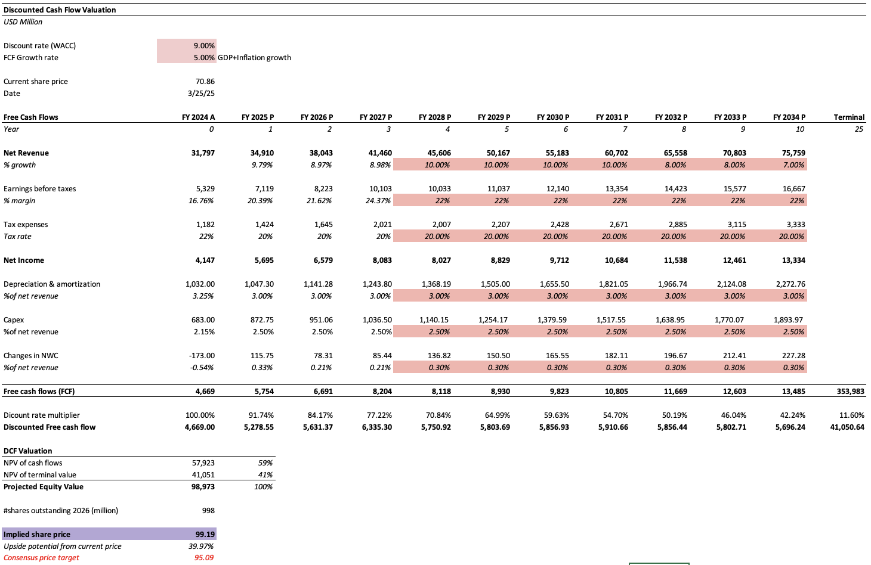
Appendix – PayPal DCF

Slide 29
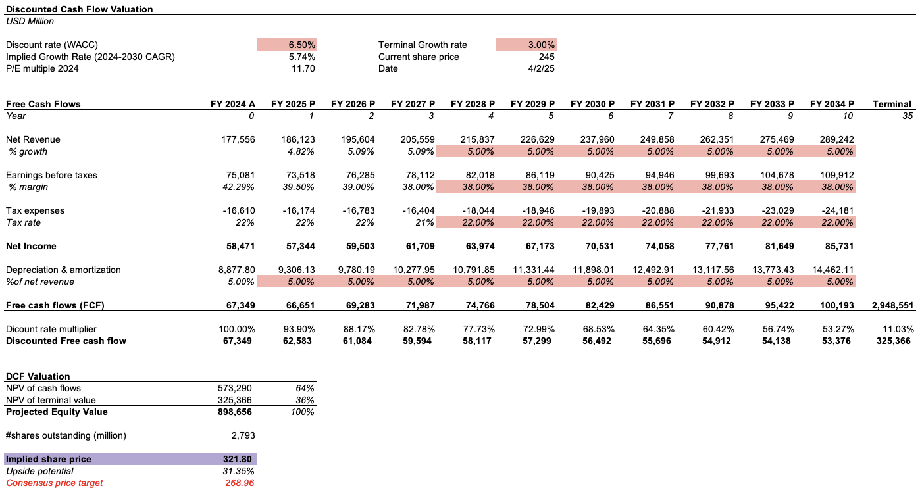
Appendix – JPM DCF

Slide 30
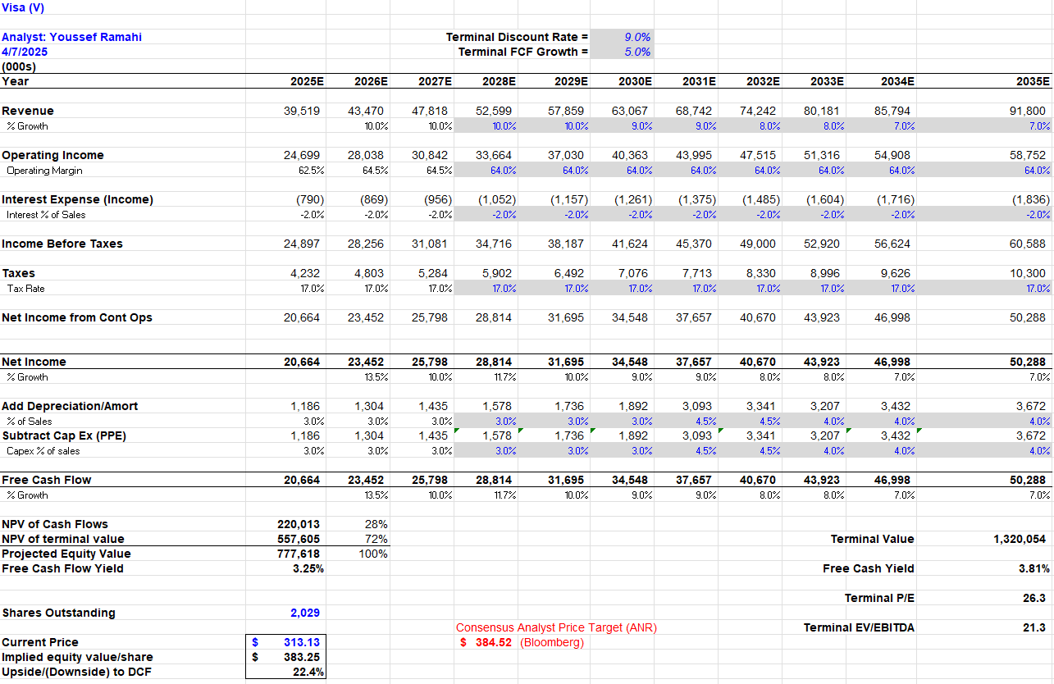
Appendix – Visa DCF

Slide 31
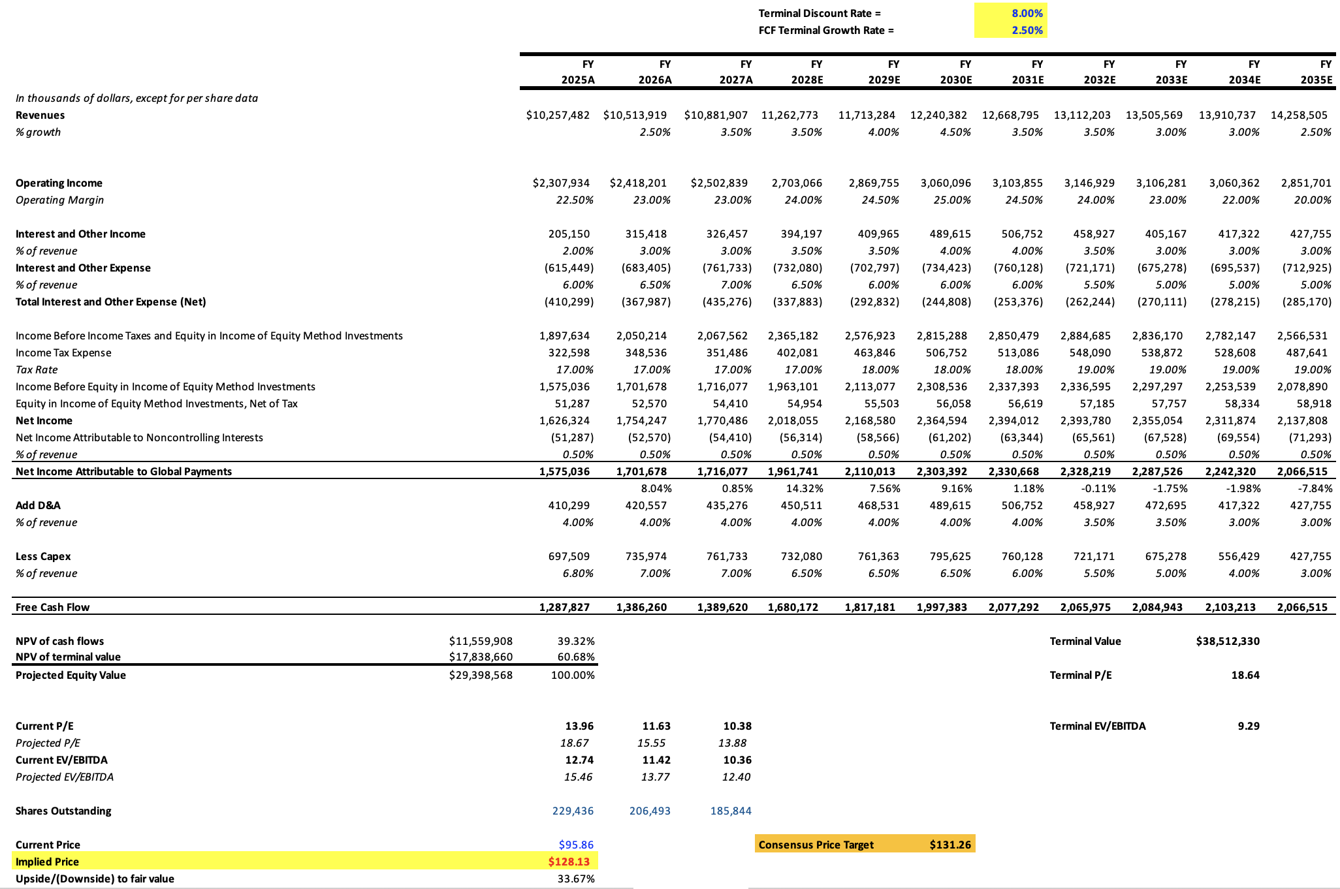
Appendix – GPN DCF

Slide 32
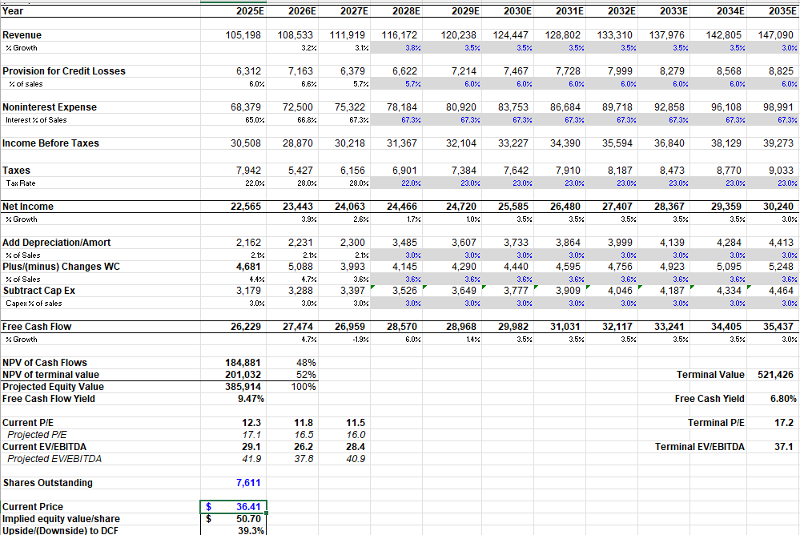
Appendix - BAC DCF

Slide 33
Appendix – HBAN DCF

Slide 34
Appendix – MKTX DCF

