Slide 1
Financials
By Animesh, Youssef, Prasun, Ram and Vishal

Slide 2
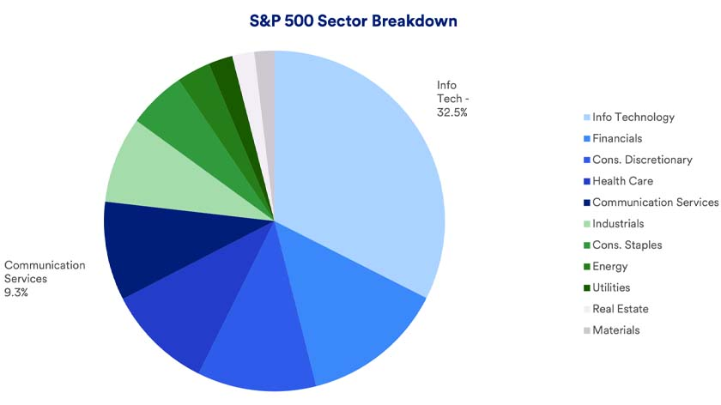
Overview of the Financials Sector
Financials: The Backbone of the Economy
Size & S&P 500 Share → ~13% of S&P 500
Key Industries → Banks, Insurance, REITs, Asset Mgmt.
Top Companies → JPMorgan, BofA, Wells Fargo, BlackRock
YTD Performance → Outperformed tech, but lagged health care
What Drives It? → Rates, inflation, economic cycles
Notes:
The financial sector is the backbone of the economy, making up about 13% of the S&P 500. It’s not just about banks, this sector spans insurance, real estate investment trusts (REITs), and asset management firms, all of which play a massive role in the movement of money. The biggest players include JPMorgan, Bank of America, Wells Fargo, and BlackRock, powerhouses that control trillions in assets.
So far this year, financials have held up better than tech but haven’t quite kept pace with energy. However, in the last quarter, concerns over interest rates and inflation have caused some turbulence. This sector thrives when the economy is strong, but when uncertainty creeps in, volatility follows.

Slide 3
Product Segmentation
Banking Services :
  Retail & Commercial Banking -> Bank of America, JPMorgan Chase
  Investment Banking & Advisory -> Goldman Sachs, Morgan Stanley
Asset Management & Brokerage :
  Investment Management -> BlackRock, State Street
  Discount & Full-Service Brokerage -> Charles Schwab
Insurance : MetLife, Prudential etc.
Consumer & Business Lending :
  Credit Cards & Payments Services -> Visa, PayPal
  Auto & Mortgage Loans -> Wells Fargo, US Bancorp

Slide 4
Impact Factors
Federal Reserve Policy -> Interest rate changes affect profitability, loan demand and investment activity
Economic Growth -> Strong economy is conducive for more lending, investment banking and asset management activity, while a slowdown does the opposite
Regulations -> Stricter banking regulations increases the capital requirements for the banks and affects their lending capacity
Real Estate Market -> Slowdown in the commercial and residential real estate market negatively affects lenders and dents their profitability

Slide 5
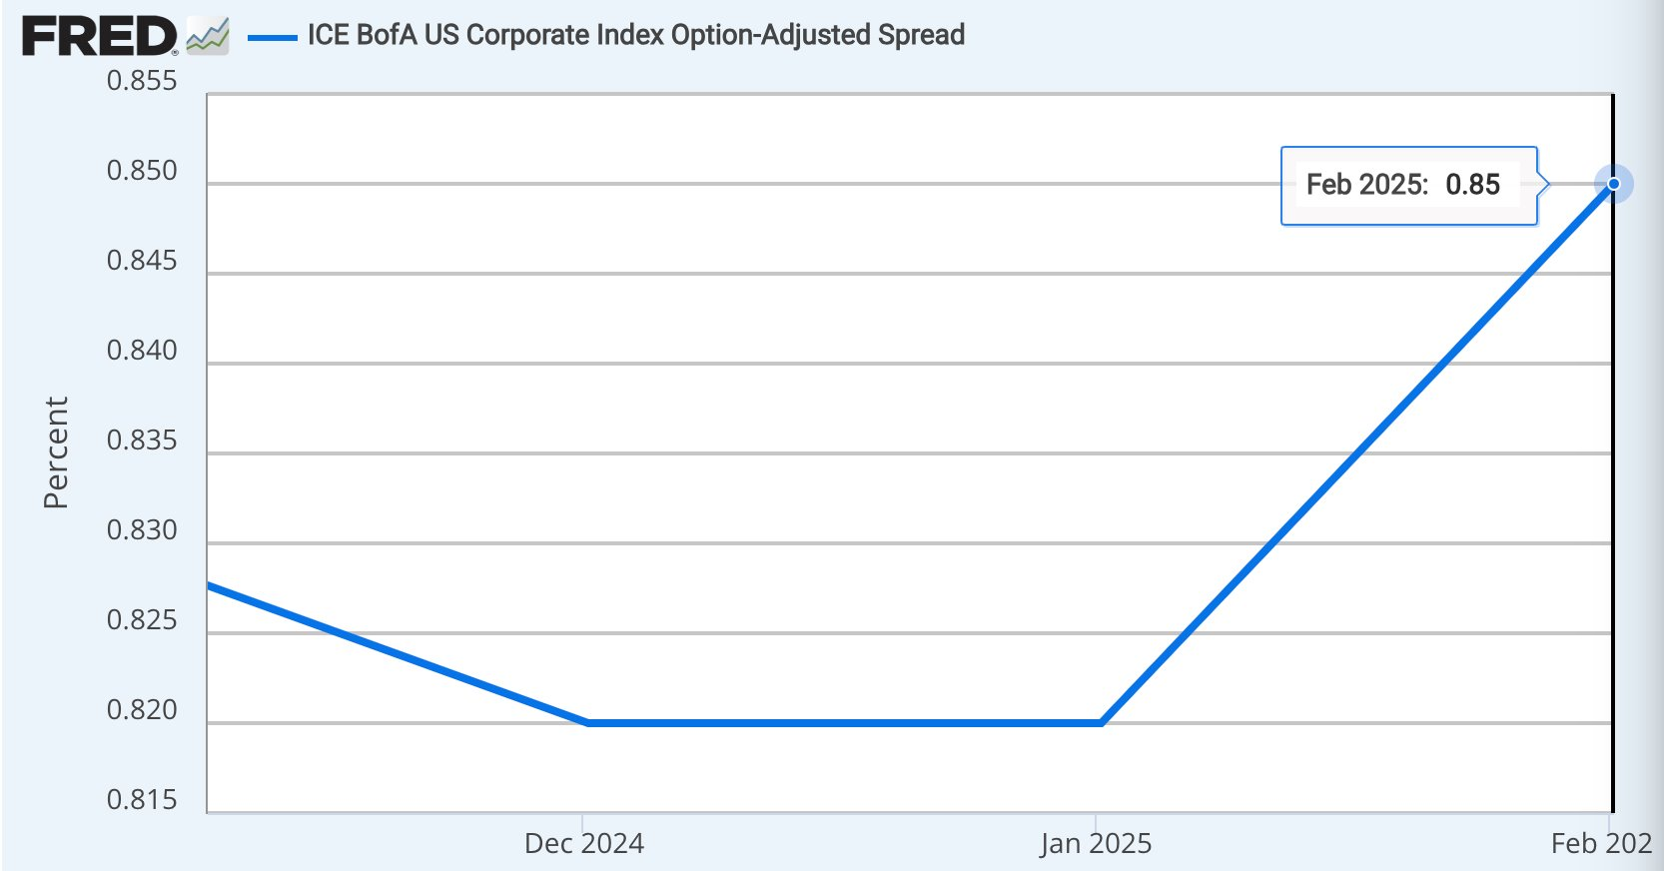
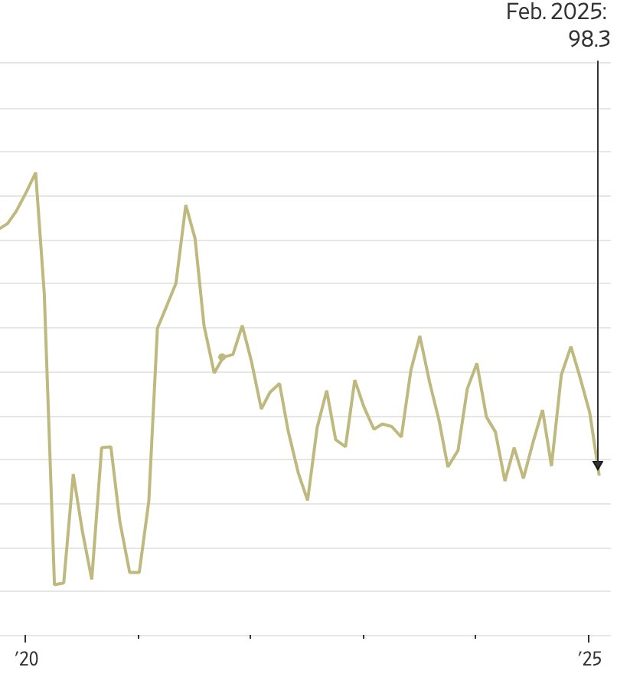
Credit Cycle
Currently transitioning from peak to late-cycle phase:
i. High Interest Rates -> Federal Reserve has maintained high interest rates, but banks have maintained high NIM
ii. Tightening Credit Conditions -> Banks have been more selective in lending as result of rising default risk, leading to slower loan slower growth
iii. The latest Consumer Sentiment index fell to 98.3 in its latest reading
iv. Increasing credit loss provisioning for banks

Slide 6
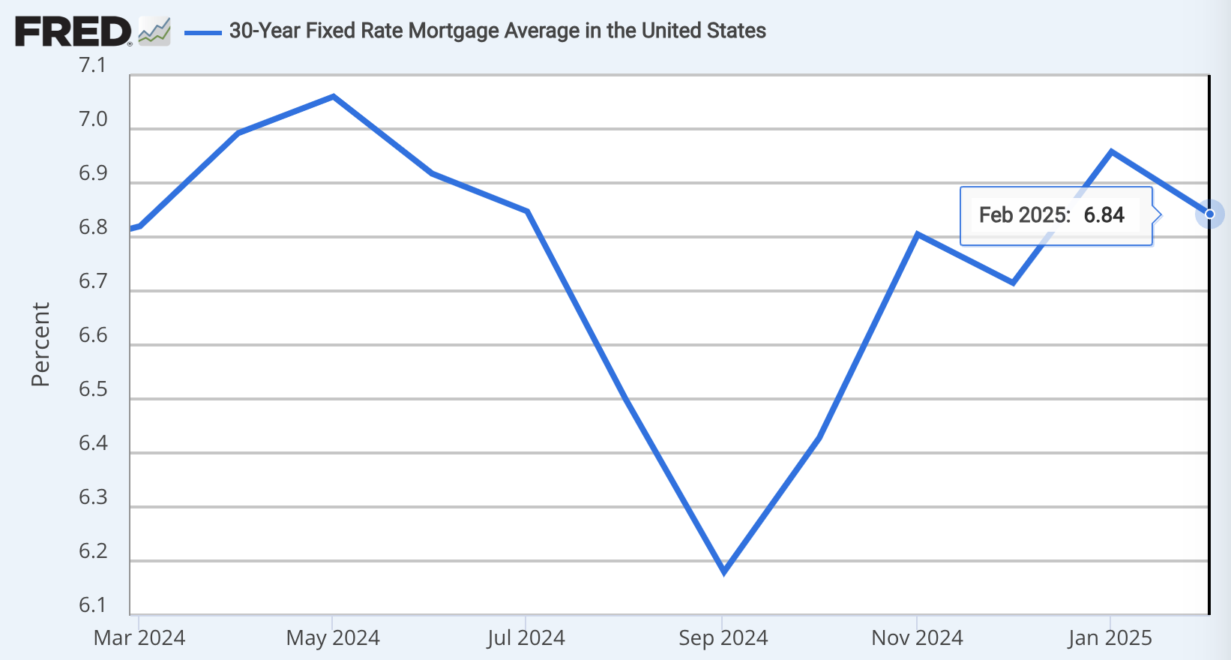
Lending Downturn
Mortgage -> Home sales hit lowest levels since 1995. Sales fell 4.9% in January as mortgage rates remain near peak levels averaging at 6.84%
Auto Loans -> Car prices may surge because of expected tariffs leading to lower demand as consumers try to cut back on discretionary spending
Credit Cards -> Increasing defaults (especially low-income households) due to increasing borrowing costs and sustained higher levels of inflation

Slide 7
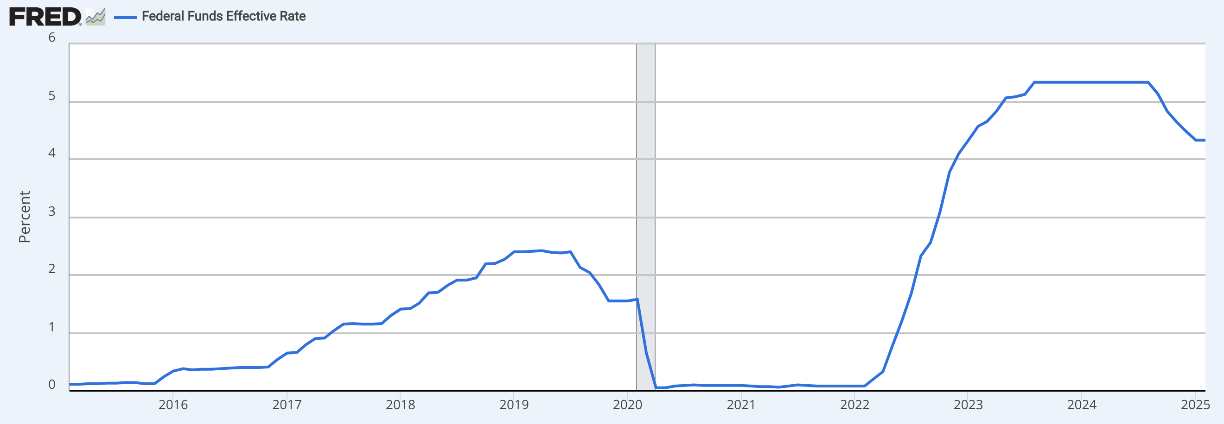
Economic Analysis
2024 witnessed the highest interest rate environment since 2000

Slide 8
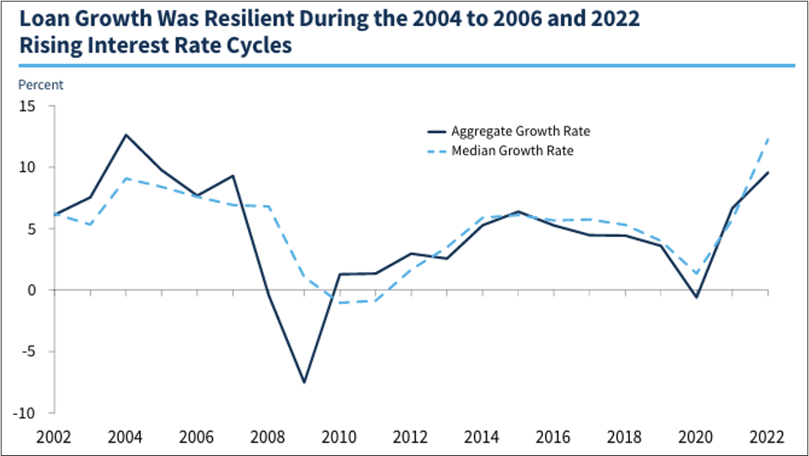
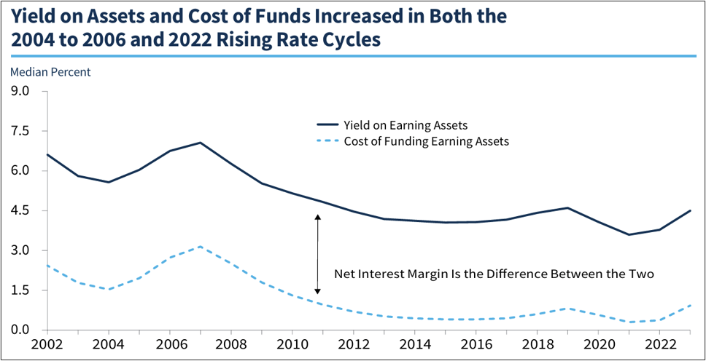
Interest Rates
Interest rates have a positive effect on banks improving their Net Interest Income
However, higher the interest rates, the cost of funding also increases, as banks are unable to extend loans at higher rates due to weak loan demand
Loan demand may be supported by strong labor markets and high inflation (high growth environment)

Slide 9
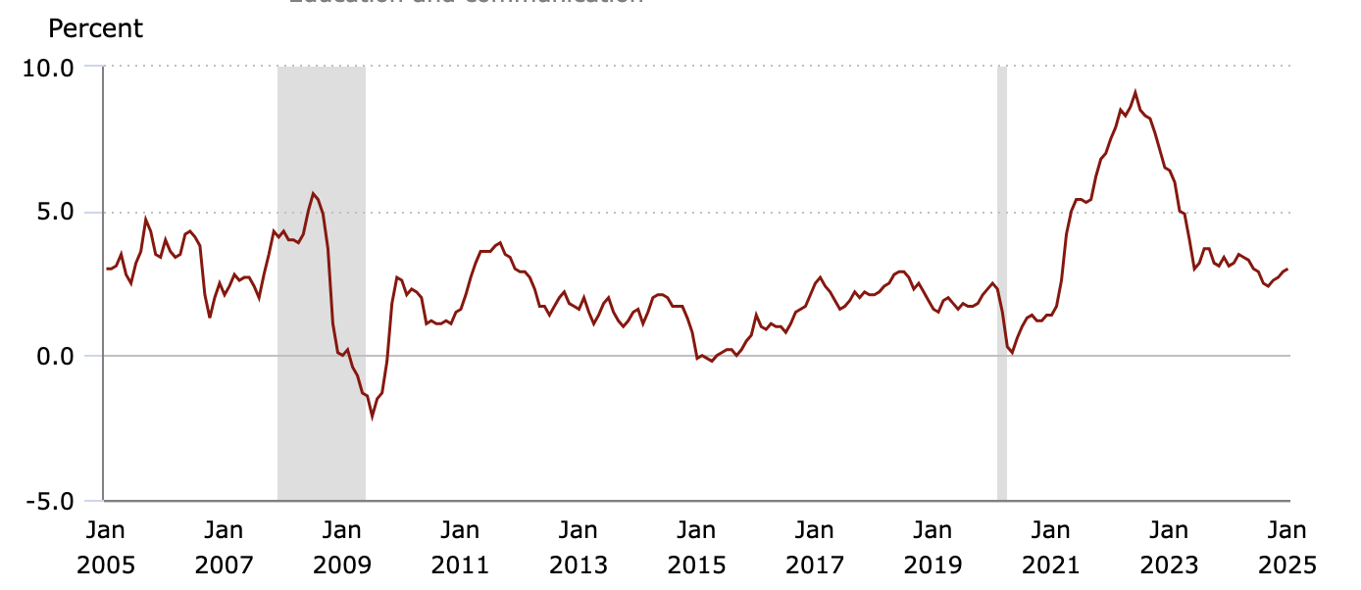
Inflation
Banking systems are largely insulated from inflation
- Both bank income and expenses rising with inflation to similar degrees

Slide 10
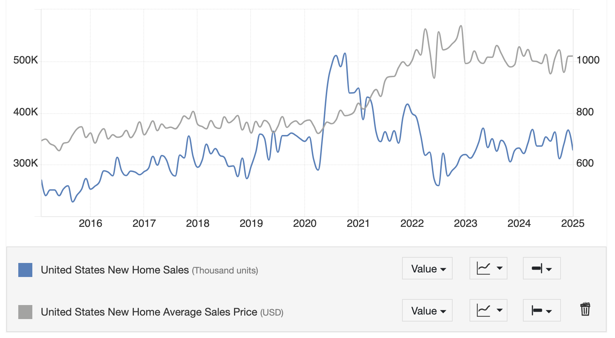
New Home Sales
Housing prices is major driver of inflation
New Home sales have declined in value significantly since 2021 as average home prices have reached all-time highs

Slide 11
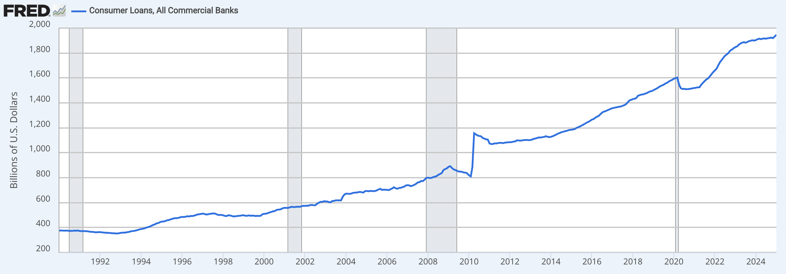
Consumer Spending
Consumer loans at all time high as inflation and interest rates remain high and wage growth has not kept up.

Slide 12
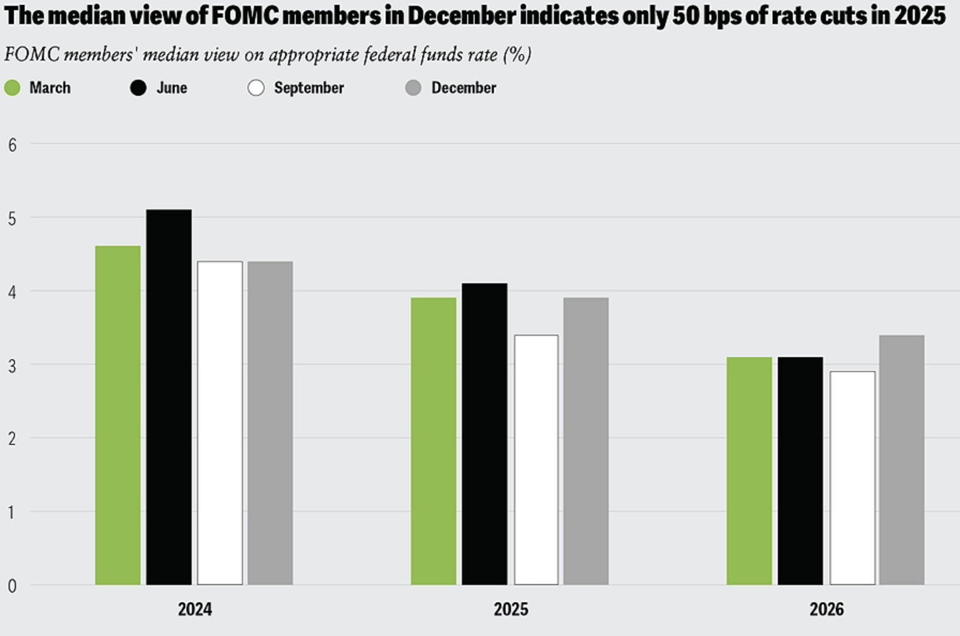
Outlook for 2025/26
Only one rate cut expected this year of around 50 bps
Tariff hikes will impact inflation
Mortage rates not expected to drop in the near future (to remain above 6%)
Lower corporate tax rates expected under current administration

Slide 13
Financial Analysis
Top 10 By Market Cap (2023)
 | Revenue Growth | Op Inc | EBITDA | Net Income
BRK/A | 20.70% |  | 17.20% | 10.30%
JPM | 22.30% | 40% |  | 31%
V | 11.40% |  | 70.60% | 55.60%
MA | 12.20% |  | 61.70% | 47.50%
BAC | 4.10% | 29.40% | 25.80% | 25.80%
WFC | 11.10% | 29.70% |  | 23.70%
MS | 0.90% | 24% |  | 17.50%
AXP | 14.50% | 17.40% |  | 13.60%
GS | -2.30% | 23.50% |  | 17.30%
BX | -7.40% | 40.40% |  | 18.60%
Average | 8.75% | 29.20% | 43.83% | 26.09%

Slide 14
Financial Analysis
Top 10 By Market Cap (2024)
 | Revenue Growth | Op Inc | EBITDA | Net Income
BRK/A | 1.90% |  | 19.90% | 12.80%
JPM | 12.30% | 42.80% |  | 32.40%
V | 10.30% |  | 70.20% | 56.60%
MA | 12.20% |  | 61.60% | 48.10%
BAC | 3.20% | 29% |  | 25.20%
WFC | -0.40% | 29.70% |  | 22.60%
MS | 14.10% | 28.60% |  | 20.80%
AXP | 9% | 19.60% |  | 15.20%
GS | 15.70% | 34.70% |  | 25.50%
BX | 68.40% | 50.30% |  | 22.10%
Average | 14.67% | 33.53% | 50.57% | 28.13%

Slide 15
Financial Analysis
 | Revenue Growth | Op Inc | EBITDA | Net Income
FY2023 | 8.75% | 29.20% | 43.83% | 26.09%
FY2024 | 14.67% | 33.53% | 50.57% | 28.13%
Ratios to Note:
Growth of Revenue
Net Income

Slide 16
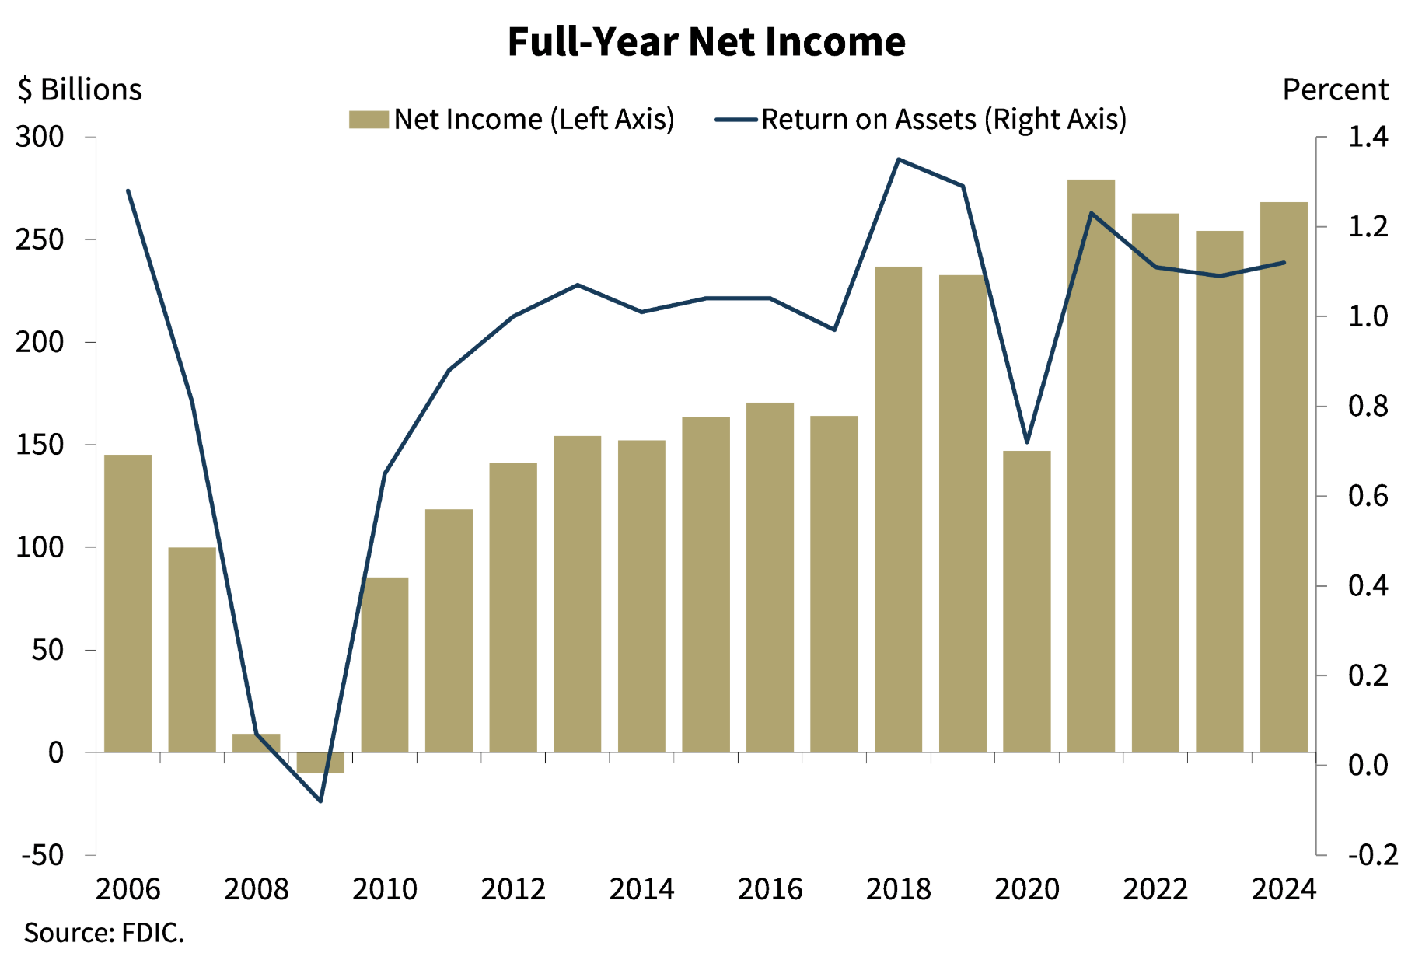
Financial Sector Performance
Net income and RoA in banking has been increasing

Slide 17
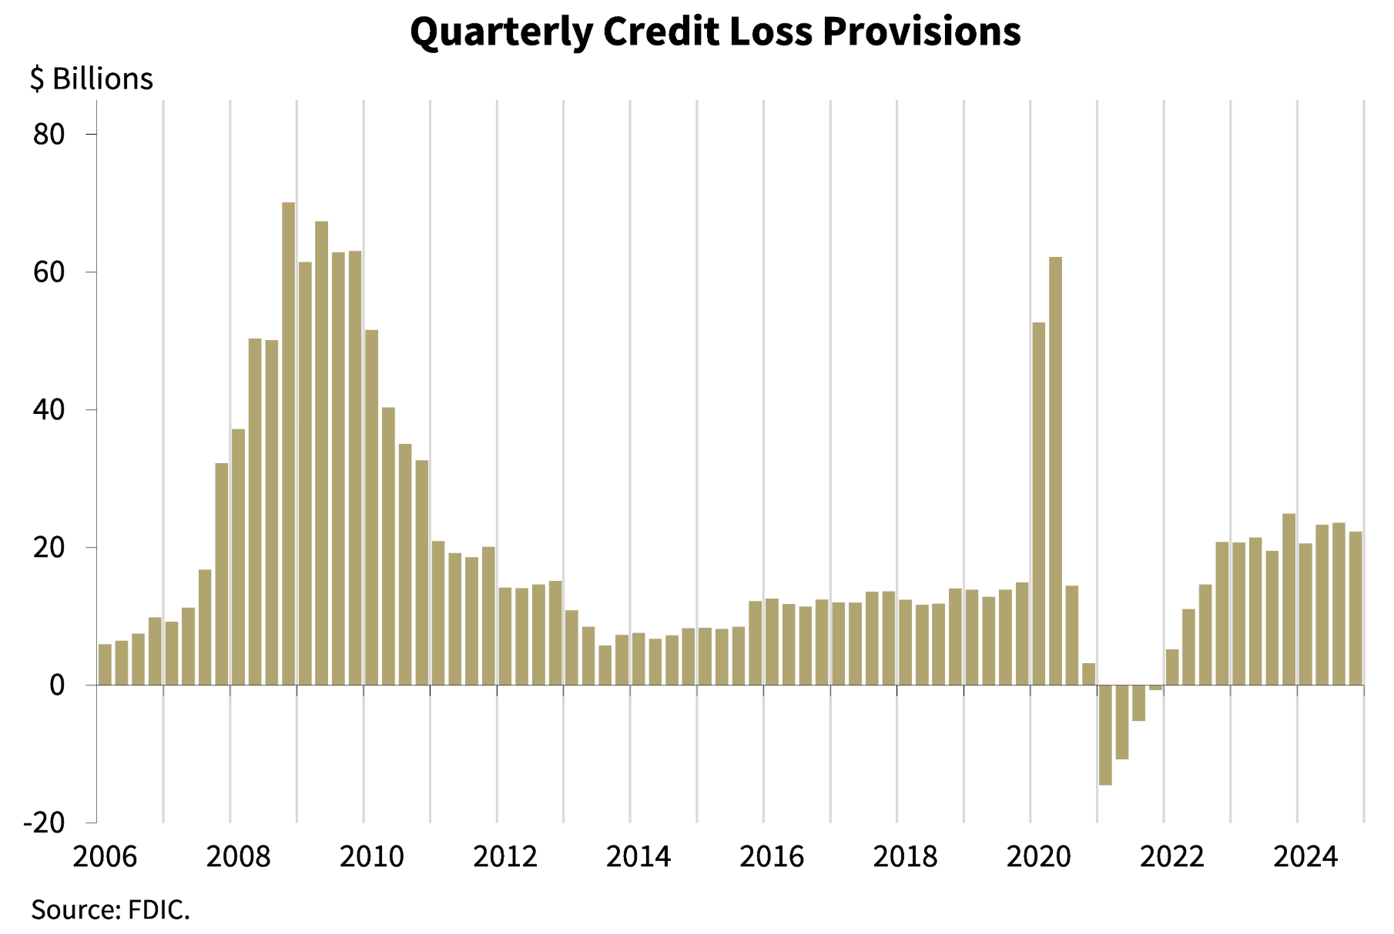
Higher Credit Loss for Banks
Due to low credit quality, credit loss has been increasing

Slide 18
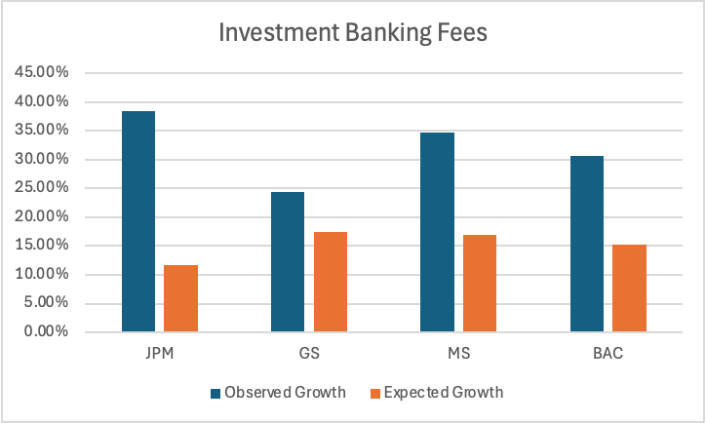
Investment Banking Fees
Strong growth in revenues from investment banking fees was observed in FY24 against FY23, indicating robust M&A and capital markets activity

Slide 19
Investment Management Outlook
ETFs continue to do well, with mutual funds converting to active and passive ETFs
Higher AUM and higher advisory fees will have a positive impact on the overall margins

Slide 20
SPX vs. Financials Returns
SPX
17% returns LTM
-1.6% returns L3M
-0.7% returns L1M
Financials
30% returns LTM
3% returns L3M
1.7% returns L1M

Slide 21
SPX vs. Financials Valuation
SPX Current (Average)
P/E 26.7 (21.5)
P/B 5.2 (3.7)
P/S 3.0 (2.3)
P/EBITDA 13.5 (12.7)
Financials Current (Average)
P/E 19.4 (14.8)
P/B 2.4 (1.6)
P/S 2.6 (2.2)
P/EBITDA 13.5 (16.2)

Slide 22
Intrasector Returns (GICS)
Banks
38.5% returns LTM
3.6% returns L3M
-0.1% returns L1M
Financial Services
10.9% returns LTM
7.3% returns L3M
5.3% returns L1M
Insurance
25.3% returns LTM
3.1% returns L3M
7.5% returns L1M

Slide 23
Intrasector Valuation - Banks
Current (Average)
P/E 12.9 (14.3)
P/B 1.5 (1.6)
P/S 3.3 (2.6)
EV/EBITDA N/A N/A
Financials Current (Average)
P/E 19.4 (14.8)
P/B 2.4 (1.6)
P/S 2.6 (2.2)
P/EBITDA 13.5 (16.2)

Slide 24
Intrasector Valuation – Financial Services
Current (Average)
P/E 23.2 (17.7)
P/B 3.4 (2.1)
P/S 5.1 (2.7)
EV/EBITDA 8.4 (10.2)
Financials Current (Average)
P/E 12.9 (14.3)
P/B 1.5 (1.6)
P/S 3.3 (2.6)
EV/EBITDA N/A N/A

Slide 25
Intrasector Valuation - Insurance
Current (Average)
P/E 16.0 (16.3)
P/B 2.8 (1.6)
P/S 1.9 (1.2)
EV/EBITDA N/A N/A
Financials Current (Average)
P/E 12.9 (14.3)
P/B 1.5 (1.6)
P/S 3.3 (2.6)
EV/EBITDA N/A N/A

Slide 26

Recommendation & Sector Positioning
Overweight or Underweight? Let’s Decide
Recommendation → Overweight: Strong earnings & growth
Drivers → Higher economic activity, Higher capital markets activity, loan growth
Biggest Risks → Recession, lower credit quality, rate surprises
Overweight Industries → Banks, Asset managers, Payment services companies
Underweight Industries → REITs, Fintechs, Insurance companies
Notes:
So, should we be overweight or underweight financials? Right now, I’d say overweight. Banks and insurers are in a strong position as interest rates stabilize, and demand for financial services remains solid.
The biggest risks? If we hit a recession, credit risks rise, and banks might struggle with loan defaults. Plus, if the Fed surprises us with rate changes, we could see unexpected volatility.
Within financials, I’d go overweight on banks, asset managers, and insurers, these firms thrive in a stable rate environment. On the other hand, I’d underweight REITs and fintech stocks since higher borrowing costs hit them hard. Traditional finance is proving resilient, while some of the newer, digital players are facing challenges.
So, overall financials are a strong bet, but we need to be selective on which industries to back!

