Slide 1
Financials Sector
Stock Recommendation Presentation
Luke Houston, Pradyot Jillella, Byoungjun Jo, Jacob Katz

Slide 2
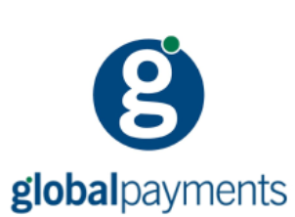



Overview
The Financials Sector contains companies engaged in banking, financial services, consumer finance, capital markets and insurance activities
$7.6 trillion market cap; 73 constituents
Key financial indicators that impact the sector:
              Interest rates
              Credit Conditions
              Global liquidity
Other significant constituents: JPMorgan Chase, Goldman Sachs, MetLife, Moody’s, American Express

Slide 3
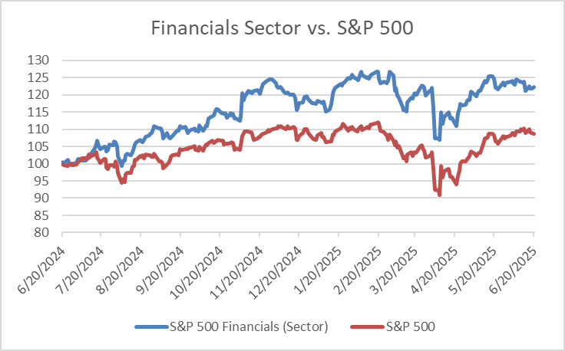
Sector Recommendation
The SIM portfolio is Overweight in the Financials sector
SIM Weight | S&P 500 Weight | +/-
14.77% | 13.99% | 0.78%
1-Year Return
Financials | 23.36% | S&P 500 | 10.26%

Slide 4

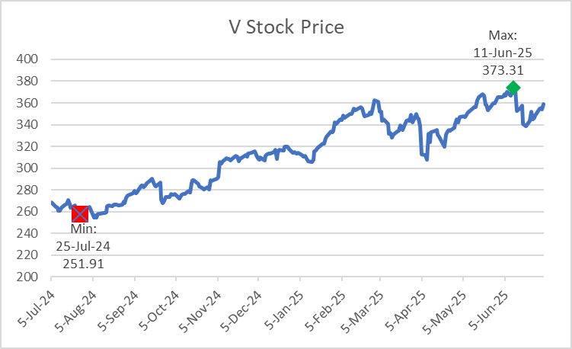
Overview
Visa Inc. (V)
A global payments technology company facilitating digital payments across 200+ countries
Operates the world’s largest retail electronic payments network
Makes money by charging fees to financial institutions for processing transactions, not issuing cards or taking credit risk
Market Data (*billions)
Market Cap* | $695.89
Shares Outstanding* | 1.729
52 Week Range | $252.70-$375.51
1 Year Return | 34.05%
YTD Return | 10.8%
Beta | 0.94
EPS (FY24) | $9.73
Dividend Yield | 0.66%
Revenue (FY24)* | $35.9
YoY Rev Growth (23v24) | 10.0%
Operating Inc (FY24)* | $23.60

Slide 5
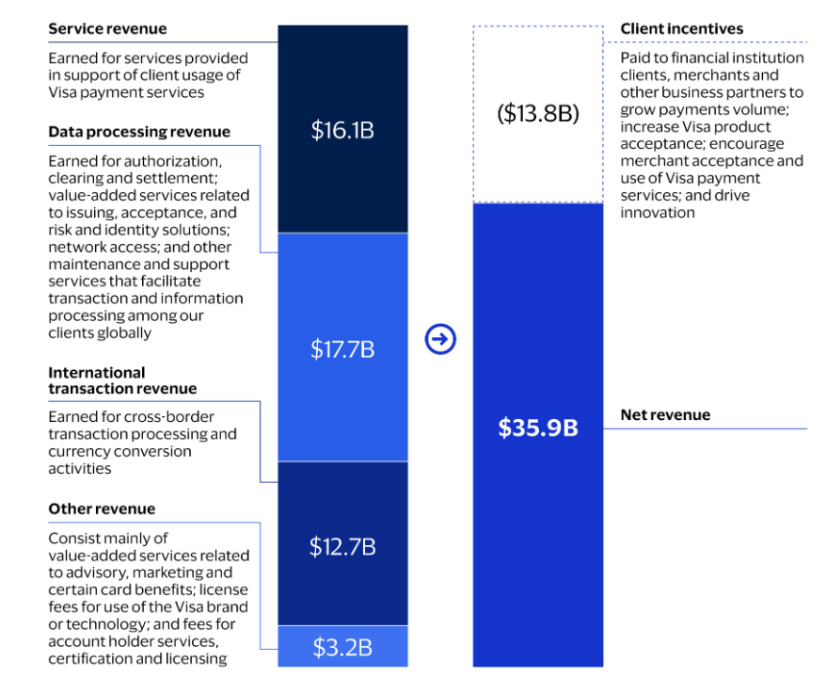
Business Analysis
Does not report enterprise structure based on defined business segments, but instead has 5 main revenue categories:
Service, Data Processing, International Transactions, Other, and Client Incentives
Visa has an extremely capital-light business model, allowing it to maintain a high profit margin rarely seen among large, mature companies.
Fee volume impacted by international travel, interest rates, and consumer activity

Slide 6
Financial Analysis
Strong revenue growth
  Projected to double 2020 revenue by 2026
Steady profit margins, even as business grows
Model EPS aligned with consensus
      Anticipated to nearly triple from 2020-2027

Slide 7
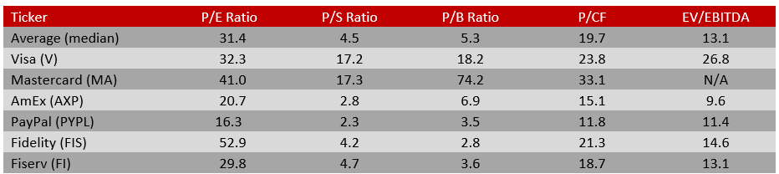
Valuation
DCF model has Visa significantly overpriced
Visa above median across all multiples
Blended/weighted-average method to derive final price target, using DCF, peer median P/E as base case and 10% premium to median P/E as premium case
Recommendation:
Hold

Slide 8
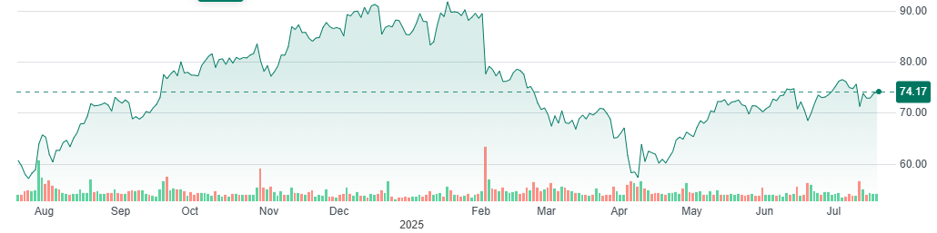
Overview
Background on company
Market Data (*billions)
Market Cap* | $72.133
Shares Outstanding* | 1.039
52 Week Range | $55.85-$93.66
1 Year Return | 23.62%
YTD Return | -13.10%
Beta | 1.45
EPS | 4.45
Dividend Yield | -
Revenue (FY24)* | $31.797
Rev Growth (23vs24) | 6.81%
Operating Income* | $5.325
PayPal Inc. (PYPL)
A leading global fintech company specializing in online payments
Enables consumers and merchants to send and receive money, pay for goods, and manage funs electronically
Has roughly 430 million active accounts worldwide

Slide 9
Business Analysis
Bulk of their revenue comes from transaction fees (merchant and currency conversion fees)
Key competitors include Stripe, Square (Block), Apply Pay, Google Pay
Competitive advantages in global scale, strong digital wallet ecosystem, and unbranded processing via Braintree
Growth with stem from rising e-commerce volume, digital wallet adoption, and unbranded checkout integration
Business Break Down
Segment | Brief Description | % of Revenue
Transaction Revenues | Fees from processing transaction | 90%
Value-Added Services | Subscription fees, interest income, credit-related services, and referral agreements | 10%

Slide 10
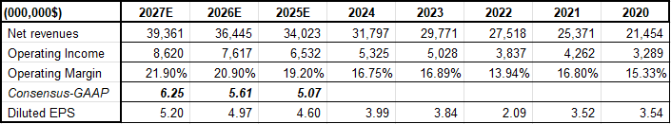
Financial Analysis
Strong revenue growth
Revenue projected to grow from $21.5B (2020) to $39.4B by (2027), reflecting an 83% increase over 7 years.
Expanding operating income & margin
Operating income expected to grow from $3.3B (2020) to $8.6B (2027).
Operating margin projected to improve steadily from %15.3 (2020) to 21.9% (2027).
Model EPS aligned with consensus expectations
Diluted EPS forecasted to increase from 3.54 (2020) to 5.20 (2027).
Reflects a 47% increase in earnings per share, indicating strong earnings leverage.

Slide 11

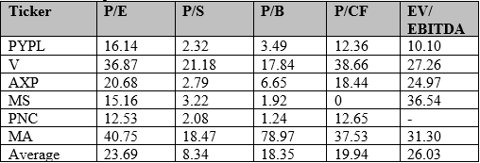
Valuation
Based on the DCF model, the stock is trading well below what the DCF model suggests it's worth.
PayPal's valuation multiples are consistently lower than those of comparable companies, implying that the market may be assigning PayPal a discount.
This supports the view that PayPal is undervalued compared to peers.
Recommendation:
Buy

Slide 12

Overview
Market Data
Market Cap | 356.41 B
Shares Outstanding | 7.53 B
52 Week Range | 33.07 - 49.31
Beta | 1.31
EPS (TTM) | 3.41
Current Price | 47.77
Dividend Yield | 2.17%
Financial Data
Revenue (TTM) | 97.45 B
Rev Growth (quarterly) | 5.70%
Bank of America Corp. is a financial institution offering a wide array of services from consumer banking, global wealth management to global banking and markets, with headquarters in Charlotte, North Carolina.
Recently:
Q2 Earnings show growth in revenue and net income.
Strong consumer spending
Macroeconomic strength
Exploring stablecoins as regulations show digital asset favorability

Slide 13
Business Analysis
Strengths
Maintained strength in all business segments with diversified model.
Growing digital bank usage and enhanced fintech presence
Risks
Interest rates, and macroeconomic sensitivities.
Cybersecurity and data protection
Credit quality
Business Breakdown
Segment | Brief Description | % Of Revenue (YTD)
Consumer Banking | General retail banking to individuals | 39.36%
Global Asset & Wealth Management | Financial management of high-net-worth clients | 22.09%
Global Banking | Lending, commercial and investment banking | 21.56%
Global Markets | Equity, fixed income, and currency trading | 23.22%
Other | Corporate treasury, liability management, discontinued projects | -6.23%
Q2 Earnings

Slide 14

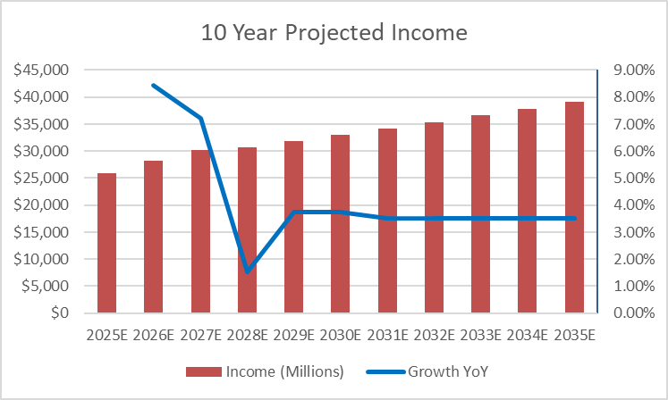
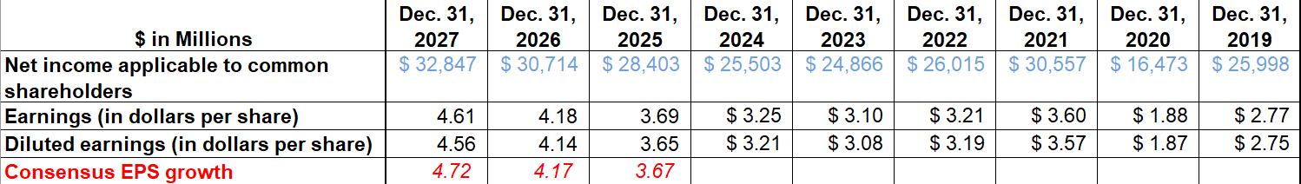
Financial Analysis
Outperformed earnings expectations the past 4 quarters.
Revenue grew by 4%, NI grew by 7%. EPS was $0.89
Expecting continuous earnings growth.
Annual expected dividend yield of 2.17%

Slide 15

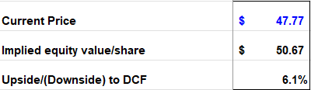
Valuation
Discount and Growth Rate:
Bank of America DCF
Discount rate was found using CAPM and conservative subjective reasoning. Growth rate follows the same line of reasoning. Both could be perceived to be higher as technology inevitable comes with new opportunities, and costs.
Price Ratios
10% weight placed on P/E, P/B, and P/S target price.
70% weight placed on DCF.
Final Target Price: $50.57
Implied Gain: 5.86%
Dividend: 2.17%
Expected Return: 8.03%
Metric | Current Stock Price | Current Multiple | Target Multiple | Target / Current | Target Price | Implied Return
P/E | $47.77 | 13.92 | 14.75 | 1.0596 | 50.62 | 5.96%
P/B | $47.77 | 1.28 | 1.50 | 1.172 | 55.98 | 17.19%
P/S | $47.77 | 3.54 | 3.25 | 0.929 | 44.37 | -7.14%
Recommendation
BUY

Slide 16


Overview
Global Payments Inc. Is a leading worldwide payments-technology company, providing software-driven commerce solutions to millions of businesses for over 50 years.
$3.7T worth of annual payment volume processed
94 B transactions enabled each year
6 M+ merchant and partner locations served
Presence in 175+ countries / 100+ markets
Approximately 27 K employees worldwide
Market Data
Market Cap | $20.34B
Shares Outstanding | 246.7M
52 Week Range | $65.96–$120.02
1 Year Return | ‑19.4%
YTD Return | -26%
Beta (5-yr monthly) | 0.94
EPS (GAAP) | $6.16
Dividend Yield | 2.48%
Financial Data (FY23)
Revenue | $10.1B
Rev Growth (YoY) | 4.7%
Operating Income | $2.3B
Operating Margin | 23.1%

Slide 17
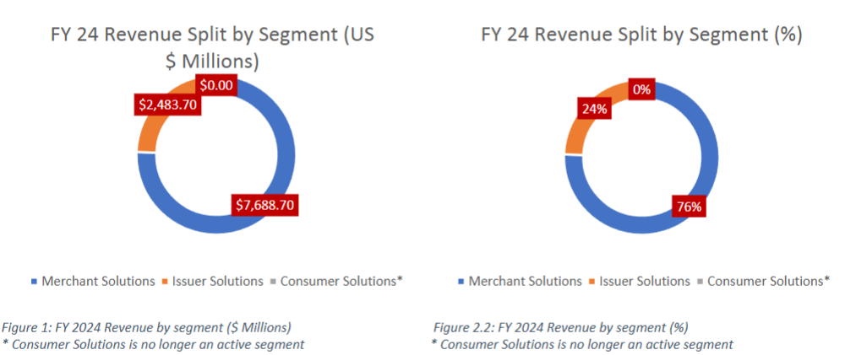
Business Analysis
Post the divestiture of Issuer Solutions as part of the Worldpay acquisition, GPN will be operating mainly through its Merchant Solutions segment (SaaS POS, value-added software) as well as a small bucket accounting for miscellaneous services.
Merchant Solutions generates ≈ $7.7 B revenue and ~$2.6 B operating income which constitutes roughly three-quarters of consolidated profit.
Long-term moat backed by 50-year track record underpinning extensive bank and merchant ties spanning 170+ countries, processing 94B transactions at a volume of $3.7T annually.
Post‑Worldpay integration, the company ranks among the top three global acquirers by transaction count and cross‑border reach.
Divestiture cash is funding a cloud‑native platform that unifies routing, fraud analytics and POS software, positioning GPN for higher‑margin software upsell and faster time‑to‑market ($600M cost-save run-rate).

Slide 18
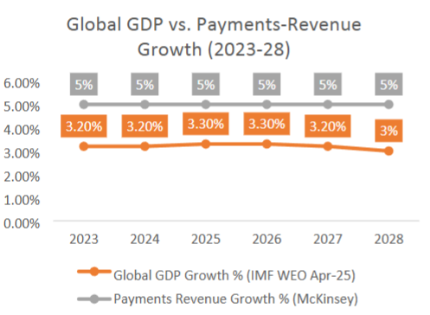
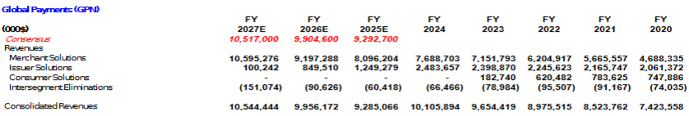
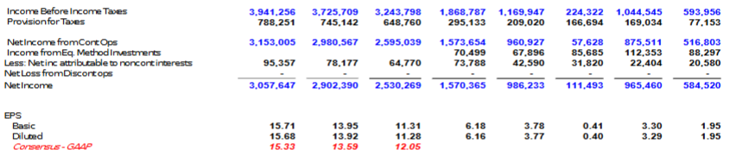
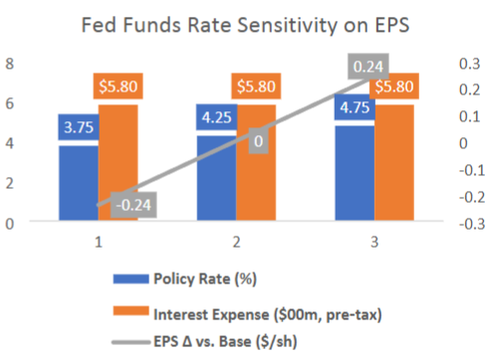
Financial Analysis
GPN has had a solid earnings trajectory with Net income climbing from $966M in 2021 to $986M in 2023 and is forecast to exceed $1.6B in 2024 as the Worldpay cost‑synergy program ramps
Revenue moves with purchase‑volume growth, cross‑border travel, and SMB formation, so broader economic conditions remain the key swing factor.
Provided the merger synergies ramp as per management's schedule, consensus calls for high‑single‑digit revenue growth and double‑digit EPS growth through 2027.

Slide 19


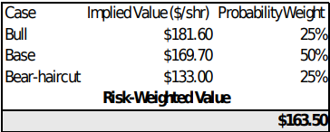
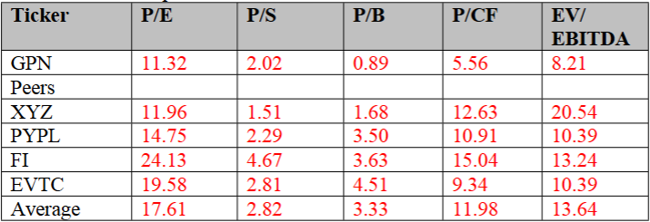
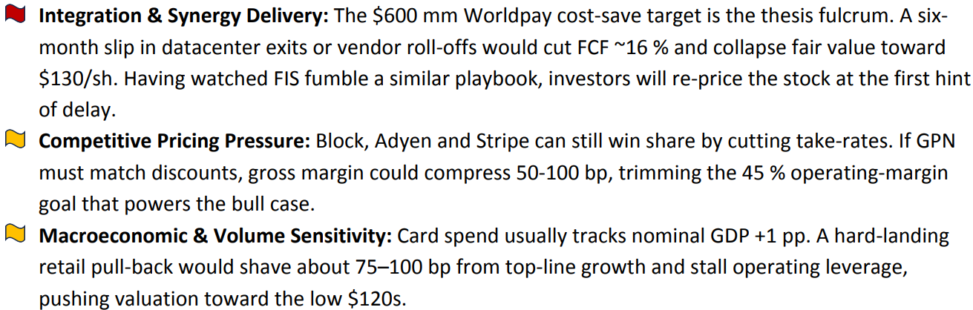
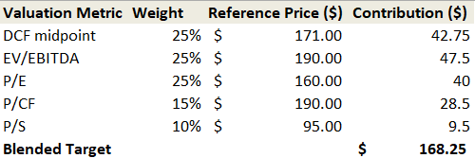
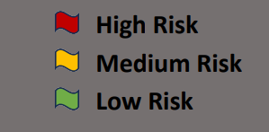
Valuation
GPN DCF Summary
Terminal Discount and Growth Rate:
12 % WACC, 50 bp above the peer average, to capture the execution premium around the Worldpay integration and any unforeseen macro shocks. A 3.0 % terminal FCF‑growth rate mirrors the IMF’s long‑term dollar‑GDP outlook, signaling that GPN merely keeps pace with broad economic activity once synergy benefits level out.
Price Target:
Equi-weighting the risk-weighted DCF value and football field model: $165.88
Valuation Model (Football Field)
Key Risks:
Recommendation:
BUY

Slide 20
Stock Recommendations
Recommend the SIM portfolio increases its weight in the financial sector from 14.77% to 18.42%, an increase of 3.65%.
Stock | Current Price | Target Price | Expected Return | Recommendation | SIM Weight | Recommended Weighting
Visa | $349.05 | $369.24 | 5.8% | HOLD | 4.48% | 4.48%
PayPal | $74.17 | $94.00 | 26.73% | BUY | 1.08% | 2.98%
GPN | $81.16 | $165.88 | 104.39% | BUY | 0% | 1.50%
BAC | $47.77 | $50.57 | 8.03% | BUY | 4.15% | 4.40%

