Slide 1
FINANCIALS Sector overview
Luke Houston, Pradyot Jillella, Byoungjun Jo, Jacob Katz

Slide 2

Financials Industry Overview
The Financials Sector contains companies engaged in banking, financial services, consumer finance, capital markets and insurance activities.
$7.6 trillion market cap; 73 constituents
Financials sector is:
14.31% of the S&P 500
14.96% of the SIM Portfolio

Slide 3
Financials Industry Overview
Industry | Purpose | Examples
Banks | Accept deposits, make loans, and provide other financial services to individuals and businesses. Includes commercial and regional banks | JPMorgan Chase, Bank of America, Wells Fargo, U.S. Bancorp, Truist
Capital Markets | Firms involved in investment banking, brokerage, asset management, and trading of securities | Goldman Sachs, Morgan Stanley, Charles Schwab, BlackRock
Insurance | Offer risk protection products like life, health, property, and casualty insurance | MetLife, Prudential Financial, AIG, Chubb, Progressive, Travelers
Financial Services | Offer services such as credit rating, data analytics, mortgage services, and payment processing | S&P Global, Moody’s, Fiserv, Visa
Consumer Finance | Provide credit cards, personal loans, auto financing, and other lending directly to individuals | American Express, Capital One, Discover Financial
Within the top-10 constituents by index weight

Slide 4
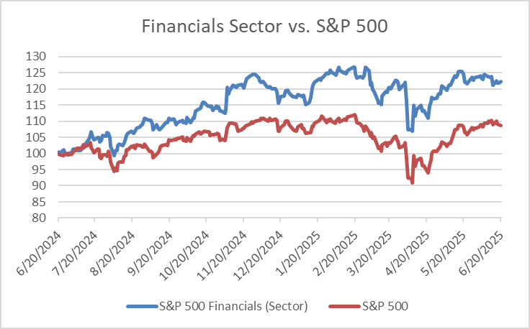
Sector Performance
Financials 1 –year return
23.36%
S&P 500 1–year return
10.26%
Notes:
Next, we have the various industries within the financial sector. This includes central banks (like the federal reserve which manages all other banks), retail and commercial banks (like your JPMorgan, AMerican Express, or Bank of AMerica that offer services to individual customers or an entire business), Credit Unions (like the Navy Federal Credit Union that is a nonprofit providing your typical banking services), Savings and loan associations (which provide individual customers with checking accounts, personal loans, and home mortgages), Investment banks (these help individuals or businesses raise capital by issuing securities), Brokerage firms (which assist individuals in buying and selling securities among investors, Insurance companies (like Allstate that help individuals transfer the risk of loss), and finally mortgage companies (like rocket mortgage that specialize in mortgage loans)
https://www.investopedia.com/ask/answers/061615/what-are-major-categories-financial-institutions-and-what-are-their-primary-roles.asp#:~:text=and%20facilitating%20prosperity.-,The%20major%20categories%20of%20financial%20institutions%20are%20central%20banks%2C%20retail,insurance%20companies%2C%20and%20mortgage%20companies.

Slide 5
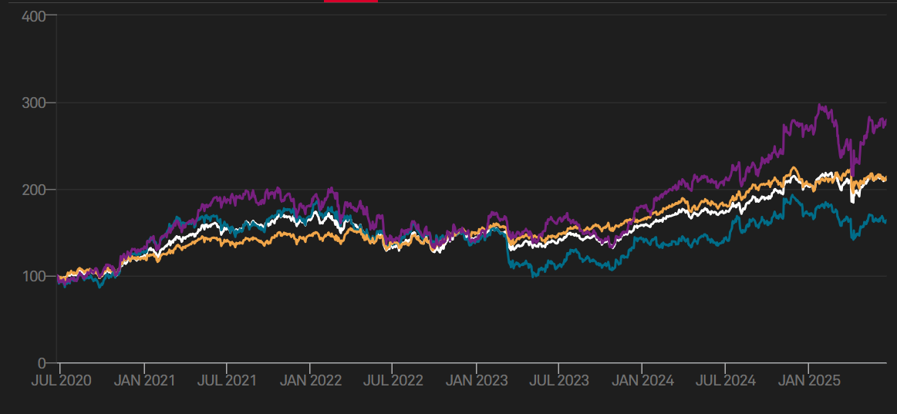



Financials Industry Overview
Pre-2023, Banking, Insurance, and Consumer Finance indices largely moved together
After the SVB failure, Bank stocks have underperformed
Consumer finance outperforming since 2024, driven by technology enhancements and new products

Slide 6
Business Analysis

Slide 7
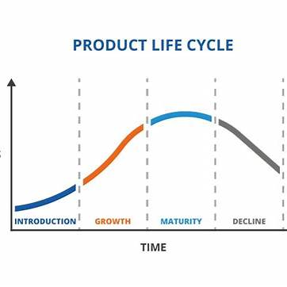
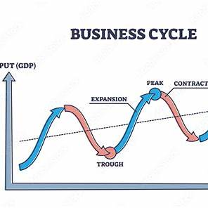
Demand Review
The finance sector is very cyclical and considered in its maturity phase.
Key Drivers: Interest rate cycle, credit markets, inflation, global liquidity
Inputs/Outputs: Primarily capital and tech as the input, and an output of loans, asset management, and other capital services
Notes:
Tech breakthroughs as an external factor

Slide 8
Supply Review
Traditional Finance:
High regulation & very infrastructure heavy
Again, more mature with high barriers to entry
Fintech:
Much more scalable via cloud, apps, and APIs
Lower costs and quicker to market but still regulated heavily
Tech as a Multiplier:
AI and automation
Cloud enables global reach
Notes:
Legacy finance not growth and higher barriers to entry, while fintech has moderate barriers to entry

Slide 9
Profitability and Pricing
Supply & Demand:
Strong demand & tight capital = higher margins
Oversupply = fee & margin compression
Product Segmentation:
High-margin: Investment banking, asset mgmt
Low-margin: Retail banking, insurance
Market Dynamics:
Highly concentrated among top firms
Fintech is fragmenting and applying pricing pressure
Customers have more power due to digital switching
Substitution & Entry:
Substitutes: Crypto, DeFi, P2P lending (emerging)
Entry barriers high in legacy finance, lower in fintech

Slide 10
Porter's 5 Forces
Competitive Rivalry | High | Many competitors in the finance space that have been at it for hundreds of years.
Supplier Power | Moderate | Pretty much the government, and current policy.
Buyer Power | Low | Not much leverage on consumer side.
Threat of Substitution | High | In a competitive environment, consumers have options.
Threat of New Entry | Low/Mod | Hard to enter legacy finance, and moderately hard to enter fintech

Slide 11
Economic Factors

Slide 12
Economic Factors
Key Indicator | Why it matters | How it's related
Interest Rates | The profitability of banking institutions is linked to Net Interest Margin (interest earned on loans versus paid on deposits), which compresses at lower interest rates | Rising rates: helps Banks but hurts other financial institutions
Yield Curve | Linked to economic growth and profit margins | Steeper yield curve more beneficial for sector, flatter or inverted curve detrimental
Credit Conditions – rate of borrower default on loans | Reflects risk environment | Worsening credit conditions hurts profitability of banking institutions due to charge-offs
Volatility Index (VIX) – gauge of expected market volatility over the next 30 days | Measures the level of "stress" in the market | High volatility negatively impacts trading volumes and investor confidence

Slide 13
Financial Analysis

Slide 14
Sales & earnings growth rates
Recent Growth Rates
10-Year Average Growth Rates
Revenue Growth (Q1 2025)
  -4.7% YoY for the Financial Sector
Major Companies
  JPMorgan: 6.2% YoY
  Goldman Sachs: 8.1% YoY
  Berkshire Hathaway: 3.5% YoY
  Visa & Mastercard: Double-digit EPS growth due to strong transaction volume.
Revenue Growth
  Annualized ~3-5% across the sector
EPS Growth
  Annualized ~5-7% over the last decade
Historical Trends
  Financials have underperformed technology and healthcare in terms of revenue growth, but consistently provide strong earnings.

Slide 15
Margins & Profitability
Operating & Net Profit Margins
ROE & Comparison to S&P 500
Operating Margins
  Asset Management & Investment Firms: 18-19% operating margin
  Banks & Insurance: 5-10% operating margin
Net Profit Margins
  Financial Sector; 10-12%
  Net Profit Margin for financial firms has grown from ~8% to ~14% over the past decade
ROE
  11-12% for financial sector on average
Comparison to S&P 500
  Financials have historically maintained higher operating and net margins compared to the broader S&P 500, which has an average net margin of ~13%.

Slide 16
Free Cash flow & Capital Use
Free Cash Flow Generation
Capital Utilization
Banks & Financial Services
  Financial firms typically generate high free cash flow, driven by interest income (banks) and management fees (asset managers)
  Banks and insurers are strong cash flow generators but with lower capital expenditures
Financial Companies tend to be capital-light, not requiring significant capital investment to grow (except for insurance companies that need reserves)
Capital is primarily returned to shareholders through dividends and stock buybacks

Slide 17
Current and historical trends
Current Margins
Margins vs. S&P 500
Current Margins
  Financial sector net profit margins are at historical highs (around 14%)
  Future Outlook
    Margin expansion is likely to slow in the future due to rising capital costs and inflationary pressures
    While banks benefit from higher interest rates, some insurance companies face underwriting losses.
The financial sector's margins are typically higher than the broader S&P 500 which is around 13%
Future Trend
  Financials are likely to maintain their margins or see them slightly contract compared to the broader market.

Slide 18
Valuation Analysis

Slide 19
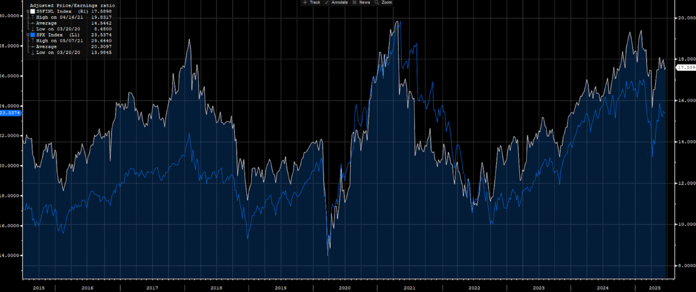
P/E Analysis
-2x discount to the S&P 500 in 2012, peaking at –21x during 2021 and expected to be –5x in 2025E
Widest gap during 2020-2021 due to pandemic-induced credit fears and tech bubble multiples.
Narrowing margin since 2022 due to tech rerates and rebuilt NIM due to Fed hikes.
Outlook seems to be a narrower gap: -4x from –5x in 2025E from a conservative standpoint. Basel III, CCAR lifts and tech valuations all carry implications.

Slide 20
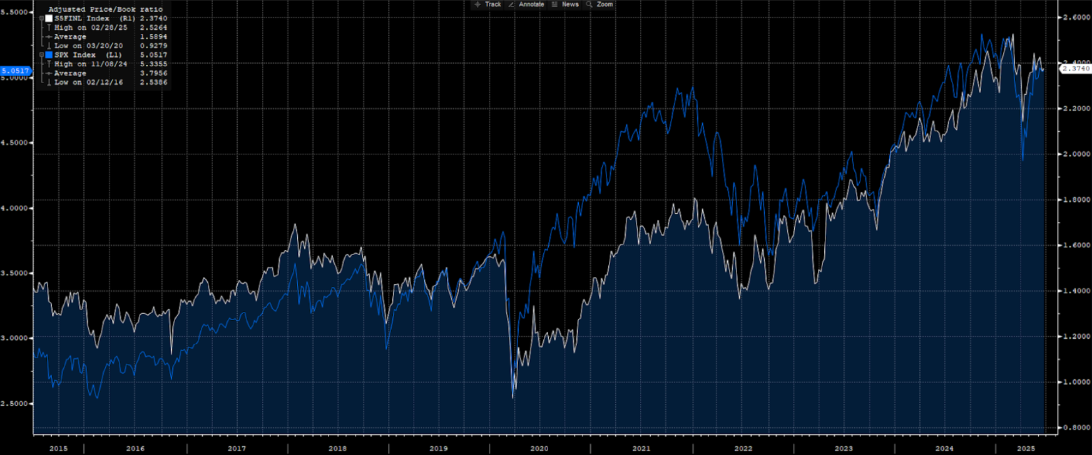
P/B Analysis
Financials trades at 2.37x, -2.7x discount to S&P 500's 5.05x ≈ -53% discount
2018-2020 ROE capped due to low rates limiting P/B, 2021-present P/B climbs across industry.
Gap movers: Higher NIM lifts returns, Basel buffers tie sector books down compared to peers, Tech & Pharma premiums boost S&P books.
Potential outlook sees 2026E industry P/B rise to 2.5x with softer Basel restrictions and increased buybacks.

Slide 21
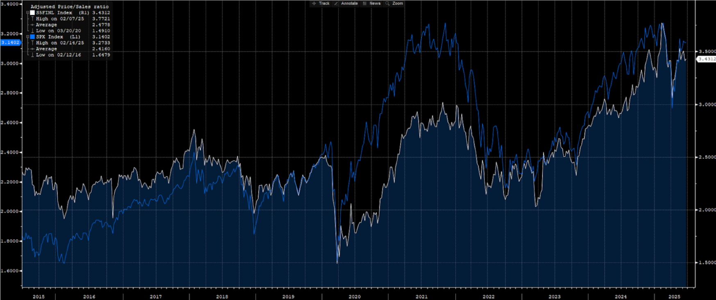
P/S Analysis
Financials trades at 3.43x to S&P 500's 3.14x, +0.29x premium ≈ 9%
2018-2019 no sector edge traded at 2.2x, 2020 crash due to falling NII down to 1.5x, 2021 onwards rate hikes drive back revenue surge with a new high of 3.77x Feb '25 trading above market
Gap movers: Capital-light fintech industries comprise 20% of the sector index and carry high P/S, Energy & Staples laggards for S&P 500 P/S
Conservative outlook: 3.1x by 2026 as revenue growth cools but stays positive.

Slide 22
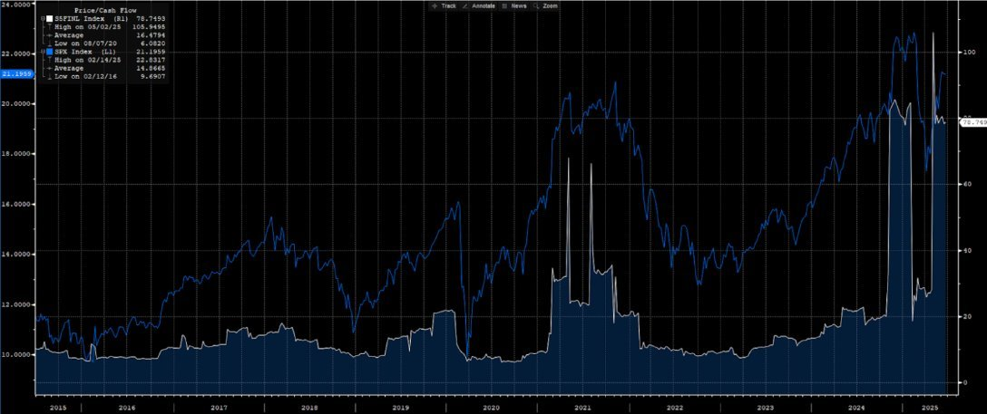
P/CF Analysis
Financials trades at 79x to S&P 500's 21x with a premium of +58x ≈ 275%
C/F for Financials especially jumpy as operating C/F fluctuates with large deposit flows
Most recent spike due to SVB incident inducing bank run of $42 bn attempted withdrawals in March '23 (largest bank run on record)
Sector will eventually revert to mean between 8x and 22x as deposit growth stabilizes
Mean reversion already underway, expected to be 35x by 2026E bar renewed deposit outflows

Slide 23
REcommendation
Key considerations
1. Economic Outlook
2. Interest Rates
3. Underrepresentation of Consumer Finance sub-industry within portfolio
Recommendation: Keep Financials at 15% of the total portfolio, but rebalance holdings, selling bank stocks and buying from higher-upside Consumer Finance industry

