Slide 1
Financials stock recommendations
Luke Schofield, adam schworer, & Christopher Tompkins
Professor Royce west
BUSFIN 4228

Slide 2





Table of contents
Financials Sector Review
Bank of America Corp.
JPMorgan Chase & Co.
Visa Inc.
PayPal Holdings Inc.
Global Payments Inc.
Final Recommendations & Vote

Slide 3
Sector Review
Financials

Slide 4
financials Sector vs s&p500 Performance
 | Previous Month | YTD | Previous Year
S&P 500 | +0.31% | +15.83% | +13.14%
Financials Sector | -0.48% | +9.31% | +3.50%
Consumer Finance | -0.16% | +22.71% | +17.60%
Commercial Banks | +1.82% | +22.40% | +14.27%
Capital Markets | -1.69% | +11.06% | +4.83%
Diversified Financial Services | -2.71% | +0.24% | -2.59%
Insurance | +2.33% | +0.85% | -7.07%
Source: BarChart.com (as of 11/26/25)

Slide 5
Breaking Down the Financial Sector
Industry | Ticker | P/E | P/B | P/S | ROE (%)
Industry | Ticker | P/E | P/B | P/S
Banks | S5BANKX | 13.6 | 1.59 | 2.16
Capital Markets | S5CAPM | 23.64 | 3.45 | 3.95
Consumer Finance | S5CFINX | 28.94 | 2.44 | 2.54
Financial Services | S5DIVF | 24.92 | 3.19 | 4.02
Insurance | S5INSU | 14.33 | 2.27 | 1.63
Financial Sector | S5FINL | 19.24 | 2.43 | 2.83
S&P 500 | SPX | 28.02 | 5.50 | 3.35
Source: Bloomberg Terminal

Slide 6
Valuation of Largest companies in the sector
Company | Ticker | P/E | P/B | P/S
Berkshire Hathaway Inc. | BRK-B | 16.79 | 1.6 | 2.69
JPMorgan Chase & Co. | JPM | 14.59 | 2.51 | 4.97
Visa Inc. | V | 33.72 | 17.77 | 16.93
Mastercard Incorporated | MA | 38.59 | 66.46 | 17.49
Bank of America Corporation | BAC | 14.10 | 1.35 | 3.76
Source: Bloomberg & Yahoo Finance

Slide 7
Key Marco factors at play
Tailwinds
Headwinds
Moving toward lower interest rates can boost economic activity leading to an increase in lending and deposit growth
  Despite looming uncertainty of a December cut, whoever Trump appoints in 2026 will cut rates
Increased deal activity consisting of IPO's and M&A during this administration
Interest rate volatility, if rates are cut to fast or stay to low this could impact banks profitability
Regulatory pressure could lead to tighter capital and liquidity requirements from Basel III Endgame could weigh on returns.

Slide 8
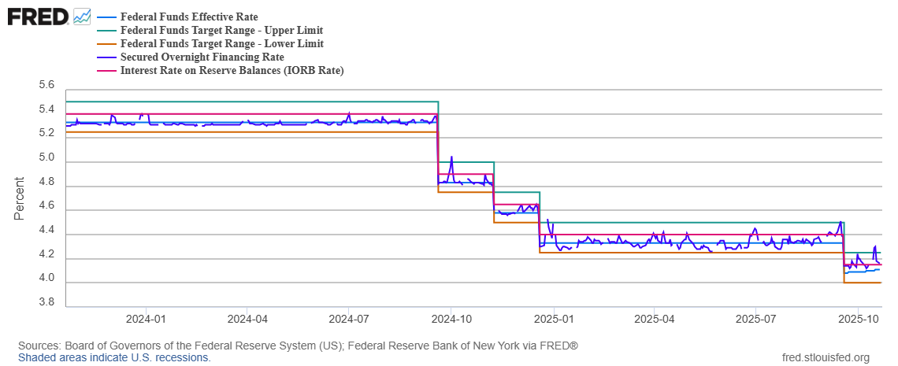

Interest Rates

Slide 9
Bank of America corp.
Financials

Slide 10
Overview
$3.4 trillion in Assets
2nd Largest U.S. Bank, headquartered in Charlotte, NC
8 Lines of Business: Retail Banking, Preferred, Merril Lynch Wealth Management, Bank of America Private Bank, Business Banking, Global Commercial Banking, Global Corporate & Investment Banking, Global Markets
Over 200,000 employees, operating in over 35 countries
Market Cap | Shares Outstanding | 52 Week Range | 1 Year Return | YTD Return | Beta | EPS | Dividend Yield
$397.4 billion | 7.3 billion | $54.69 - 33.07 | 12.92% | 21.13% | 1.30 | 3.66 | 2.09%

Slide 11
Business Analysis
Business Segment | YTD 3Q25 Net Income | YTD 3Q24 Net Income
Consumer Banking | $3.4 billion | $2.7 billion
Global Wealth & IM | $1.3 billion | $1.1 billion
Global Banking | $2.1 billion | $1.9 billion
Global Markets | $1.6 billion | $1.5 billion
All other | ($6 million) | ($295 million)
Total | $8.5 billion | $6.9 billion

Slide 12
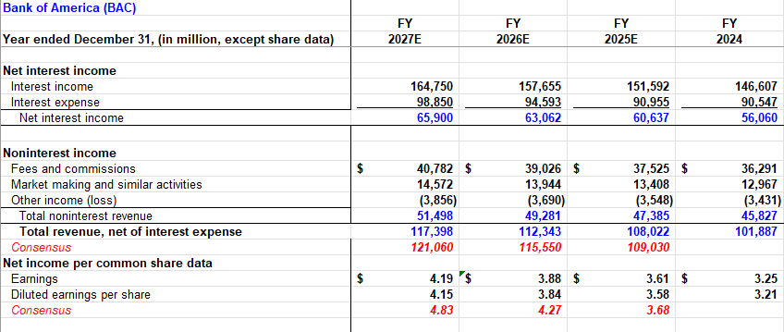
Financial Analysis

Slide 13

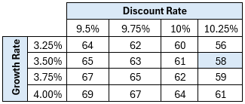
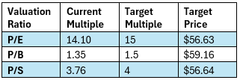
Valuation
Total Projected Yield: 11.2%
  9.2% upside + 2% dividend yield

Slide 14
Jpmorgan chase & co.
Financials

Slide 15
Overview
$4.5 trillion in assets
Largest U.S. Bank, headquartered in New York, NY
3 Business Segments: Consumer & Community Banking (CCB), Commercial Investment Bank (CIB), Asset & Wealth Management (AWM)
Over 300,000 employees, operating in over 100 countries
Market Cap | Shares Outstanding | 52 Week Range | 1 Year Return | YTD Return | Beta | EPS | Dividend Yield
$867.9 billion | 2.77 billion | $319.56 - 202.16 | 25.37% | 30.45% | 1.08 | 20.19 | 1.92%

Slide 16
Business Analysis
Business Segment | YTD 3Q25 Net Income | YTD 3Q24 Net Income
CCB | $5 billion | $4 billion
CIB | $6.9 billion | $5.7 billion
AWM | $1.7 billion | $1.6 billion
Corporate | $825 million | $1.8 billion
Total | $14.4 billion | $12.9 billion

Slide 17
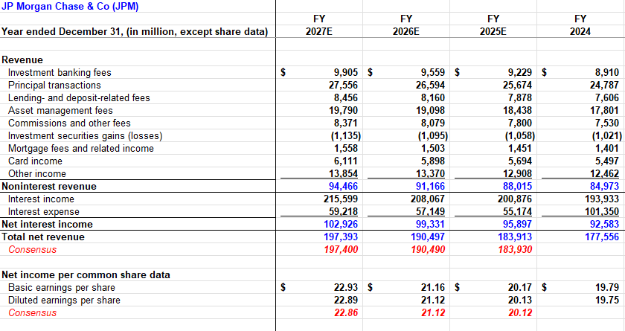
Financial Analysis

Slide 18

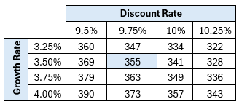
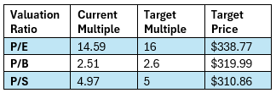
Valuation
Total Projected Yield: 17%
  15.1% upside + 1.9% dividend yield

Slide 19
JPM is more diversified globally with more net income attributed to Investment Banking Activities
  ++Pro-business regulatory environment
BAC heavily relies on Consumer Banking
  --more exposure to unemployment
JPM and BAC have high historical correlation ~0.9
  Holding both provides little diversification benefit
JPM historically outperforms BAC and has lower Beta
Conclusion:
Prioritize JPM position over BAC

Slide 20
Visa Inc.
Financials

Slide 21
Overview
Revenue Segments
Largest card-network in the US over 50% market Share
Handles payments between consumers, merchants, governments, banks and more
They generates revenue by charging a fee on these, transactions
Risks
Cybersecurity threats
Regulatory changes
Economic threats
Market Cap | Shares Outstanding | 52 Week Range | 1 Year Return | YTD Return | Beta | EPS | Dividend Yield
635.52B | 1.69 B | 299.00-375.51 | 6.81% | 5.85% | .82 | 10.21 | .81%
Source: Yahoo Finance

Slide 22
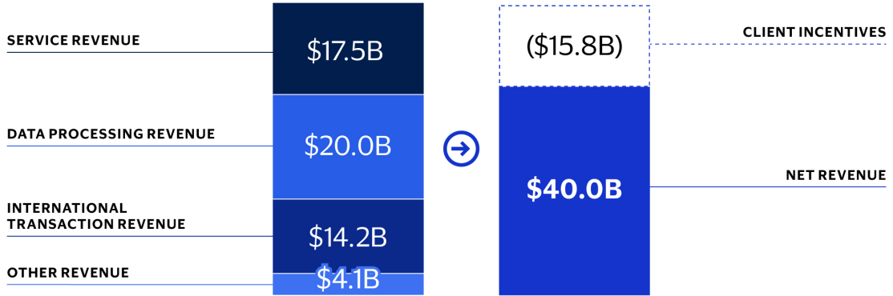
Business Analysis
10k Business Segments
Service Revenue
Data Processing
International Transactions
Other Revenue
The Company then deducts the client incentives what's left is the Net Revenue
Source: Visa 10K

Slide 23
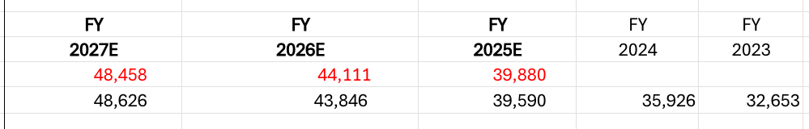
Financial Analysis
We have Net Revenues slightly below consensus. However overall still moving in a positive direction.
Again, we have the earning per diluted share slightly below the consensus estimates
Justification: Inflation could reduce disposable income, Additionally I would expect to see increased competition with the growing FinTech industry that could compress margins. Lastly Visa has faced some antitrust scrutiny

Slide 24
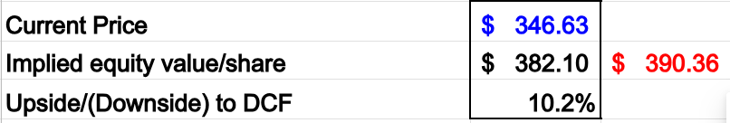
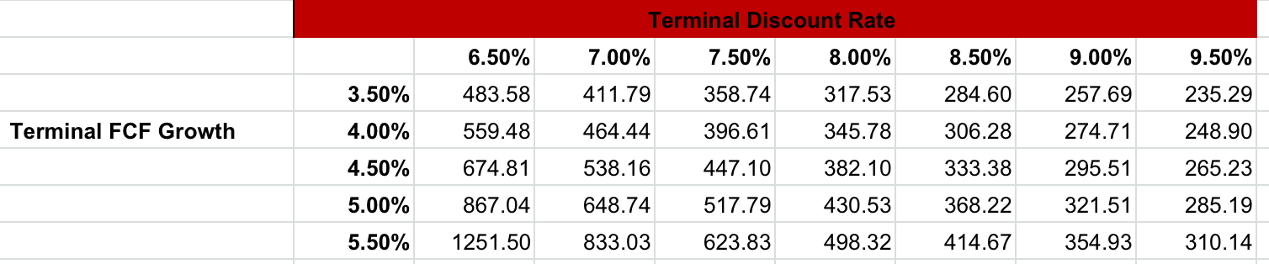
Valuation
While we a lot of potential in Visa we are still recommending that we trim our current position to remain within the parameters of the SIM portfolio
This DCF sensitive analysis various drastically, with the highest price over 1000.00 however Visa is a much more mature company so we don’t expect to see it rise that much. Another key point os that the downside is limited with very few of these below the current price

Slide 25
PayPal Holdings Inc.
Financials

Slide 26
Overview
PayPal Holdings Incorporated is a global digital payment and financial-technology company that allows merchants and consumers to receive, send, and manage money both online and in-store.
Risks
Intense competition
Regulatory changes
Interest rate risk
Market Cap | Shares Outstanding | 52 Week Range | 1 Year Return | YTD Return | Beta | EPS | Dividend Yield
58.66B | 935.65M | 55.85 - 93.66 | -30.25% | -28.27% | 1.43 | 4.98 | .91%

Slide 27
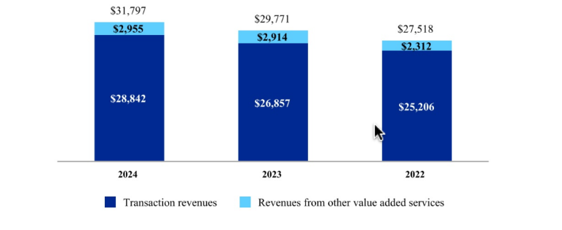
Business Analysis
10K Business Segments:
Transaction Revenues
Other Value Added Services
The Transaction Revenues business segment includes merchant fees which is the company's core revenue driver other services include:
Consumer fees
Cross-border transaction fees
Foreign exchange fees
Source: PayPal 10k
The Other Value-Added Services:
Include fees & interest on credit
Partner and referral revenues
Investment gains or losses
Interest on balances
Other supplementary services like fraud tools and data analytics

Slide 28
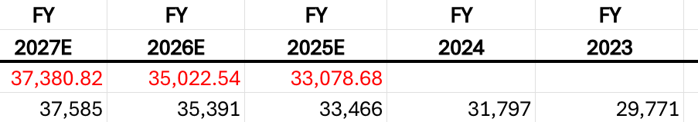
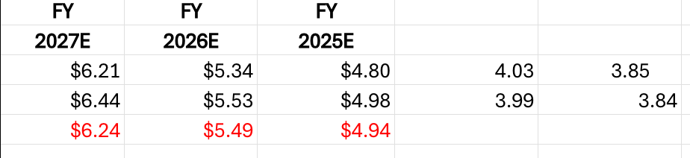
Financial Analysis
We are projecting PayPal to be slightly under consensus in Net Revenues however they are still moving in positive direction
We can see. This projection trickle down to the diluted earning per share we are also slightly below consensus but again moving in a positive direction
The main reason for the blow consensus growth is the intense competition that will arise in the Fin-Tech industry over the next few years

Slide 29
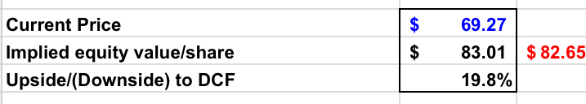
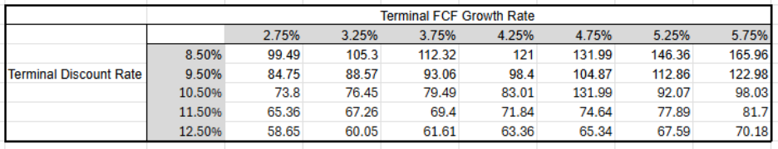
Valuation
While PayPal has a lot of upside potential shown here in the valuation slide especially in the . There are many competitors emerging in the Fin-Tech Space therefore we are recommending we HOLD this stock
Absolute Basis | High | Low | Average | Current
P/E | 122.69 | 11.66 | 42.54 | 13.29
P/B | 17.84 | 2.76 | 6.36 | 3.24
P/S | 16.65 | 1.82 | 6.07 | 2.09
EV/EBITDA | 60.57 | 8.61 | 25.57 | 9.16

Slide 30
Global payments Inc.
Financials

Slide 31
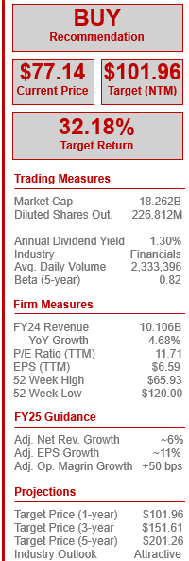
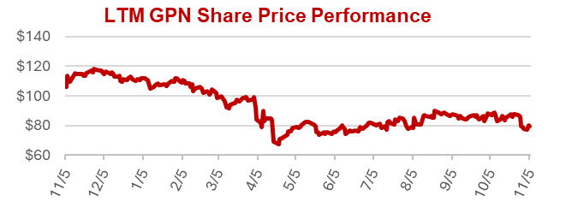
Overview
Global Payments Inc. (“GPN”) is a global provider of payment technology and software solutions, serving merchants, issuers, and consumers globally across an array of industries
Offers secure credit, debit, and digital payment processing while also offering integrated business software to support operations such as payroll, analytics, and customer engagement
Founded in 1967, a part of National Data Corporation and spun off in 2001. The Atlanta payment processor has an extensive acquisition track record, with over 40 transactions
Most recently, the firm is expecting to close on its acquisition of Worldpay, a UK-based payment processor, for $24.25 billion to expand its global presence and merchant solutions segment
Business Segments:
  Merchant Solutions – Point-of-Sale (POS) systems
  Issuer Solutions – Supports financial institution with credit and debit card issuing services
  Consumer Solutions – Financial services offered directly to consumers
Source: GPN Investor Relations

Slide 32
Business analysis
Operational Improvements: GPN sold their Consumer Solutions segment in 2023 to Searchlight Capital, and the firm is in the process of divesting its Issuer Solutions segment to Fidelity National Information Services by 2026. The firm will soon be a unified Merchant & Commerce platform, aimed to optimize efficiency and margins.
Competitive Advantage: GPN’s Merchant & Commerce platform combines point-of-sale (POS), routing, and acquiring into a single system. This gives merchants better approval rates and lower costs. GPN’s moat is its pure scale, as the firm can deliver the same platform in over 170 countries, something most competitors cannot even do.
Addressable Market: Global payment industry revenue grew by an average of ~7% annually from 2019-2024 but slowed to about 4% in 2024 due to interest-income contraction. There is optimism for the top line to pick back up as 2025 closes, and as we head into 2026 as interest rates fall.
Source: GPN SEC Filings

Slide 33


Growth drivers
Scale from Worldpay Acquisition
  GPN reported that FY24 transaction volume was over 66 billion. The firm expects this number to increase to over 94 billion after the acquisition of Worldpay is complete.
  Creates operational efficiencies by combining platforms and processes, while offering opportunities to cross-sell services across a global customer base.
Continued Focus on Integration with the New Genius Platform
  Strengthens merchant engagement though a more seamless, end-to-end payment experience, while improving customer satisfaction and retention
  Drives adoption of higher-margin services such as analytics, loyalty programs, and financing solutions, supporting recurring revenue growth
Expansion into High-Growth Internation and Digital Markets
  Positions GPN to capitalize on rapidly growing segments such as e-commerce, mobile wallets, and alternative payment methods.
  Diversifies revenue streams geographically and across product lines, reducing reliance on mature markets while capturing opportunities for long-term growth

Slide 34
Financial analysis Drivers
Revenue Growth by Segment – Merchant Solutions revenue grew 7.5% in 2024 to $7.69B, with modeled growth of ~5.5% rising to 12%+ and then 14%+ as Worldpay synergies ramp. Issuer Solutions will run off over multiple years, BCS is fully phased out, and intersegment eliminations should decline rapidly.
Transaction Growth & Margin Expansion – Management expects 5–7% annual transaction volume growth, supporting continued margin expansion after a 110 bps Q3 improvement. Merchant Solutions’ operating margin is projected to reach 35% by FY27.
Operational Efficiency – As GPN becomes a pure Merchant & Commerce platform and rolls out the Genius system, SG&A is expected to fall to 41% of revenue by FY27.
Share Buybacks – Management plans $6B+ in repurchases over three years, reducing diluted shares by 11%, 9%, and 7.5% annually.
Debt Reduction – With Worldpay now funded, GPN will aggressively deleverage, lowering interest expense to under 4% of revenue over the next few years.

Slide 35
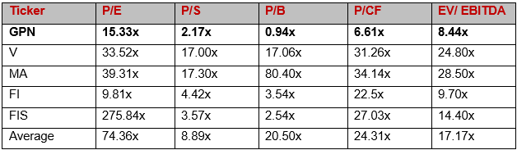
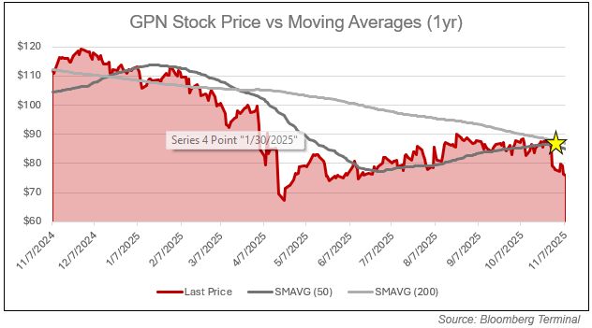
Peer comps & technical analysis
The stock is cheap and its time to buy!

Slide 36
Risks to GPN recommendation
Unrealized Synergies: Although the acquisition of Worldpay has received all required regulatory approval, all revenue and cost synergies are pure speculation and have yet to materialize
High Leverage: Although the firm is making significant process, the firm still operates at a net leverage ratio of 2.9x, with more closing costs yet to be paid for on the Worldpay deal. The firm also has a daunting debt maturity schedule over the next three years
Transitionary Period: As GPN transitions to a Merchant & Commerce platform, this transitory period can make or a firm with high levels of leverage. Every decision made executive team, and upper management comes with greater consequences
Macroeconomic Risks: GPN’s topline is heavily tied to consumer spending and foreign exchange rate fluctuations, both of which are in fragile states in the current geopolitical environment

Slide 37
Thesis & valuation
GPN offers a unique mix of stability and growth. The recently approved acquisition of Worldpay and the sale of the Issuer Solutions segment will refine GPN into a streamlined, global merchant-commerce platform with greater scale and software integration. As synergies become realized in FY25 and leverage declines, free cash flow should outpace top line growth. This will fuel additional buybacks and acquisitions for the firm. With this said, the stock trades a notable discount to its peers, due to execution concerns, macroeconomic risks, and high leverage. With the Federal Reserve continuing to lower rates, and with additional tailwinds from a shift to digital payments, GPN is set to close the valuation gap and produce substantial returns.
Keeping these concerns in mind, we still give Global Payments a “buy” rating, as we believe the upside to far outweigh the downside. Over the next twelve months, we give GPN a price target of $101.96, yielding a return of 32.18% over that period.

Slide 38
Final Recommendations
Financials

Slide 39
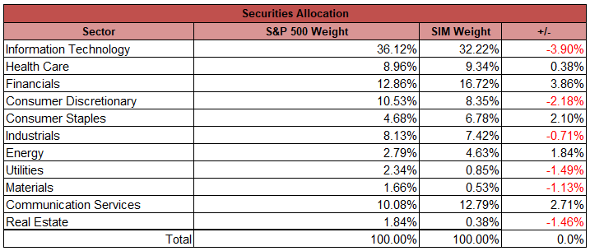
SIM recommendation by subsector
We recommend that the SIM portfolio remain overweight in the financial sector, but with some trimming to remain within 3% of the benchmark (S&P 500)
Commercial Banks – Overweight, potential rates cuts in 2025 and 2026 may lead to economic stimulation and increased lending.
Capital Markets - Neutral, geopolitical uncertainty may affect trading volumes.
Consumer Finance – Neutral, while rate cuts may stimulate the economy, too much uncertainty surrounding employment
Financial Services - Overweight, steady fee income, overall growth on a global scale.
Insurance – Underweight/Neutral, Lower interest rate could compress investment income.
Source: SIM (as of 10/31/25)

Slide 40
Final Recommendations
 | Current Price | Target Price | Expected Return | Status | Current Weight | Proposed Weight
Bank of America | $53.24 | $58.12 | 9.2% | SELL | 4.62% | 4% (-62 bps)
JP Morgan | $308.92 | $355.42 | 15.1% | SELL | 5.20% | 5% (-20 bps)
Visa | 346.63 | 382.10 | 10.2% | SELL | 4.11% | 3.50% (-61bps)
PayPal | $69.27 | $83.01 | 19.8% | HOLD | 1.38% | 1.38% (flat)
Global Payments | $77.14 | $101.96 | 32.18% | BUY | 1.40% | 2.00% (+60bps)
New Financials Sector Weight
15.88%

Slide 41
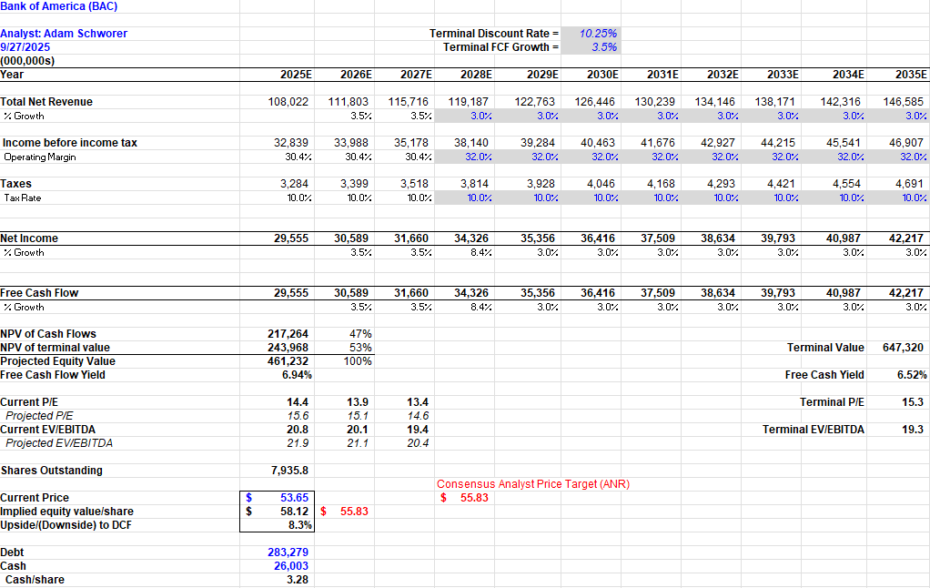
Appendix #1: Bank of America corp. dcf

Slide 42
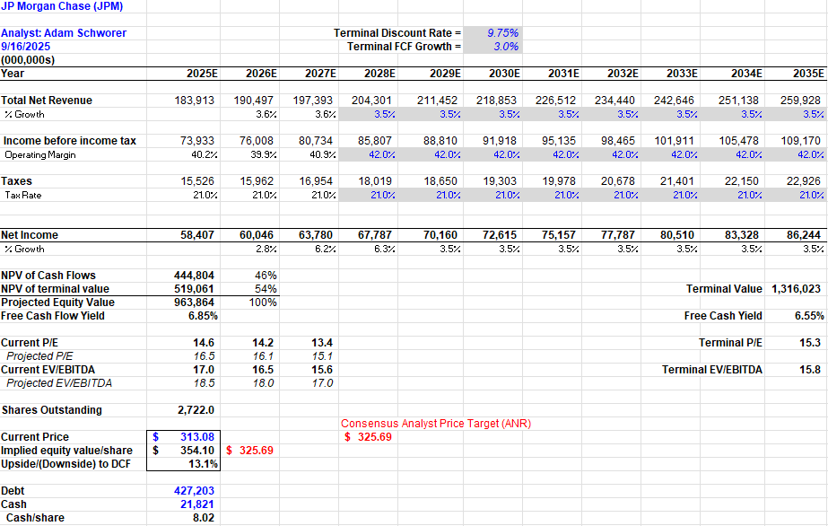
Appendix #2: jpmorgan chase & Co. dcf

Slide 43
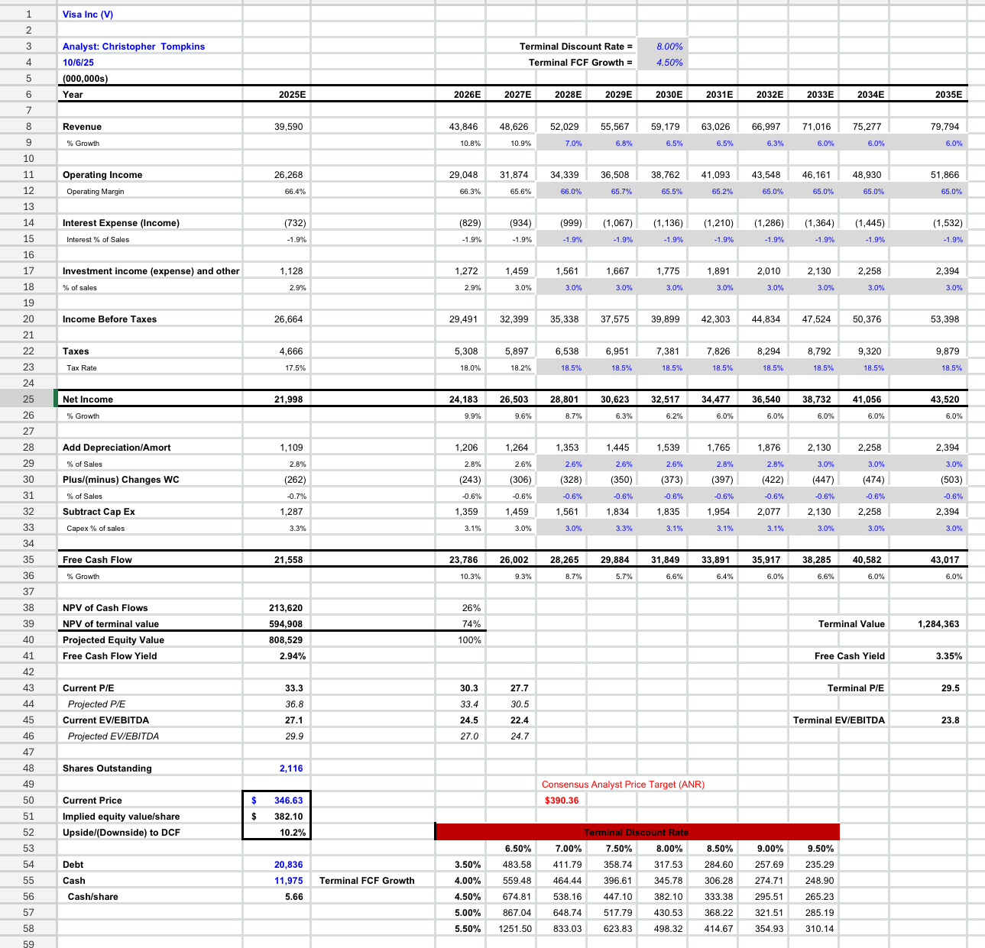
Appendix #3: visa inc.dcf

Slide 44
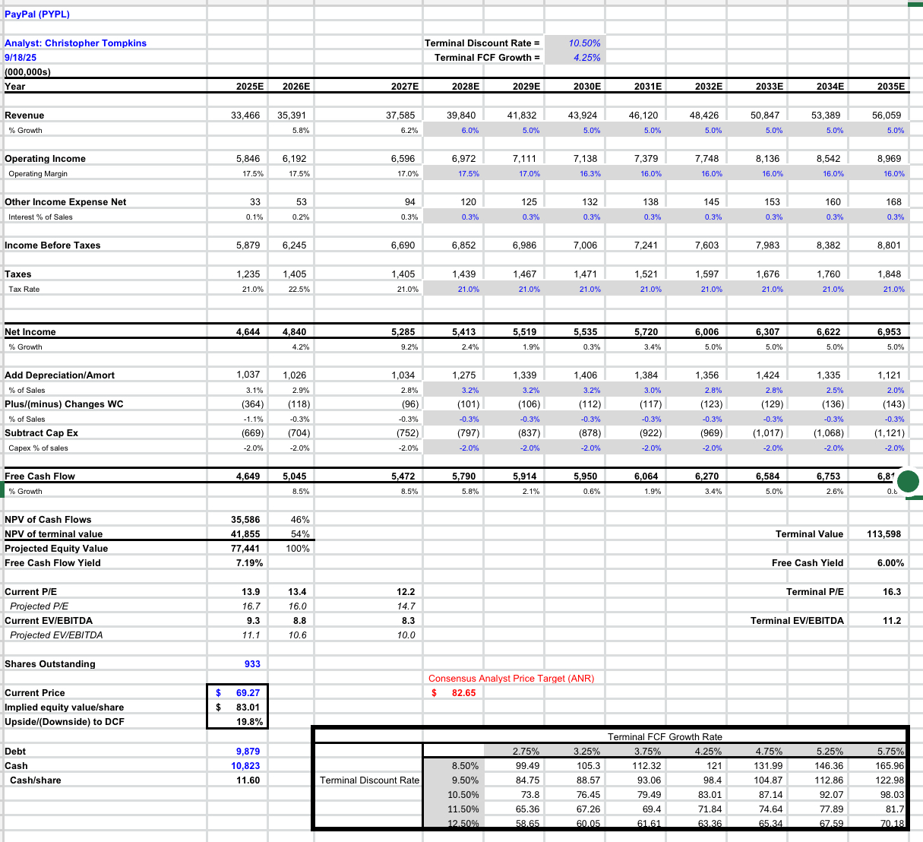
Appendix #4: paypal holdings inc. dcf

Slide 45
Appendix: global payments inc. dcf
Appendix #5: Global Payments Inc. DCF

