Slide 1
Financials sector analysis
Luke Schofield, adam schworer, & Christopher Tompkins
Professor Royce west
BUSFIN 4228

Slide 2
Table of contents
Overview:
  Sector Size
  Industries
  Participants
  Sector Performance
Business Analysis:
  Demand
  Supply
  Profitability & Pricing
Economic Analysis:
  Regression
Financial Analysis:
  Sales
  Earnings
Valuation Analysis:
  Multiples
  Technical
Recommendation:

Slide 3
Overview
Financials sector

Slide 4
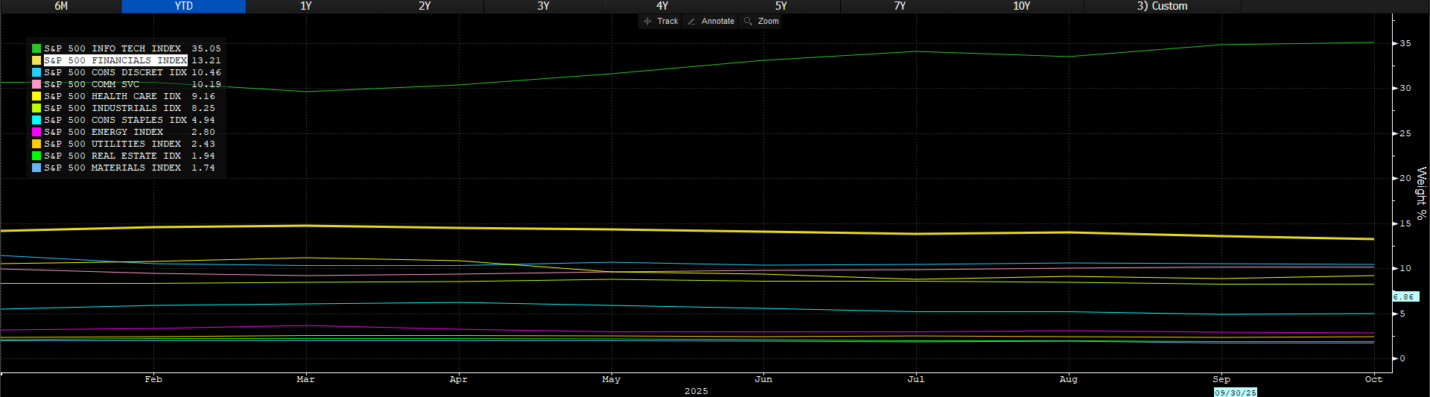
Sector Size
Source: Bloomberg Terminal (as of 10/21/25)

Slide 5
Industries within financials vs s&p500
 | Previous Month | YTD | Previous Year
S&P 500 | +1.25% | +14.62% | +15.16%
Financials Sector | -1.91% | +9.67% | +12.44%
Consumer Finance | -0.16% | +20.63% | +35.38%
Commercial Banks | -3.18% | +20.09% | +27.97%
Capital Markets | -2.69% | +12.39% | +14.43%
Diversified Financial Services | +0.08% | +3.54% | +5.65%
Insurance | -2.95% | -1.32% | -5.60%
Source: BarChart.com (as of 10/21/25)

Slide 6
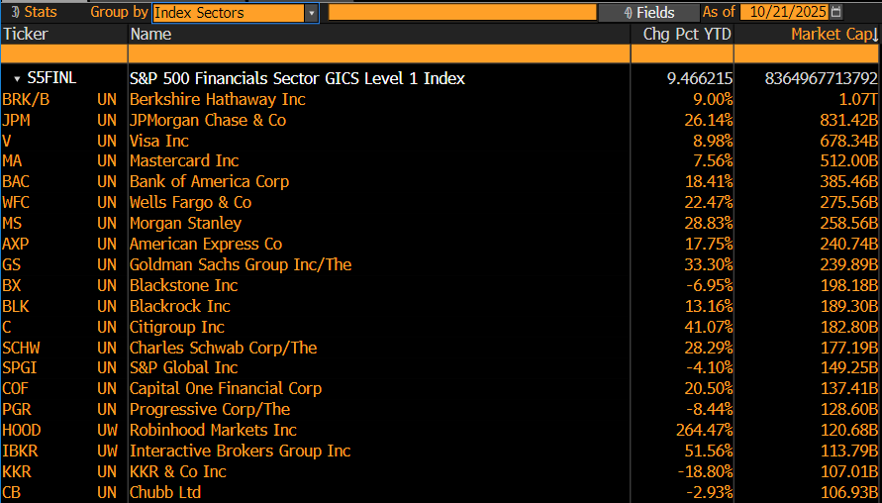
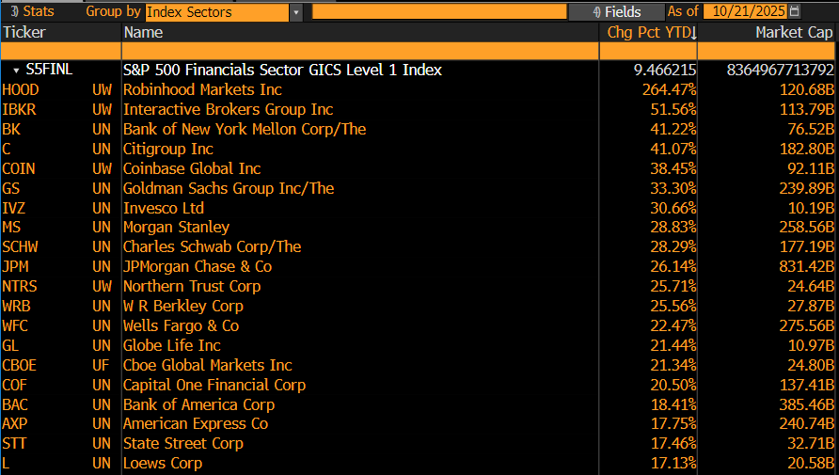
Largest companies within Financials
By Market Cap:
Top Returns YTD:
Source: Bloomberg Terminal (as of 10/21/25)

Slide 7
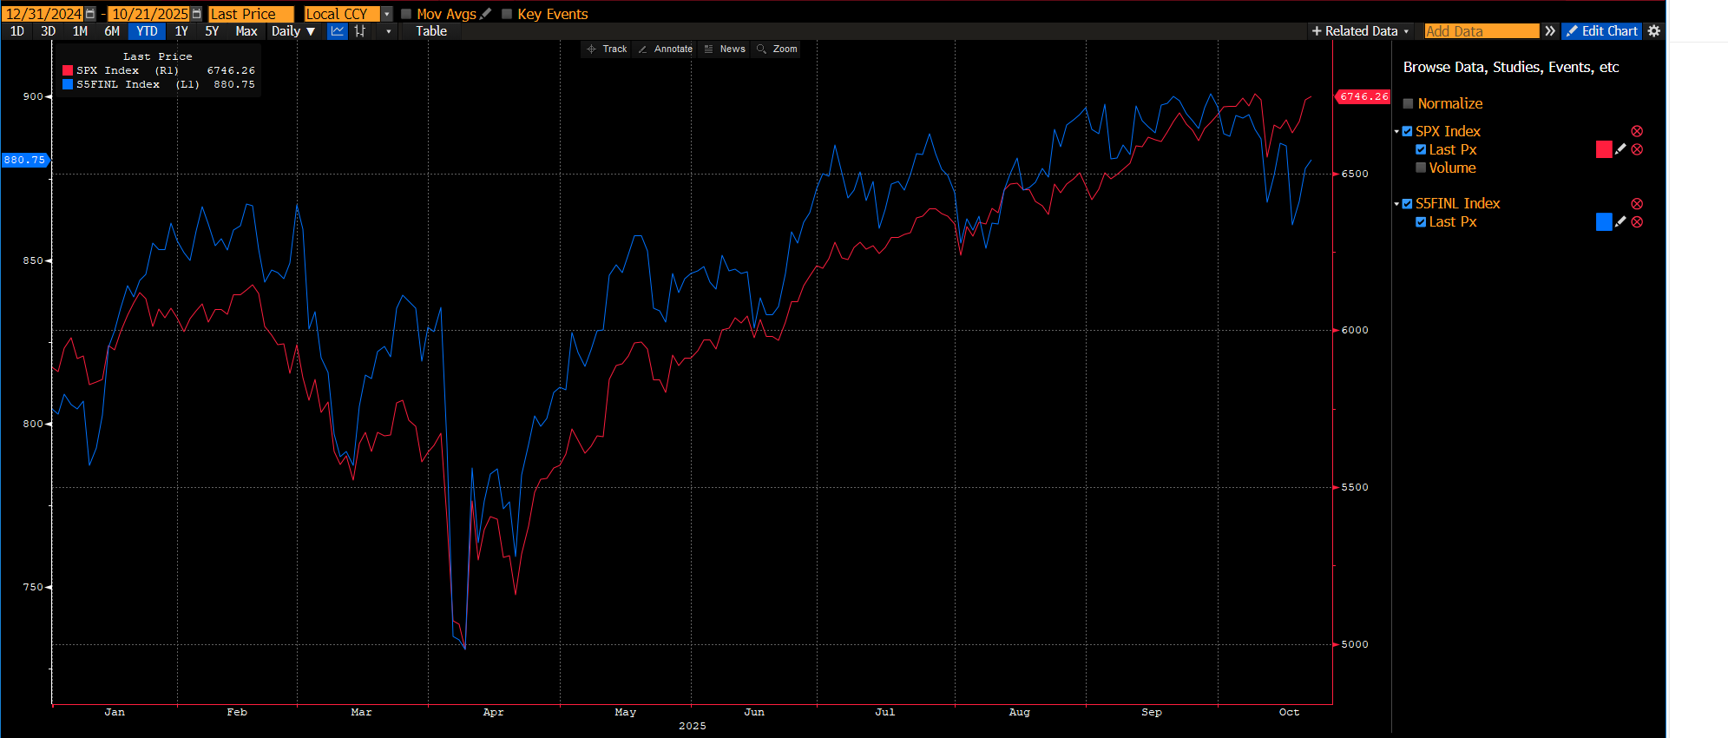
ytd performance
Source: Bloomberg Terminal (as of 10/21/25)

Slide 8
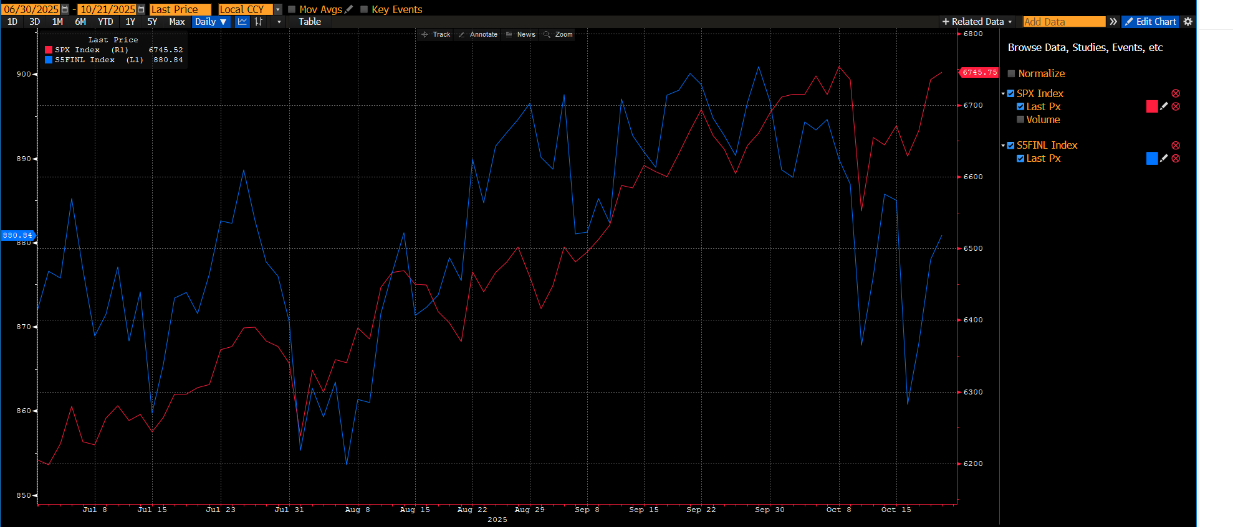
YTD H2 performance
Source: Bloomberg Terminal (as of 10/21/25)

Slide 9
Business Analysis
Financials sector

Slide 10
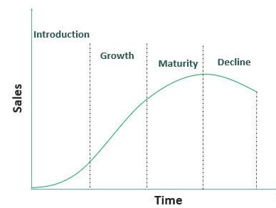
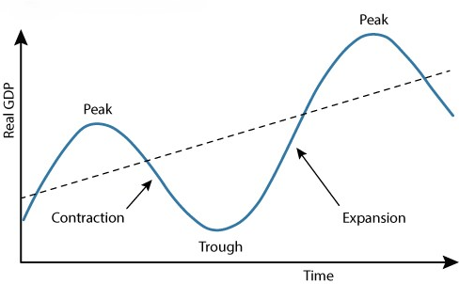
Life Cycle
Business Life Cycle
Economic Life Cycle
Financials Sector
Fintech
Banking & Insurance
The current economy is in a mid-cycle expansion, showing mixed signals of both continued growth and moderation. This phase is characterized by a mix of positive and slowing signals, such as rising corporate profits and credit demand alongside softening in manufacturing and labor markets in some regions. Strong demand for financials continues to be seen, but the question is how long this trend will last in the current economy?
Sources: Wall Street Mojo & The Federal Reserve of St. Louis

Slide 11

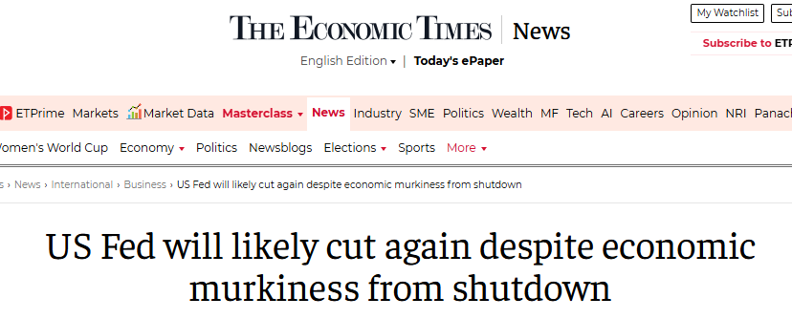
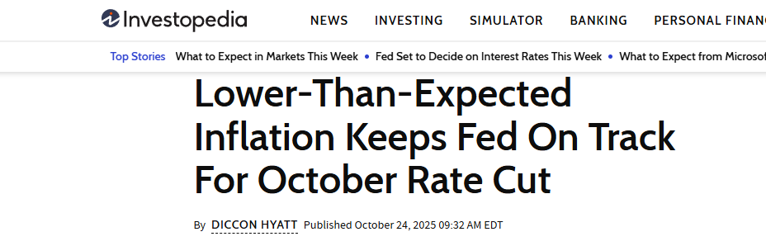
Economic influence on Demand
Financials are highly influenced by interest rates, creating a cyclical industry
Although interest rates increase profitability and the interest rate spread, at a certain point, demand begins to steadily fall for financial services
On the other hand, low interest rates lower profit spreads but increase demand
In summary, banks prefer moderately higher interest rates, that keep demand steady, while expanding profit margins. This sweet spot for banks is right around 3.00% - 4.00%.
The current fed funds rate is 4.00% - 4.25%, with two more rate cuts expected this year, indicating strong future demand for the financials sector.
Sources: NBC News, The Economic Times, & Investopedia

Slide 12
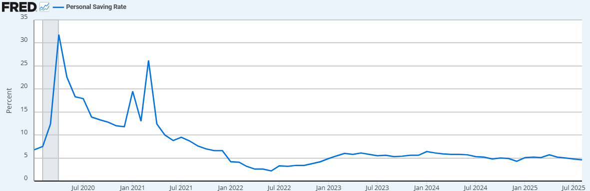
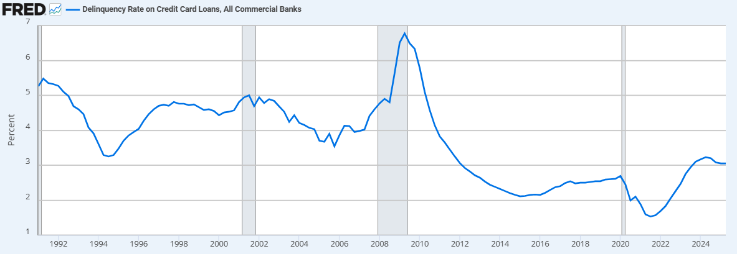
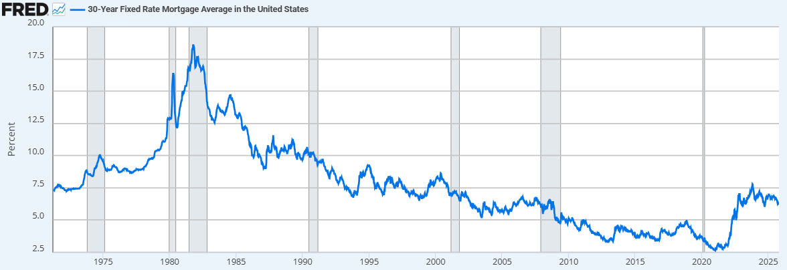
External Factors
Personal Savings Rates
  Banks want lower savings rates increase borrowing and spending, despite higher deposits.
  Currently rate of 4.6% is good for banks, below recent rates over the last 5 years
Delinquency Rates on Credit Cards
  Lower rates are beneficial for banks, maintaining table interest income and keeping credit losses low
  Current rate of 3.1% is moderate, slightly below long-term averages since 1992.
  This is beneficial for banks
Auto Loans
  Repossessions are hitting record highs, as auto loan delinquency rates hit record highs as well
  Not a good sign for banks, but this could be attributed to higher automobile prices and less on consumers
Mortgage Loans
  Despite decreasing demand and an increased supply in homes, mortgage rates remain relatively high at 6.3%
  This rate is beneficial for banks as long Americans continue to buy homes and as long as defaults remain in the auto industry
Source: FRED

Slide 13
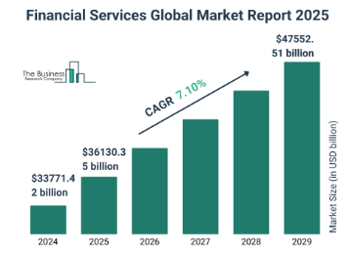
Supply Trends
In 2025, the supply of financials is expanding:
  New Capacity
    Digital banking and fintech entrants are increasing credit and payment platform capacity
    The overall global financial services market is projected to grow at ~7% CAGR (FY24-FY29) according to the Business Research Company
  Concentration & Ease of Entry
    High barrier to entry exist due to high regularity, capital, and reputational requirements to succeed
  Technological Drivers
    The adoption of AI and data-driven platforms is enabling faster scaling of services, and therefore capacity
Source: The Business Research Company

Slide 14
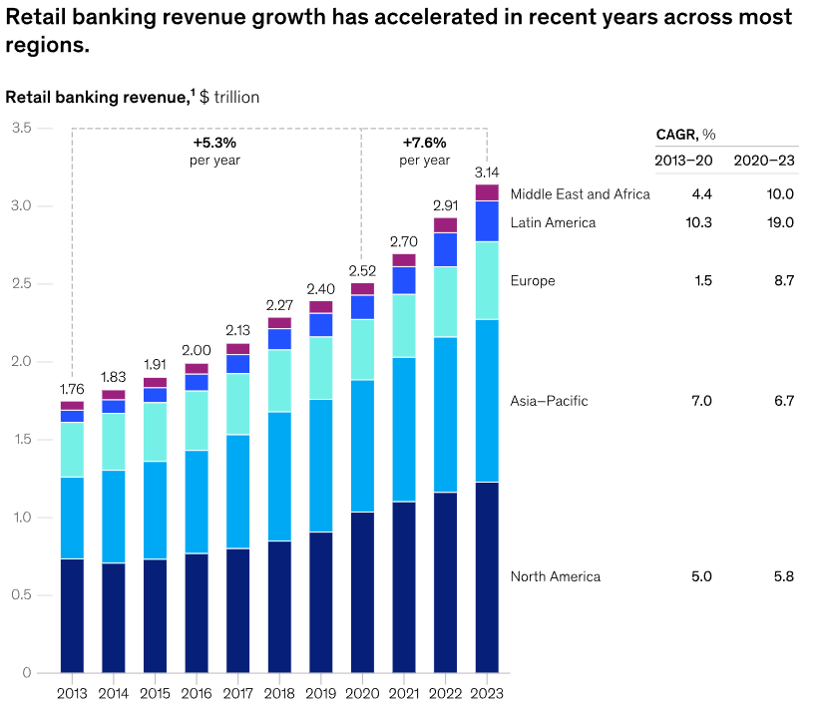
Profitability & Pricing
In 2025, the profitability of financials is growing:
  Interest Rate Environment
    As mentioned, as interest fall but remain moderate, demand will increase, and margins will remain strong for banks
  Pricing Power
    Higher margin segments like investment banking and private credit are growing, offering better pricing than retail banking
    Retail banking remains to produce revenue growth in most regions around the globe
  Competition and Substitution
    Non-bank entrants increase substitution for financial services, pressuring fees and margins
    Customers will continue to have more choice, but banks will continue to ride reputation to justify pricing
  Market Concentration
    Large banks and fintech firms enjoy scaling advantages and stronger pricing power, pressuring margins on smaller firms
Source: McKinsey & Company

Slide 15
Economic Analysis
Financials sector

Slide 16
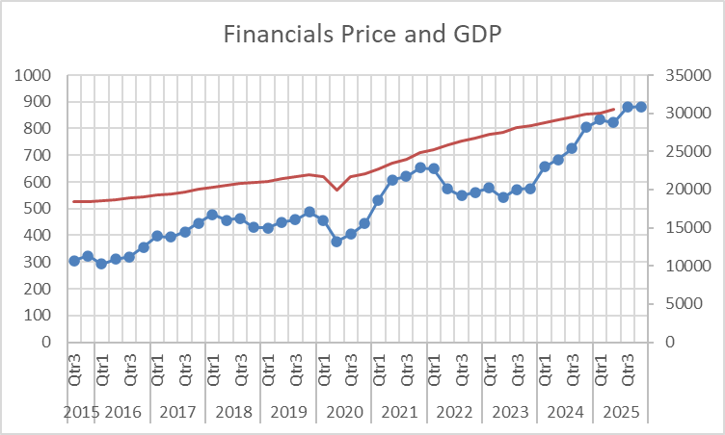
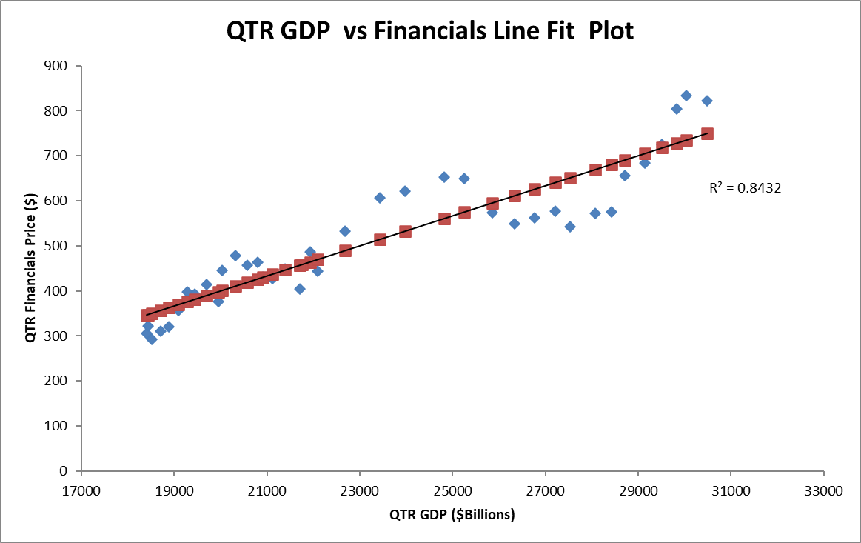
Gross Domestic Product (GDp)
Data Source: spglobal.com and fred.stlouisfed.org

Slide 17
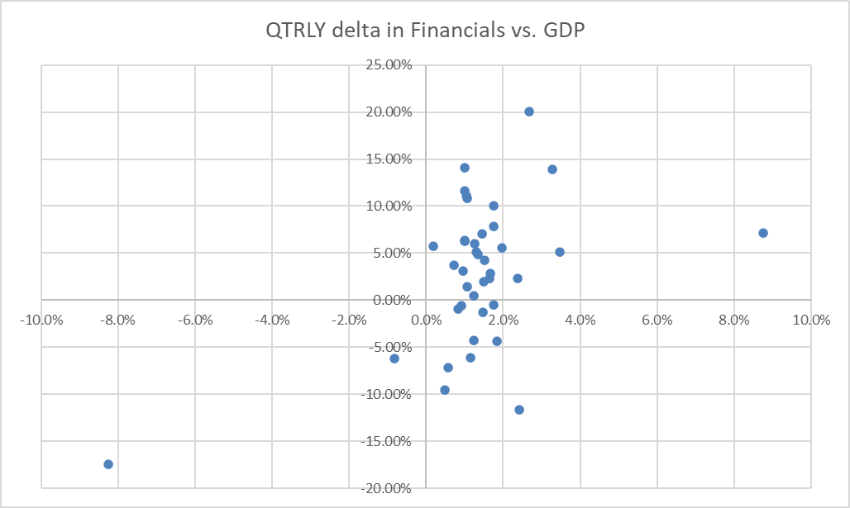
Gross Domestic Product (GDp)
Two Quarters of negative GDP growth during onset of Covid pandemic saw negative quarterly price movement for Financial sector
If Quarterly GDP growth greater than 2%, more likely to see increase in financial sector price; GDP less than 1% more likely to see a price decrease.
Atlanta FED estimates Q3 2025 GDP at 3.9% growth, actual financials increase at 7.06% (red dot)
Data Source: spglobal.com and fred.stlouisfed.org

Slide 18
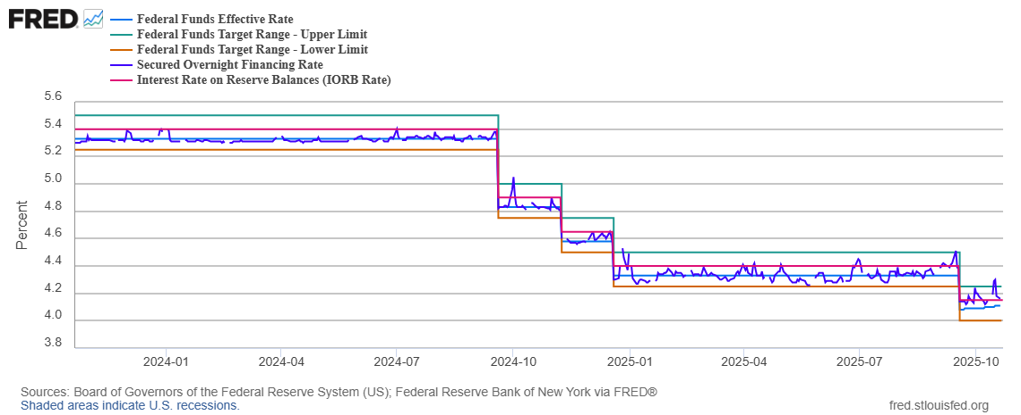
Interest Rates

Slide 19
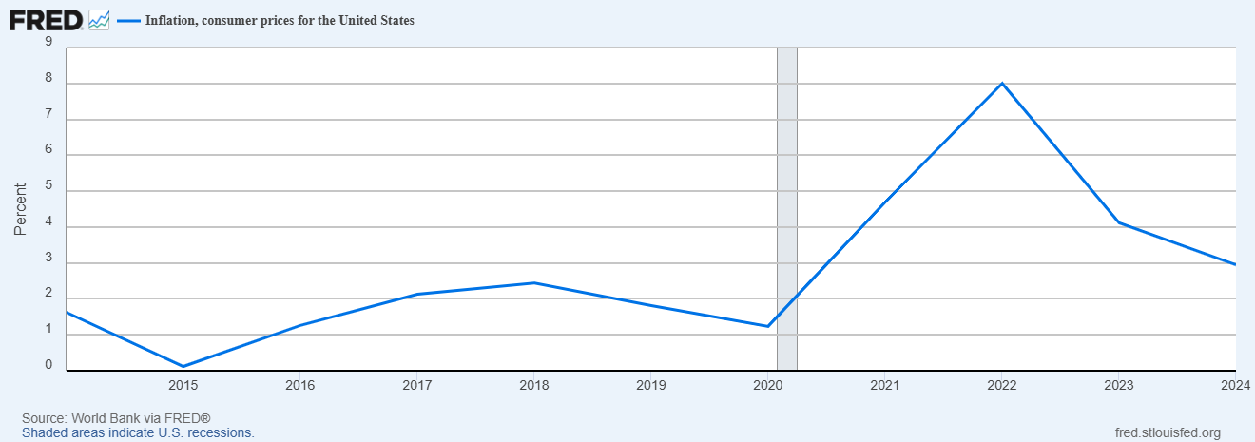
Inflation (CPI)

Slide 20
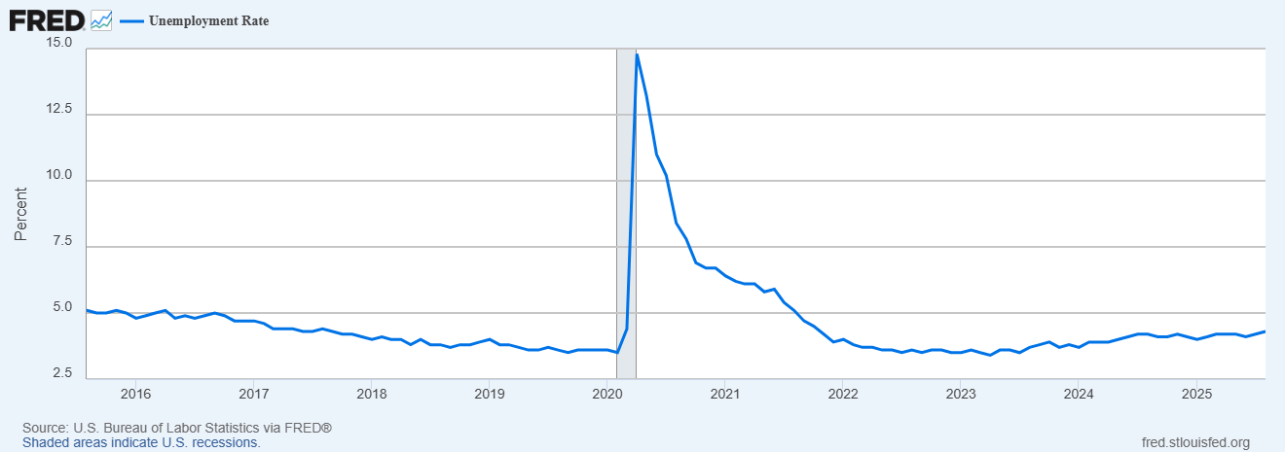
Unemployment Rate

Slide 21
Financial analysis
Financials sector

Slide 22
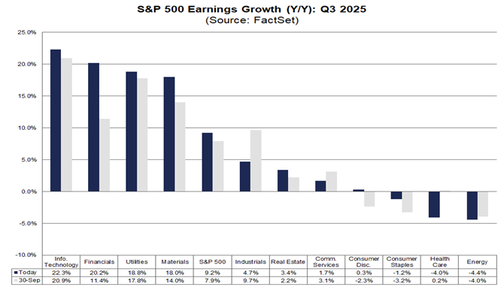
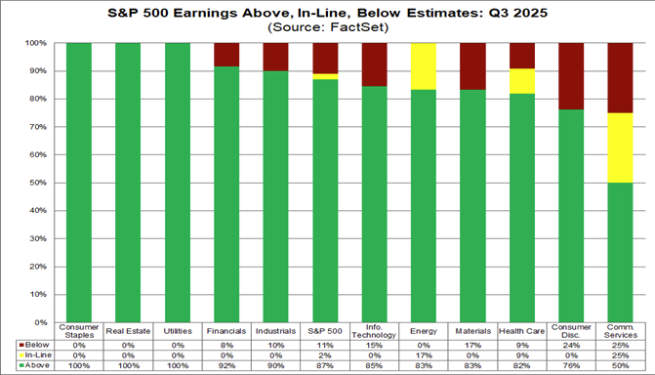
Earnings
EPS surprises reported by Morgan Stanley ($2.80 vs. $2.10), Capital One Financial ($5.95 vs. $4.49), Bank of America ($1.06 vs. $1.04), JPMorgan Chase ($5.97 vs. $4.85), Chubb ($7.49 vs. $6.17), Travelers Companies ($8.14 vs. $6.39), Goldman Sachs ($12.25 vs. $11.03), and Wells Fargo ($1.66 vs. $1.55).

Slide 23
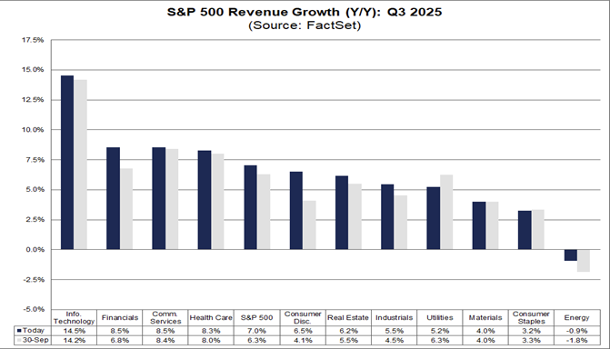
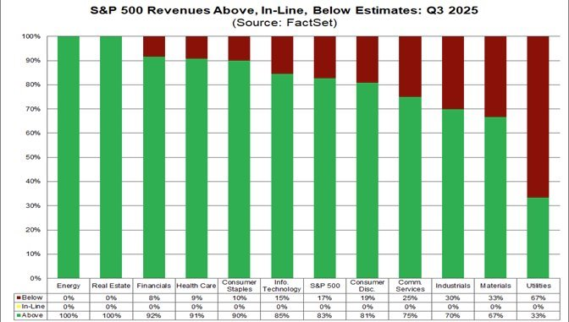
Revenue
Positive reported actual revenue versus expected by Morgan Stanley ($18.22 billion vs. $16.69 billion), JPMorgan Chase ($46.43 billion vs. $45.47 billion), Goldman Sachs ($15.18 billion vs. $14.12 billion), and Citigroup ($22.09 billion vs. $21.09 billion).

Slide 24
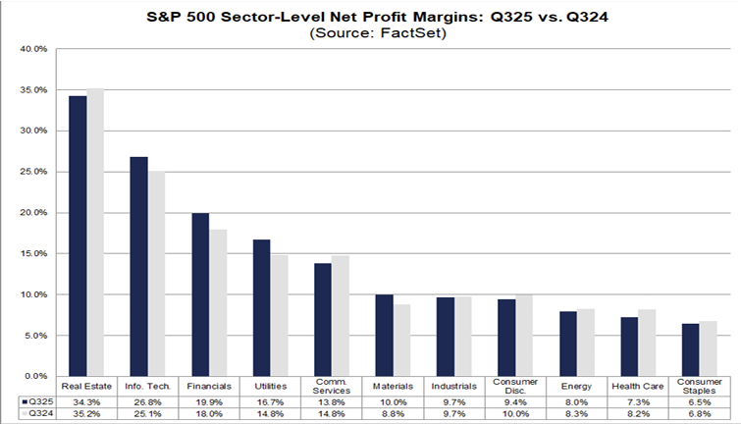
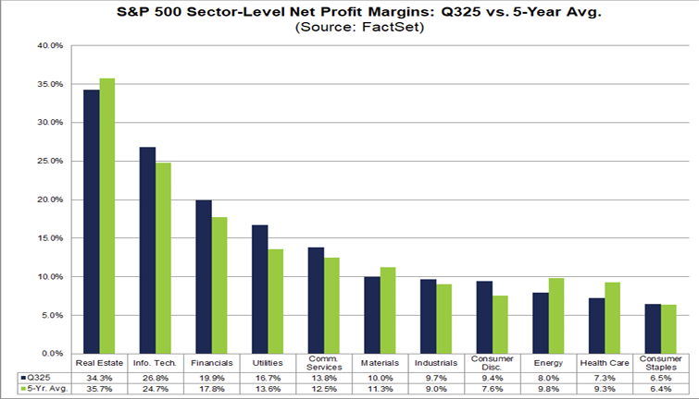
Profit Margin
Financials reporting increase in Net Profit Margins Q3 2024-2025 and maintaining above the 5 year average.

Slide 25
Valuation analysis
Financials sector

Slide 26
Valuation of Largest companies in the sector
Company | Ticker | P/E | P/B | P/S
Berkshire Hathaway Inc. | BRK-B | 16.79 | 1.6 | 2.69
JPMorgan Chase & Co. | JPM | 14.59 | 2.51 | 4.97
Visa Inc. | V | 33.72 | 17.77 | 16.93
Mastercard Incorporated | MA | 38.59 | 66.46 | 17.49
Bank of America Corporation | BAC | 14.10 | 1.35 | 3.76
Source for Financial data: Bloomberg/Yahoo Finance

Slide 27
Breaking Down the Financial Sector
Industry | Ticker | P/E | P/B | P/S | ROE (%)
Industry | Ticker | P/E | P/B | P/S
Banks | S5BANKX | 13.6 | 1.59 | 2.16
Capital Markets | S5CAPM | 23.64 | 3.45 | 3.95
Consumer Finance | S5CFINX | 28.94 | 2.44 | 2.54
Financial Services | S5DIVF | 24.92 | 3.19 | 4.02
Insurance | S5INSU | 14.33 | 2.27 | 1.63
Financial Sector | S5FINL | 19.24 | 2.43 | 2.83
S&P 500 | SPX | 28.02 | 5.50 | 3.35
Source for Financial data: Bloomberg

Slide 28
10- year History for the Financial Sector
S5FINL | HIGH | LOW | MEAN | CURRENT
P/E | 20.19 (1/30/25) | 7.84 (03/23/20) | 15.09 | 19.24
P/B | 2.53 (7/25/25 | .8712 (03/23/20) | 1.62 | 2.43
P/S | 2.90 (2/18/25) | 1.21 (03/23/20) | 2.24 | 2.83
Source for Financial data: Bloomberg

Slide 29
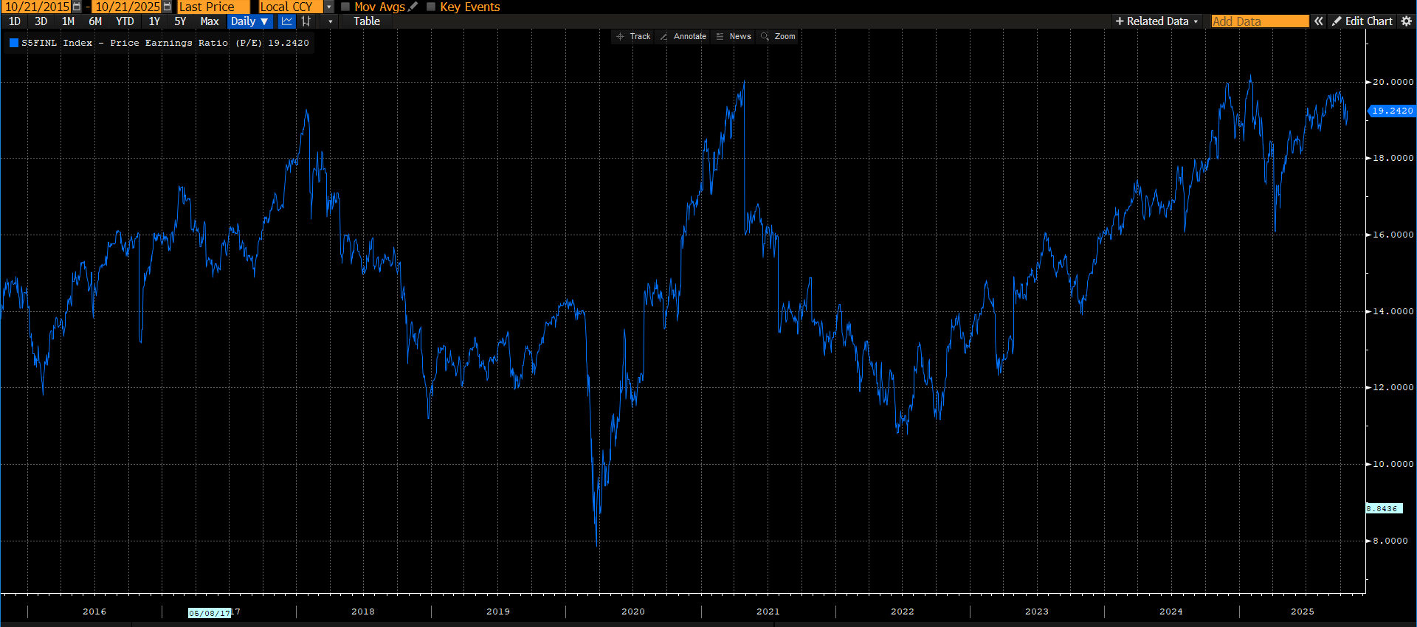

Slide 30
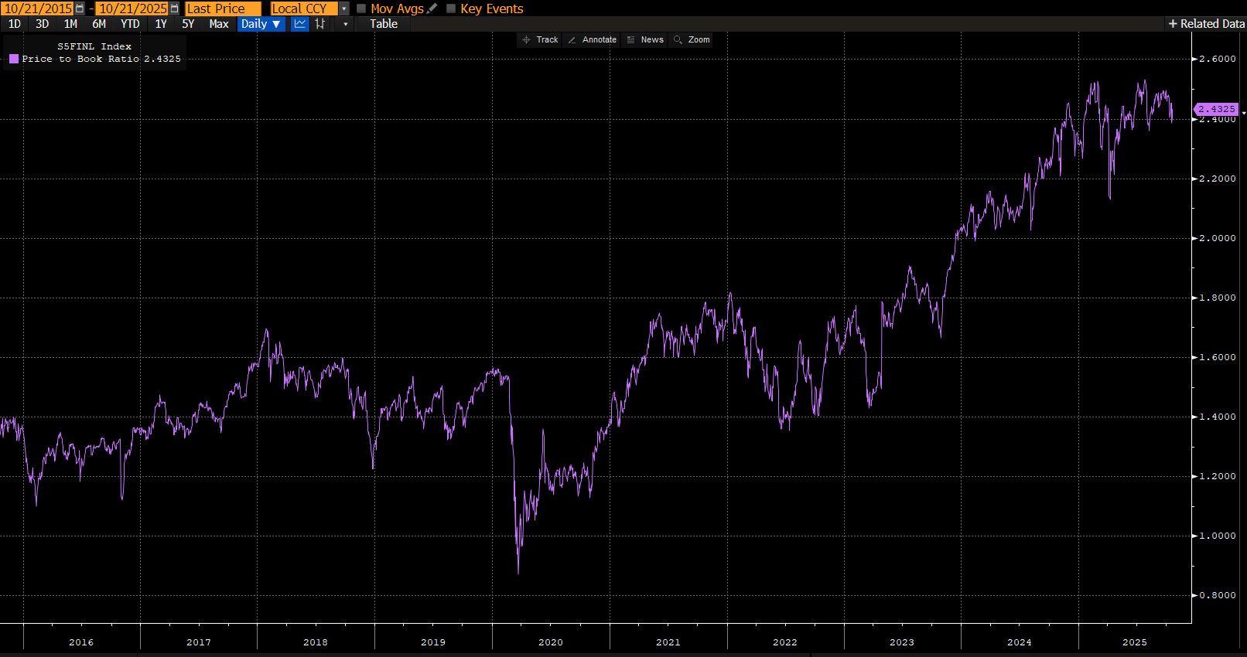

Slide 31
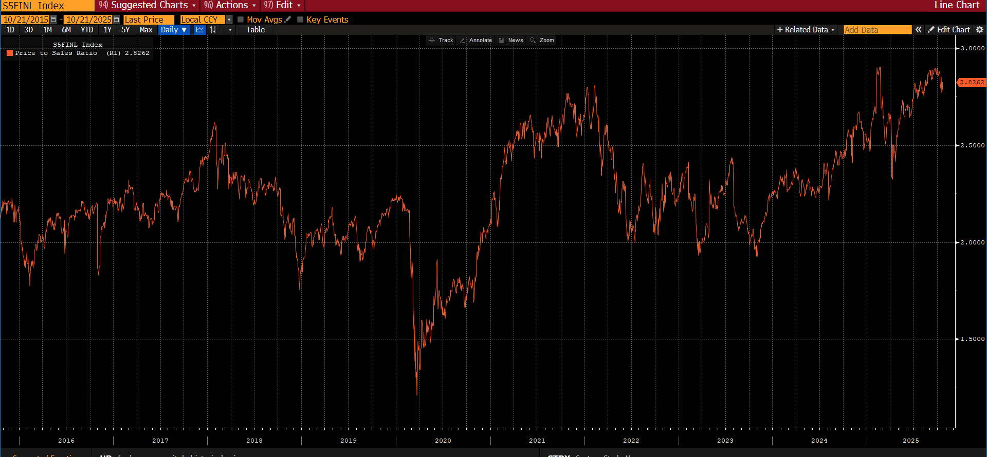

Slide 32
recommendation
Financials sector

Slide 33
Factors that could influence the Sector
Biggest Positives
Biggest Risk
Moving toward lower interest rates can boost economic activity leading to an increase in lending and deposit growth
Increased deal activity consisting of IPO's and M&A during this administration
Interest rate volatility, if rates are cut to fast or stay to low this could impact banks profitability
Regulatory pressure could lead to tighter capital and liquidity requirements from Basel III Endgame could weigh on returns.

Slide 34
Where the SIM portfolio is now – Where we think it should be
We recommend that the SIM portfolio remain overweight in the financial sector
Banks – Overweight, potential rates cuts in 2025 and 2026 may lead to economic stimulation and increased lending.
Capital Markets - Neutral, geopolitical uncertainty may affect trading volumes.
Consumer Finance – Neutral, while rate cuts may stimulate the economy, too much uncertainty surrounding employment
Financial Services - Overweight, steady fee income, overall growth on a global scale.
Insurance – Underweight/ Natural, Lower interest rate could compress investment income.

Slide 35
Q&A

