Slide 1

Energy Sector Recommendations
Evan Palcho, Noah Saliba, Khaleb Rykard

Slide 2
Agenda
Overview
Stock Discussion
  CononcoPhillips
  Exxon Mobil
  Chevron
  Shlumberger
  Energy Transfer
Recommendations

Slide 3
Sector Overview - Size and Composition
The Energy Sector makes up ~4.17% of the S&P 500 as of 7/7/25
Market Cap of 2.922T made of 254 Companies
Companies that produce, refine or manufacture equipment in the oil and gas industry. Also includes companies that mine uranium or coal.
The SIM portfolio as of 6/30/25 is holding 3.68% in the Energy sector. The portfolio currently holds ConocoPhillips and Shlumberger LTD
Notes:
The Energy sector currently makes up about 3% of the S&P 500, down significantly from over 10% in the early 2010s. This shift reflects the rise of sectors like tech and consumer discretionary, and oil price volatility over the past decade. Despite this smaller weight, energy still plays an outsized role in global economics and politics. The sector is essential for transportation, industry, and power generation, and it’s undergoing major transformation toward low-carbon energy sources.

Slide 4
Sector Performance YTD
• YTD: +1.42%, S&P 500 5.92%.
• Outlook: Volatile, tied to oil markets, geopolitical risk, and OPEC+ decisions.
Notes:
In Q1 2025, Energy was the best-performing sector, gaining over 9% while the S&P 500 overall fell. This was driven by rebounding oil prices and investors rotating into value sectors. However, Q2 has been weaker, with energy stocks giving back some of those gains as oil prices softened. That leaves the sector slightly negative year-to-date. It shows just how sensitive this sector is to oil price swings and global headlines.

Slide 5
business Drivers
  •Macro‑economic: global GDP growth slowing to ~2.4 %, USD up ~6 % YTD
  •Demand: jet fuel +6 % y/y; petrochemical feedstocks rising; gasoline flat amid EV adoption.
  •Supply: OPEC+ easing cuts adds 1.6 mb/d; U.S. oil rig count down to 425
  •Geopolitical & inventories: Strategic Reserve at $45/barrel floor; sanctions relief on Russia and Iran

Slide 6
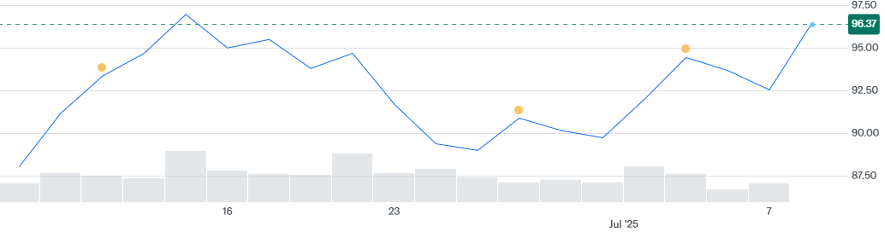
ConocoPhillips
As of 7/7/25 it is trading at $92.54
52 week range is $79.88-$118.40
Year Target is $116.07
Stock price is highly correlated with price of oil.
In November 2024 ConocoPhillips acquired Marathon Oil with an all-stock acquisition and the assumption of $5.4B of debt.
1 month stock price chart for ConocoPhillips
Notes:
ConocoPhillips stock has fallen since the acquisition of Marathon as it made the purchase using all stock and acquired 5.4 Billion in debt. This along with the major tariffs issued on April 1st have kept the stock price low. However, it has grown over 10% in the last month after boasting a better than expectation Q1. Company has announced that it expects to save $1B in the next 12 months in synergies due to the Marathon acquisition and it is also selling off non core assets in a strategy to reduce its debt to equity ratio.

Slide 7
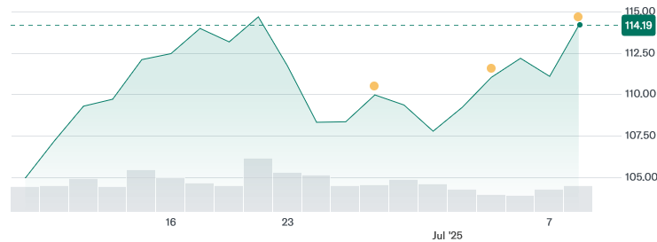
Exxon mobil
As of 7 / 7 / 25 it is trading at $111.11
52-week range is $97.80 – $126.34
Year target is $124.07
Stock price is highly correlated with the price of oil.
In November 2023 Exxon Mobil completed its $4.9 B all-stock acquisition of Denbury Inc, adding the largest CO₂ pipeline network in the U.S.
1 month stock price chart for Exxon Mobil
Notes:
ConocoPhillips stock has fallen since the acquisition of Marathon as it made the purchase using all stock and acquired 5.4 Billion in debt. This along with the major tariffs issued on April 1st have kept the stock price low. However, it has grown over 10% in the last month after boasting a better than expectation Q1. Company has announced that it expects to save $1B in the next 12 months in synergies due to the Marathon acquisition and it is also selling off non core assets in a strategy to reduce its debt to equity ratio.

Slide 8
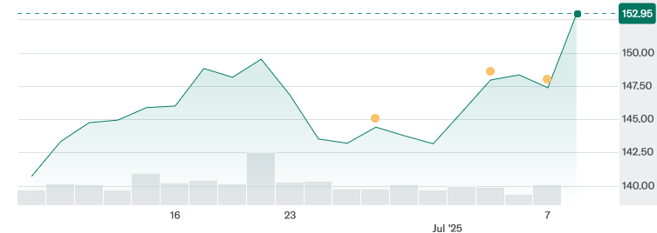
chevron
As of 7 / 7 / 25 it is trading at $147.40
52-week range is $132.04 – $168.96
Year Target is $160.65 (average analyst estimate)
Stock price is highly correlated with the price of oil.
In October 2023 Chevron announced a $53B stock acquisition of Hess Corporation, giving it a major stake in Guyana’s fast-growing offshore fields.
1 month stock price chart for Chevron
Notes:
ConocoPhillips stock has fallen since the acquisition of Marathon as it made the purchase using all stock and acquired 5.4 Billion in debt. This along with the major tariffs issued on April 1st have kept the stock price low. However, it has grown over 10% in the last month after boasting a better than expectation Q1. Company has announced that it expects to save $1B in the next 12 months in synergies due to the Marathon acquisition and it is also selling off non core assets in a strategy to reduce its debt to equity ratio.

Slide 9
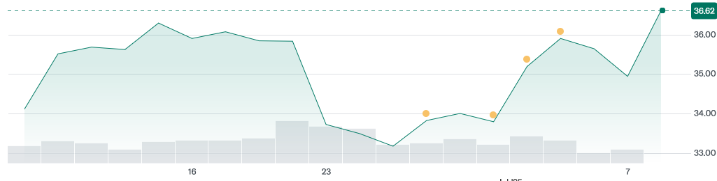
Schlumberger
As of 7/7/25 it is trading at $34.95
52 week range is $31.11-50.94
Year Target is $47.12
Stock price is highly correlated with price of oil.
Correlation with oil prices is low, rather it better correlates with activity on oil fields
1 month stock price chart for Schlumberger
Notes:
ConocoPhillips stock has fallen since the acquisition of Marathon as it made the purchase using all stock and acquired 5.4 Billion in debt. This along with the major tariffs issued on April 1st have kept the stock price low. However, it has grown over 10% in the last month after boasting a better than expectation Q1. Company has announced that it expects to save $1B in the next 12 months in synergies due to the Marathon acquisition and it is also selling off non core assets in a strategy to reduce its debt to equity ratio.

Slide 10
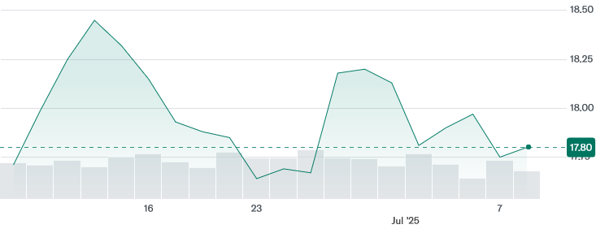
Energy transfer
As of 7 / 7 / 25 it is trading at $17.75
52-week range is $14.60 – $21.45
Year Target is $22.83 (average analyst estimate)
Stock price is highly correlated with oil & NGL prices.
In July 2024 Energy Transfer acquired WTG Midstream for about $3.25 B, expanding its Permian Basin gas-gathering and processing network.
1 month stock price chart for Energy Transfer
Notes:
ConocoPhillips stock has fallen since the acquisition of Marathon as it made the purchase using all stock and acquired 5.4 Billion in debt. This along with the major tariffs issued on April 1st have kept the stock price low. However, it has grown over 10% in the last month after boasting a better than expectation Q1. Company has announced that it expects to save $1B in the next 12 months in synergies due to the Marathon acquisition and it is also selling off non core assets in a strategy to reduce its debt to equity ratio.

Slide 11
Stock Comparison-Upside
Company | Exxon Mobil | Chevron | ConocoPhillips | The Williams Company | Kinder Morgan | Energy Transfer | Marathon Petroleum | Shlumberger
Ticker | XOM | CVX | COP | WMB | KMI | ET | MPC | SLB
Stock Price | 111.12 | 147.39 | 92.54 | 58.5 | 28.36 | 17.76 | 176.46 | 34.96
1 Year Estimate | 124.07 | 165.53 | 116.07 | 61.57 | 30.49 | 22.71 | 166.86 | 47.12
Upside | 11.65% | 12.31% | 25.43% | 5.25% | 7.51% | 27.87% | -5.44% | 34.78%
Notes:
According to the 1 year consensus Shlumberger, Energy Transfer and ConocoPhillips all have strong upside this coming year.

Slide 12
Valuation
Valuations indicate price ratios for most companies expanding or maintaining by historical data
multiples normalized from pandemic but still below market levels, giving energy room to stay cheap rather than get cheaper—provided oil holds at $80-100 band cap-ex discipline persists. Investors can rely on cash-return yield (majors, mid-stream) or cyclical growth (SLB, COP) while being mindful of of WMB and KMI.

Slide 13

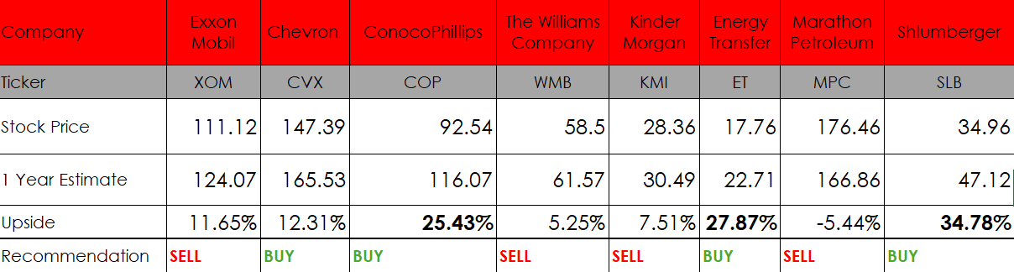
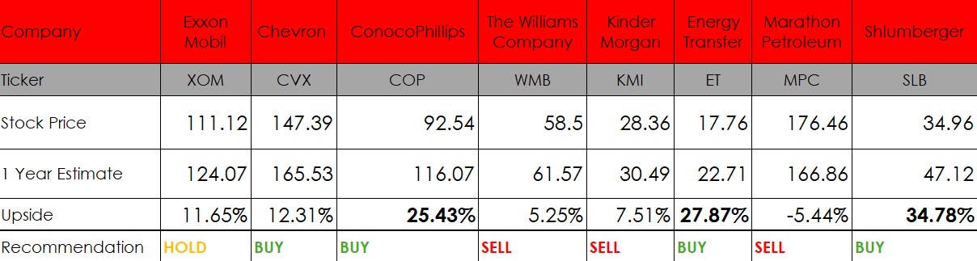
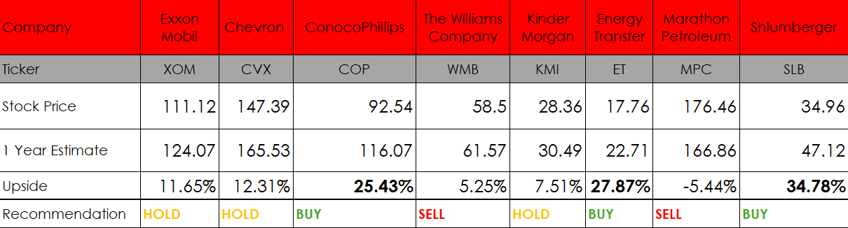
Recommendation
XOM: Lower RAR, Lower FCF to CAPEX, High FCF.
CVX: Low price upside, Diversified assets
KMI: Low FCF, Too low price upside
WMB: Low FCF, Regulatory pressure
MPC: Earnings loss, Falling oil price
COP: High FCF, Undervalued
ET: Decreasing leverage, high upside
SLB: historical buybacks, AI advancements

Slide 14
Sources
$22.5 Billion ConocoPhillips, Marathon Oil Deal Creates A Shale Giant
ConocoPhillips (COP) Stock Price, News, Quote & History - Yahoo Finance
Schlumberger Limited (SLB) Stock Price, News, Quote & History - Yahoo Finance
Exxon Mobil Corporation (XOM) Stock Price, News, Quote & History - Yahoo Finance
Chevron Corporation (CVX) Stock Price, News, Quote & History - Yahoo Finance

