Slide 1

Energy Sector
Evan Palcho, Noah Saliba, Khaleb Rykard

Slide 2
Agenda
•1. Overview
•2. Business Analysis
•3. Economic Context
•4. Financial Performance
•5. Valuation Summary
•6. Strategic Recommendation

Slide 3
Sector Overview - Size and Composition
• The Energy Sector makes up ~3% of the S&P 500 as of Q2 2025.
• Historically more prominent, its share has declined due to tech sector growth and oil price volatility.
• Still plays a critical role in economic and geopolitical contexts.
Notes:
The Energy sector currently makes up about 3% of the S&P 500, down significantly from over 10% in the early 2010s. This shift reflects the rise of sectors like tech and consumer discretionary, and oil price volatility over the past decade. Despite this smaller weight, energy still plays an outsized role in global economics and politics. The sector is essential for transportation, industry, and power generation, and it’s undergoing major transformation toward low-carbon energy sources.

Slide 4
Industries in the Sector
• Oil & Gas Exploration and Production (E&P)
• Integrated Oil & Gas (Upstream + Downstream)
• Refining & Marketing
• Midstream (Pipelines & Storage)
• Energy Equipment & Services
• Coal & Consumable Fuels
• Renewable Energy (Solar, Wind, Biofuels)
Notes:
This slide shows the breadth of industries within the Energy sector. We’re not just looking at oil drilling. Upstream E&P companies find and produce oil and gas, while integrated majors like Exxon handle everything from drilling to refining. Midstream firms manage pipelines and transport, and downstream firms refine and sell end products like gasoline. There’s also a growing presence of renewable energy and biofuels, which are increasingly part of the broader energy conversation.

Slide 5




Largest Companies in the Sector
• Exxon Mobil (XOM)
• Chevron (CVX)
• ConocoPhillips (COP)
• Schlumberger (SLB)
• EOG Resources (EOG)
• Kinder Morgan, Marathon Petroleum, Halliburton
Notes:
These are the dominant players in the Energy sector. Exxon Mobil and Chevron alone make up a significant chunk of the sector’s market cap. ConocoPhillips is a leader in exploration and production, while Schlumberger and Halliburton serve the drilling and oilfield services side. Companies like EOG Resources and Kinder Morgan round out the sector’s diversity. While the sector is broad, it’s very top-heavy in terms of market value concentration.

Slide 6
Sector Performance YTD / QTD
• Q1 2025: +9.3%, led all S&P 500 sectors.
• Q2 2025: Pullback due to falling oil prices; net YTD ~–2% to –3%.
• Outlook: Volatile, tied to oil markets, geopolitical risk, and OPEC+ decisions.
Notes:
In Q1 2025, Energy was the best-performing sector, gaining over 9% while the S&P 500 overall fell. This was driven by rebounding oil prices and investors rotating into value sectors. However, Q2 has been weaker, with energy stocks giving back some of those gains as oil prices softened. That leaves the sector slightly negative year-to-date. It shows just how sensitive this sector is to oil price swings and global headlines.

Slide 7
Business Analysis - Demand
• Oil & Gas: Mature to late-mature phase.
• Renewables: High-growth phase through 2030.
• Sector is cyclical – demand rises in economic booms, falls in recessions.
• U.S. demand flat; emerging markets (India, China) drive growth.
• EV adoption and energy efficiency are displacing oil demand.
Notes:
The demand side of energy is very cyclical. When economies grow, transportation and industrial activity increase, driving up demand for oil and gas. In contrast, recessions bring sharp pullbacks. Oil is in a mature phase globally, with demand plateauing in developed countries. Emerging markets are now the growth engine. Renewables, on the other hand, are in a high-growth stage and are beginning to take market share from fossil fuels

Slide 8

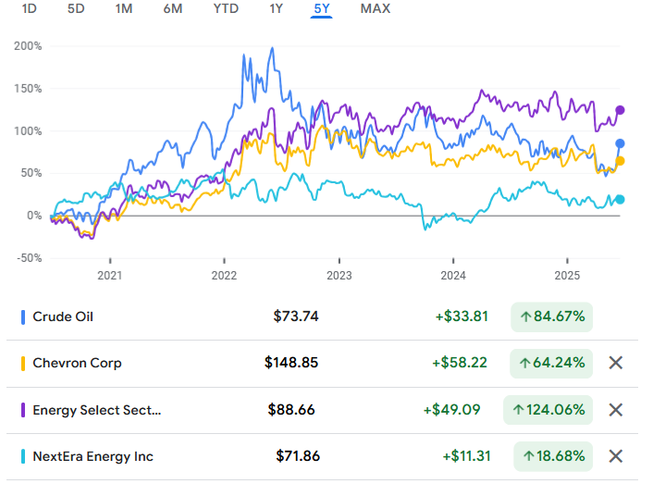
Economic Analysis
Producer’s stock price tends to move with crude oil (even alt energy).
XLE move on average 5.8% for every 10% of crude movement
Beta is subject to shock in current political climate

Slide 9
Demand Influences & Users
• Geopolitical Events: OPEC+, wars, sanctions influence demand.
• Regulatory Pressures: Carbon taxes, EV mandates cut fossil demand.
• Technology: Efficiency, EVs, renewables changing demand patterns.
• User Segments: Transportation (oil), Utilities (gas), Industry (both).
Notes:
Multiple external forces shape energy demand. Geopolitical events like wars and sanctions affect supply and drive stockpiling. Regulations, like EV mandates and emissions rules, reduce oil demand long-term. Technology plays a role too, from more fuel-efficient engines to EV adoption. Oil is mainly used in transportation, gas in heating and power, and electricity from renewables powers homes and emerging industries like data centers.

Slide 10
Business Analysis - Supply
• U.S. shale (Permian) is a key source of new oil and gas.
• OPEC+ controls supply through coordinated cuts.
• Renewable supply growing rapidly (solar, wind additions).
• LNG capacity expanding globally – especially U.S., Qatar.
• Infrastructure and policy constraints can limit supply growth.
Notes:
On the supply side, U.S. shale production is a major growth driver, especially in the Permian Basin. OPEC+ actively manages supply to support prices, and recent cuts have helped stabilize markets. LNG export capacity is also expanding, especially in the U.S. For renewables, supply is growing rapidly as solar and wind scale globally. However, all these supply sources face challenges—whether it’s capital discipline, infrastructure, or permitting delays.

Slide 11

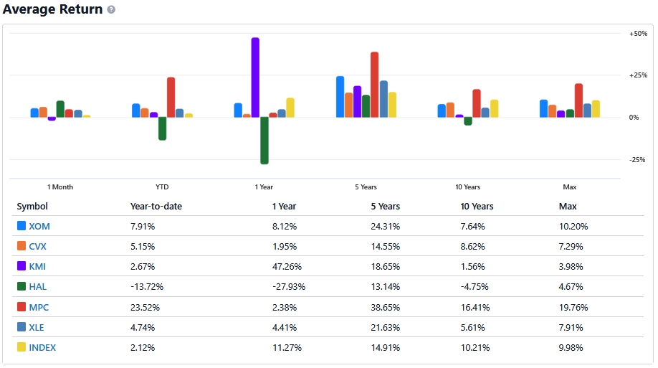
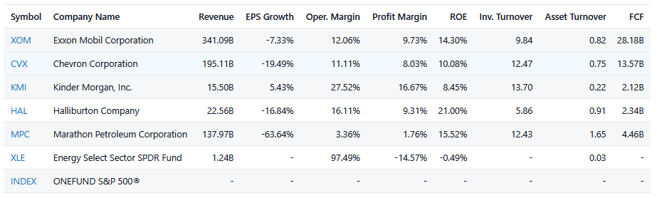
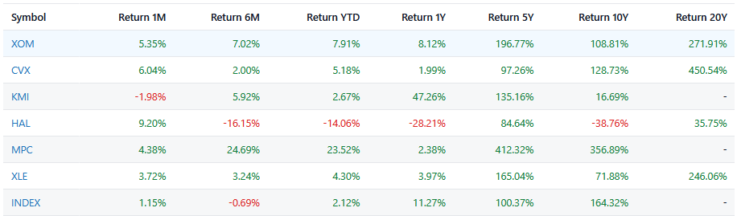
Financial Analysis
Oil price hikes in 2022
Sector is down in currently, but shows outperformance of Total Return after last economic cycle.
Capital intensive
Net generates cash
Potential for solid future earnings

Slide 12
Profitability & Pricing
• Oil & gas profitability depends on commodity prices.
• Upstream: High margins when oil > $70/barrel.
• Refiners: Profit from spreads between crude and product prices.
• Renewables: Stable margins under long-term contracts.
• Tech and cost efficiency are key margin drivers.
Notes:
Profitability in the sector is largely tied to commodity prices. Upstream companies profit when oil is above their breakeven price—often $50–70 per barrel. Refiners do well when there’s a wide spread between crude and finished products. Renewables tend to have steadier margins, especially with long-term power contracts. Technology and cost control are key to staying profitable in a volatile pricing environment.

Slide 13
Porter’s Five Forces - Energy Sector
• Ease of Entry: LOW – High capital, tech, and regulatory barriers.
• Buyer Power: LOW – Essential commodity, inelastic demand.
• Supplier Power: HIGH – OPEC, limited advanced equipment providers.
• Industry Rivalry: HIGH – Intense competition among oil majors.
• Substitution Risk: MEDIUM – EVs, renewables, hydrogen rising.
Notes:
Porter’s model helps us understand the strategic forces at play. Entry barriers are high due to capital and regulatory needs. Buyers have limited power because energy is essential. Suppliers—especially OPEC and major equipment firms—hold strong positions. Rivalry is intense among oil companies, especially in shale. Substitution risk is growing as renewables and EVs become more viable. Overall, the sector is highly competitive and under pressure to adapt.

Slide 14
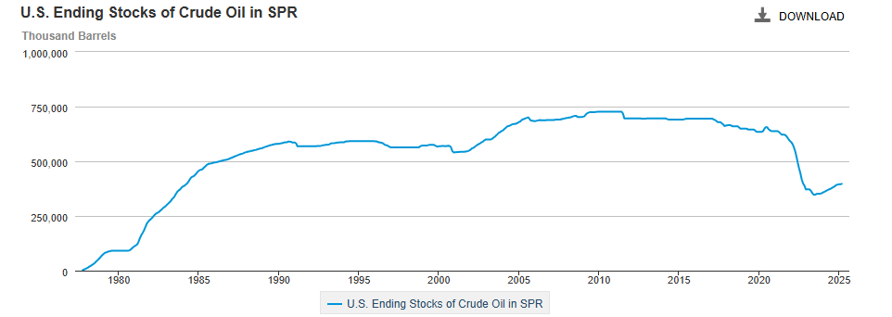
Oil Reserves
Notes:
Despite a recent rise from 2023 to now the U.S oil Reserves is still about 300 million barrels lower than it was in the 2010’s.

Slide 15
Oil Reserves
US Strategic Oil Reserves opened in 2021 for Hurricane Ida, COVID relief, Russia-Ukraine War, and OPEC cuts.
Appx. 248.3 million barrels of oil between 2021 and 2022.
Strategic reserves have been refilled 55 million barrels.
US gov't shows interest in strengthening domestic resources for national security.
Notes:
US Strategic Oil Reserves began being tapped in 2021 for Hurricane Ida, COVID relief, Russia-Ukraine War, and OPEC cuts.​
Appx. 248.3 million barrels of oil were released in the year that it lasted.
Strategic reserves have been refilled 55 million barrels, leaving them at around 56% full.
If the tech sector indicates anything, it's that the government is interested in shoring up the homefront for national security, which can easily lead to lots of spending and production incentives in the sector.

Slide 16
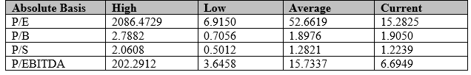
Absolute Ratios
•P/E: Below average meaning the price is undervalued.
• P/B: Above average suggest that price is overvalued.
• P/S: Below average suggest price is undervalued.
• P/EBITDA: Below average suggest price is undervalued.

Slide 17
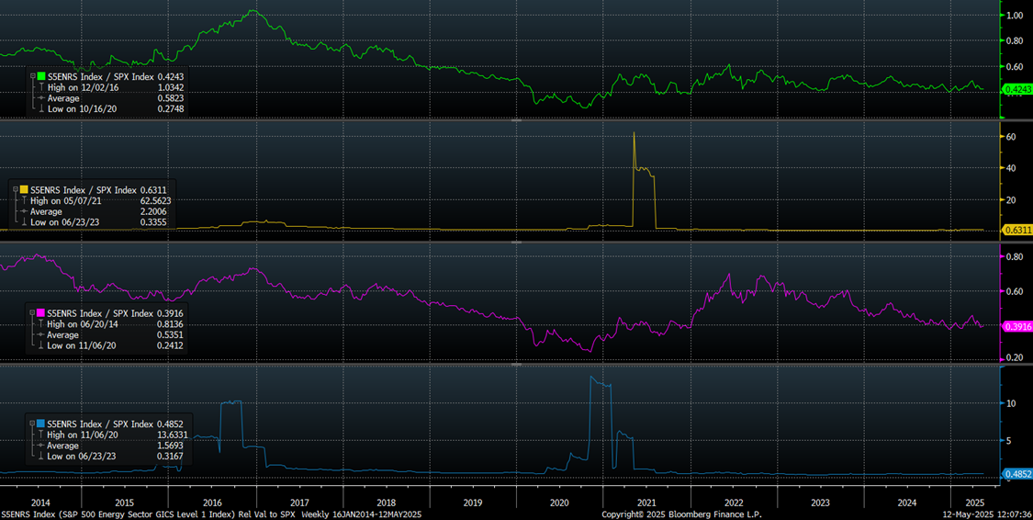
Valuation Relative to S&P 500

Slide 18
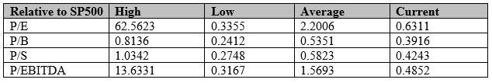
Relative to S&P 500
•P/E: Below average meaning the price is undervalued.
• P/B: Below average suggest that price is undervalued.
• P/S: Below average suggest price is undervalued.
• P/EBITDA: Below average suggest price is undervalued.

Slide 19
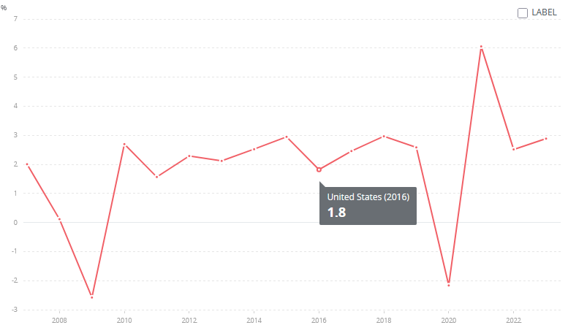
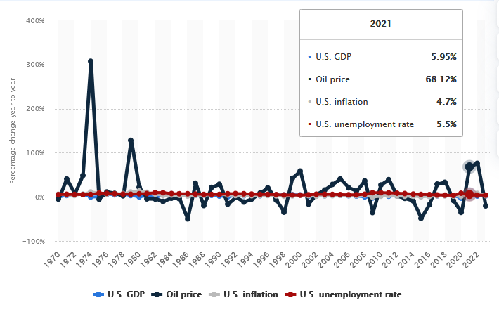
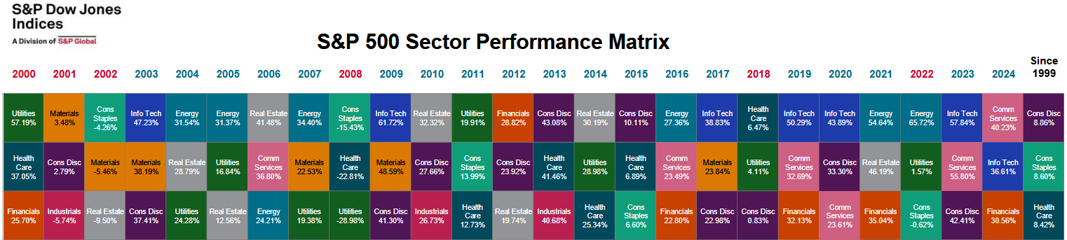
Late Cycle Performance
• End of Dot Com Bubble • Dot Com Recovery
• Great Recession Recovery • Pre-COVID-19 lockdown
Notes:
Energy performs well at the end of cycles
the end of the dot com bubble in 2002, then the end of the recovery cycle before the Great Recession.
It pops up again in 2016, when GDP was showing it would likely hold steady around 2-3%.
When we are really in for it with COVID 19, specifically stagflation

Slide 20
Recommendations
• The energy market is influenced by industry and with analyst debating a recession that puts energy need at risk
• Despite a possible recession energy is a relative inelastic commodity.
•While industry demand may be down in the future there is a looming energy shortage which could drive pricing up.
• With the ratios showing a majority of being undervalued our recommendation is to BUY!

Slide 21
Sources
S&P Global – S&P 500 Sector Weights and Performance
  https://www.spglobal.com/spdji/en/indices/equity/sp-500-energy-sector/#overview
International Energy Agency (IEA) – Oil Market Report, World Energy Outlook, Renewables 2024
  https://www.iea.org/reports/oil-market-report
  https://www.iea.org/reports/world-energy-outlook-2023
  https://www.iea.org/reports/renewables-2024
U.S. Energy Information Administration (EIA) – Energy Data and Forecasts
  https://www.eia.gov

Slide 22
Sources (Cont.)
OPEC – Monthly Oil Market Report, 2025 Outlook
  https://www.opec.org/opec_web/en/publications/338.htm
Deloitte – Oil & Gas Outlook 2024, Energy Transition Insights
  https://www2.deloitte.com/global/en/pages/energy-and-resources/articles/oil-and-gas-industry-outlook.html
Charles Schwab – Sector Performance Insights
  https://www.schwab.com/learn/story/sector-views
Bloomberg & Reuters – Energy Sector News and Financial Data
  https://www.bloomberg.com/markets/sectors/energy
  https://www.reuters.com/business/energy/

Slide 23
Sources (Cont.)
StockAnalysis.com – Compare XOM vs CVX vs KMI vs HAL vs MPC, 2025
  https://stockanalysis.com/stocks/compare/xom-vs-cvx-vs-kmi-vs-hal-vs-mpc/
Google Finance – Crude Oil (CLW00) Future Contract Prices & Comparison with CVX, XLE, NEE, 5‑Year Window, 2025
  https://www.google.com/finance/quote/CLW00:NYMEX?window=5Y&comparison=NYSE%3ACVX%2CNYSEARCA%3AXLE%2CNYSE%3ANEE
Investopedia – 10 Biggest Solar Companies, 2025
https://www.investopedia.com/10-biggest-solar-companies-5077655

