Slide 1
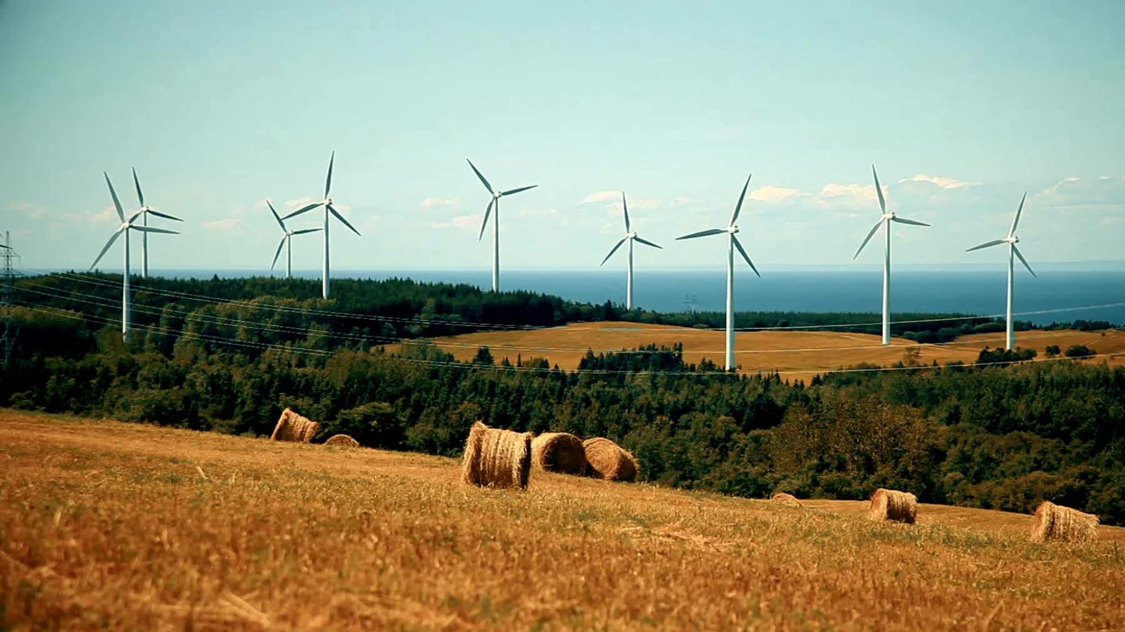
Energy Sector
Jarrod Crano, Reese Delahanty, & Hunter Grannum

Slide 2




Agenda
Overview:
Very briefly recap of sector recommendation.
Review what stocks we currently own in the portfolio.
Sector Performance
Trends and Sector Influences
Discussion of Stocks:
HAL
SLB
COP
Recommendations
Class Vote

Slide 3
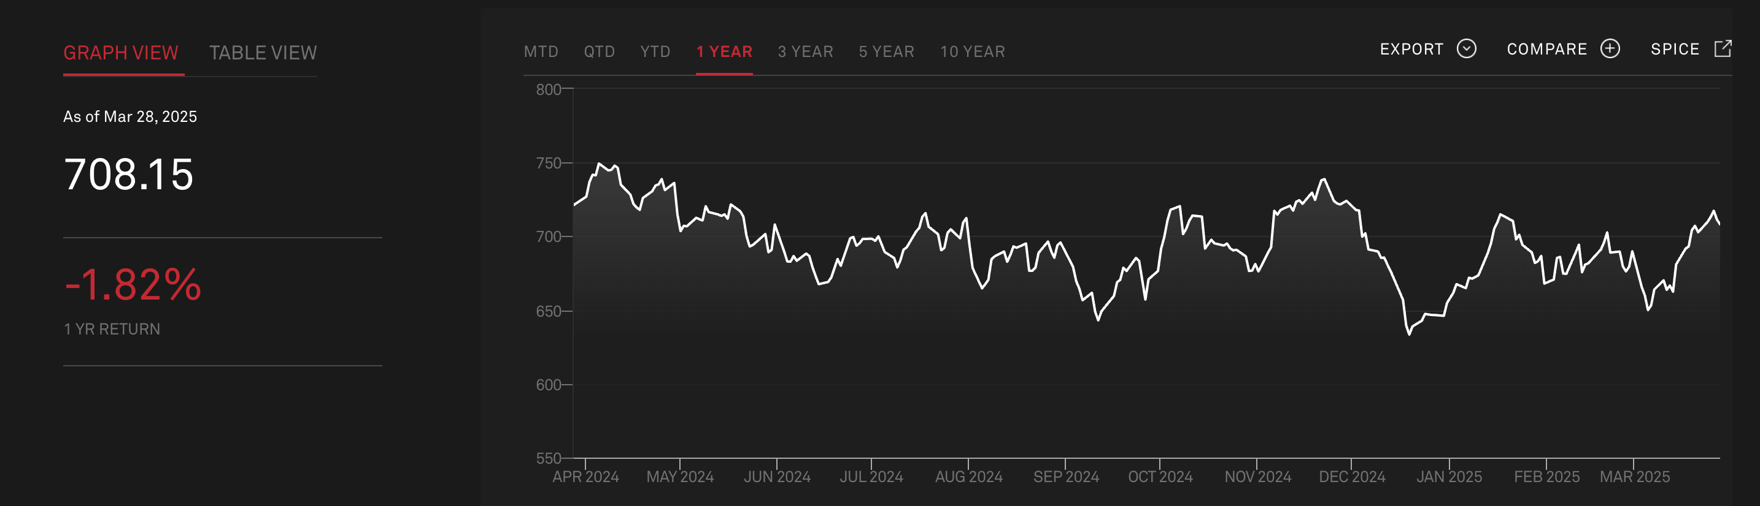
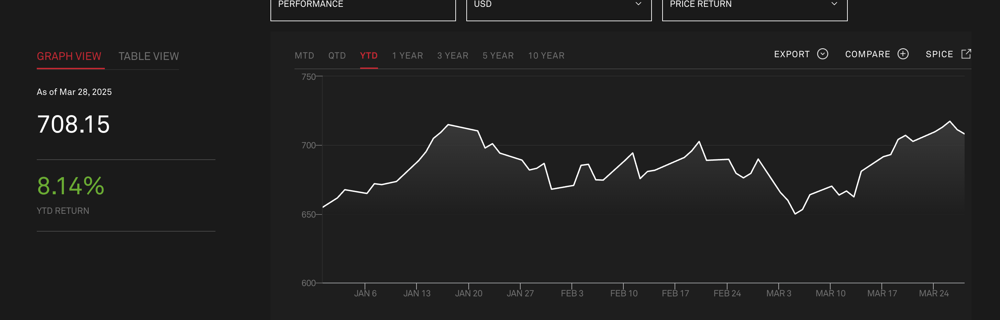
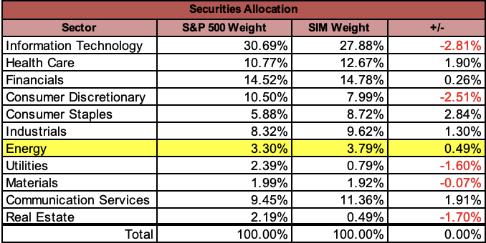
Overview
Quantity | Security | Ticker | %age Assets
5,740 | HALLIBURTON CO | HAL | 1.62%
4,870 | SCHLUMBERGER LTD | SLB | 2.17%
Companies within the sector are primarily involved in the exploration, production, and distribution of energy resources, including oil, natural gas, and consumable fuels.
Underperforming S&P 1-YR (+6.4%)
Outperforming S&P YTD
(-5%)
Energy Sector
1-Year
YTD
Notes:
The sector is comprised of compones primarily involved in ….
The SIM is currently overweight holding Halliburton and Schlumberger.
1-year performance has down 1.8%, although YTD the sector is up 8.1%.

Slide 4
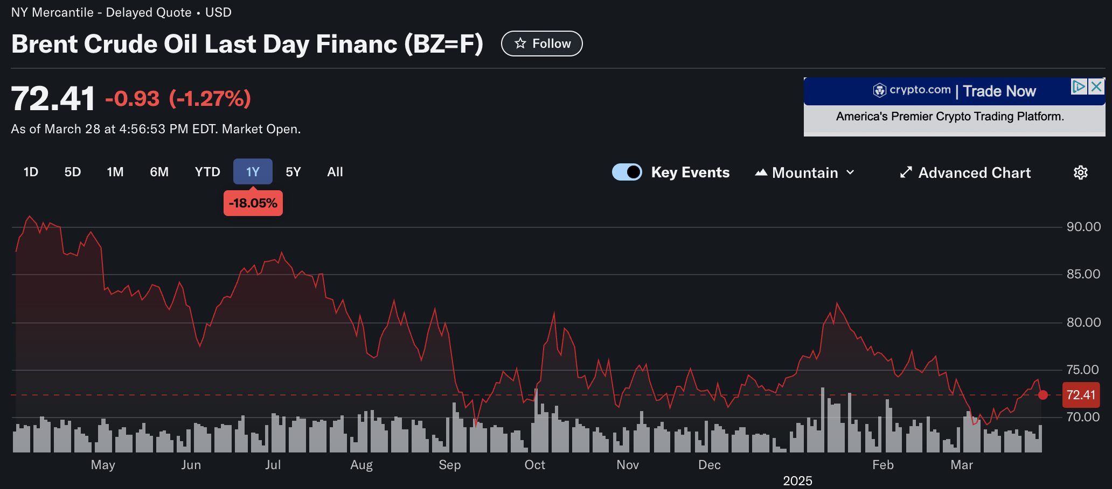
Trends & Macro Influences
Oil Futures -18% over the past year.
Energy demand is accelerating, in part due to high compute demands.
Tariff Uncertainty: OPEC maintains its oil-demand growth forecasts amid uncertainties related to tariffs and trade disputes, projecting an increase of 1.4 million barrels per day for 2025.
Renewable energy supply grew 80% YoY in 2024 but still remains a fraction of the market.
Microsoft buys rights to Three-Mile Island, GPU & AI investments continue to accelerate.
Geopolitical instability remains a wildcard, with conflicts in Ukraine and the Middle East keeping risk premiums on oil.

Slide 5

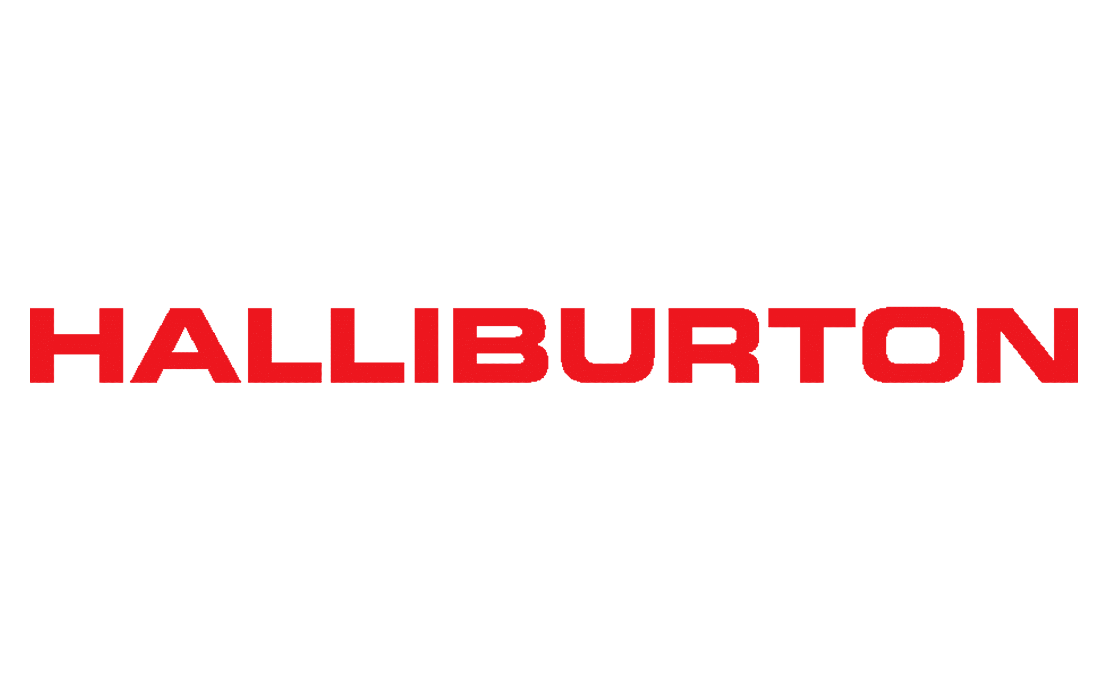
Overview (HAL)
Halliburton is a global oilfield services leader, helping energy companies drill, evaluate, and produce oil and gas efficiently. Its two main segments—Completion & Production and Drilling & Evaluation—drive innovation in hydraulic fracturing, digital tech, and global energy solutions.
Market Data*
Market Cap | $21.8B
Shares outstanding | 868.1M
52 Week Range | $23.42 - 41.56
FY24 EPS | $2.83
Current Price | $25.07
Revenue | $25.5 B
1 YR return | -36.4%
Absolute Valuation | Current price ($) | Current Multiple | Target Multiple | Target/Current (%) | Target Price
P/E | 25.07 | 8.89 | 12.0 | 135% | 33.84
P/B | 25.07 | 2.07 | 2.8 | 135% | 33.84
P/S | 25.07 | 0.96 | 1.3 | 135% | 33.84
P/EBITDA | 25.07 | 5.83 | 7.5 | 129% | 32.25
*Data as of 3/28/2025

Slide 6
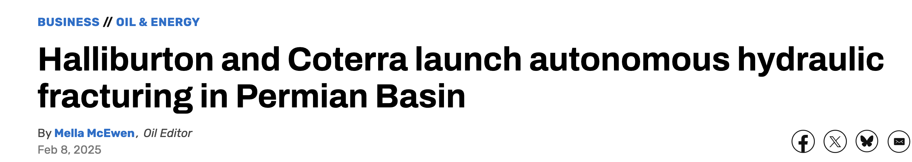
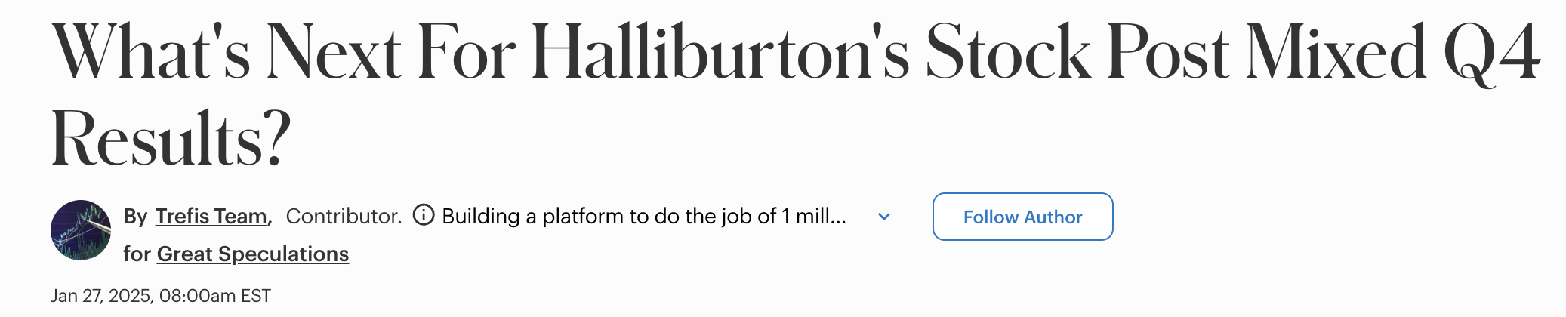
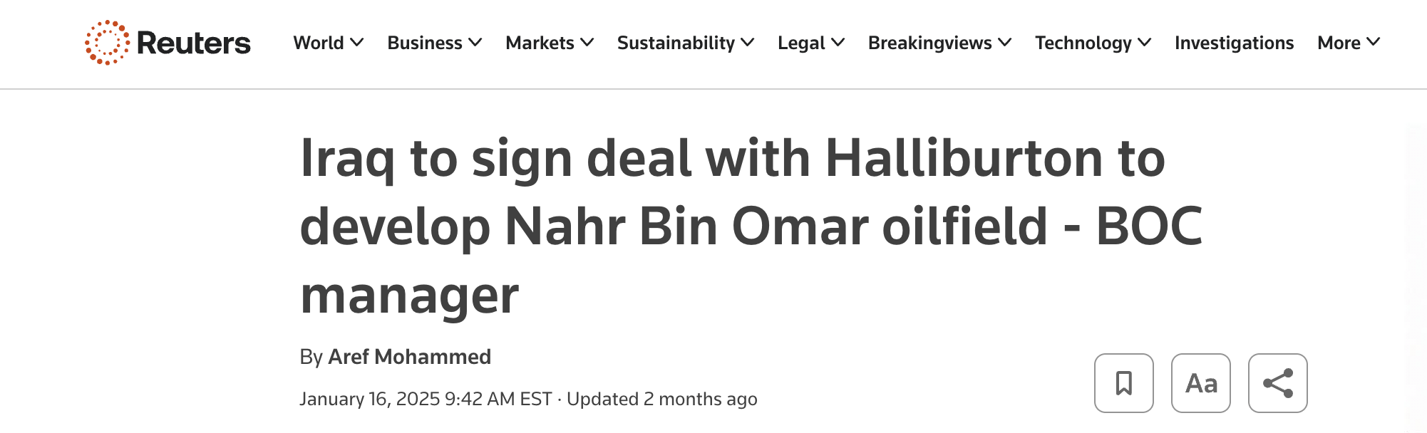

Recent News & Developments

Slide 7
Risks
Opportunities
Overexposed to North America
~40% of revenue comes from NA, which is seeing softening drilling activity and pricing pressure.
FY25 Guidance Revised Down
▸ Flat-to-declining revenue outlook
▸ Margin compression expected (especially in Completion & Production)
Macro Headwinds
▸ Oil oversupply, weak demand growth
▸ Capex discipline among shale producers
▸ Regulatory risk & clean energy transition
Undervalued vs. Peers
Trading at discount to SLB and Baker Hughes on P/E and EV/EBITDA – re-rating could drive 30–35% upside.
Strong International Growth
Middle East and offshore projects continue to expand; ~60% of revenue now international.
Tech-Led Efficiency Gains
Investments in automation (e.g. Octiv Auto Frac), electric fleets, and Halliburton Labs startups can expand margins over time.
Robust Free Cash Flow
Over $2.6B in FCF (2024), with 60% returned to shareholders – supports long-term shareholder value.

Slide 8
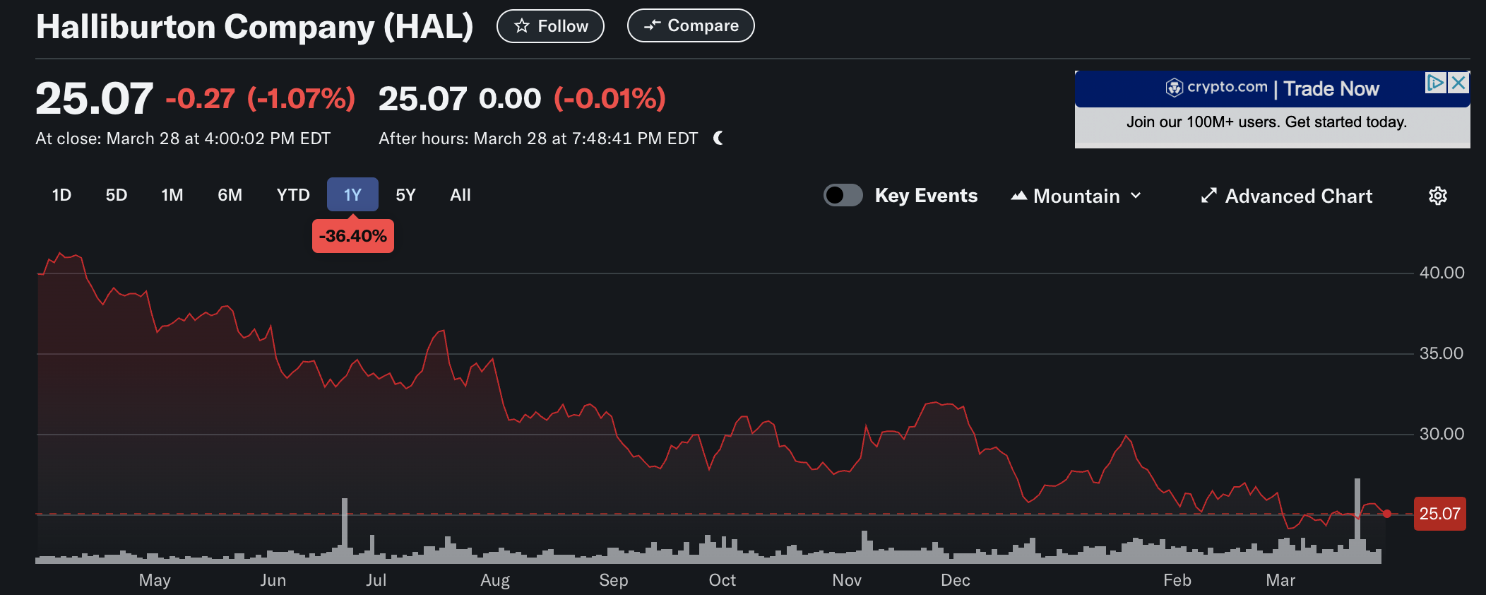
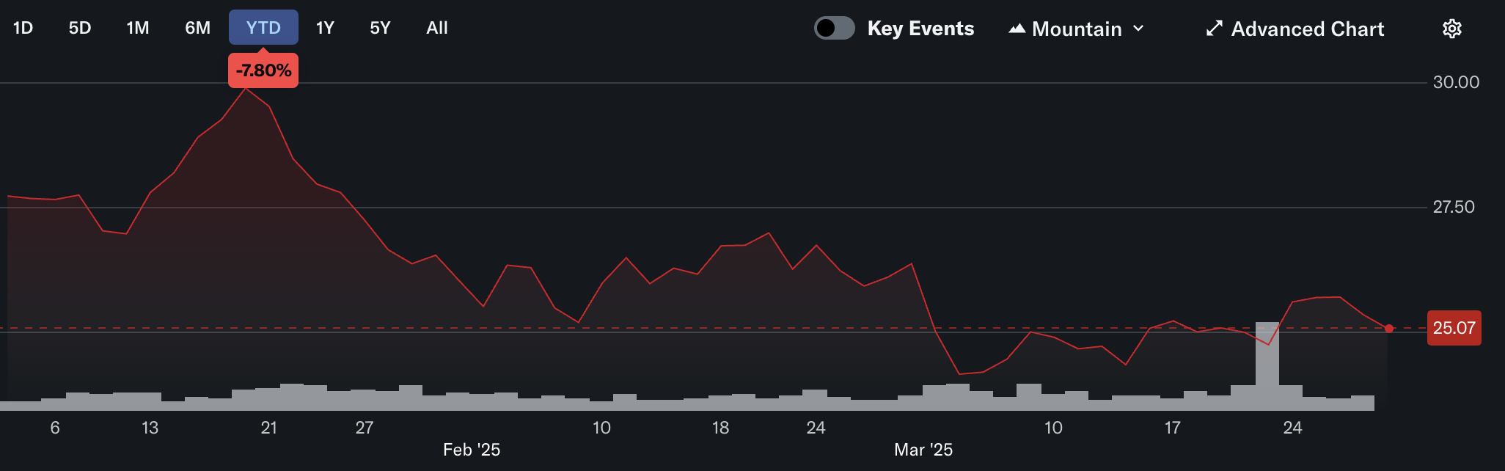
Stock Performance & Valuation
-7.8% YTD -36.4% 1-YR
FY24 Q4 earnings missed expectations, and management issued cautious FY25 guidance citing oil oversupply, pricing pressure in North America, and margin compression.
Recommendation: SELL
We recommend selling or underweighting HAL in the portfolio due to near-term earnings pressure, deteriorating pricing in core markets, and weak sentiment around oilfield services. However, we believe HAL has long-term rebound potential, and its valuation is likely to re-rate closer to peer multiples once revenue growth and margin expansion resume. The energy team should continue to monitor the company next semester as macro conditions evolve and firm performance improves.
Halliburton shares have significantly underperformed both peers and the broader market, reflecting investor concerns about near-term earnings.

Slide 9

Business Analysis
Global leader in oilfield services and technology
  Operates in 100+ countries
  Specializes in oil extraction and production services
4 Main Business Segments
  Well Construction
  Production Systems
  Reservoir Performance
  Digital & Integration
Risks/Opportunities
  Transition to clean/renewable energy
  Digital transformation
  Geopolitical risks affecting oil prices
Recent Performance
  10% YoY Revenue Growth in 2024
  EPS growth
  Strong international growth

Slide 10
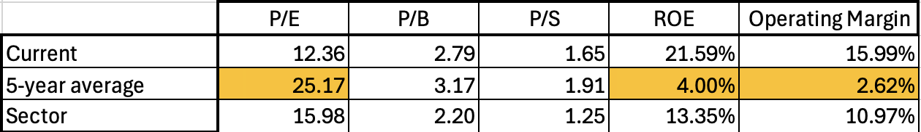
Financial Analysis
Market Data*
Market Cap | $56.95 B
Shares outstanding | 1.36 B
52 Week Range | $36.52 - $55.65
FY24 EPS | $3.11
Current Price | $41.88
Revenue | $36.289 B
1 YR return | - 21.55%
O
*Skewed by 2020 data
Excluding 2020, 5-year ROE = 19.68% and Op. Margin = 14.82%
Lower multiples compared to 5-year averages -> some variability when compared to broader sector
Higher ROE and Op. Margin than 5-year average and broader sector

Slide 11
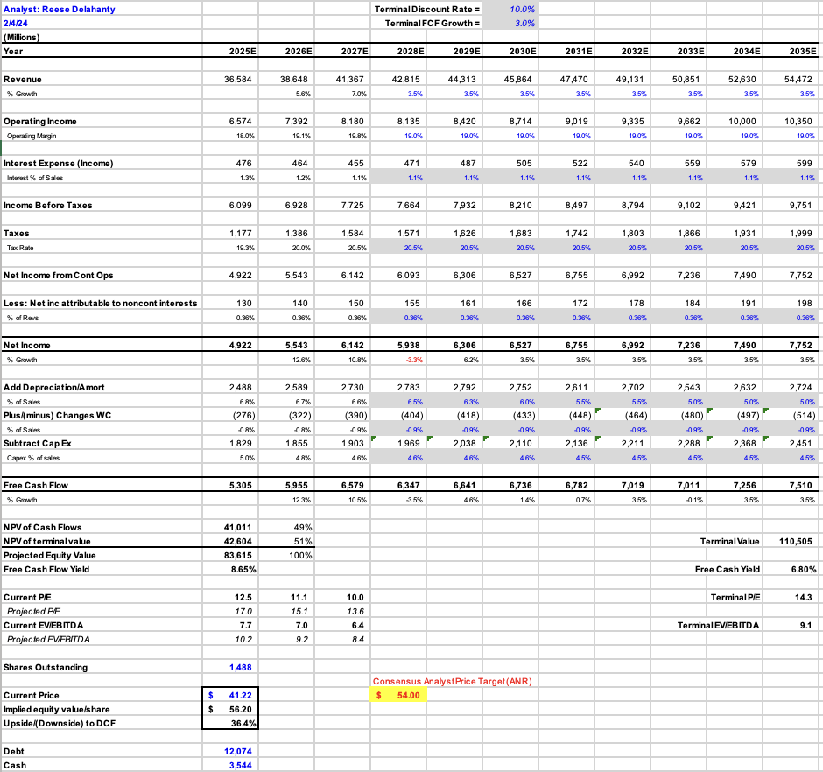
Valuation
10% Terminal Discount Rate
3% Terminal FCF Growth
Current Stock Price -> $41.88
Analyst Price Target -> $54.00
Our Price Target -> $56.20
34.19% implied upside -> undervalued
Potential catalysts for price appreciation include offshore drilling activity and enhanced digital services
BUY

Slide 12

Overview (COP)
MARKET DATA
Market Cap | $130.254 B
Shares Outstanding | 1.18 B
52 Week Range | $86.81 - $135.18
FY24 EPS | $7.81
Current Price | $102.37
Revenue | $54.74 B
1 YR Return | -16.48%
ConocoPhillips is a leading independent oil and gas exploration and production company based in Houston, Texas. Operating in over a dozen countries, it focuses on the extraction and marketing of crude oil, natural gas, and LNG (Liquefied natural gas). Formed from the 2002 merger of Conoco and Phillips Petroleum, the company is known for its global scale, technological expertise, and commitment to sustainable energy practices.

Slide 13
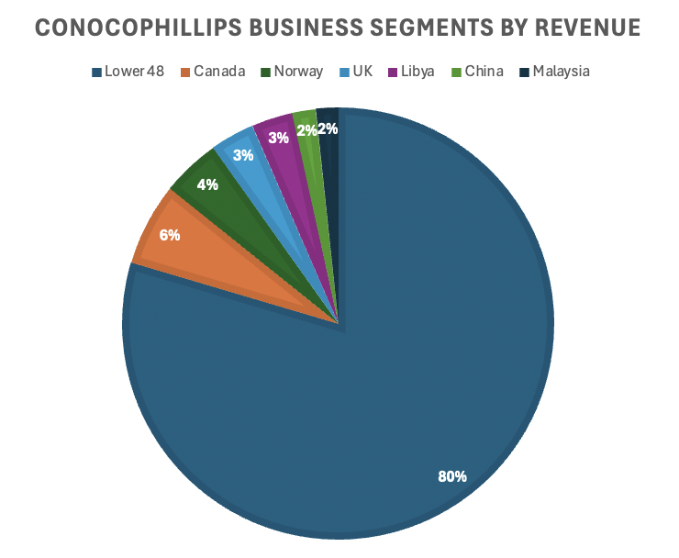
Business Analysis
The company operates across multiple regions, including the United States, Canada, Europe, Asia Pacific, and the Middle East, with significant production from areas like the Permian Basin, Eagle Ford, and Alaska's North Slope.
In 2024, ConocoPhillips reported revenues of $56.95 billion and a net income of $9.245 billion, reflecting strong financial health and profitability.
The company has pursued strategic growth through acquisitions, notably the $22.5 billion purchase of Marathon Oil in November 2024, enhancing its asset base and production capabilities.

Slide 14
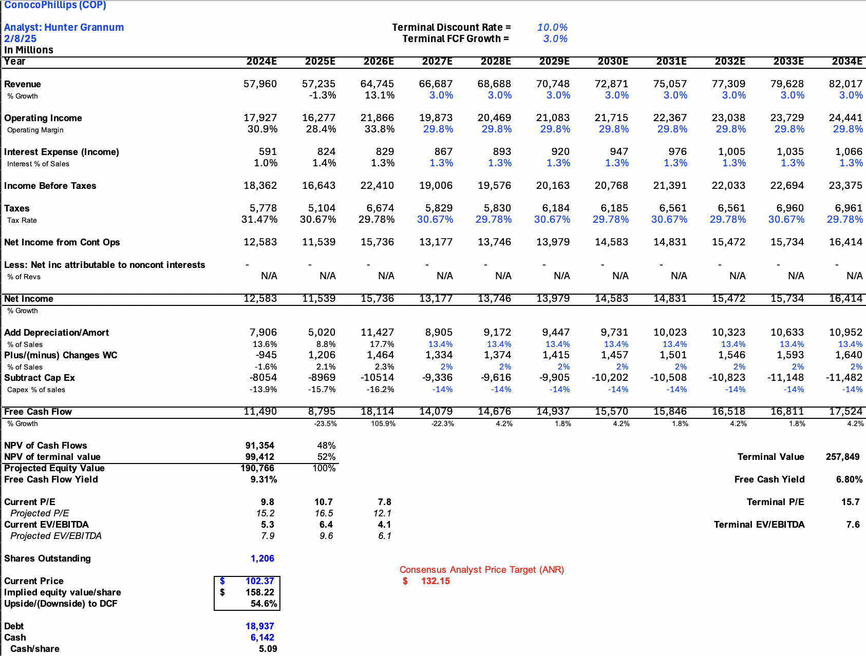
Valuation
10% Terminal discount rate
3% Terminal FCF Growth
Current Stock Price -> $102.37
Analyst Price Target -> $132.15
Our Price Target -> $158.22
54.6% implied upside -> undervalued
Strong cash flow from global oil and gas operations, which supports consistent dividends and stock buybacks.

Slide 15
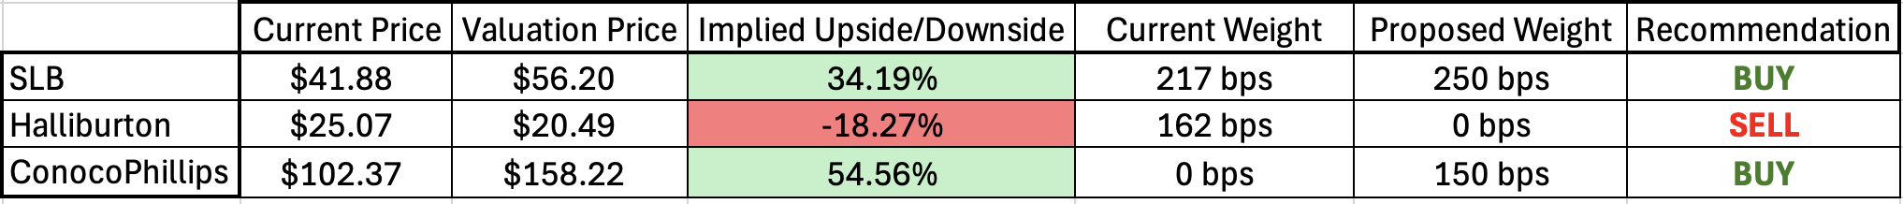
Energy Sector Recommendation
Recommend Underweight the Sector
01
Recommend BUY
Schlumberger Limited (SLB)
02
Recommend BUY ConocoPhillips (COP)
03
Recommend SELL Halliburton Company (HAL)
04

Slide 16
Risks to Recommendation
Underweight the Sector
Rebound Risk: If oil prices spike due to geopolitical instability or unplanned OPEC+ cuts, the sector could outperform broader markets, and underweighting would underperform.
Undervaluation Catch-Up: Energy stocks are already trading at a discount to the S&P 500; any rotation into value or cyclicals could lift the sector.
Buy: Schlumberger (SLB)
International Exposure Risk: SLB’s strength is global, but any regulatory hurdles or instability in the Middle East, Latin America, or Africa could hurt operations.
Tech Competition: SLB is known for innovation, but failure to maintain its edge in digital oilfield services could compress margins over time.
Buy: ConocoPhillips (COP)
Commodity Price Sensitivity: COP is highly leveraged to oil and gas prices—if crude prices remain flat or decline further, earnings could weaken.
Exploration Cost Risk: Aggressive investments in exploration or M&A (e.g., the rumored interest in Suriname blocks) could create capital inefficiencies or disappointments.
Sell: Halliburton (HAL)
Valuation Rebound Risk: If North American drilling picks up faster than expected or margins recover more quickly, HAL could outperform and re-rate.
Undervalued Relative to Peers: HAL is trading well below peer multiples (P/E, EV/EBITDA); any investor rotation into value names could narrow this gap.

Slide 17
Appendix

Slide 18
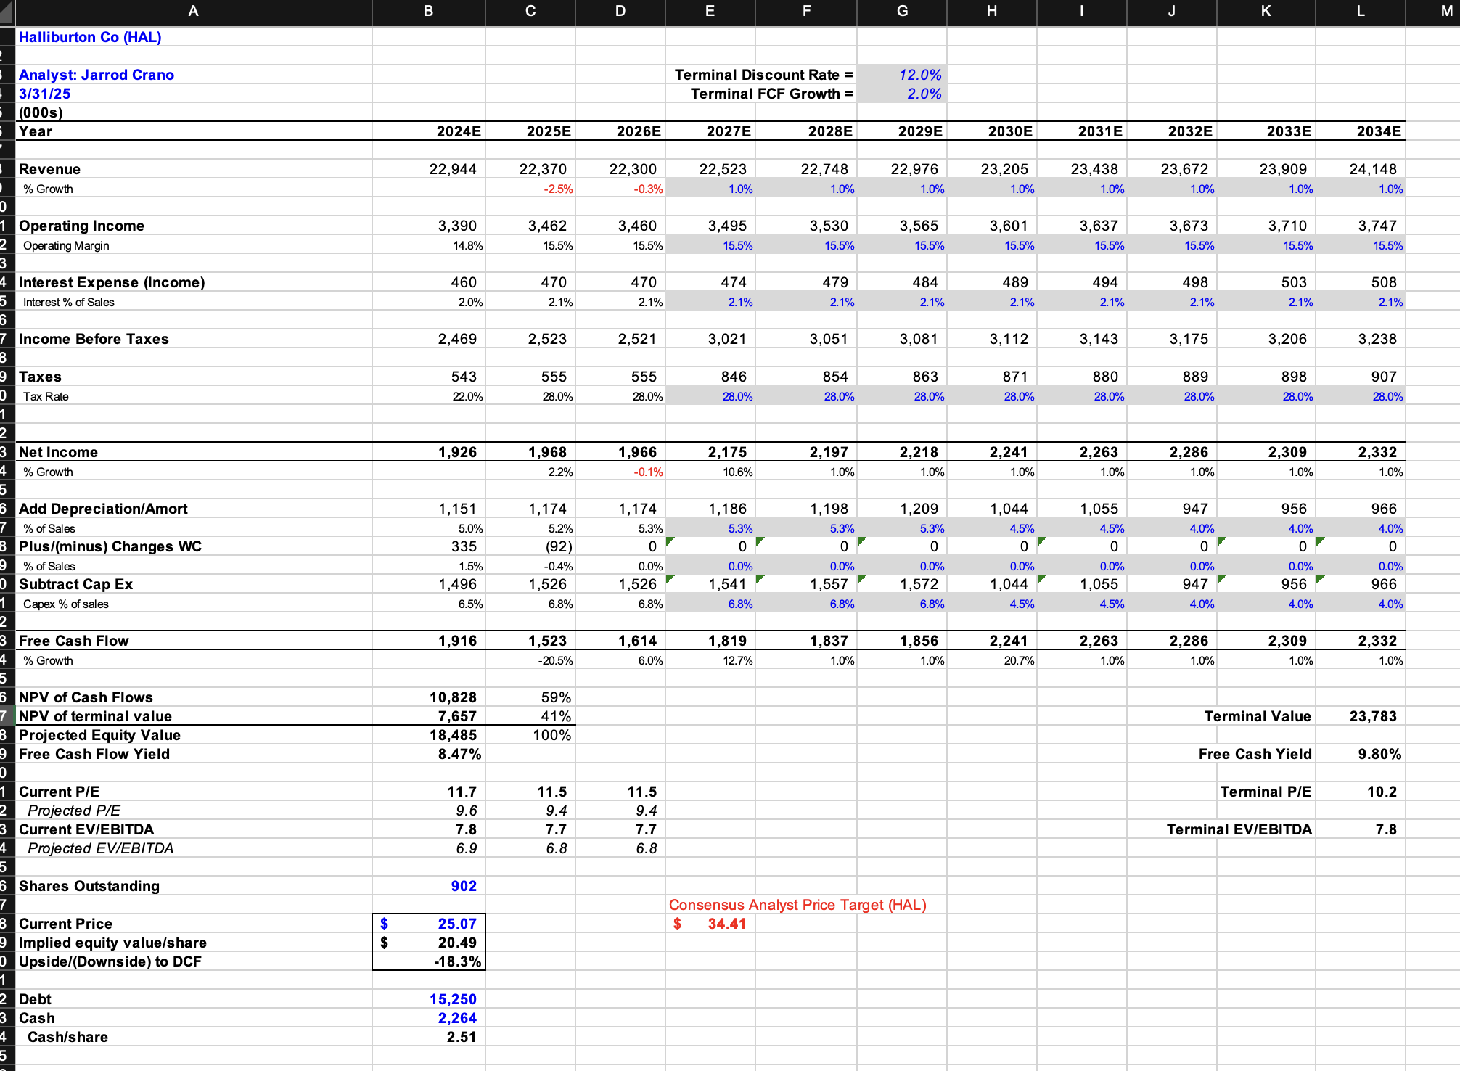
HAL
DCF

Slide 19
SLB
DCF

Slide 20
COP
DCF

