Slide 1
Energy Sector
Jarrod Crano, Reese Delahanty, Hunter Grannum

Slide 2
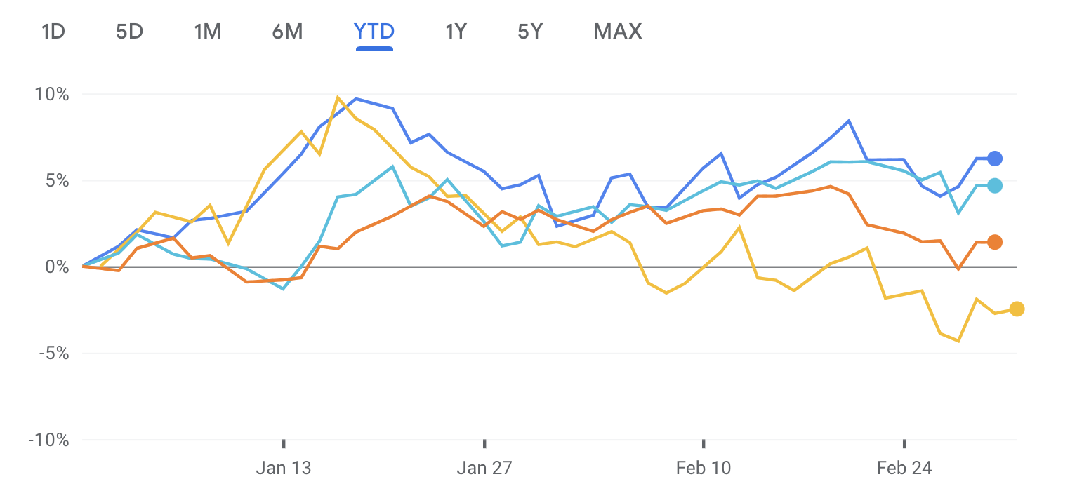
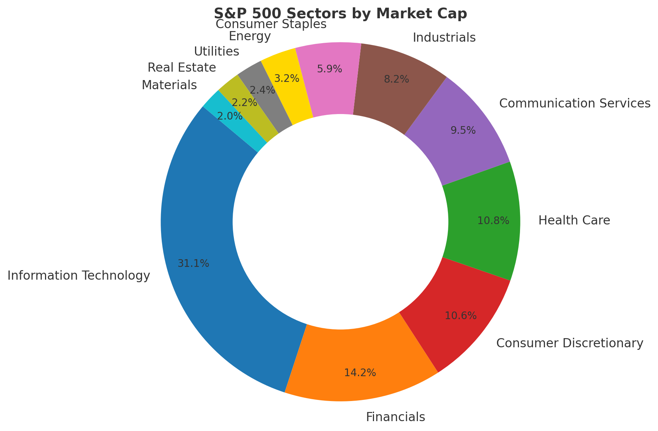
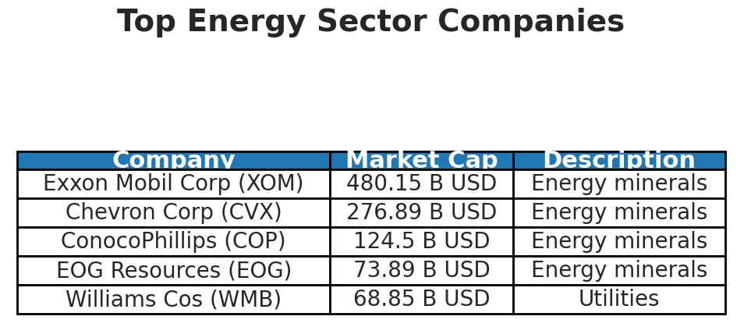
BUSFIN 4221/7225
Overview +4.61% QTD/YTD
Integrated Oil & Gas – Large companies involved in exploration, production, refining, and marketing.
Exploration & Production (E&P) – Companies that discover and extract crude oil and natural gas.
Refining & Marketing – Companies that convert crude oil into gasoline, diesel, and jet fuel for consumers.
Drilling – Firms providing drilling services to E&P companies.
Equipment & Services – Suppliers of technology, equipment, and services for oil and gas operations.
Storage & Transportation – Operators of pipelines, storage facilities, and tankers for oil and gas.
Renewable Energy – Companies producing energy from solar, wind, hydro, and other non-carbon sources.

Slide 3

Business Analysis

Slide 4




BUSFIN 4221/7225
Business Analysis
Mature
Factor | US Economy Impact | Foreign Economy Impact
Demand | The US consumes 16% (and produces 15%) of the world's energy, despite having only 4% of the global population. | Foreign economies are playing an increasingly important role in the energy sector as their demand for energy grows rapidly.
Policies and Regulations | Government incentives for renewable energy can drive investment in clean technologies. Stricter environmental regulations can impact the production and consumption of fossil fuels. | Foreign countries are also rapidly investing in technologies such as nuclear, putting the US behind countries such as China.
Cyclical
Competitive
Distributed & Nuclear

Slide 5

Economic Analysis

Slide 6
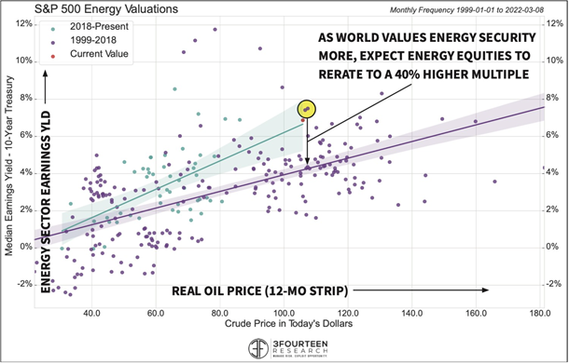
Economic Analysis Regression
BUSFIN 4221/7225
The energy sector shows a strong link to oil prices, with a 0.65 beta. The R² of 0.42 indicates oil prices explain 42% of sector movements, confirming a significant but not sole influence.
Oil prices drive energy stocks, impact inflation, and influence investments. Rising prices boost energy firms but increase costs for businesses and consumers. Governments and investors balance fossil fuels and renewables amid economic shifts.

Slide 7

Financial Analysis

Slide 8
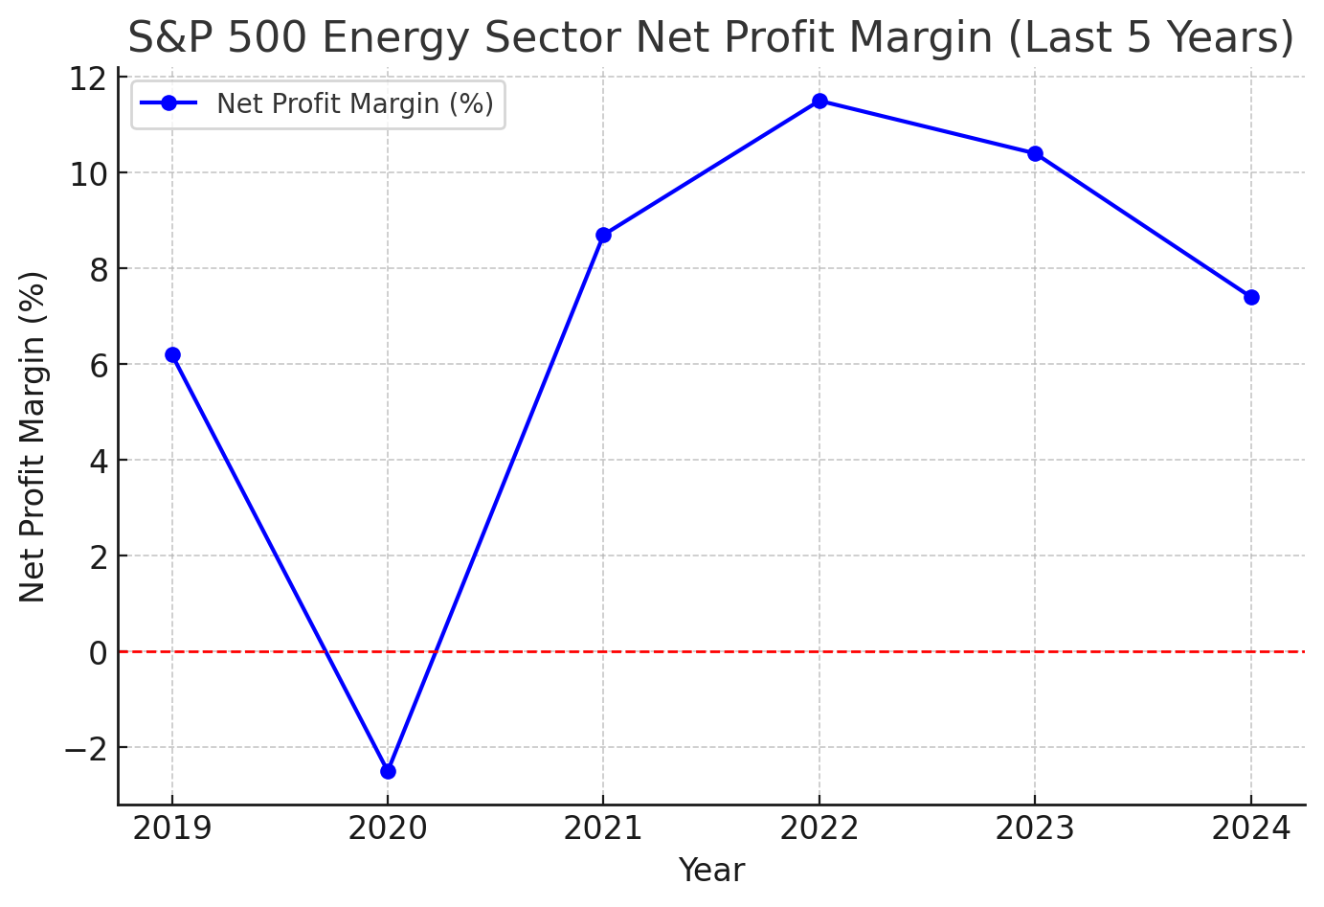
Margins and Profitability Metrics
BUSFIN 4221/7225
Operating Margin: The after-tax unadjusted operating margin for the Integrated Oil & Gas sub-sector is 12.3%.
Net Margin: Q4 2024, the S&P 500 Energy sector reported a net profit margin of 7.4%, a decline from 10.4% y/y and below its five-year average of 9.4%.
Return on Equity (ROE): As of January 2025, the ROE for the U.S. Coal & Related Energy sector is 11.34%.
Research & Development (R&D) as a Percent of Sales: about 1%
Historical Comparison of Margins:
The current operating margin of 12.3% can be pieced together within the sector's performance over the past decade. For instance, the sector experienced significant volatility, with a notable downturn in 2020 (-33.68%) and substantial growth in 2021 (54.64%) and 2022 (65.72%).

Slide 9
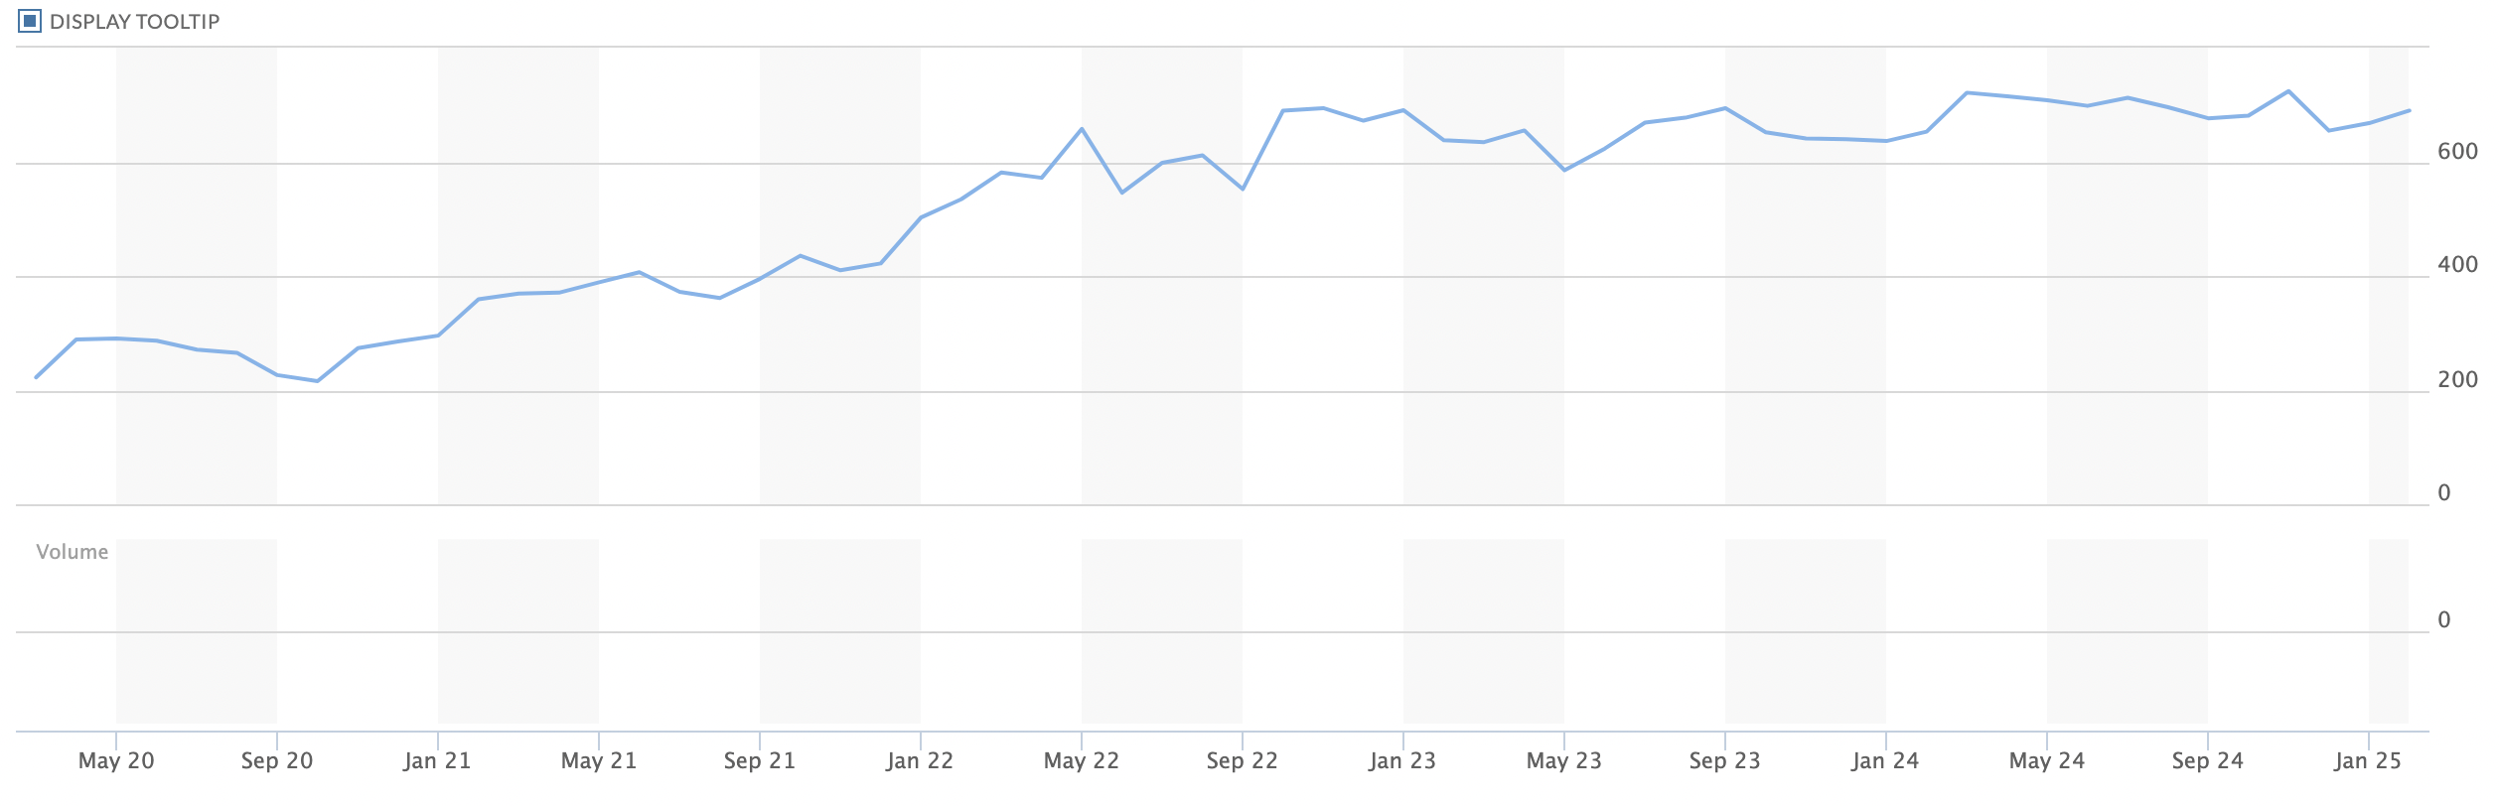
BUSFIN 4221/7225
Energy Sector 5Y Analysis
Earnings Per Share (EPS):
Q3 2024: $10.54,
15% decrease from the previous quarter and a 32.04% decline y/y
Q4 2024 Earnings: y/y earnings decline of 30.7% in Q4 2024
largest of all sectors in the S&P 500.
This decline is attributed to lower oil prices, with the average price of oil in Q4 2024 ($70.32) being 10% below that of Q4 2023 ($78.53).

Slide 10

Valuation Analysis

Slide 11
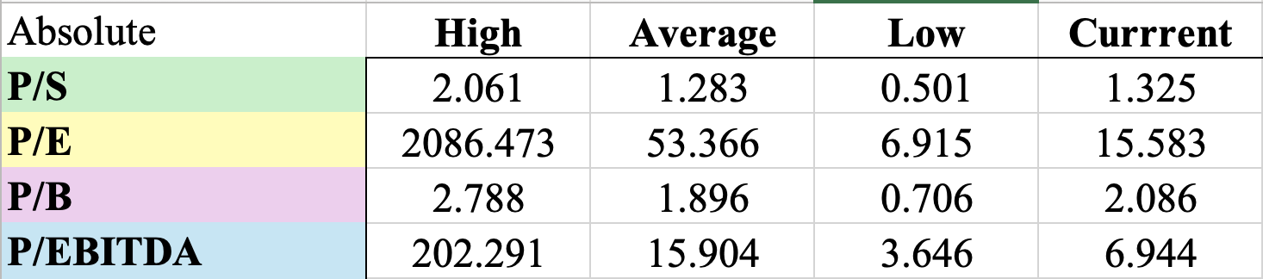
BUSFIN 4221/7225
Absolute Valuation

Slide 12
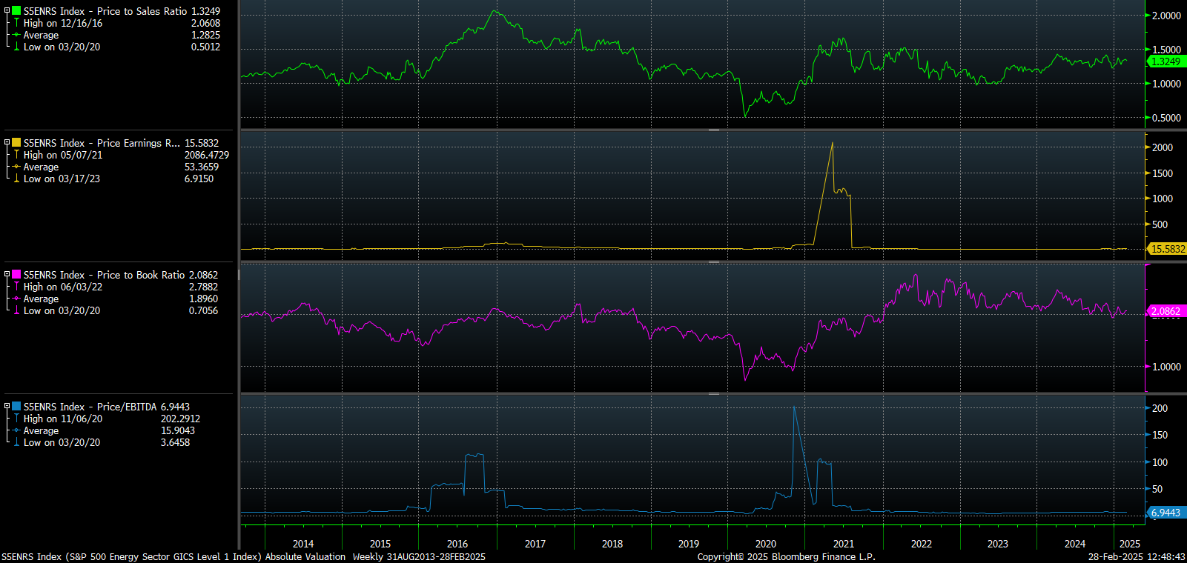
Absolute Valuation
BUSFIN 4221/7225

Slide 13
BUSFIN 4221/7225
Noticeable Trends
Oil price volatility and decline from 2014 – 2016 led to shocks in P/S and P/EBITDA
COVID impacts
Elevated oil prices have pushed valuations higher than pre-pandemic levels
Highly cyclical industry
Intra-Sector Trends
  Drilling trades at significantly higher multiples than Equip/Services
  Companies within each industry are assigned similar multiples

Slide 14
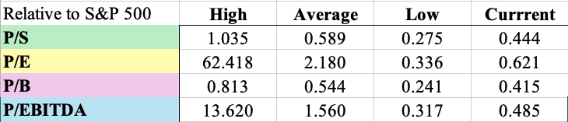
BUSFIN 4221/7225
Relative Valuation to S&P 500

Slide 15
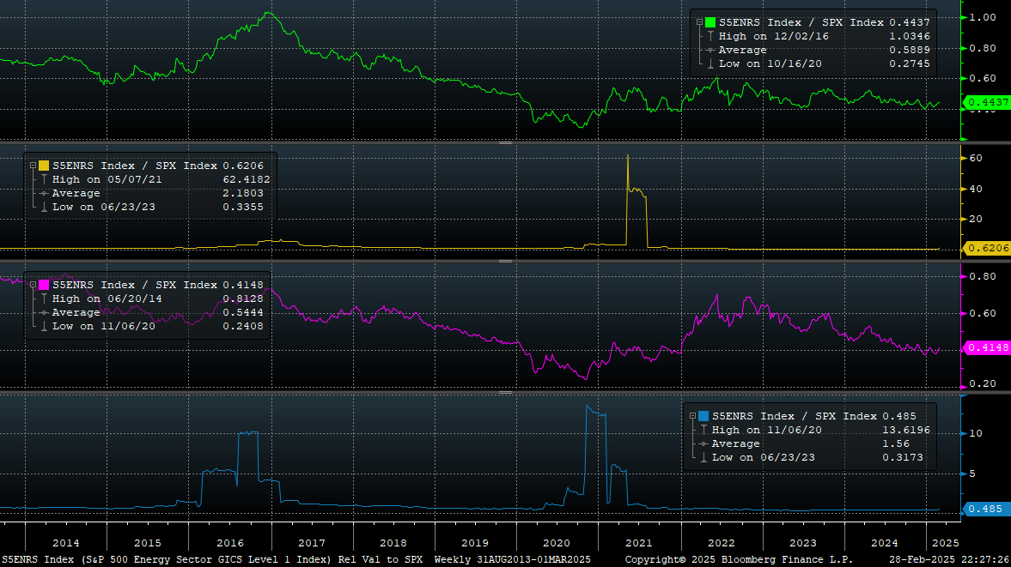
Relative Valuation to S&P 500
BUSFIN 4221/7225

Slide 16
Takeaways from Relative Comparison
BUSFIN 4221/7225
Energy trades at a discount relative to the market
Higher valuations relatively during 2015-16 and 2020-21
Mature sector
Highly cyclical
Likely to continue trading at a discount in the future

Slide 17

Recommendation

Slide 18
Overweight or Underweight?
BUSFIN 4221/7225
Currently overweight by 49 basis points
Recommend modest underweight
Oil futures
Cyclicality
Renewable transition
Opportunities elsewhere

Slide 19
Upsides and Risks
BUSFIN 4221/7225
Upsides:
  Higher returns elsewhere
  Avoid energy stock tumbles
  Hedge against economic slowdowns
Risks
  Miss out on potential gains
  Energy & Inflation

Slide 20
Intra-Sector Weightings
BUSFIN 4221/7225
Drilling Industry:
  Underweight
  Limited expansion opportunities
  Margin tightening
Equipment/Services:
  Overweight
  Steadier demand
  Diversification

Slide 21
Thank you!
BUSFIN 4221/7225

