Slide 1



Energy Stock Recommendations
Chase Gorman, Joey Grecenuk, Marsel Gataulin, Matthew Fryman

Slide 2

Agenda
Sector Recap
Portfolio Review
Stock Discussion
Final Recommendations
Q&A

Slide 3

Business Analysis
Sector Recap

Slide 4
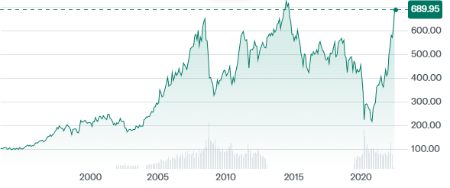
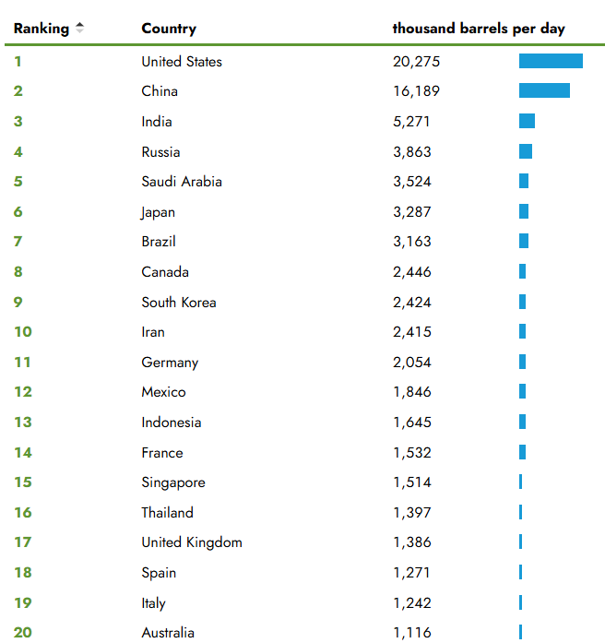
Economic Trends
Highly Cyclical
Thrives during economic expansions, contracts in recessions.
Global growth dependence
U.S. and China remain dominant demand drivers, while Europe’s sluggish recovery limits upside.
Inflation and high interest rates
Increase capital costs for exploration, refining, and new infrastructure, discouraging reinvestment.
GDP
Remains the strongest correlating factor for energy sector returns

Slide 5
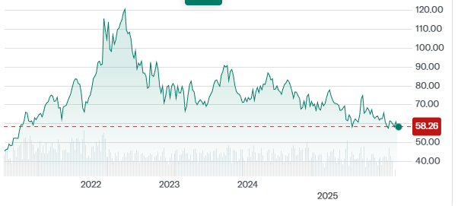
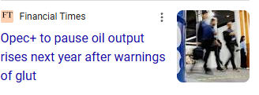
Supply & Demand
Crude Oil Price
OPEC+
Crude oil dropped to 5 year low, pause on oil output for Q1 of 2026
Supply Uncertainty
Persists due to ongoing conflicts in Ukraine and the Middle East.
LNG demand
Growth in East Asia and Europe offsets reduced Russian gas imports, keeping global demand steady.
Renewable Energy Growth
Slows fossil fuel expansion, placing the traditional energy sector in a mature life cycle.

Slide 6
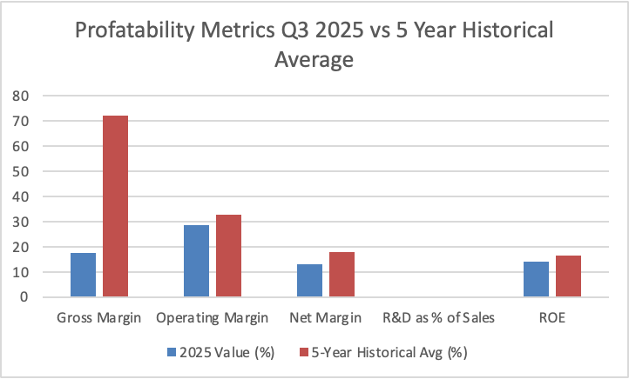
Margins & Profitability
Margins
Operating margins compressed to 28.7% from 32.8% five year average and net margins went to 13% vs 17.9%
Post pandemic tailwinds fading
Oil price normalization pressures revenue growth.
Free cash flows
Strong free cash flow yields persist, but limited reinvestment is a red flag.
Minimal R&D
0.34% of sales which shows a dependence on commodity pricing vs innovation

Slide 7
Business Analysis
Exxon Mobil

Slide 8

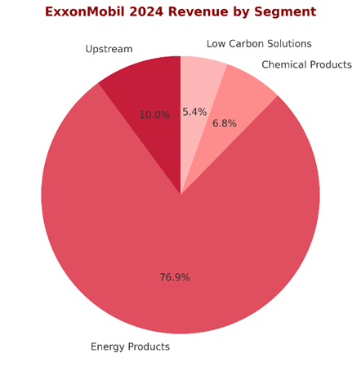
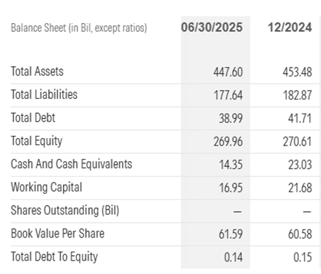
Business Analysis
Integrated business model
Balanced exposure across Upstream, Downstream, and Chemical segments
Low Volatility
Strong project pipeline growth (Permian, Guyana) but already priced in
Compared to Peers
Chevron- similar scale, but CVX benefits more from refining margin tailwinds
Exxon is balanced and stable, but doesnt have high upside compared to peers
Key Business Drivers
Economic: Revenue and EPS growth is moderate compared to recent years
Supply: Rising OPEC production lowers the upside to crude oil
Demand: Stable long term demand, but decarbonization puts pressure on chemical segment
Margins: Upstream tied to mid $70 oil bands, refining margins steady
If the stock has performed poorly, why?
Price has traded pretty flat for months
Crude oil prices at a 5 year low
Most upside is already priced in

Slide 9
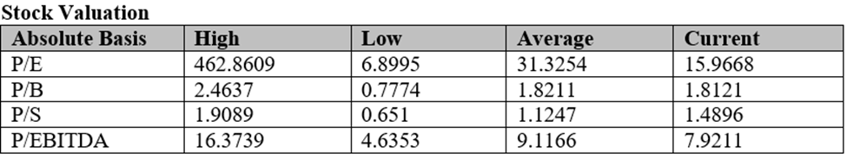
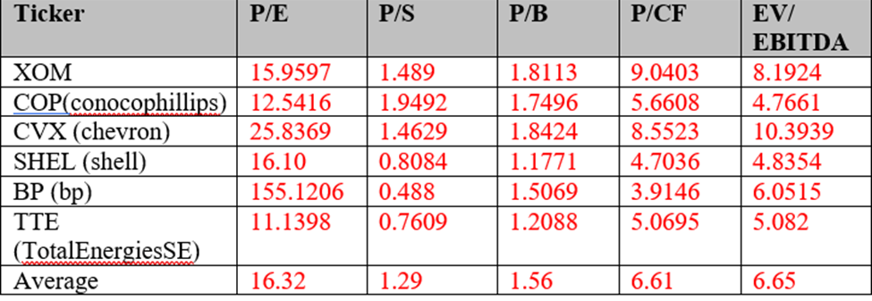
Valuation
Integrated business model
Implied Equity Value: $132.11
Current Price 11/6/25: $119.01
Implied Upside: +11.01%
DCF: used 10% discount rate, 3.75% terminal growth rate
Potential Price Appreciation
Exxon upside capped by 5 year low oil prices/ OPEC+ increases
Other energy stocks have much higher appreciation potential
Historical Valuation Ratios
P/E: 15.96 (below long term average of 31.3
EV/EBITDA: 7.92 (below long term average of 9.12)
P/B: 1.81 (in line with long term average)
P/S: 1.49 (slightly above historical average)
Current Valuation vs Sector and S&P 500
Trades at a premium to peers on P/CF, P/B, EV/EBITDA (excluding CVX)
Trades at a discount to CVX on P/E and EV/EBITDA
Expected Future Valuation Direction
Multiples likely to remain steady and slightly contract
DCF shows long term value, near term value expansion is unlikely

Slide 10
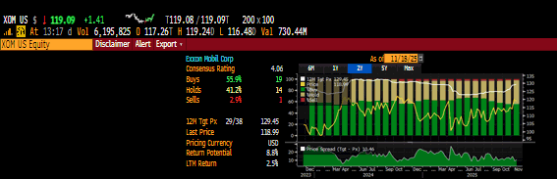
Fair Valuation / Limited Upside
Price: $119.01 | Target: $132.11 (+11.01%)
Multiples near averages: P/E 15.96, EV/EBITDA 7.92, P/B 1.81
Upside not strong enough to initiate a new position
Consensus = High Uncertainty
41.2% HOLD → signaling uncertainty in upside
High HOLD % suggests some “buys” are soft holds, many “holds” = implicit sells
Moderate growth
Revenue of $319.5 billion 2025, to $341.16 billion in 2027
EPS growth slowed, normalized margins
Peers offer better risk/return
Exxon= stable but low short term upside potential compared to COP/CVX
Risks
OPEC+ adding 1.78m barrels per day= 5 year crude oil low
Guyana/ Venezuelan tensions risk their key low cost production facility
Weak industrial demand worldwide

Slide 11
Business Analysis
ConocoPhilips

Slide 12

Business Analysis
Business Analysis:
Large independent E&G company - upstream activities
Investing in NA crude/bitumen/natural gas (Delaware Basin, Alaska), Qatari LNG - all priced in
Strong fundamentals - low volatility
Business Drivers:
North American operations: Produces 63% of consolidated liquid and 74% of consolidated natural gas
Natural gas is a growth driver due to COP’s diversified points of investment: Qatar
:NFE, NFS, PALNG on Gulf Coast and Port Arthur - coupled with relatively high prices and growing demand in Europe and Asia - all are already priced in (80% complete physically)
Stock Performance:
Poor performance 1-year decline = 20.96%
Volatility in oil and gas prices
Weak prior income statements, did not beat estimates in Q1 and Q2 of 2024
Risks:
OPEC+ increasing production
Middle Eastern conflicts hurting logistical routes - Qatari LNG projects
Concentration in Lower 48 geographic segment
Synergization issues with Marathon Oil

Slide 13
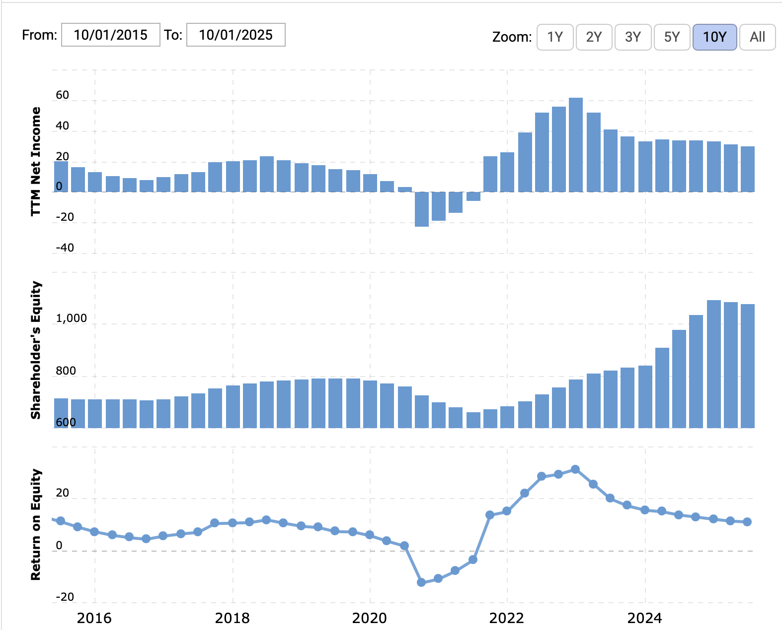
Financial Analysis
Revenue Growth: Consensus expectations of >7% annual revenue growth
Competitive FCF yield:
DCF forecasts a 6.0%-7.5% yield in 2025.
Gross Margin:
24%
Net Income:
Strong forecasted yearly growth
ROE:
Decreasing YOY since 2023
Not surprising due to significant investment
in physical assets (LNG) and Marathon Oil

Slide 14
Valuation
Business Model:
Implied Equity Value: $129.66
Current Price (11/11/2025): $89.60 | SIM Buy Price $87.31
Implied Upside: 47.49% (off SIM price)
DCF: 9% discount rate, 2.50% terminal growth rate
Potential Price Appreciation:
Dependent on oil prices and natural gas prices
High upside potential comparative to other stocks in energy sector
Historical Valuation Ratios:
P/E: 12.5415 (sector average 16.52)
P/S: 1.9492 (sector average 1.29)
P/B: 1.7496 (sector average 1.56)
P/CF: 5.6608 (sector average 6.61)
EV/EBITDA: 4.7661 (sector average 6.65)
Overall: Trades at a discount in most valuation metrics in comparison to peers

Slide 15
Business Analysis
Energy Transfer

Slide 16

Business Analysis
Analysis
Key Driver’s
Performance
ET is one of the largest U.S. midstream operators with a fully integrated network
More diversified than peers such as KMI or WMB, with exposure to gas, NGLs, and crude
Export footprint gives ET a major global advantage
ET benefits from scale that allows it to capture volumes across every major U.S. basin
Rising U.S. natural gas demand from LNG, power generation, and data centers
Strong NGL export growth supported by world-scale terminals
Multi-year infrastructure projects increasing capacity and long-term cash flow
Fee-based contracts provide stable revenue despite commodity volatility
Stock underperformed due to sector weakness and a recent earnings miss
Q3 EPS fell 12.5 percent as interest expense increased
ET down about 14 percent YTD even though operational volumes hit record highs
Pullback reflects market sentiment, not deterioration in ET’s core business

Slide 17
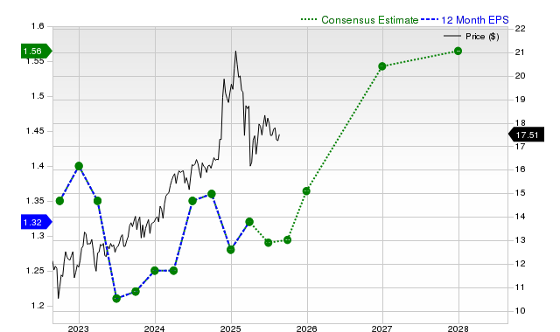
Financial Analysis
Revenue projected to grow from $82.7B to $93.5B
Net income rising from $4.39B to $5.54B over the same period
EPS increasing from $1.28 to $1.66,
Free cash flow growing from $3.4B to $3.9B, supporting distributions
ET recovered sharply after the 2020 downturn that reduced volumes and cash flow
Revenues and earnings have more than doubled since pandemic lows
Current environment is supported by stronger LNG, NGL, and natural gas demand
Future growth driven by export expansion, industrial demand, and new projects entering service
The CEO also serves as Board Chairman reduces independent oversight and weakens checks on major decisions.
ET’s large debt load increases sensitivity to interest rates and refinancing costs, which could pressure cash flow and maintain its valuation discount.

Slide 18
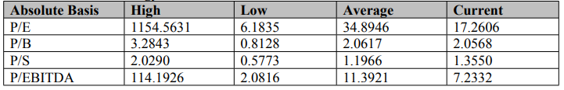
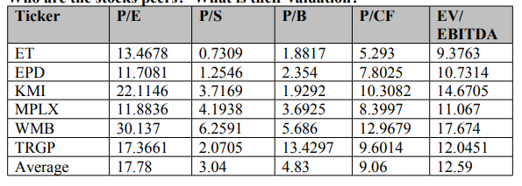
Valuation Analysis
Target Price: $28.43
Yield: 8.04 %
Total Upside: 75.24%
ET trades below peer averages across all major multiples
P/E: 13.47 vs. peer avg 17.78, P/S: 0.73 vs. 3.04, EV/EBITDA: 9.38 vs. 12.59
Sector multiples also sit below 10-year averages, signaling broader undervaluation
ET’s discount reflects sentiment on leverage rather than operating performance
ET has traded in a downtrend since February but is stabilizing above $16 support, Resistance remains near $17.50–$18.00

Slide 19
Business Analysis
SLB

Slide 20
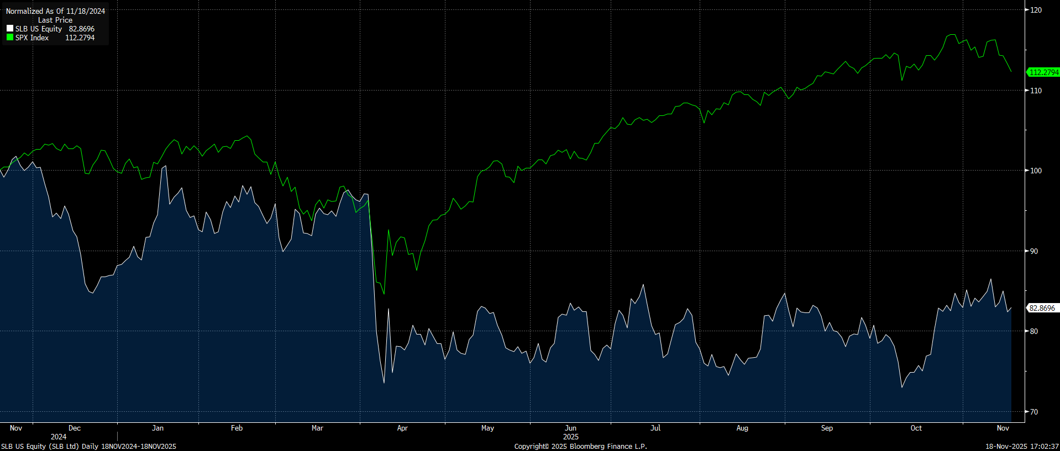
SLB Business Analysis
Resilient international markets
  HSD-LDD growth in international markets
  82% of revenues outside the U.S.
Energy security
  SLB positioning for “Energy Trilemma”
→ Security, affordability, & decarbonization
Digital
  Higher margins
  Cap-light
First week of April: Tariffs announced, OPEC+ meeting
April 4th: Aker BP, Stimwell and SLB extend alliance
April 8th: Wells Fargo upgrade to OW
→ “Digital segment and heavy exposure to international markets”

Slide 21
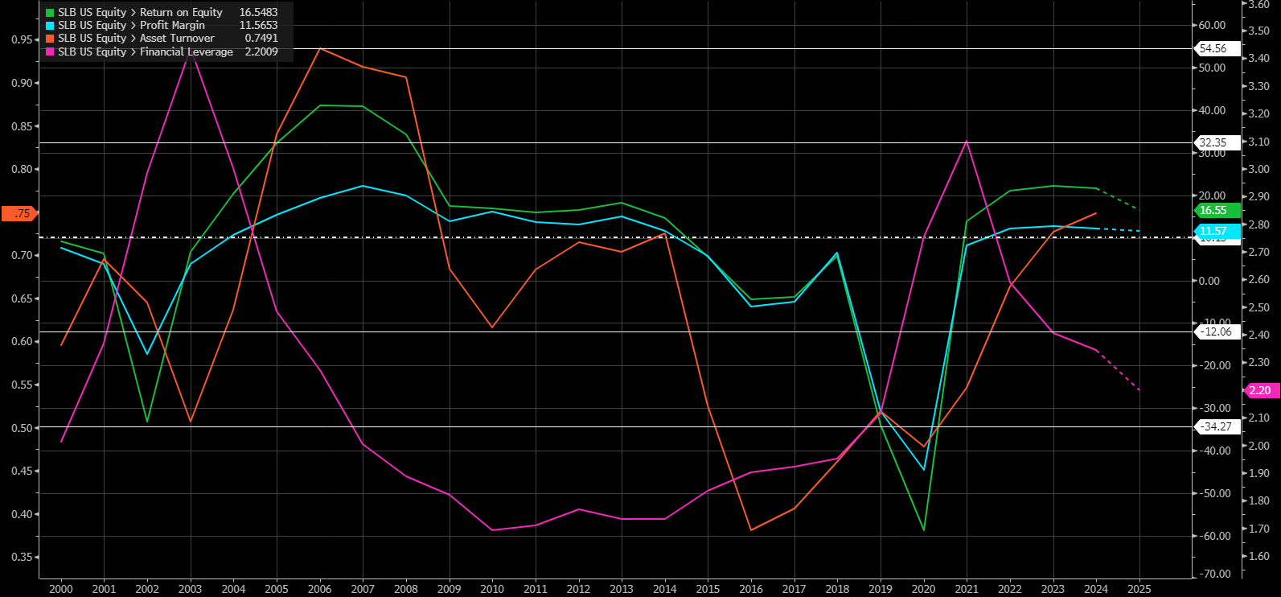
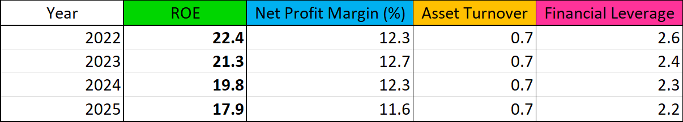
SLB Financial Analysis: ROE
ROE trending lower
  Lower margins (60%)
  Lower leverage (40%)
Lower Margins
  Non-recurring charges 2x 2024
  ChampionX & Aker Subsea
Financial Leverage
  2025 ROE of 21.1% if 2022 leverage ratio used

Slide 22
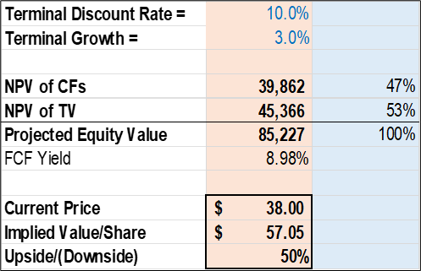
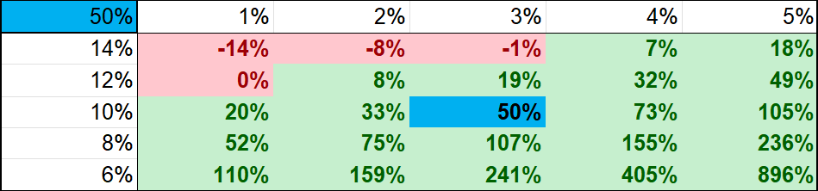
SLB Valuation - $57 price target - 50% upside

Slide 23
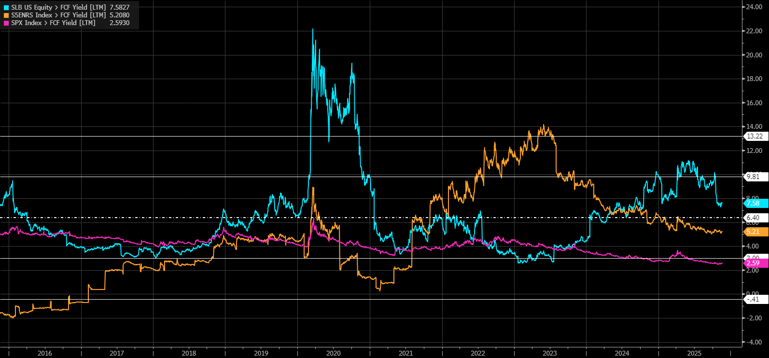
SLB Valuation: FCF Yield
Attractive FCF
  Higher than energy sector
  Higher than S&P 500
SPX: 2.59
Energy Index: 5.21
SLB: 7.58

Slide 24
Business Analysis
Final Recommendations

Slide 25

Stocks Currently in Portfolio
Stock
Ticker
Qnty
Unit Cost
Mkt Price
Total Cost
Mkt Value
ConocoPhillips
Energy Transfer LP
Schlumberger
COP
ET
SLB
1,530
5,880
6,460
$87.31
$17.82
$30.60
$88.86
$16.83
$36.06
$133,584
$104,776
$197,702
$135,955
$98,960
$232,947

Slide 26
Recommendations
Company: | Exxon Mobil | ConocoPhilips | Energy Transfer | SLB
Current Price: | $119 | $87.31 | $17 | $36
Current Weighting: | - | 1.296% | 0.943% | 2.22%
Buy/Sell/Hold | Hold | Hold - 25 Bps | Buy - 25 Bps | Buy - 50 Bps
Weighting (post) | - | 1.546% | 1.193% | 2.72%
Target Price: | $132.11 | $129.66 | $28.43 | $57
Upside/Downside | +11.01% | +47.91% | +67.20% | +58%

Slide 27
Business Analysis
Q&A

Slide 28
Business Analysis
Work Cited

Slide 29
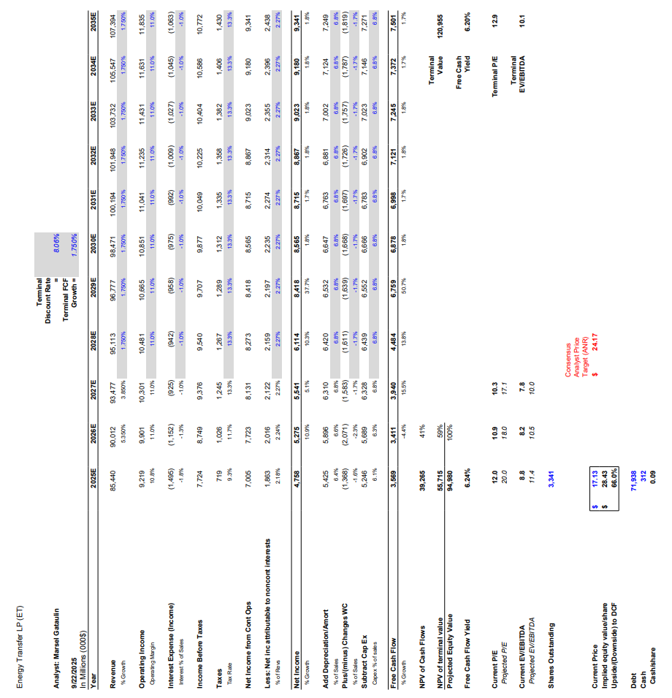
Energy Transfer LP DCF

Slide 30
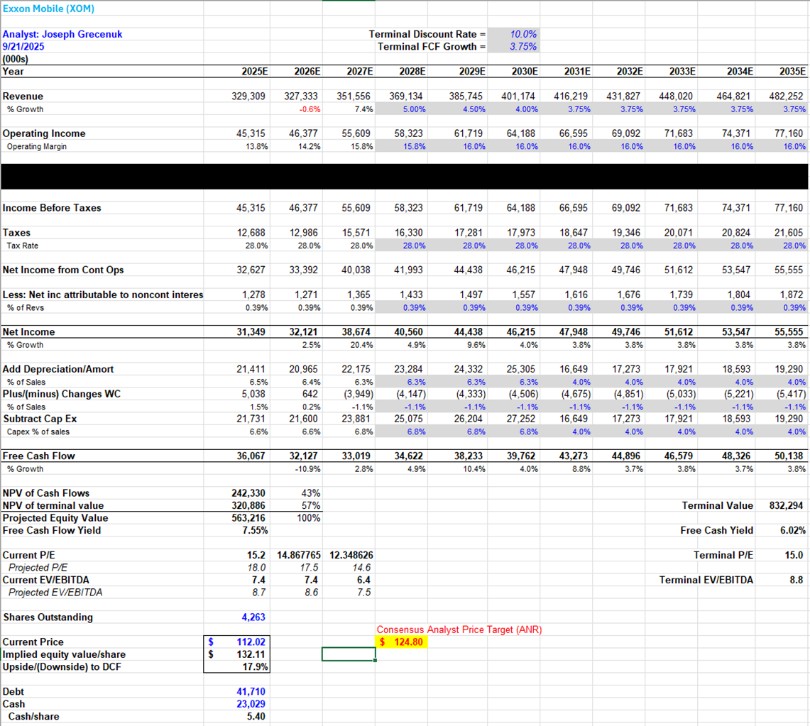
Exxon Mobil DCF

Slide 31
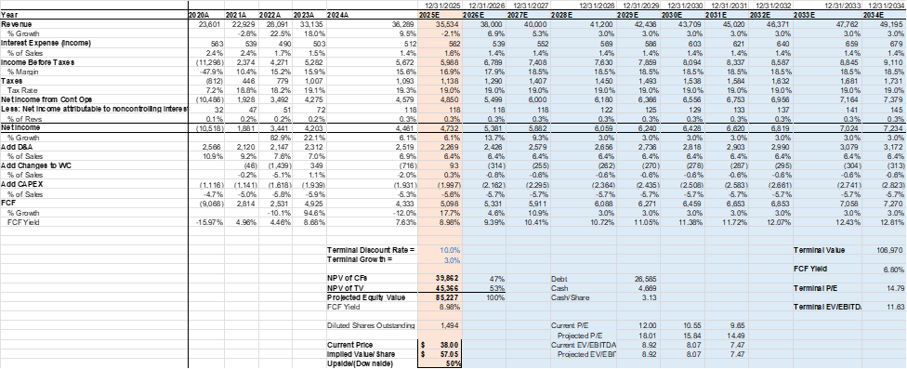
SLB Mobil DCF

Slide 32
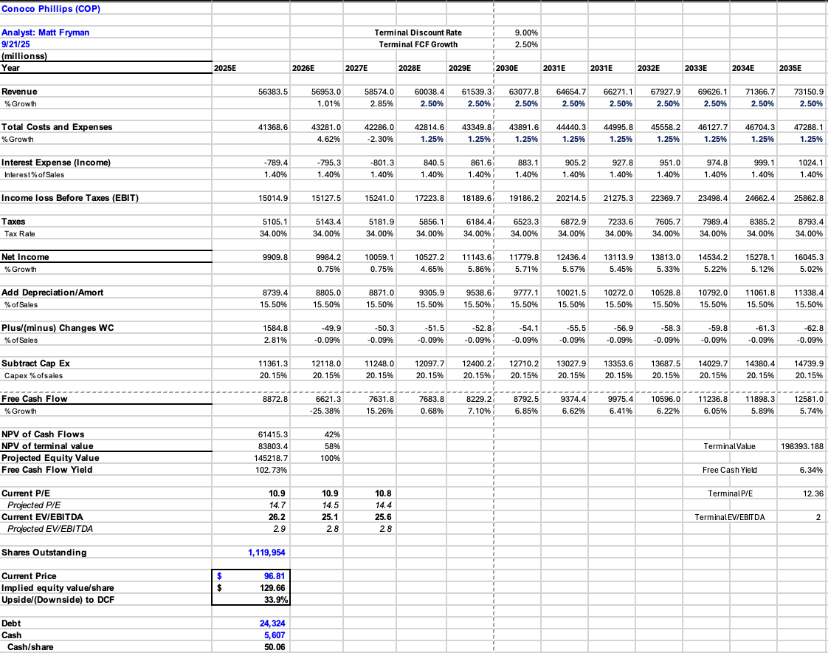
Conoco Phillips DCF

Slide 33
https://finance.yahoo.com/quote/%5EGSPE/
https://finance.yahoo.com/quote/CL=F/
https://www.ft.com/content/60e0e850-98bd-4617-bce7-5de7d442d158
https://www.macrotrends.net/stocks/charts/XOM/exxon/roe

