Slide 1
Stock Recommendations
Consumer Staples
Caden Leidich, Jeff Sauerland, Ben Mark, Thomas Kimpton

Slide 2
Sector Overview
Securities Allocation
Sector | S&P 500 Weight | SIM Weight | +/-
Information Technology | 32.94% | 31.26% | -1.68%
Health Care | 9.31% | 10.07% | 0.76%
Financials | 13.99% | 14.77% | 0.78%
Consumer Discretionary | 10.52% | 8.40% | -2.12%
Consumer Staples | 5.51% | 8.98% | 3.47%
Industrials | 8.60% | 7.47% | -1.13%
Energy | 3.01% | 3.68% | 0.67%
Utilities | 2.40% | 0.75% | -1.65%
Materials | 1.89% | 1.74% | -0.15%
Communication Services | 9.81% | 12.41% | 2.60%
Real Estate | 2.04% | 0.47% | -1.57%
Total | 100.00% | 100.00% | 0.0%
Consumer Staples Allocation
5.51% of S&P 500
8.98% of SIM
3.47% more than S&P 500
Average beta: .64
Stock Selection
Brown-Forman to replace Monster Beverage (BUY)
Target to replace Walmart (BUY)
Kroger (HOLD)
Phillip Morris (HOLD)
Industry Exposure
Spirits & Beverages
Distribution and Retail
Supermarket & Grocery
Tabacco
Featured Stocks
Stock Position Sim Weight Beta
Brown-Forman (BF/B) | $213,602.40 | 2.21% | .61
Kroger (KR) | $161,392.50 | 1.67% | .33
Target (TGT) | $293,340.00 | 3.03% | 1.21
Phillip Morris (PM) | $200,343.00 | 2.07% | .42

Slide 3
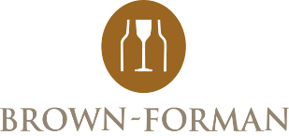
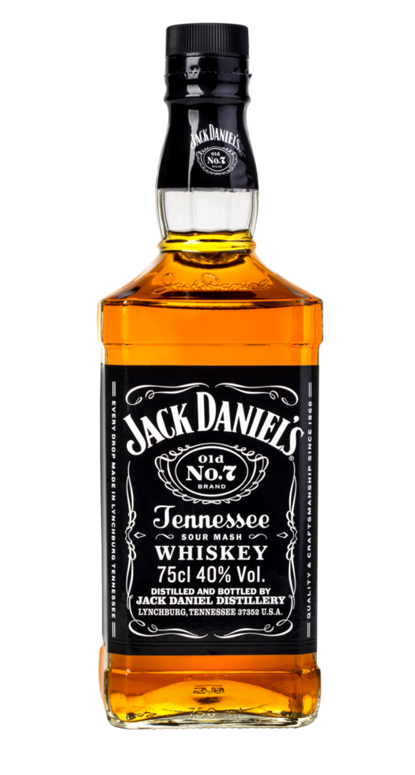
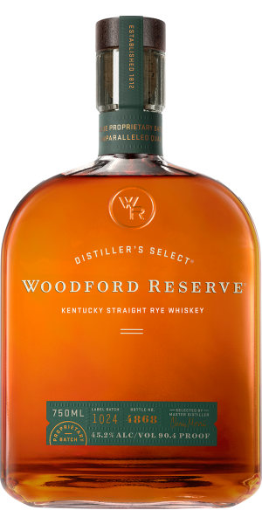

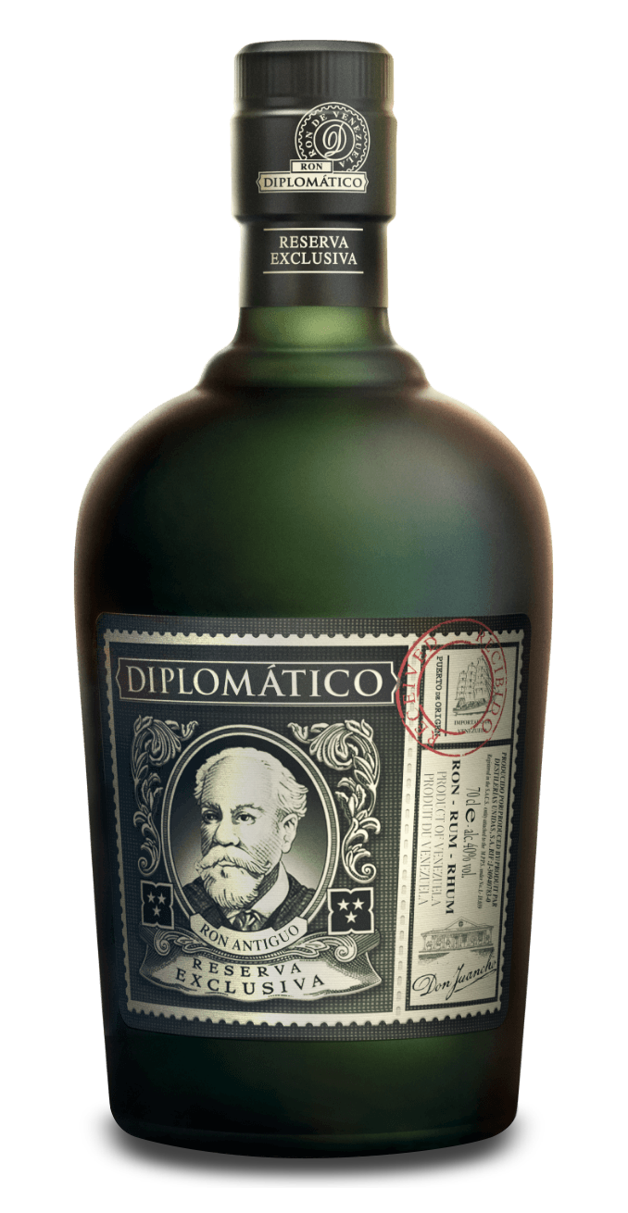
Brown-Forman (BF/B)
Brown-Forman is a leading global spirits company best known for Jack Daniel’s, one of the world’s top-selling whiskey brands.
The company owns a portfolio of premium brands including Woodford Reserve, Old Forester and more.
With operations in over 170 countries, Brown-Forman generates more than half of its revenue internationally and focuses on long-term growth.
Owner of
  #1 American Whiskey
  #1 Super-Premium American Whiskey
  #1 RTD in Mexico
  3rd largest Super Premium+ Rum
Market Cap | 12.27B
Current Price | $28.47
Target Price | $34.51
Dividend Yield | 3.53%
Total Projected Return | 27.8%
52-week Range | 25.53 - 49.89

Slide 4
Company Breakdown
Business & Market Overview
Whiskey: 71% of Revenue
Ready-To-Drink (RTD): 12%
Tequila: 7% of Revenue
Rest-Of-Portfolio: 10%
  This section includes Rum, Gin, Champagne, Brandy, and Wine Segments
Approximately 16.8% of Brown-Forman’s market share was accounted by the sales of Jack Daniels alone, leaving 6.9% to rest of whiskey portfolio

Slide 5
Business analysis
Growth Drivers
The Jack Daniels family of brands
  One of the most globally recognized whiskey brands
  Brand extensions of Honey, Fire, Apple, and now Blackberry
Geographic Expansion
  More than half of Brown-Forman’s revenue is generated abroad
  Sales growth in emerging markets such as Brazil
Product Innovation
  RTD product line including New Mix and Jack & Coke
  Various extensions of the Jack & Coke, and Jack Daniels Brand.
Company Risks
Consumer Behavior Shifts
  The past few years have shown declines in both whiskey and alcohol consumption as a whole
Macroeconomic and Geopolitical Uncertainty
  Quarter 4 of 2025FY has shown that a decline in consumer discretionary spending and lack of ability to cheaply export goods is one of the company’s largest risks
Inflation and Cost Pressures
  During Quarter 4, higher input costs shrink margins and make producing goods much more expensive.

Slide 6
Financial analysis
Sales were expected to fall slightly for this recent year due to sale of Sonoma-Cutrer.
Brown-Forman has historically relied on steady growth with a long-term focus
New restructuring plans costed a total of $63 million in efforts to save around $70-$80 in annualized savings.
Competitors are facing similar EPS growth, and have also taken a hit on sales this year
Both companies’ stocks have witnessed heavy losses year to date as DEO is down around (17%), and BF/B is down (25%).
Net Sales Forecast | FY | FY2 | FY3
(000000$) | 2027E | 2026E | 2025E
Consensus | 4,300 | 4,130 | 4,050
Estimates: | 4,372 | 4,278 | 4,094
EPS | FY | FY2 | FY3
 | 2027E | 2026E | 2025E
Basic | 2.27 | 2.24 | 2.17
Diluted | 2.24 | 2.23 | 2.16
Consensus - GAAP | 2.02 | 1.86 | 1.81
Diageo Plc (DEO) | 7.17 | 6.76 | 6.24

Slide 7
Valuation
Brown-Forman has the lowest P/E multiple out of all its competitors as well as the average.
The current P/E is over half of what it used to be just 5 years ago.
Severely undervalued company
Yields consistently rank in top 30th yields when compared to peers
  Forward dividend yield of 3.2%
  Earnings yield of 7.3%
Ticker | P/E | P/S | P/B | Market Cap
Brown Forman Corp (BF/B) | 15.4 | 3.2 | 3.19 | 12.8B
Diageo (DEO) | 16.11 | 2.78 | 5.45 | 55.73B
Constellation Brands (STZ) | 18.5 | 2.89 | 4.21 | 29B
Average | 16.67 | 2.96 | 4.3 | 31.2B

Slide 8
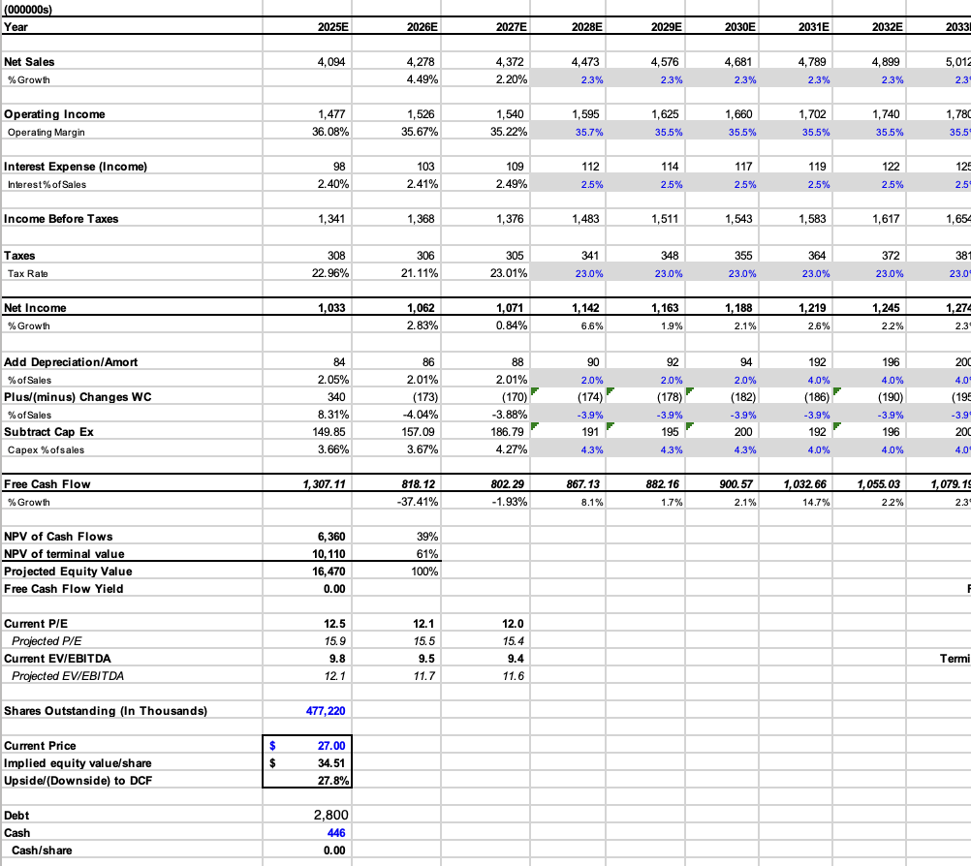
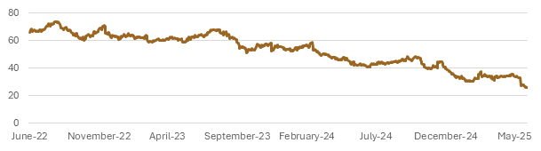
DFC & Recommendation
2.3% Growth rate
8% discount rate
$23 Billion terminal value
Technical analysis
Price Target: $34.51
Current Price: $28.43
27% upside
BUY Recommendation
Ability to weather through unfavorable conditions
Current price reflects short-term concerns
Attractive dividends with 3.2% yield

Slide 9
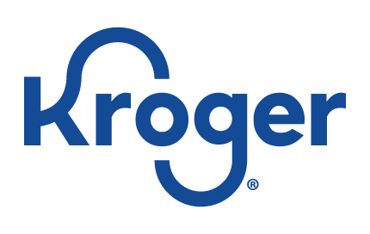
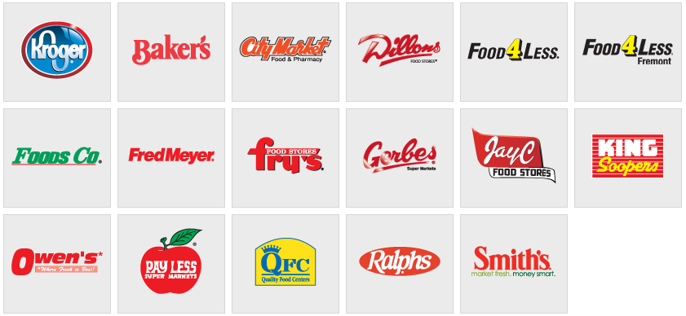
The Kroger Co. (KR)
Company Description: The Kroger Company is a grocery retailer that operates supermarkets, pharmacies, and fuel centers. It offers a wide range of food, household, and private-label products both in-store and online.
Market Cap | 46.823B
Current Price | $71.00
Target Price | $71.45
5Y Dividend Yield | 2.00
Total Projected Return | 30.16%
52-Week Range | $50.69-$74.11

Slide 10
Company Breakdown
Revenue By Segments in Billions
Kroger Primary Segments
Perishable- Fresh Foods that drive daily customer in-store interactions
Pharmacy- Prescriptions, immunizations, and consultations made easily accessible to customers
Supermarket Fuel- Discounted fuel at Kroger owned stations boosting customer loyalty though their rewards program
Other- Financial offerings, clinics, and in-store brand extensions
Non-Perishable- Packaged goods, canned foods, beverages, and household items
Product/Service | 2025 (Estimates) | 2024 | 2023
Perishable | 36.32B | 35.69B | 35.43B
Pharmacy | 15.69B | 14.26B | 13.38B
Supermarket Fuel | 16B | 16.62B | 18.63B
Other Product | 6.7B | 6.57B | 6.7B
Non Perishable | 77B | 76.90B | 74.12B

Slide 11
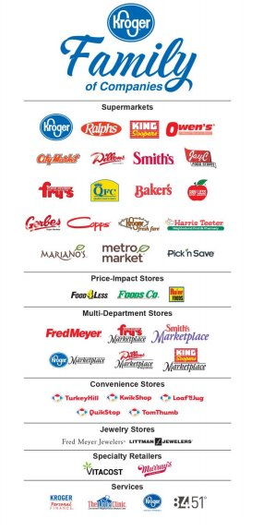
Business Analysis
Growth Drivers
Digital Expansion
Private Label Brands
Automated Fulfillment Centers
Pharmacy and Healthcare Services
Fresh and Local Sourcing
Company Risks
Labor and Union Risk
Thin Profit Margins
Similar Companies
Shift in Consumer Behavior

Slide 12
Financial Analysis
Net Sales Forecast | FY | FY2 | FY3
(000) | 2027E | 2026E | 2025
Consensus | 153,550,000 | 149,490,000
Estimate | 153,066,769 | 150,065,460 | 147,123,000
Net Sales Projected to continue to rise because of the growth of digital, pharmacy, and private-label expansion
Earnings per share projected to go up while they focus on cost efficiency through automation
Kroger's P/E is lower than tech and consumer discretionary implying investor caution in the grocery sector. However, it could indicate Kroger is undervalued
EPS | FY | FY2 | FY3
 | 2027E | 2026E | 2025
Basic | 7.15 | 7.01 | 3.74
Diluted | 7.11 | 6.97 | 3.67
Consensus GAAP | 5.17 | 4.75

Slide 13
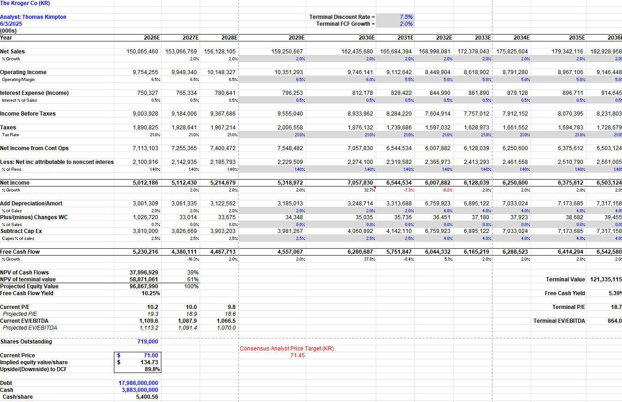
DCF Valuation
Model Assumptions:
Discount Rate: 7.5%
Terminal Growth Rate: 2.0%
Analysis:
Current Price: $71
Implied Price: $134.73
Upside: +89.8%
Analyst Price: $74.50

Slide 14
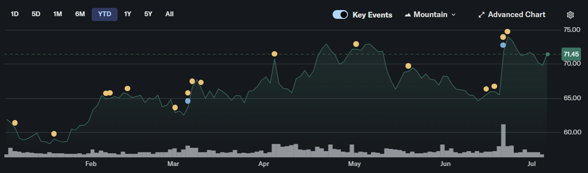
Recommendation
Recommendation | The Kroger Co.
Stock Rating | HOLD
Price Target | $74.50
Shares Outstanding | 719 Billion
Implied Upside | 89.8%

Slide 15

Philip Morris International (PM)
Company Description:
Philip Morris International (PM) is one of the world leading tobacco companies. PM operates in over 170 countries, the brand has been able to grow while adapting to the changing environments. Once known for Marlboro, the company has made a shift to smoke-free products and healthier alternatives like ZYN.
Company Overview: | Philip Morris International (PM)
Industry | Consumer Staples
52 Week Price Change | 101.62 - 181.2
Diluted Shares Outstanding | 1.56 Billion
5 year dividend Yield | 2.96%
Return on Assets (ttm) | 13.75%
Return on Equity (ttm) | 69.48%

Slide 16
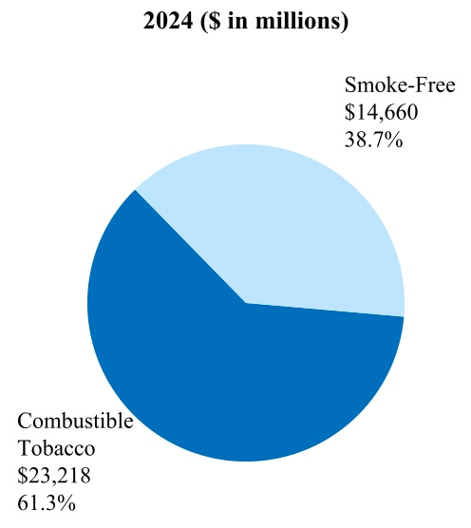
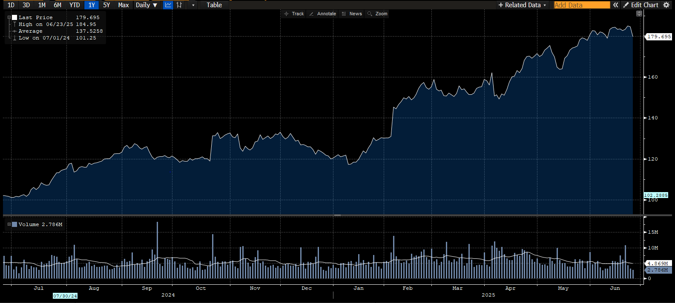
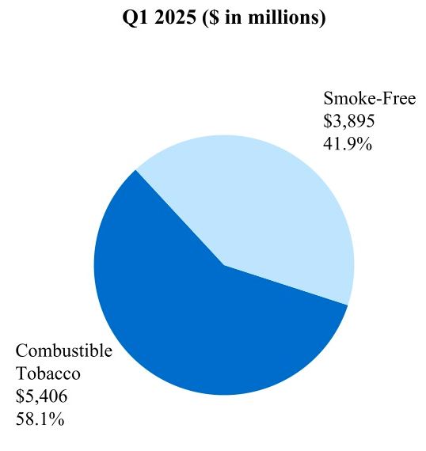
Company Breakdown
Smoke-Free products are quickly taking over the net revenue percentage for PM. In 2024 Smoke-Free products were 38.7% of total net revenues, up from 36.5% in 2023. For 2025 Q1 Smoke-Free climbed to 41.9% of net revenue share. This shift has helped the stock price for PM climbed to historic height shown below for the last 12 months.
Business Segment Breakdown:

Slide 17
Business Analysis
Growth Driver
Shift to Smoke Free Products:
YOY the company has seen their smoke-free products grow in revenue
Pricing Power
Due to market dominance, PM has a strong leverage to controlling their pricing
Geographic diversification
PM operates in over 170 counties around the world with many markets growing
R&D Investment
Constant investment is made to adapt and grow different brands owned by PM
Potential Risks:
Regulatory & legal Challenges
Cities and countries pushed to ban flavored nicotine products
Increase in excise taxes
Declining Cigarette Usage
Overall decline in cigarette usage and shipments YOY
In part due to users switching over to smoke-free alternatives
Public Perception
Health trends, even with PM's health alternatives, can hurt sales and growth

Slide 18
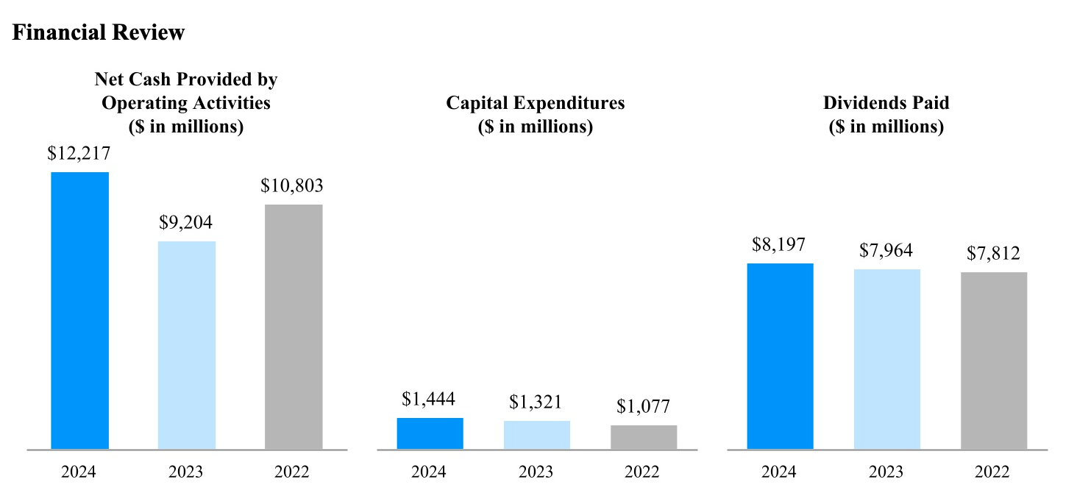
Financial Analysis
Sales are expected to grow each of the next three years
This growth of sales in contributed to the growth in their smoke-free products
Recent investment into a new plant / expansion is also a factor in the growth outlook
Net sales Forecast | FY | FY2 | FY3
In Billions | 2027E | 2026E | 2025E
Consensus | 47,230 | 44,400 | 41,040
Estimate | 48,752 | 45,828 | 41,249
EPS | FY | FY2 | FY3
 | 2027E | 2026E | 2025E
Basic | 7.30 | 7.37 | 6.39
Diluted | 7.31 | 7.36 | 6.38
Consensus | 9.28 | 8.34 | 7.46

Slide 19
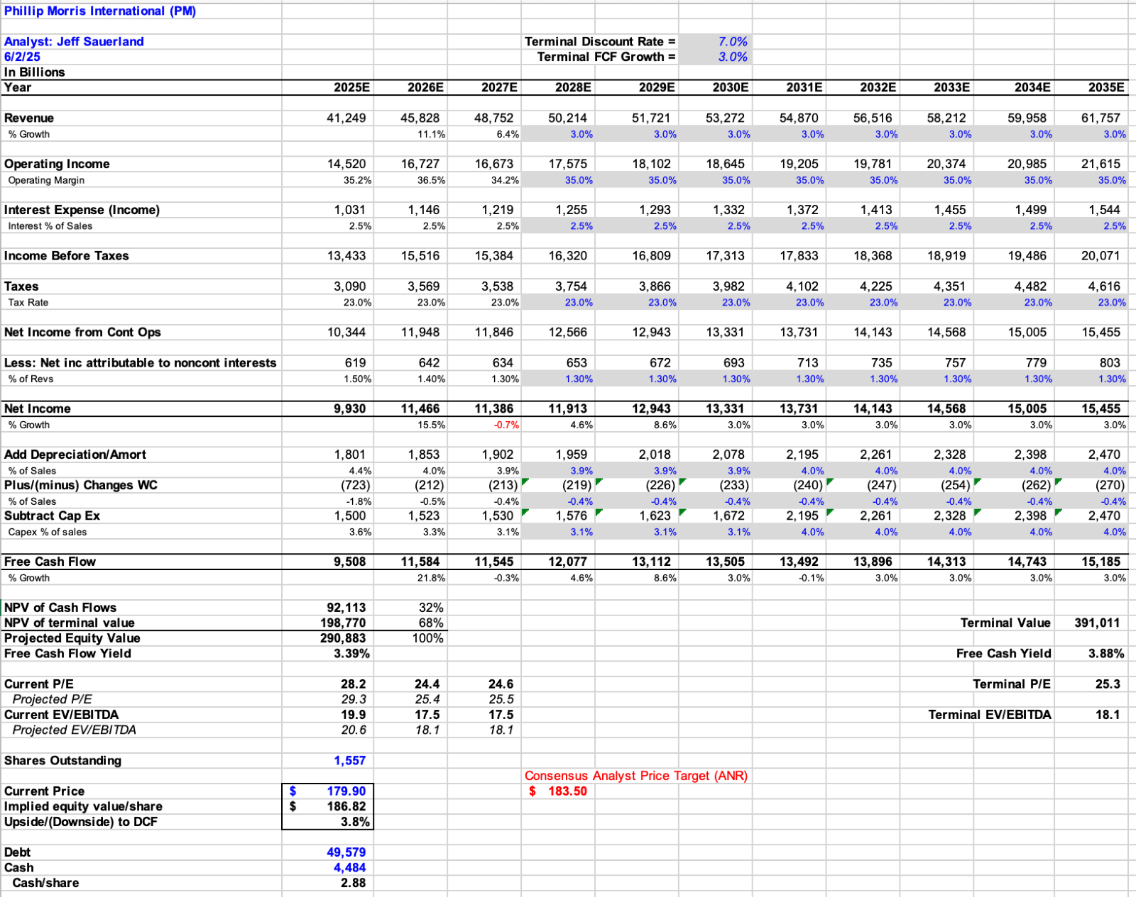
DCF Valuation
Model Assumptions:
Discount Rate: 7.0%
Terminal Growth Rate: 3.0%
Analysis:
Current Price: $179.90
Implied Price: $186.82
Upside: +3.85%
Analyst Price: $183.50

Slide 20
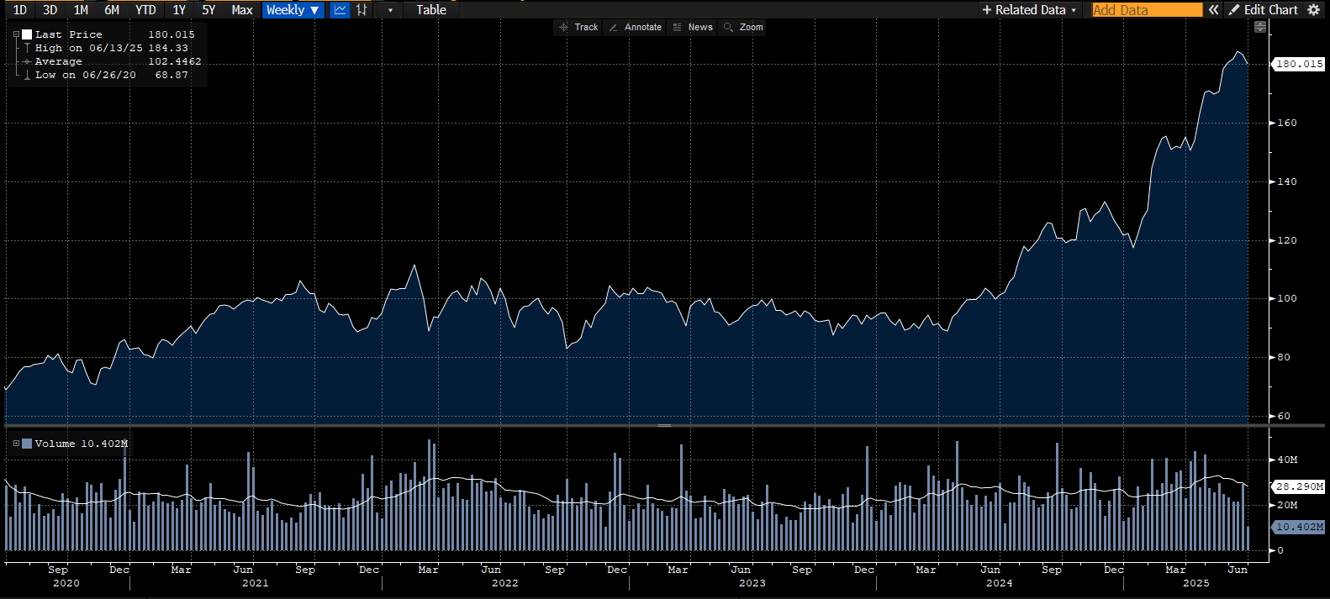
Recommendation
Recommendation | Phillip Morris International (PM)
Stock Rating | HOLD
Price Target | $186.82
Diluted Shares Outstanding | 1.58 Billion
Implied Upside | 3.85%
Last 60 weeks graph

Slide 21


Target Corporation (TGT)
Market Cap | 46.35B
Current Price | $102.01
Target Price | $148.67
5Y Dividend Yield | 2.6%
Total Projected Return | 45.74%
52-Week Range | $87.35-$167.40
Company Description:
Target is one of the largest commercial retail chains in the United States. They focus on providing high quality products across each of their many segments at affordable prices. They differentiate using their owned brands to control their product and gain high margins on what they sell.

Slide 22
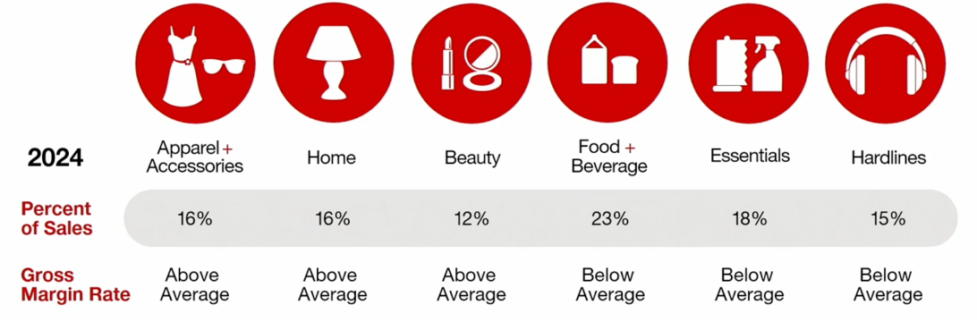
Company Breakdown
Target provides a wide range of goods as shown above. They personally have nearly 50 owned brands that spread across some of their most profitable segments such as apparel, home goods, and food. They have also made a strong campaign to integrate an omnichannel service, serving consumers across the nation in person or online, using programs like Target Circle 360, an online paid subscription membership.

Slide 23
Business Analysis
Growth Drivers:
Owned Brands:
Target's "owned brands" are a strong growth driver for an industry that is heavily reliant on large purchases, from both the US and internationally.
Brand Loyalty:
They have built significant trust with their customers in a market that is one of the most heavily influenced by brand loyalty.
Technological Advancements:
Target has begun to use AI for programs such as forecasting its holiday demands. Target uses one of its subsidiaries, Shypt, to move beyond the market normal of just providing same-day and fast delivery to its customers (Drone Delivery, Virtual)
Potential Risks:
DEI Rollbacks:
Target's $2 million DEI commitment has been completely reversed, marking one of the largest corporate DEI rollbacks we have seen in recent memory, leading to a lot of backlash from consumers and investors.
Recent Sales Struggles:
We have seen a 2.8% decrease in year-over-year sales in Q1 of 2025. This has left the stock volatile, as it has dropped 24% since the beginning of 2025.

Slide 24
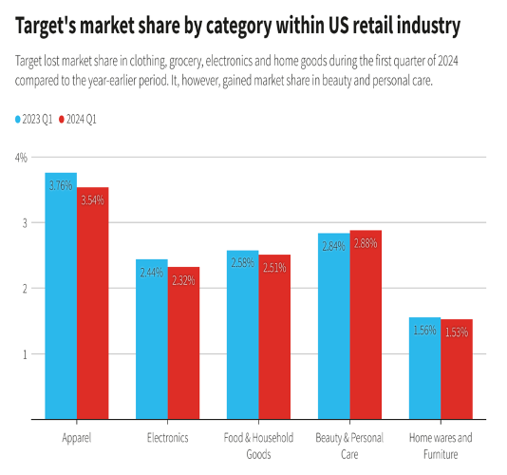
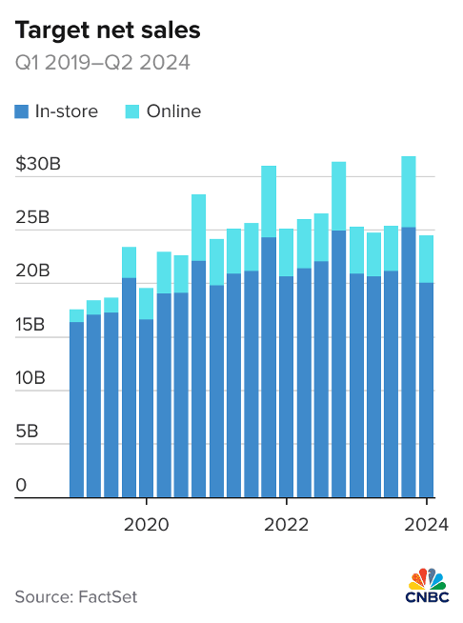
Financial Analysis
Despite a drop this year, Target's net sales are projected to rise into the future as a slow in social backlash slows and they rebuild their strong brand loyalty.
They have continued to invest into their physical stores, with a goal to add 300 new stores in the next decade, which will benefit both their in-person sales but also help them online as these all add to the network of product hubs around the nation.

Slide 25
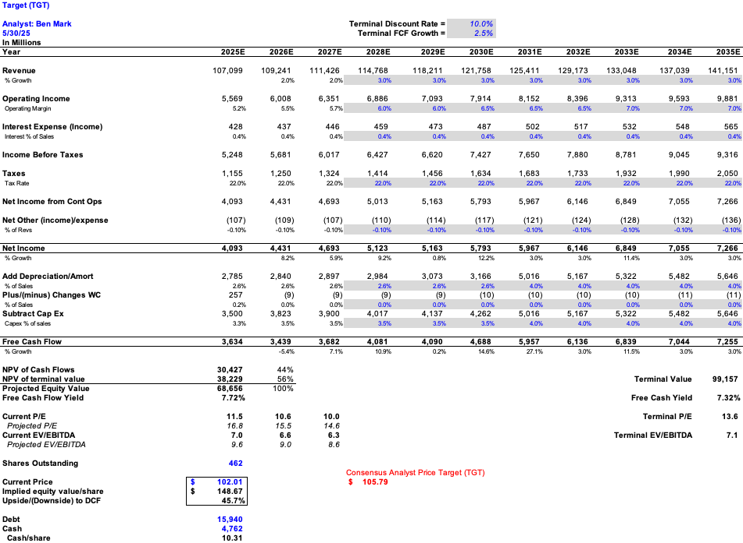
DCF Valuation
Model Assumptions:
Terminal Discount Rate: 10.0%
Terminal FCF Growth: 2.5%
Analysis:
Current Price: $102.01
Implied Price: $148.67
Upside: +45.75%
Analyst Price: $105.79

Slide 26
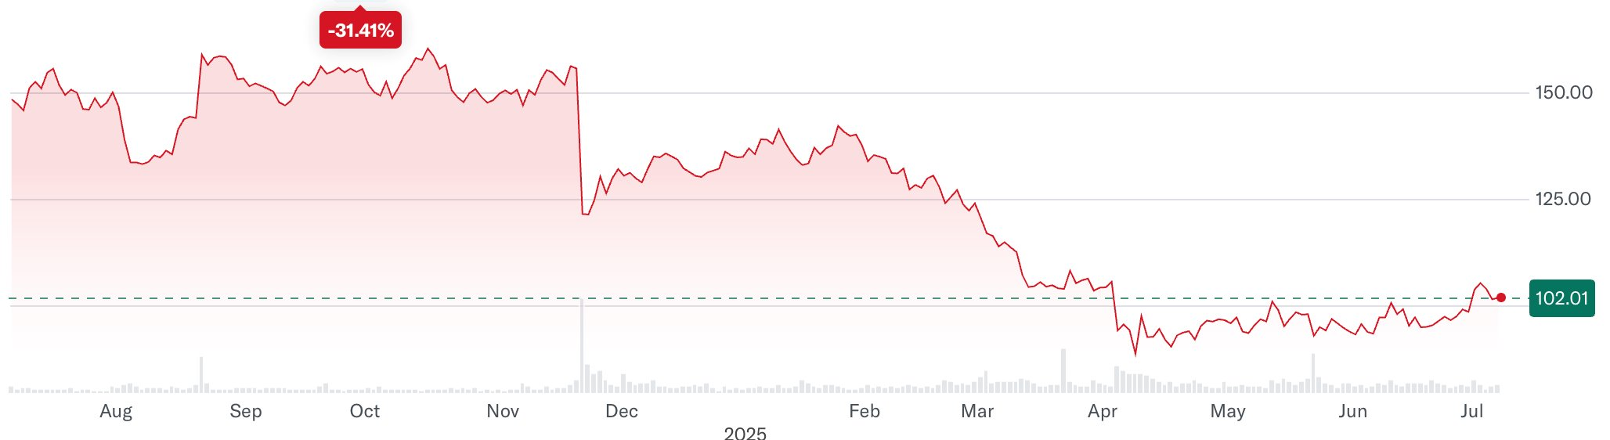
Recommendation
Recommendation | Phillip Morris International (PM)
Stock Rating | BUY
Price Target | $148.67
Diluted Shares Outstanding | 462 Million
Implied Upside | 45.74%

Slide 27

Recommendation Summary
 | Current Price | Target Price | Expected Return | Status | Current Weight | Proposed Weight
Brown-Foreman | $28.47 | $34.51 | 21% | BUY | 0% | 2.21%
Kroger | $70.00 | $74.50 | 6.00% | HOLD | 1.67% | 1.67%
Phillip-Morris | $179.9 | $186.82 | 3.85% | HOLD | 6.25% | 6.25%
Target | $102.01 | $148.69 |  | Buy | 0% | 2.80%

