Slide 1
Consumer Staples
Aiden Callahan, Andrew Campbell,
Gar Chatain, Ivy Cheng,
David Coleman
Notes:
Presenter 1(Aiden)

Slide 2










Consumer Staples Overview
Consumer Staples
Sector Size in S&P 500:
5.64% (as of 03/27/2025)
Sector Performance Summary
Year-to-Date Performance
  Cons Stap Return: 3.14%
  S&P 500 Return: -2.89%
  Overperformed: +6.03%
1Y Performance
  Cons Staples Return: 5.85%
  Price Return: 8.55%
  Underperformed: -2.7%
Food and Beverage
Personal
Household
Source: spglobal
Notes:
Presenter 1 (Aiden)

Slide 3
Consumer Staples Sector Recap
Sector Recommendation: Remain Overweight
S&P 500 Weight: 5.88% , Current SIM Weight: 8.72%
Pros: Uncertainty in market, Consumer Staples more defensive, lower relative P/E ratios (compression), investor confidence (rising P/B and P/S)
Cons: Tariffs , Inflation, Thin Margins in Grocery
Overweight: Tobacco (strong brand loyalty, high profitability, domestic manufacturing)
Underweight: Food products that are manufactured in Mexico, Canada, or China
Notes:
Presenter 1 (Aiden)

Slide 4
Consumer Staples Current Stocks
Stock | Unit Cost | Current Price (3/27) | Recommendation
Kroger | $52.32 | $66.54 | HOLD
Mondelez | $68.66 | $66.98 | HOLD
Monster | $53.75 | $58.49 | HOLD
Walmart | $44.62 | $85.68 | BUY
Notes:
Presenter 1 (Aiden)

Slide 5
Business Analysis
Category | Walmart (WMT) | Philip Morris (PM)
Sector | Consumer Staples - Retail | Consumer Staples - Tobacco
Business Model | Global Retail Chain | Global Tobacco Company
Revenue 2024 | ~$648B | ~$38B
Dividend Yield | ~1.4% | ~3.49%
Market Position | #1 US retailer, leads in grocery and e-commerce | #1 global tobacco firm
Recommendation | BUY | BUY
Notes:
Presenter 2 ( Dave)

Slide 6
Growth/Business Drivers
Walmart
Price Leadership: Walmart’s unmatched scale and everyday low pricing strategy make it a defensive powerhouse, gaining share during inflationary periods as value-conscious consumers seek the lowest prices.
Omnichannel Growth: Its omnichannel ecosystem—including Walmart+, curbside pickup, and online grocery—has driven 20% YoY e-commerce growth and deepened customer loyalty across both digital and physical channels.
High-Margin Expansion: Walmart’s high-margin businesses like Walmart Connect (up 27% YoY) and its expanding fintech and marketplace offerings are fueling future growth beyond traditional retail.
Philip Morris
Margin Expansion: Zyn delivers gross margins 8x higher than traditional cigarettes, driving profitability.
Growth Catalyst: The nicotine pouch market is projected to grow at a 29.6% CAGR through 2030—Zyn holds 76% market share in this space.
Brand Strength: Zyn’s quality, cult-like following, and viral popularity among Gen Z create a brand moat unmatched by competitors.
Notes:
Presenter 2 (Dave)

Slide 7
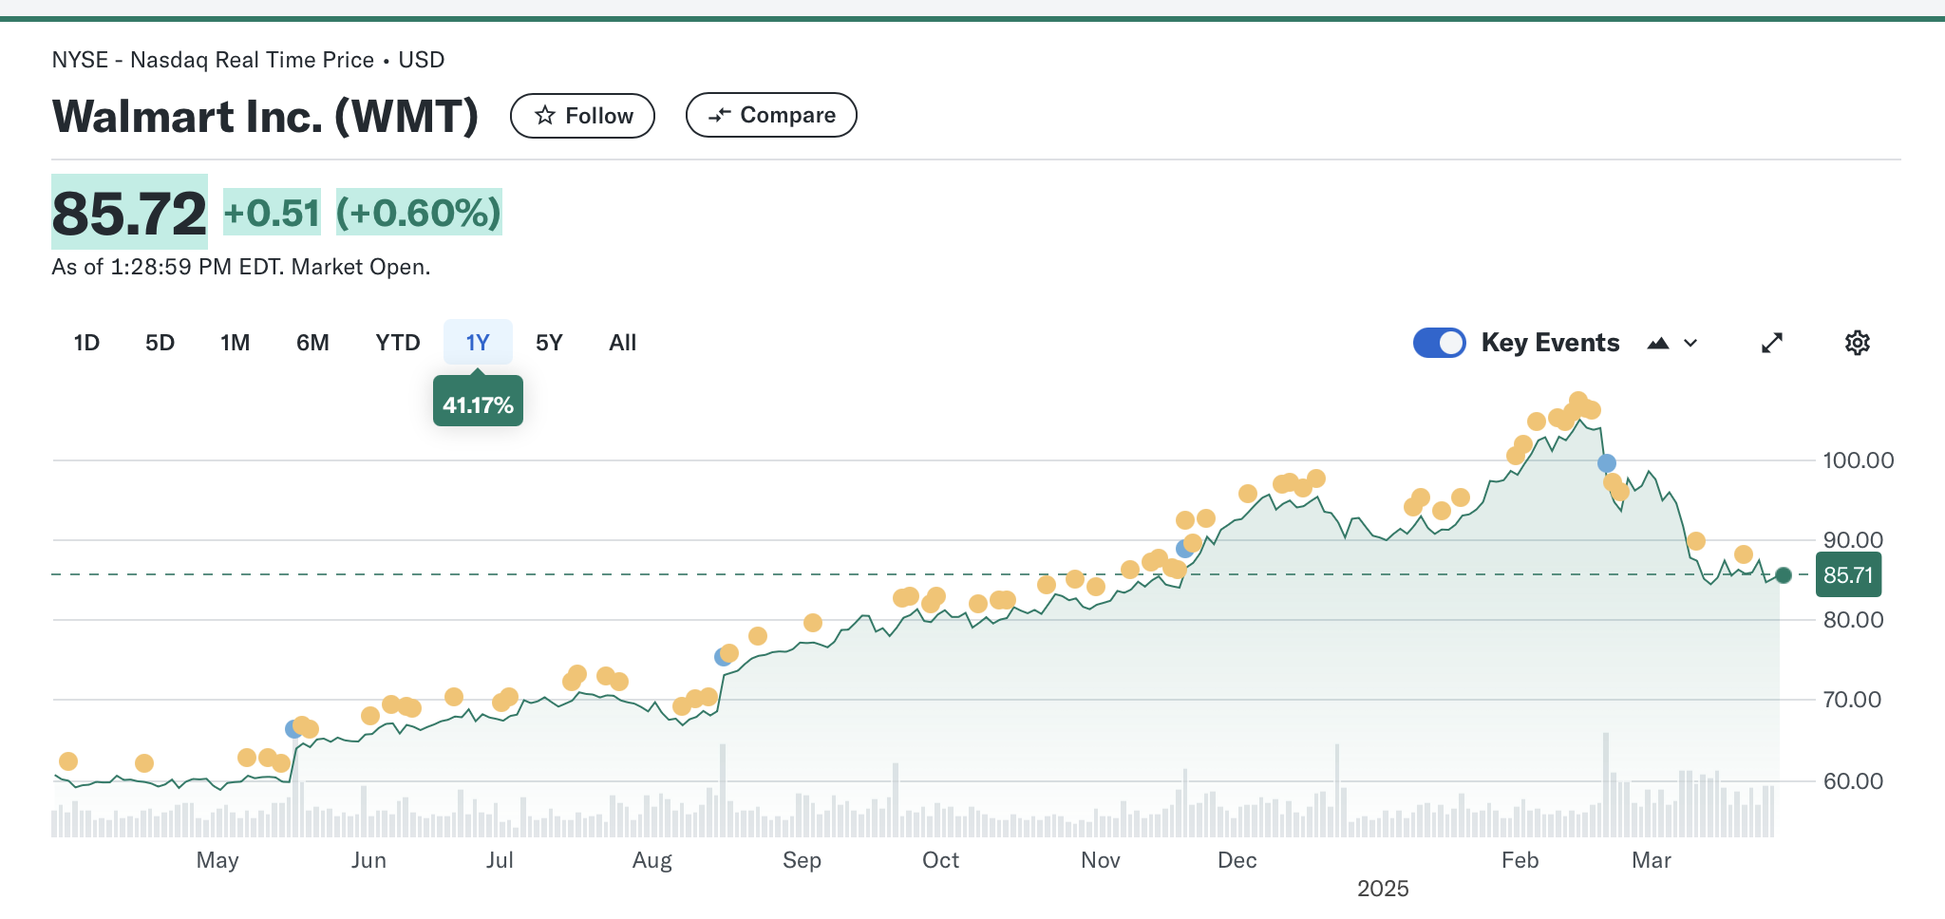
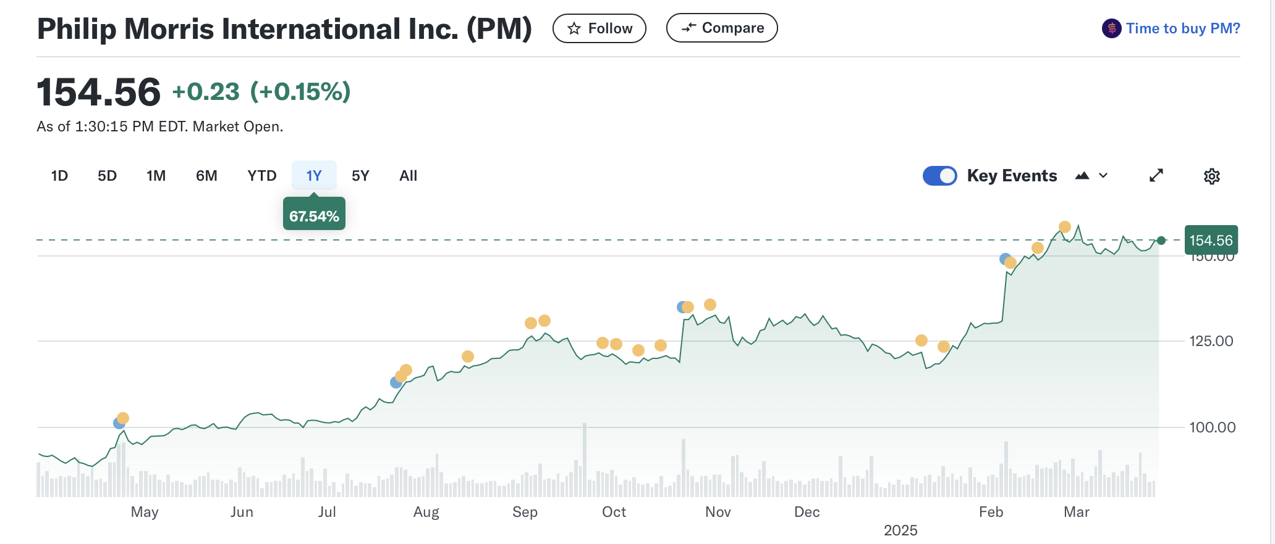
1 Year Stock Performance
Notes:
Presenter 2 (Dave)

Slide 8
Financial Analysis
Category | Walmart | Philip Morris
ROE | 20.99% | 16.00%
Profitability | 23.7% | 19%
Growth | 6.1% | 7.7%
Historical Earnings | 2022: $13.6B 2023: $11.7B 2024: $15.5B | 2022: $31.76B 2023: $35.17B 2024: $37.88B
Projected Earnings | 2025: $19.3B 2026: $20.6B 2027: $21.8B | 2025: $41.48B 2026: $44.80B 2027: $47.93B
Notes:
Presenter 3 (Andrew)

Slide 9
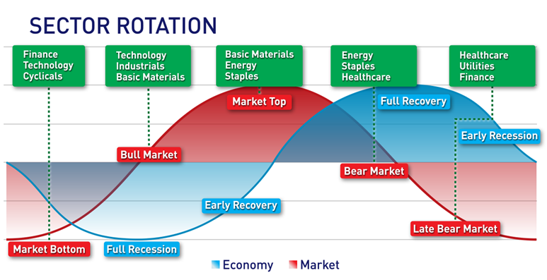
Market Environment
Market most likely trending towards a Bear Market
Consumer Staples will thrive in this environment
Source: The Market Made Easy. (n.d.). Sector rotation investing. The Market Made Easy. https://themarketmadeeasy.com/sector-rotation-investing/
Notes:
Presenter 3 (Andrew)

Slide 10
Valuation
Stock | Current Price (3/27) | Target Price | Potential Upside/Downside | P/E Ratio | Rec.
Kroger | $66.54 | $69.11 | +3.9% | 13.98 | HOLD
Mondelez | $66.98 | $61.47 | -8.23% | 19.19 | HOLD
Monster | $58.49 | $57.74 | -1.2% | 37.89 | HOLD
Walmart | $85.68 | $108.42 | +26.1% | 42.25 | BUY
Philip Morris | $154.52 | $172.23 | +11.5% | 22.87 | BUY
Notes:
Presenter 3 (Andrew)
https://www.snoqap.com/posts/2019/9/30/macroeconomic-factors-and-performance-of-consumer-staples-and-consumer-discretionary-sectors

Slide 11
S&P/Sector Price Ratios
Ratio | Typical Range (Cons. Stap.) | Typical Range (S&P 500)
P/E | 18-25 | 15-25
P/B | 3-6 | 2-5
P/S | 1.5-4 | 1-4
P/CF | 12-20 | 10-20
EV/EBITDA | 11-28 | 10-18
Price ratios in consumer staples trend slightly higher than broad S&P 500
Notes:
Presenter 4 (Gar)

Slide 12
Philip Morris Price Ratios
Metric | Philip Morris International | British American Tobacco | Altria Group | Average
Market Capitalization ($ Billions) | $235.64 | $69.21 | $97.47 | $134.11
Enterprise Value ($ Billions) | $277.12 | $102.76 | $119.27 | $166.38
P/E | 25.22 | 23.18 | 8.81 | 19.07
EV/EBITDA | 17.60 | 12.20 | 9.63 | 13.14
P/FCF | 19.2 | 10.6 | 10.3 | 13.37
Notes:
Presenter 4 (Gar)

Slide 13
Walmart Price Ratios
Metric | Walmart | Costco | Target | Average
Market Capitalization ($ Billions) | $689.29 | $412.47 | $47.22 | $382.99
Enterprise Value ($ Billions) | $733.71 | $407.36 | $62.33 | $401.14
P/E | 42.05 | 57.28 | 14.19 | 37.84
EV/EBITDA | 18.70 | 32.43 | 8.56 | 19.89
P/CF | 21.04 | 37.10 | 8.61 | 22.25
Notes:
Presenter 4 (Gar)

Slide 14
Recommendation
Stock | Current Price 3/27 | Current Weighting | Buy/Sell/Hold | Buy/Sell/Hold Weighting | Target Price (expected return)
Kroger (KR) | $66.54 | 1.56% | Hold | - | $69.11
Monster (MNST) | $58.49 | 2.00% | Hold | - | $57.74
Mondelez (MDLZ) | $66.98 | 1.99% | Hold | - | $61.47
Philip Morris (PM) | $154.52 | N/A | Buy | +.30% .30% | $172.23
Walmart (WMT) | $85.68 | 3.17% | Buy | +.14% 3.31% | $108.42
Sim Portfolio Weighting increases .44% from 8.20% to 8.64%
Notes:
Presenter 5 (Ivy)

Slide 15
Primary Catalysts
Walmart
Price Leadership: Walmart’s unmatched scale and everyday low pricing strategy make it a defensive powerhouse, gaining share during inflationary periods as value-conscious consumers seek the lowest prices.
Omnichannel Growth: Its omnichannel ecosystem—including Walmart+, curbside pickup, and online grocery—has driven 20% YoY e-commerce growth and deepened customer loyalty across both digital and physical channels.
High-Margin Expansion: Walmart’s high-margin businesses like Walmart Connect (up 27% YoY) and its expanding fintech and marketplace offerings are fueling future growth beyond traditional retail.
Philip Morris
Margin Expansion: Zyn delivers gross margins 8x higher than traditional cigarettes, driving profitability.
Growth Catalyst: The nicotine pouch market is projected to grow at a 29.6% CAGR through 2030—Zyn holds 76% market share in this space.
Brand Strength: Zyn’s quality, cult-like following, and viral popularity among Gen Z create a brand moat unmatched by competitors.
Notes:
Presenter 5 (Ivy)

Slide 16
Risks for Recommendation
Phillip Morris
Regulatory Scrutiny: Potential tax increases or advertising restrictions on ZYN could reduce profitability and limit brand exposure, especially if social media promotion is curbed.
Competitive Threats: Rising quality or pricing appeal of competitors like Velo (BAT) and On! (Altria) could erode ZYN’s dominant market share.
Slower Market Growth: If the nicotine pouch market grows at a slower rate than the projected 29.6% CAGR, PM may miss revenue and margin expectations
Walmart
Intense competition from retailers like Target, Costco, and Dollar General, especially in the fast-growing e-commerce space.
Economic downturns could also reduce consumer spending on non-essential items, affecting Walmart’s sales.
Faces regulatory and legal risks, such as fines for antitrust violations or labor disputes in international markets.
Notes:
Presenter 5 (Ivy)

Slide 17
Appendix A Walmart DCF
Notes:
https://www.morganstanley.com/im/publication/insights/investment-insights/ii_consumerstaples_en.pdf
https://www.ship.edu/contentassets/569211b0c6f243808c3c64f54e816cd2/effects-of-macroeconomics-variables-on-consumer-staples.pdf

Slide 18
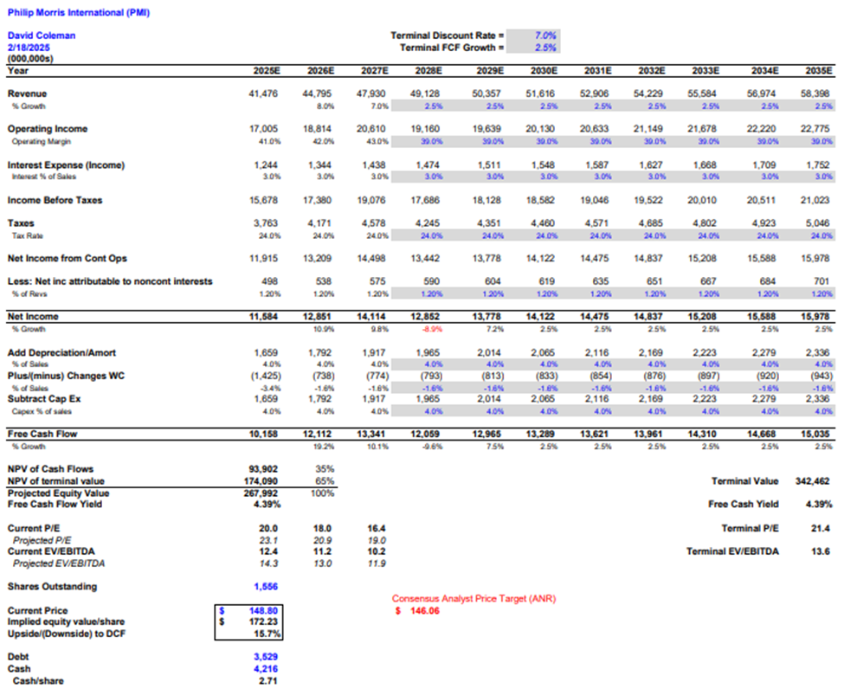
Appendix B Philip Morris DCF
Notes:
https://www.morganstanley.com/im/publication/insights/investment-insights/ii_consumerstaples_en.pdf
https://www.ship.edu/contentassets/569211b0c6f243808c3c64f54e816cd2/effects-of-macroeconomics-variables-on-consumer-staples.pdf

